Slide 1
Chat Healthy A Consumer web site supporting a chat interface to finding care
https://www.chathealthy.ai

Slide 2
Overview
The Find care application demonstrates all the core competencies to solve AI problems using a variety of AI techniques and tools.
In addition, it is the MVP for an AI application that can help consumers and healthcare professionals to find care for particular types of facilities and problems.
It also offers hospitals and health insurance companies a starter kit to manage their own networks of providers.

Slide 3
Project goals
Create website that:
Allows via chat interface a user to find care.
Keep data fresh and accurate (phase 1 operational)
Allow users to ask general questions about the American health care system.
Do not under any circumstances give medical advise beyond what types of care to seek based on user input.
While ensuring user privacy, keep a log of user activities based on cookies and or registration. (Ensure that the HIPAA laws around ‘research data are preserved and declare in privacy statement that all user data is anonymized as per HIPAA standards.

Slide 4
Core Component architecture
Azure
Cloudflare
wwww.chatHealthy.ai
Hugging Face
chatHealthy.ai
Subscription: FindCare-AI US EAST2
Function App- Pay Per use
DevPipelineManagment Services
Python 12.10.2
Core coded in Python library: ChatHealthyLib.pipelines
Host static Web Pages
DNS services
Page to embed CoreChatUX inside of HTMLl Page
Core Chat UX
AI GPU serviceds
Dev Ops
Git Hub
Account: skip.snow@gmail.com
Repos:
SkipSnow/findCare
SkipSnow/ChatHealthyDataPipeline
Dev
Cursor: deploy from cursor
Model cursor’s native
Cluster: ChatHealthyDB_dev
Claud Projects via claude.ai
MD file for project prompt
Mongo
DB services, Data Bae
AI GPU services
Account: skip.snow@gmail.com
Cluster: ChatHealthyDB_dev

Slide 5
Web site architecture
The AI logic is done via a Gradio services hosted on spaces. on Hugging Face.
This component is embedded via an Iframe into the home page of the site.
At this point one AI interface is anticipated to handle all use cases. The ‘about us will be a static page that leads to many sub pages about the chatHealthy.ai business. Which currently is SkipSnow doing business as chatHealthy.ai.

Slide 6
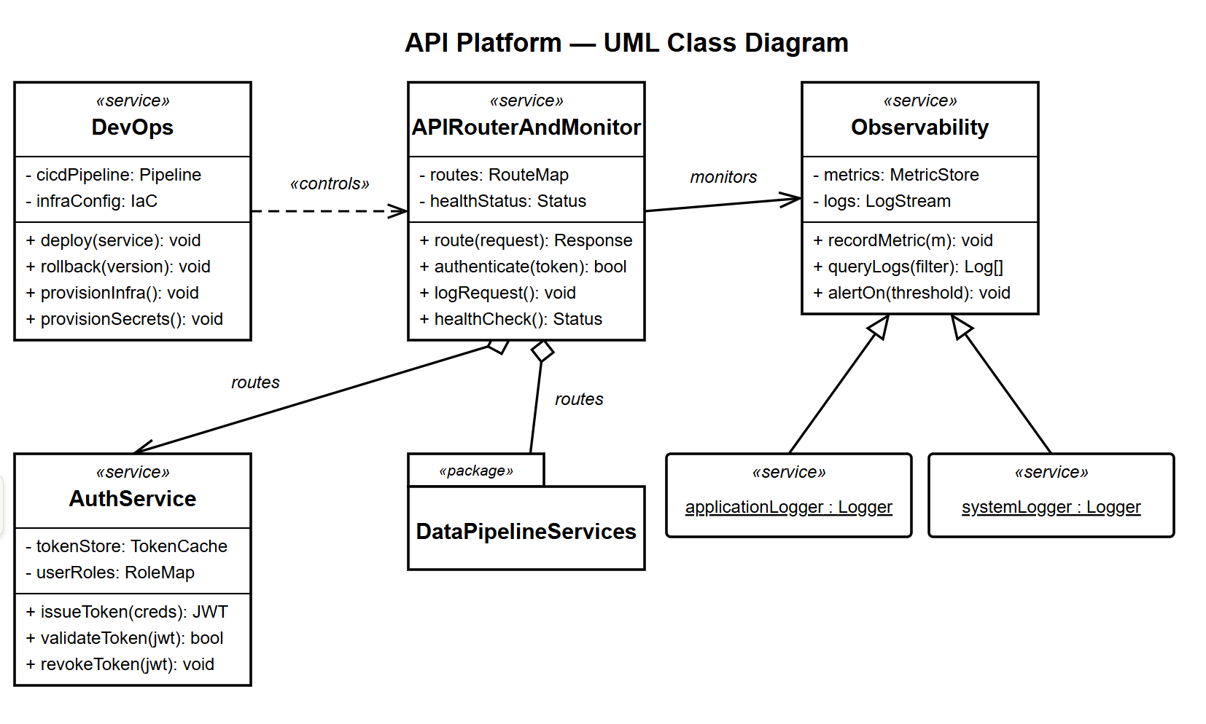

Slide 7
Commercial application of web site
As of now this is thought of as an AI portfolio piece by Skip Snow without commercial implications.

Slide 8
Data Pipelines
There are several data sources that contribute to this effort and they must be kept fresh. This means that on a schedule the data must be refreshed by the pipeline without human oversight.
Major data sources
National provider data

Slide 9
Appendix

Slide 10
Azure deployment Architecture
Subscription: ChatHealthy
└── Resource Group: ChatHealthyDataPipelines
├── Tag: environment → dev | qa | prod
├── Tag: version → 1.0.0
│
├── Namespace: PipelineInfrastructure [SHARED]
│ ├── Storage Account [SHARED]
│ │ └── Blob Container
│ │ └── Tag: environment → dev
│ ├── Virtual Network / Subnet [SHARED]
│ └── Key Vault [SHARED]
│
└── Namespace: ProviderDataPipelineApp
├── Function App: FetchAndDistributeProviderData
│ └── Tag: environment → dev
├── Function App: NPDBDataToMongo
│ └── Tag: environment → dev
└── Storage → ref: PipelineInfrastructure
The use of deployment facts in a predictable matter allow for a business to respond to changes to its operating model.
Resource groups can cross all boundaries but should be maped to an accounting and HR model.
Other resource groups to be created are and two are planed,
Chat HealthyTest, This is where the accuracy chat Healthy's responses are tested against Boolean based criteria. And design decisions are revisited.
Find Care Run Time application
There is only 1 azure subscription.

