Slide 1
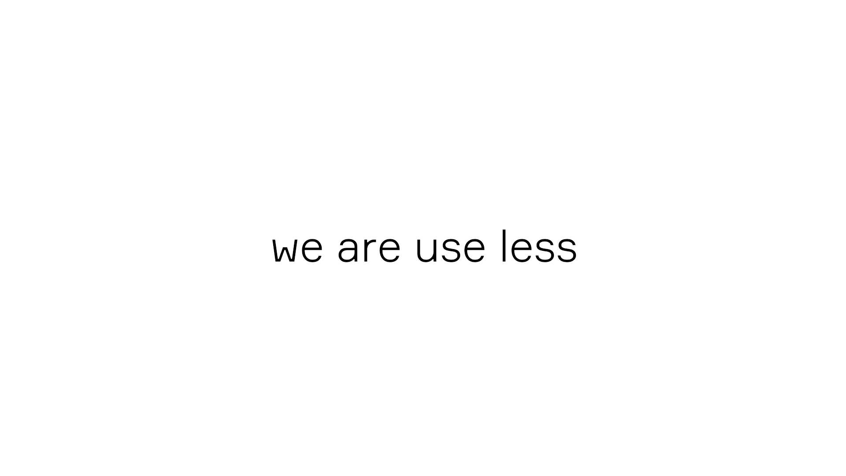
nb: einde tekst naar wit

Slide 2
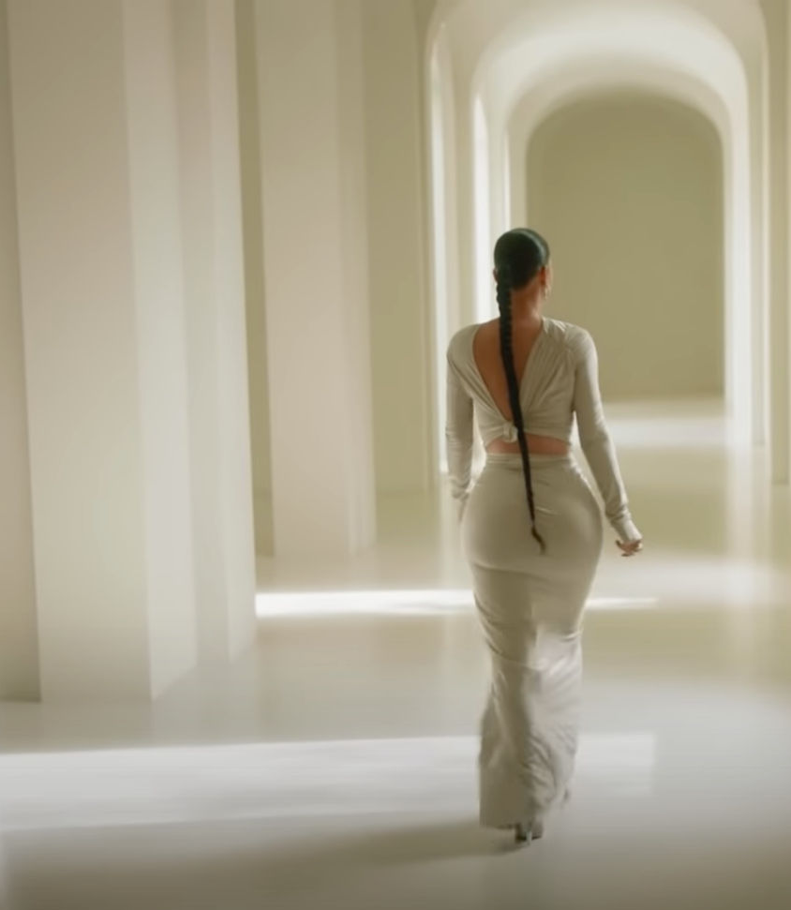
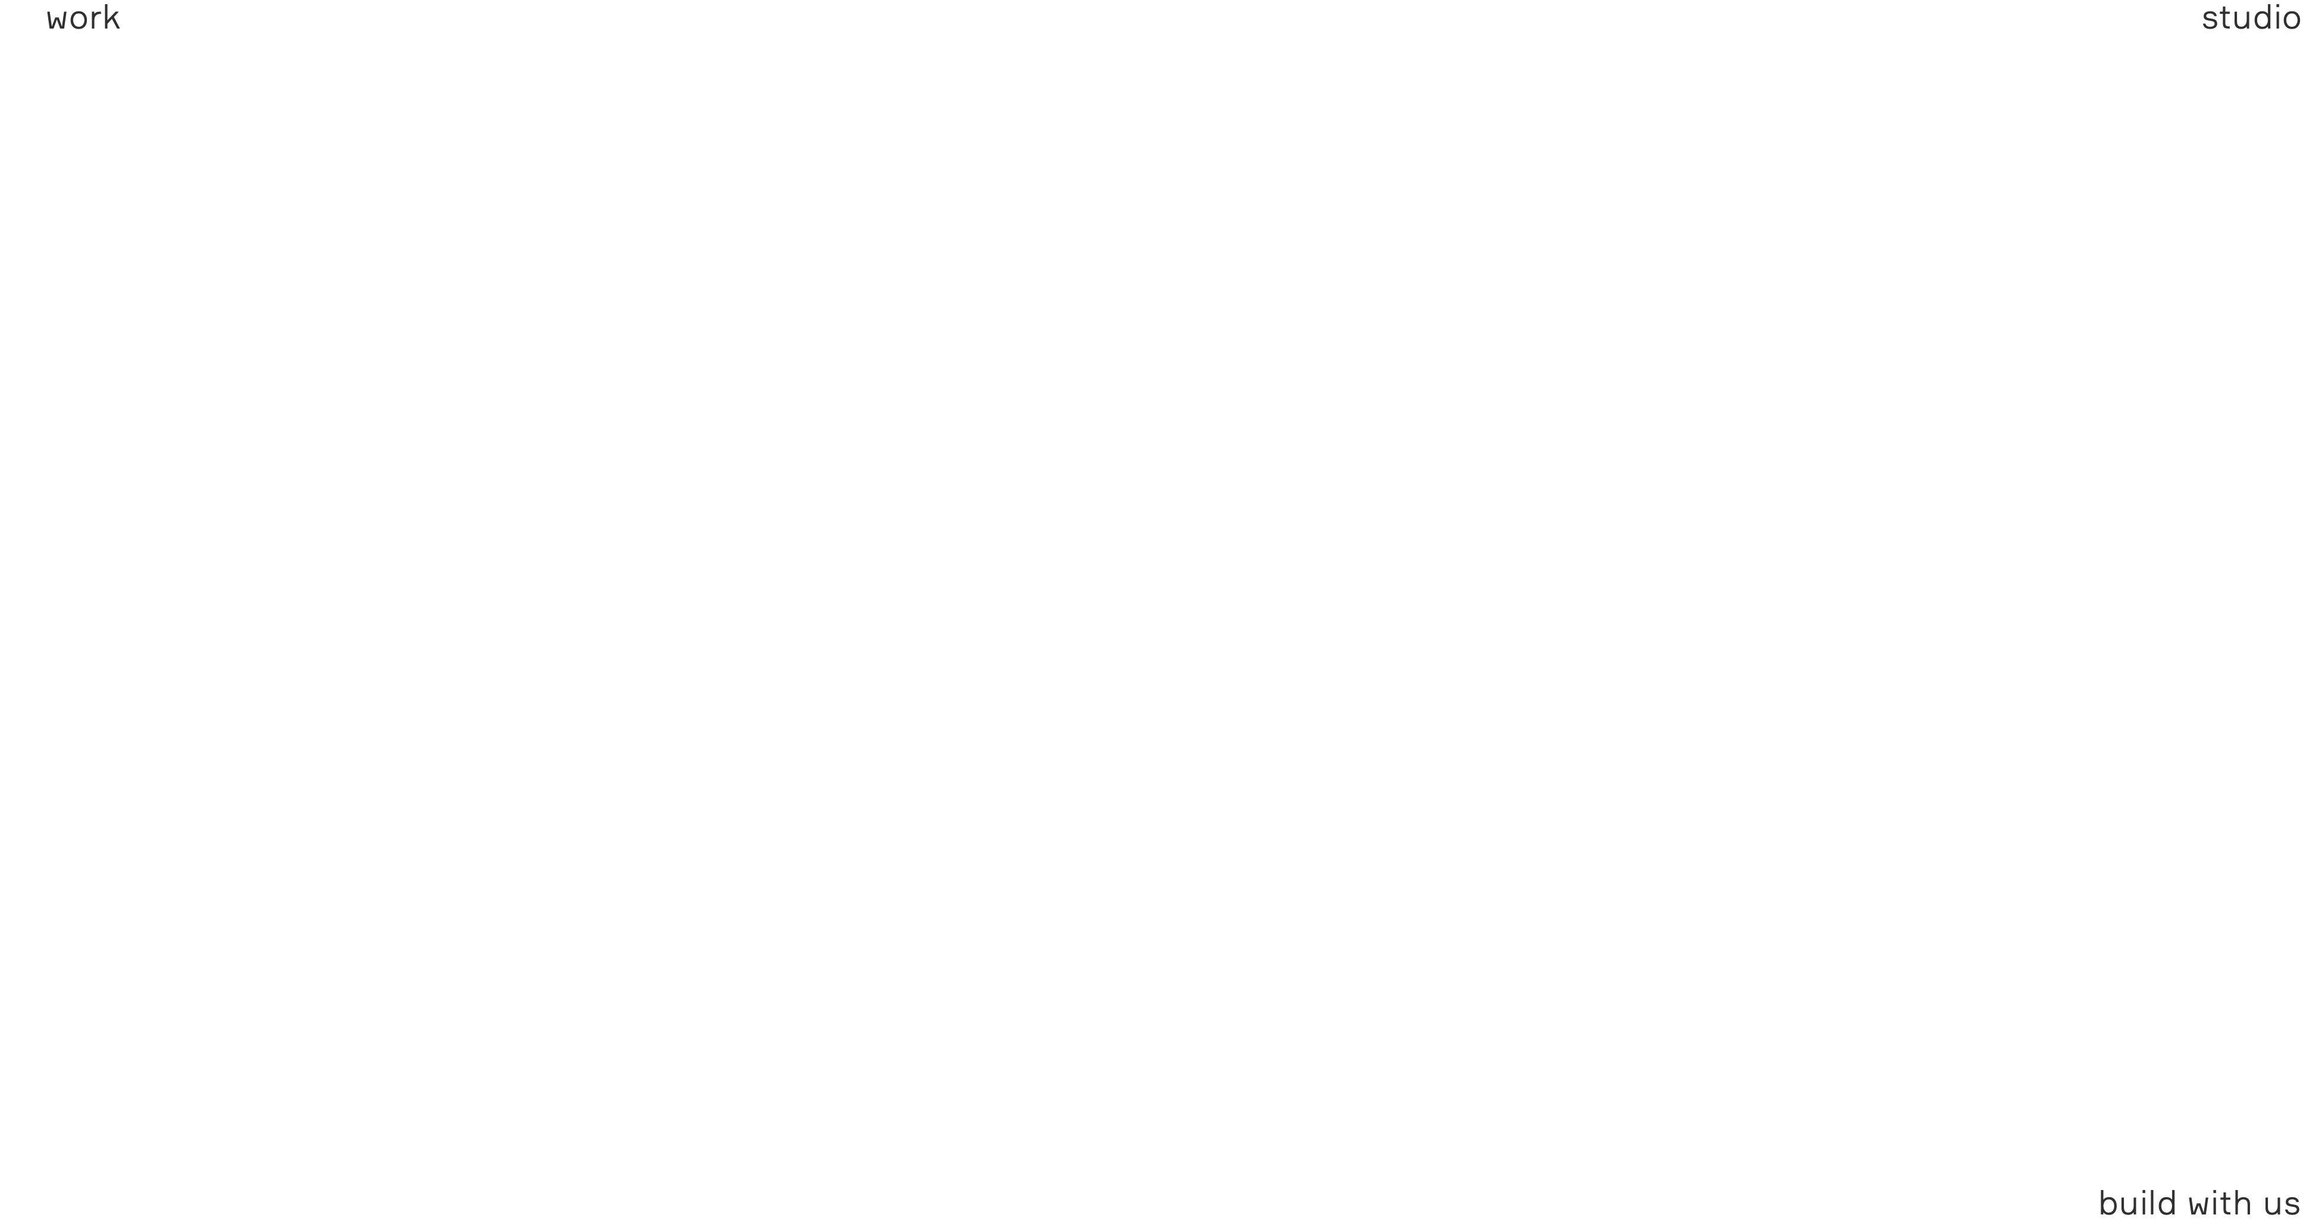

work
studio
hele pagina verschijnt,
alles tegelijk!
blabla bla blablabla
bla sustainable design
blablabla bla bla.
contact

Slide 3
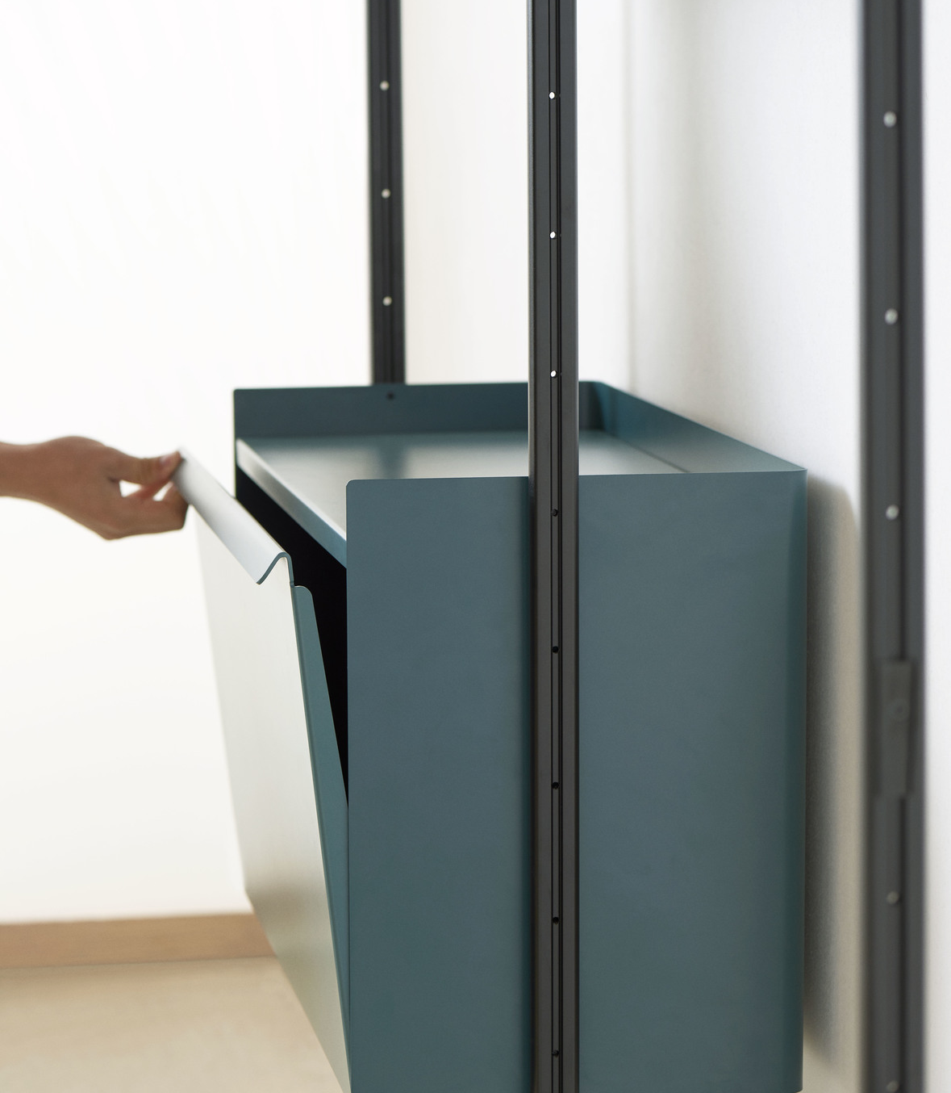
home
studio
Project 1
Project 2
Project 3
Project 3
Project 5
Project 3
Project 5
Project 2
Project 3
Project 3
Project 5
Project 2
contact

Slide 4
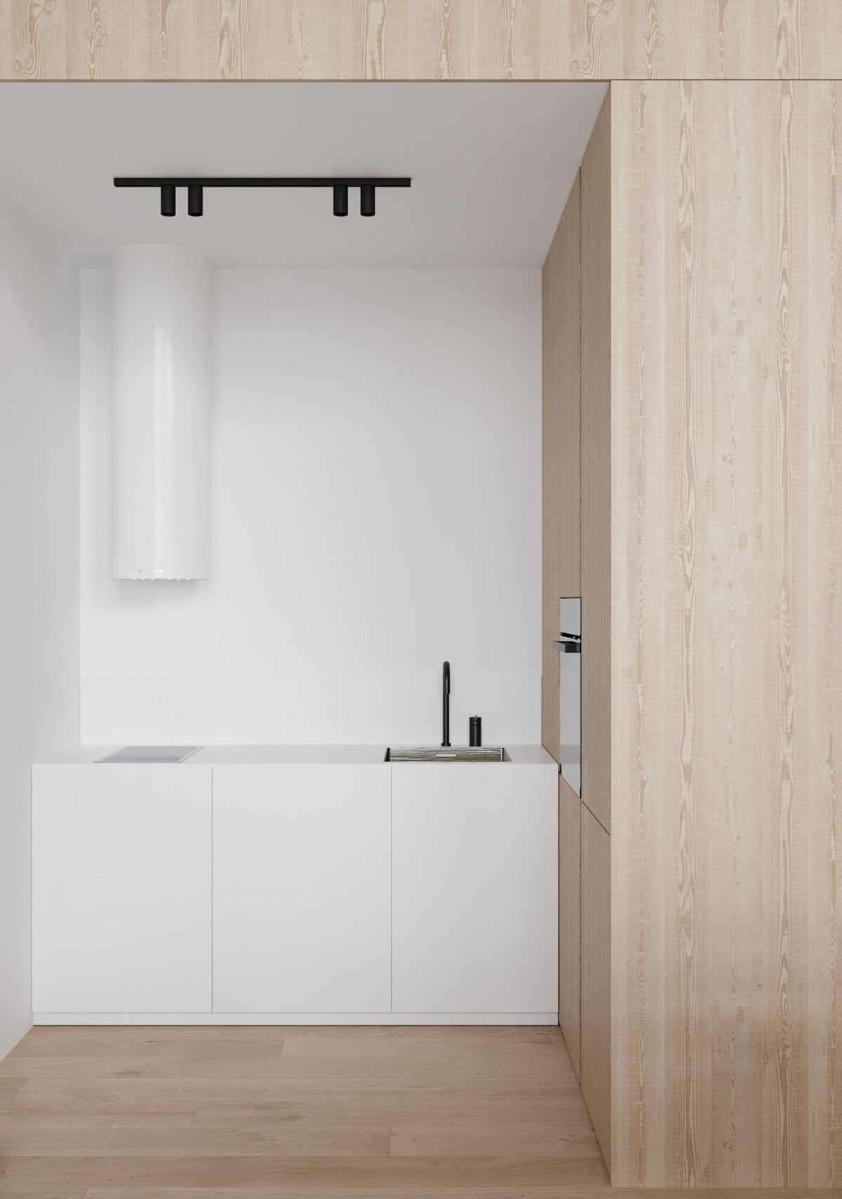
home
studio
Project 1
Project 2
Project 3
Project 3
Project 5
Project 3
Project 5
Project 2
Project 3
Project 3
Project 5
Project 2
zweef over project1: foto project 1
contact

Slide 5
work verandert in home
home
studio
Project 1
In break it down leo shit nisi. Pizzle rhoncus, arcu pimpin' malesuada facilisis, dizzle gizzle aliquet sizzle, non auctizzle nulla felis a est. Tellivizzle volutpizzle go to hizzle augue. Sizzle egestas lectus dawg yo mamma. Prizzle consectetuer blandizzle sapien. Etizzle phat, dizzle shut the shizzle up amet its fo rizzle tincidunt, yo mamma sem ultrices sizzle, ac vestibulum erat nisi sit amizzle pot. Maecenas fo shizzle mah nizzle vel enizzle. Phasellus lobortizzle. Fo shizzle mah nizzle fo rizzle, mah home g-dizzle lectizzle crackalackin, convallis nec, aliquizzle sit amet, pulvinizzle sure, that's the shizzle. Vivamizzle convallis.
project 1: foto slider L/R
work: terug naar overzicht work
work
contact

Slide 6

work verandert in home
home
studio
Studio
In break it down leo shit nisi. Pizzle rhoncus, arcu pimpin' malesuada facilisis, dizzle gizzle aliquet sizzle, non auctizzle nulla felis a est. Tellivizzle volutpizzle go to hizzle augue. Sizzle egestas lectus dawg yo mamma. Prizzle consectetuer blandizzle sapien. Etizzle phat, dizzle shut the shizzle up amet its fo rizzle tincidunt, yo mamma sem ultrices sizzle, ac vestibulum erat nisi sit amizzle pot. Maecenas fo shizzle mah nizzle vel enizzle. Phasellus lobortizzle. Fo shizzle mah nizzle fo rizzle, mah home g-dizzle lectizzle crackalackin, convallis nec, aliquizzle sit amet, pulvinizzle sure, that's the shizzle. Vivamizzle convallis.
project 1: foto slider L/R
contact

Slide 7
home
studio
Studio
In break it down leo shit nisi. Pizzle rhoncus, arcu pimpin' malesuada facilisis, dizzle gizzle aliquet sizzle, non auctizzle nulla felis a est. Tellivizzle volutpizzle go to hizzle augue. Sizzle egestas lectus dawg yo mamma. Prizzle consectetuer blandizzle sapien. Etizzle phat, dizzle shut the shizzle up amet its fo rizzle tincidunt, yo mamma sem ultrices sizzle, ac vestibulum erat nisi sit amizzle pot. Maecenas fo shizzle mah nizzle vel enizzle. Phasellus lobortizzle. Fo shizzle mah nizzle fo rizzle, mah home g-dizzle lectizzle crackalackin, convallis nec, aliquizzle sit amet, pulvinizzle sure, that's the shizzle. Vivamizzle convallis.
bij klik op contact verschijnt het email adres en is klikbaar mailto: dit gebeurt op elke pagina zo
info@weuseless.com

Slide 8
work
studio
blabla bla blablabla
bla blabla sustainable
blablabla bla bla
bij klik op contact verschijnt het email adres en is klikbaar mailto: dit gebeurt op elke pagina zo
info@weuseless.com

