Slide 1
MANAGEMENT AGENT
Resident request
classifier
Condominium operations prototype
Working local website with an offline classifier and Ollama inference
Notes:
Slide version of the existing edited video showcase. Visual direction: output/demo/stills and scripts/render_demo.py. Updated local Ollama evidence comes from reports/ollama-verification.json. The application classifies requests and suggests routing. Ticket creation and autonomous agents belong to future phases.

Slide 2
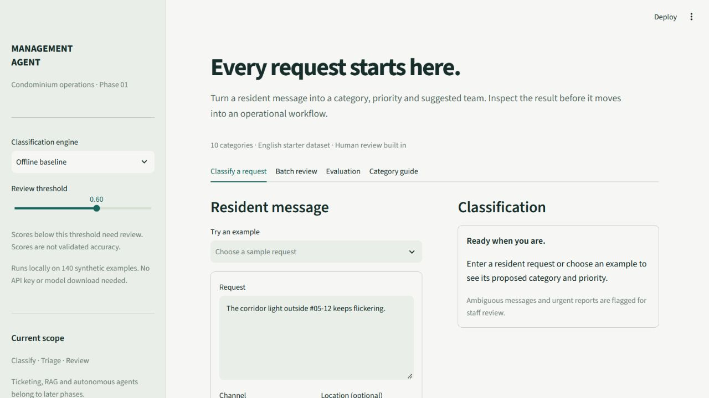
Resident intake
A resident writes a message
Staff can add a location
10 fixed request categories
Actual app screen with a synthetic resident message
02 / 08
Notes:
Source: output/demo/captures/01-intake.jpg. Authentic app capture with a synthetic message. The default offline baseline uses the project's train.csv and requires no API key.

Slide 3
Classifier workflow
01
Resident message
The website passes the request to this project's Classifier.
02
Safety screen
Explicit urgent reports bypass the model and require staff triage.
03
Selected classifier
Offline TF-IDF baseline or local Gemma through Ollama.
04
Validation and review
Staff inspect the category, priority, evidence and suggested team.
03 / 08
Notes:
Sources: condo_classifier/service.py, schema.py, backends.py and README.md. The website calls the existing project Classifier. LangGraph orders the safety screen, backend classification and review policy. Emergency rules bypass model inference. Model outputs undergo schema and evidence validation. No work tickets or emergency dispatch occur.

Slide 4
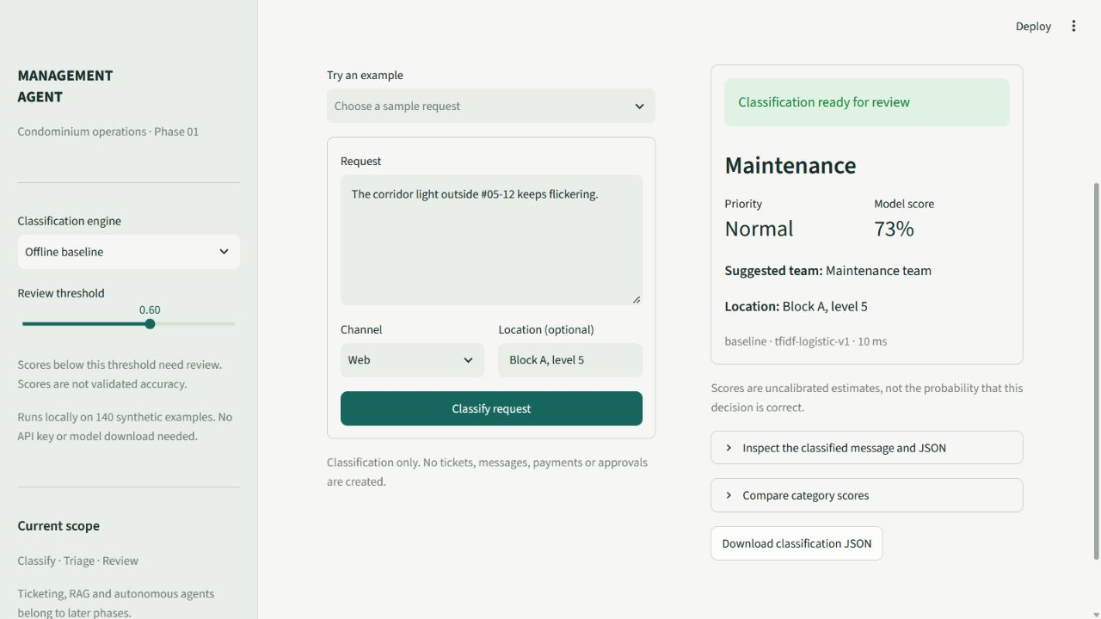
Structured classification
Category: Maintenance
Priority: Normal
Suggested team: Maintenance
Uncertain requests remain visible for staff review
04 / 08
Notes:
Source: output/demo/captures/02-maintenance.jpg. The pictured request demonstrates the offline classifier, with maintenance category, normal priority and suggested maintenance team. A model score does not represent validated real-world accuracy.

Slide 5
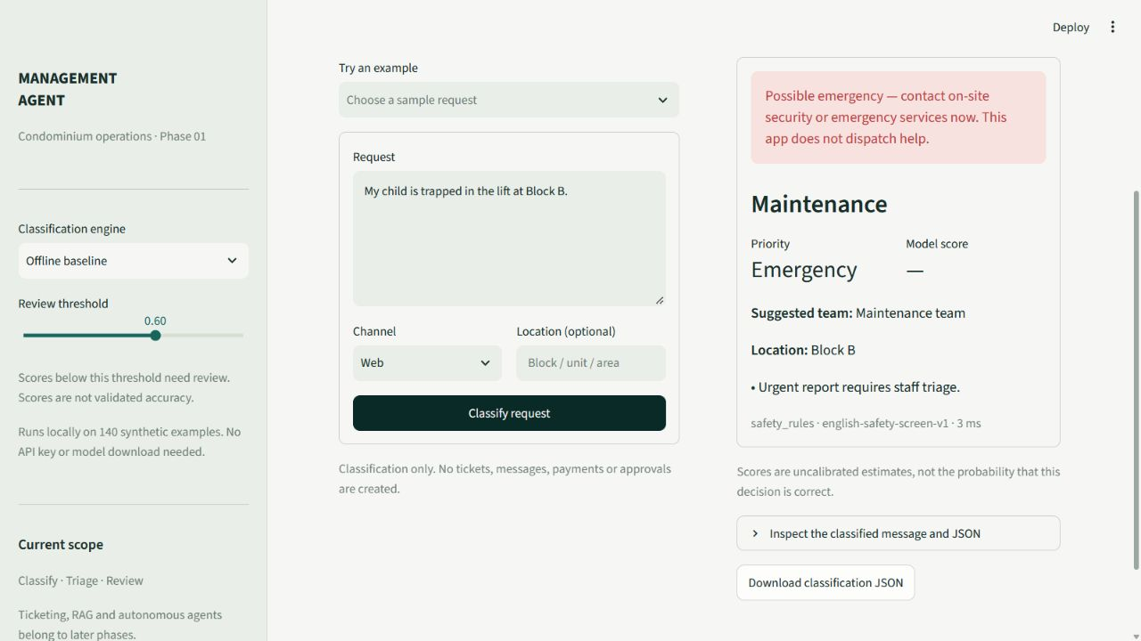
Urgent reports and human review
Emergency rules run first
Staff confirm every Gemma result
The app flags urgency. People act.
No emergency dispatch or automatic ticket creation
05 / 08
Notes:
Source: output/demo/captures/03-emergency.jpg. Synthetic child trapped in lift example. Safety rules identify selected explicit English emergency phrases. All Ollama classifications require human confirmation because model confidence is uncalibrated. The app flags urgent reports but does not dispatch assistance.

Slide 6
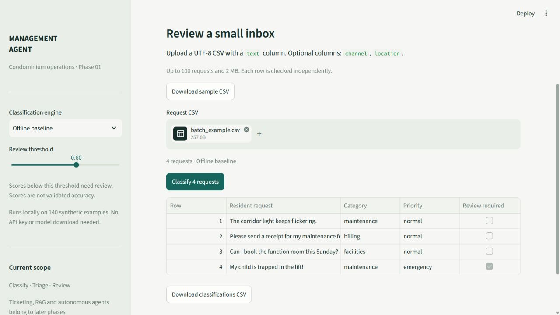
Batch review
Upload a CSV inbox
Inspect each request and its status
Export the classification results
Up to 100 rows per CSV upload
06 / 08
Notes:
Source: output/demo/captures/04-batch.jpg. Batch supports up to 100 rows and a 2 MB CSV. The text column is required. Invalid inputs and provider errors receive row-level status. Exports include classifications for review, with spreadsheet formula protection.

Slide 7
Local evaluation results
Same 50 ordinary synthetic requests. Five additional emergencies used rules.
Outcome | Offline baseline | Gemma 3
Valid, correct category | 48 / 50 | 42 / 50
Rejected model outputs | 0 | 2
Default website engine | Yes | Optional
gemma3:4b 4.3B parameters Q4_K_M RTX 3080
1.12 s average valid warm response 1.32 s including rejected attempts
First cold response: 86.6 s. Measurements: 3 October 2026.
Synthetic development checks. Real resident accuracy remains unverified.
07 / 08
Notes:
Measured on 3 October 2026 in Singapore time. Sources: reports/ollama-verification.json, reports/baseline-evaluation.json and README.md. Comparison excludes five emergency cases handled by rules. Both classifiers ran the same 50 ordinary synthetic requests. Gemma produced 48 valid responses, of which 42 had correct categories. Two invalid outputs went to review. Warm valid response mean 1123.69375 ms, mean all attempts 1316.566 ms, cold classification 86598.8 ms. Hardware RTX 3080 with 10 GB VRAM. Gemma3:4b 4.3B Q4_K_M. Synthetic development evidence is not independent real resident validation.

Slide 8
Local startup
1
Open the project folder
C:\Users\Skith\Documents\MSG
2
Run start_project.cmd
The launcher starts Ollama and the website.
3
Open http://localhost:8501/
Choose Offline baseline or Ollama in the sidebar.
Offline only: start_project.cmd -SkipOllama
08 / 08
Notes:
Startup supplied by project launcher start_project.cmd and scripts/start_project.ps1. From C:\Users\Skith\Documents\MSG, running start_project.cmd starts or reuses local Ollama at 127.0.0.1:11434 and Streamlit at localhost:8501, then opens the website. The app defaults to Offline baseline. Select Ollama in its sidebar to use gemma3:4b. The offline-only option is start_project.cmd -SkipOllama. Existing standalone Ollama installation is scoped to this workstation. For a clean installation follow README.md.

