Slide 1
HW4
Principal Component Analysis
Chao Hsuan Lin
Po-Chih Kuo

Slide 2
Goal
Implement basic PCA (Principal Component Analysis)
Understand the key aspects of applying PCA on both the training and testing datasets
Reconstruct images by using PCA and visualize the principal components
Implement Sparse PCA (advanced section).
Compare the differences between PCA and Sparse PCA.

Slide 3
Grading Policy
Item | Score
Basic Implementation | 60%
Advanced Implementation | 30%
Basic & Advanced Report | 10%

Slide 4
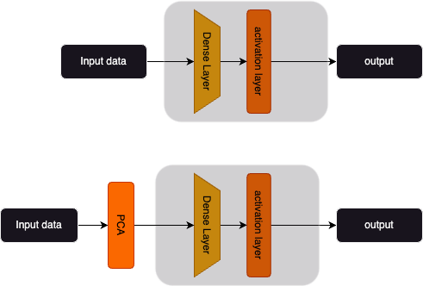
Flow chart
Custom neural networks
HW3:
Custom feature extraction
Fixed neural networks
HW4:

Slide 5
Basic Implementation (60%)
Basic PCA
Implement centering function. (5%)
Implement covariance matrix computation. (10%)
Calculate eigenvectors and eigenvalues. (10%)
Reduce the dimensions to two and generate scatter plots.
(Training dataset 5%, Validation dataset 5%)
Reconstruct image by using K components and compare with the original image (Training dataset 5%, Validation dataset 5%)
Calculate the minimum # of principal components to cover 80%
variance (5%)
PCA + neural network for classification
Use PCA and the model from HW3 (advanced part) to train models on the imbalance MNIST dataset. (10%)
(you will get the points for this part if the testing f1_score > 0.92)
Notes:
Standard 拉出來 –mean就好 train eigenvector and testing eignvector

Slide 6
Advanced Implementation (30%)
Sparse PCA
In advanced part, you are asked to implement Sparse PCA.
1. Initialize components (5%)
2. Iterative thresholding (5%)
3. Normalize components (5%)
4. Transform the data (5%)
Ranking (10%):
Implement a multi-class classifier on the augmented MNIST dataset.
Employ custom data preprocessing and dimensionality reduction techniques to enhance model performance.
*Importing pre-existing modules and altering the model's fundamental settings are not permitted.

Slide 7
Basic & Advanced Report (10%)
Describe what problems you encountered and how did you solve them when implementing the basic and advanced functions. (2%)
Briefly describe how you implement the basic PCA. (3%)
Plot eigenvectors and the reconstruct image (1%)
Plot the distribution of eigenvalues (1%)
Introduce the preprocessing/PCA methods you implemented in advanced part. (3%)
Do not exceed 1 page!
Name your report file as “report.pdf”.

Slide 8

PCA
Step1: Centralize
We need to centralize features before PCA, to ensure that the mean of each feature is zero.
Yes, just simple centralize. Be cautious and ensure that centralization is conducted along features rather than samples.

Slide 9
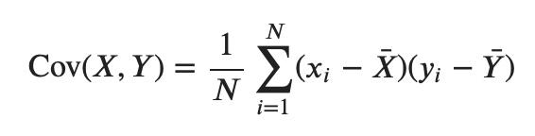
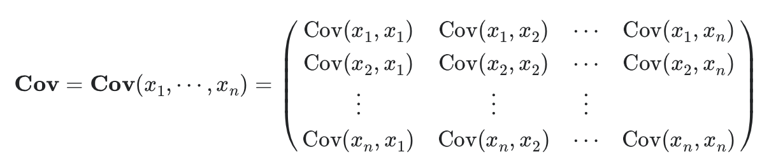
PCA
Step2: Covariance matrix computation
For each pair (x_{i},x_{j}) of measurements we calculate the covariance
*Only basic matrix operations are permitted in this part.

Slide 10
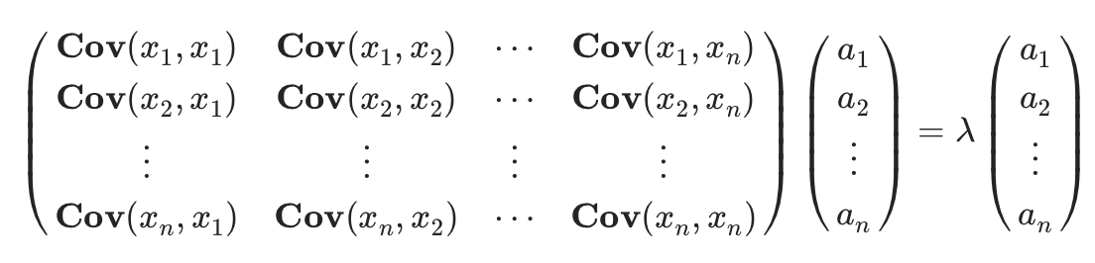
PCA
Step3: Find the eigenvalues and eigenvectors of the
covariance matrix
We say that the column vector a is an eigenvector for the covariance matrix Cov, with eigenvalue λ.
*Feel free to use the advanced functions for efficiency.

Slide 11
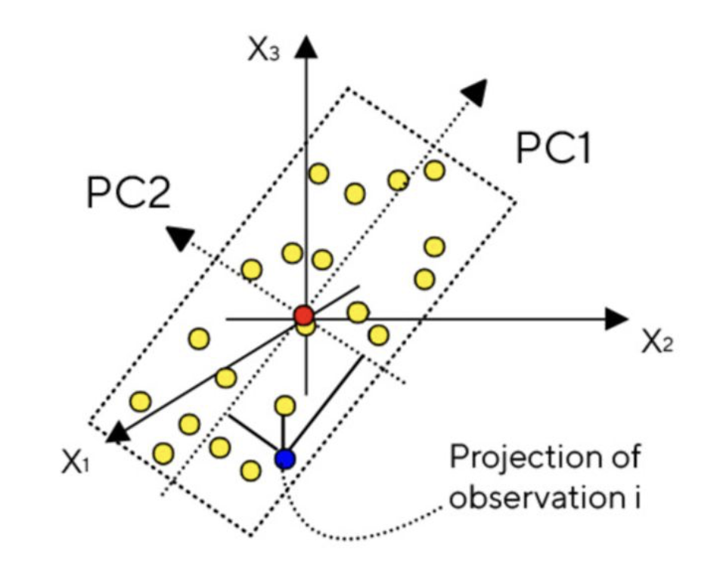
PCA
Step4: Projection
We will sort the eigenvectors by their corresponding eigenvalues, select the top few eigenvectors (principal components), and then project the data from its original coordinates onto these selected eigenvectors.

Slide 12
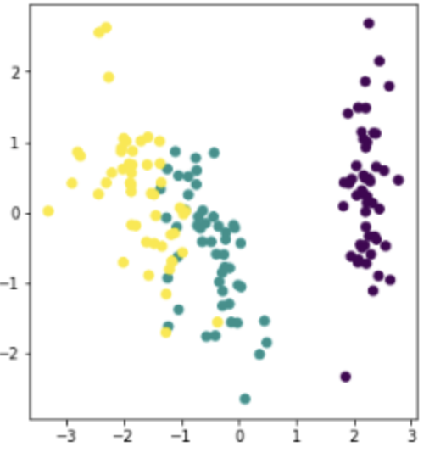
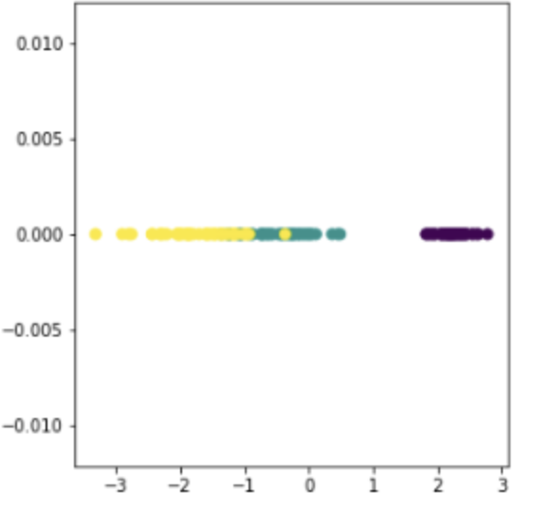
PCA
Visualize the principle components with IRIS datasets

Slide 13
Sparse PCA
Sparse PCA is a variation of Principal Component Analysis that emphasizes sparsity, encouraging a concise representation by focusing on a subset of key features. This makes the results more interpretable, especially in high-dimensional datasets.
Step1: Centralize

Slide 14
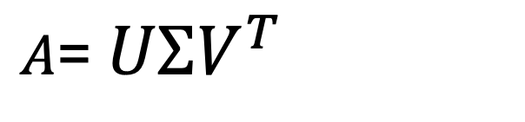
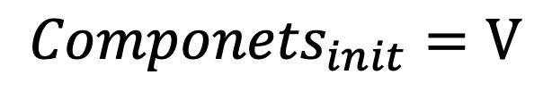

Sparse PCA
Step2: Initialize Components by SVD
Step3: Iterative Thresholding

Slide 15
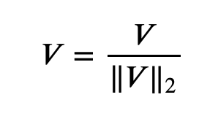
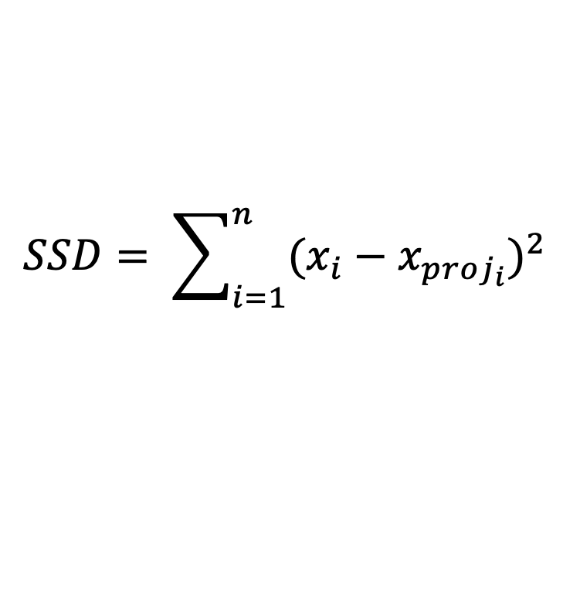

Sparse PCA
Step4: Normalize Components:
Step5: Repeat Iterations:
Repeat steps 3-4 for a specified number of iterations or until convergence based on the change in sum of squared differences (SSD) between origin data and projected data.

Slide 16
Data
Basic Data:
We will continue using the imbalanced MNIST dataset from HW3 as our
basic dataset.
Advanced Data:
For the advanced data, we'll also use the imbalanced MNIST dataset
from HW3.
However, to increase the challenge in the advanced part, we have
introduced additional noise and applied rotational transformations.

Slide 17
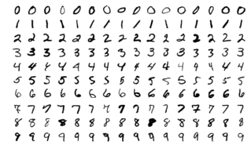
Basic Data (Same as HW3)
Multi-class classification: MNIST handwritten digit dataset
The MNIST dataset contains around 70,000 small square 28×28 pixels grayscale images of handwritten single digits between 0 and 9. We resampled it to make it into imbalanced dataset.
The details of the training set and testing set:
shape of x_train: (31065, 28, 28)
shape of y_train: (31065,)
shape of x_test: (7767, 28, 28)

Slide 18
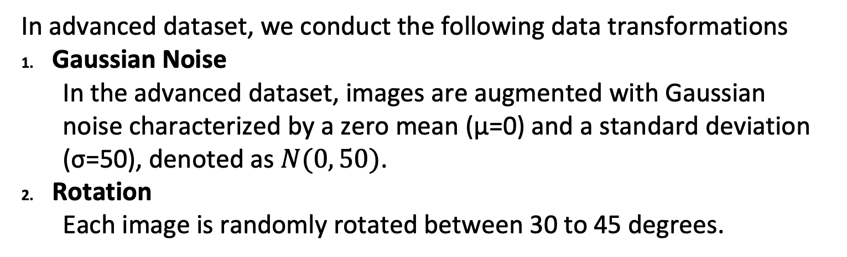
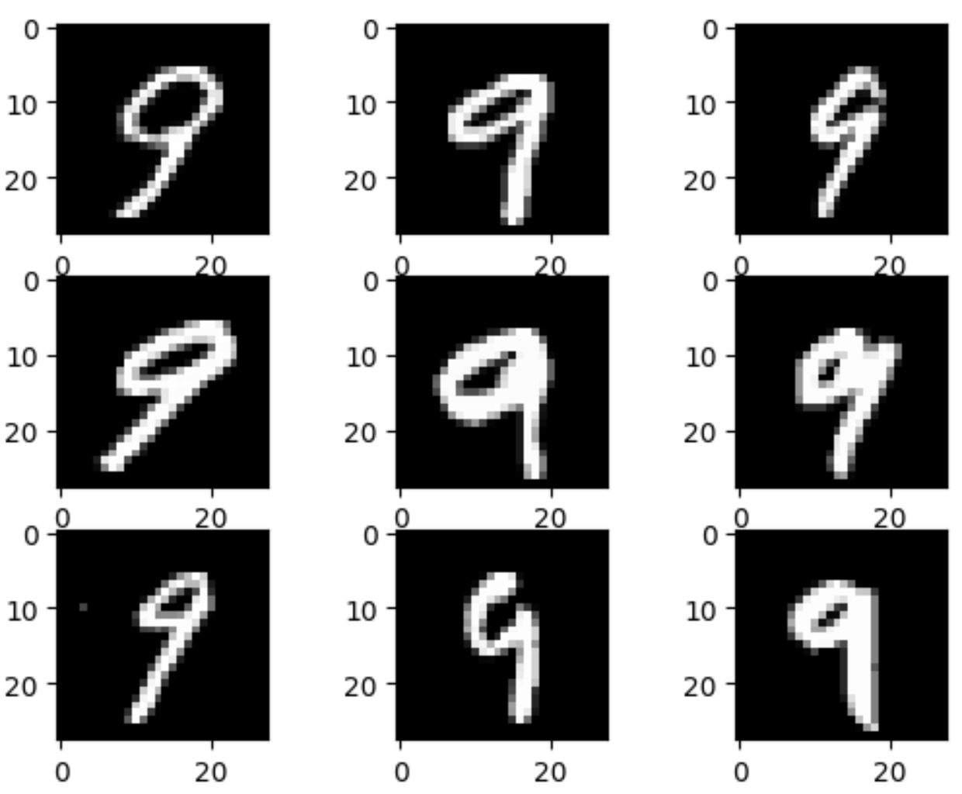
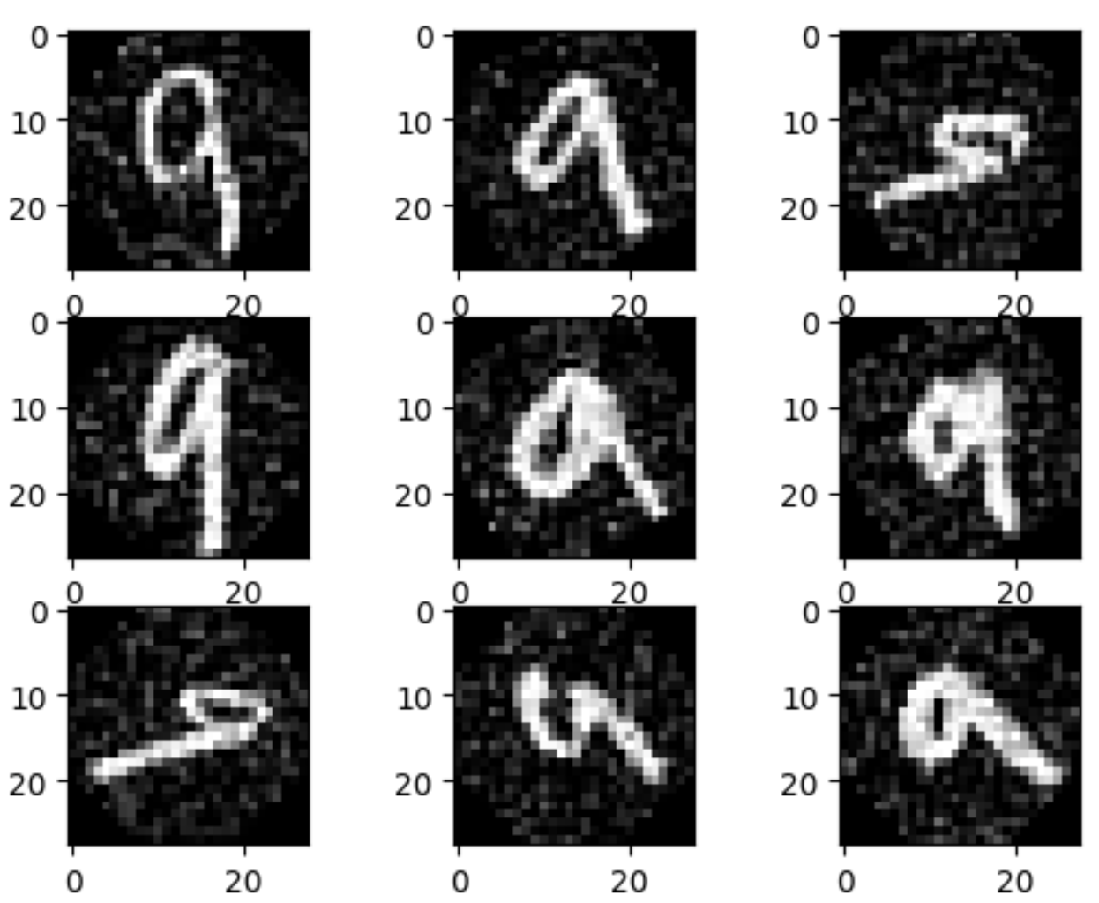
Advanced Data
Original MNIST Dataset
Transformed MNIST Dataset

Slide 19
Items for you
Template:
HW4.ipynb
PCA.ipynb
Loss.ipynb
Model.ipynb
Trainer.ipynb
Config.ipynb
Data_preprocess.ipynb
Utils.ipynb
DATA:
basic_data.npz
advanced_dta.npz
Sample output: sample_output.npy
HW4
HW3
Helper functions
!!Please do not modify these three files!!

Slide 20
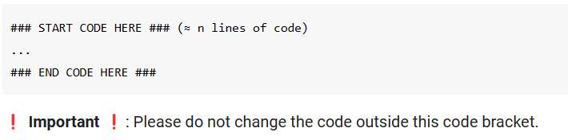
Template
Except for the imported packages in the template, you cannot use any other packages.

Slide 21
Output NPY File Format
Named as “output.npy”
This file is a dictionary that stores your output for each function and all the PCA classification prediction. Note that the hyperparameter and weights of both classifiers will also be stored in the output file to check whether your predictions come from the same classifier you submitted.
Please take note: unlike Assignment 3, in this file, you are required to provide a basic PCA prediction and advanced PCA prediction.

Slide 22
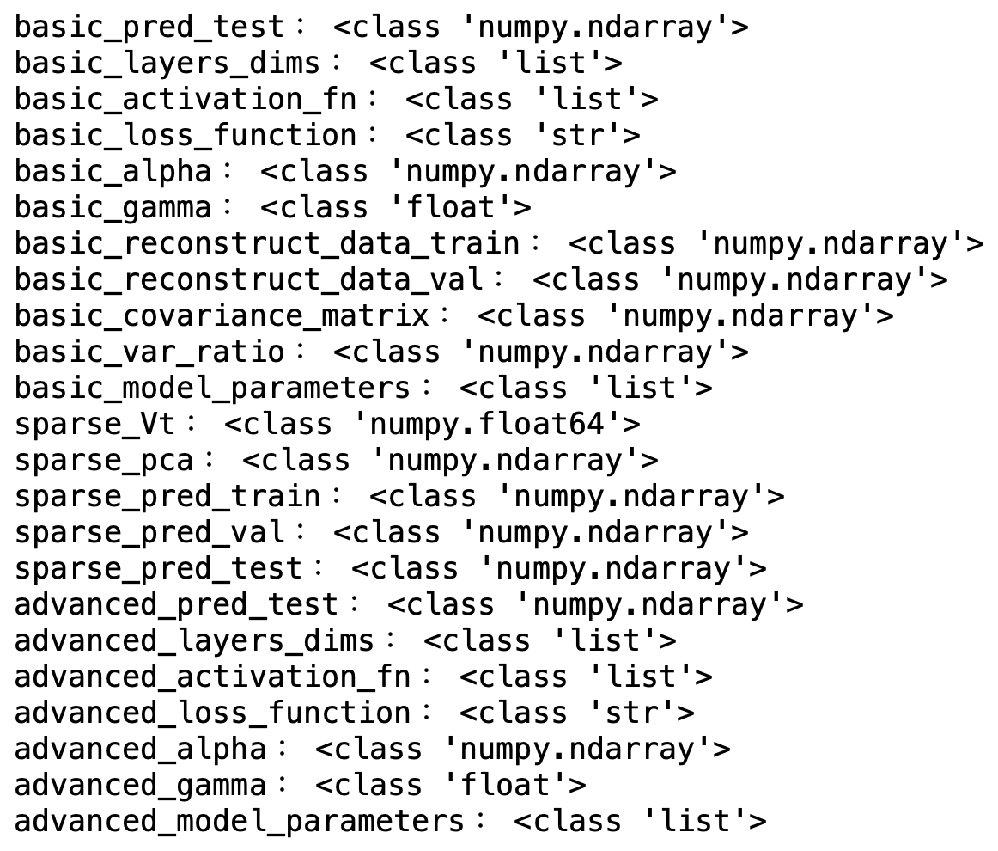
Output NPY File Format
Sample Output

Slide 23
The Evaluation Metric
In the basic and advanced function implementations, you will get a full score if your output is exactly the same as the standard answer, or else you will get a zero mark for each function implementation.
For the ranking part, we will use F1 score to evaluate your classifier.
Ranking part: You will be compared with others who submit the advanced prediction.

Slide 24
Requirement
Do it individually! Not as a team! (team is for final project)
Announce date: 2023/12/14
Deadline: 2023/01/09 23:59 (Late submission is not allowed!)
Hand in your files in the following format (Do not compress them)
HW4.ipynb - output.npy
PCA.ipynb - report.pdf
Loss.ipynb
Model.ipynb
Trainer.ipynb
Config.ipynb
Data_preprocess.ipynb
Utils.ipynb

Slide 25
Penalty
0 points if any of the following conditions:
Plagiarism
Late submission
Not using template or import any other packages
Incorrect input/output format
Incorrect submission format
Predictions mismatch (your predictions did not come from the same classifier you submitted)
Directly copy code from ChatGPT

Slide 26
Questions?
TA: Chao Hsuan Lin 林晁璿 (raylin89910@gmail.com)
No debugging service

Slide 27


Kind reminder

