Slide 1
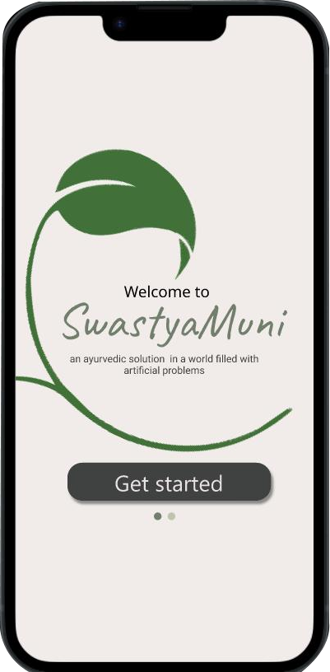

HEXORA
SwastyaMuni
In our fast-paced world, ancient traditions like Ayurveda and yoga often go overlooked. To reconnect people with their cultural roots, a new Ayurveda-based chatbot SwastyaMuni. This AI-powered tool will provide accessible information on Ayurvedic principles in your pocket. It ’ll also guide you about yoga, aiming to rekindle interest in these valuable practices. By doing so, it seeks to bring balance to modern l ives while preserving our cultural heritage As well as bring immense knowledge and health benefits

Slide 2
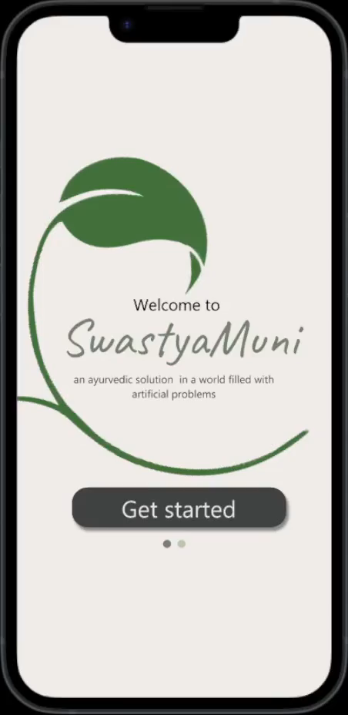
Features
The first ever Personalized AI Healthcare Chabot trained on ancient books on Ayurveda
Disease prediction and Ayurvedic remedies
Body type predictions and fitness routine recommendations
Yoga asan recommendations and alignment assessment
MultiLingual support
Binaural beats to help you focus and lighten up your mood
Spreading awareness about Ayurveda and yoga's among the youth

