Slide 1
Lecture 1
Operating Systems (COMP1562)

Slide 2

Computer System Components
Hardware – provides resources of the
computer system,
Operating system – supervises and coordinates
using of the hardware by
various applications run by users,
Applications – determine the way how the
hardware is used in order to
satisfy users requirements; these
include compilers, databeses,
computer games, business
application, etc.,
Users - entities using all the components
(people, other computers, etc.).
Mariusz Pelc © 2014/2015
(with support from Dr Kevin McManus)

Slide 3
Computer System Components
User 1
User 2
User 3
(…)
User N
System and User Programs
Compiler
Word Processor
WEB Browser
Database
Operating System
Hardware
Fig.1. Computer System Components
Mariusz Pelc © 2014/2015
(with support from Dr Kevin McManus)

Slide 4
Operating Systems and its Tasks
Operating system – a very sophisticated and advanced software providing mechanisms and services that allow users to exploit the hardware resources of the computer system.
Operating system’s tasks:
Managements of computer resources, including:
  Processors,
  Memory (RAM),
  I/O devices
    Keyboard, screen, mouse,
Mariusz Pelc © 2014/2015
(with support from Dr Kevin McManus)

Slide 5
Operating Systems and its Tasks
    Storage,
    Networks,
    Printers (and other peripherial devices),
  Communication ports
    Serial, parallel, ethernet, (USB?),
  System buses
    Data/address,
    Communication between processors, memory and I/O modules, e.g. (ISA/EISA), PCI/AGP, SCSI
Mariusz Pelc © 2014/2015
(with support from Dr Kevin McManus)

Slide 6
List of known/official operating systems (Wikipedia)
1 Proprietary
1.1 Acorn Computers
1.2 Amiga (6)
1.3 Apollo Computer
1.4 Apple Inc. (37)
1.5 Atari (3)
1.6 BAE Systems
1.7 Be Inc.
1.8 Burroughs Corporation
1.9 Control Data Corporation (CDC)
1.10 Convergent Technologies
1.11 Data General
1.12 DataPoint
1.13 Digital/Tandem Computers/Compaq/HP (21)
1.14 Fujitsu
1.15 Green Hills Software
1.16 Hewlett-Packard (3)
1.17 Honeywell
1.18 Intel Corporation (2)
1.19 IBM (~70)
1.20 International Computers Limited
1.21 LynuxWorks (originally Lynx Real-time Systems)
1.22 Micrium Inc.
1.23 Microsoft (37)
1.24 NCR Corporation
1.25 Novell (3)
1.26 Quadros Systems
1.27 QANTEL
1.28 RCA
1.29 RoweBots
1.30 SCO / The SCO Group (9)
1.31 Unicoi Systems
1.32 Wind River Systems
1.33 SDS (Scientific Data Systems)
1.34 TRON Project
1.35 UNIVAC (later Unisys)
1.36 Unisys
1.37 Wavecom
1.38 Wang Laboratories
1.39 Other
1.39.1 Lisp-based
1.39.2 Non-standard language-based
1.39.3 Other proprietary non-Unix-like
1.39.4 Other proprietary Unix-like and POSIX-compliant
2 Non-proprietary
2.1 Unix-like
2.1.1 Research Unix-like and other POSIX-compliant
2.1.2 Free/Open source Unix-like
2.1.3 Other Unix-like
2.2 Non-Unix-like
2.2.1 Research non-Unix-like
2.2.2 Free/Open source non-Unix-like
3 Disk Operating Systems
4 Network
5 Web operating systems
6 Generic/commodity and other
7 For Elektronika BK
8 Hobby
9 Embedded (~30)
9.1 Personal digital assistants (PDAs)
9.2 Digital media players
9.3 Robots
9.4 Smartphones (16)
9.5 Routers (17)
9.6 Microcontrollers, Real-time (~40)
10 Capability-based
10.1 LEGO Mindstorms
11 See also
11.1 Category links
12 References
13 External links
Mariusz Pelc © 2014/2015
(with support from Dr Kevin McManus)

Slide 7
Typical Architectures of Operating Systems
There are the following typical architectures of operating systems:
General Purpose Systems
  Personal Computers,
  Workstations,
  Multiuser systems performing various tasks
Real-Time Systems
  Industrial processes control systems,
  Traction control systems,
  Visualisation systems,
  Monitoring systems,
Embedded Systems
  Microcontrollers (with dedicated software, usually no keyboard, rarely a display (LCD), working in real-time)
Multitasking Systems
  Systems with time division (processor is beign assigned to different tasks usually sequencially, the switching between tasks is very quick and frequent assuring full interaction with user)
Multiprocessor Systems,
Distributed Systems
Mariusz Pelc © 2014/2015
(with support from Dr Kevin McManus)

Slide 8
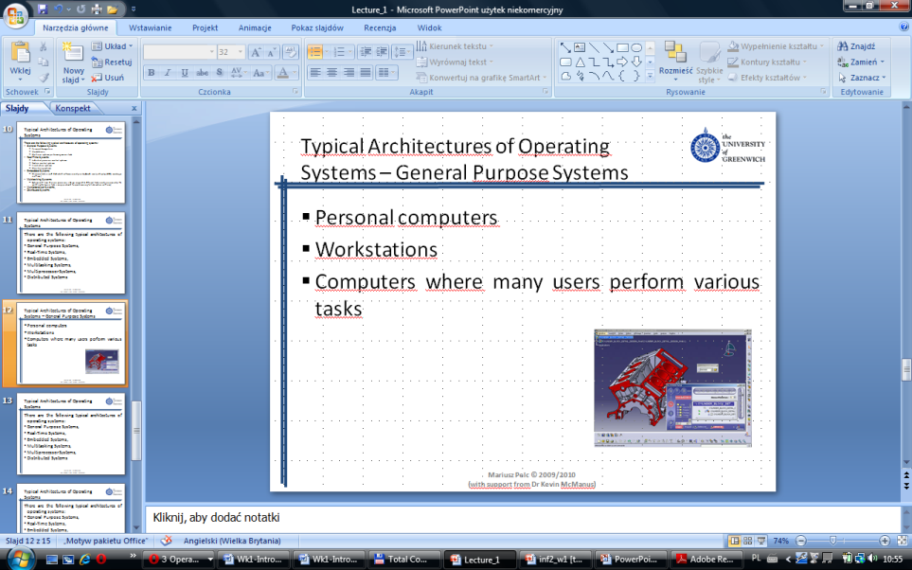
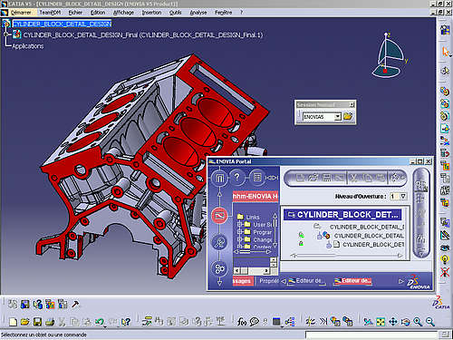

Typical Architectures of Computer Systems – General Purpose Systems
Personal computers
Workstations
Computers where many users perform various tasks
Mariusz Pelc © 2014/2015
(with support from Dr Kevin McManus)

Slide 9


Typical Architectures of Computer Systems - Real-Time Systems
Systems that supervise scientific experiments
Industrial processes control systems
Traction control systems
Visualisation systems
Monitoring systems (traffic monitoring)
Mariusz Pelc © 2014/2015
(with support from Dr Kevin McManus)

Slide 10
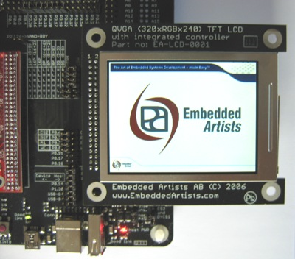
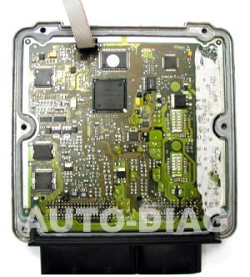
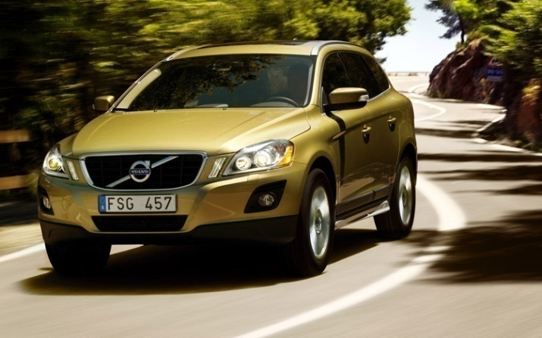
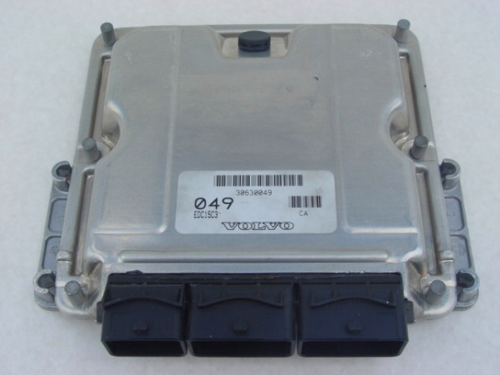
Typical Architectures of Computer Systems - Embedded Systems
Microcontrollers
Dedicated software
Usually no keyboard (some do have a display)
Working as long as the host system works
Working in real-time
Mariusz Pelc © 2014/2015
(with support from Dr Kevin McManus)

Slide 11
Typical Architectures of Computer Systems – Multitasking systems
Systems with time division
In these systems processor is being assigned (for example sequencially) to various tasks
The switching takes very short so there is guaranteed full interaction with a user
Word processing
CPU
Printing
File download
Fig.2. Processing in multitasking systems
Mariusz Pelc © 2014/2015
(with support from Dr Kevin McManus)

Slide 12
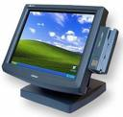
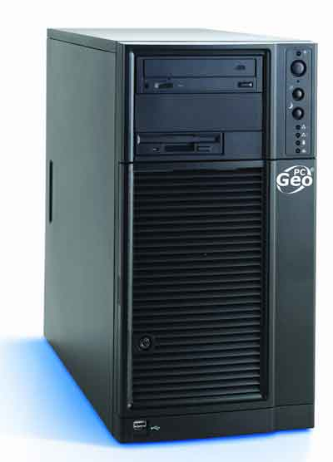
Typical Architectures of Computer Systems – Multiuser Systems
They are literal implementation of multitasking systems
Each user can work on different task from remote terminal equipped with in I/O devices (a keyboard, display, etc.)
Mariusz Pelc © 2014/2015
(with support from Dr Kevin McManus)

Slide 13
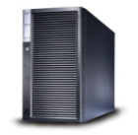

Typical Architectures of Computer Systems – Distributed systems
Can be homogenous or heterogeneous systems
Different users may access to different resources
Parallel computing via adequate task decomposition
Higher system reliability
Mariusz Pelc © 2014/2015
(with support from Dr Kevin McManus)

Slide 14
Typical Computers Architectures
There are the following typical computers architectures:
Harvard Architecture
Modified Harvard Architecture
SHARC Architecture (Super Harvard Architecture)
Von Nemunann’s Architecture
Modified Von Neumann’s Architecture
Mariusz Pelc © 2014/2015
(with support from Dr Kevin McManus)

Slide 15
Typical Computers Architectures – Harvard vs Modified Harvard vs SHARC
Harvard Architecture:
2 separate buses one for instructions and one for data
When instruction is being fetched from the first one, the other one can provide an argument.
Modified Harvard Architecture:
Separate code and data memory butcommon data and address bus.
Operations (for example for DSP processors) need at least 2 arguments
It is possible to send data using instruction bus.
SHARC Architecture:
When sending 2 values at one time (instruction and 2 arguments).
Solution provided by Analog devices uses cache memory storing instructions for next use. Both buses provide only data.
Mariusz Pelc © 2014/2015
(with support from Dr Kevin McManus)

Slide 16
Typical Computers Architectures – von Neumann/Modified v.N. Architecture
von Neumann Architecture:
Computer divided into three functional parts:
  Processor
  Memory
  I/O devices
Code and data placed in the same shared momory
Cannot access memory more than once per cycle
Modified von Neumann Architecture:
Faster memory clocking than instruction clock; 4 times faster memory clocking makes possible fetching instruction, data and write operation in once cycle.
Mariusz Pelc © 2014/2015
(with support from Dr Kevin McManus)

Slide 17
Typical Computers Architectures – von Neumann Architecture
Memory
Memory
Control
Unit
Arithmetic
Logic
Unit
Floating
Point
Unit
Accumulator
Input
Output
Fig.3. von Neumann Computer Architecture
Mariusz Pelc © 2014/2015
(with support from Dr Kevin McManus)

Slide 18
Typical Computers Architectures – von Neumann vs Harvard Architecture
A very informative Flash tutorial
Mariusz Pelc © 2014/2015
(with support from Dr Kevin McManus)

Slide 19
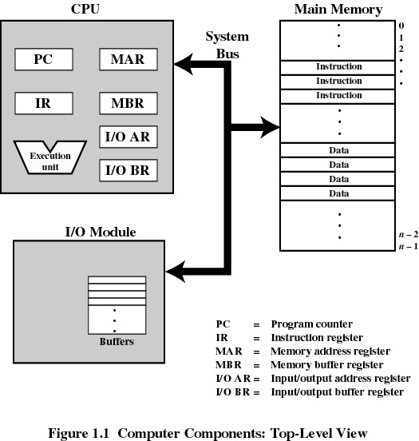
Closer view on von Neumann Computer Architecture
Fig.4. von Neumann Computer Architecture;
functional view
Mariusz Pelc © 2014/2015
(with support from Dr Kevin McManus)

Slide 20
Closer view on von Neumann Computer Architecture – Processor Registers
User-accessible registers
  May be referenced directly from assembler (machine) code
  Are available to all programs (applications and system programs)
Types of user-accessible registers
  Data/Universal registers:(AX <Acumulator>, BX, CX, DX for 80x86), (R0-R7 for 8051/805x5),
    MOV CX,1000h (80x86))
  Address registers
    Index registers (SI, DI for 80x86)
    MOV CX,DS:[SI] (80x86)
    Segment registers (pointers)
    MOV AX,SEG TEXT (80x86)
    MOV DS,AX (80x86)
    Stack pointer
    PUSH AX ;SP=SP+2; (80x86)
Mariusz Pelc © 2014/2015
(with support from Dr Kevin McManus)

Slide 21
Closer view on von Neumann Computer Architecture – Processor Registers
Control and status registers
  Program Counter (PC) – contains the address of
  an instruction to be fatched
  Instruction register – contains the most recent
  instruction fetched
  Processor Status Word (PSW); sometimes called Flag Register – contains bits set by the
  processor as a result of
  operations (overflow, zero
  value, etc.)
  – can be accessed by a
  program and some bits can be programmatically altered
Mariusz Pelc © 2014/2015
(with support from Dr Kevin McManus)

Slide 22
von Neumann Instruction Cycle
Control unit fetches next program instruction from memory (using PC).
PC is incremented by the size of instruction fetched.
Instruction is executed (after prior decoding and loading operands required by the instruction into CPU registers).
ALU stores the results (if any) in specified (or default) registers or in momory.
Fetch - execute cycle
Fetch instruction
Increment
PC
Execute instruction
START
STOP
Fig.4. Basic execution cycle
Mariusz Pelc © 2014/2015
(with support from Dr Kevin McManus)

Slide 23
Typical operations peformed by processor
Data copying
  From memory to a register
  From a register to memory
  From memory to memory (some processors)
Arithmetic operations
  Addition
  Subtraction
  Comparison
  Incrementation/Decrementation
  Sign change
Bitwise operations
  Logical product - AND
  Logical addition - OR
  Modulo 2 - XOR - XOR
  Negation - NOT
  Shift/Rotation left/right - SHL/ROL/RCL, SHR/ROR/RCR
Jumps
  Conditional (JZ – jump when Zero flag set, JC – jump when Carry flag set)
  Not conditional (JMP/SJMP/AJMP)
Mariusz Pelc © 2014/2015
(with support from Dr Kevin McManus)

Slide 24
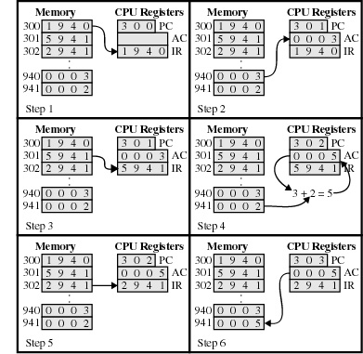
Example of hypothetical program execution
Hypothetical 16 bit processor
16 bit accumulator AC
16 bit instruction register IR
12 bit program counter PC
Instruction format:
4 bit opcode
12 bit address
opcodes:
0001 = load AC
0010 = store AC
0101 = add to AC
(from Stallings)
Mariusz Pelc © 2014/2015
(with support from Dr Kevin McManus)

Slide 25
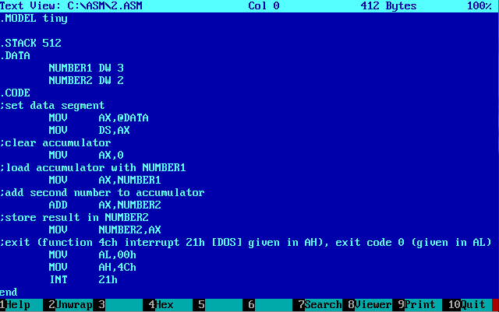
Example of real program execution
Mariusz Pelc © 2014/2015
(with support from Dr Kevin McManus)

Slide 26
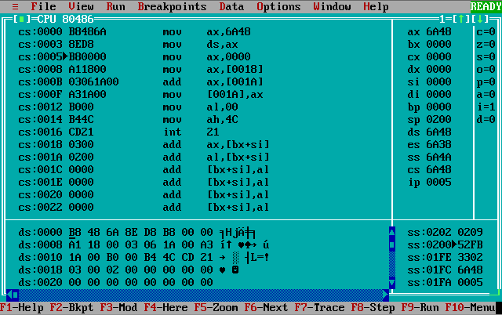
Example of real program execution
Mariusz Pelc © 2014/2015
(with support from Dr Kevin McManus)

Slide 27
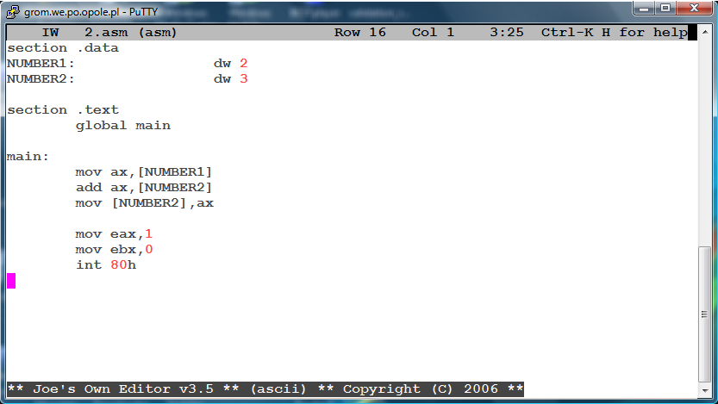
Example of real program execution
Mariusz Pelc © 2014/2015
(with support from Dr Kevin McManus)

Slide 28
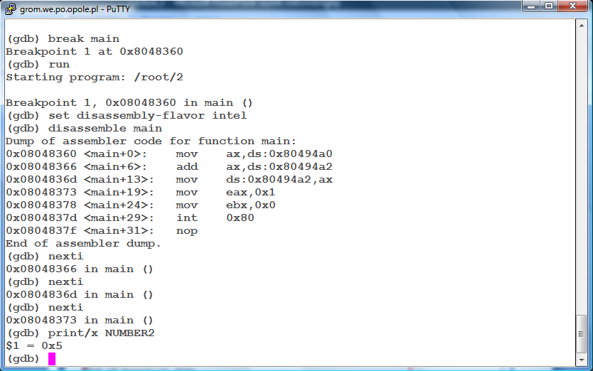
Example of real program execution
Mariusz Pelc © 2014/2015
(with support from Dr Kevin McManus)

Slide 29
Processors core types
CISC – Complex Instruction Set Computers
Not optimised
Complex specialised instructions
Many addressing types
Many instructions can directly refer to memory
Slow instruction decoding
RISC – Reduced Instruction
Set Computers
Reduced number of addressing modes
Reduced communication between memory and the processor
More internal registers
Pipelining
Mariusz Pelc © 2014/2015
(with support from Dr Kevin McManus)

Slide 30
DMA
Principle: DMA is an essential feature of all modern computers, as it allows devices to transfer data without subjecting the CPU to a heavy overhead.
This means that computers and microprocessors allows certain hardware subsystems (such as graphic cards, network cards, hard drive, etc.) within the computer to access system memory for reading and/or writing independently of the central processing unit.
Mariusz Pelc © 2014/2015
(with support from Dr Kevin McManus)

Slide 31
DMA
I/O exchanges occur directly between the device and memory.
Processor grants I/O module authority to access the memory (read from or write to).
Relieves the processor responsibility (supervision) on for the exchange.
Processing power can be used to do some other things.
Mariusz Pelc © 2014/2015
(with support from Dr Kevin McManus)

Slide 32
DMA – How it works?
I/O Instructions
Operating system reads the buffer from the buffers queue.
The device driver sets up in DMA registers the source and destination memory address and the data length.
DMA controller begins the data transmission.
During the transmission processor can do other things (though the DMA controller is stealing some memory cycles from the processor so it may work a bit slower.
After send operation is complete, DMA controller sends an interrupt to the processor (after sending the whole data block).
CPU
Memory
I/O Devices
Mariusz Pelc © 2014/2015
(with support from Dr Kevin McManus)

Slide 33
Interrupts
What is interrupt? Interrupt is an interruption of the normal sequence of execution in response to the real-world/real-time events.
Benefits? Interrupts improve processing efficiency (event-triggered processing ).
How it works? Currently running process is being suspended because of an event external to that process . The process state has to be stored for resume purposes. Now the interrupt handler is started in order to determine the next operations. Once it finishes it’s job, the suspended process is being resumed.
Mariusz Pelc © 2014/2015
(with support from Dr Kevin McManus)

Slide 34
Types of Interrupts
Program interrupts
  Run-time interrupts
    Arithmetic overflow,
    Division by zero,
    Memory violation (reference outside allowed memory space),
Hardware interrupts
  Timer,
    Overflow/zero/equal to
  I/O,
    A piece of hardware generates an interrupt wanting to be handled
Mariusz Pelc © 2014/2015
(with support from Dr Kevin McManus)

Slide 35
Types of Interrupts
Program interrupts
  Run-time interrupts
    Arithmetic overflow,
    Division by zero,
    Memory violation (reference outside allowed memory space),
Hardware interrupts
  Timer,
    Overflow/zero/equal to
  I/O,
    A piece of hardware generates an interrupt wanting to be handled
Mariusz Pelc © 2014/2015
(with support from Dr Kevin McManus)

Slide 36
Interrupt handler
In case of an interrupt occurs, the control is transferred to the interrupt handler being part of the operating system. It’s main features re:
It is responsible for determine the nature of the interrupt and performs whatever actions are needed.
It is processor specific (depending on processor type it may work a bit different).
It is maskable (the user can make up a decision whether it is enabled or disabled usually via setting/clearing some specific bit(s) in control register(s)).
Mariusz Pelc © 2014/2015
(with support from Dr Kevin McManus)

Slide 37
Interrupt Cycle
Processor checks for interrupts.
If there is no interrupt it fetches the next instruction and the current program is being continued.
If any interrupt is raised
  Processor suspends the current program,
  Current status (flag register and program counter) are pushed to the stack,
  The interrupt handler is being run and the interrupt is being handled.
  The status is being restored so that the suspended program may continue from the place before the interrupt was raised.
Mariusz Pelc © 2014/2015
(with support from Dr Kevin McManus)

Slide 38
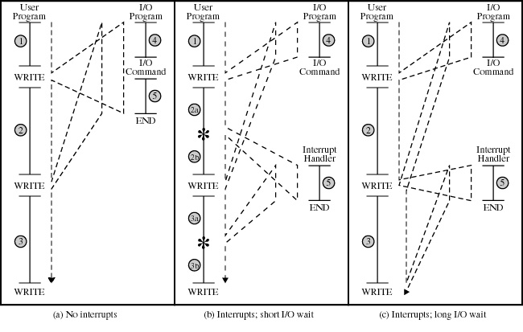
Program flow control with and withoug interrupts
Mariusz Pelc © 2014/2015
(with support from Dr Kevin McManus)

Slide 39
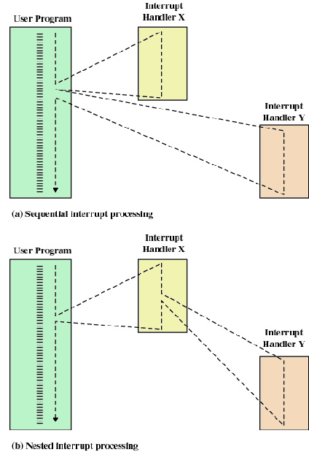
Multiple interrupts
There are two ways of dealing with interrupts:
Disable interrupts while an interrupt is being processed
  Processor ignores any new interrupt request signals
Prioritise interrupts
  Processor services highest priority first
Mariusz Pelc © 2014/2015
(with support from Dr Kevin McManus)

Slide 40
Multiple interrupts – sequential order
Disable interrupts so processor can complete handling of the current.
Interrupts remain pending until the processor enables interrupts again.
After interrupt handler routine completes, the processor checks for additional interrupts and adequate interrupt handler is being executed.
Mariusz Pelc © 2014/2015
(with support from Dr Kevin McManus)

Slide 41
Multiple interrupts – nested interrupts
Higher priority interrupts cause lower-priority interrupt service routines to wait/suspend
  Lower-priority interrupt handler is interrupted
Example: network vs. hard disk
Mariusz Pelc © 2014/2015
(with support from Dr Kevin McManus)

Slide 42

Memory hierarchy
Registers
Cache memory
Operating memory
Electronic drive
Magnetic drive
Optical drive
Magnetic tape
Fig.5. Memory hierarchy
Mariusz Pelc © 2014/2015
(with support from Dr Kevin McManus)

Slide 43
Caching
Faster memory system can be used as cache memory for slower memory system.
In case of any information is needed, first cache memory is being searched; depending on search results the information is copied to cache.
Cache design is a compromise between cache size and so-called replacement algorithm. In the optimal situation the HIT ration is between 80-99%, which means that 80-99% of information is being found in cache.
Mariusz Pelc © 2014/2015
(with support from Dr Kevin McManus)

Slide 44
Caching – coherency issue
In the hierarchical memory structure the same information may appear on different levels.
It is necessary to guarantee (using hardware or software methods) that the information was coherent on all levels.
Mariusz Pelc © 2014/2015
(with support from Dr Kevin McManus)

Slide 45
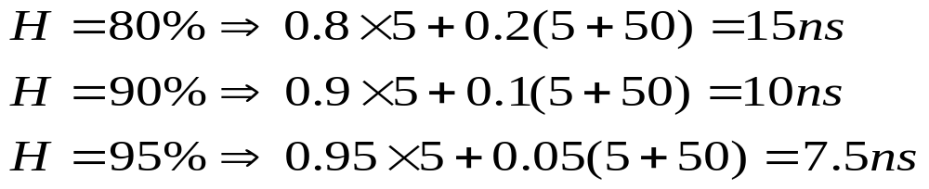
Caching – cache hit ratio
Hit ratio H
  fraction of all memory accesses that are found in cache.
Consider a machine with
  1k words cache, access time 5ns (0.005us)
  1M words memory, access time 50ns (0.05us)
If the data is not in cache then the data is copied from memory
  access time for cache miss 55ns
Requires high H for success, e.g
Mariusz Pelc © 2014/2015
(with support from Dr Kevin McManus)

