Slide 1
Integrated Project-I
E-Commerce Website
Supervisor
Under the Guidance Of
Name : Dr. Hakam Singh
Designation: Assistant Professor
Department of Computer Science & Engineering
Submitted By:
Udit Sharma - 2111985054
Sourav Kumar - 2111985060
Vishal - 2111985057
Vaibhav - 2111985055
Chitkara University, Himachal Pradesh

Slide 2
CONTENT
Introduction
Problem
Solution
Objectives
Features
Requirement Analysis
Design
Data flow diagram
Homepage
Cart
Checkout
Login
Coding
Testing
Implementation & Maintenance
Conclusion & Future scope

Slide 3
INTRODUCTION
E-commerce is the business of buying and selling things over the Internet. Our website is designed to provide a seamless shopping experience for our customers, with a wide range of products, easy navigation, and multiple payment options. We believe that our platform offers a unique and convenient way to shop online. Today, We will be taking you through some of the key features of our website, as well as highlighting the benefits of shopping with us.

Slide 4
PROBLEM
One of the biggest problems is the lack of transparency and reliability in pricing and shipping policies.
Many online retailers have inconsistent policies, which can cause confusion and mistrust among consumers.
Another problem is the difficulty of finding products that meet specific needs and preferences.
Many online retailers have limited product offerings and a lack of customization options.

Slide 5
SOLUTION
Our website will offer a seamless and enjoyable online shopping experience for our target audience.
We will provide clear and consistent pricing and shipping policies to build trust with our customers.
Our website will offer a wide range of products and customization options to meet the diverse needs and preferences of our target audience.
Our website will be designed with a user-friendly interface to make online shopping easy and stress-free.

Slide 6
OBJECTIVES
Increase online sales by 30% in the first year of launch, by providing a user-friendly interface.
Expand the product range by adding at least 100 new products every month to attract new customers and increase revenue.
Increase customer engagement by offering personalized recommendations based on customer behavior and purchase history.
Improve website search functionality to enable customers to easily find products

Slide 7
FEATURES
Clear navigation menu to easily find products and categories
Multiple Payment Options
Personalized product recommendations based on purchase history.
Advanced filters for price range, brand, category, and more
Social media sharing buttons for products
User-generated content display, such as customer photos and reviews.

Slide 8
REQUIREMENTS
SOFTWARE
Operating System: Window 8 and later versions.
GUI internet browser (Like Microsoft Edge)
Visual studio 2020
HTML

Slide 9
CONTINUED
2. HARDWARE
Minimum Hardware Requirement that can support GUI Internet browser and Window 10 Operating System.
233 MHz Processor
1 GB RAM

Slide 10
CONTINUED
3. DATABASE
SQL Server 2022

Slide 11
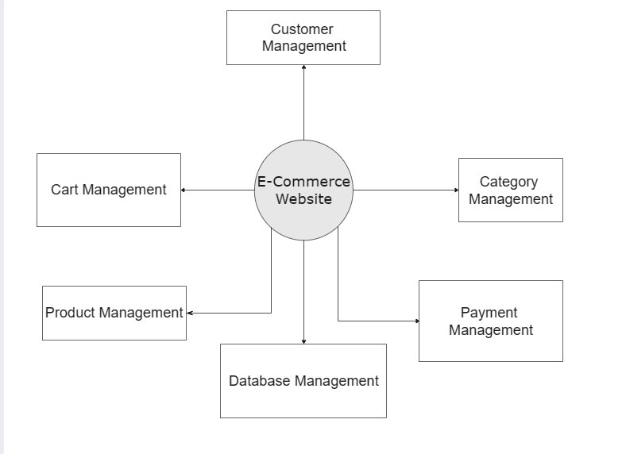
DESIGN-DATAFLOW DIAGRAM
0-level Data Flow Diagram

Slide 12
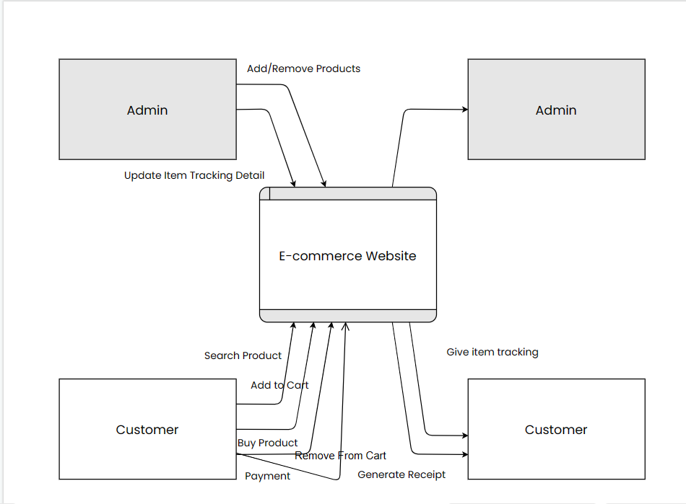
CONTINUED
1-level DFD

Slide 13
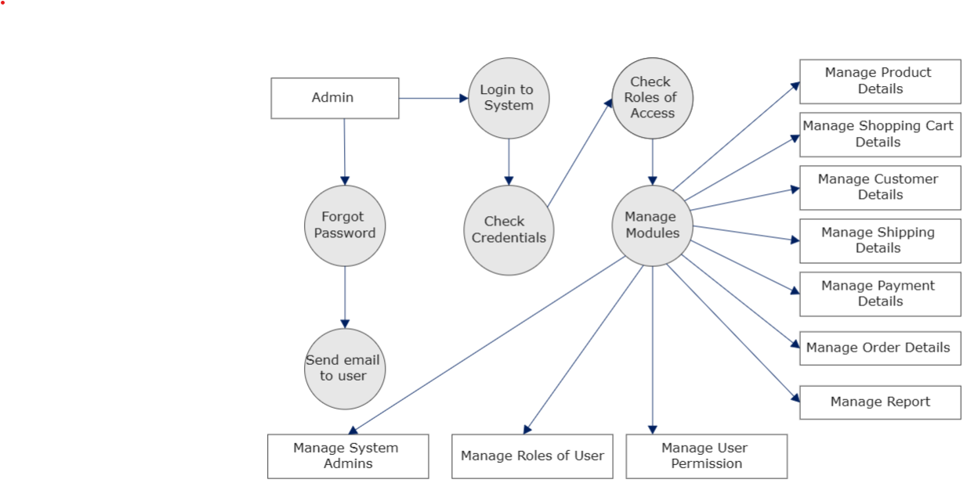
CONTINUED
2-level DFD

Slide 14
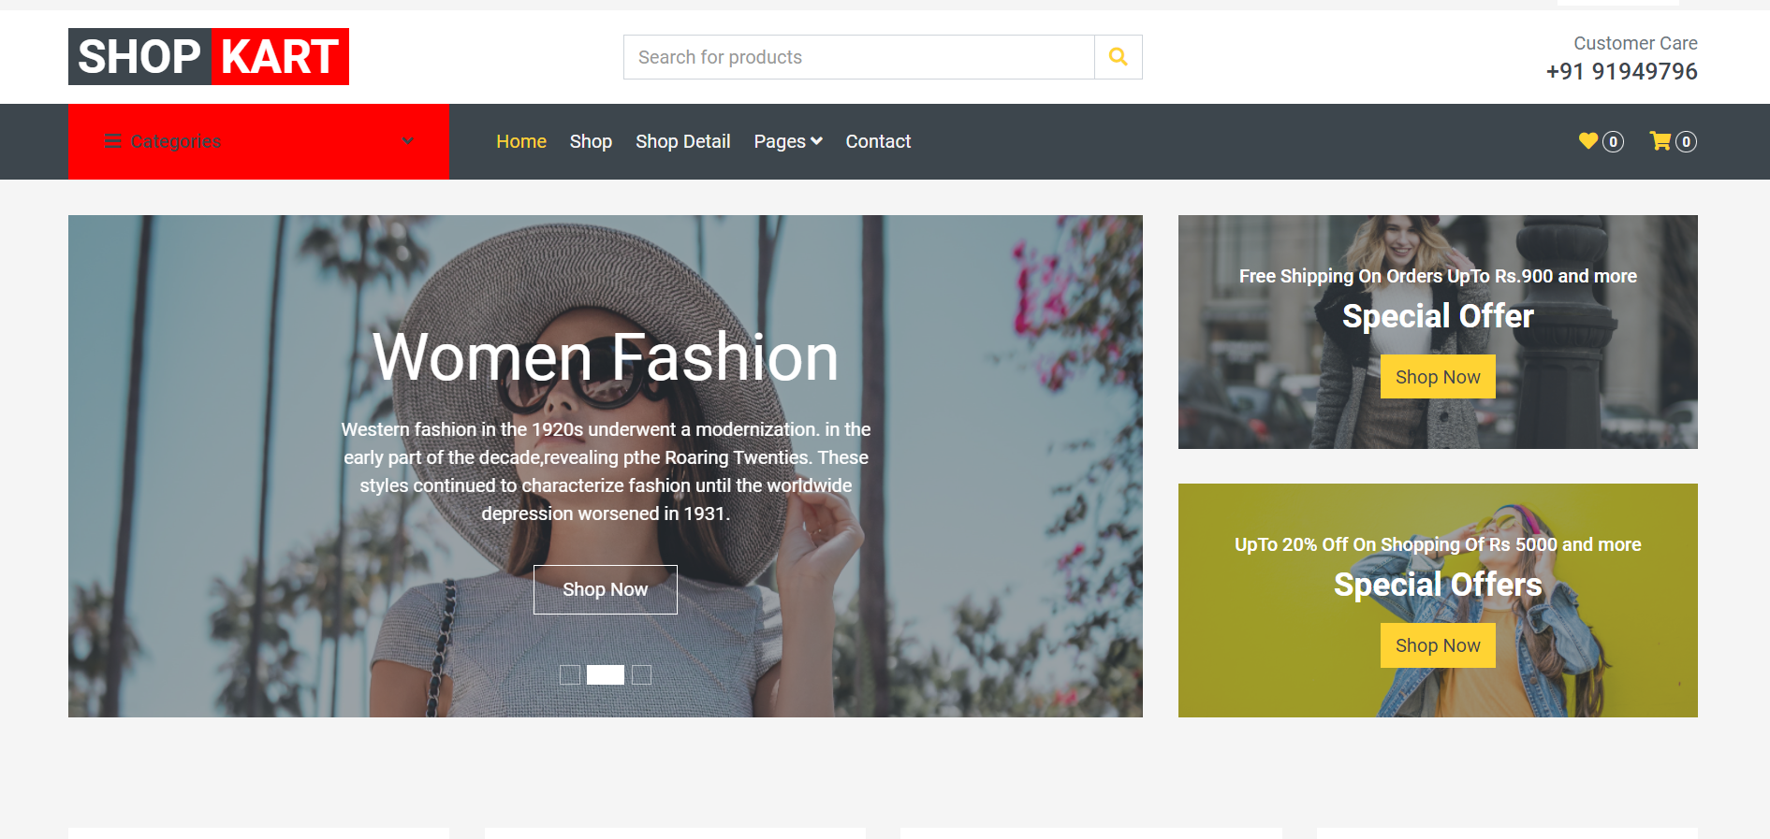
HOMEPAGE
Homepage

Slide 15
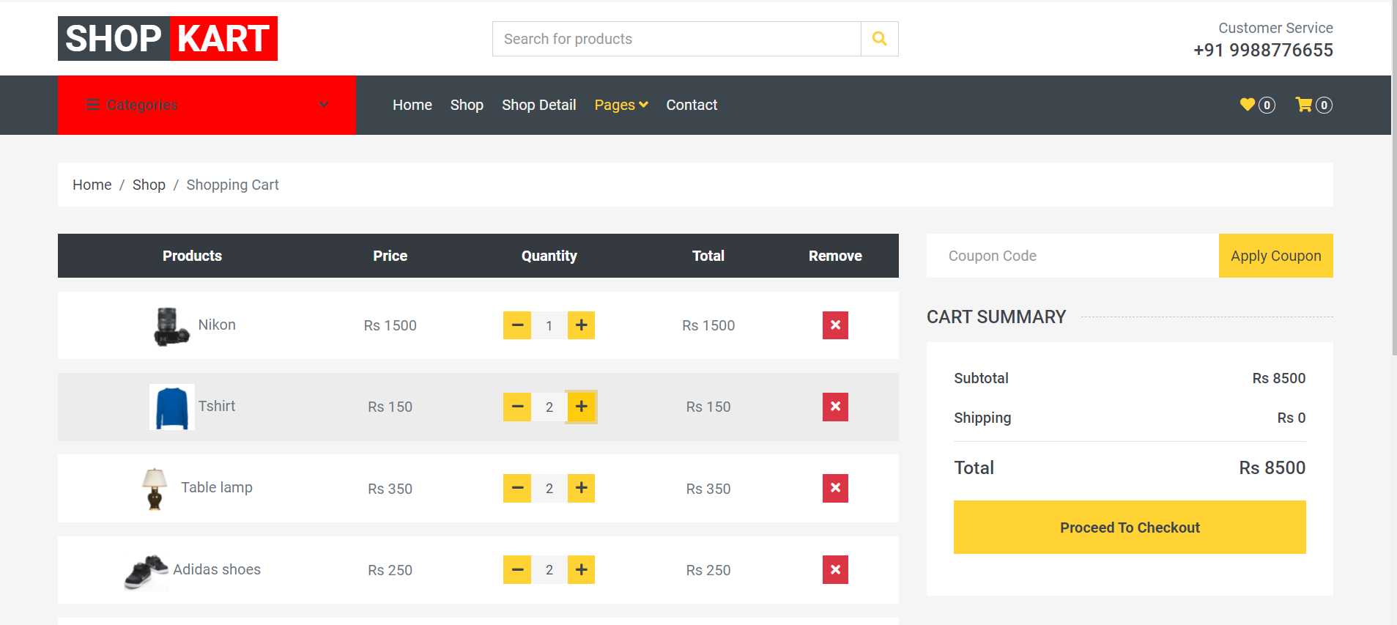
SHOPPING CART
Shopping Cart

Slide 16
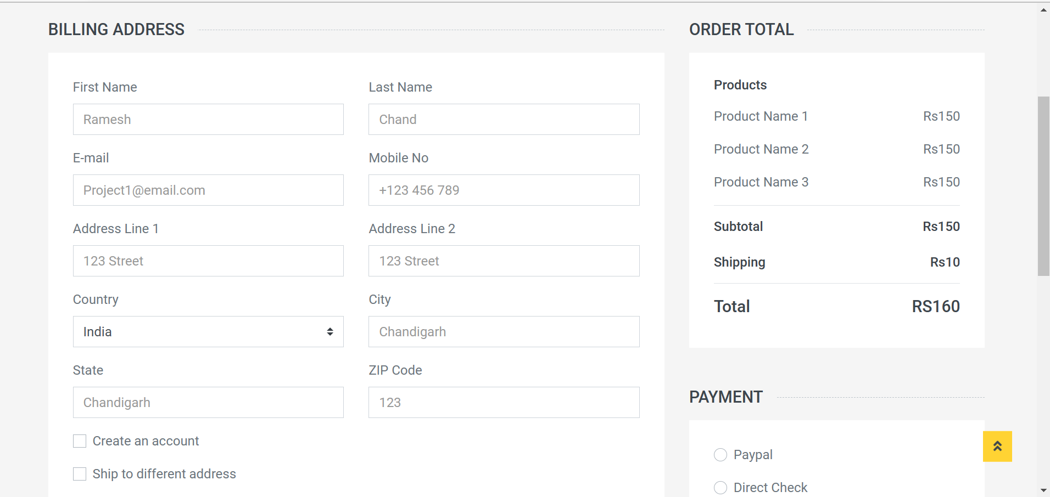
CHECKOUT
Checkout

Slide 17
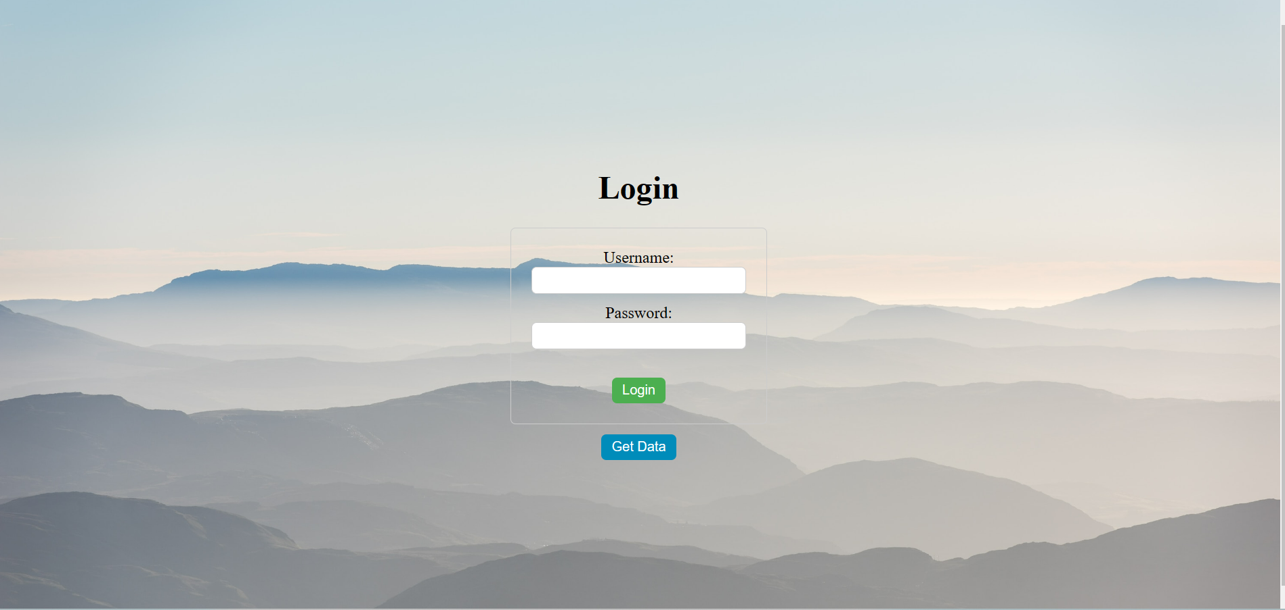
LOGIN PAGE
Login Page

Slide 18
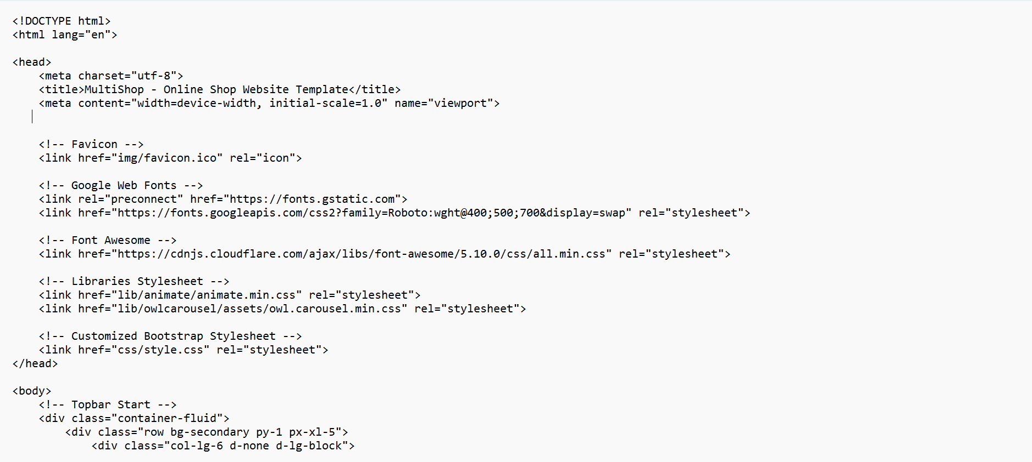
CODING-MASTERPAGE

Slide 19
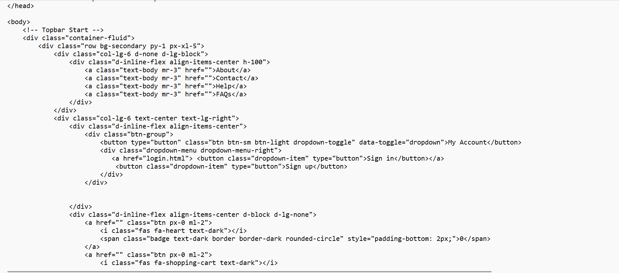
CONTINUED

Slide 20
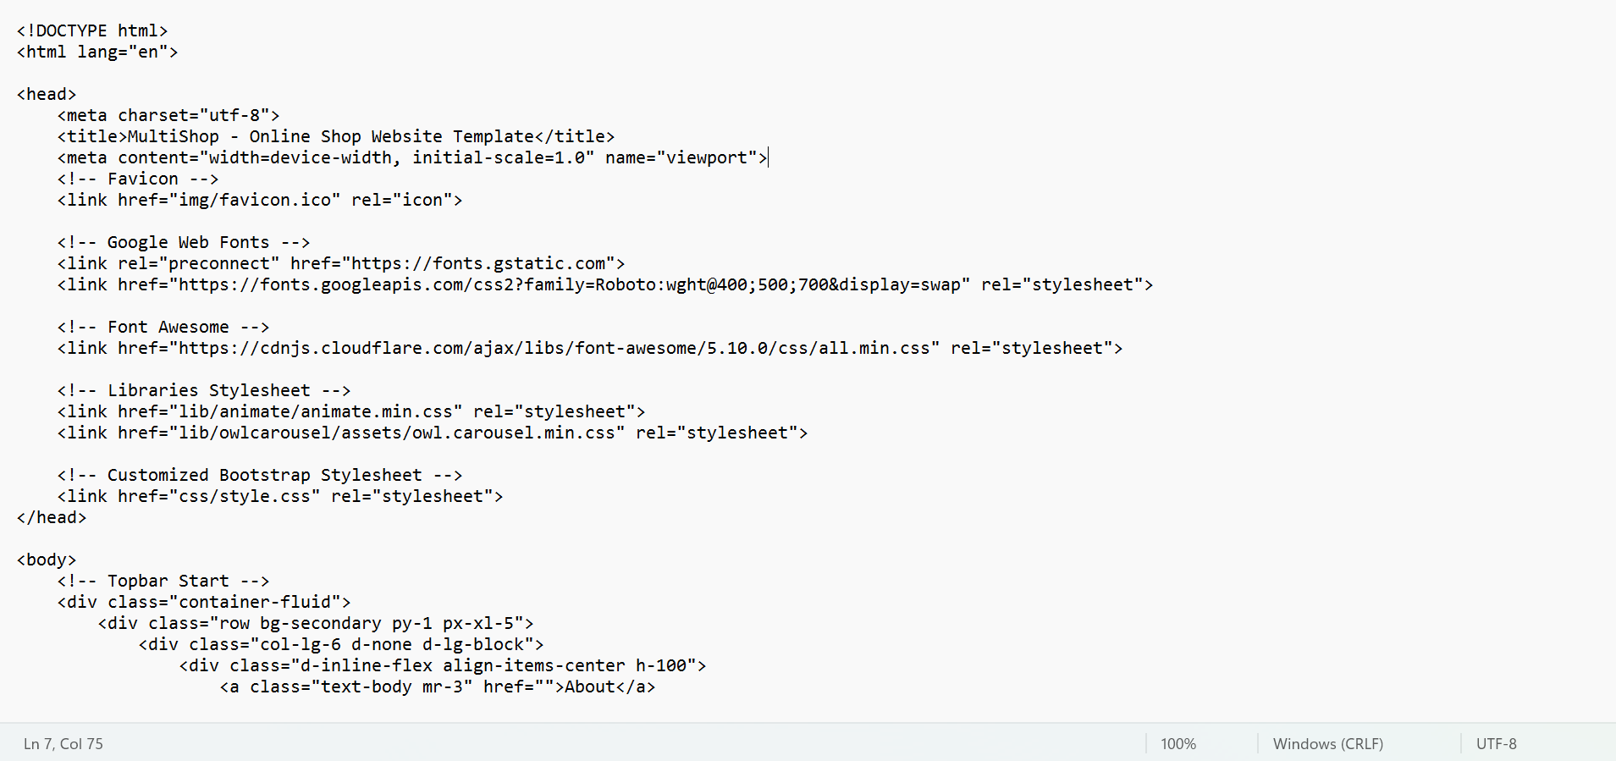
CHECKOUT PAGE

Slide 21
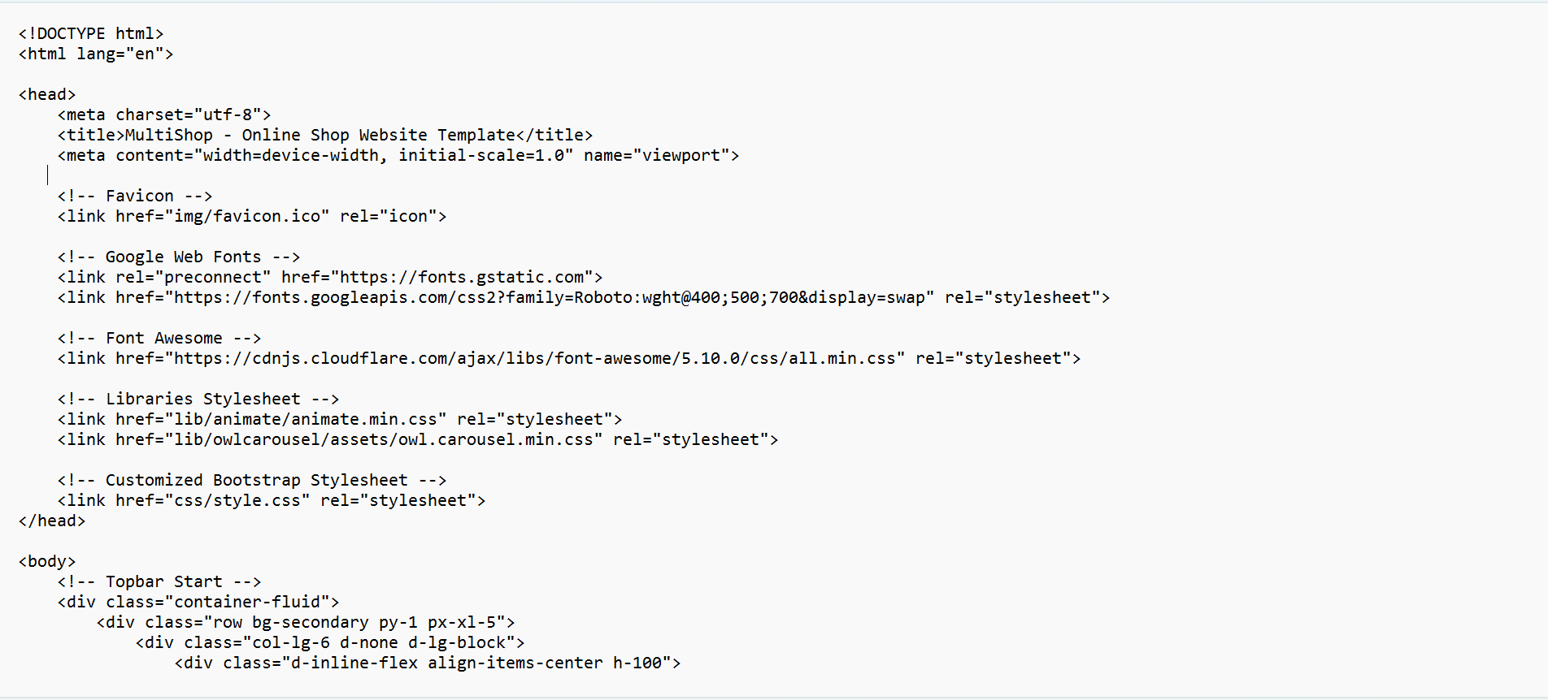
CART PAGE

Slide 22
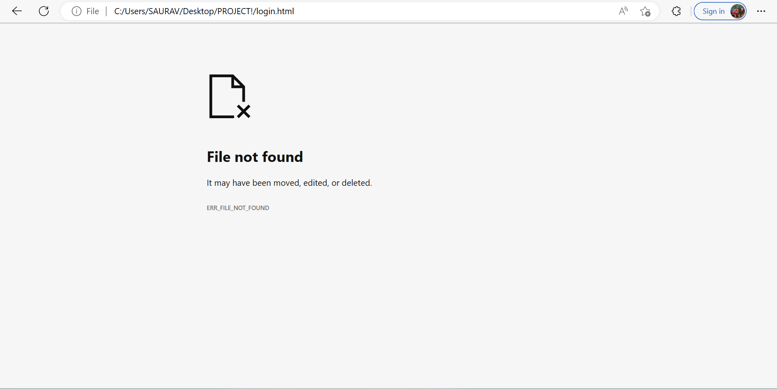
TESTING
Error occurred while loading the file . The file was missing.

Slide 23
IMPLEMENTATION & MAINTENANCE
File was restored and the page was working.

Slide 24
CONCLUSION & FUTURE SCOPE
In conclusion, we have designed and developed a comprehensive shopping website that aims to provide a convenient and enjoyable shopping experience to our users. We have implemented various features such as user-friendly navigation, advanced search functionality, detailed product descriptions, and secure payment options to ensure that our customers can easily find and purchase the products they need.
Overall, our shopping website is designed to meet the needs and expectations of modern-day shoppers. We look forward to hearing feedback from our users and making continuous improvements to enhance their shopping experience.

Slide 25
CONTINUED
Implementing personalized product recommendations based on customer search history and behavior to enhance the shopping experience
Incorporating augmented reality and virtual reality technology to allow customers to visualize products before purchase
Developing a mobile application for the website to increase accessibility and convenience for customers on-the-go
Implementing chatbots or virtual assistants to provide 24/7 customer support and assistance with inquiries and orders

Slide 26
THANK YOU

