Slide 1

UCSC Plaza
July 6th, 2016
Project Release Plan
Team name : Team Amlesh the Great
Team member names
Kyungmin So (PO)
Youngsoo Jang (initial Scrum Master)
Hobin Ryu
Seungwoo Lee
Amlesh Sivanantham
James Garbagnati

Slide 2
UCSC Plaza
Project Release Plan
Web application which can gather people for group activity and notice some events.
matching soccer team, notice event in dormitory, Finding video game partner, etc
HTML5, CSS, JavaScript, PHP, Google API
Improve the quality of UCSC Campus life and Communication.

Slide 3
Sprint 1
Project Release Plan – User Stories
(5) User Story 1: As a member of the UCSC community, I want to be able to log in to an unique account made for me, so that I can use the application “UCSC Plaza.”
(3) User Story 2: As an event planner, I want my event to be shown to members of the UCSC community, so that I can advertise strictly to UCSC members.
(8) User Story 3: As an event planner, I want to add or delete my events, so that other members of UCSC can see if my event is available.
(5) User Story 4: As an event-goer, I want to see a map of the UCSC campus, so that I know where events are planned to happen.
(3) User Story 5: As an event-goer, I want to be able to see details of an event, so that I can decide whether I want to attend or not.

Slide 4
Sprint 2
Project Release Plan – User Stories
(5) User Story 1: As an event planner, I want to be able to manage my event, so that I can apply certain constraints to the event.
(3) User Story 2: As an event-goer, I want to be able to send or rescind an application to a specific event, so that the event planner knows whether I plan to attend or not.
(3) User Story 3: As an event planner, I want to see who applied to my event and be able to accept or decline their application, so that the event goers know if they are allowed to partake or not.
(5) User Story 4: As an event-goer, I may wish for privacy settings, so that I can ensure that my event-attendance is not seen by the public.
(8) User Story 5: As an event-goer, I want to be able to search for specific events, so that I may apply to attend the event.

Slide 5
Sprint 3
Project Release Plan – User Stories
(5) User Story 1: As an event-goer, I want to see the current and maximum attendance for the event, so that I can ensure there is space for me to attend and that it is not overcrowded.
(5) User Story 2: As an event-planner, I want to ensure that my event does not exceed maximum attendance, so that my event is not overcrowded and has enough room for all event-goers.
(3) User Story 3: As an event-goer, I want to be able to see and submit my own rating for an event, so that I can decide to go to an ongoing event or offer my opinion towards the event.
(3) User Story 4: As an event planner, I want to get some feedback on my event, so that I can improve the experience of my event.

Slide 6
Sprint 3
Project Release Plan – User Stories
(8) User Story 5: As an event-goer, I want to be able to socialize over an event, so that I can share my opinion with friends and other participants.
(21) User Story 6: As an event-goer, I want to be able to see if my friends are going to a certain event, so that I know which events have my friends in it.
(13) User Story 7: As an event-goer, I want to receive recommendations on other events tailored to my preference, so that I can see events that I may attend in the future.

Slide 7
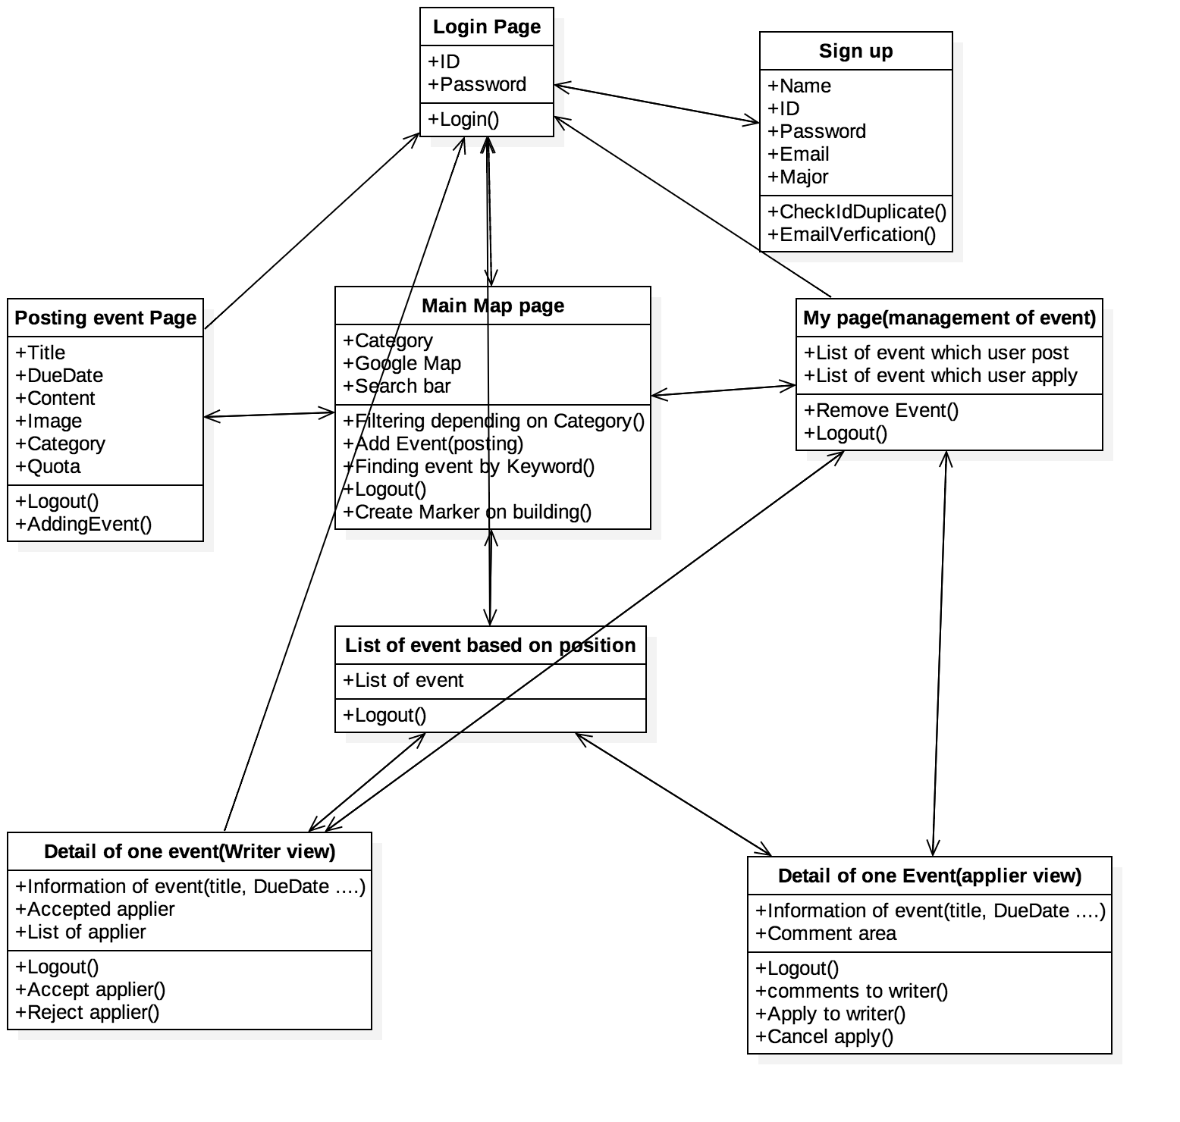
Project Release Plan – Architecture

Slide 8
UCSC Plaza
Project Release Plan – Challenges/Risks
Challenge/Risk 1 - Communication
Challenge/Risk 2 - Unfamiliar Web development
Challenge/Risk 3 - Design user friendly UI

Slide 9
UCSC Plaza
Project Release Plan – Technologies
Front-end : HTML5, CSS, JavaScript
Back-end : PHP
DataBase : Mysql
Server : AWS, Apache

