Slide 1

H13 Credit Data

Slide 2
Table of Contents
FACTS / Key slide
EDA
EDA Summary
Modeling
Data
Regression
Classification

Slide 3
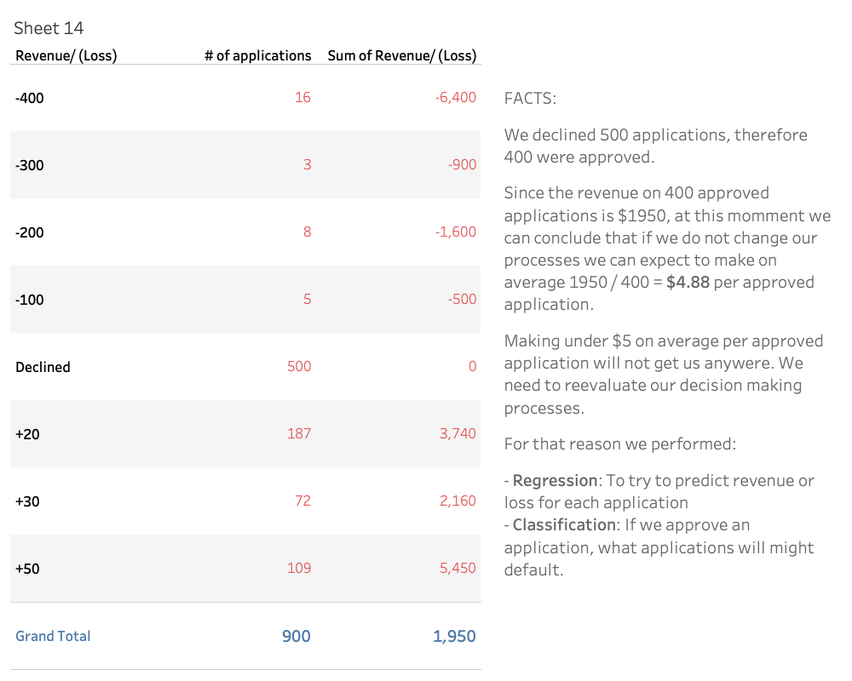

Slide 4
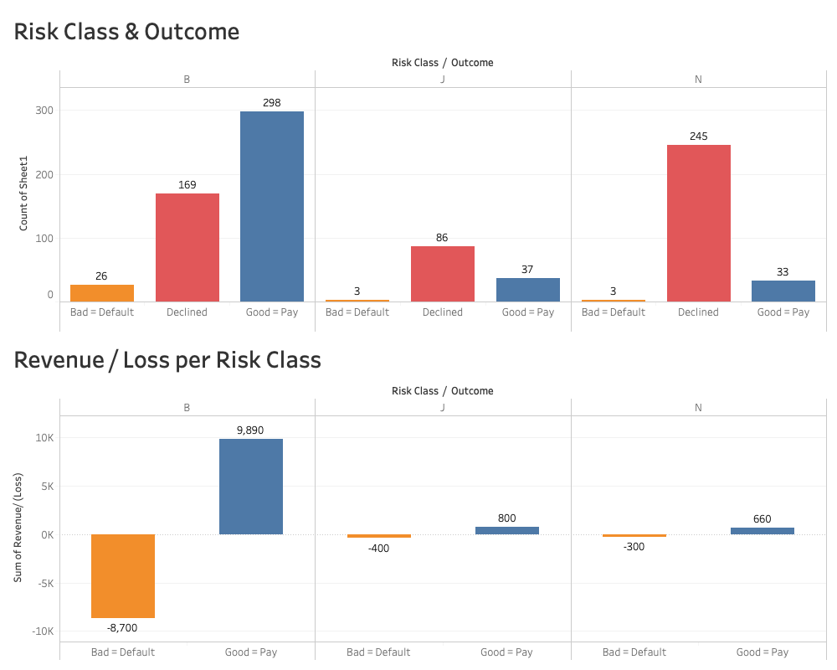

Slide 5
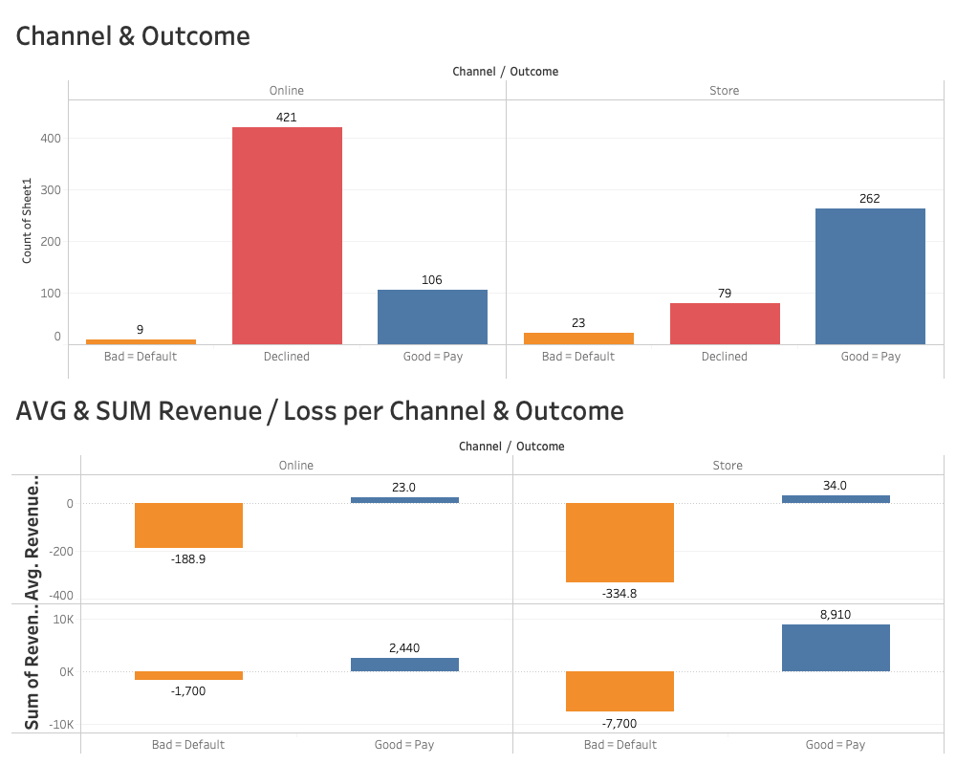

Slide 6
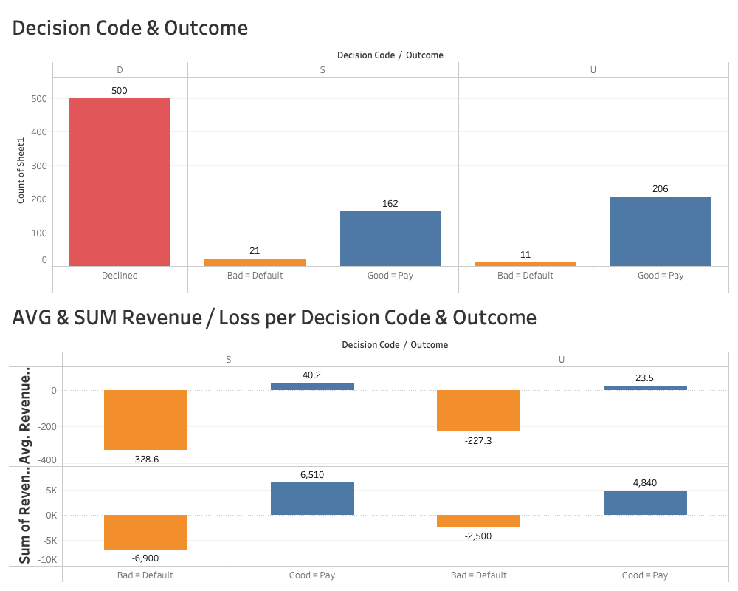

Slide 7
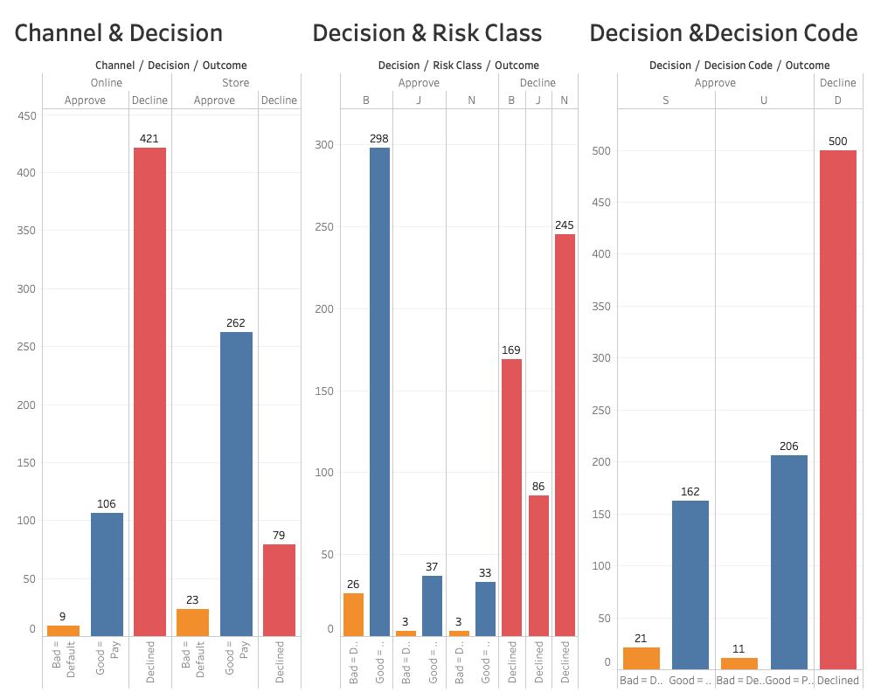

Slide 8
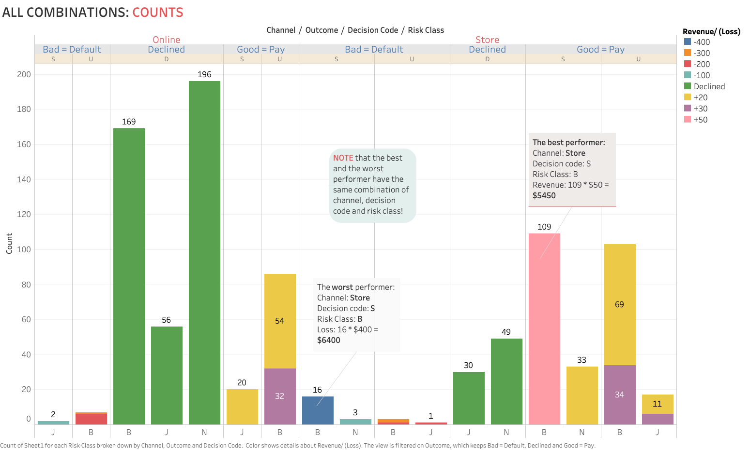

Slide 9
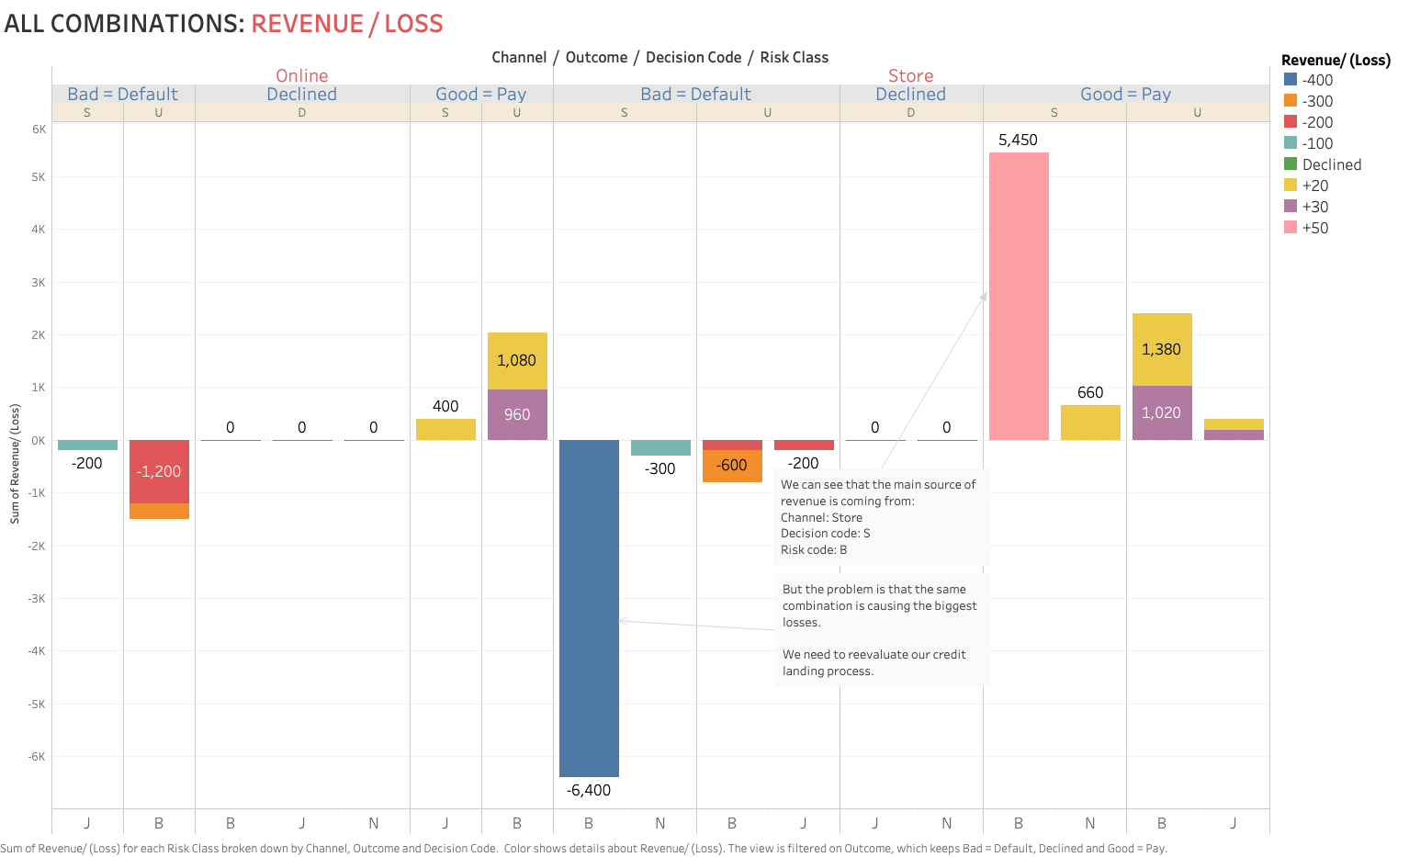

Slide 10
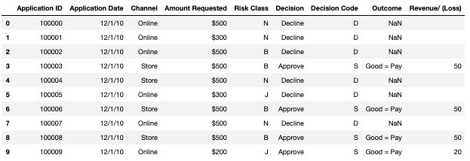
Modeling: Data
Credit application data
Original data – 900 rows, 9 columns

Slide 11
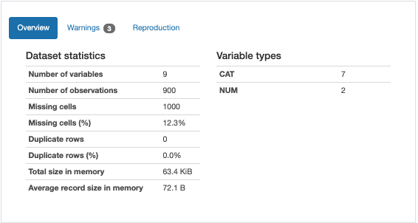
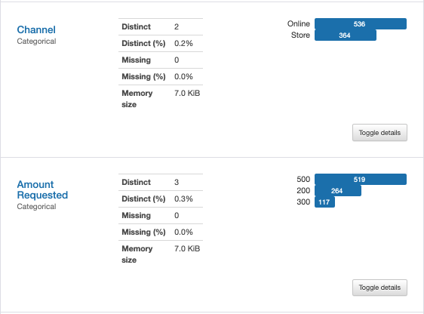
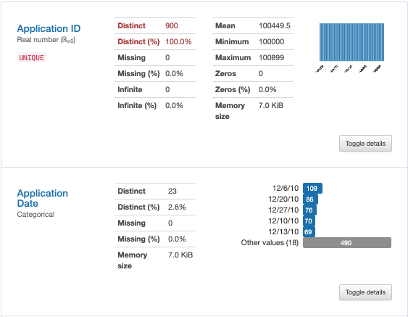
Overview - Variables

Slide 12
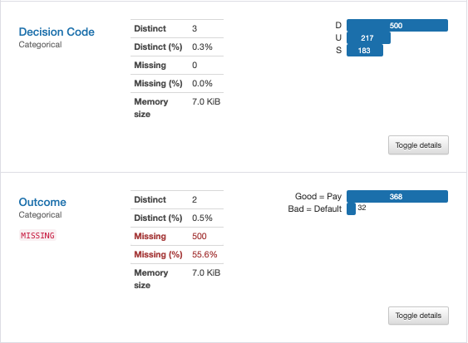
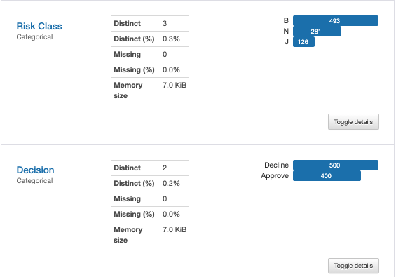
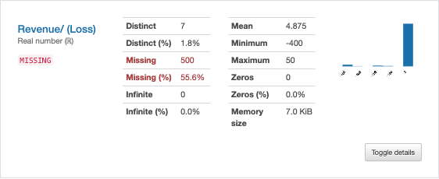
Overview - Variables

Slide 13
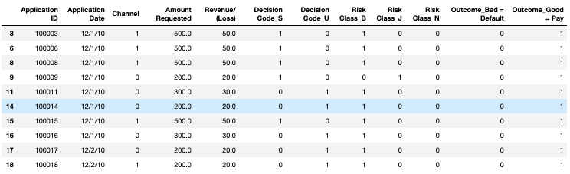
Modeling: Cleaned Data
For the modeling part we dropped all DECLINED applications.
Cleaned data: 400 rows, 12 columns
Dealing with categorical data
If a categorical column has only 2 unique value --> label encoder
Decision code (Note: dropped decision code D( all decline) )
Outcome
If a cat column has > 2 unique values --> one hot encoding
Risk Class

Slide 14
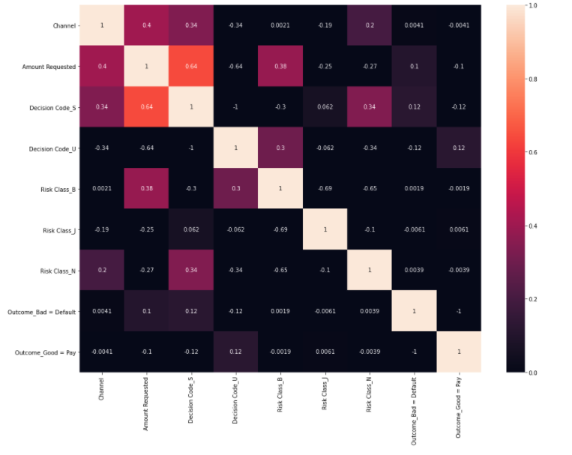
Modeling: Correlation matrix

Slide 15
Modeling: Regression
Objective: We are trying to predict Revenue / Loss using regression.

Slide 16
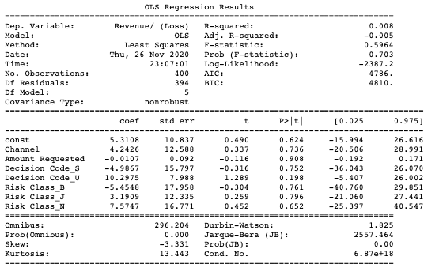
Modeling: Regression, OLS
If we try to run OLS without
Outcome bad = Default
Outcome good = Pay
These are the results. I tried to perform backward selection and one by one eliminate variable with the highest p-value until they are all < 0.05, but that was unsuccessful.
For that reason, we will process with the analysis (next slide) with above-mentioned 2 variables.

Slide 17
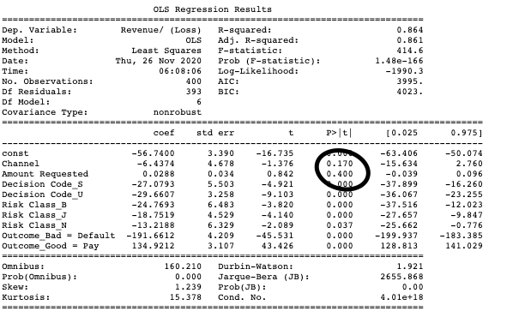
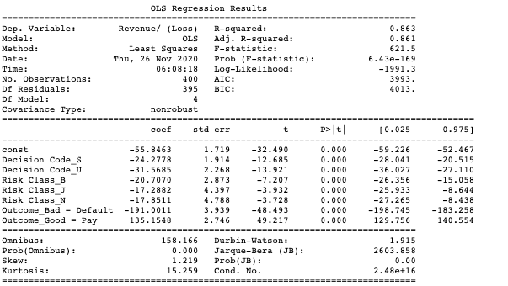
Modeling: Regression, OLS
After eliminating variables where p-value > 0.05, we dropped
Channel
Amount Requested

Slide 18
Modeling: Regression, RMSE results
Model cv=10 | RMSE
LinearRegression() | 35.76
Ridge | 35.17
Lasso | 35.14
Elastic net | 41.81
Decision tree regressor | 7.75
RandomForestRegressor | 8.40
RandomForestRegressor – rand_grid_search_best_params | 8.01
SVM | 83.73
For RandomForestRegressor – rand_grid_search_best_params where RMSE = 8.01:
95% confidence interval for the test RMSE = [4.62, 10.34]

Slide 19
Modeling: Classification
Objective: We are trying to predict who will default using classification.

Slide 20
Modeling: Classification
Facts:
We are working with imbalanced data.
Outcome variable:
Pay : 368
Default: 32
For that reason I am using oversampling SMOTE. After using SMOTE data has 257 records each for both pay and default outcome.

Slide 21
Modeling: Classification, result
Model: LogisticRegression()
Accuracy of logistic regression classifier(cv = 10): 0.705

Slide 22
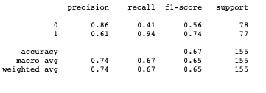
Modeling: Classification, classification report, confusion matrix
Confusion matrix
32 | 46
5 | 72
Reasoning:
Since we are trying to predict who goes bad, that means that we have already approved the loan.
In that situation I would argue that if we predict that someone is going to default but they actually pay the loan back, we can live with that mistake, because at the end of the day they will pay us back.
Here we are talking about a PRECISION --> TP / (TP + FP).
Precision is important but I believe in this situation we should care more about RECALL, because we really do not want to predict that someone will pay us back but eventually that customer defaults. Good news is that recall score is almost 0.94.
In this situation we care more about Precision / Recall curve, but we will also plot ROC AUC curve.

Slide 23
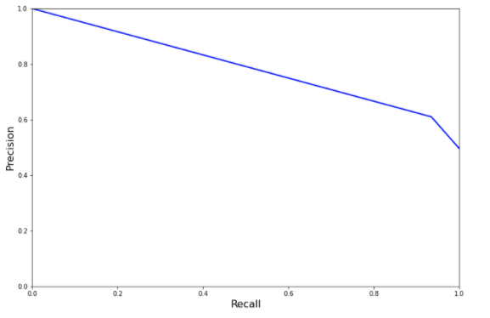
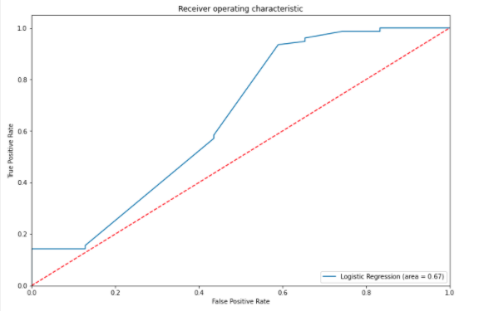
Modeling: Precision/Recall curve & ROC AUC curve
Note that if we look at the Precision/Recall curve and we care more about recall, we will probably go with recall as high as possible, probably 95+% while precision in that scenario would be about 50%.

Slide 24
Next Steps
900 records are not enough to build a robust model. The # 1 goal should be collecting more data, preferably better variables. That will dramatically increase our chances to build reliable models and help decision makers.

