Slide 1

What word would describe you best?

Slide 2
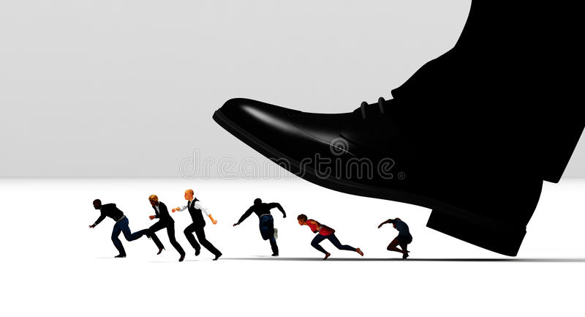
2. What were the first impressions you got from walking into in our organization?

Slide 3


3. Name at least 1 of your strengths (Strong points)? And 1 of your flaws (Weak points)?
BUT

Slide 4

4. What are your favorite websites, apps or other resources? Why?

Slide 5

5. What is your worst memory from work?

Slide 6

6. If you could change something from the past, what would it be?

Slide 7

7. If you could compare yourself with any animal, which would it be and why?

Slide 8

8. What piece of advice would you give your previous boss?

Slide 9

9. What makes you uncomfortable?

Slide 10

10. What is your experience in IT?

Slide 11

11. If I say “English”, what do you say?

Slide 12

12. Do you have a question for me?
Have you been honest ?

