Slide 1
Bean Boy Development
presents

Slide 2
Bean Me Up(?)
Slogan? Or nah? (no images yet! Sorry!)

Slide 3
Planning
For many of our members, the experience from making the space shooter from COMP391 was an influencing factor
2D platformer: Mario franchise, …

Slide 4
Game Overview
The game revolves around a bean – named Bean Boy – navigating through space in his Space Can in hopes of escaping a deadly solar explosion
However, he requires more fuel to successfully escape the blast radius, and so he must explore various planets in search of this fuel
(is this the sort of information for this slide?)

Slide 5
Game Definition
Platformer + Space Shooter Hybrid

Slide 6
Game Definition (cont.)
Space Shooter
When navigating between planets, the game will be in a 2D space shooter format
Platformer
This portion will take place on planets as Bean Boy searches for fuel

Slide 7
Game Definition (cont.)
The main mechanic that will distinguish our game is the __________________ !!!
Secondary Mechanics
Main Mechanic

Slide 8
Game Definition (cont.)
Needs
Free movement on the X and Y plane while Bean Boy navigates space in his Space Can
Ability to shoot ammunition from the Space Can to attack enemies
Ammunition is upgradable via power-ups found in space
Gradually moving blast radius animation/timer/fuel gauge to measure progress
Bean Boy can move side to side, jump, and crouch when exploring planets (2D platformer)
Bean Boy may be damaged by coming in contact with enemies or their ammunition
Simple sound effects will be activated when guns are shot, Bean Boy is hit, etc.
Secondary Mechanics

Slide 9
Game Definition (cont.)
Wants
Cut scenes at the start and end of the game to provide a more immersive story for the user
…
Secondary Mechanics

Slide 10
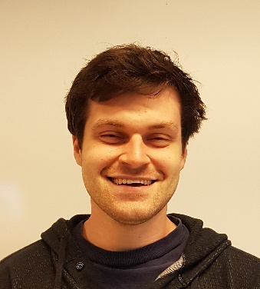
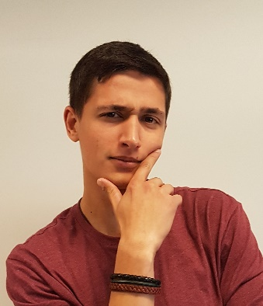
Roles
Software Engineers: Daniel Stokes & Eskender Memetov
(the points below are copied from the pdf. Revise as needed)
Responsible for scripting and scene generation. Must communicate with game designer to fully implement the ideas of the game.
Maintain a logical coding standard throughout the project.
Responsible for management of the GitHub repository and change messages.
Responsible for feature implementation and feature limitations

Slide 11
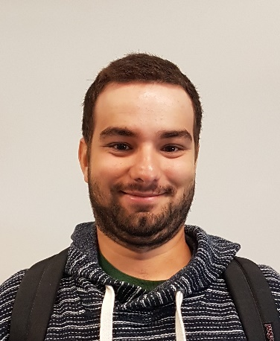
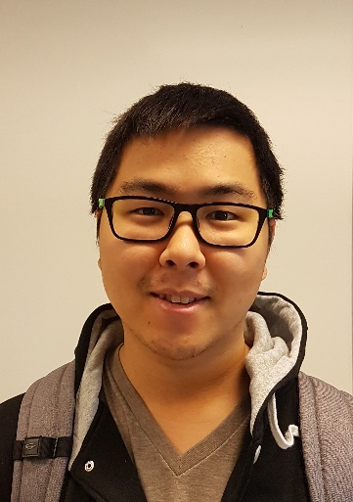
Roles (cont.)
Producer/Project Manager: Scott Welsh
(the points below are copied from the pdf. Revise as needed)
Overall management over the project.
Scheduling and tracking of tasks and group deadlines
Responsible for all documentation including the game design document, presentation files and other.
Game Designer: James Li
Responsible for defining your game's main mechanic and all subsequent secondary mechanics along with formal and dramatic elements of the game
Work with all other roles to ensure consistency and clarity across all disciplines.
Planning of each levels including asset placement and events occurring throughout the level

Slide 12
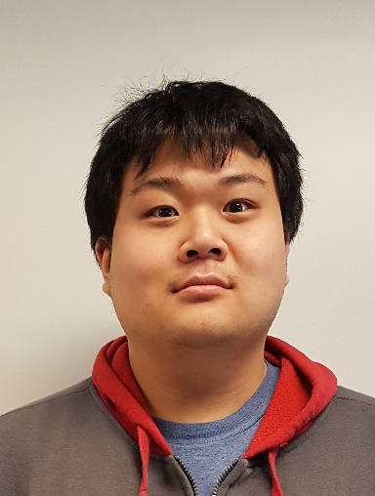
Roles (cont.)
Artist/Sound Engineer: Semy Jin
Develop and acquire art, sound and other multimedia assets required for the completion of the game
Create of concept art and drafts for sprites and other images to be used in the game
Revise as needed by the team
Edit assets to optimally balance quality and game performance
QA Tester: Brandon Koo
(the points below are copied from the pdf. Revise as needed)
Systematically testing of all implements features during the build process.
Ensure bug-free submissions for each build
Creating feedback documentation (bug reports, usability reports, etc)

Slide 13
Preparation
Creation of multiple communication lines between team members
Discord, Slack, Email, Google Drive, GitHub
Regular meetings
To discuss individual and collaborative progress
To critique and advise each other
To integrate and test various game components
Abiding by the project schedule, as agreed upon by team members
Finishing all portions of the project prior to the deadline to allow for necessary discussion and revision(s)

