Slide 1
Greenhouse digital TWIN
Ioannis Tsampras ioannis.tsampras@upnet.gr
Stavros Kanias up1066584@upnet.gr

Slide 2
Contents
The Project
Goals & System Design
Architecture - Technologies
The Inner Workings
Deployed Demo
Our Work / Timetable

Slide 3

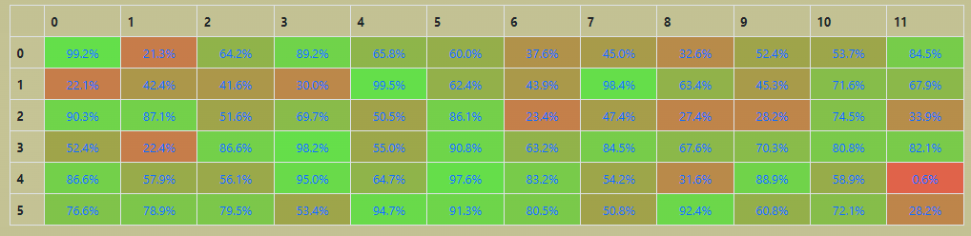

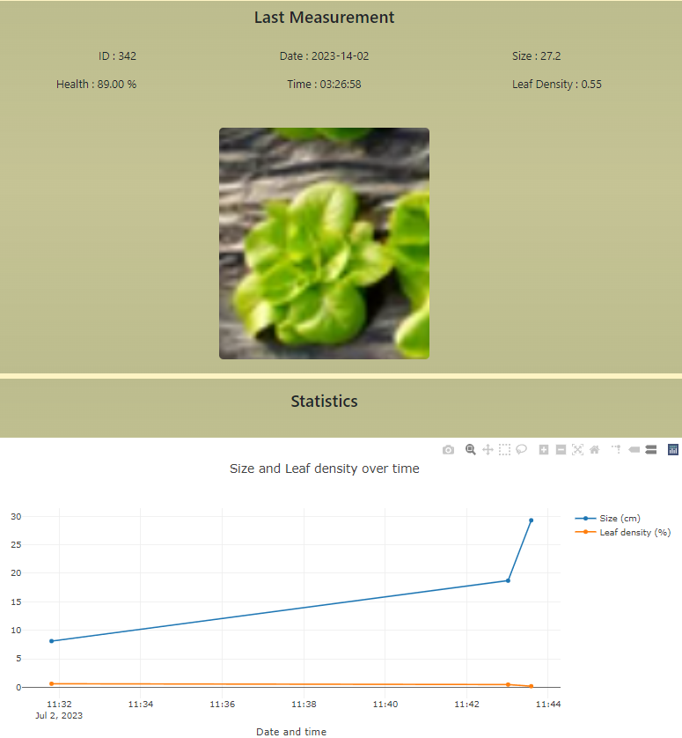
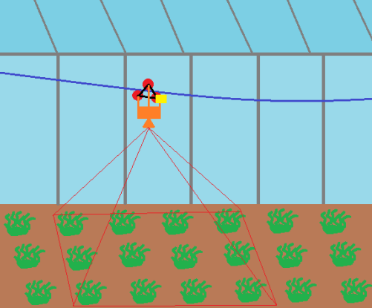
The project
…..
A Device, Cloud and Processing infrastructure for distributed digital twins of herbaceous plant type greenhouses.
Taking advantage of dwindling power and hardware cost for edge data ingestion we implement an AI solution in top-view image mapping and detection along with a distributed database cloud solution.
Our cable-lift low cost and easy installation robot moves through the length of a greenhouse, takes top-down images and in real time maps it’s position while detecting individual plants, saving multiple snapshots for each and forwarding metrics & sensor data to the cloud.

Slide 4
PRIMARY GOALS
Optimization Axes
Low cellular data usage
Inexpensive hardware & installation
Full digital representation
ARCHITECTURAL CHOICES
System Design
Mapping and detection on edge (cost, data usage)
Metrics extraction on site , updating central Db only for metrics (data usage)
On demand access to media through distributed Db, central Db cache (data usage)
MQTT front view refresher
LAN option for data extraction (data usage)

Slide 5
SOFTWARE Architecture
Simulation or Environment
MQTT Broker
Sys Call
Data Ingestor
Subscribe
Publish
Edge API Controller
Distr. Db
Front View
. . .
Server
(back-end)
. . .
Serve Pages
Request Media
Update Database
Front View
Edge API Controller
Central Db

Slide 6



DEVICE FLOW DIAGRAM
Environmental Sensors (Temp, Humidity, CO2 and more)
Motor & Driver
Camera
Sensor
Sensor
Sensor
GPIO PINS
USB
Dev Board
Front View
LAN
Central Db
MQTT Broker
Mail Service
LAN
Access point
Server
Internet

Slide 7
The INNER WORKINGS​

Slide 8




MEET OUR TEAM
TAKUMA HAYASHI
MIRJAM NILSSON
FLORA BERGGREN
RAJESH SANTOSHI
President
Chief Executive Officer
Chief Operations Officer
VP Marketing

Slide 9








MEET OUR TEAM
TAKUMA HAYASHI
MIRJAM NILSSON
RAJESH SANTOSHI
RAJESH SANTOSHI
President
Chief Executive Officer
Chief Operations Officer
VP Marketing
GRAHAM BARNES
ROWAN MURPHY
ELIZABETH MOORE
ROBIN KLINE
VP Product
SEO Strategist
Product Designer
Content Developer

Slide 10
PLAN FOR PRODUCT LAUNCH
Deploy strategic networks with compelling e-business needs
PLANNING
Synergize scalable e-commerce
MARKETING
Disseminate standardized metrics
DESIGN
Coordinate e-business applications
Foster holistically superior methodologies
LAUNCH
STRATEGY

Slide 11
TIMELINE
Q1
Synergize scalable e-commerce
Q2
Coordinate e-business applications
Q3
Deploy strategic networks with compelling e-business needs
Q4
Disseminate standardized metrics

Slide 12
AREAS OF FOCUS
B2B MARKET SCENARIOS
CLOUD-BASED OPPORTUNITIES
Develop winning strategies to keep ahead of the competition
​Capitalize on low hanging fruit to identify a ballpark value
​Visualize customer directed convergence​
Iterative approaches to corporate strategy
​Establish a management framework from the inside​

Slide 13
HOW WE GET THERE
ROI
NICHE MARKETS
SUPPLY CHAINS
Envision multimedia-based expertise and cross-media growth strategies​
​Engage worldwide methodologies with web-enabled technologies​
Pursue scalable customer service through sustainable strategies​
Engage top-line web services with cutting-edge deliverables​​​
Cultivate one-to-one customer service with robust ideas​
Maximize timely deliverables for real-time schemas​

Slide 14
SUMMARY
At Contoso, we believe in giving 110%. By using our next-generation data architecture, we help organizations virtually manage agile workflows. We thrive because of our market knowledge and great team behind our product. As our CEO says, "Efficiencies will come from proactively transforming how we do business."​

Slide 15
THANK YOU
Mirjam Nilsson
mirjam@contoso.com
www.contoso.com

