Slide 1
Greenhouse digital TWIN
Ioannis Tsampras ioannis.tsampras@upnet.gr
Stavros Kanias up1066584@upnet.gr

Slide 2
Contents
The Project
Goals & System Design
Architecture - Technologies
The Inner Workings
Deployed Demo
Our Work / Timetable

Slide 3
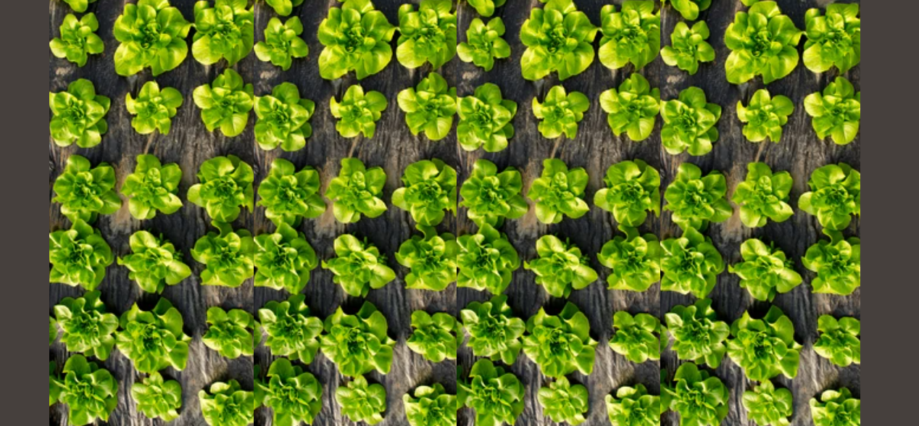
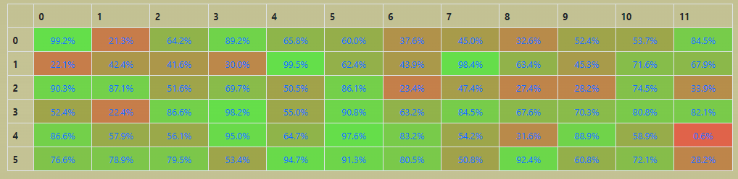
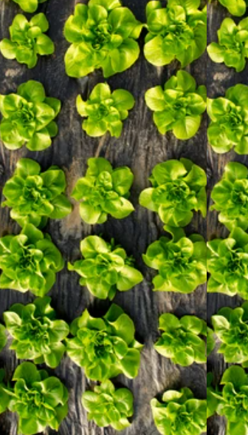
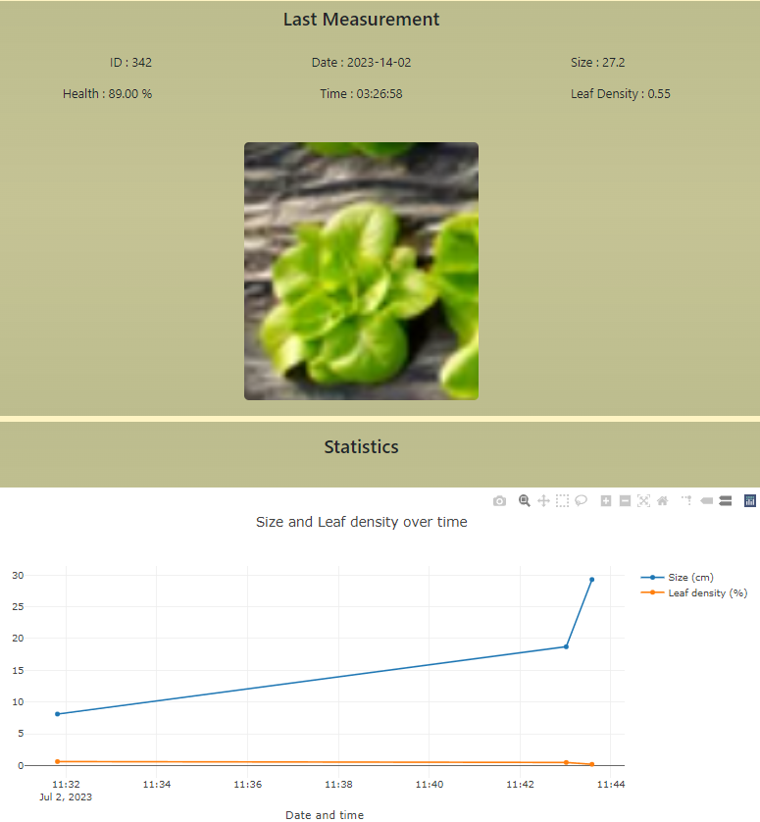
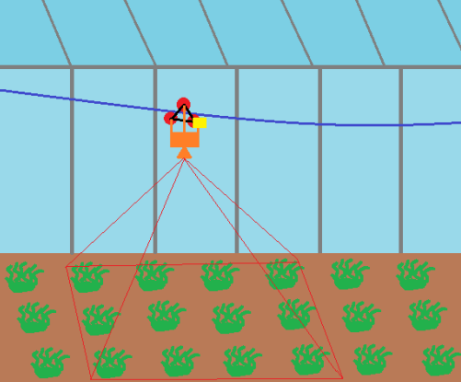
The project
…..
A Device, Cloud and Processing infrastructure for distributed digital twins of herbaceous plant type greenhouses.
Taking advantage of dwindling power and hardware cost for edge data ingestion we implement an AI solution in top-view image mapping and detection along with a distributed database cloud solution.
Our cable-lift low cost and easy installation robot moves through the length of a greenhouse, takes top-down images and in real time maps it’s position while detecting individual plants, saving multiple snapshots for each and forwarding metrics & sensor data to the cloud.

Slide 4
PRIMARY GOALS
Optimization Axes
Low cellular data usage
Inexpensive hardware & installation
Full digital representation
ARCHITECTURAL CHOICES
System Design
Mapping and detection on edge (cost, data usage)
Metrics extraction on site , updating central Db only for metrics (data usage)
On demand access to media through distributed Db, central Db cache (data usage)
MQTT front view refresher
LAN option for data extraction (data usage)

Slide 5
SOFTWARE Architecture
Simulation or Environment
MQTT Broker
Sys Call
Data Ingestor
Subscribe
Publish
Edge API Controller
Distr. Db
Front View
. . .
Server
(back-end)
. . .
Serve Pages
Request Media
Update Database
Front View
Edge API Controller
Central Db

Slide 6



DEVICE FLOW DIAGRAM
Environmental Sensors (Temp, Humidity, CO2 and more)
Motor & Driver
Camera
Sensor
Sensor
Sensor
GPIO PINS
USB
Dev Board
Front View
LAN
Central Db
MQTT Broker
Mail Service
LAN
Access point
Server
Internet

Slide 7
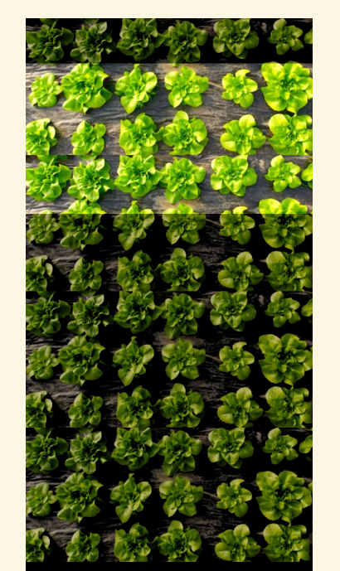
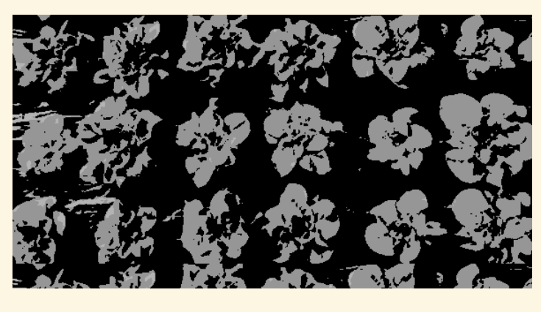
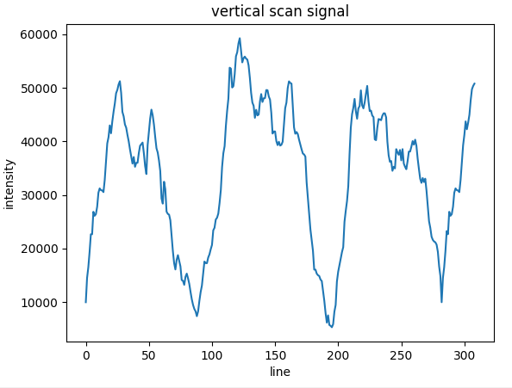
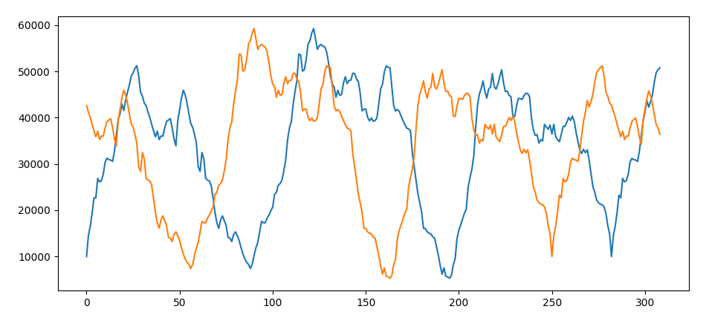
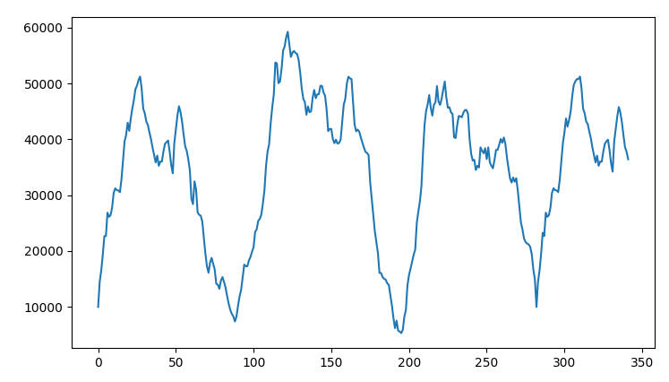
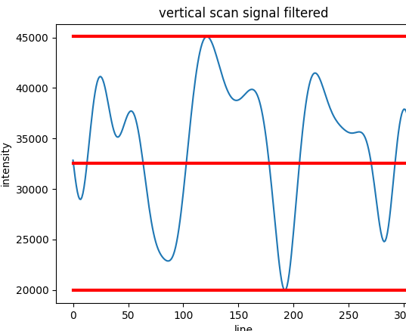
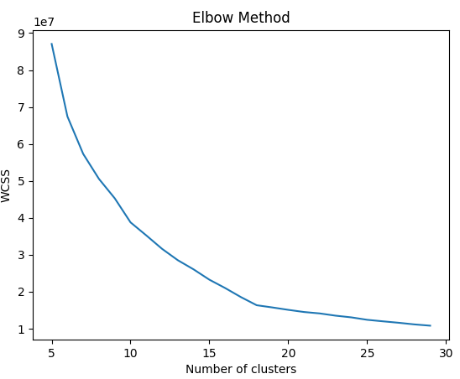
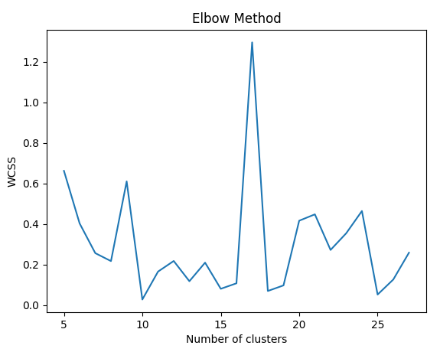
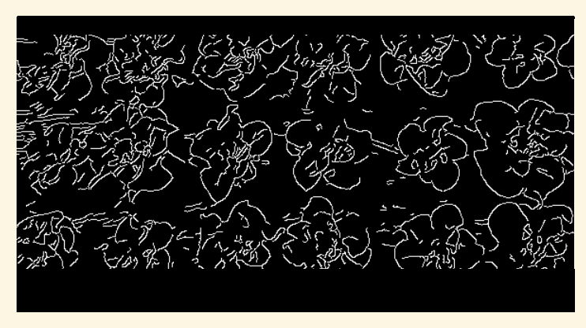
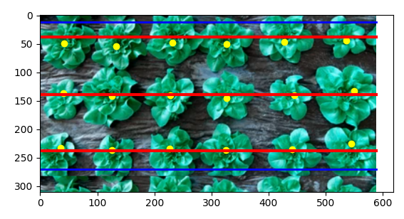
The INNER WORKINGS​
Thresholding on GB
Sum of Vertical Scan
Compare to History with Σ(Δy )
2
Store
FFT smoothing & Normalization
Translate
Attach
Total Position
Offset
Edge Filter Thresholding
Curve Finder
FFT smoothing & Normalization
Curve Finder
Crop
Curve Finder
Lines & limits
Local Indexes
Centers
Explorative low cost clustering
High Accuracy Clustering where N-clusters = k-max
snapshots
abs[(log(abs(f’(x)))’]

Slide 8
LIVE DEMO
…

Slide 9
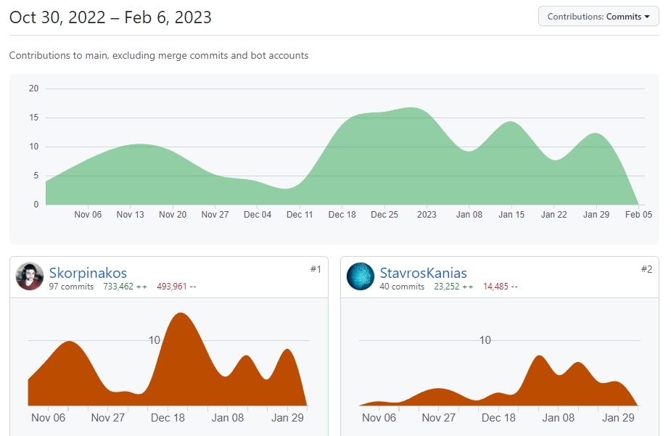
TIMELINE
Edge Controller API
Mapping System
Image Detection AI
Simulation
Hardware & Deployment
Log-in & Visualization
Edge API Integration
MQTT Front View
Database &
Server
Webpage Draft

Slide 10
THANK YOU
Ioannis Tsampras & Stavros Kanias
www.github.com/Skorpinakos/IoT-2022

