Slide 1
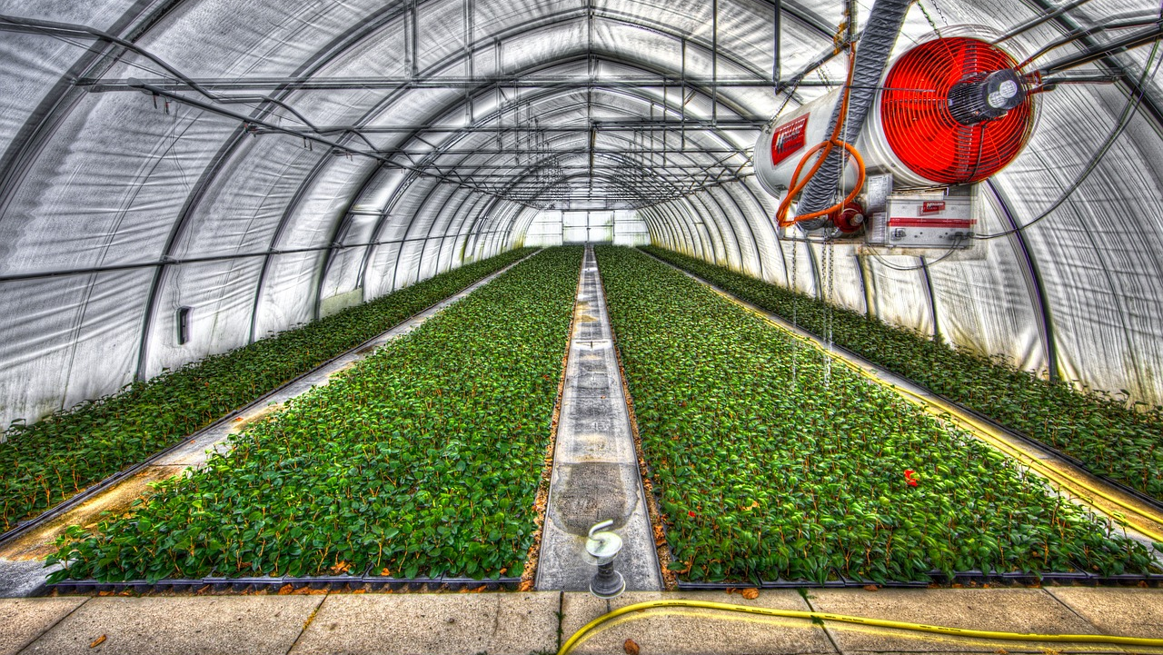
DIGITAL twins for INDUSTRIAL GREENHOUSES
A work of :
Ioannis tsampras 1066584 STAYROS KANIAS 1066563

Slide 2
The problems
Inaccessibility of greenhouses manifests monitoring costs
Individual plant screening leads to prohibiting labor intensity
Lack of close and continuous data-streams halts health & growth check-ups
Infrequent updates increase failure response times
Current automated solutions are rather expensive and hard to implement or lack required detail

Slide 3
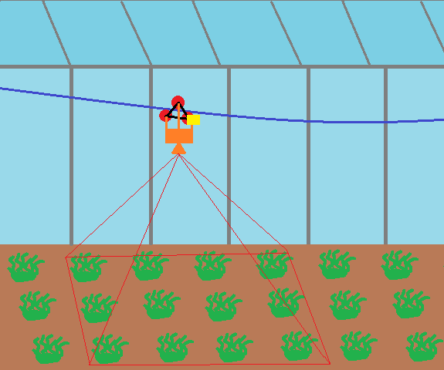
THE SOLUTION
Individual plant monitoring with edge-AI
Low-cost hardware and installation
Data management for low-bandwidth metric updates and on-demand multimedia access
Constant data ingestion and in-browser data visualization
Our cablelift-based image ingestor and processor edge IoT module

Slide 4
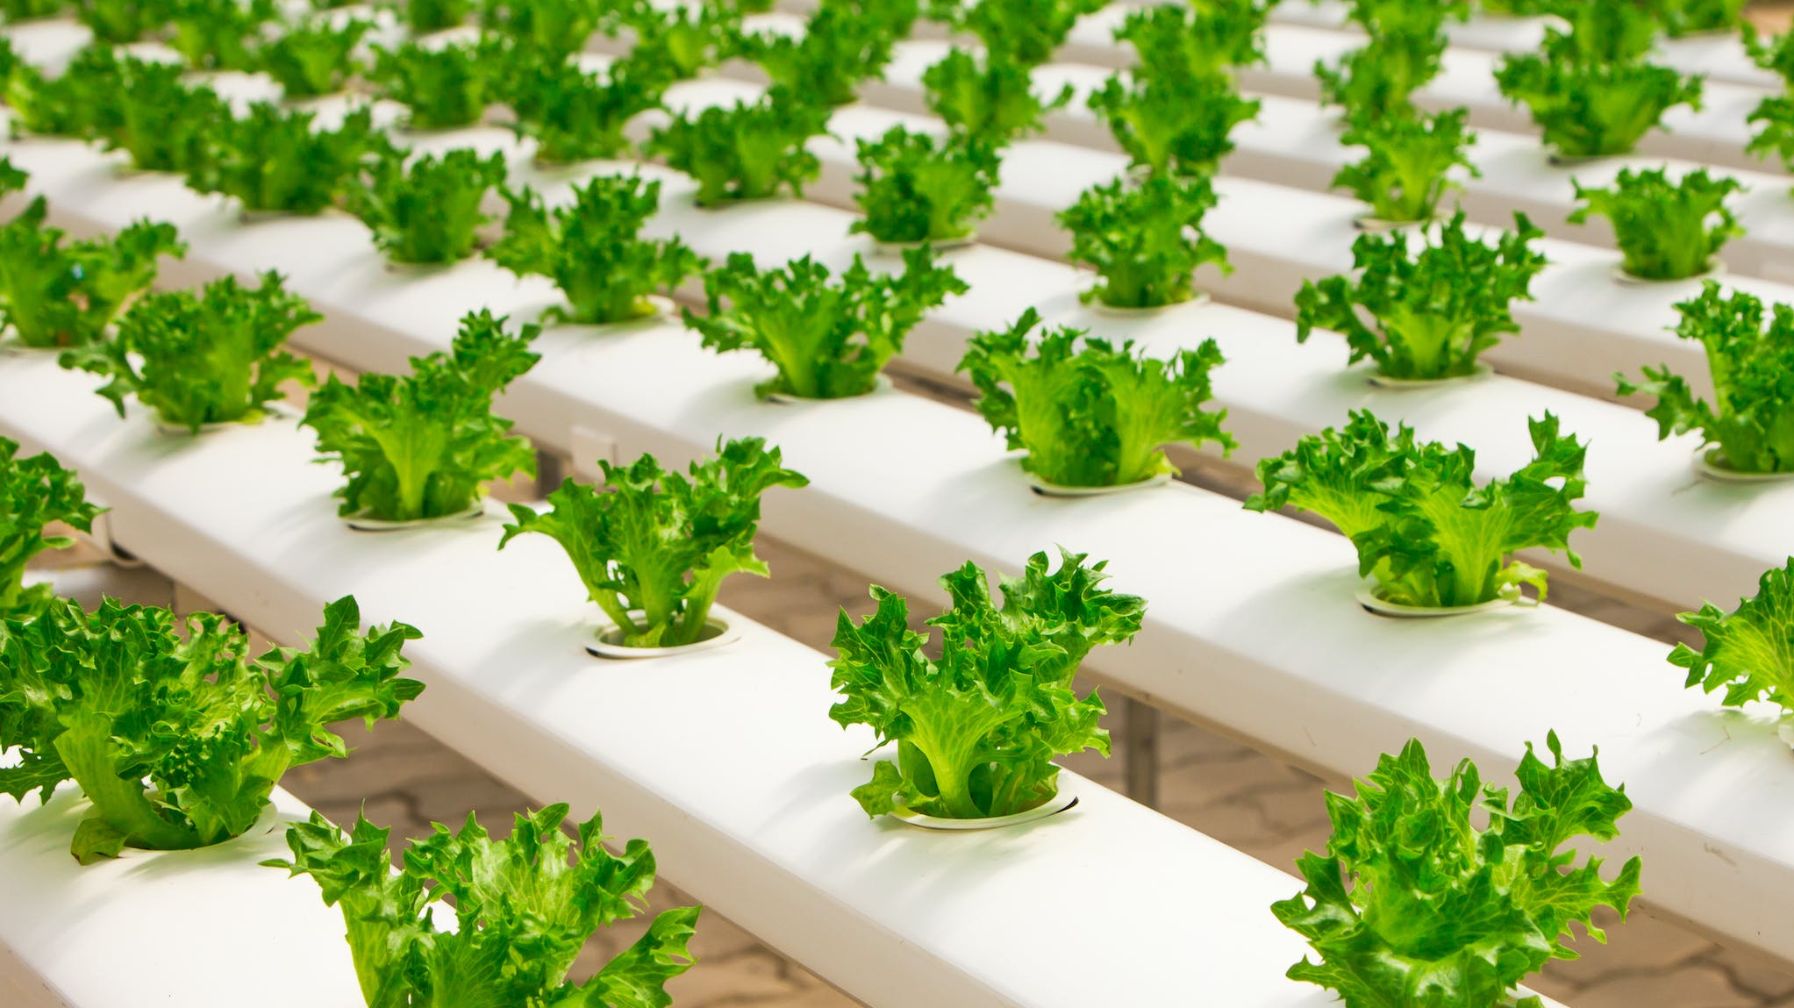
Unique value proposition
Our logistically and economically inexpensive, zero-maintenance and zero-labor approach offers an industrial-scale solution and precise enough data-mining for NN-training applications

Slide 5

Differentiating factor
On-site processing with lightweight AI
No-rail installation using our image-mapping algorithm
Achieved image quality enables smart-management, disease prevention and big-data options

Slide 6
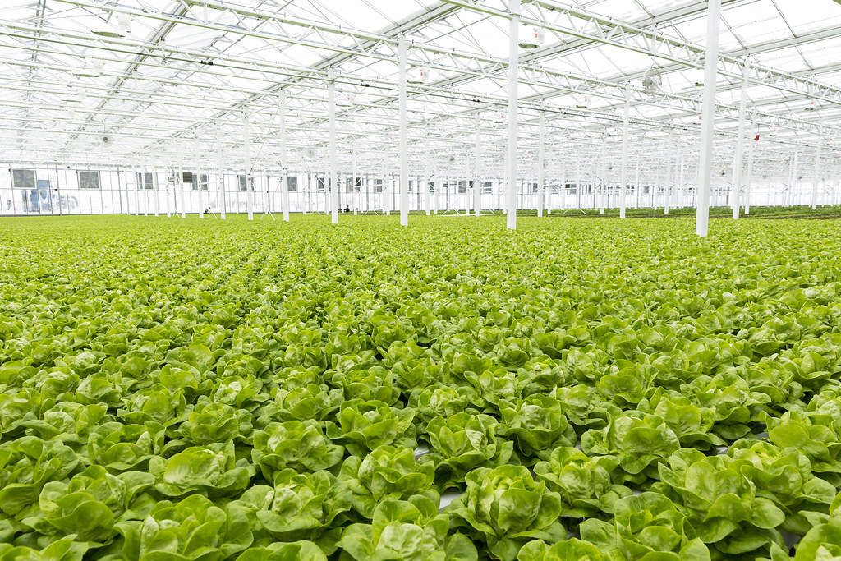
OUR TARGET GROUP
Since our deployment kit will work with any herbaceous plant based greenhouse and at any scale we offer service to:
Small-scale farmers with remote facilities
Large-scale industrial producers
GMO research laboratories, universities and farms

Slide 7
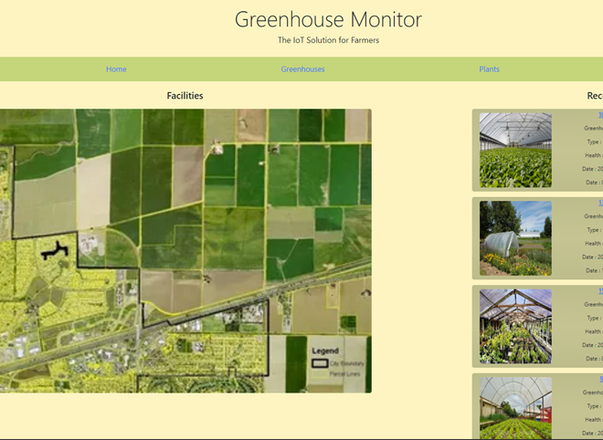
WEBSITE DRAFT
Per facility information (location, size, type ..), overall measurements (temp, humidity, robot status .. ) and average plant metrics
Disease or Infrastructure Failure warnings
Insights and 'heat'-maps
Individual plant measurements and metrics (health, growth, leaf growth...)
2D Digital Twin of each Greenhouse

Slide 8
KIT HARWARE AND PRICING
Kit price:
75 €
Monthly service fee: 10 €
Our kit features :
Raspberry Pi Zero 2 W board
10 Ah Battery System
8MP Pi-Camera sensor
DC Motor, Controller and 3D printed parts
Distance, photosensitive, humidity, temperature sensors
Automated Solar charger and supply
LTE-WiFi station Module
https://www.emnify.com/pricing

Slide 9
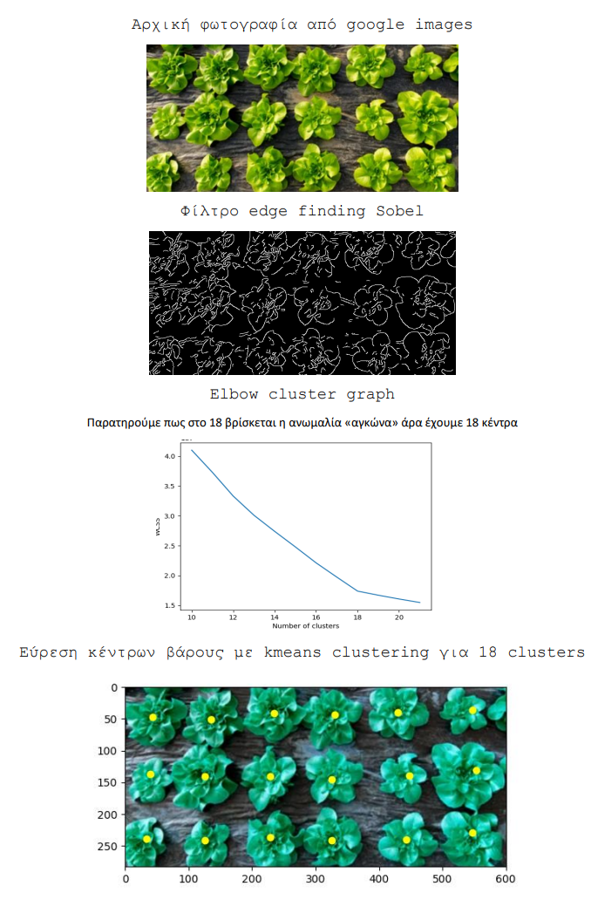
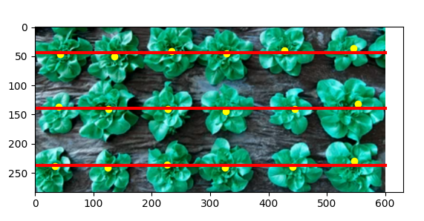
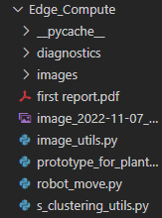
Edge-AI v1.8

