Slide 1
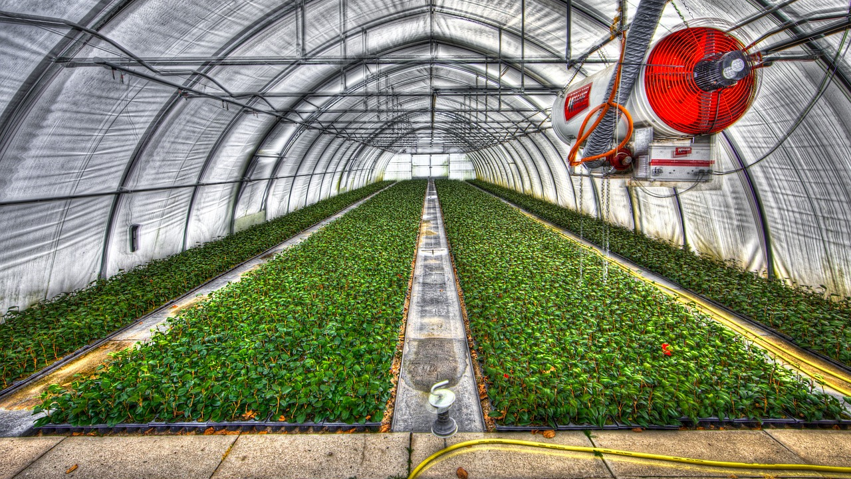
DIGITAL twins for SMART-HOME GREENHOUSES
A work of :
Ioannis tsampras 1066584 STAYROS KANIAS 1066563

Slide 2
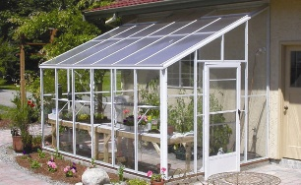
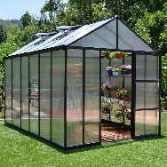
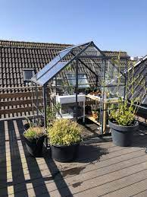
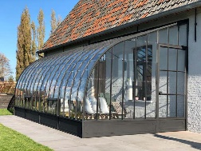
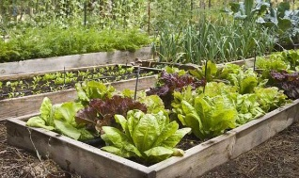
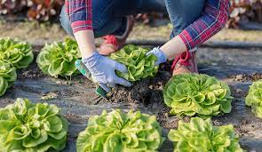
THE PROBLEM
While home gardens & greenhouses are often brought up when sustainable city growth is discussed as :
means of micro-climate stabilizer
atmospheric control
terrace cooling/insulating
distributed source of produce
… the current solutions for enabling un-specialized citizens to evaluate and manage crops are immature and a burden to homeowners excluding the vast majority and appealing only to hobbyists. Such solutions often involve manually providing media (images or video) to specialists for advice or require time investments for personal research.

Slide 3
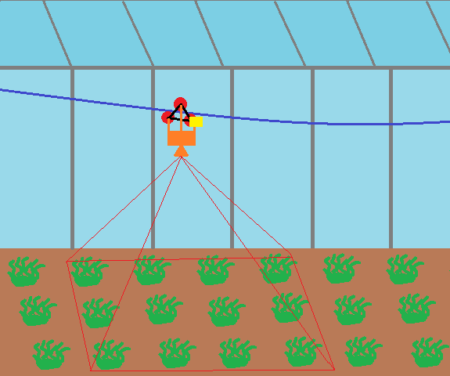
THE SOLUTION
Individual plant monitoring with edge-AI
Low-cost hardware and installation
Data management for low-bandwidth metric updates and on-demand multimedia access
Constant data ingestion and in-browser data visualization
Our cablelift-based image ingestor and processor edge IoT module

Slide 4
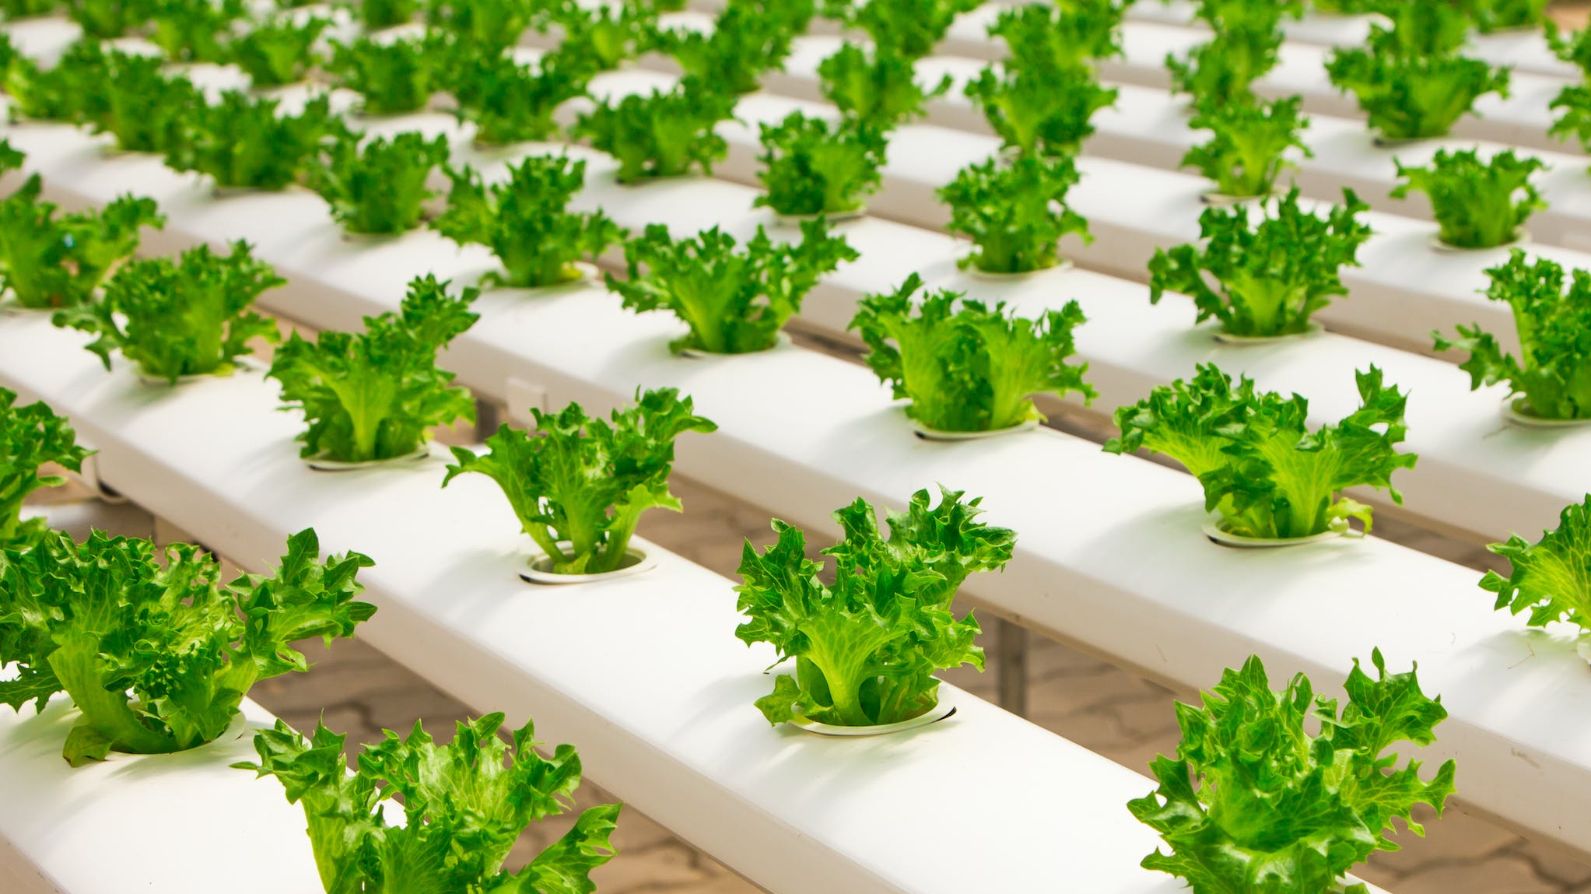
Unique value proposition
Our logistically and economically inexpensive, zero-maintenance and zero-labor approach offers an affordable & convenient solution for monitoring home grown produce while also recording image data precise enough NN-training applications

Slide 5

Differentiating factor
On-site processing with lightweight AI
No-rail installation using our image-mapping algorithm
Achieved image quality enables smart-management and disease prevention with alerts
User convenience

Slide 6
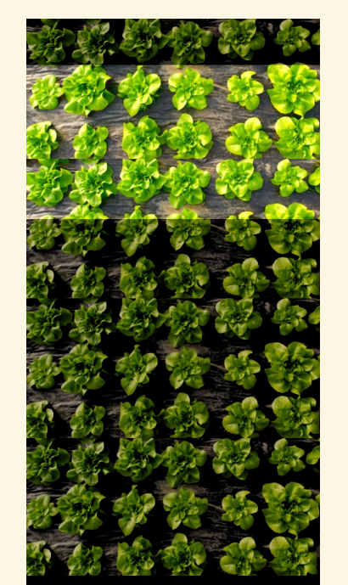
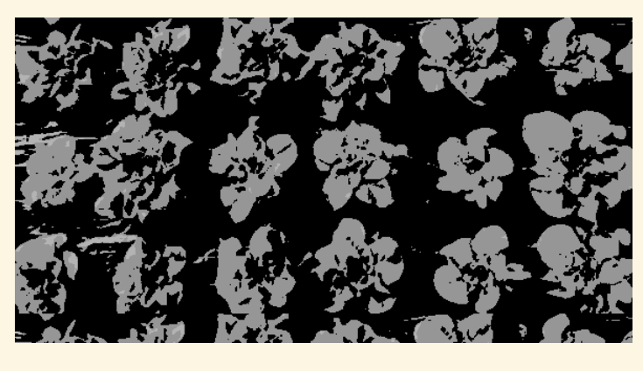
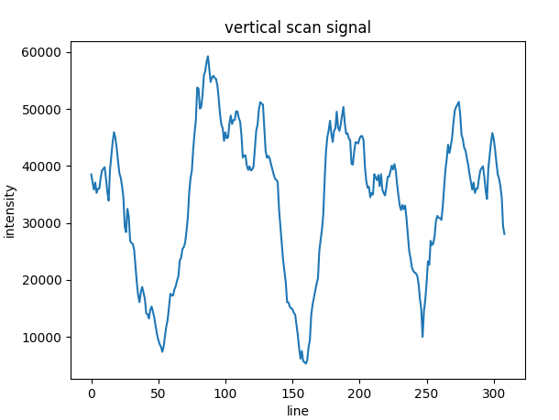
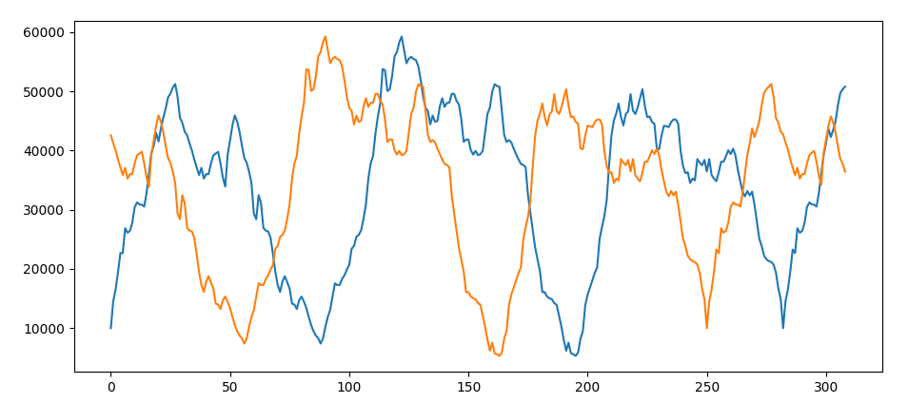
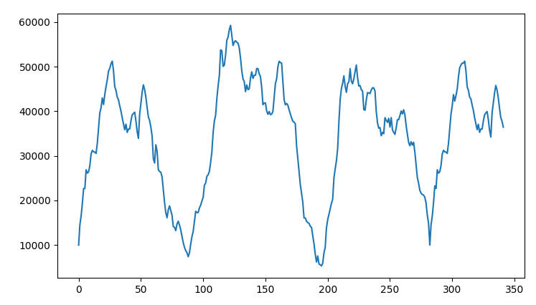
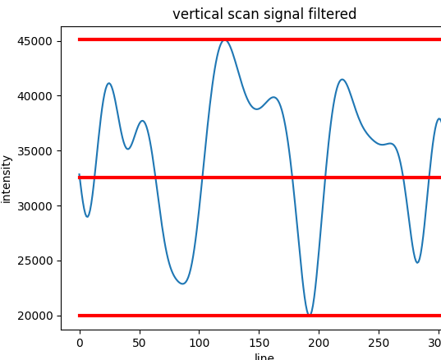
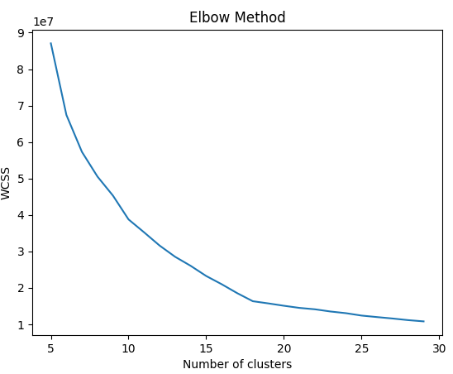
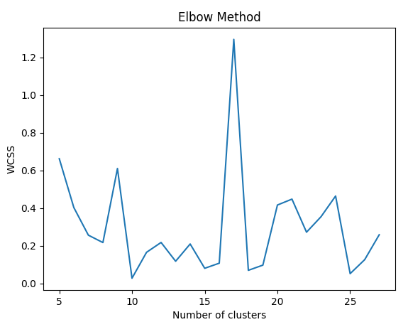
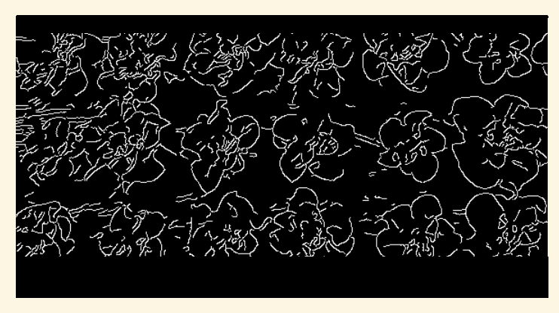
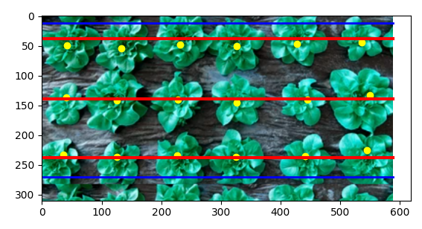
Our MODEL​
Thresholding on GB
Sum of Vertical Scan
Compare to History with Σ(Δy )
2
Store
FFT smoothing & Normalization
Translate
Attach
Total Position
Offset
Edge Filter Thresholding
Curve Finder
FFT smoothing & Normalization
Curve Finder
Crop
Curve Finder
Lines & limits
Local Indexes
Centers
Explorative low cost clustering
High Accuracy Clustering where N-clusters = k-max
snapshots
abs[(log(abs(f’(x)))’]

Slide 7
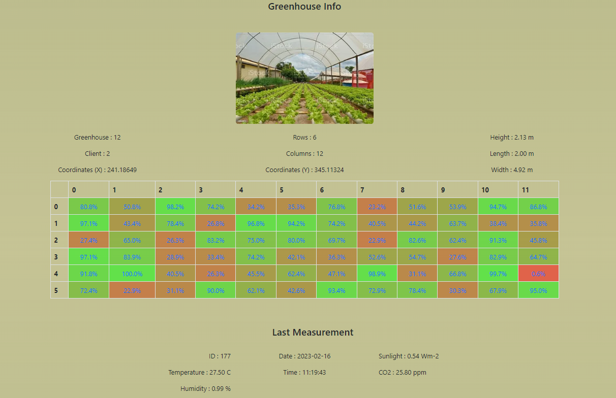
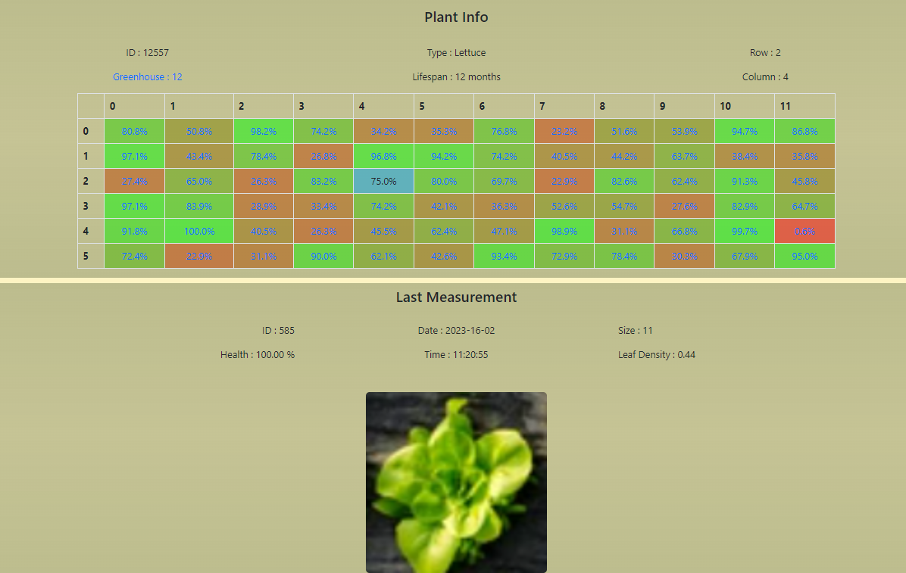
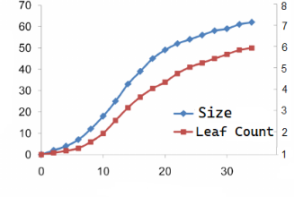
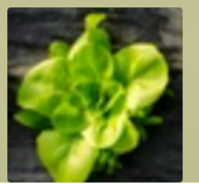
Our site​
2
Greenhouse page with global measurements and plant Map
Individual Plant Page with latest information
Interactive Heat-Map
Size : 60%
Leaf Count : 6

