Slide 1
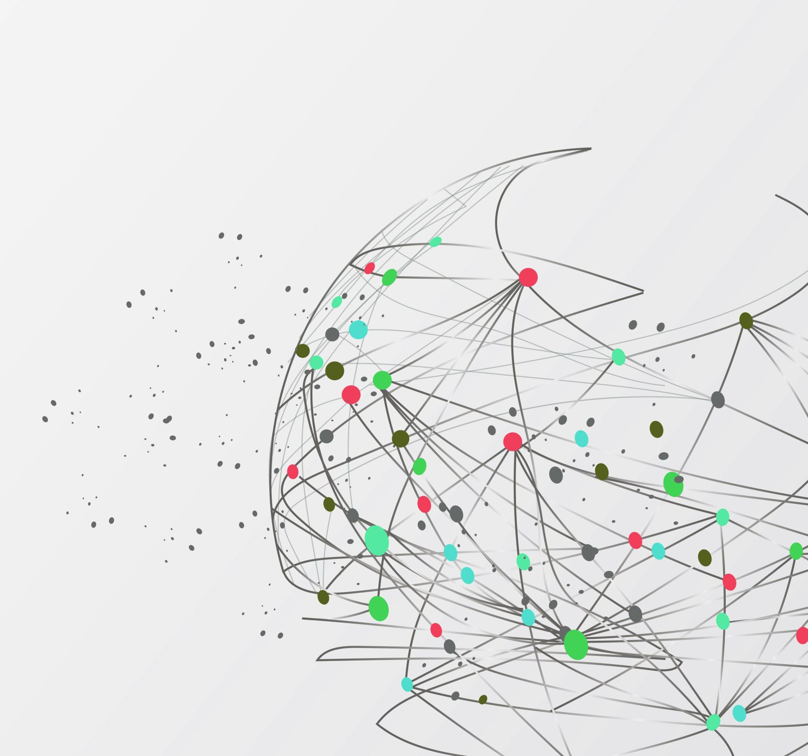
MQTT
What is it and why should I care ?

Slide 2
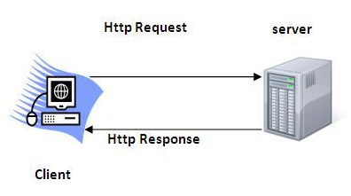
Context
The HTTP technology stack
The HTTP protocol is the backbone of the modern web application
Commonly used as the communication method of a RESTful API (OpenAPI)
It sits on top of the OSI layers (higher than TCP)
There is an “one-way” restriction to them
It coaxes the client-server model where only the client initializes an “event” (requests a resource)
HTTP requests on a server’s endpoint spawn a handling pipeline
They are synchronous and implement a request-response scheme
They contain many data types (text, json, html, media and more) with no specific size limits
but web sockets go brr ?

Slide 3
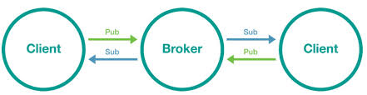
MQTT
An alternative ?
It is a newer messaging protocol serving a (maybe) different purpose
It introduces the “broker” concept for many-to-many & both-ways communication
Originally a low overhead solution for embedded systems in limited CPU-power and bandwidth conditions
It also stacks above the TCP layer (usually)
It thrives in scenarios where “events” are spawned by many sources
Clients can now publish (like post) information under a “topic” or subscribe (like get) to one
When a topic is updated all subscribers receive the “event” (a message)
Pub/Sub instead of request-response scheme
Limits on message sizes

Slide 4

Why tho ?
And where ?
The IoT sphere is the main “consumer”:
Device (sensor/actuator) grids (smart homes, logistics, wearables etc.)
Edge to Cloud Bridge (as a way to expose edge data from a vertical to cloud consumers)
Real time Monitoring and Management
But there’s more:
Social Media (both Facebook’s Messenger and Instagram utilize MQTT)
Web-Dev as a server-side event communicator, avoiding “state” leaking to a RESTful API
Systems with parts behind NAT or without static IP’s

Slide 5
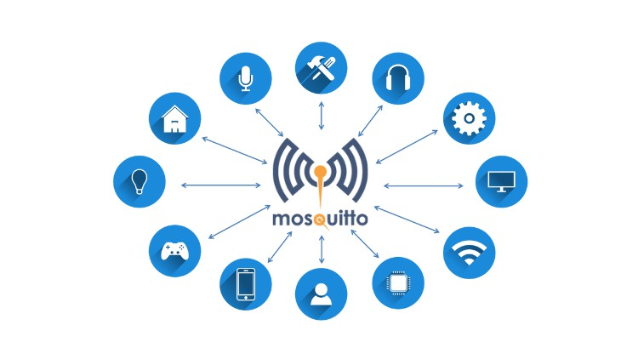
How?
With what?
You can host a broker in your local network or use a public one (since it is a light-weight protocol public brokers exist free of charge)
There are many implementations both open source (e.g. Mosquitto, Apache ) and proprietary (e.g. IBM Watson, AWS IoT Core)
You can connect to the broker with js, node, python, java, C/C++/C#, Go, Swift and others using packets like paho-mqtt or scripts
After a connection is established through a “client” object you can use the appropriate methods to publish messages under topics, subscribe to a topic and set handling functions for your subscriptions

Slide 6
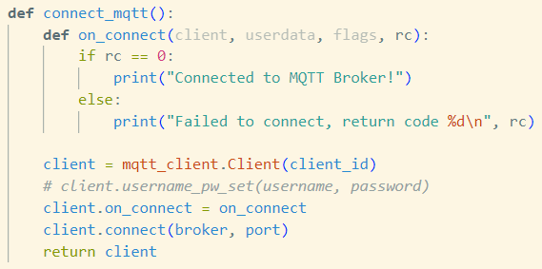
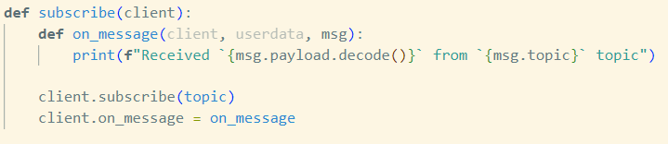
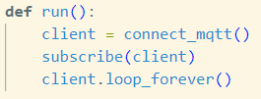
Tutorial
Import client class
Git Dirty
Set a connect handler and connect
Set a subscription handler and subscribe
Run the above

Slide 7
Links
https://www.openapis.org/what-is-openapi
https://cedalo.com/blog/http-vs-mqtt-for-iot/
https://www.influxdata.com/blog/mqtt-use-cases/
http://www.steves-internet-guide.com/using-javascript-mqtt-client-websockets/
https://www.emqx.com/en/blog/how-to-use-mqtt-in-python

