Slide 1

Contents
Introduction
The Problem
Past Attempts & Alternatives
Considerations
Smart Solution Proposal
Impact & Effects
Validity & Feasibility
Mock-Up & Features
Implementation & Requirements
Context

Slide 2
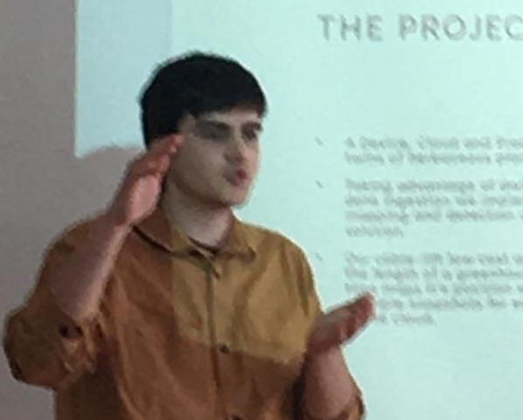
Introduction
This is a presentation regarding a smart solution for de-crowding the University’s Restaurant waiting Line
My name is Ioannis Tsampras:
23 years old from Patras
Recently graduated from ECE
Currently pursuing a M.Sc. in CEID
Employed in the Network Architecture & Management Research Group @ ECE
Interests include : IoT, Computer Vision, HumanComputerInteraction, Cloud & Data Science
LinkedIn GitHub E-mail

Slide 3
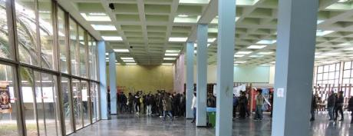
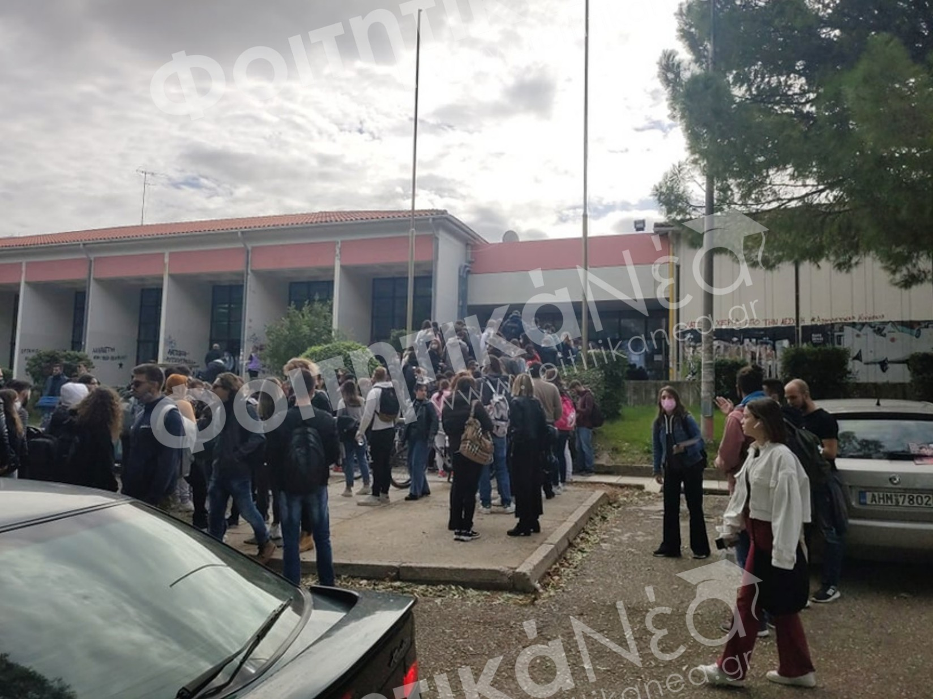
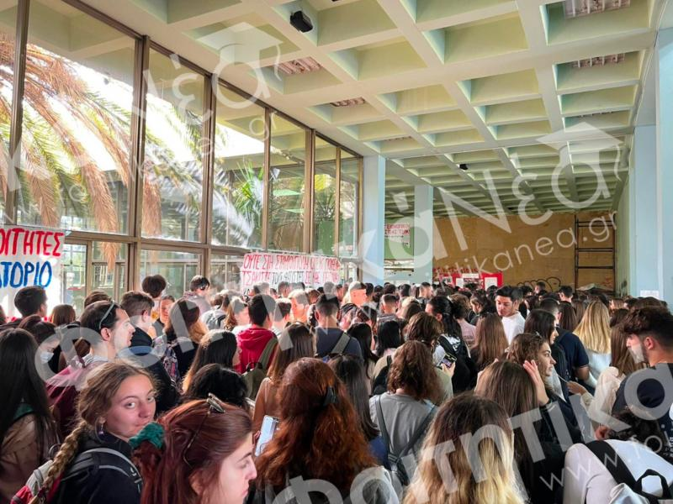
The Problem
Line Growth
People Flow Rate
Max Service Rate
Service Rate
11:00
12:00
13:00
14:00
15:00
16:00
illustration
While the total capacity of the University Restaurant is able to accommodate most students during its operating hours, fluctuating traffic manifests people-flow spikes and therefore congestions that :
Increase waiting time
Stress the kitchen / Drop Quality
Slow down overall service
Create unhealthy crowding
Line Size

Slide 4

Past Attempts & Alternatives
More Lines ?
Increase Serving Rate ?
Adjust Lecture Schedules ?
Create Restaurant Time Slots for each Department ?
Second Restaurant ?
Increase Restaurant Capacity ?
Incentivize Temporal Distribution for Students ?

Slide 5

Considerations
Scanning ID’s is not the bottleneck, more lines won’t increase serving rate, although a small de-crowding benefit is present.
Increasing serving rate is costly and inefficient since new resources would be unused when not in peak traffic.
Adjusting Lecture Schedules to temporally spread-out University Visitors is a viable but hard to implement method. Although, randomizing start/end hourly fractions for lectures does help to alleviate minor traffic spikes.
Imposing time slots for departments is considered unfair by the public and achieves only minor benefits when it comes to spreading. They also appear hard to enforce.
A second restaurant faces the same problems found in idea No. 2.
Increasing restaurant capacity is irrelevant to the problem and is rarely a bottleneck.
To incentivize students to spread out themselves during the day requires:
A way to monitor the current situation in the waiting line.
Sensors do not provide reliable results and are subject to costs, maintenance, vandalism, public discord. *
Cameras might derive precise estimations by deploying computer vision algorithms but face the same problems as sensors with added privacy concerns and larger power and network requirements.
Crowd-sourced reporting is unreliable and unsure to be adopted.
Google’s Maps-API provides such functionality but in a very limited and unreliable way.
Means to inform the students.
An app requires long development time.
A normal website would encounter enormous amounts of requests daily with hourly spikes.
Incentives are needed for the students to follow “instructions”. Nobody likes orders.

Slide 6


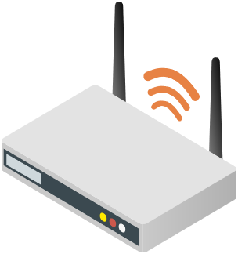



Proposed Smart Solution
Following the temporal spread approach from the previous slides
Use the access points installed on the premises to monitor connected Wi-Fi clients and estimate the size of the line, waiting time & more. Due to the nature of a roaming network, users’ devices automatically connect to the closest AP. No need for any new sensors.
By providing the current traffic and a prediction graph to the users they are indirectly incentivized to visit during low-load periods.
To avoid maintaining a system servicing tens of thousands requests, in a few hours each day, deploy a static webpage in the cloud and update it every minute or so.
Monitoring connected devices on the 2nd OSI layer (hashed MACs) for each AP does not risk student-data or privacy, avoiding legal complications.
Zero Cost
GDPR Safe
Non-Intrusive

Slide 7
Impact & Effects
Students will now be able to gauge the wait-time and avoid visiting during peak hours, creating better campus conditions.
The lines will diminish in size, avoiding negative PR for the University.
More students could be served since the restaurant would be utilized more efficiently.
Decreased crowding minimizes hygiene concerns and allows the food quality to be maintained.
Bonus: No check-friend required !

Slide 8
Validity & Feasibility
Are the claims listed in the previous slides valid ? Simply informing the students about the long wait-time might not discourage all of them from visiting, or is it ?
Students might not be able to time their visit differently due to their academic or personal schedules.
What do they have to say ?
If you knew the line size, would you have still visited now ?
Why would you visit at this time regardless of the situation ?
Questions were asked to 39 students waiting in line at 16/11/23 13:00-14:00

Slide 9
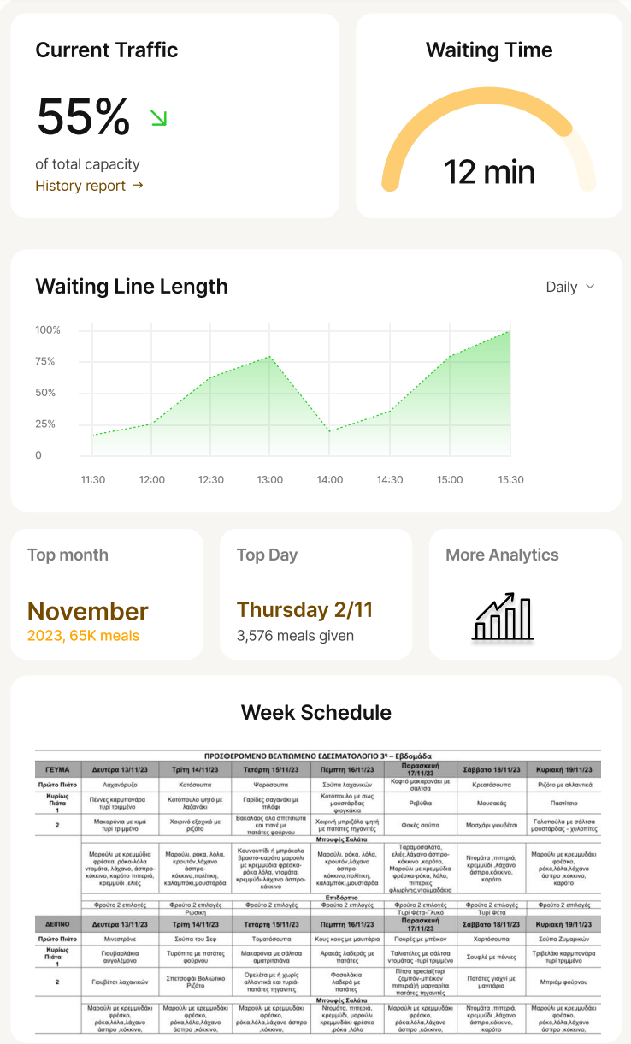

Mock-Up & Features
Projection
Current Status
Graph & Projection
Visiting Time Suggestion
Week’s Schedule
More Complex Analytics
Alarms & Insights for Admin
12:58

Slide 10



Implementation & Requirements
Key requirements for the system are:
Access to the AP’s in the vicinity of the restaurant
High-Throughput Static WebPage Hosting
Suggested Implementation Scenarios:
Provide AP access & develop/deploy/maintain independently as an add supported open project
Assign project as part of the University’s cyberspace “My.Upatras” & deploy on premises
Development Time – Under a Month / 40 WorkHours
Operational Costs – Zero (if done correctly)
Infrastructure Engagement – Handful of Requests/Minute & No security concerns

Slide 11

Context
This application came up during the use-case exploration phase of the Smart-Campus internal Project, part of NAM’s portfolio. However, the current proposal may be developed independently (or not).
The NAM Group, under Prof. Spyros Denazis, has many smart applications currently operational in its portfolio. Some of them, that might be of interest to the Rectorate, are listed bellow:
Sense.City, an issue tracking, management and crowd-sourcing platform for both Municipalities and Educational Facilities (through the soon-to-be-added “Schools” plug-in). Deployed in 8 Cities with more than 20.000 users and increasing adoption.
SafeAmea, a privacy-oriented citizen registry used for civil protection agencies. Currently operational in two Municipalities and growing !

