Slide 1
Collaborative Data Science Projects: Enhancing Learning and Research
Presentation by [Your Name]
Date: October 8, 2024

Slide 2
Introduction
Objective: Introduce the concept of structured, weekly collaborative projects.
Why Collaboration?
- Enhances learning through diverse perspectives.
- Promotes problem-solving skills.
- Prepares for industry or academic team environments.

Slide 3
Project Structure
Frequency: Weekly projects to keep momentum and learning continuous.
Duration: Each project could span a week or two, depending on complexity.
Roles: Rotate roles like project lead, data analyst, methodologist, communicator, etc.

Slide 4
Project Selection
Method: Voting system for project topics.
Criteria: Relevance to current studies, feasibility within the timeframe, learning potential.

Slide 5

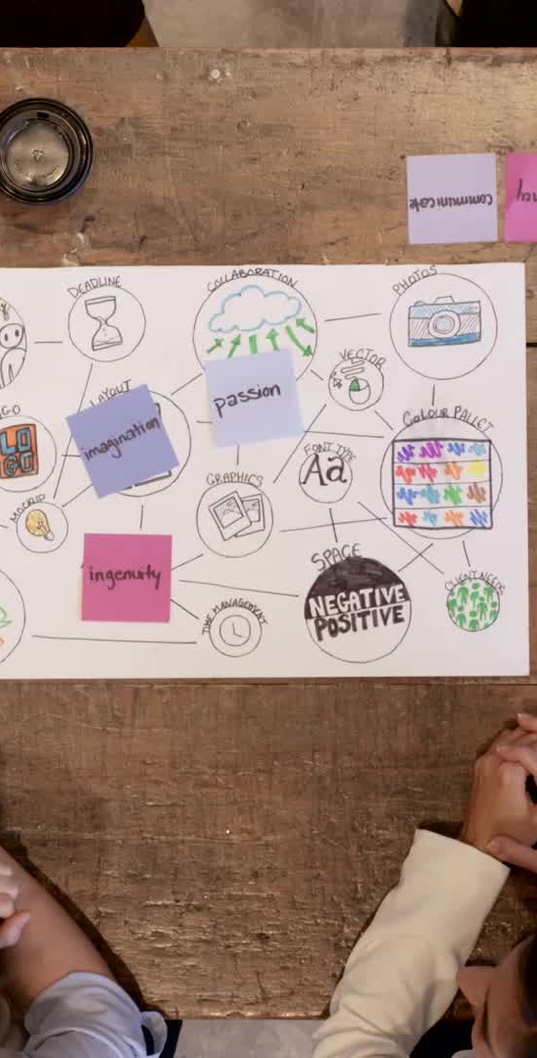
Team Assessment and Surveys
Learning from Terri: Highlight her expertise in surveys and assessments.
Types of Surveys:
- Pre-project surveys to gauge interest and background.
- Mid-project feedback for adjustments.
- Post-project review for learning outcomes and satisfaction.

Slide 6
Feedback Channels
Professional Feedback:
- Use tools like Slack, Microsoft Teams, or a designated forum.
- Set guidelines for constructive criticism.
Respectful Communication: Emphasize the importance of professionalism and respect.

Slide 7
Inclusivity and Confidence Building
Strategies for Inclusivity:
- Ensure quiet voices are heard through structured rounds of feedback.
- Pair more confident members with less confident ones for mutual learning.
Confidence Building:
- Celebrate small wins.
- Provide platforms for presentation and peer review.

Slide 8
Case Study or Example Project
Brief Overview: Show a past project or hypothetical example.
What Worked: Highlight successful collaboration points.
Learning Points: Areas where improvements were made.

Slide 9
Tools and Resources
Software: Mention tools like Jupyter Notebooks, GitHub for version control, etc.
Learning Platforms: Links to online courses or resources for mastering necessary skills.

Slide 10
Conclusion
Recap: The benefits of structured collaboration.
Future Steps: Encourage continuous improvement, maybe consider a project showcase or conference.

Slide 11
Q&A
Invite questions from the audience.

