Slide 1



Introduction to Object Detection

Slide 2
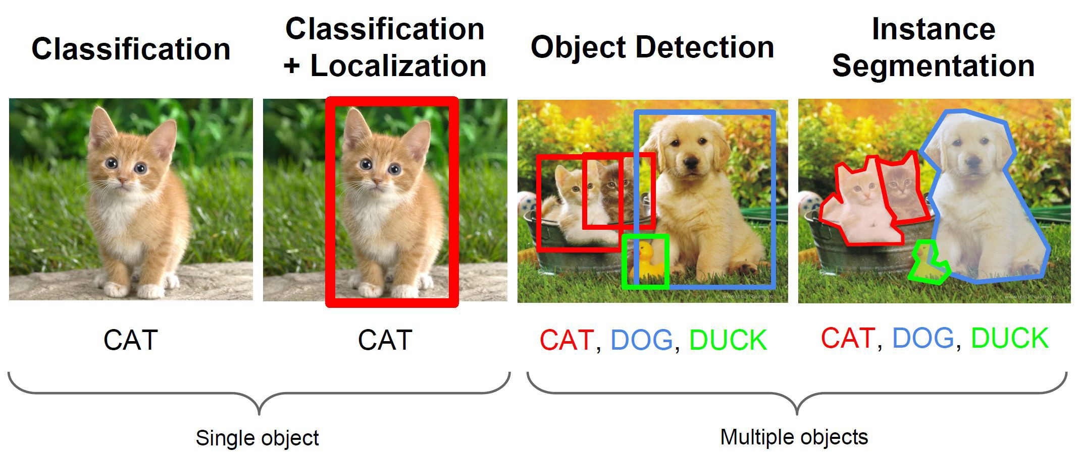
Computer Vision Tasks
Source: CS231n Object detection http://cs231n.stanford.edu/slides/2016/winter1516_lecture8.pdf

Slide 3
Computer Vision Tasks
Source: CS231n Object detection http://cs231n.stanford.edu/slides/2016/winter1516_lecture8.pdf

Slide 4
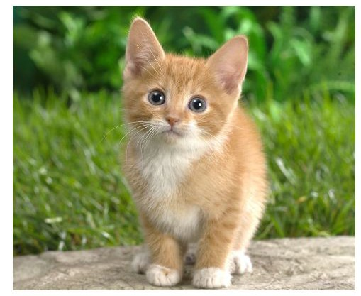
Classification + Localization
Classification:
Input: Image
Output: Class label
Loss: Cross entropy (Softmaxlog)
Evaluation metric: Accuracy
Localization:
Input: Image
Output: Box in the image (x, y, w, h)
Loss: L2 Loss (Euclidean distance)
Evaluation metric: Intersection over Union
Classification + Localization:
Input: Image
Output: Class label + box in the image
Loss: Sum of both losses

Slide 5

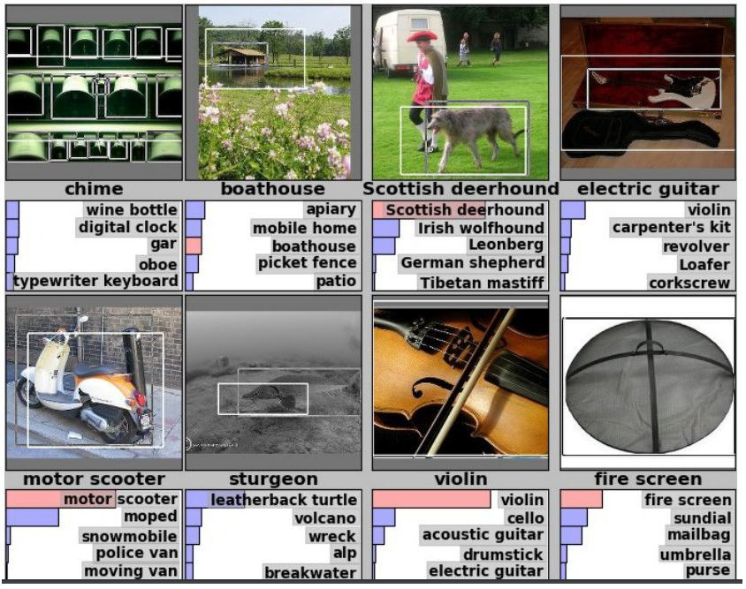

Classification + Localization: ImageNet Challenge
Dataset
1000 Classes.
Each image has 1 class with at least one bounding box.
~800 Training images per class.
Evaluation
Algorithm produces 5 (class + bounding box) guesses.
Example is correct if at least one of guess has correct class AND bounding box at least 50% intersection over union.

Slide 6
Intersection Over Union (IoU)
Important measurement for object localization.
Used in both training and evaluation.
Intersection(A,B)
IoU(A,B)
=
Union(A,B)

Slide 7
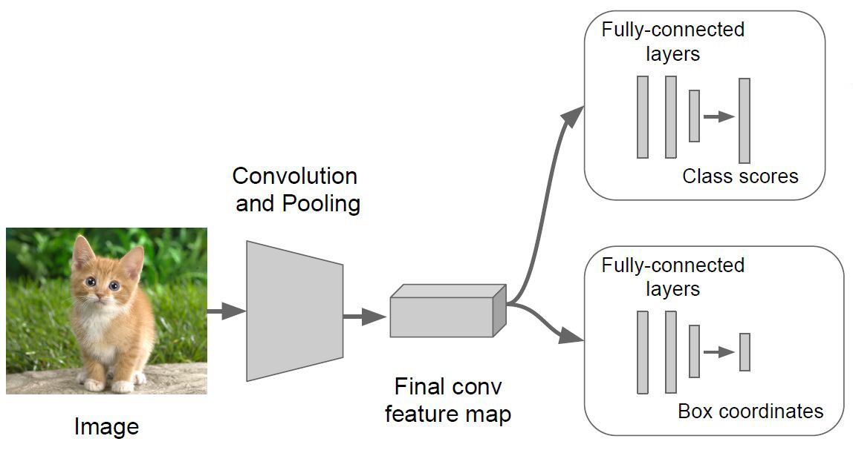
Classification + Localization: Model
Classification Head:
C Scores for C classes
Localization Head:
Class agnostic: (x,y,w,h)
Class specific: (x,y,w,h) X C

Slide 8
Computer Vision Tasks
Source: CS231n Object detection http://cs231n.stanford.edu/slides/2016/winter1516_lecture8.pdf

Slide 9
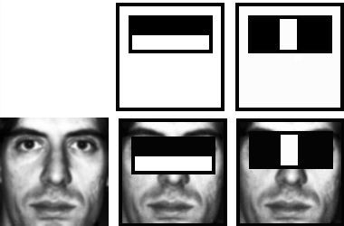
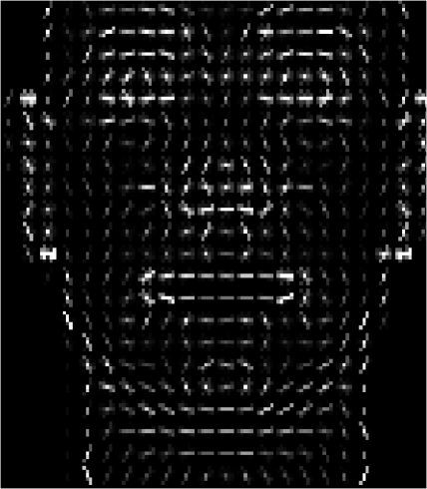
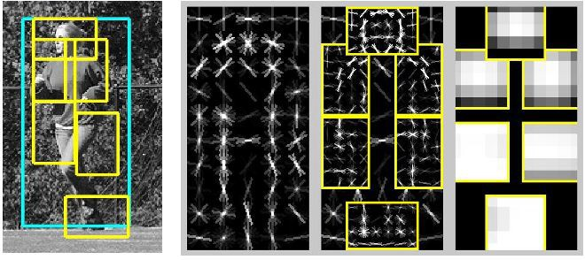
Object Detection 2001-2007
Rapid Object Detection using a Boosted Cascade of Simple Features (2001)
Viola & Jones
Histograms of Oriented Gradients for Human Detection (2005)
Dalal & Triggs
Object Detection with Discriminatively Trained Part Based Models (2010)
Felzenszwalb, Girshick, Ramanan
Fast Feature Pyramids for Object Detection (2014)
Dollar

Slide 10
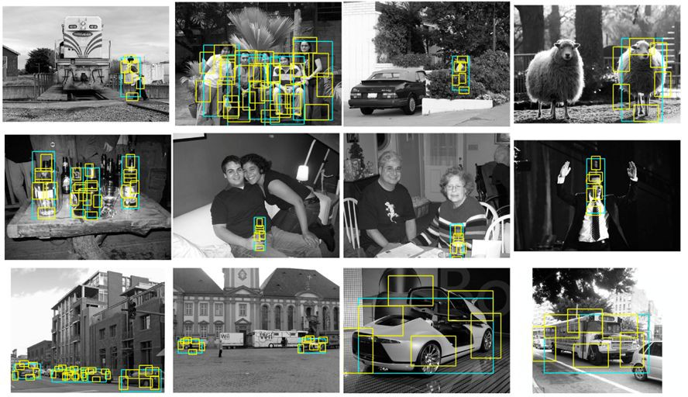
Object Detection 2007-2012
Source: Ross Girshick’s CVPR 2017 Tutorial http://deeplearning.csail.mit.edu/instance_ross.pptx

Slide 11
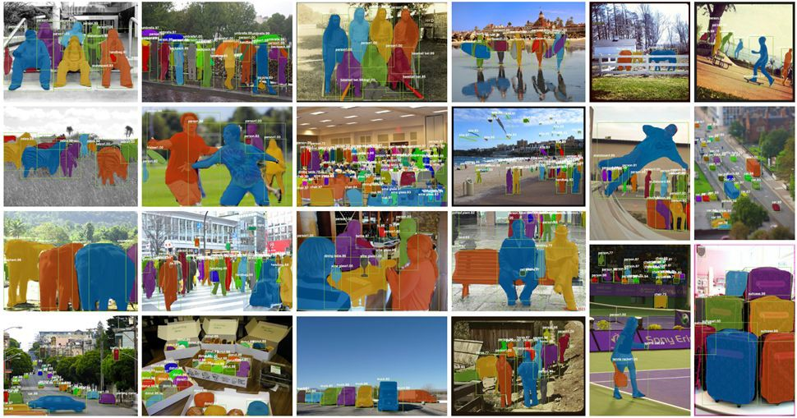
Object Detection Today
Source: Ross Girshick’s CVPR 2017 Tutorial http://deeplearning.csail.mit.edu/instance_ross.pptx

Slide 12
Object Detection: Datasets
2007
2013
2015
MS COCO
80 Classes
200K Training images
1.5M Training objects
Pascal VOC
20 Classes
11K Training images
27K Training objects
ImageNet ILSVRC
200 Classes
476K Training images
534K Training objects
Was de-facto standard, currently used as quick benchmark to evaluate new detection algorithms.
Essentially scaled up version of PASCAL VOC, similar object statistics.
More categories and more object instances in every image. Only 10% of images contain a single object category, 60% in Pascal. More small objects than large objects.

Slide 13
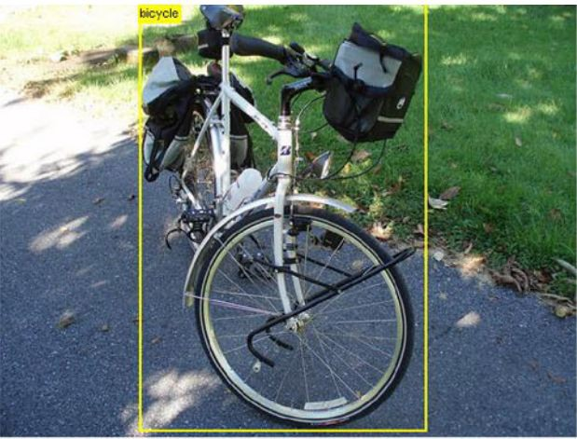
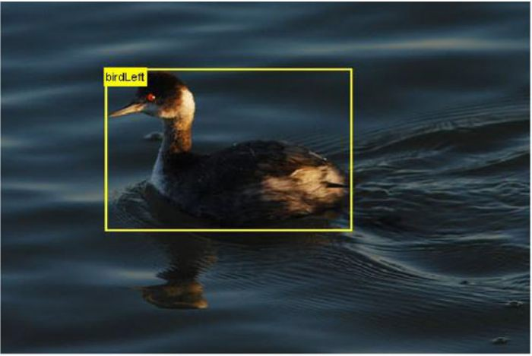
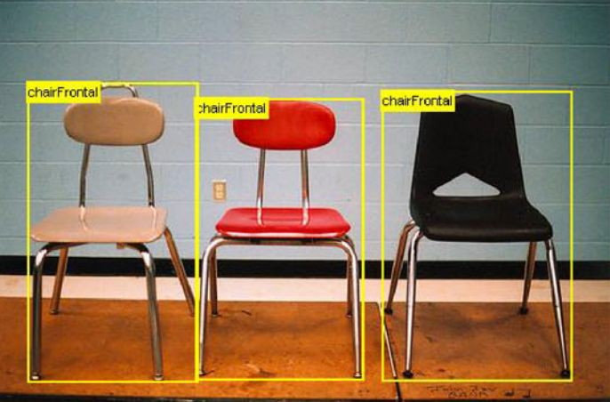
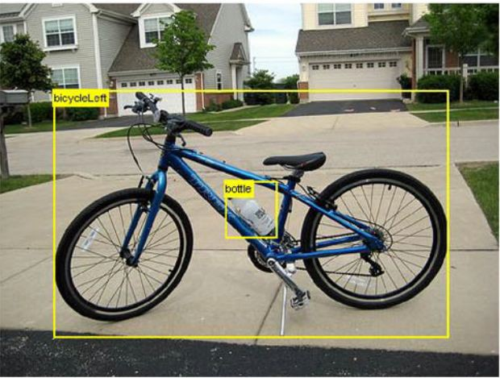
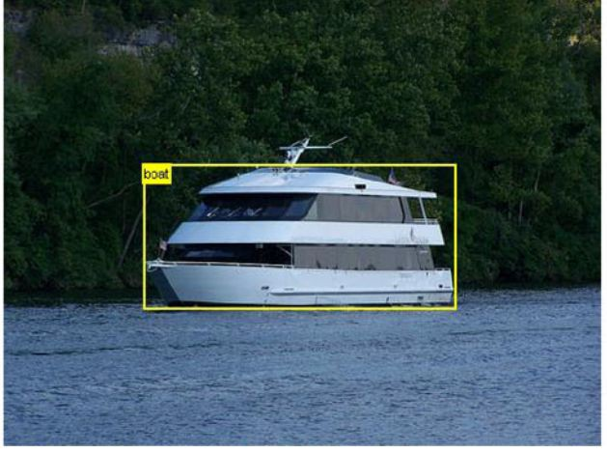
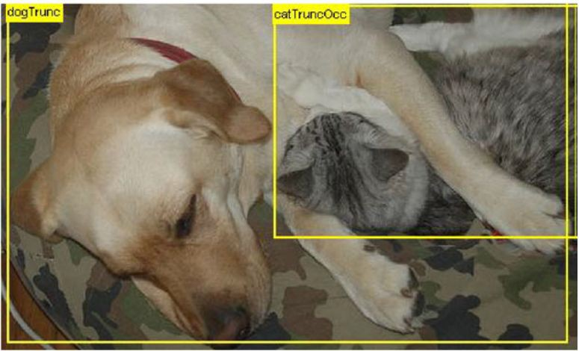
Pascal Examples

Slide 14
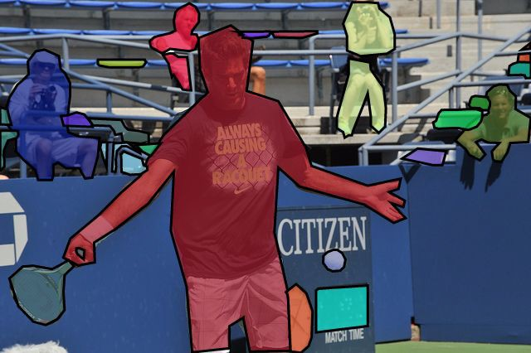
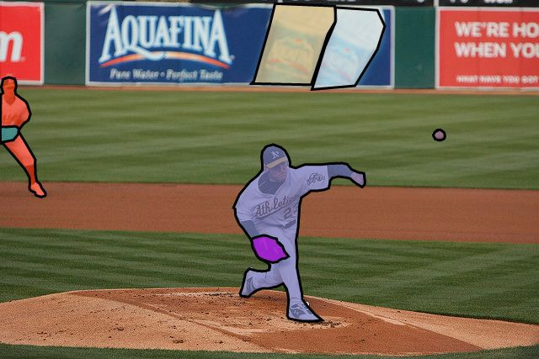
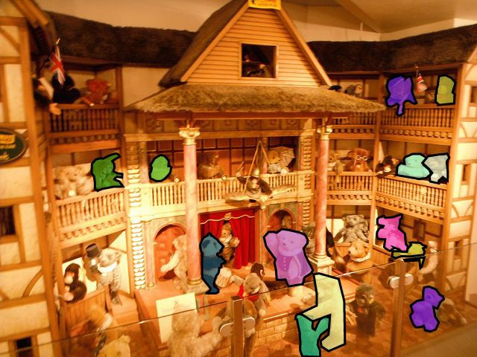
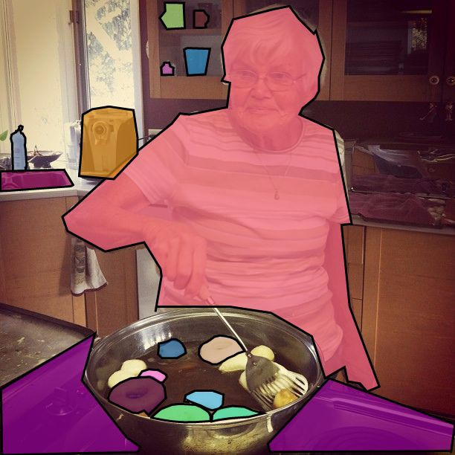
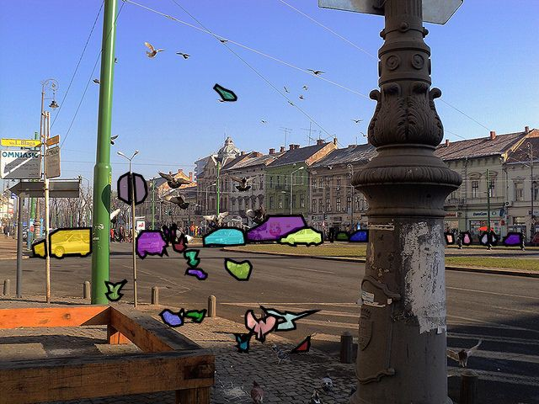
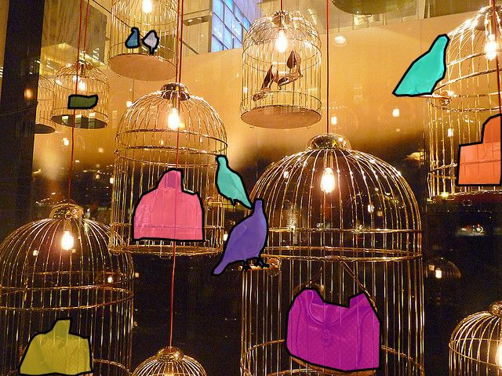
COCO Examples

Slide 15
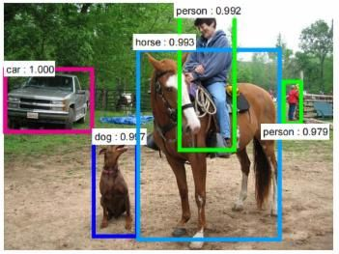



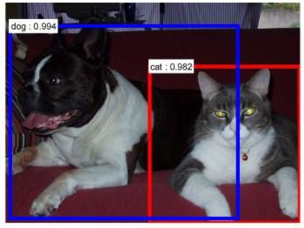
Object Detection
Input: Image
Output: For each object class c and each image i, an algorithm returns predicted detections: ocations with confidence scores .
l

Slide 16
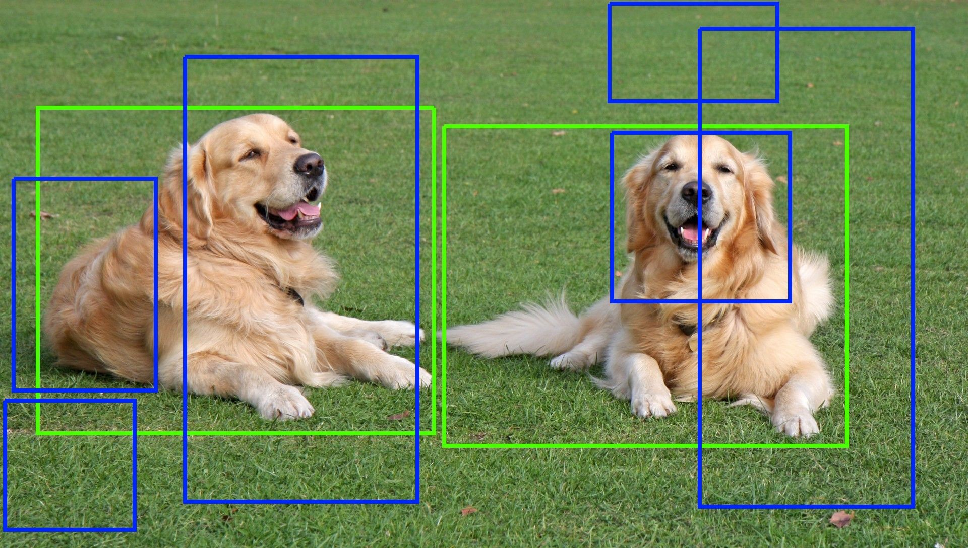
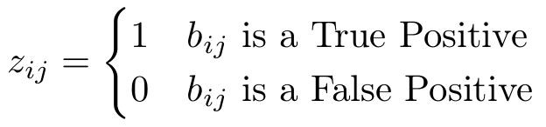
Object Detection: Evaluation
True positive: correct class prediction AND IoU > 50%.
False positive: wrong class or IoU < 50%.
False negative: missed (not detected) object
Only one detection can be matched to an object.
●

Slide 17
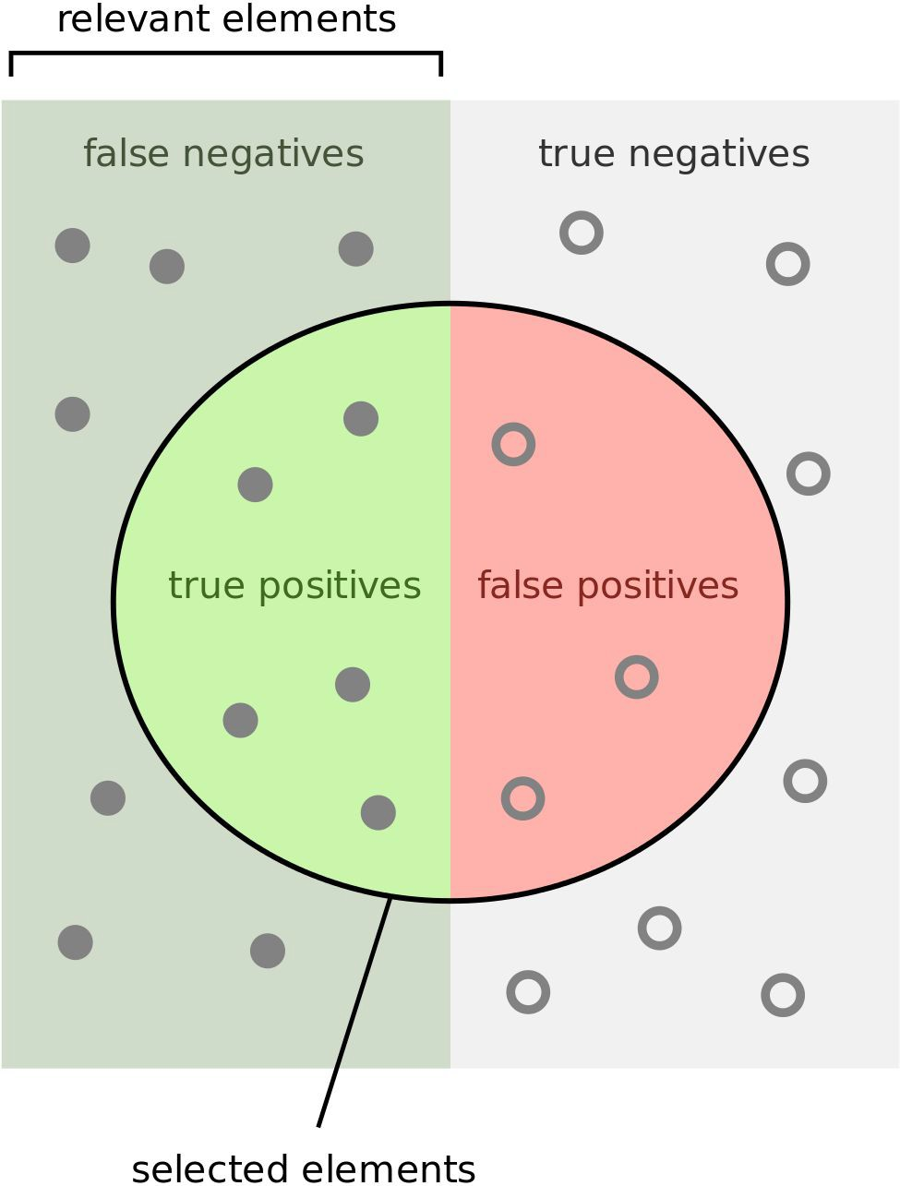
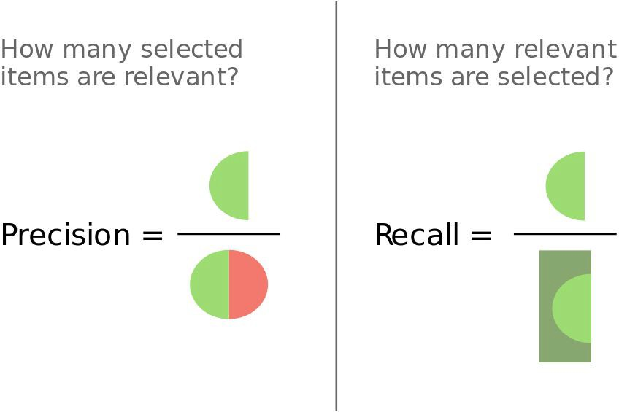
Object Detection: Evaluation
Mean Average Precision (mAP) across all classes, based on Average Precision (AP) per class, based on Precision and Recall.

Slide 18
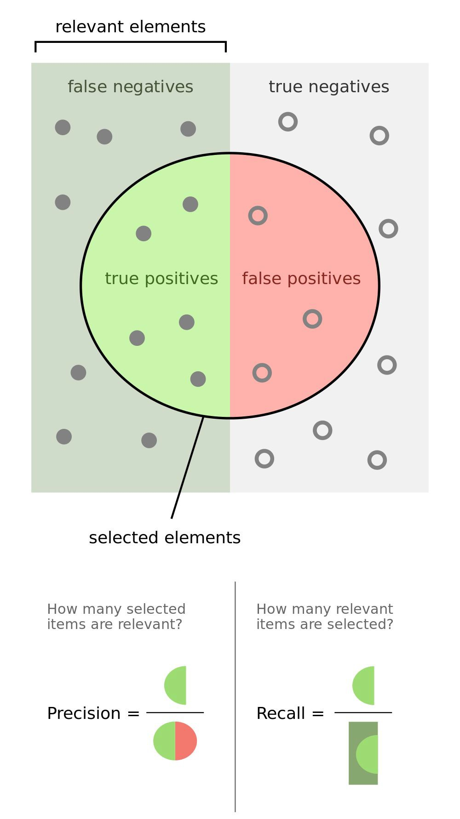
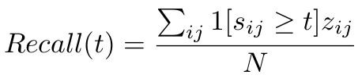
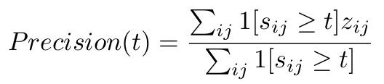
Precision And Recall For a Threshold

Slide 19
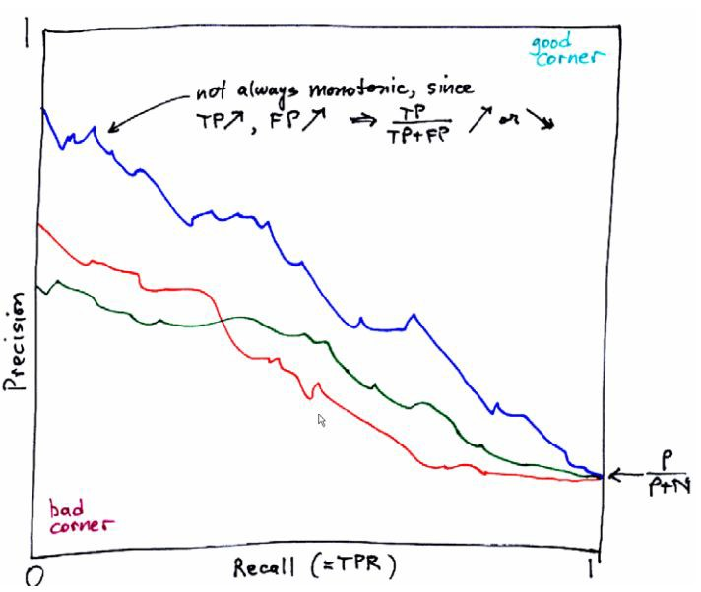
Precision-Recall Curve
Source: Drawing by Prof. William H. Press, the University of Texas at Austin

Slide 20
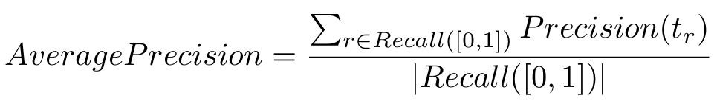
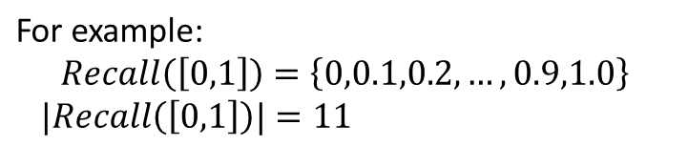
Average Precision (AP)
[In the vision community] AP is the estimated area under the PR curve

Slide 21
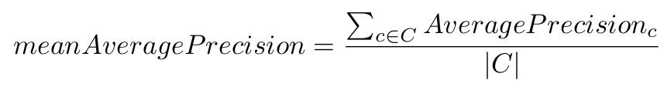
Mean Average Precision (mAP)
The winner of each object class is the team with the highest average precision
The winner of the challenge is the team with the highest mean Average Precision (mAP) across all classes.

Slide 22
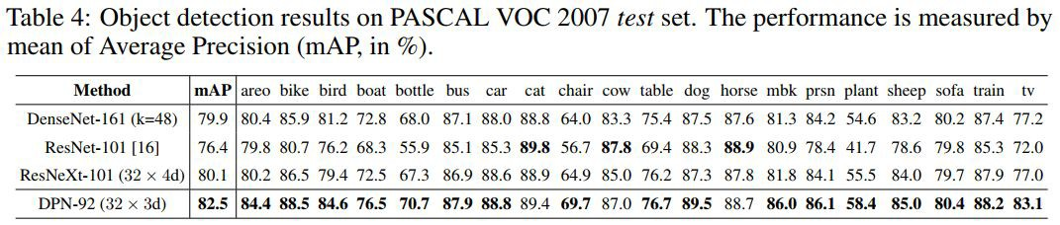
Object Detection: Evaluation
Mean Average Precision (mAP) across all classes, based on Average Precision (AP) per class, based on Precision and Recall.

Slide 23
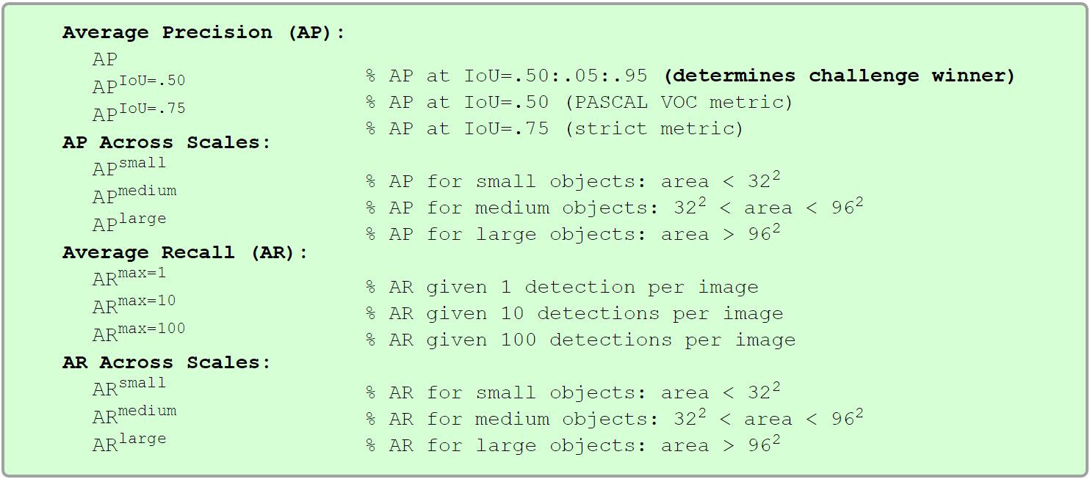
Object Detection: Evaluation
Today new metrics are emerging
Averaging precision over all IoU thresholds: 0.5:0.05:0.95
Averaging precision for different object sizes (small, medium, big)
Averaging recall as a metric to measure object proposal quality.

Slide 24
Looking for brilliant researchers
cv@brodmann17.com

