Slide 1

Computer Vision-Based Traffic Monitoring System for Vehicle Detection and Classification
Traffic Monitoring System Project
Mihir Patel

Slide 2
Introduction
Overview: This project aims to create an automated system for detecting and classifying vehicles on the road. Accurate vehicle detection is essential for traffic monitoring, autonomous driving, and urban planning.
Problem Statement: Growing vehicle numbers require effective monitoring. Existing systems lack real-time accuracy.
Goal: To develop a model that combines ML and CV techniques to detect and classify vehicles in real-time.

Slide 3
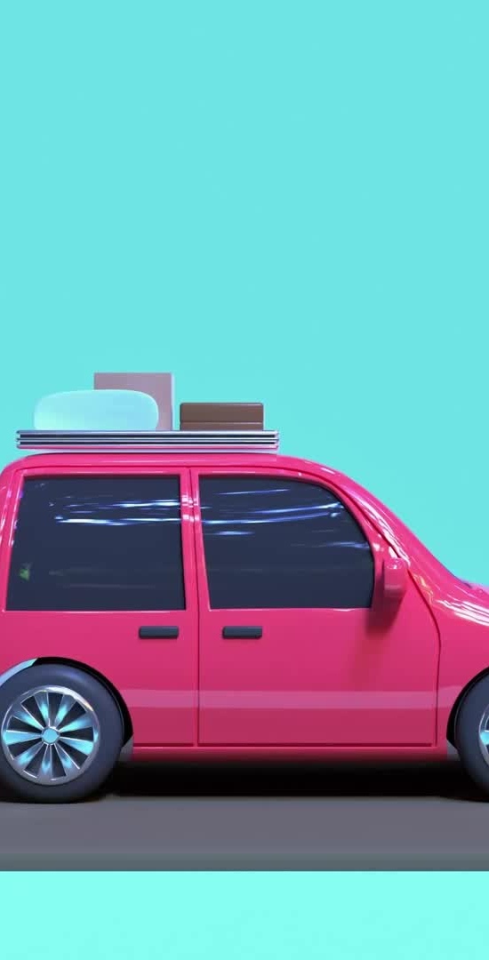
Approach
Haar Cascade: Used to propose initial regions where vehicles may be present. This step reduces the area of search and improves efficiency.
Sliding Window Technique: Used to scan finer regions within each Haar Cascade-proposed area to locate exact positions of vehicles.
CNN (Convolutional Neural Network): A deep learning model that extracts visual features from each window, allowing the model to "see" patterns in vehicle shapes.
SVM (Support Vector Machine): A machine learning classifier that processes the CNN features to distinguish between vehicles and non-vehicles.

Slide 4

Dataset
Dataset Used:
KITTI dataset, a widely used dataset in autonomous driving research, containing images captured from a moving vehicle.
Sample Images:
The dataset includes images with various vehicles, pedestrians, and other objects.
Classes:
The dataset has been divided into two classes: vehicles (e.g., cars, trucks, buses) and non-vehicles (e.g., empty road or background areas).

Slide 5
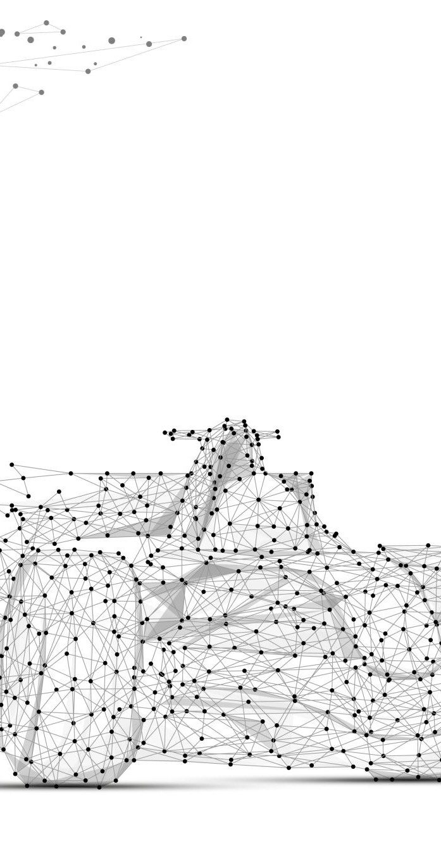
Haar Cascade for Region Proposal
Purpose:
To efficiently identify regions of interest that might contain vehicles. Haar Cascade reduces the need to scan the entire image by proposing likely regions with vehicles.
How It Works:
Haar Cascade is a machine learning-based approach that uses features like edge, line, and rectangle patterns. It rapidly scans the image to identify potential vehicles based on these patterns.

Slide 6
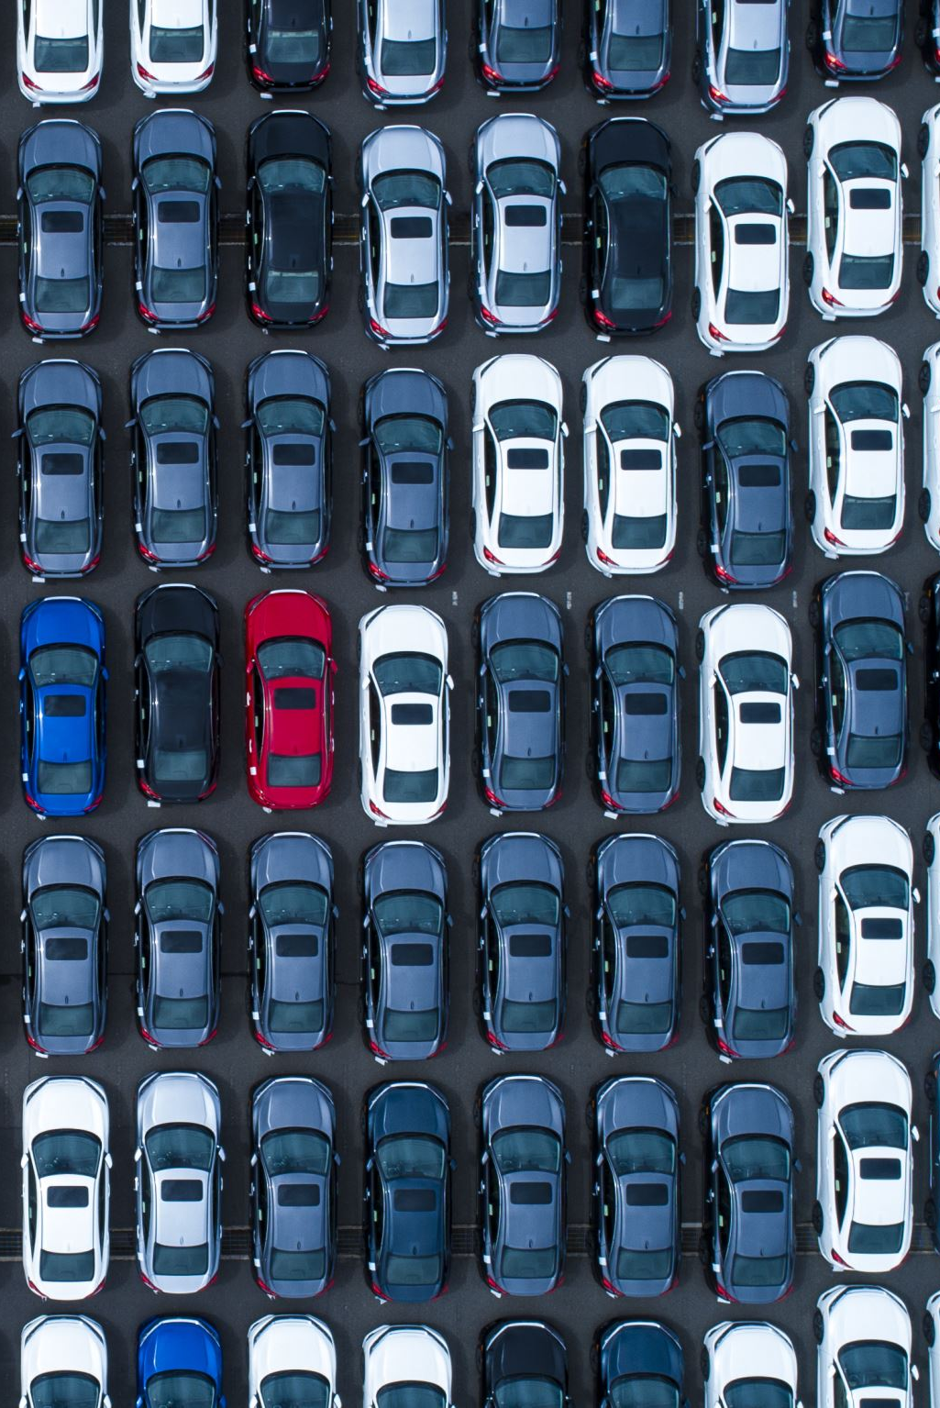
Sliding Window Technique
Purpose:
To further refine the search within the proposed Haar Cascade regions, allowing for precise localization of vehicles within those areas.
Description:
A fixed-size window slides across the proposed regions, systematically examining smaller sections to improve detection accuracy.
Step Size and Window Size:
The step size controls the overlap between each window, while the window size determines the scale of objects it can detect. In this project, a smaller step size was used to ensure thorough scanning of each region.

Slide 7
CNN for Feature Extraction
CNN Architecture:
The CNN model has multiple layers, including convolutional layers (to detect edges and shapes), pooling layers (to reduce the size of data and capture important features), and fully connected layers (to output the feature vector).
Feature Extraction:
Each window's visual data is passed through the CNN, which extracts a feature vector, representing the visual patterns in that region. The feature vector allows the SVM to differentiate between vehicles and non-vehicles.

Slide 8
SVM Classification
Purpose:
The SVM classifier uses the CNN-generated feature vector to classify each window as containing a vehicle or not.
Training Data:
The SVM classifier was trained using labeled examples of vehicle and non-vehicle regions, helping it learn to distinguish between the two categories accurately.
Classification:
Once trained, the SVM classifies each window by comparing it to the learned patterns, outputting a binary label (vehicle or non-vehicle) for each window in real-time.

Slide 9
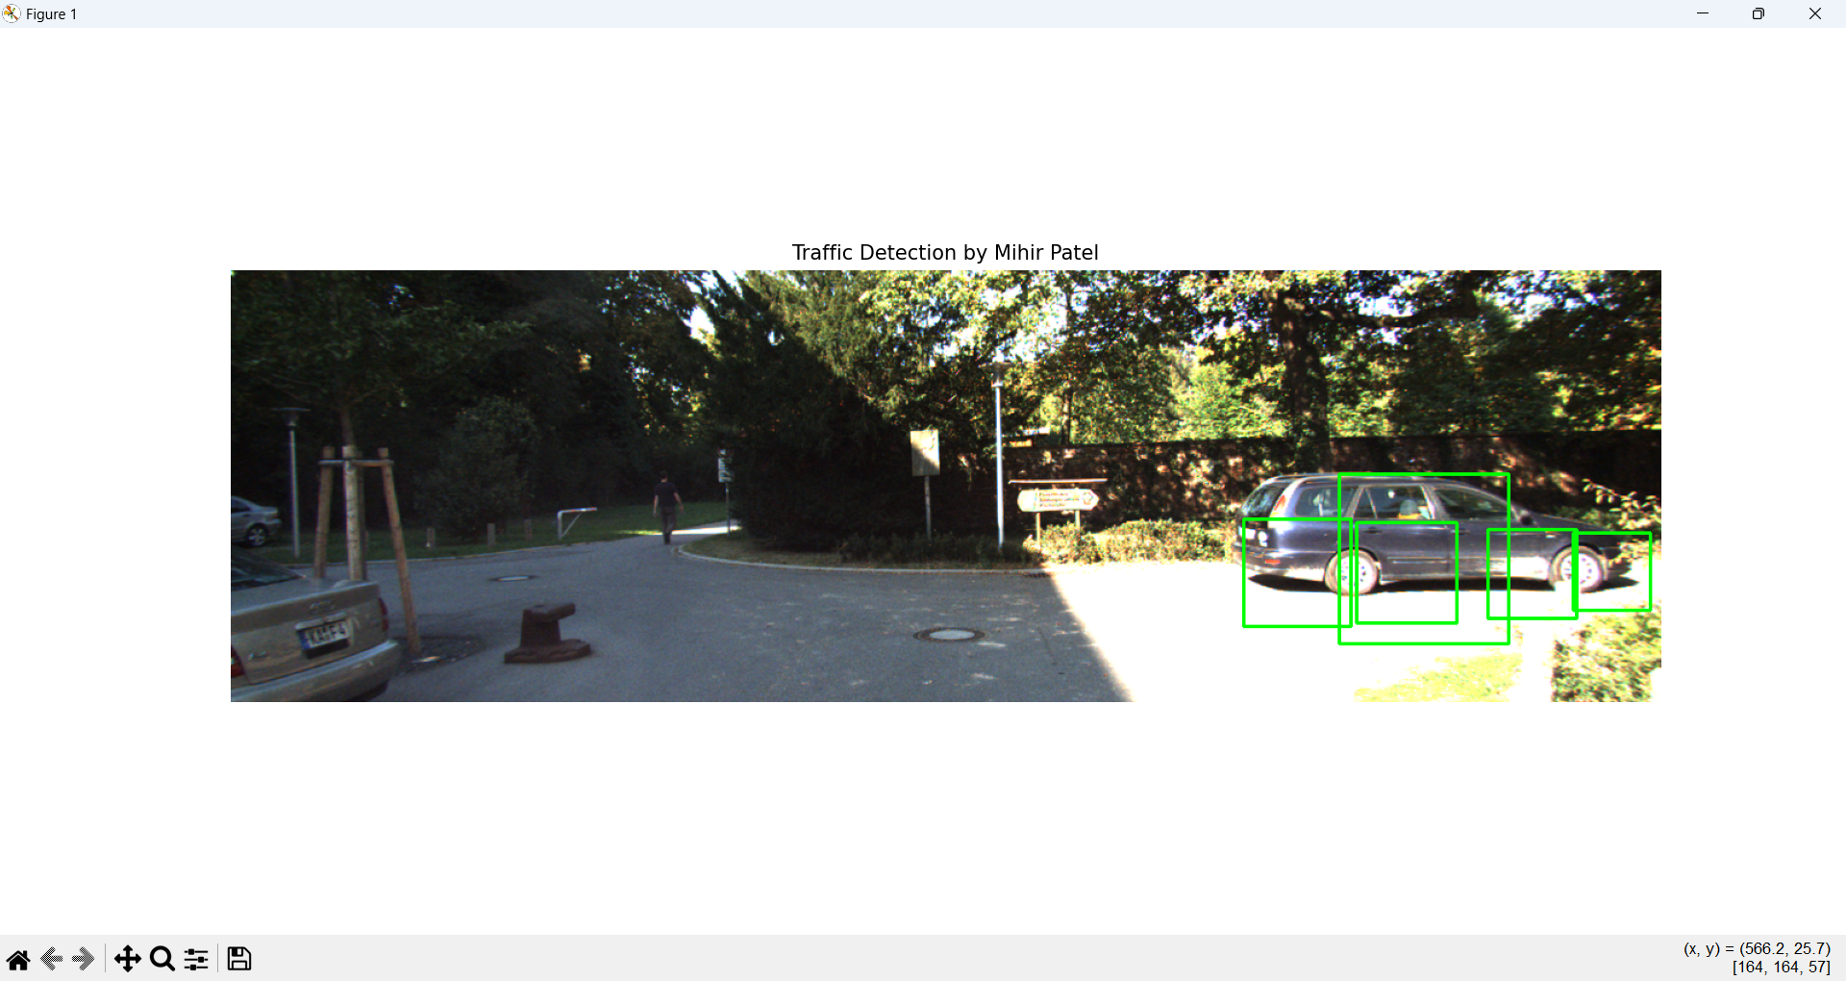
Results and Observations
bounding boxes around detected vehicles, illustrating the system's ability to identify vehicles accurately.

Slide 10
Conclusion and Future Work
Summary: This project demonstrated a vehicle detection system combining Haar Cascade, Sliding Window, CNN, and SVM.
Challenges: Low-light detection, overlapping vehicles, and processing speed.
Future Work: Explore YOLO/SSD for real-time detection, and integrate vehicle tracking and counting features.

