Slide 1
EXPLORATORY DATA ANALYSIS
Hotel Booking Analysis
Uncovering Booking Patterns & Cancellation Drivers Across City and Resort Hotels
Prepared by Shubham Prasad Kuiri
Data Analyst Intern | India
Dataset: 119,390 Bookings • 32 Features • City & Resort Hotels

Slide 2

PROBLEM STATEMENT
The Business Challenge
The hotel industry operates in a highly competitive environment where understanding booking patterns, customer behavior, and factors influencing cancellations is crucial for optimizing revenue and improving customer satisfaction. This project aims to analyze hotel booking data to identify key trends, patterns, and insights that can help hotel management make data-driven decisions.
This project involves conducting an Exploratory Data Analysis (EDA) on a dataset of hotel bookings. The dataset contains detailed information on each booking, including booking date, arrival date, length of stay, customer details, special requests, and more. The analysis will be performed using Python, leveraging libraries such as Pandas, Seaborn, and Matplotlib for data manipulation and visualization.
THE GOAL
After solving the questions, provide insights about the hotel performance, trends, and recommendations you want to give to the hotel.
Hotel Booking Analysis — EDA & Strategic Insights
2

Slide 3
INTRODUCTION
The Business Context & Project Objectives
119,390
More than 1 in 4 hotel bookings in this dataset ends in cancellation — a direct hit to revenue predictability and operational planning.
Total Booking Records
PROJECT OBJECTIVE
This project analyzes booking data from a City Hotel and a Resort Hotel to uncover the patterns behind cancellations, revenue (ADR), and customer behavior — turning raw reservation records into data-driven recommendations for hotel management.
32
WHAT THIS ANALYSIS DELIVERS
Features per Booking
Identify which booking attributes most influence cancellations
Understand seasonal demand, pricing (ADR) and revenue patterns
Profile customer segments — by type, origin, and loyalty
Translate findings into actionable recommendations for management
27.5%
Overall Cancellation Rate
3

Slide 4
DATA OVERVIEW
Dataset Snapshot & Preparation
DATA CLEANING & PREPARATION
87,377
2
Removed 32,013 duplicate records (119,390 → 87,377 unique bookings).
Imputed missing values: company/agent → 0, country → mode, children → median.
Converted reservation_status_date from text to proper datetime format.
Investigated outliers in ADR and guest counts (adults/children/babies).
Saved a cleaned dataset for reproducible, repeatable analysis.
Clean, unique records
(after removing duplicates)
Hotel types — City Hotel
& Resort Hotel
177
€106.35 avg
Countries represented
among guests
Average Daily Rate
(ADR) across bookings
WHY THIS DATA MATTERS
With 32 attributes spanning booking timing, pricing, guest profile and cancellation status, this dataset provides enough granularity to isolate exactly which factors drive cancellations and revenue.
4

Slide 5
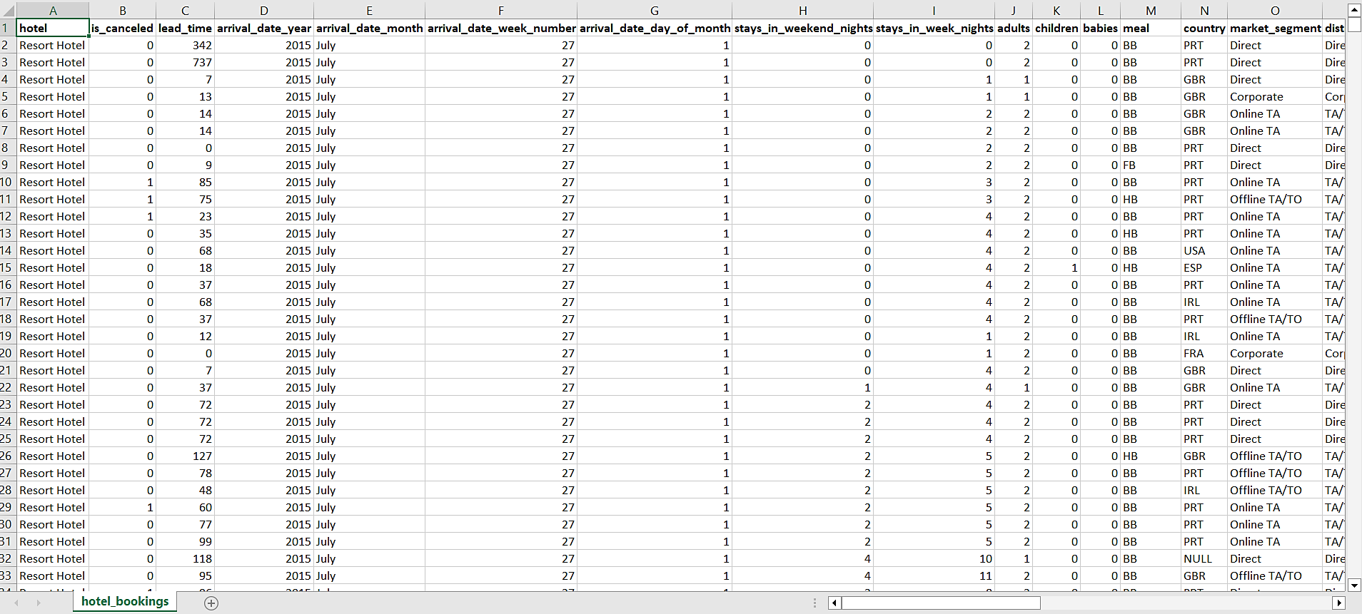
DATA OVERVIEW
Dataset Overview
Hotel_bookings.csv
5

Slide 6
METHODOLOGY
Analytical Approach & Tools
01
Data Cleaning
02
Descriptive Statistics
Handled missing values, fixed data types, removed duplicate records
Summary statistics for numerical & categorical variables
03
Data Visualization
04
Time Series Analysis
Distribution and relationship charts across key variables
Monthly booking, cancellation & ADR trends over time
05
Segmentation Analysis
06
Booking & Cancellation Analysis
Behavior by hotel type, customer type & booking channel
Linked booking attributes to cancellation & ADR outcomes
Tools: Python (pandas, numpy) for data wrangling • matplotlib & seaborn for visualization • Jupyter Notebook for reproducible analysis
6

Slide 7
SECTION ONE
Objective Questions
Ten data-driven answers on booking timing, pricing, and guest composition
Hotel Booking Analysis — EDA & Strategic Insights
7

Slide 8
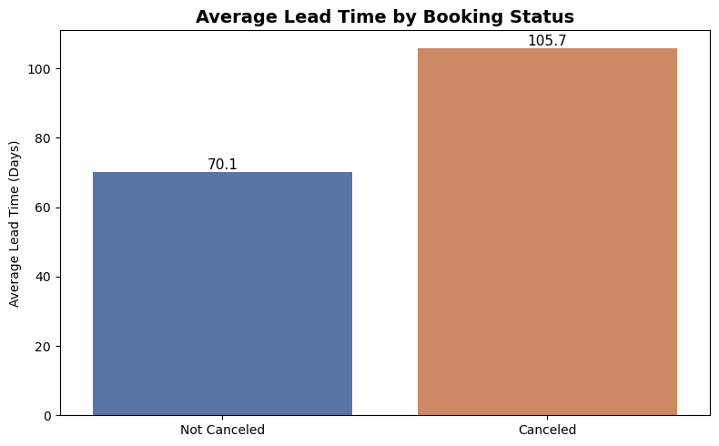
OBJECTIVE QUESTION 01
Average Lead Time: Canceled vs. Completed Bookings
Canceled bookings average 105.7 days lead time vs. just 70.1 days for completed stays.
Guests who eventually cancel book roughly 36 days earlier, on average, than those who check out.
Bookings made well in advance are noticeably more susceptible to cancellation.
Lead time is a strong early signal that can feed a cancellation-risk score.
8

Slide 9
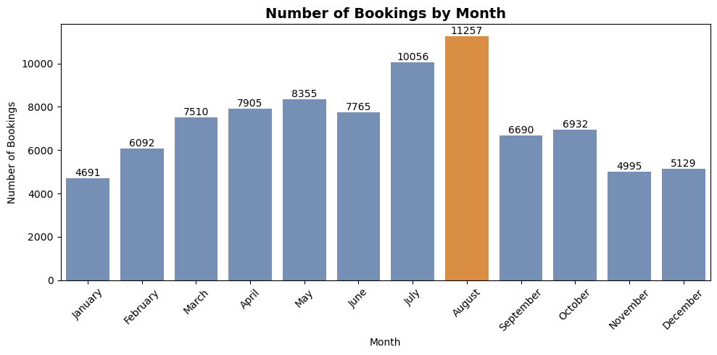
OBJECTIVE QUESTION 02
Which Month Sees the Highest Booking Volume?
August is the busiest month with 11,257 bookings.
Volume climbs steadily from January and peaks across July–August.
A sharp decline follows August, marking the end of peak season.
January is the quietest month (4,691 bookings) — the clearest off-season signal.
9

Slide 10
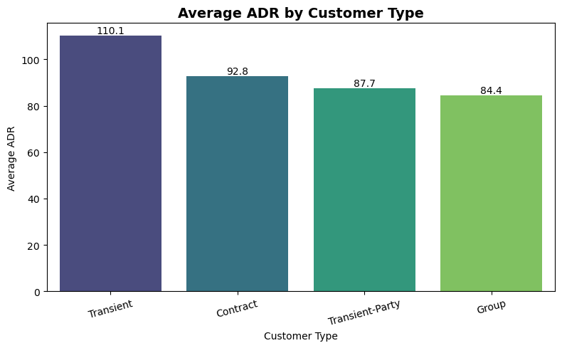
OBJECTIVE QUESTION 03
ADR Distribution Across Customer Types
Transient (individual) customers generate the highest ADR at 110.1 — the most valuable segment.
Contract (92.8), Transient-Party (87.7) and Group (84.4) follow, in that order.
Individual travelers consistently pay more per night than group or contract bookings.
Group bookings show the lowest ADR, consistent with bulk-rate discounting.
10

Slide 11
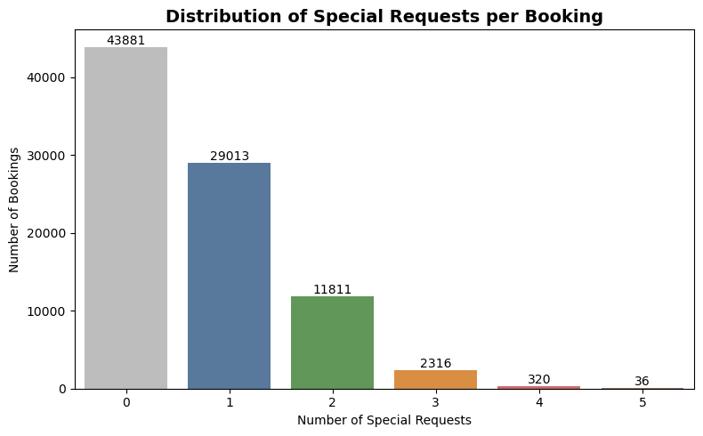
OBJECTIVE QUESTION 04
Special Requests: Volume & Average per Booking
43,496 bookings included at least one special request; 43,881 had none — almost an even split.
Guests make 0.70 special requests per booking on average.
Of those who do ask, most request just one thing (29,013 bookings).
Requests of four or five are rare — heavy customization is uncommon.
11

Slide 12
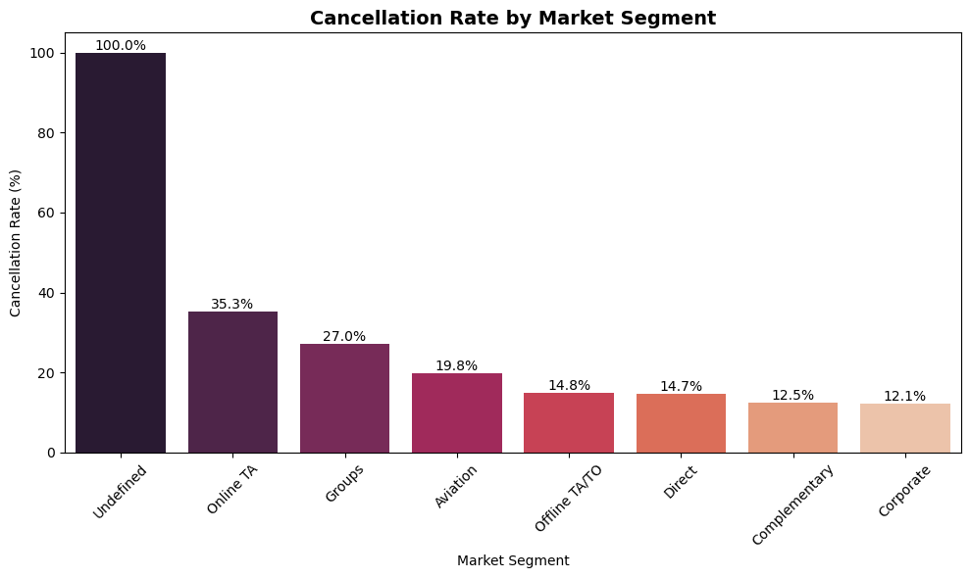
OBJECTIVE QUESTION 05
Cancellation Rate by Market Segment
Online TA has the highest cancellation rate among major segments, at 35.3%.
Groups (27.0%) and Aviation (19.8%) also run well above average.
Corporate (12.1%) and Complementary (12.5%) bookings are the most reliable.
Online TA combines the largest volume with the highest risk — the top priority for intervention.
12

Slide 13
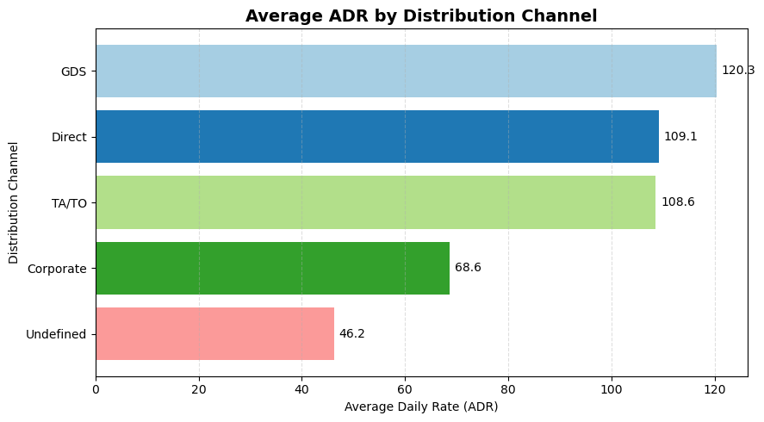
OBJECTIVE QUESTION 06
Which Distribution Channel Earns the Highest ADR?
GDS delivers the highest ADR at 120.3 — the most profitable channel per booking.
Direct (109.1) and TA/TO (108.6) channels also perform strongly.
Corporate bookings run a noticeably lower ADR (68.6), reflecting negotiated rates.
GDS and Direct channels merit continued investment for revenue growth.
13

Slide 14
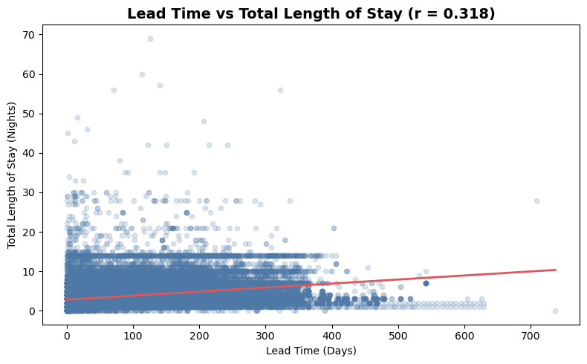
OBJECTIVE QUESTION 07
Correlation Between Lead Time and Length of Stay
Lead time and total length of stay show only a weak positive correlation (r = 0.318).
Guests who book further ahead tend to stay marginally longer, not substantially longer.
Most stays cluster within 0–15 nights regardless of how early the booking was made.
Lead time alone is not a reliable predictor of stay duration.
14

Slide 15
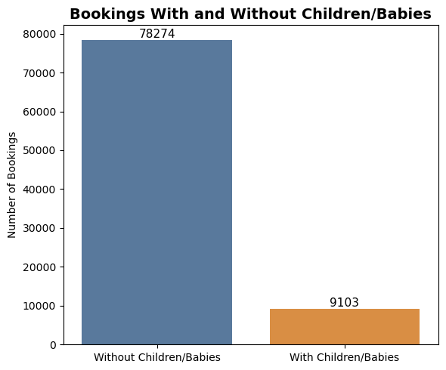
OBJECTIVE QUESTION 08
Bookings That Include Children and/or Babies
89.6% of bookings (78,274) have no children or babies.
Only 10.4% (9,103) are family bookings.
Couples, solo travelers and business guests make up the core customer base.
Family travel is a smaller but meaningful segment worth targeted packages.
15

Slide 16
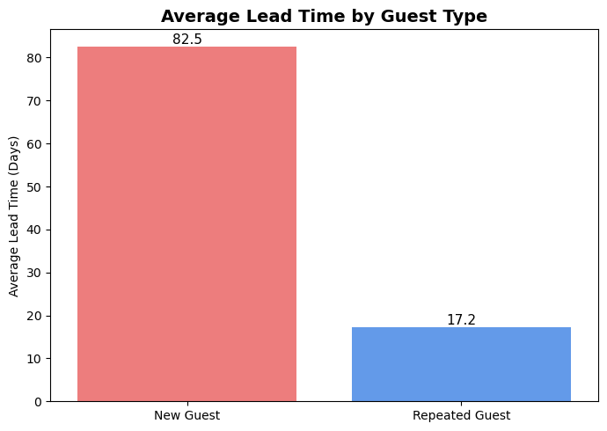
OBJECTIVE QUESTION 09
Lead Time: Repeated Guests vs. New Guests
New guests book 82.5 days ahead on average — repeated guests book just 17.2 days out.
Repeat guests plan far closer to arrival, reflecting familiarity and confidence in the hotel.
New customers appear to need more advance planning time before committing.
A loyalty program could shift more first-time guests toward repeat, shorter-lead bookings.
16

Slide 17
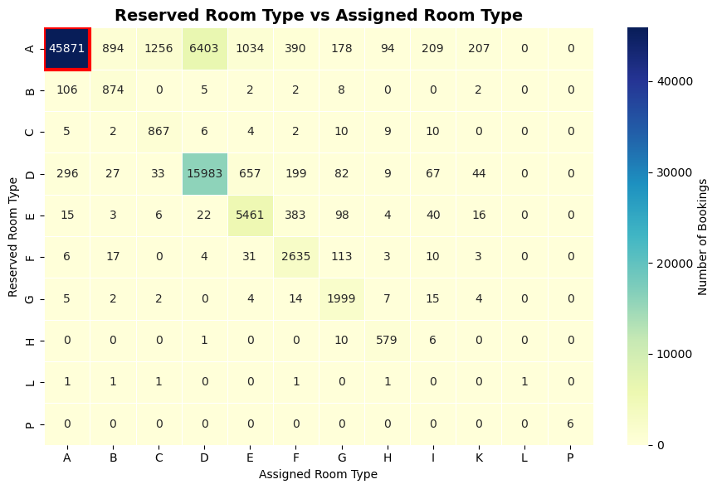
OBJECTIVE QUESTION 10
Most Common Reserved vs. Assigned Room Type
Room Type A → Room Type A is the most common allocation, with 45,871 bookings.
Most bookings sit along the diagonal — guests generally receive what they reserved.
The main exception is A → D (6,403 bookings), suggesting frequent upgrades or reassignments.
Other reassignments are rare, pointing to efficient room inventory management.
17

Slide 18
SECTION TWO
Subjective Questions
Deeper behavioral stories behind cancellations and guest origin
Hotel Booking Analysis — EDA & Strategic Insights

Slide 19
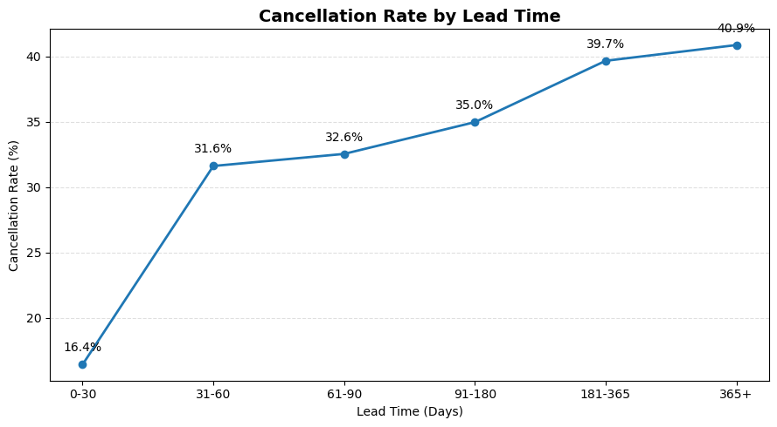
SUBJECTIVE QUESTION 01
How Does Lead Time Affect Cancellation Likelihood?
Cancellation rate climbs steadily with lead time: 16.4% (0–30 days) to 40.9% (365+ days).
The rate nearly doubles once bookings pass the 31–60-day mark (31.6%).
Bookings made far in advance carry meaningfully higher cancellation risk.
Lead time is a strong, actionable input for risk-based booking and deposit policies.
19

Slide 20
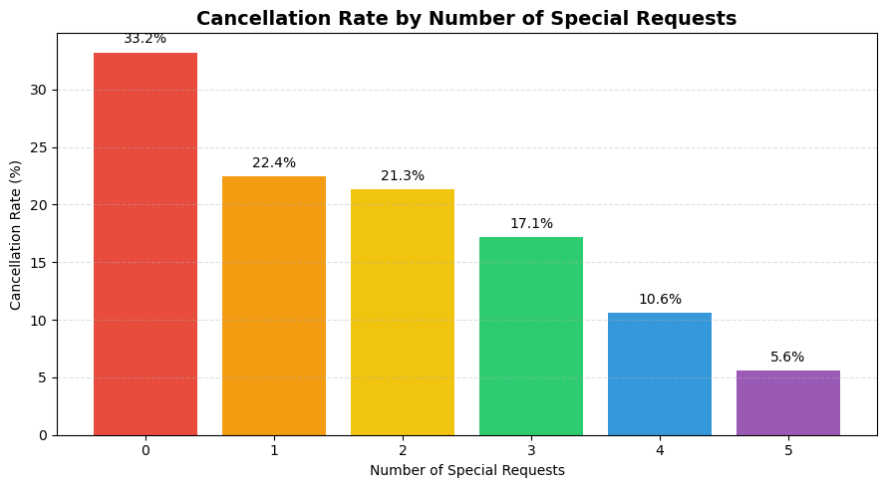
SUBJECTIVE QUESTION 02
What Impact Do Special Requests Have on Cancellations?
Bookings with no special requests have the highest cancellation rate (33.2%).
Cancellation rate falls consistently as the number of requests rises.
Guests with 5 requests cancel least often (5.6%) — the most reliable group.
Encouraging guests to specify preferences appears to correlate with stronger commitment.
20

Slide 21
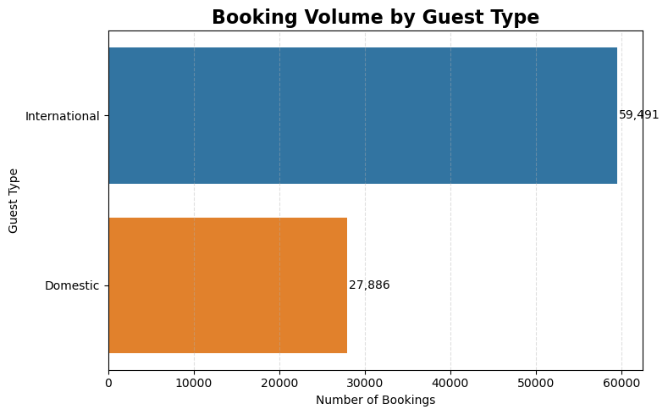
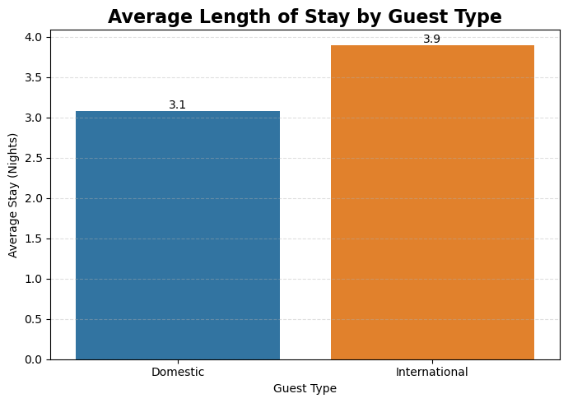
SUBJECTIVE QUESTION 03
Booking Behavior: International vs. Domestic Guests
International guests generate 59,491 bookings vs. 27,886 domestic — more than double
International guests also stay longer on average (3.9 vs. 3.1 nights)
The hotel has strong international appeal, while domestic remains a solid base segment
Longer international stays translate into higher occupancy and revenue per booking
21

Slide 22
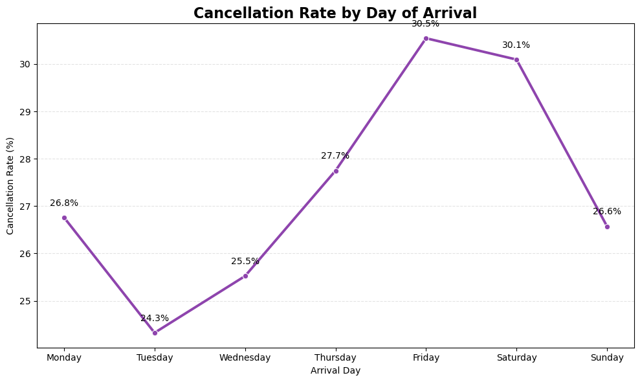
SUBJECTIVE QUESTION 04
What Is the Impact of Day-of-Week on Cancellations?
Friday (30.5%) and Saturday (30.1%) see the highest cancellation rates.
Tuesday is the most reliable day to arrive (24.3%), with Wednesday close behind (25.5%).
Cancellation risk climbs steadily from Tuesday through Friday, then eases toward Sunday (26.6%).
Weekend-adjacent arrivals consistently carry higher cancellation risk than midweek ones.
22

Slide 23
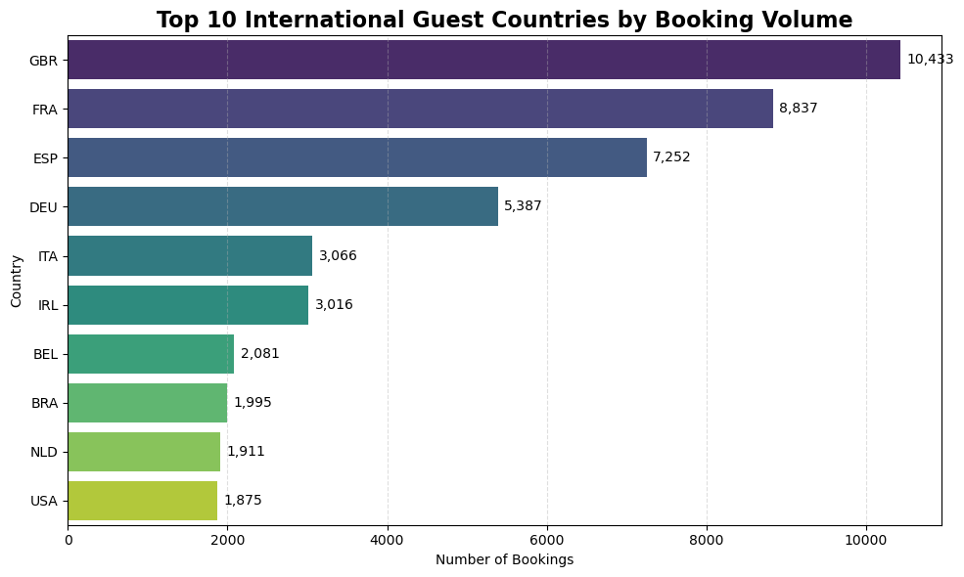
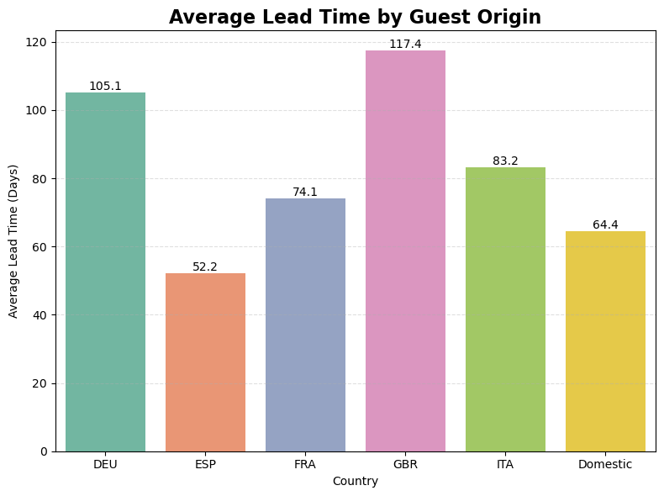
SUBJECTIVE QUESTION 05
Top International Markets & How They Compare
Great Britain (10,433), France (8,837) and Spain (7,252) are the top three international markets.
European countries dominate the list of international guest origins.
GBR and Germany book furthest ahead (117 and 105 days); Spain books latest (52 days).
Domestic guests (64 days) sit mid-range — later than most top international markets except Spain.
23

Slide 24
STRATEGIC RECOMMENDATIONS · 1 OF 3
Reduce Cancellations at the Source
1
Tiered deposit policy by lead time
2
Prioritize Online TA cancellation management
Canceled bookings average 105.7 days of lead time vs. 70.1 for completions. Require partial deposits on bookings placed 60+ days out to lock in early commitments.
Online TA drives the largest booking volume and the highest cancellation rate (35.3%). Even small improvements here have outsized revenue impact.
3
Prompt guests for special requests at booking
4
Review the Non-Refund policy design
Cancellation rate falls from 33.2% (no requests) to 5.6% (5 requests). A simple preference prompt at checkout can nudge commitment upward.
Non-Refund bookings still cancel 94.7% of the time. Reassess whether this policy is achieving its intended lock-in effect or needs redesign.
24

Slide 25
STRATEGIC RECOMMENDATIONS · 2 OF 3
Optimize Revenue & Pricing
1
Extend the seasonal pricing window
2
Grow GDS and Direct channel share
ADR peaks in August (150.9) and troughs in November (72.8). Consider stretching premium pricing slightly earlier/later into the shoulder season.
GDS (120.3 ADR) and Direct (109.1) outperform Corporate (68.6). Shifting mix toward these channels improves per-booking revenue and cuts commission costs.
3
Targeted retention for City Hotel bookings
4
Premium packages for Transient guests
City Hotels cancel at 30.0% vs. 23.5% for Resort Hotels, while carrying the larger revenue share — the highest-leverage property type for retention efforts.
Transient customers already pay the highest ADR (110.1). Curated upsells (room upgrades, add-ons) can extend this without discounting group/contract rates.
25

Slide 26
STRATEGIC RECOMMENDATIONS · 3 OF 3
Grow Underserved Guest Segments
1
Family-friendly packages
2
Loyalty program for new-to-repeat conversion
Family bookings (children/babies) are just 10.4% of volume. Bundled family packages could grow this segment meaningfully with limited cannibalization risk.
New guests book 82.5 days out vs. 17.2 for repeat guests. A loyalty program could shorten planning cycles and build repeat, lower-risk demand.
3
Last-minute domestic promotions
4
Expand beyond the top-3 international markets
Domestic guests already book later (64 days) than most top international markets. Flash/last-minute offers could fill gaps closer to arrival dates.
GBR, France and Spain dominate international demand. Targeted campaigns in Italy, Ireland and adjacent markets can diversify the guest base.
26

Slide 27
CONCLUSION
What the Data Tells Hotel Management
Cancellations are predictable: lead time, deposit type, market segment and special-request count all move the cancellation rate in consistent, actionable ways.
Revenue is seasonal and channel-dependent: ADR peaks in August and GDS/Direct channels consistently out-earn Corporate and TA/TO.
Guests fall into distinct behavioral groups: new vs. repeat, domestic vs. international, transient vs. group — each with a different planning horizon and value profile.
These are not just numbers — they are a roadmap. Acting on lead time, channel mix, and guest segmentation can meaningfully reduce cancellations and lift revenue without changing a single room.
Hotel Booking Analysis — EDA & Strategic Insights
27

Slide 28
ACKNOWLEDGEMENTS
References & Sources
DATA SOURCE
hotel_bookings.csv — 119,390 records, 32 features, covering a City Hotel and a Resort Hotel
TOOLS & LIBRARIES
Python — pandas & numpy for data cleaning and aggregation
matplotlib & seaborn for all visualizations in this analysis
Jupyter Notebook for exploratory analysis and documentation
PREPARED BY
Shubham Prasad Kuiri — Data Analyst Intern
Hotel Booking Analysis — EDA & Strategic Insights
28

