Slide 1

AN EXPERIMENTATION & STATISTICAL ANALYSIS REPORT
Twitter Overspending A/B Test
Does impression-based pricing reduce advertiser overspend?
Prepared by Shubham Prasad Kuiri
Dataset Twitter A_B testing.csv · 15,474 campaigns
Data Science & Statistics Project

Slide 2
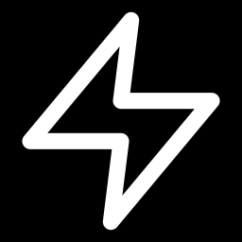
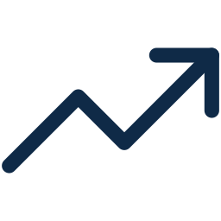
THE CONTEXT
A billing delay is quietly costing advertisers money
Twitter bills advertisers for ad clicks — but there is a reporting delay between when an ad is served and when the click is recorded. That lag means advertisers can be charged for clicks that land after their budget is already spent.
Twitter's Fix
Instead of billing per click, charge advertisers for ad impressions — removing the reporting lag that causes overspend in the first place.
A SIMPLE EXAMPLE OF THE PROBLEM
$10
$20
To test it, Twitter ran a one-week randomized A/B experiment splitting advertisers into two arms:
budget remaining
billed in clicks
CONTROL: Click-based
clicks keep landing after this point
$10 of that is pure overspend
TREATMENT: Impression-based
TWITTER AD BILLING A/B TEST
02

Slide 3



PROJECT AIM
What this analysis set out to answer
Ten questions from the product team, distilled into three driving objectives.
01
02
03
Does it reduce overspend?
Does it work for everyone?
Are there side effects?
Quantify whether impression-based billing lowers the incidence and magnitude of overspend versus the click-based model.
Test whether the effect is uniform across small, medium, and large advertisers — or concentrated in certain segments.
Check whether advertiser behavior (budget-setting) changed too, and be candid about what the data can and can't prove.
TWITTER AD BILLING A/B TEST
03

Slide 4






HOW WE TESTED IT
A clean, randomized, one-week experiment
CONTROL — Click-Based Billing
TREATMENT — Impression-Based Billing
7,733 campaigns (49.97% of total)
Advertisers billed per click — subject to reporting-lag overspend.
7,741 campaigns (50.03% of total)
Advertisers billed per impression — the new, latency-free model.
RANDOMIZATION UNIT
DURATION
PRIMARY OUTCOME
BALANCE CHECK
Individual campaign
One week
Spend exceeding budget
Size mix confirmed even
TWITTER AD BILLING A/B TEST
04

Slide 5



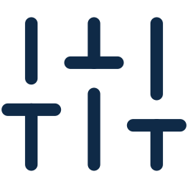
THE DATASET
15,474 campaigns, clean and well-balanced
15,474
4
0
49.97 / 50.03
Total campaigns
Fields captured
Missing values / duplicates
% Control / Treatment split
FIELDS IN THE DATASET
COMPANY-SIZE MIX IS EVEN ACROSS ARMS
treatment
boolean
New (impression) vs. old (click) product
company_size
categorical
small / medium / large advertiser
campaign_budget
float ($)
Budget set by the advertiser
campaign_spend
float ($)
Actual amount spent
TWITTER AD BILLING A/B TEST
05

Slide 6

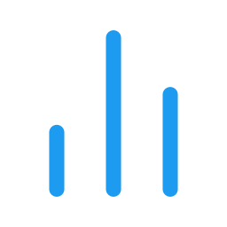




HOW WE ANALYZED IT
Built for skewed, real-world ad-spend data
Campaign spend and budget are heavily right-skewed — a handful of huge advertisers dominate the raw averages. Every methodology choice below accounts for that.
Log-scale visuals
Median alongside mean
Rank-based tests
Distributions plotted on a log scale so a few extreme campaigns don't flatten the rest.
The median better reflects the "typical" campaign under heavy skew.
Mann-Whitney U, Kruskal-Wallis and Levene's test are outlier-robust and assumption-free.
Parametric cross-checks
Signed vs. actual overspend
Interaction modeling
Welch's t-test and two-proportion z-tests run alongside as a sensitivity check.
Underspend (negative deviation) is kept separate from true overspend so averages aren't diluted.
A treatment × company-size logistic model tests heterogeneity directly, not by eyeballing subgroup p-values.
TWITTER AD BILLING A/B TEST
06

Slide 7
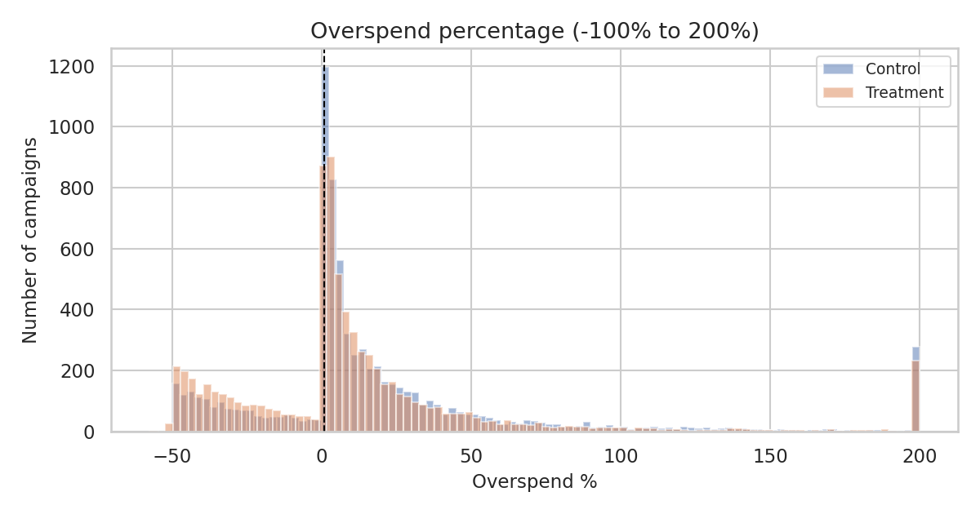
EXPLORATORY ANALYSIS
Confirming the skew before trusting any average
WHAT THIS TELLS US
Both groups are dominated by a long right tail of high-overspend campaigns — raw means alone would be misleading.
The dashed line marks the 1% overspend threshold used as the headline metric in Q1.
Extreme values are real advertiser behavior, not data errors — confirmed during data-quality checks (Section 3).
Overspend % distribution — both arms are right-skewed, and treatment (orange) is visibly shifted left toward lower overspend.
TWITTER AD BILLING A/B TEST
07

Slide 8
PART TWO
What the Data Shows
Ten questions, answered with the numbers behind them.
08

Slide 9

QUESTION 1
The 1%-overspend rate dropped significantly
"How many campaigns overspent by more than 1% of budget — in control vs. treatment?"
−7.0 pts
5,716 / 7,733 control campaigns
5,180 / 7,741 treatment campaigns
percentage-point reduction in overspend incidence
Statistically decisive
Two-proportion z-test: z = -9.54, p < 0.001. The reduction cannot be explained by random chance at any conventional threshold.
TWITTER AD BILLING A/B TEST
09

Slide 10
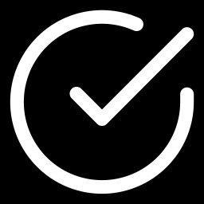
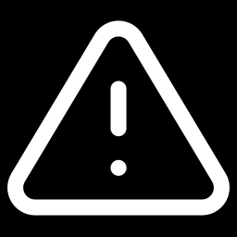
QUESTION 2
The effect is real — but not identical across sizes
"Was treatment effective at reducing overspend, and did that vary by company size?"
SIGNIFICANCE BY SEGMENT
Small
p < 0.001 · −8.0 pts
Large
p < 0.001 · −7.9 pts
Medium
p = 0.52 (simple test)
The interaction model confirms medium companies' treatment effect genuinely differs from large companies' (p = 0.023) — a real signal, not just a small sample.
Overspend incidence (>1% threshold) by company size
TWITTER AD BILLING A/B TEST
10

Slide 11

QUESTION 3
Treatment advertisers have lower median budgets — but why is unproven
"Are treatment advertisers entering lower budgets because they're wary of the new product?"
MEDIAN CAMPAIGN BUDGET
What the data can — and can't — prove
$65
$39
Confirmed: budgets genuinely differ between arms — this is a robust, statistically significant pattern, consistent with the PM's concern.
Not confirmed: the dataset has no survey, sentiment, or motivation data — so "wariness" as the cause is a plausible story, not a demonstrated fact.
Control
Treatment
Mann-Whitney U: p < 0.001
Welch t-test (log): p < 0.001
41% lower
Recommendation: validate with an advertiser survey before attributing the gap to caution.
TWITTER AD BILLING A/B TEST
11

Slide 12
QUESTION 4
Mean vs. median tell a consistent — and more honest — story
"What is the average overspend percentage for campaigns in each group?"
WHY THE GAP MATTERS
The mean is much higher than the median in both arms — a signal that a small number of large-overspend campaigns pull the average up. The median is the fairer "typical campaign" number.
Both views agree
Mann-Whitney U on the full distribution: p < 0.001 — treatment is meaningfully lower whichever summary statistic you trust.
TWITTER AD BILLING A/B TEST
12

Slide 13
QUESTIONS 6 & 9
Small advertisers overspend the most — in both arms
"What demographic factors correlate with overspend? Does company size matter within each arm?"
KRUSKAL-WALLIS TEST
Control: H = 438.3, p < 0.001
Treatment: H = 270.4, p < 0.001
Company size significantly affects overspend within both arms. Small companies overspend most consistently — likely reflecting less sophisticated bidding/pacing infrastructure.
Note: this is distinct from Q2 — it tests size vs. overspend within a model, not whether the treatment effect itself varies by size.
Mean overspend % by company size and group
TWITTER AD BILLING A/B TEST
13

Slide 14
QUESTION 8
Treatment campaigns spend closer to — not past — their budget
"Is there a significant difference in the percentage of budget spent between groups?"
125.3% → 117.6%
average share of budget spent
Mann-Whitney U: p < 0.001
Welch t-test (log-ratio): p < 0.001
Both robust and parametric tests agree — the median matters most here since a small budget can create an extreme ratio for a single campaign.
100% = full budget spent, no overspend, no underspend
TWITTER AD BILLING A/B TEST
14

Slide 15
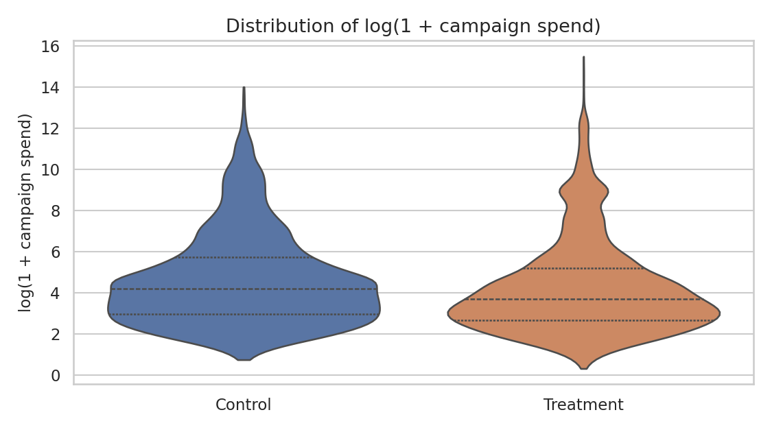
QUESTION 10
A striking variance gap that doesn't quite clear significance
"Is the variance in campaign spend significantly different between control and treatment?"
6.33×
Levene's test
stat = 3.33
p = 0.068
higher raw variance
in treatment
Not significant at the 5% level
p = 0.068 is close to the 0.05 threshold but doesn't clear it. A descriptively large variance gap should not be reported as a confirmed statistical effect — it's likely driven by a handful of extreme accounts, echoing the Q3 budget-outlier pattern.
log(1+spend) distribution & spread by group
TWITTER AD BILLING A/B TEST
15

Slide 16
HONEST ABOUT GAPS
Three questions this dataset can't answer
Rather than approximate or fabricate figures, these are flagged explicitly — with what would be needed to close the gap.
Q5
Q6
Q5
Q6
Q7
Click-Through Rate
Industry Breakdown
Engagement Metrics
Q7
MISSING
MISSING
MISSING
No impression or click counts in the data
No industry / vertical field — only company size
No likes, retweets, or replies in the data
WOULD NEED
WOULD NEED
WOULD NEED
Join ad-serving logs with per-campaign impression & click counts
Add an industry field to the advertiser or campaign table
Join tweet-level engagement data linked to each campaign
TWITTER AD BILLING A/B TEST
16

Slide 17


TURNING FINDINGS INTO ACTION
Strategic recommendations
1
2
3
Roll out in phases
Treat medium as an open question
Validate the budget hypothesis
Prioritize small and large advertisers first, where the overspend reduction is largest and most robust.
The interaction model shows a real, distinct effect — not a null result. Fund a dedicated follow-up before forcing rollout.
Survey treatment advertisers directly rather than inferring "wariness" from budget numbers alone.
4
5
6
Track medians, not just means
Set per-segment KPI targets
Close the data gaps
A handful of extreme accounts repeatedly distort mean-based metrics — set dashboards accordingly.
Company size independently affects overspend and treatment effect — one blended target hides both.
Join in impression/click, engagement, and industry data so CTR and engagement can be answered next.
TWITTER AD BILLING A/B TEST
17

Slide 18
BOTTOM LINE
Impression-based billing works — and the data tells us exactly where to push it first.
−7.0 pts
2 of 3
7.7 pts
overspend-incidence reduction, overall
company sizes show confirmed, significant gains
lower average % of budget spent
Recommended decision: approve a phased, segment-aware rollout — paired with the monitoring and data-collection steps outlined above.
18

Slide 19

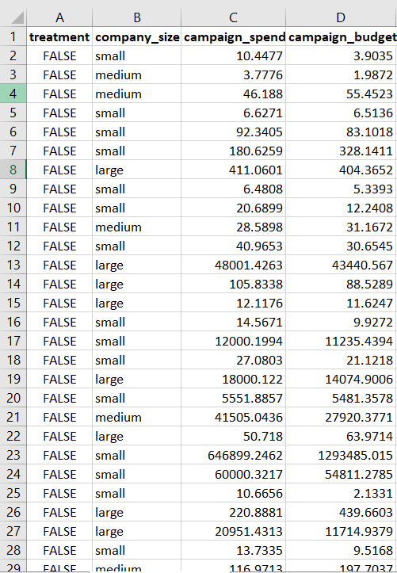
SOURCE
Dataset Overview
Twitter A/B testing.csv
19

Slide 20
SOURCES & TOOLS
References
Dataset
Twitter A/B testing.csv — provided project dataset, 15,474 campaigns
Task brief
Twitter A/B Testing Task — experiment context and ten guiding questions
Analysis notebook
Twitter_AB_Testing.ipynb
Tools
Python — pandas, numpy, scipy, statsmodels, seaborn, matplotlib
Statistical methods
Two-proportion z-test, Mann-Whitney U, Kruskal-Wallis, Levene's test, Welch's t-test, logistic interaction model
Prepared by Shubham Prasad Kuiri · Data Science & Statistics
19

