Slide 1
Project: Predict Binding Behaviour for Transcription Factors for given DNA Sequences
Marius Theune
Henrik Horst

Slide 2
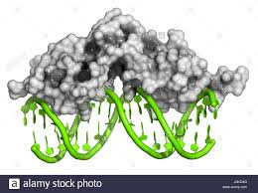
Transcriptions Factors bind to DNA to enable Transcription (i.e. specific gen can be read and cell starts to produce the encoded Protein)

Slide 3
Research Question
Can we predict just from the DNA sequence where a specific Transcription Factor(TF) will bind (Classification task).
Can we predict the strength of the binding instead of just binding or no binding (Regression task).

Slide 4
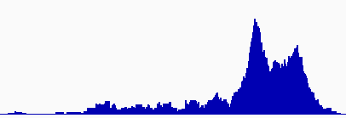
Data
Input: DNA sequence from the plant model organism Arabidopsis thaliana
Sequence of 129.000.000 letters
Output: CHiP sequencing experiment showing the binding of TFs at each position
integer value from 0 (no binding) to 500 (very strong binding) for each position
binding
No binding
…ATGATCATCAGAGT…
NN

Slide 5
Data preprocessing
Input: DNA sequence
DNA as string of letters encoding for the 4 different bases
→ One-Hot Encoding:
bases encoded as a unique vectors of 0 and 1
[[1,0,0,0] [0,1,0,0]
ACTGN → [0,0,0,1] [0,0,1,0] [0,0,0,0]]

Slide 6
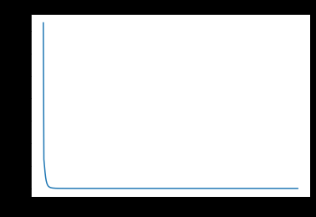
Data Distribution
The data is highly imbalanced:
Huge regions with no binding and just a few binding cases

Slide 7
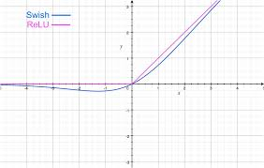
Parts of the model not covered in our course
Conv1D:
Same as Conv2D just over a sequence. So the filter size is one dimensional
Swish Activation Function:
New Function proposed by Google Ai:
F(x)= x * sigmoid(b*x)
SpartialDropout layer
Dropout that resets whole convolution filters

Slide 8
Classification Approach
For every label greater than 50 assign class 1 (binding)
For every label smaller than 30 assign class 0 (no binding)
For simplicity ignore the sequences with values between

Slide 9
Classification Approach 2
Use all values from class 1 and sample the same amount of data from class 0 the balance the data.
Take 10% from the sequence end for validation
Test data is from another chromosom

Slide 10
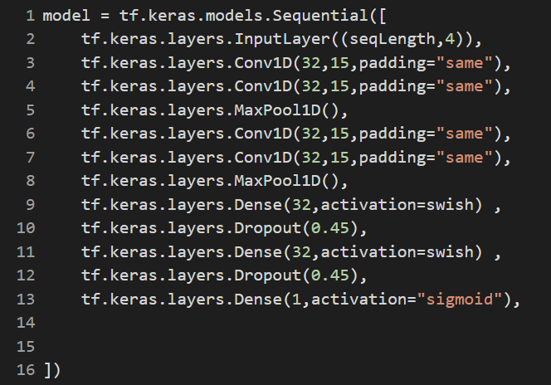
Classification Approach 3
Model:

Slide 11
Regression Approach
Taking Chip-Experiment data as they are and normalize them
Data split into 20% Validation/Test set and 80% training set
Taking less samples from data accruing often (no binding) and all data from rare (binding) cases

Slide 12
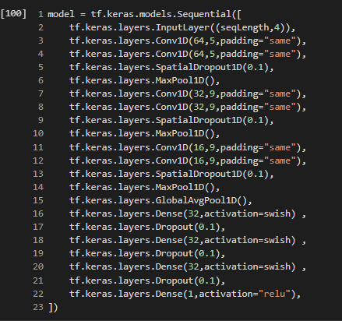
Regression Approach 2
Model:

Slide 13
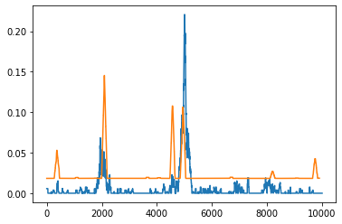
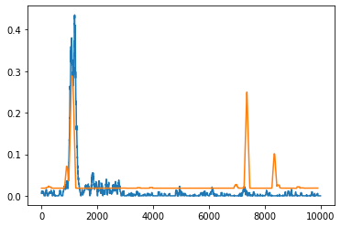
Regression Approach
Results:
Strong binding positions are often predicted correctly
Background is not 0
Some positions raise wrong positive predictions

Slide 14
Conclusion
Data preprocessing is most important
Difficult to choose the right distribution
No human level performance → no estimate for Bayesian error
Known that binding is not just dependent on DNA-sequence → more input needed

