Slide 1

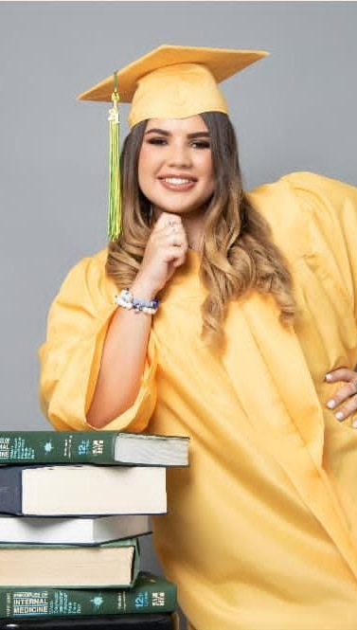

Coral S. Schmidt Montilla
Hello, as you can see my name is Coral Schmidt and I’m from Ponce, Puerto Rico. I like to draw, take pictures and play video games. My intended major is Computer Science. I am a member of Star Wars club as well as Hack PSU.

