Slide 1
Ride-Share Matching Algorithms
Comparing Optimal, Stable, and Heuristic Methods
Michael Lamberth & Timothy Chow

Slide 2
Problem Overview
Match drivers to riders using weighted bipartite matching.
Goal: maximize score while considering distance.

Slide 3
Algorithms Used
Hungarian (optimal)
Greedy (fast)
Gale–Shapley (stable)
Genetic Algorithm (heuristic)

Slide 4
Research Questions
Runtime scaling?
How close to optimal?
Stability vs score?
Does GA outperform greedy?

Slide 5
Experiment Setup
Python implementation
Random 2D instances
Sizes: 50, 100, 150
Multiple trials

Slide 6
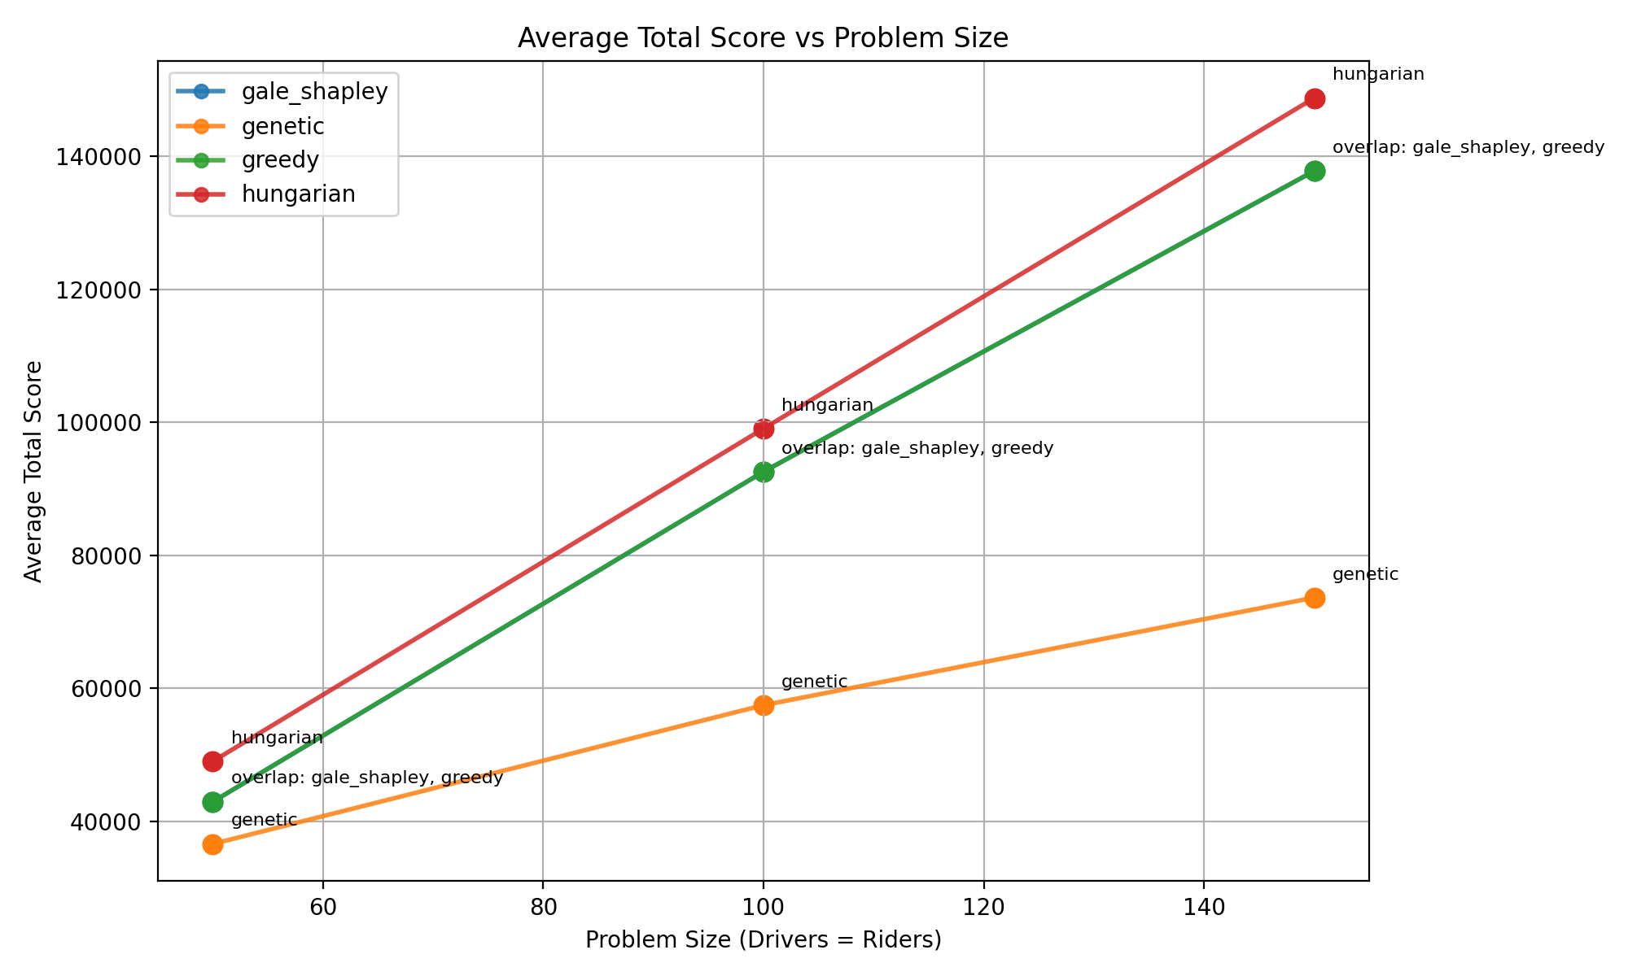
Scoring Model
Score = max(0, 1000 - distance)
Encourages short pickup distance

Slide 7
Metrics
Runtime
Total score
Matches
Avg distance
Quality vs Hungarian
Stability violations

Slide 8
Results Summary
Hungarian: best score, slow
Greedy: fastest
Gale–Shapley: stable
Genetic: mixed performance

Slide 9
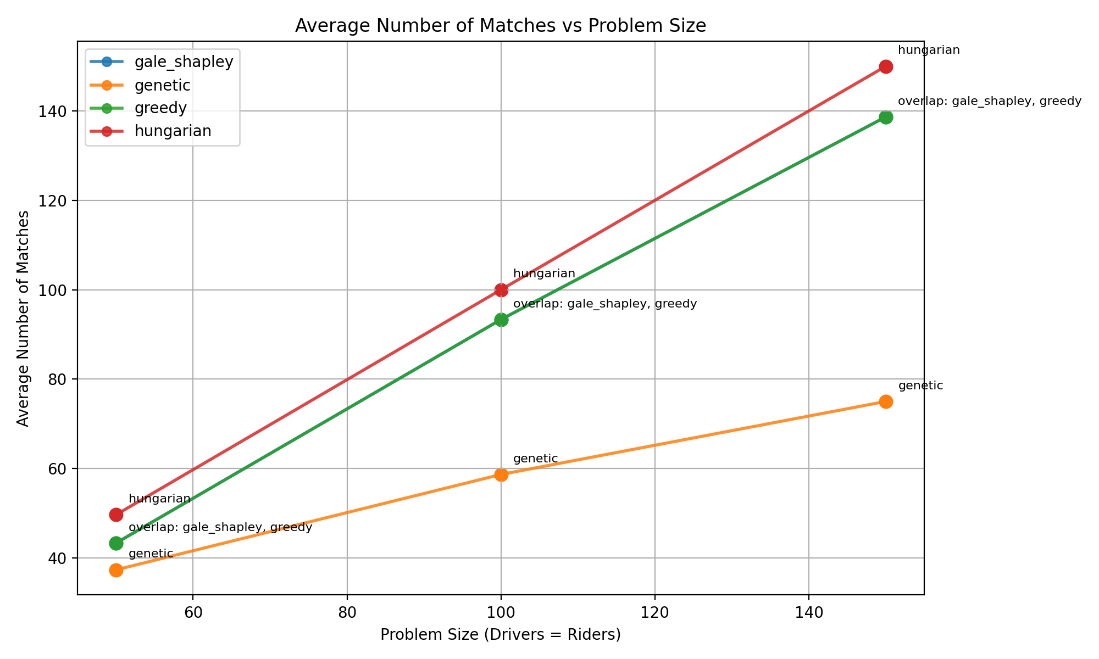
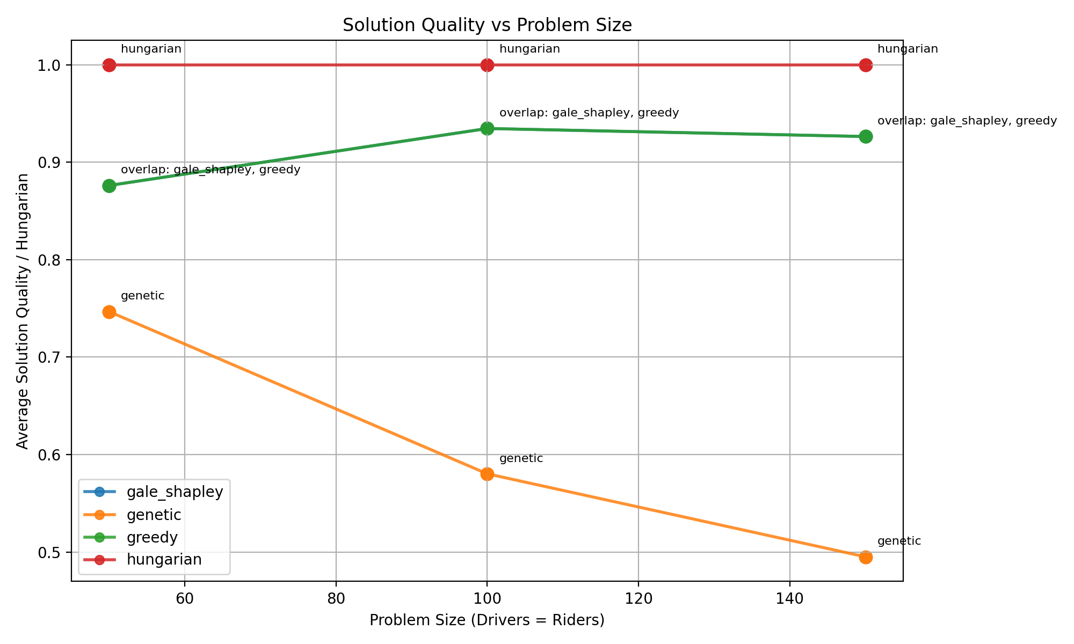
Matches vs quality
Hungarian:
High number of matches + highest total score (optimal)
Greedy: High match count, slightly lower quality
Performance gap grows with size
Gale–Shapley: Fewer or constrained matches
Prioritizes stability over total score
Genetic Algorithm: Match count like greedy
Quality varies depending on evolution

Slide 10
Key Tradeoffs
Optimality vs speed
Stability vs score
Heuristic flexibility vs consistency

Slide 11
Limitations
Synthetic data
Limited tuning
No fixed seeds
Moderate sizes only

Slide 12
Future Work
Tune GA
Use real data
Hybrid algorithms
Larger experiments

Slide 13
Conclusion
Different algorithms excel in different goals.
No single best solution for all scenarios.

