Slide 1
Mini_Project
Telecom_Customer_Churn
Suraj Kumar

Slide 2
Problem Statement Customer Churn Analysis
Customer churn occurs when customers stop doing business with a company. Retaining existing customers is more cost-effective than acquiring new ones. Churn measurement helps businesses focus on keeping customers through improved service and targeted marketing.
Existing customers often consume more services and refer new ones. Preventing churn is vital, especially in industries like telecommunications where switching costs are low.
Objective: Analyze customer data and build churn prediction models to identify customers most likely to leave, allowing focused retention efforts.

Slide 3
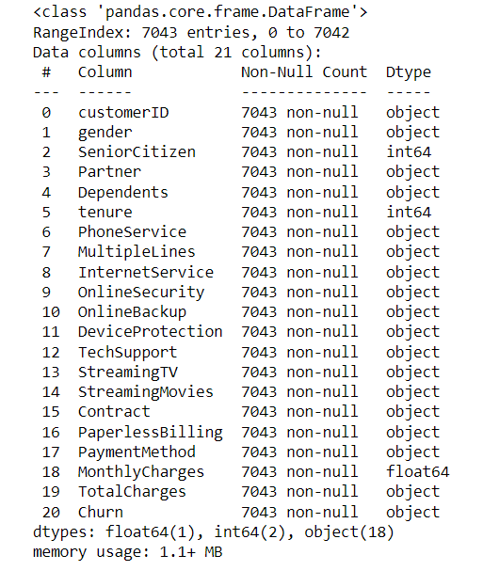
We have 21 Feature in this dataset:
Columns and data type is mentioned below:
We have dataset including Object, Integer and Float dataset.
We have total 7043 rows.
We do not have any Null Values.

Slide 4
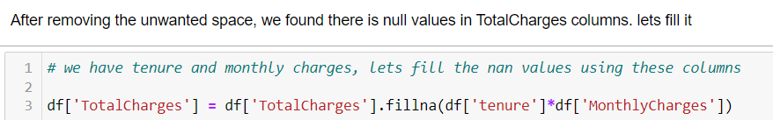
After Removing unwanted space in columns we found Null values then I treated the Null Values

Slide 5
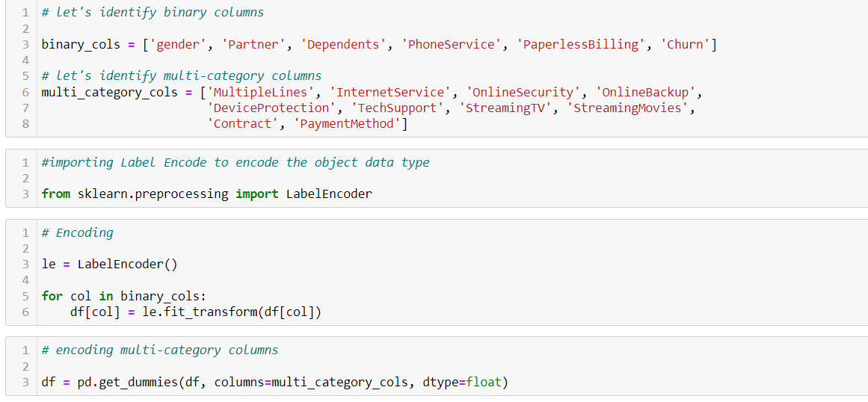
Identified the binary columns and Multi-categorical columns and encoded them as below

Slide 6
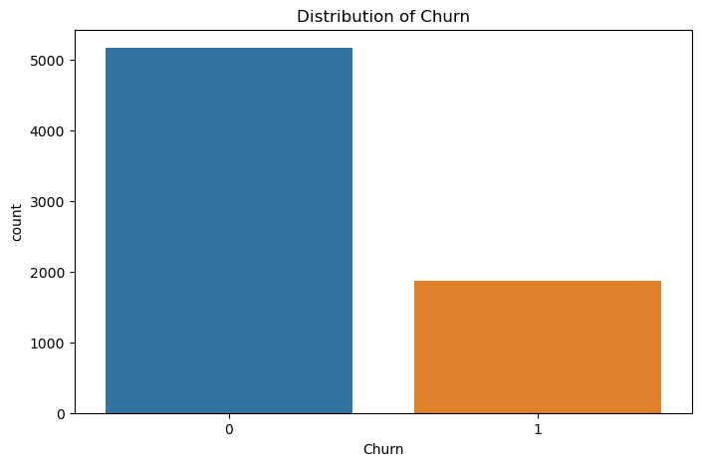
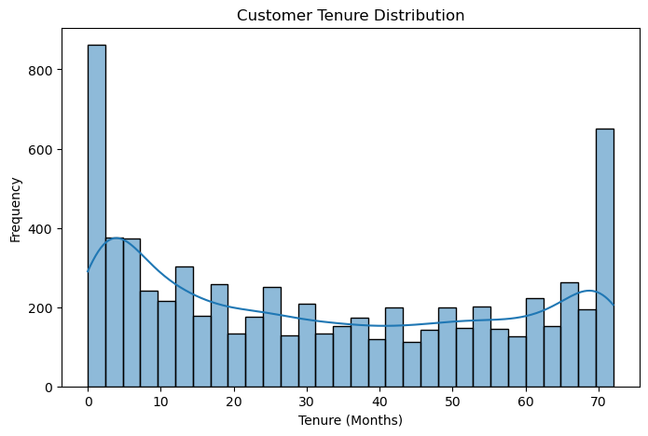
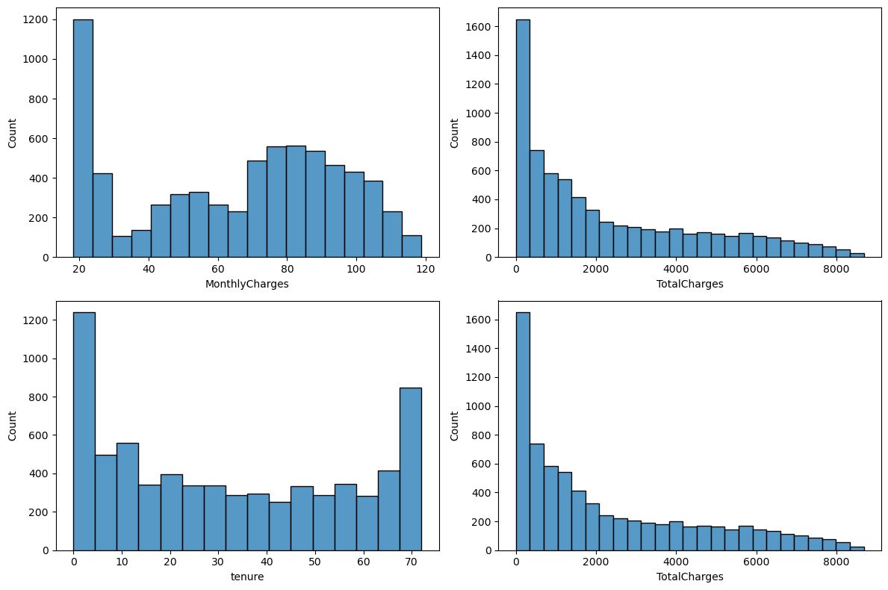
Visualizing the Dataset now
Distribution of the target variable
Customer tenure distribution
Distribution of Continuous Variables

Slide 7
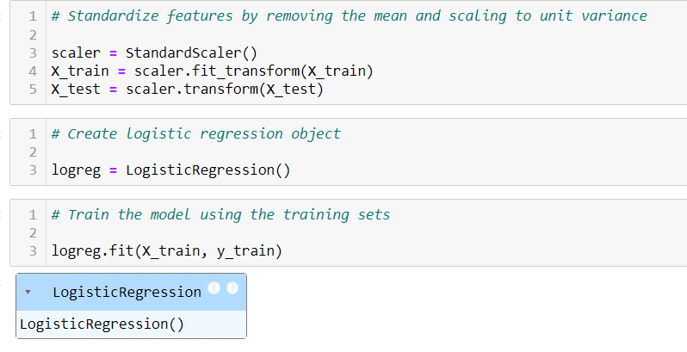
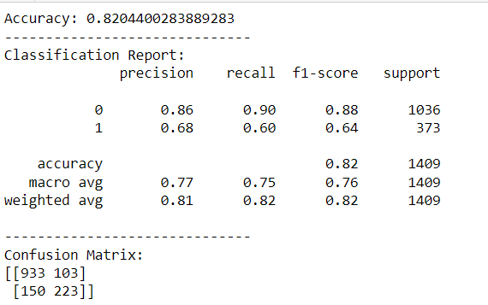
Building Our 1st Model (Logistic Regression)
Logistic Regression Model
Model Accuracy

Slide 8
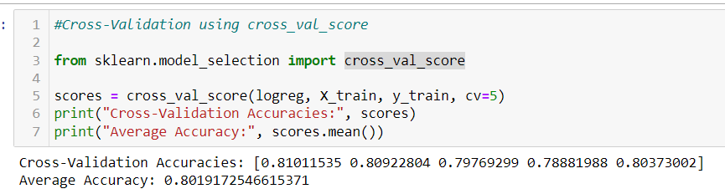
Cross Validation using cross_val_score

Slide 9
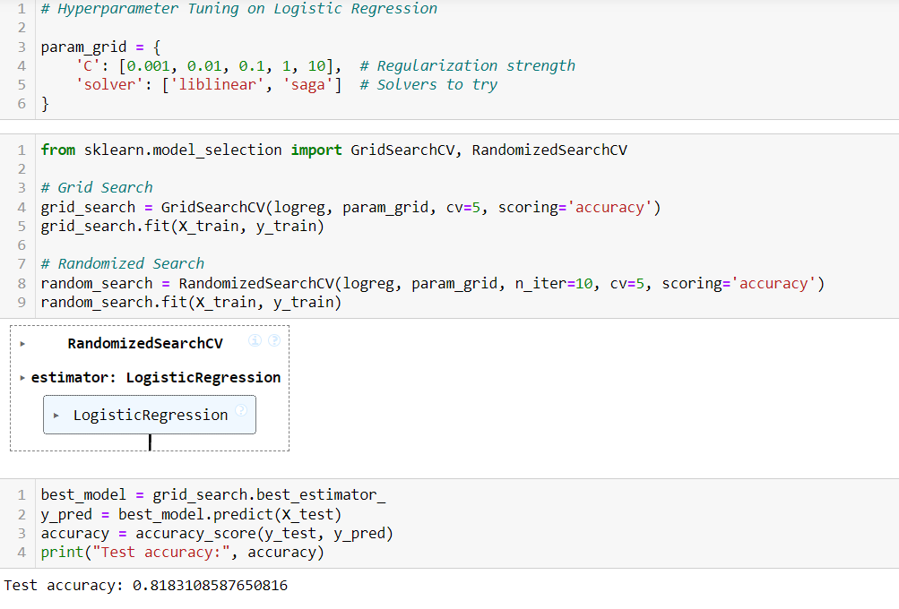
Hyper Parameter Tuning

Slide 10
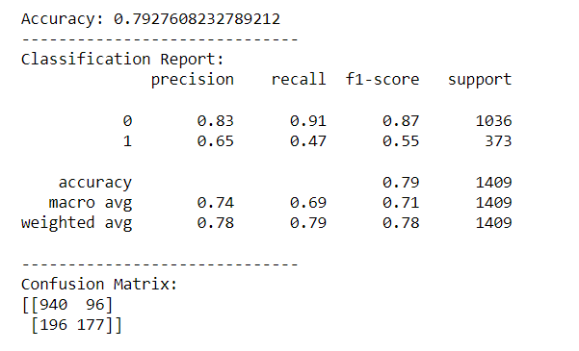
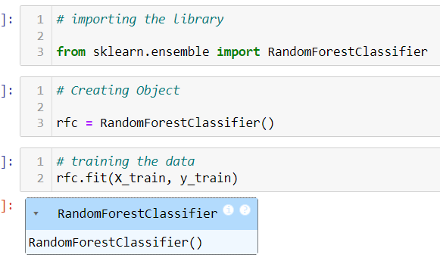
2. Random Forest Classifier Model
Random Forest Model
Prediction

Slide 11
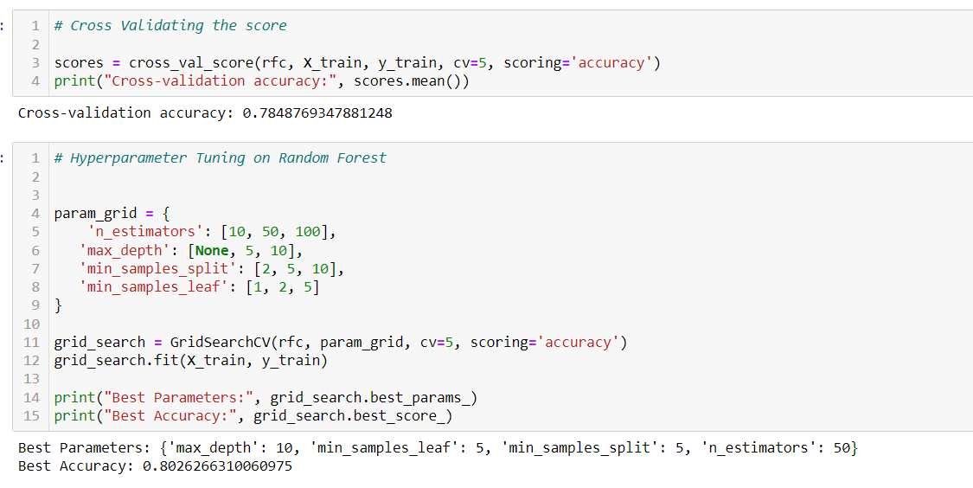
Cross Validation and Hyper parameter Tuning

Slide 12
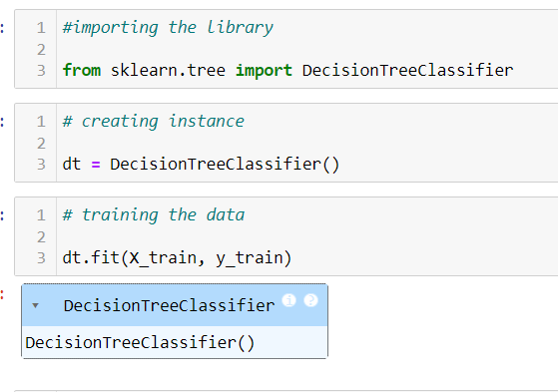
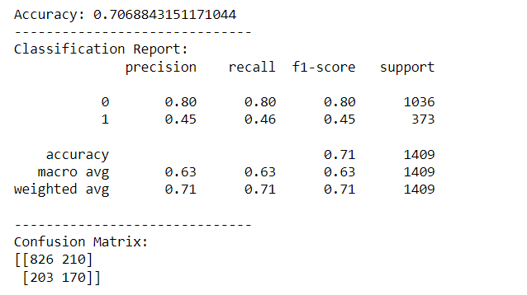
3. Decision Model
Model
Prediction

Slide 13
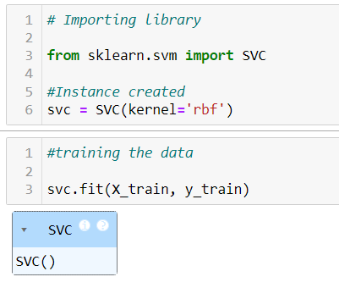
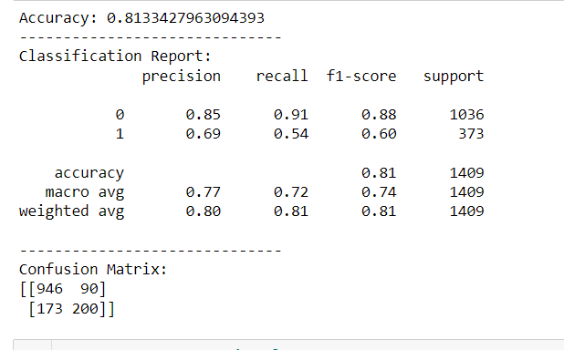
4. Support Vector Classifier Model
Accuracy
Model

Slide 14
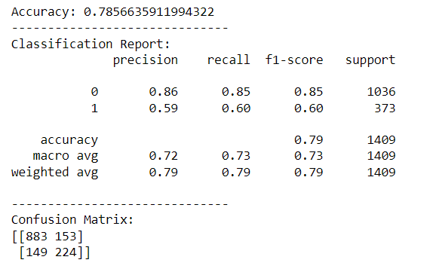
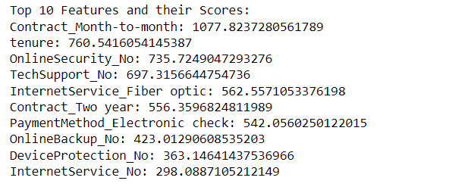
Feature Selections and Model
After Feature Selection, Random Forest Model Accuracy
Top 10 Features

Slide 15
