Slide 1
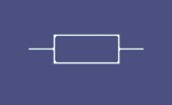


Software Eng. Dep: Extension
Addis Ababa Institute Of Technology
Fundamental of Electronics Assignment
Amanuel Legesse
ATE/3628/11
Submitted to: - Endrias Haile

Slide 2
What is an atom? What are atoms made of?
An atom is the smallest particle of an element that retains the characteristics of that element. Every solid, liquid, gas, and plasma is composed of neutral or ionized atoms.
An atom is made up of three major sub-atomic particles namely protons, electrons and neutrons. The electrons form a cloud around the nucleus and are bound to the nucleus by electromagnetic forces.
2. Why is Behr’s model of the atom called the "planetary model"?
Because it shows electrons orbiting the nucleus in distinct energy levels. This model is great for showing how the electrons are placed outside of the nucleus but is not the most recent model of the atom.
3. Describe why it is important to have both conductors and insulators?
Because for an electric current to flow in a conductor, the outer electrons of the atom are loosely bound and can freely move through the material when an electric charge is applied. And the opposite of a conductor is an insulator. An insulator opposes the flow of electricity. Insulators are important to keep us safe from electricity. The wire that carries electricity to your computer or television is covered with a rubber-like insulator that protects you from getting electrocuted.

Slide 3
4. Why is silicon the most preferred semiconductor material?
There is more force trying to hold a valence electron to the atom in silicon also are more stable at high temperatures and doesn’t results in excessive reverse current when related with germanium.
5. How does the two types of current produced in semiconductor?
When a voltage is applied across a piece of intrinsic silicon, the thermally generated free electrons in the conduction band, which are free to move randomly in the crystal structure, are now easily attracted toward the positive end. This movement of free electrons is one type of current in a semi conductive material and is called electron current.
Holes are positions in the semiconductor atoms that can be but are not occupied by electrons. An atom with a hole can "rob" the electron of an adjacent atom to fill the hole, causing the adjacent atom to lose an electron and get a hole, therefore effectively "conducting" the hole. In a circuit, holes current is produced when electrons in a semiconductor are taken away by the positive terminal.

Slide 4
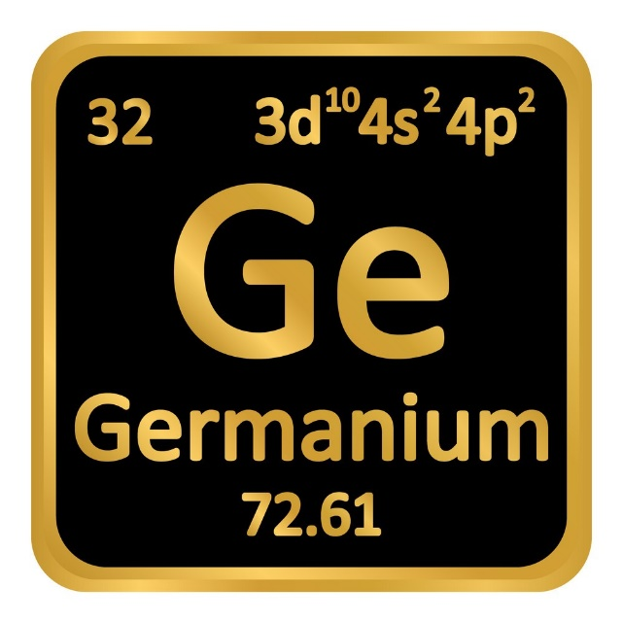
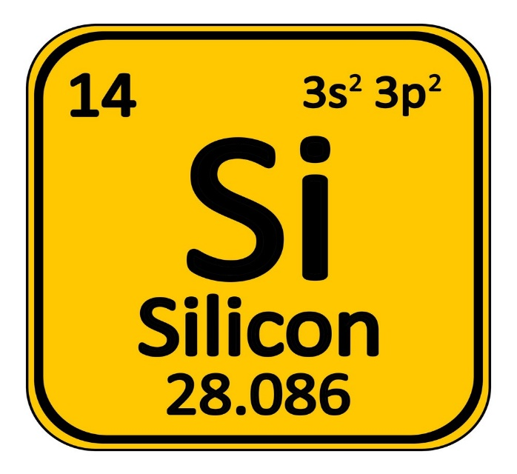
6. Can we put pure semiconductors to any use?
Yes, some of the best examples are :
Germanium
Silicon

Slide 5
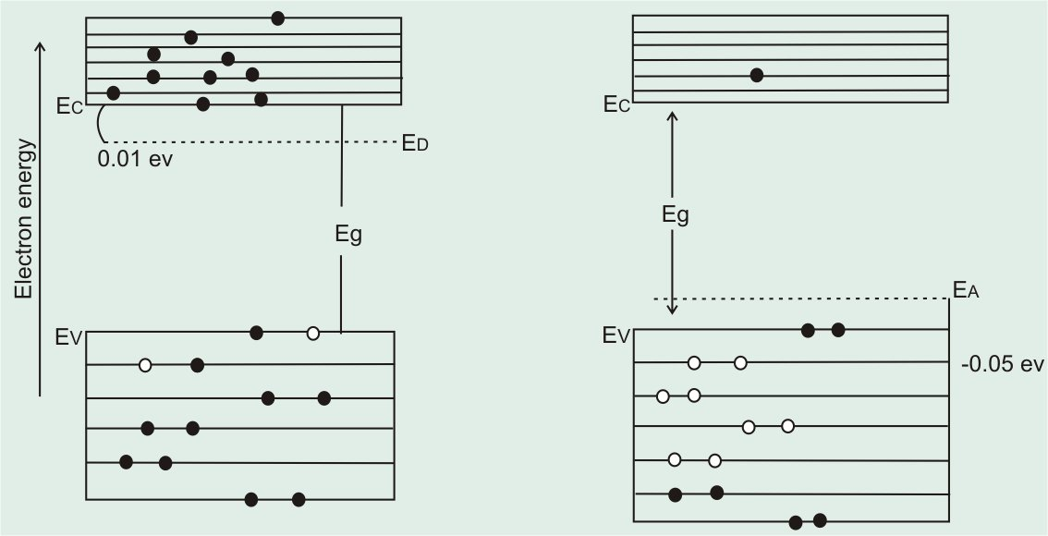
7. How are p-type and n-type semiconductor obtained? Draw a necessary diagram to show the creation of hole and the creation of free electron. What are the majority and minority carriers in each type? And why?
P-type: - are formed when a trivalent impurity is added to a pure semiconductor in a small amount and a large number of holes are created in it.
N-type: - are formed when doping a semiconductor by exposing them to other elements.

Slide 6
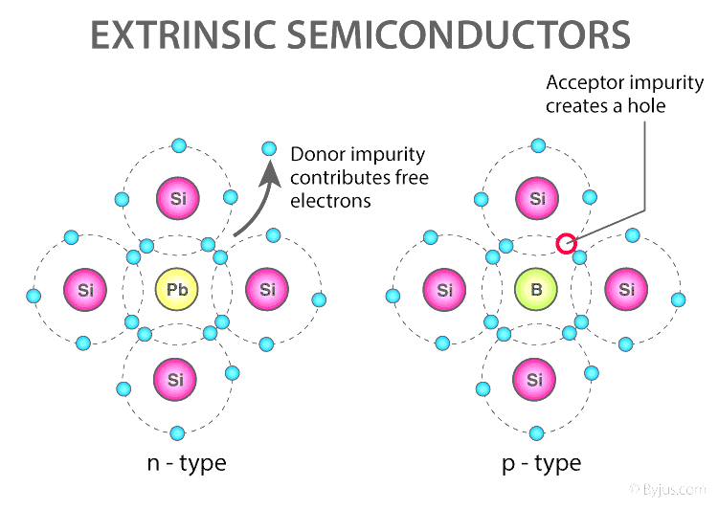
Majority and minority carriers in N-type:- the majority of current carriers in n-type material are electrons, there are also a few holes that are created when electron-hole pairs are thermally generated. These holes are not produced by the addition of the pentavalent impurity atoms. Holes in an n-type material are called minority carriers.
Majority and minority carriers in P-type:- the majority of current carriers in p-type material are holes, there are also a few conduction-band electrons that are created when electron-hole pairs are thermally generated. The holes are the majority carriers in p-type material. Conduction-band electrons in p-type material are the minority carriers.

Slide 7
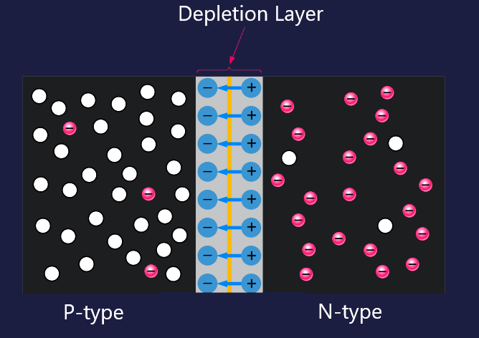
8 . Discuss how a depletion layer is formed in a P-N junction and give a brief explanation
When the PN junction is formed, the n region loses free electrons as they diffuse across the junction. This creates a layer of positive charges (pentavalent ions) near the junction. As the electrons move across the junction, the p region loses holes as the electrons and holes combine. This creates a layer of negative charges (trivalent ions) near the junction. These two layers of positive and negative charges form the depletion region

Slide 8
9 . Explain the difference between forward bias and reverse bias.
Forward bias: - is the condition that allows current through the pn junction. The resistor limits the forward current to a value that will not damage the diode. Because like charges repel, the negative side of the bias-voltage source "pushes" the free electrons, which are the majority carriers in the n region, toward the PN junction.
Reverse bias: - is the condition that essentially prevents current through the diode. The positive side of V is connected to the n region of the diode and the negative side is connected to the p region.

Slide 9
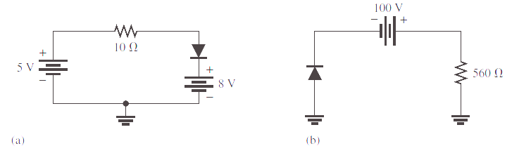

10 . Determine the forward voltage and forward current for the diode in Figure (b) for each of the diode models. Also find the voltage across the limiting resistor in each case. Assume rd = lO ohm at the determined value of forward current.
Ideal model:
$$VF=O V$$
$$IF Vbias=Rlimit$$
$$=\frac{5+8 V}{10 Ω}$$
$$=\text{1}\text{.3}\text{A}$$

Slide 10



Practical model:
$\text{V}\text{f}\text{=0.7}\text{V}$
$$If=Vbias−\frac{Vf}{Rlimit }$$
$$\frac{13 V − 0.7V}{10 Ω}$$
$$1.23 A$$
$$VRlimit= IfRlimit$$
$$1.23 A ×10 Ω$$
$$=12.3V$$

Slide 11

Complete model:
$If=\frac{Vbias −0.7V}{Rlimit+r^{′}d}$
$$\frac{\left(13 V −0.7V\right)}{10 Ω\text{ + 10} Ω }$$
$$=615 mA$$
$$\text{VRIimit} \text{=} \text{IFR}\text{Iimit}$$
$$\text{1}\text{2.3 }\text{A} \text{x} 10Ω \text{=} \text{123 }\text{V}$$
If=Vbias-0.7V/Rlimit-fr'd=100V-0.7V/5.61q2+1052=6.36mA Vf=0.7V+Ifrid=0.7V+6.36mA*1012.64.3mV VRIimit=1FRIimit=6.36mA*5.61q2=35.6V

Slide 12


11 . Determine the reverse voltage and reverse current for the diode in Figure (a) for each of the diode models. Also find the voltage across the limiting resistor in each case. Assume IR = 1 mA.
Ideal model :
$$\text{IR}\text{=}\text{OA}$$
$$\text{VR} \text{=} \text{Vbias}$$
$$\text{8}\text{V} \text{−} \text{5}\text{V} \text{=} \text{3}\text{V}$$
$$\text{VRlimit} \text{=} \text{OV}$$
Practical Model :$\text{IR}\text{=}\text{OA}$
$$\text{VR} \text{=} \text{Vbias}$$
$$\text{=} \text{3}\text{V}$$
$$\text{VRIimit} \text{=} \text{0}\text{V}$$

Slide 13

Complete Model :
$$\text{IR}\text{=}µ\text{A}$$
$$\text{VR}\text{limit}\text{ = }IRrlimit$$
$$\text{ = }\text{1}µ\text{A} \text{X}\text{ 1.0}\text{k}Ω$$
$$\text{=}\text{1}\text{mV}$$
$$VR=Vbias −VRlimit$$
$$=3V −1mV$$
$$2.999V$$

Slide 14
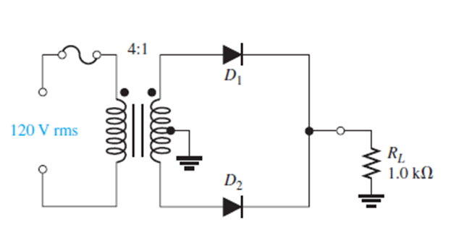

A center tapped full wave rectifier
Circuit
(a) What is the total peak secondary voltage?
$$Vp\text{sec}=\left( 0.25 \right)\left( 1.414 \right) 120V$$
$$=42.4V$$
(b) Find the peak voltage across each half of the secondary?
$\frac{Vp\text{sec}}{2}$ = $\frac{42.4 V}{2}$ = 21.2 V

Slide 15
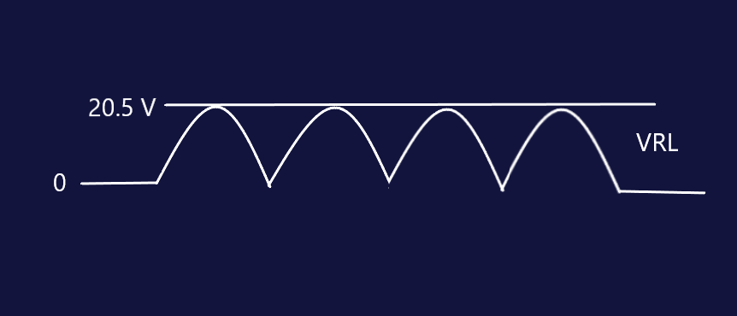
(d) Sketch the voltage waveform across RL.

Slide 16

(e) What is the peak current through each diode?
$$If= \frac{\frac{Vp sec }{2} −0.7V}{Rl}= \frac{20.5V}{1 kΩ}$$
$$=20.05mA$$
(f) What is the PIV for each diode?
$PIV=21.2V+20.5V=41.7V$

Slide 17
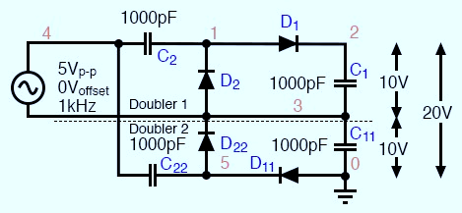
12 . With the help of a neat diagram, explain the operation Voltage Quadrupler
A voltage quadrupler is a stacked combination of two double’s shown in Figure below. Each doubler provides 10 V (8.6 V) for a series total at node 2 with respect to ground of 20 V (17.2 V)
Voltage quadrupler, composed of two doublers stacked in series, with output at node 2

Slide 18
13 . Can an ordinary diode be used as a Zener diode? Justify your answer.
Typically not. An ordinary diode is designed to be used as a rectifier and not for operating in reverse breakdown. Consequently, an ordinary diode will not be able to reliably handle much current before the junction is damaged permanently. On the other hand, a Zener diode is designed to operate in reverse breakdown and to conduct significant reverse breakdown current. Therefore, if your design requires a reverse breakdown of a diode, you should use a Zener diode
9. Explain how a Zener diode can be used as voltage regulator.
Zener Diodes can be used as a type of voltage regulator to produce a stabilized voltage output with low ripple under varying load current conditions. By passing a small current through the diode from a voltage source, via a suitable current limiting resistor (RS), the Zener diode will conduct sufficient current to maintain a voltage drop of Vought.

Slide 19
14 . How does Zener diode regulate the voltage? See answer in No3 what happens to the series current, load current and Zener current when the D.C input voltage of a Zener regulator increases?
A rectifier with an appropriate filter serves as a good source of D.C output. However, the major disadvantage of such a power supply is that the output voltage changes with the variations in the input voltage or load. Thus, if the input voltage increases, the D.C output voltage of the rectifier also increases. Similarly, if the load current increases, the output voltage falls due to the voltage drop in the rectifying element, filter chokes, transformer winding etc. In many electronic applications, it is desired that the output voltage should remain constant regardless of the variations in the input voltage or load. In order to ensure this, a voltage stabilizing device, called voltage stabilizer is used. Several stabilizing circuits have been designed but only Zener diode as a voltage stabilizer.

Slide 20

15 . Explain how a Zener diode can be used as clipper circuit.
Diode clipping and clamping circuits are circuits that are used to shape or modify an input AC waveform (or any sinusoid) producing a differently shape output waveform depending on the circuit arrangement. Diode clipper circuits are also called limiters because they limit or clip-off the positive (or negative) part of an input AC signal. As Zener clipper circuits limit or cut-off part of the waveform across them, they are mainly used for circuit protection or in waveform shaping circuits.

