Slide 1

Vendor Performance Analysis
Exploratory Data Analysis Insights — uncovering patterns in vendor profitability, inventory efficiency, and purchasing behavior to drive strategic business decisions.
EDA REPORT
DATA SCIENCE

Slide 2
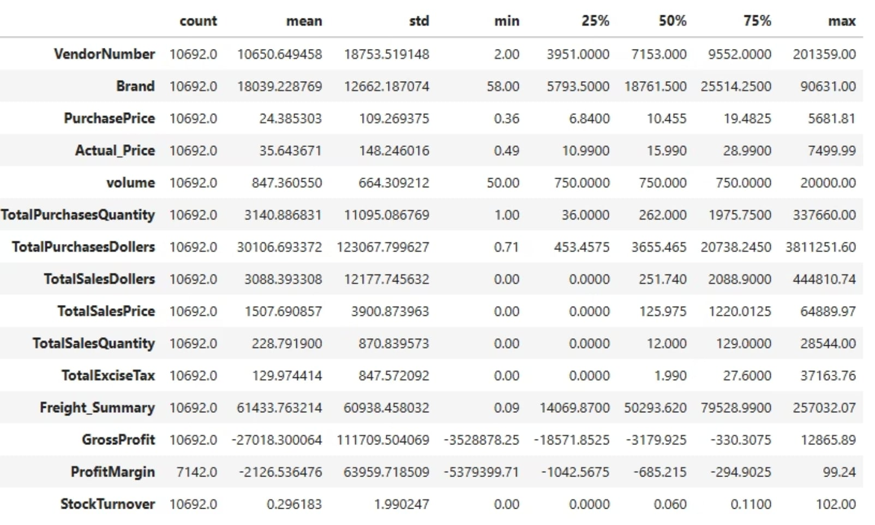
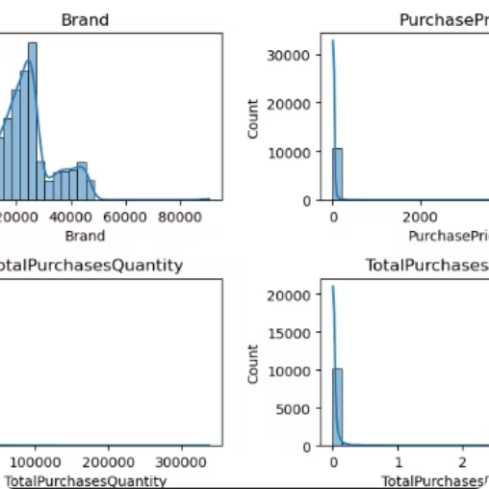
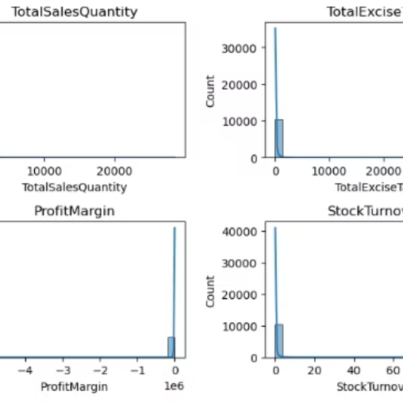
Summary Statistics & Distribution Plots
Key Numerical Columns
Distribution plots reveal the spread and skewness of core metrics including purchase price, actual price, freight cost, gross profit, and stock turnover — providing the foundation for deeper analysis.

Slide 3



Negative & Zero Value Findings
Gross Profit
Minimum value of -3,528,878.25 indicates significant losses. Certain products are sold below procurement cost, pointing to pricing or sourcing issues.
Profit Margin
Minimum of -5,379,399.71 reveals transactions where revenue is zero or insufficient to cover costs — driven by high operating costs, returns, or expense-heavy transactions.
Sales Quantity & Dollars
Minimum of 0 shows products purchased but never sold. These represent slow-moving or obsolete inventory, increasing holding costs and reducing efficiency.

Slide 4
Outliers & High Standard Deviations
Purchase & Actual Prices
Freight Cost
Stock Turnover
Max values (5,681.81 and 7,499.99) far exceed means (24.39 and 35.64), indicating highly skewed distributions with premium high-value products.
Range from 0.09 to 257,032.07 reflects wide variability in transaction sizes — from small shipments to large bulk orders, highlighting logistics planning opportunities.
Values range 0 to 102. Zero indicates stagnant inventory; values above 1 show sales fulfilled from prior stock rather than current purchases.

Slide 5
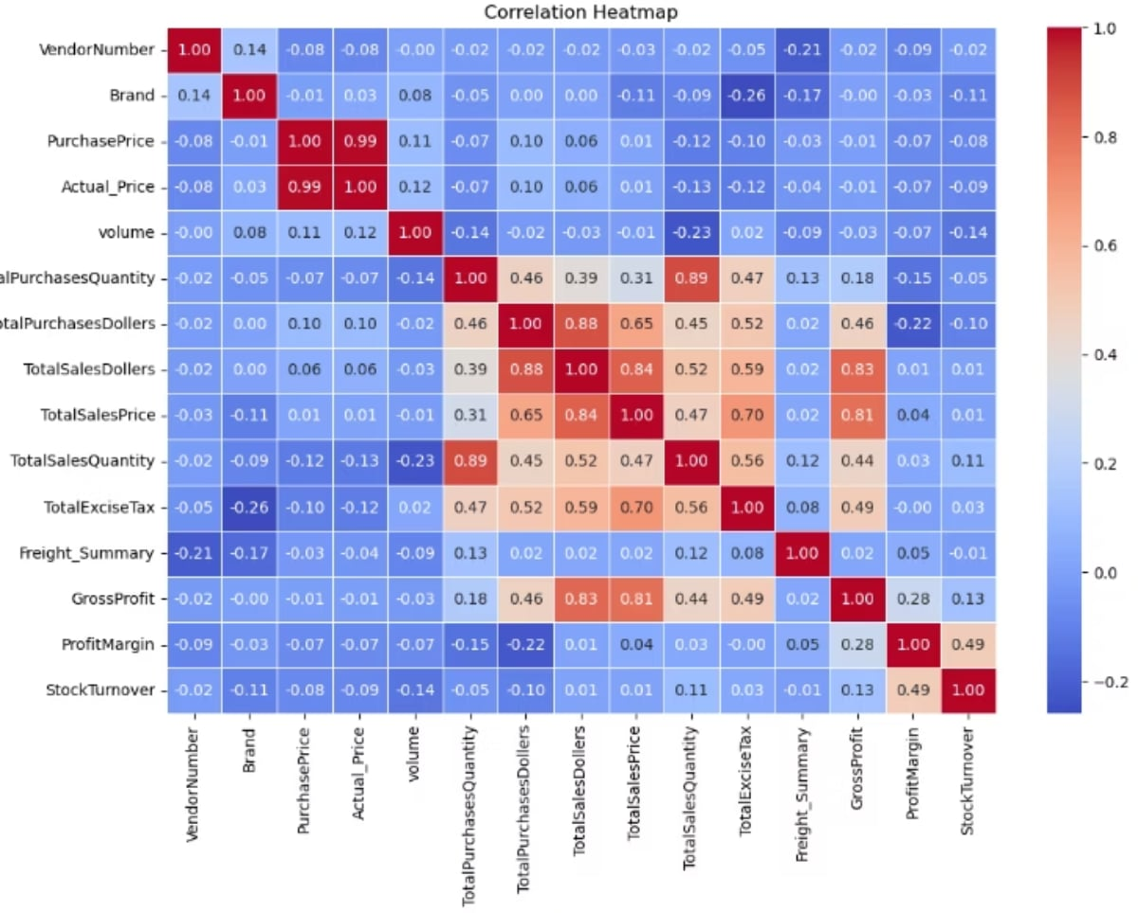
Data Filtering & Correlation Insights
Data Filtering Applied
Correlation Highlights
To enhance reliability, inconsistent data points were removed:
Purchase Price has weak correlations with Total Sales Dollars and Gross Profit — price variations don't significantly impact revenue or profit.
Strong correlation between total purchase and sales quantity confirms efficient inventory turnover.
Negative correlation between profit margin and total sales price suggests competitive pricing pressures.
Stock Turnover shows weak negative correlations with Gross Profit and Profit Margin — faster turnover doesn't guarantee higher profitability.
Gross Profit ≤ 0 (loss-making transactions)
Profit Margin ≤ 0 (unprofitable transactions)
Total Sales Quantity = 0 (unsold inventory)

Slide 6
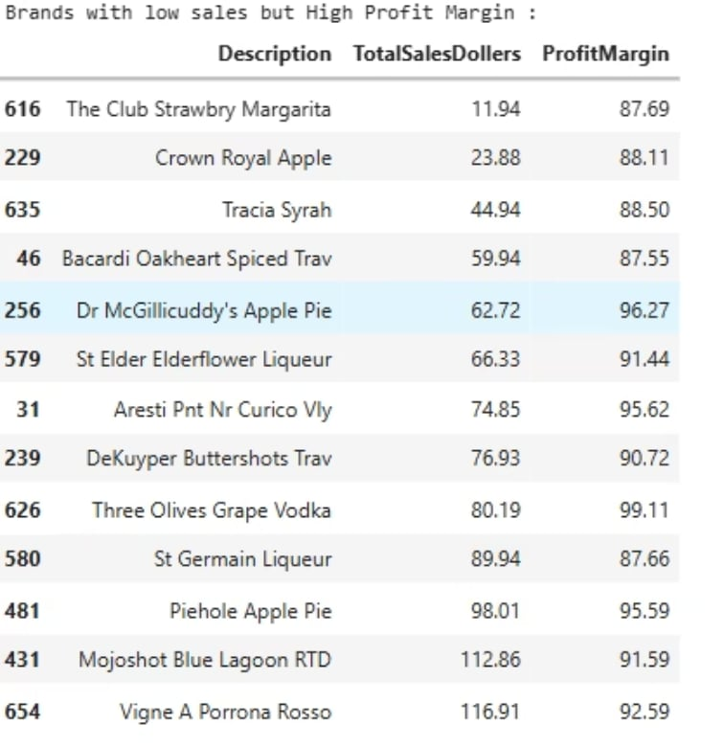

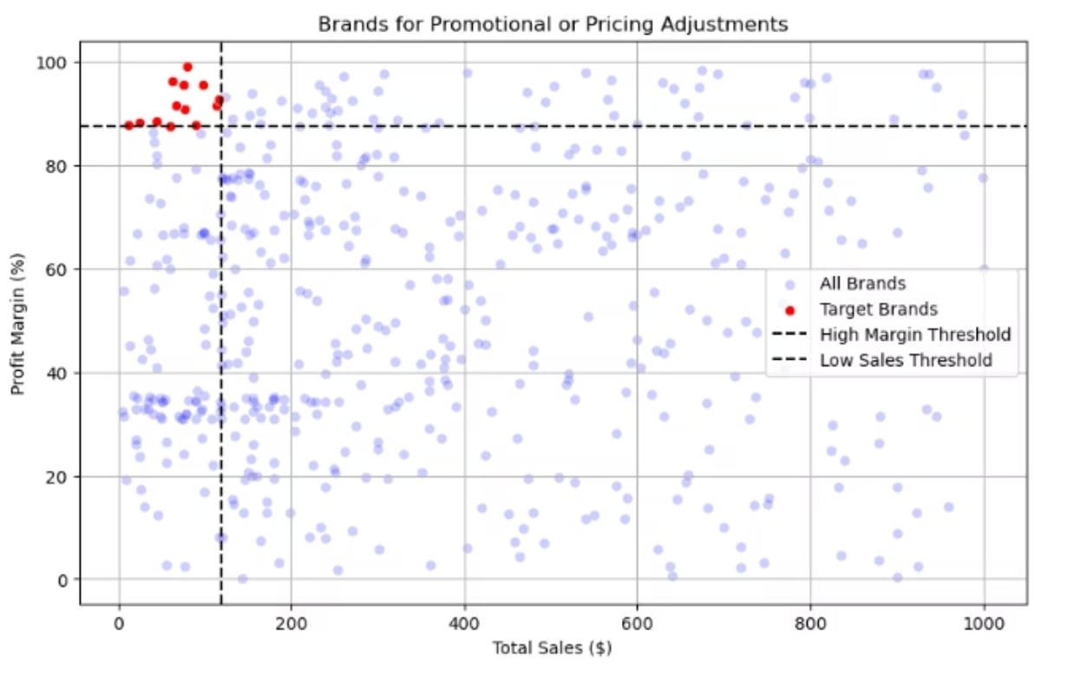
RESEARCH QUESTION 1
Brands for Promotional or Pricing Adjustment
Certain brands exhibit lower sales volumes but higher profit margins. These represent an opportunity for targeted marketing, promotions, or price optimizations to increase volume without compromising profitability.
Strategic focus on these brands can unlock latent revenue potential while preserving strong margin performance.

Slide 7
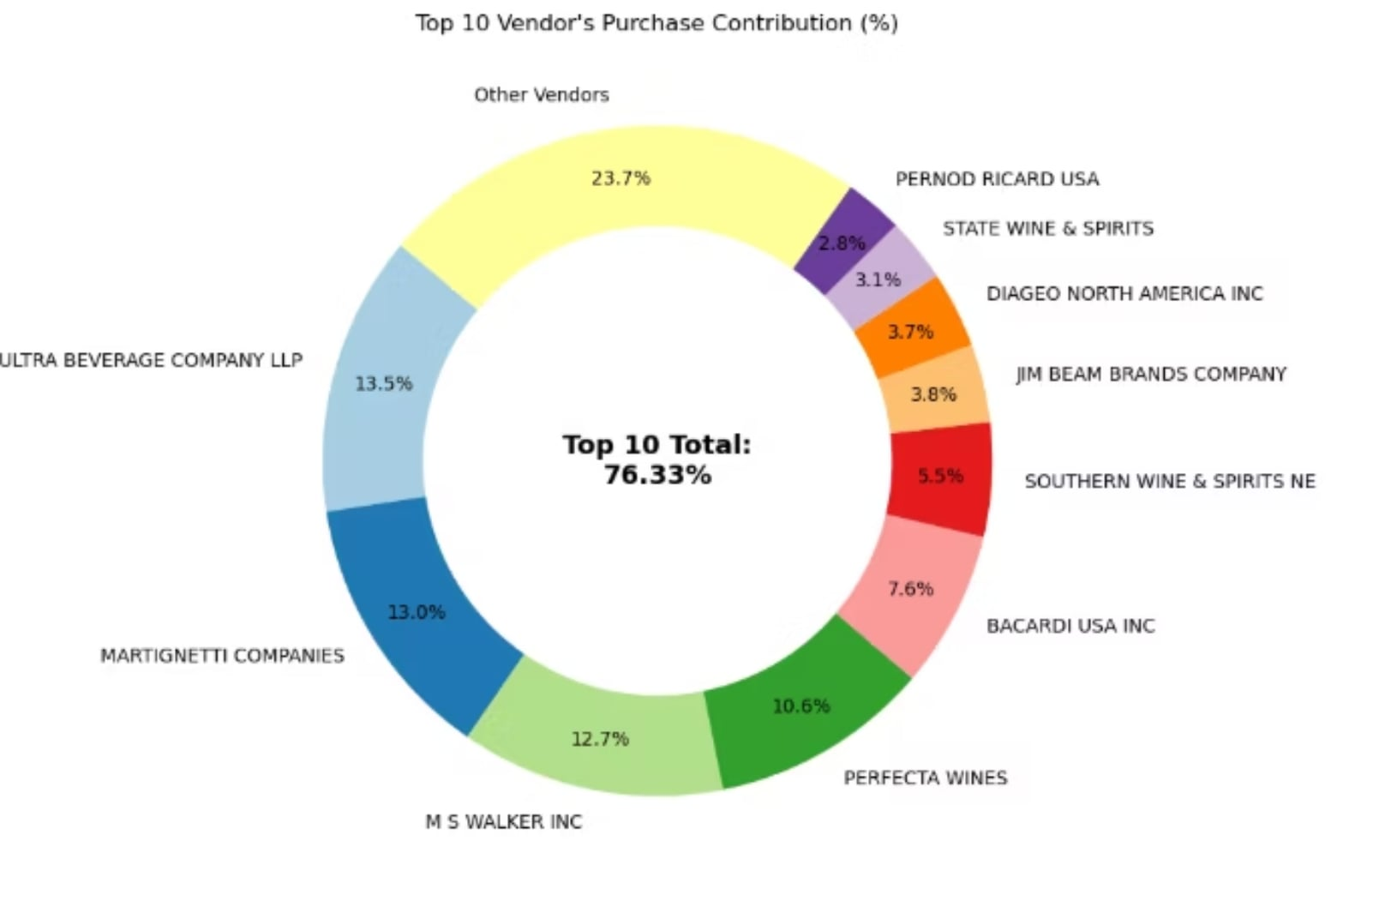
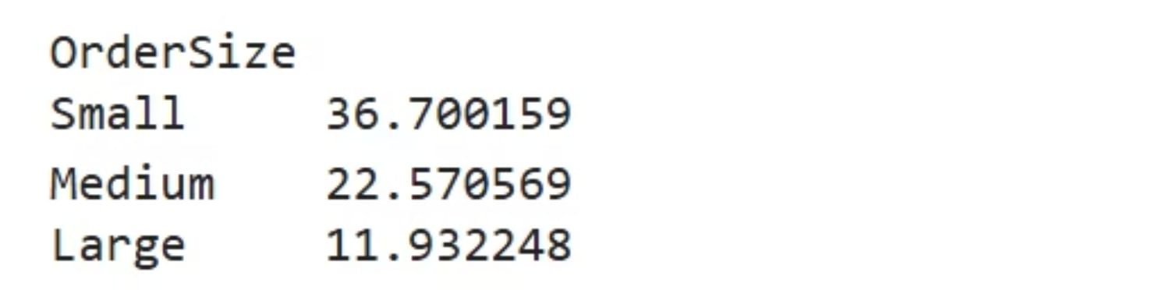
Top Vendors & Bulk Purchasing Impact
Vendor Concentration Risk
The top 10 vendors contribute 76.33% of total purchases, while all remaining vendors account for only 23.67%. This over-reliance introduces supply chain disruption risks and signals a need for vendor diversification.
Bulk Pricing Advantage
Vendors buying in large quantities receive a 72% lower unit cost — $11.93 per unit vs. higher costs in smaller orders. Bulk pricing strategies encourage larger orders, increasing total sales while maintaining profitability.

Slide 8
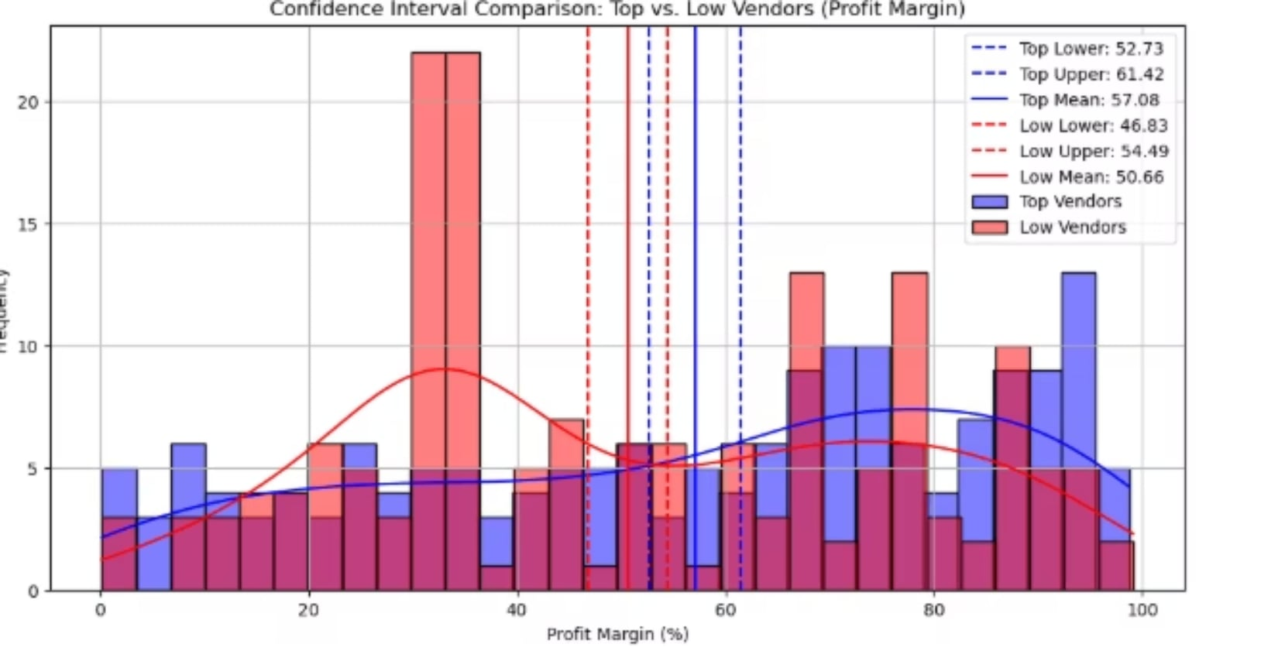
RESEARCH QUESTION 4
Profit Margin: High vs. Low-Performing Vendors
57.08%
50.66%
Top Vendors Mean Margin
Low Vendors Mean Margin
95% CI: 52.73% – 61.42%
95% CI: 46.83% – 54.49%
Top-performing vendors appear to achieve higher profit margins, but since confidence intervals overlap slightly, this alone does not conclusively establish a statistically significant difference. A formal hypothesis test is required.
High-performing vendors: Could explore selective price adjustments, cost optimization, or bundling strategies.
Low-performing vendors: Despite higher margins, low sales volume suggests a need for better marketing, competitive pricing, or improved distribution.

Slide 9

Statistical Validation of Profit Margin Differences
H0 Null
H1 Alternative
Reject H0
Distinct Models
The null hypothesis is rejected, confirming that top and low-performing vendor groups operate under distinctly different profitability models. High-margin vendors may benefit from better pricing strategies, while top-selling vendors could focus on cost efficiency to close the gap.

Slide 10


Final Recommendations
Re-evaluate Brand Pricing
Adjust pricing for low-sales, high-margin brands to boost volume without sacrificing profitability.
Diversify Vendor Partnerships
Reduce dependency on top 10 vendors (76.33% of purchases) to mitigate supply chain risks.
Leverage Bulk Purchasing
Maintain competitive pricing and optimize inventory by capitalizing on 72% unit cost savings from bulk orders.
Optimize Slow-Moving Inventory
Adjust purchase quantities, launch clearance sales, or revise storage strategies for stagnant stock.
Enhance Marketing for Low Performers
Drive higher sales volumes for low-performing vendors through improved marketing and distribution strategies.
By implementing these recommendations, the company can achieve sustainable profitability, mitigate risks, and enhance overall operational efficiency.

