Slide 1
OUTLINE
PROJECT DESCRIPTION
FIELD LAYOUT
NETWORK DESIGN & OPTIMIZATION
PRODUCTION PERFORMANCE
FLOW ASSURANCE ANALYSIS
ECONOMICAL ANALYSIS
CONCLUSIONS

Slide 2
TABLE OF THE WELLS

Slide 3
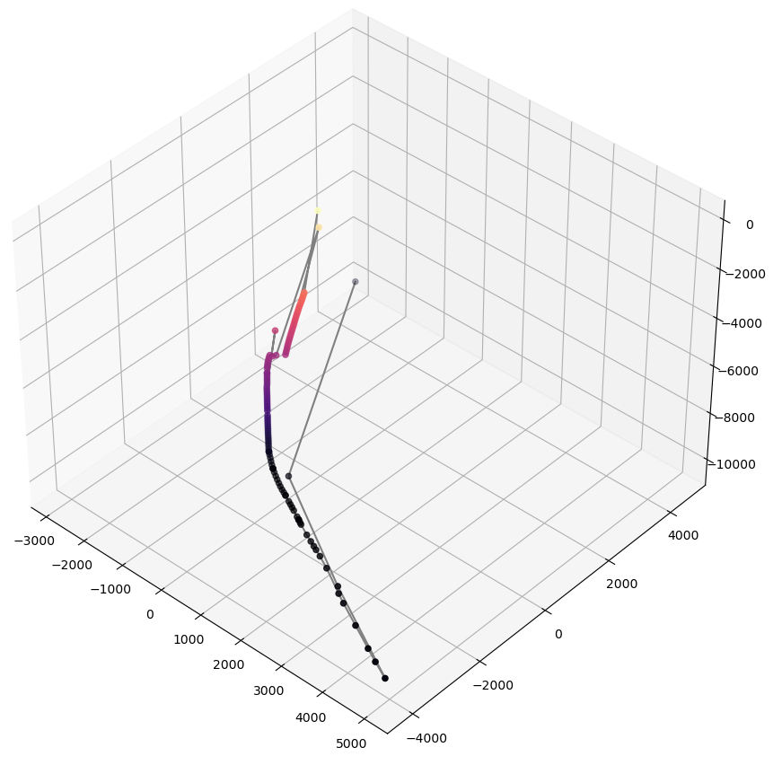
WELL #7 - FAT TIRE A 1H
OBSERVED PROBLEMS:
NO DATA FOR VERTICAL SECTION
DATA VALUES SEEM CORRUPTED
IRREGULARITIES IN DATA
OVERALL 3D PLOT LOOKS ODD. NEED FOR SUGGESTIONS TO FIX IT.

Slide 4
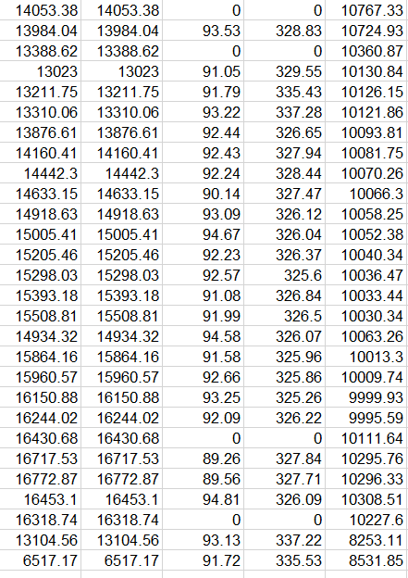
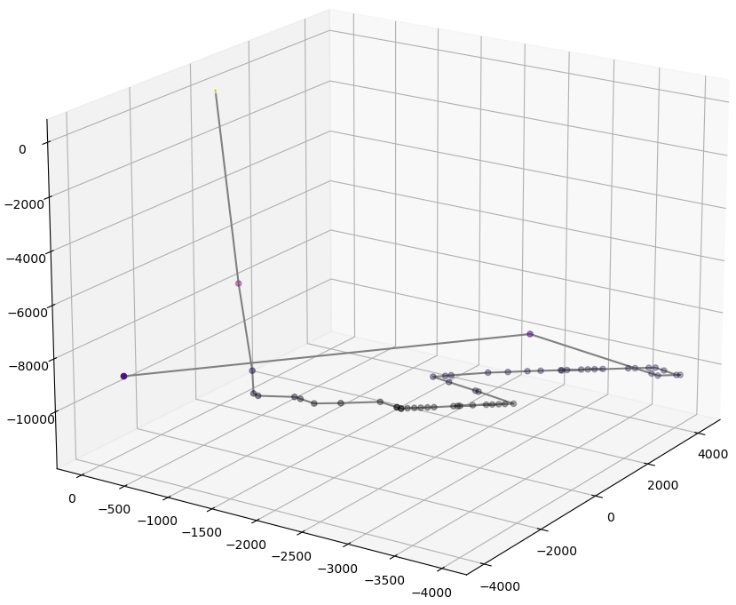
WELL #8 - FAT TIRE B 1H
OBSERVED PROBLEMS:
NO DATA FOR VERTICAL SECTION
DATA VALUES SEEM CORRUPTED
IRREGULARITIES IN MD AND TVD DATA
OVERALL 3D PLOT LOOKS ODD. NEED FOR SUGGESTIONS TO FIX IT.

Slide 5
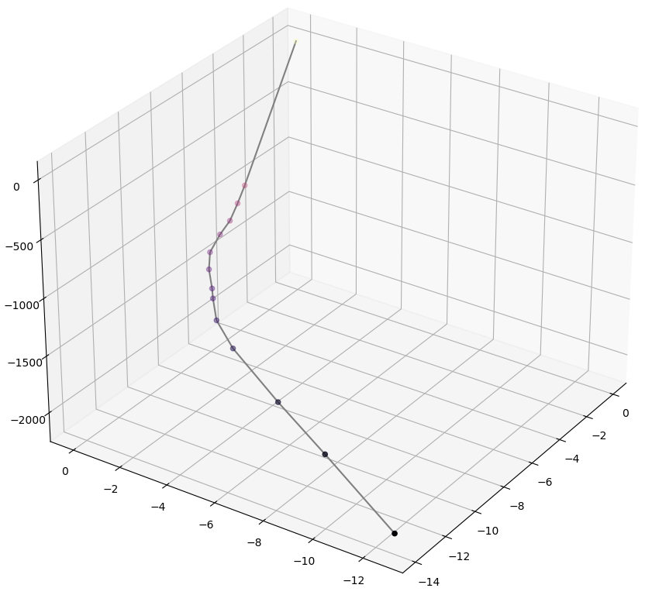
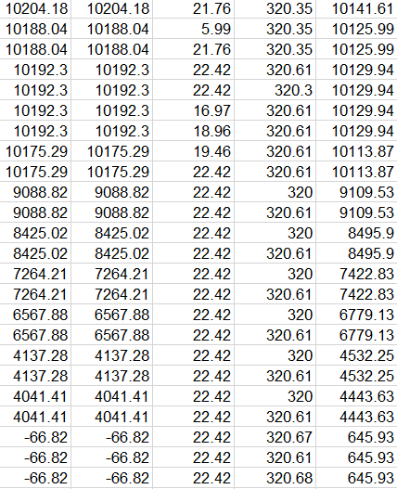
WELL #12 - LEVI GOODRICH UNIT 2 2H
OBSERVED PROBLEMS:
NO DATA FOR VERTICAL SECTION
MD HAS NEGATIVE VALUES
MD AND TVD VALUES ARE FLUCTUATING
THIS IRREGULARITY HAPPENS AGAIN IN THE DATA

Slide 6
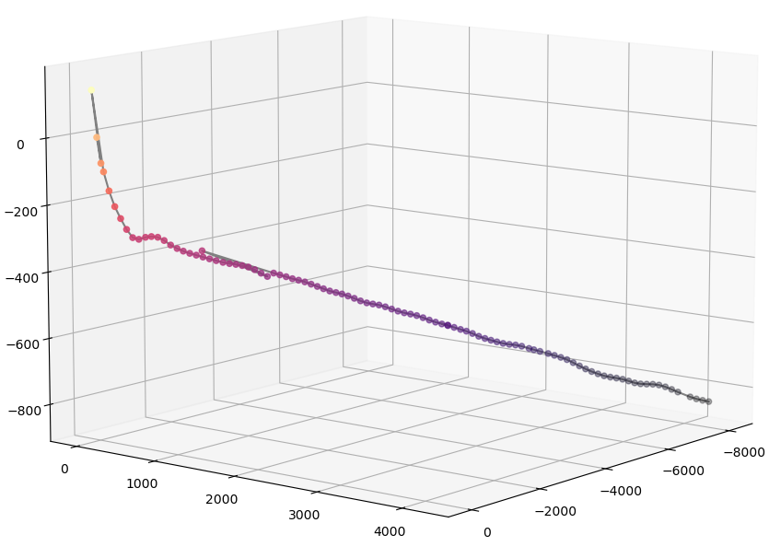
WELL #17 - ROMMEL UNIT 3H
OBSERVED PROBLEMS:
NO DATA FOR VERTICAL SECTION
LACK OF DATA FOR HORIZONTAL SECTION
UNABLE TO LOCATE THE BEGINNING AND END OF CURVATURE SECTION
IRREGULARITIES IN DATA

Slide 7
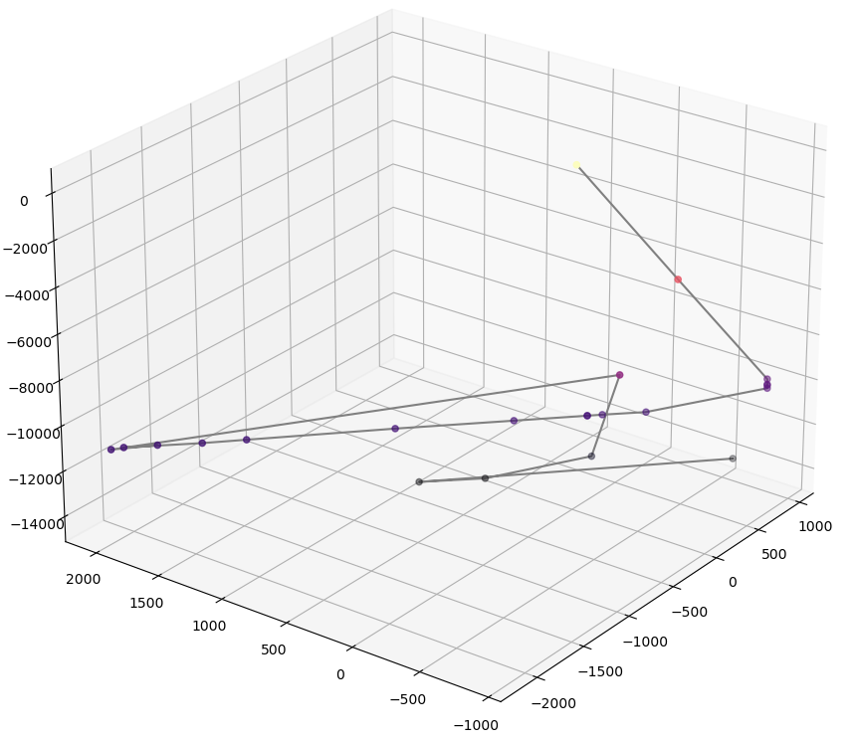
WELL #19 - SABINE D 4H
OBSERVED PROBLEMS:
NO DATA FOR VERTICAL SECTION
DATA VALUES SEEM CORRUPTED
IRREGULARITIES IN DATA
OVERALL 3D PLOT LOOKS ODD. NEED FOR SUGGESTIONS TO FIX IT.

