Slide 1

77Library Website
Course: Full Stack Java Developer
Learner Name: Sky Chua Bing Kun
Presentation Date: 22/12/2023

Slide 2
Contents
Project Objective
Deliverables
Project Environment
Tools
Project Design
Classes & Methods
Screenshots
UAT Tests Cases
Project Outcome
Improvements

Slide 3
Project Objective
77library aims to upgrade its library management system from the current reliance on Microsoft Excel The existing Excel-based approach has led to challenges such as outdated records, missing information, and inaccuracies in member and book data.

Slide 4
Proposed Solution
The website developed for managing the library as an online system, many of the problems addressed by the client can be solved - Like maybe a librarian wants to check or track books.
Using ReactJS on the frontend will enable us to integrate frameworks
Using Spring boot and MySQL to work on the backend will enable integration of the database.
A library app or platform will be able to:
Accommodate the growing library’s database
Simplify the workflow of the librarians - Management of the database / Ease their work so they can focus on other aspects of their work / Easy to access data / Data will be more presentable to users
An interactive and intuitive platform for librarian and user alike
Increase the traffic and reach out to more users as it is user friendly

Slide 5
Project Deliverables
Backend:
Spring Boot application with RESTful APIs
Database schema and data migration scripts
Unit tests for backend components
Frontend:
ReactJS application with user interface components
Routing and navigation between different pages
Integration with backend APIs for data fetching and manipulation
Documentation

Slide 6
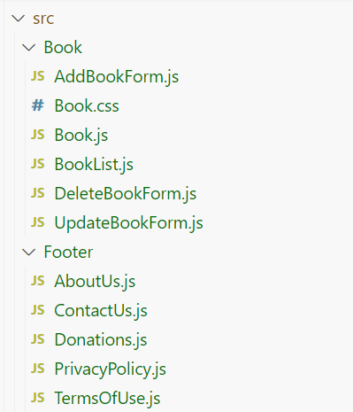
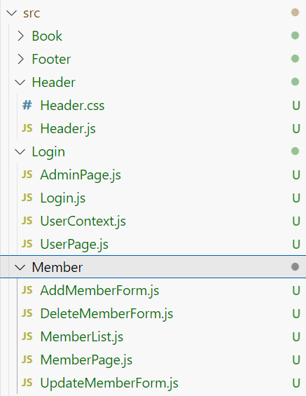
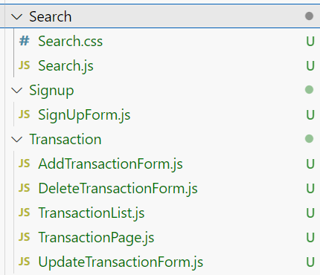
List of Evidences
Screenshots of project directory structure - ReactJS

Slide 7
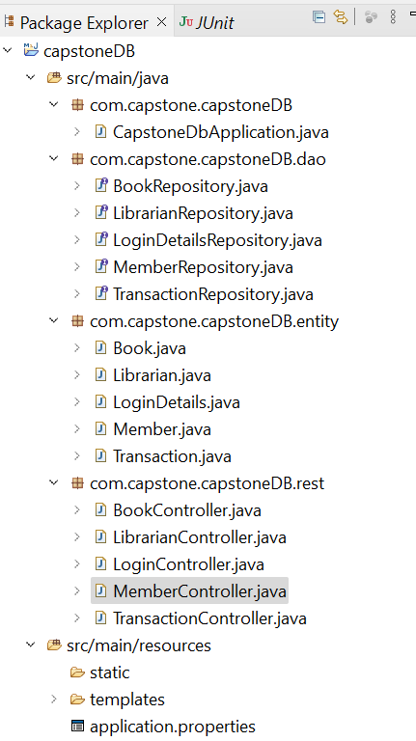
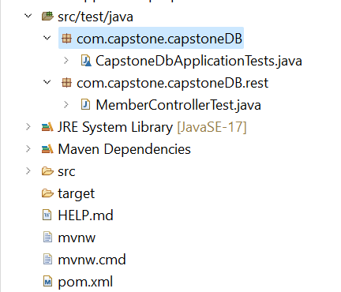
List of Evidences
Screenshots of project directory structure - Spring Boot

Slide 8
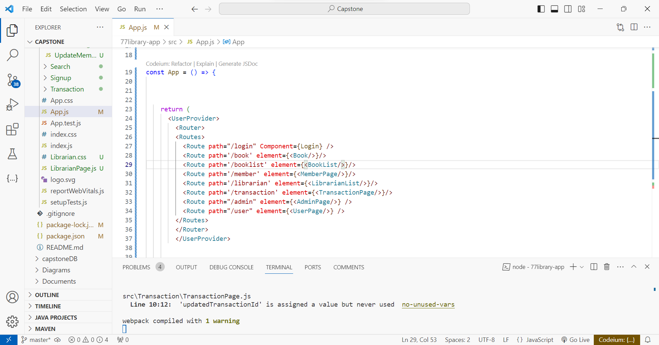
Technical Environment and Tools Used
Visual Studio Code

Slide 9
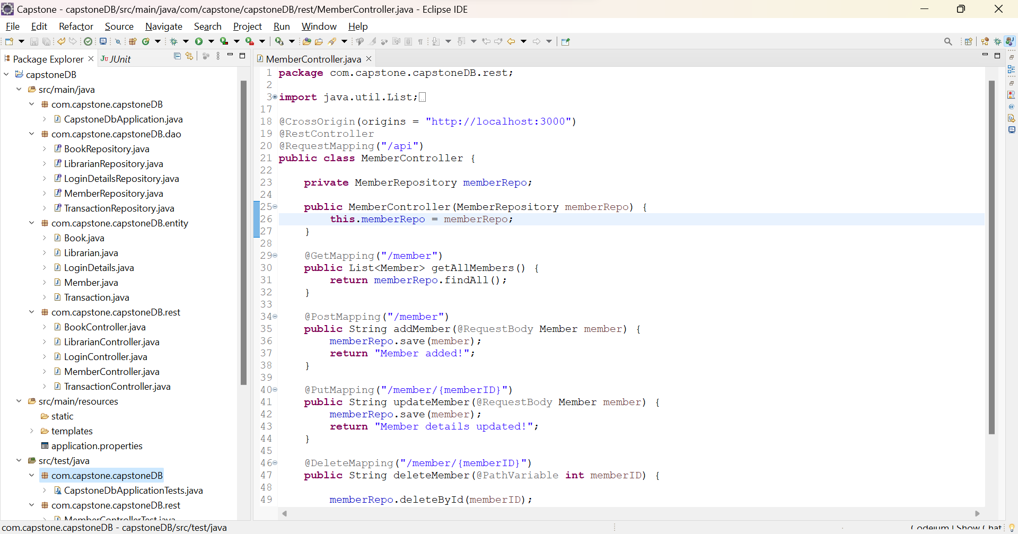
Technical Environment and Tools Used
Eclipse (Spring Boot)

Slide 10
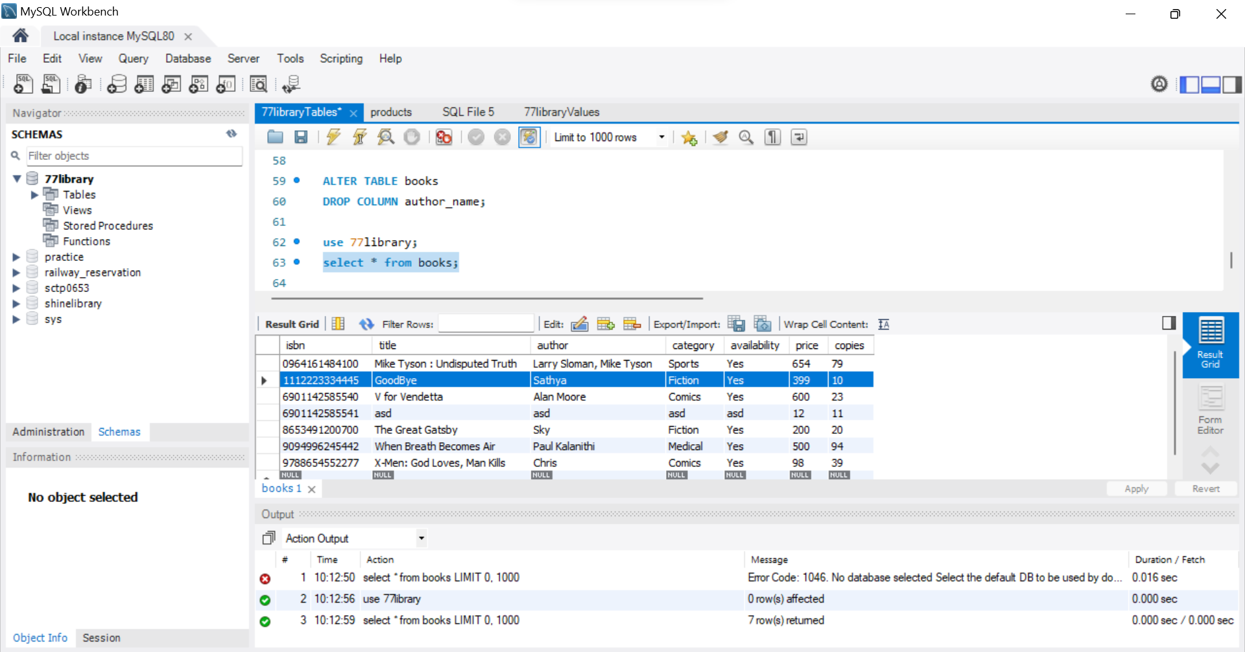
Technical Environment and Tools Used
MySQL

Slide 11
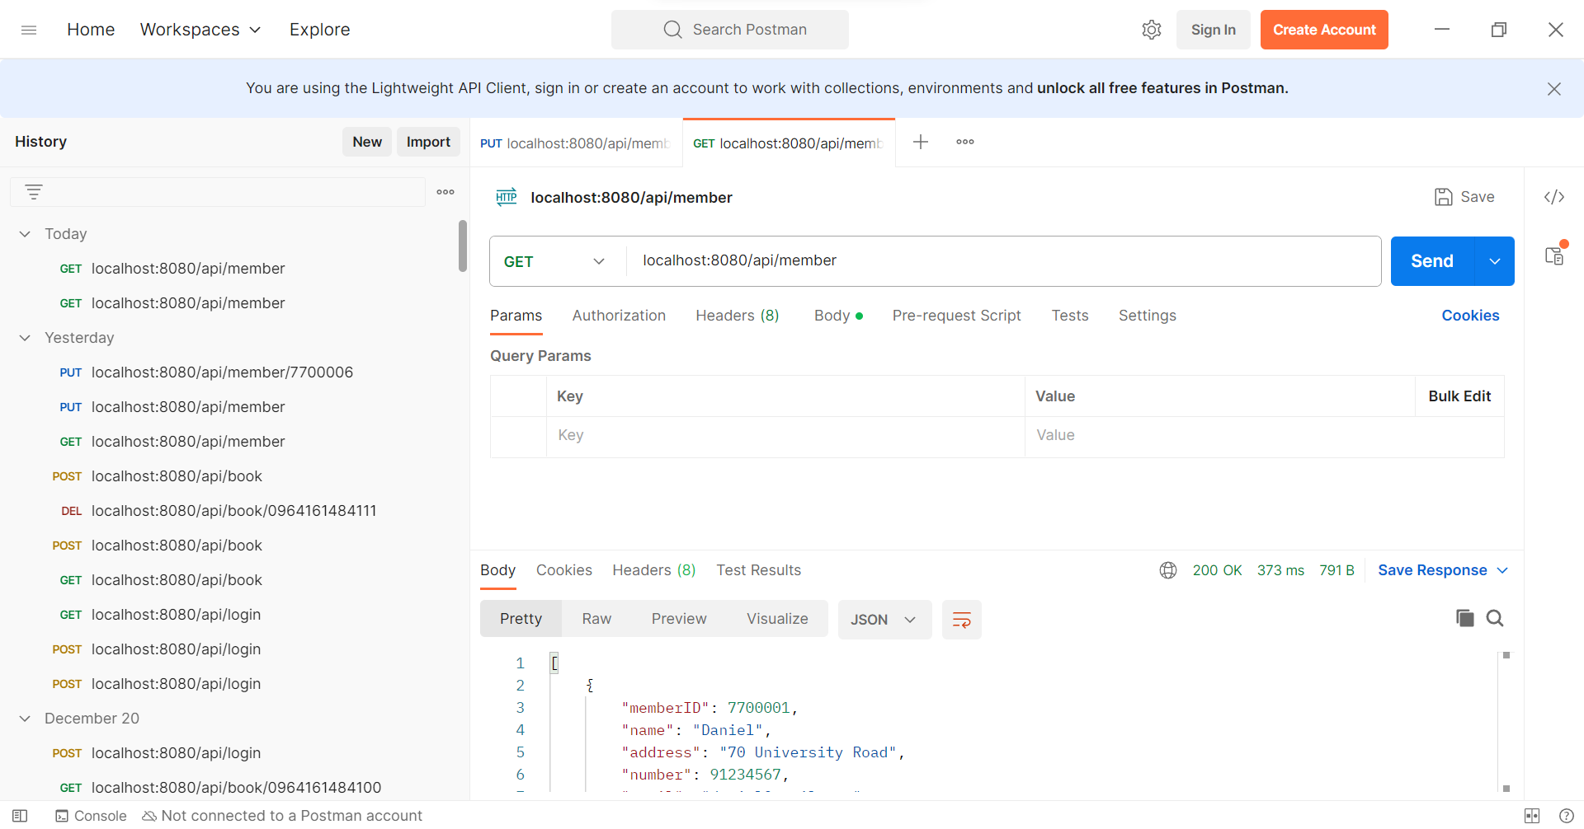
Technical Environment and Tools Used
Postman

Slide 12
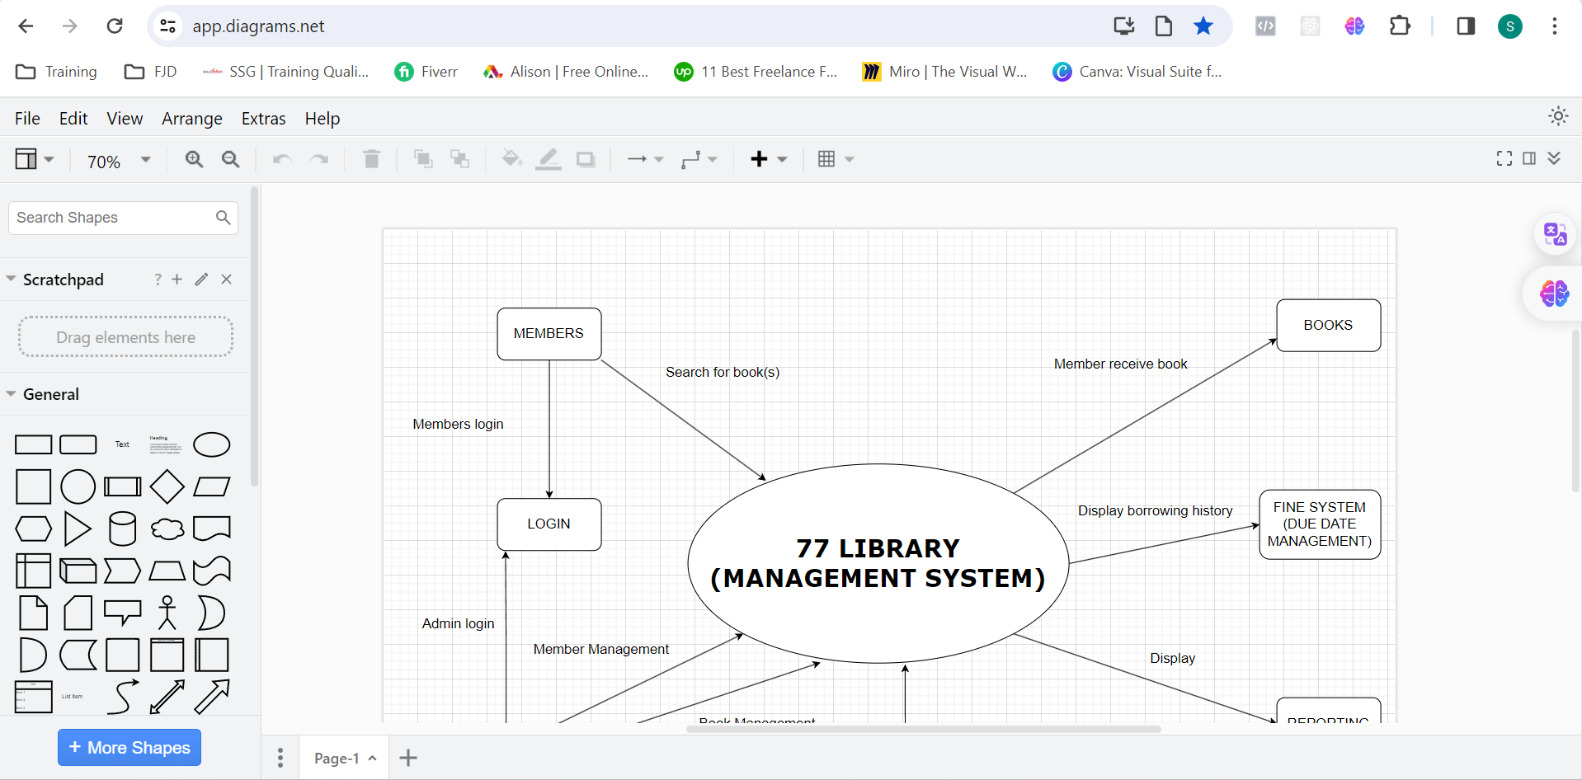
Technical Environment and Tools Used
Draw.io

Slide 13
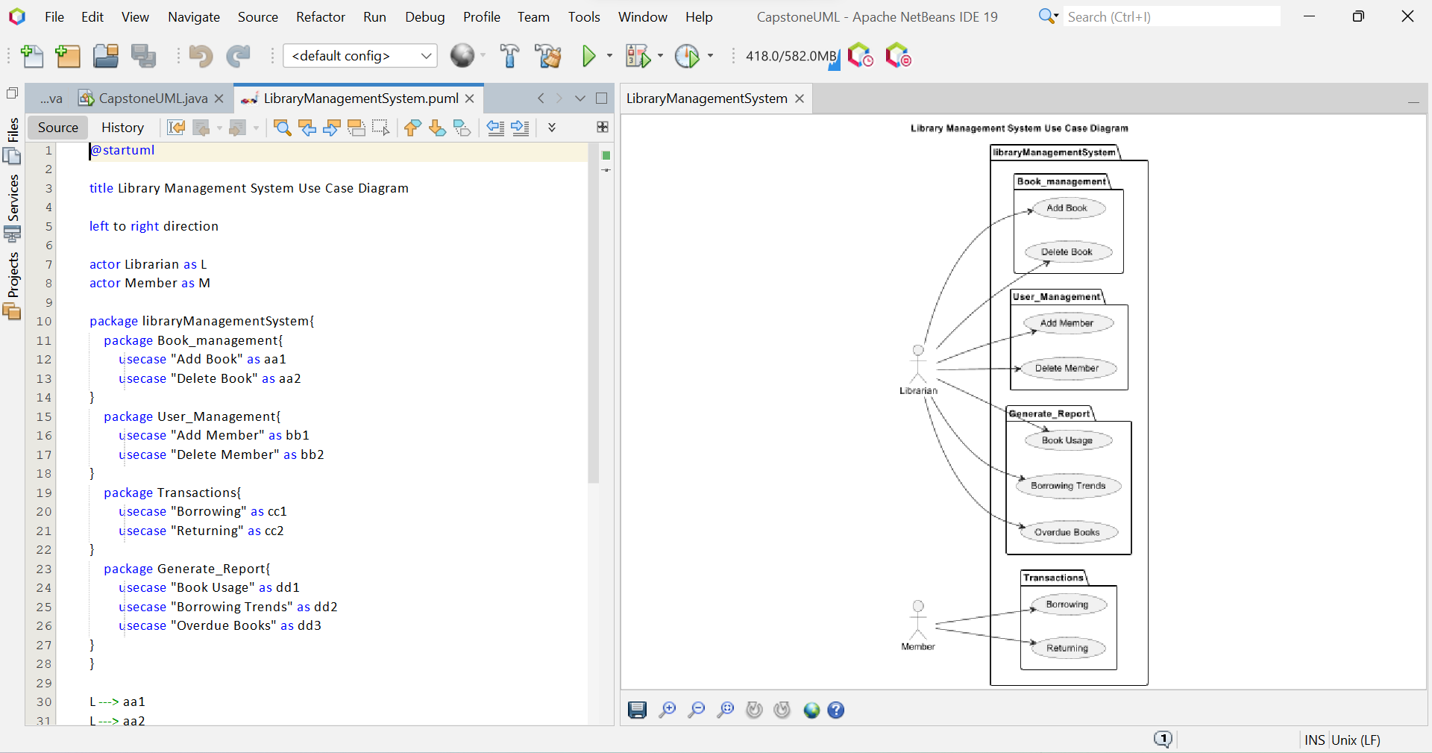
Technical Environment and Tools Used
PlantUML

Slide 14
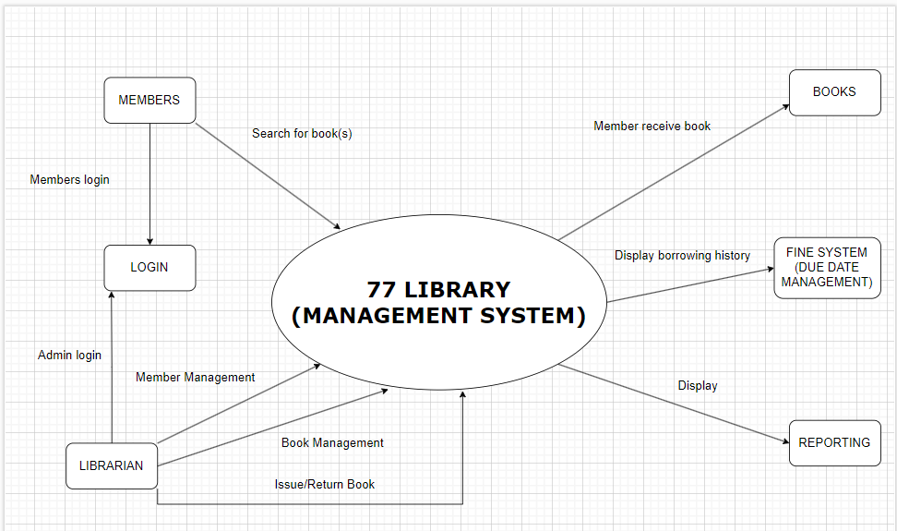
System Design

Slide 15
Classes and Methods
Dao | Entity | Rest
BookRepository | Book -Getters and Setters -Constructors | BookController public List<Book> getAllBooks() public String addBook()
MemberRepository | Member -Getters and Setters -Constructors | MemberController public String updateMember() public String deleteMember()
TransactionRepository | Transaction -Getters and Setters -Constructors | TransactionController public String addTransaction() public String deleteTransaction()

Slide 16
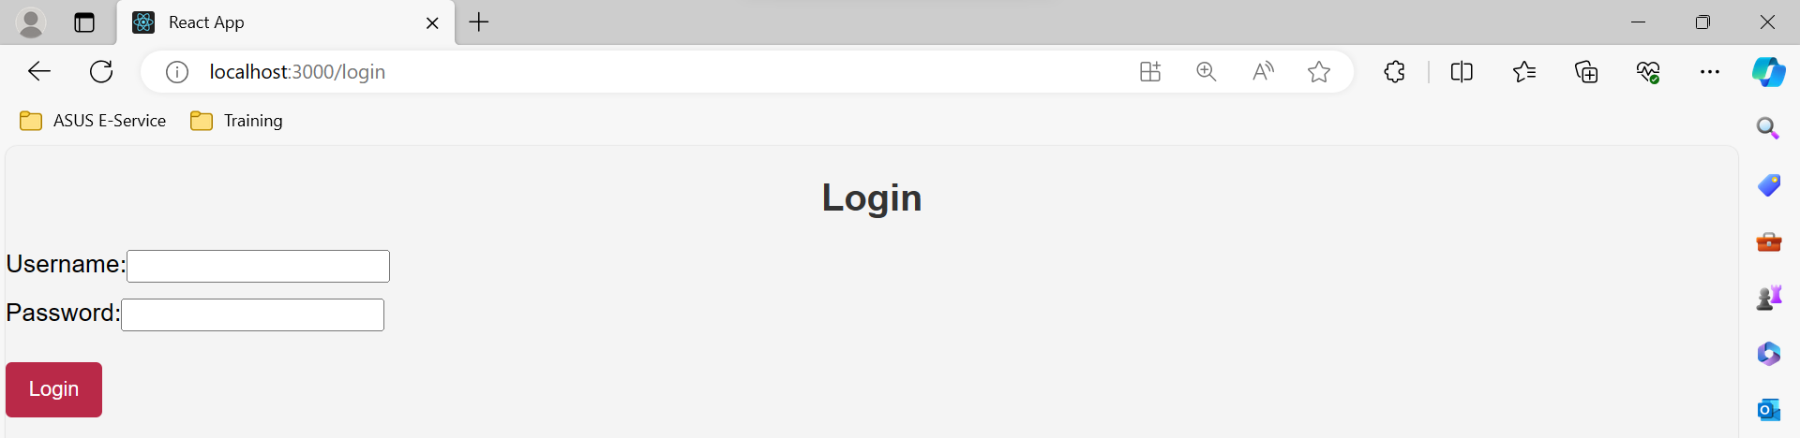
Screen Capture of Web Pages
Login Page

Slide 17
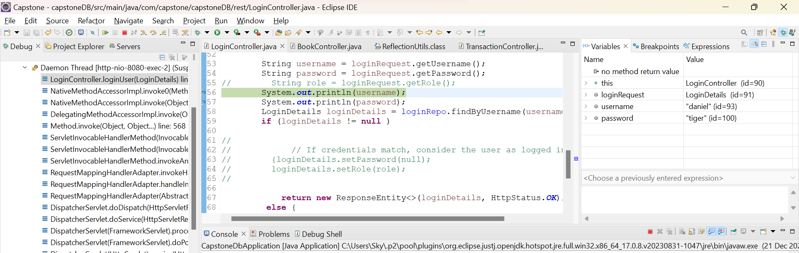
UAT Test Cases
IDE in debugging mode – Login Credentials

Slide 18
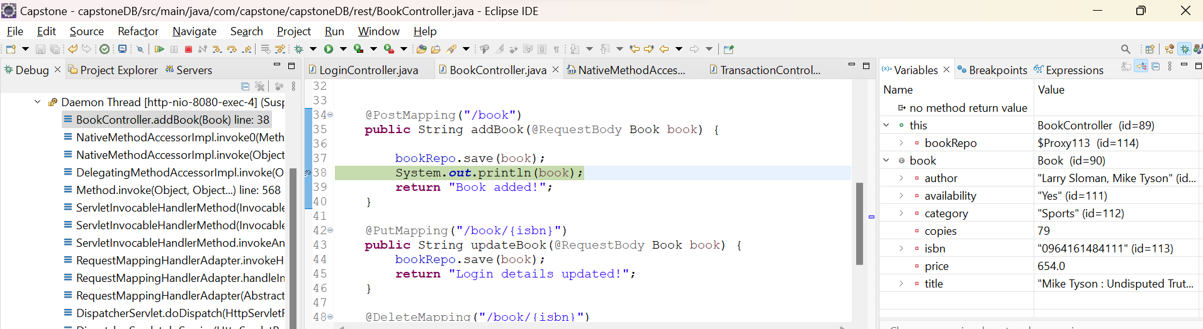
UAT Test Cases
IDE in debugging mode –Testing of book addition

Slide 19
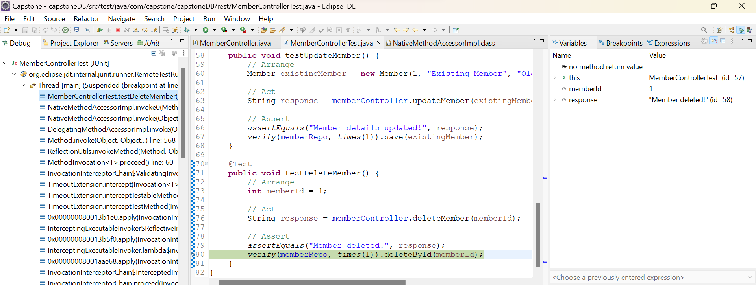
UAT Test Cases
IDE in debugging mode – Testing of member deletion

Slide 20
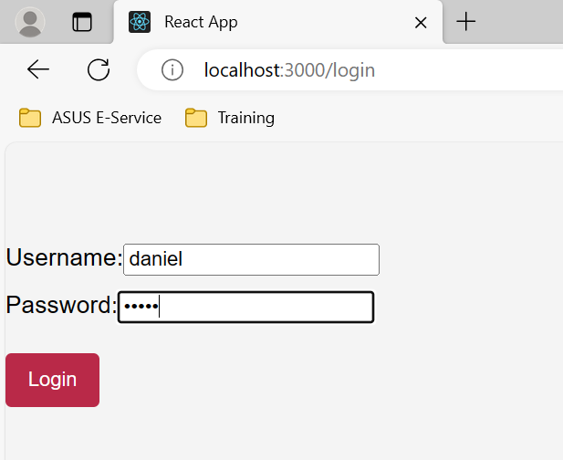
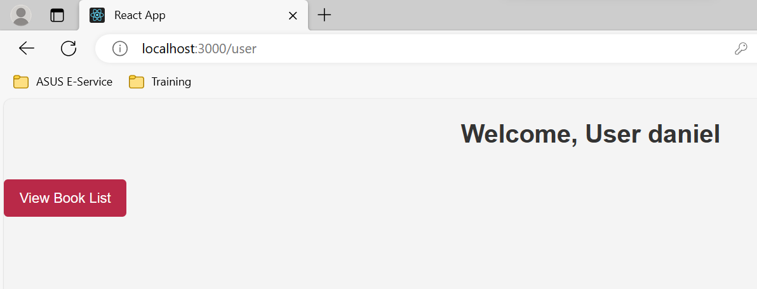
Project Results
Login for user role
After clicking ‘Login’

Slide 21
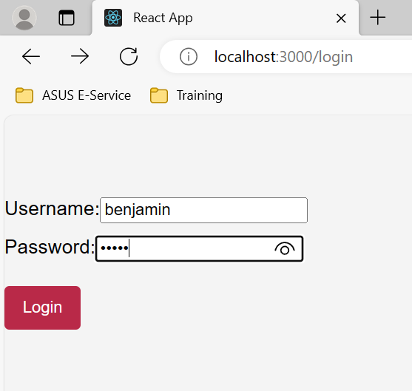
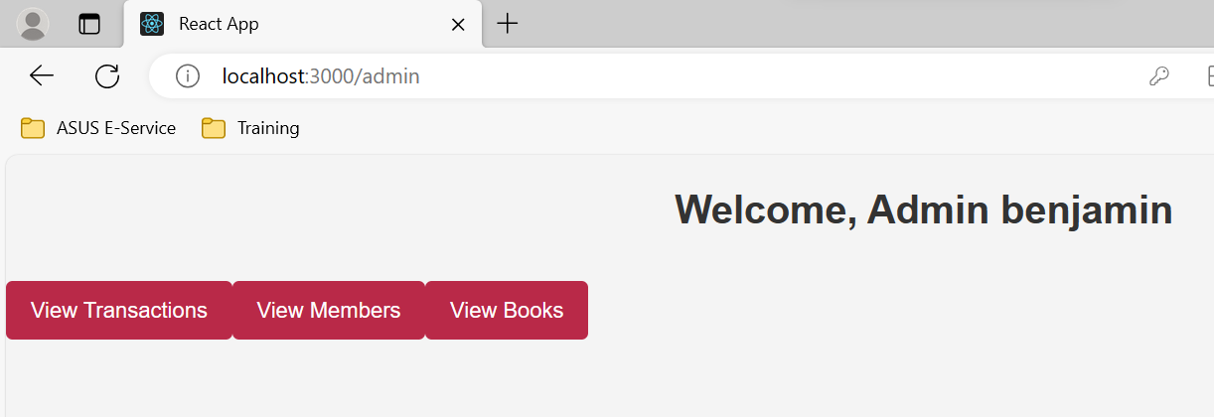
Project Results
Login for admin role
After clicking ‘Login’

Slide 22
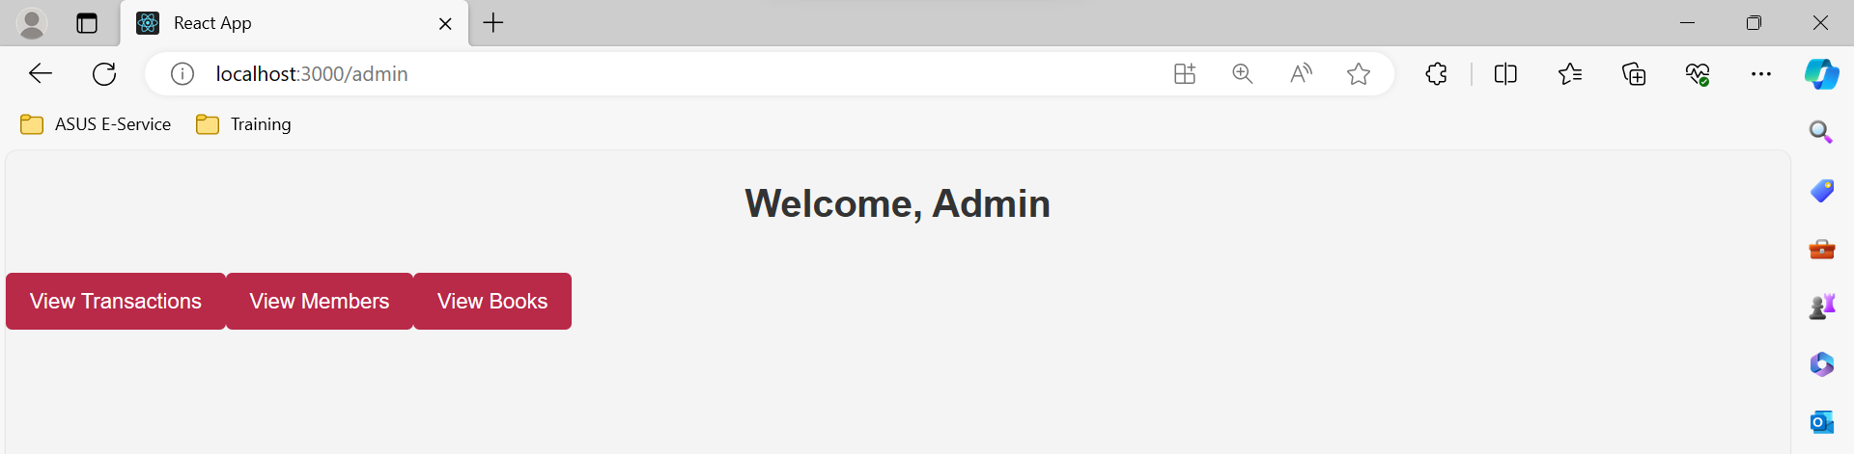
Screen Capture of Web Pages
Admin Page (After Login)

Slide 23
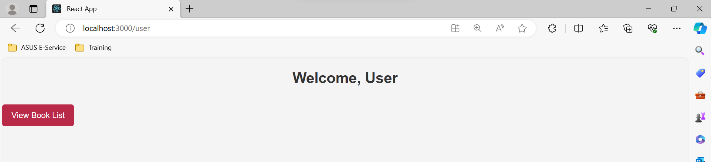
Screen Capture of Web Pages
Member Page (After Login)

Slide 24
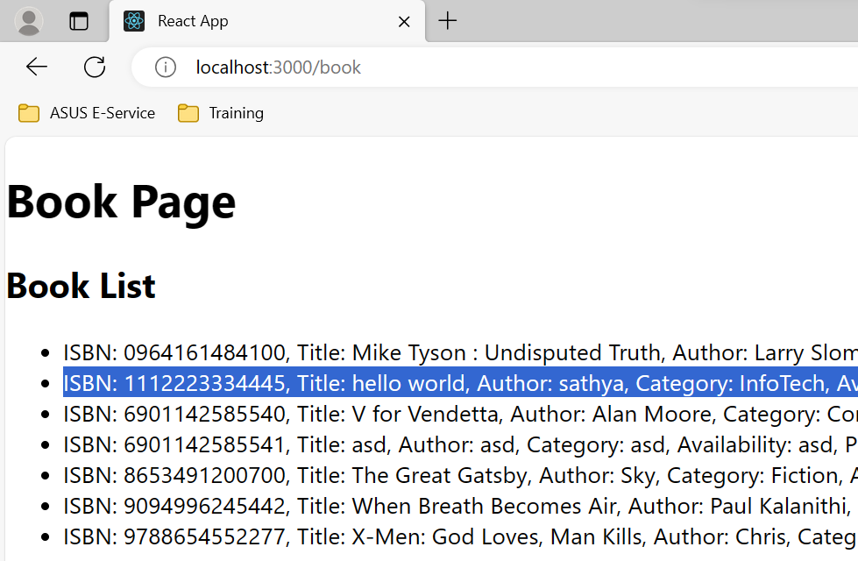
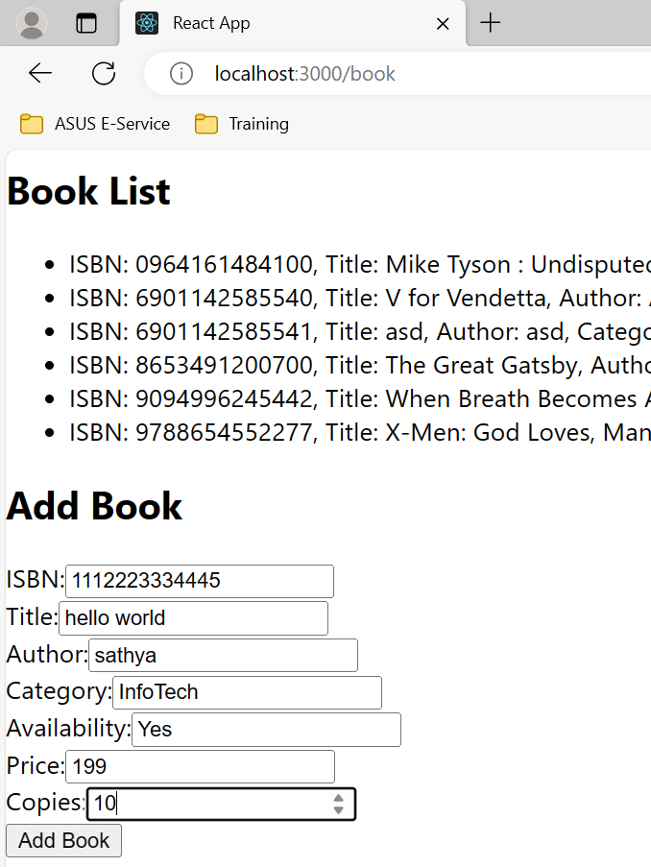
Project Results
Add Book
After clicking ‘Add Book’

Slide 25
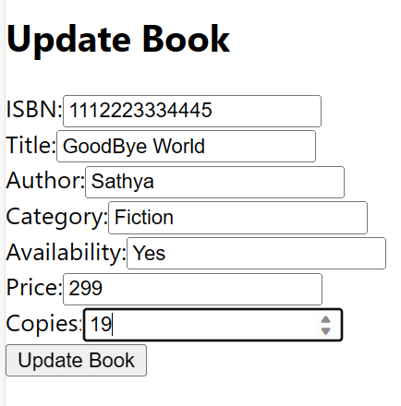
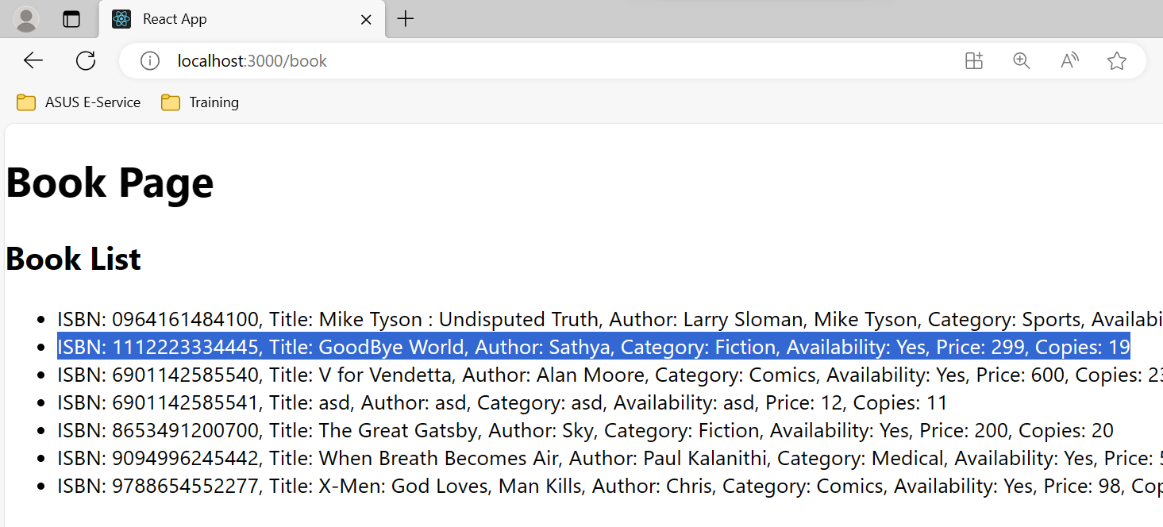
Project Results
MySQL – books Table
Update Book
After clicking ‘Update Book’

Slide 26
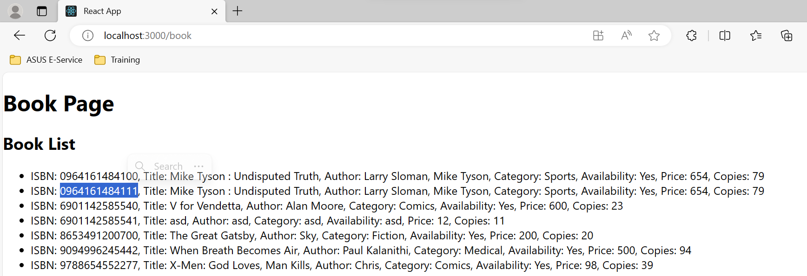
Project Results
Before Delete Book (Take note of highlighted ISBN)

Slide 27
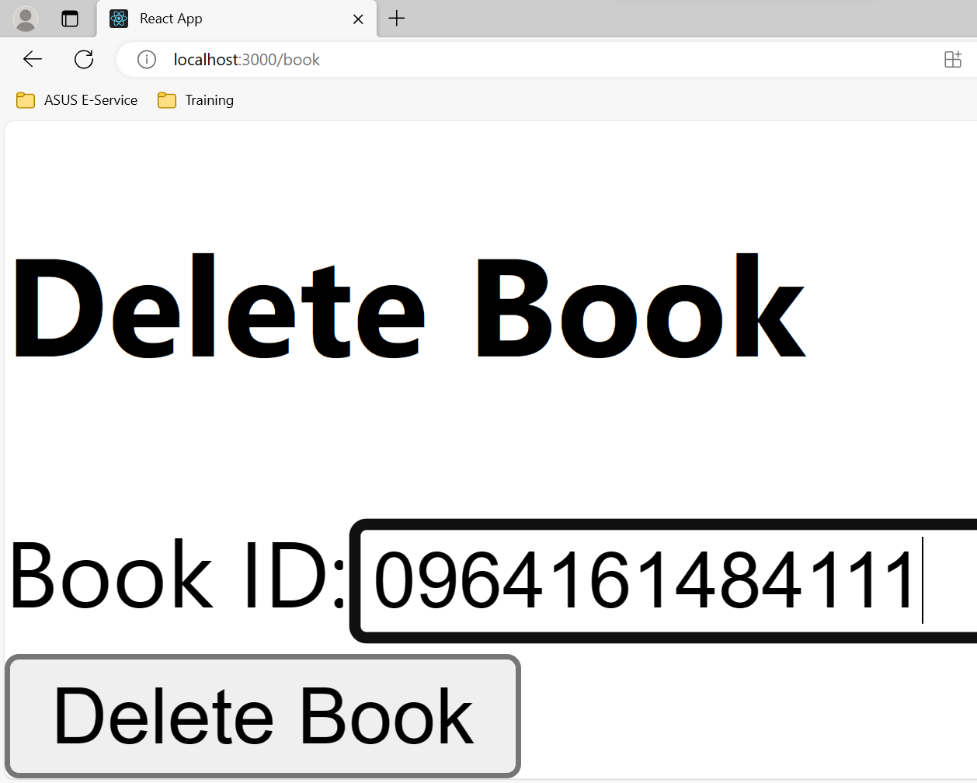
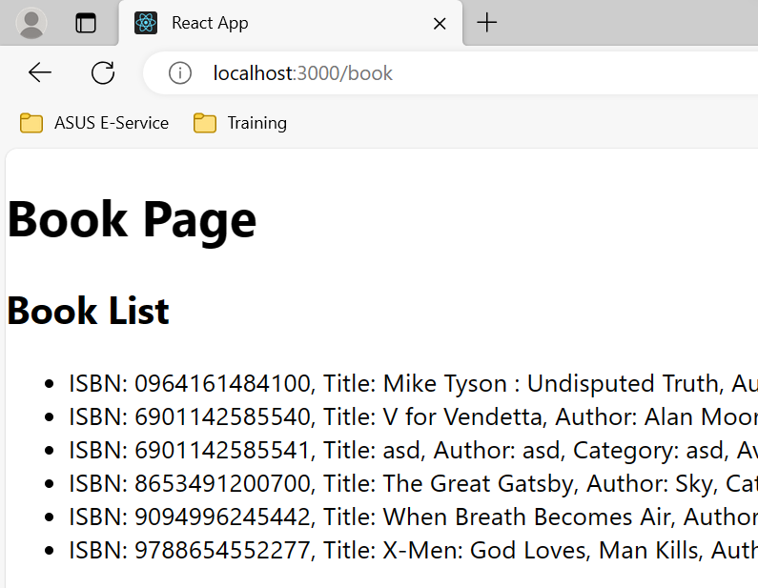
Project Results
After Delete Book
After clicking ‘Delete Book’

Slide 28
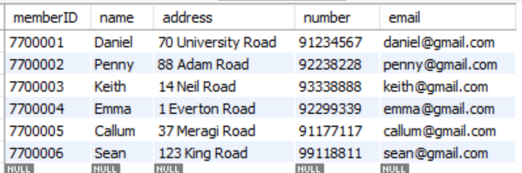
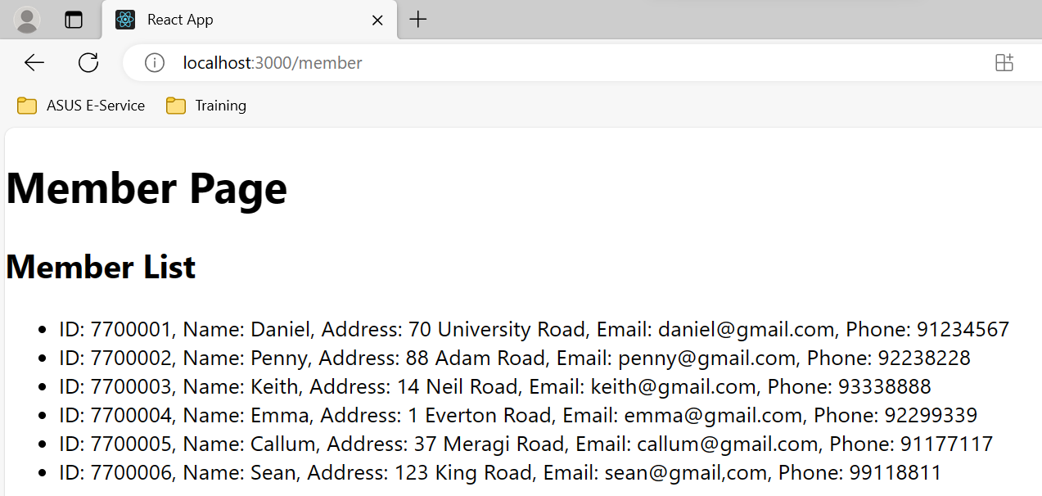
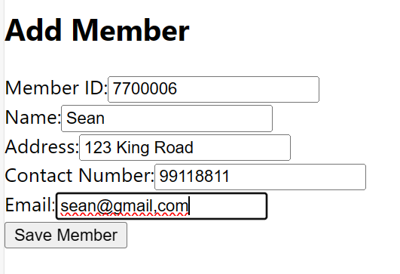
Project Results
Add Member
After clicking ‘Save Member’

Slide 29
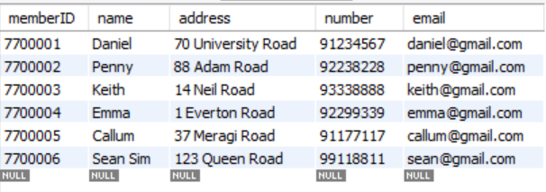
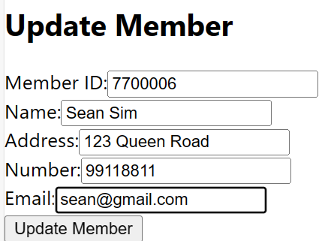
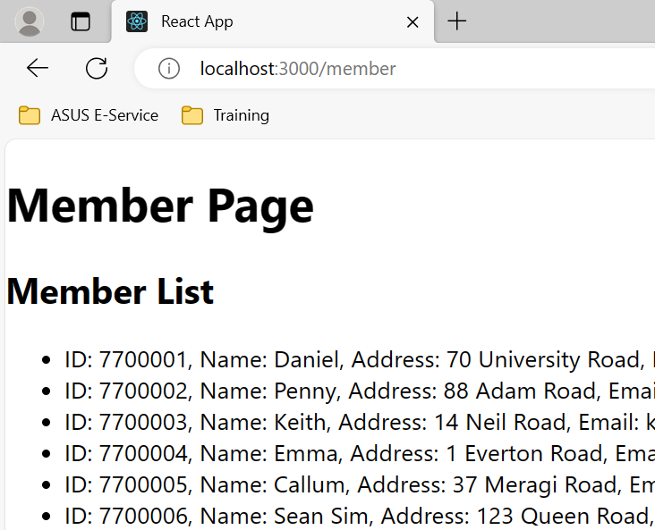
Project Results
Update Member (Name and Address)
After clicking ‘Update Member’

Slide 30
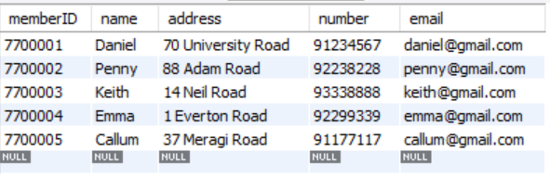
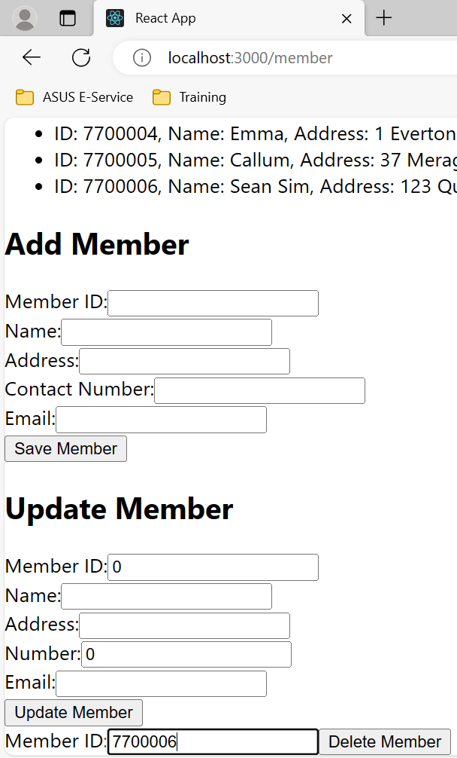
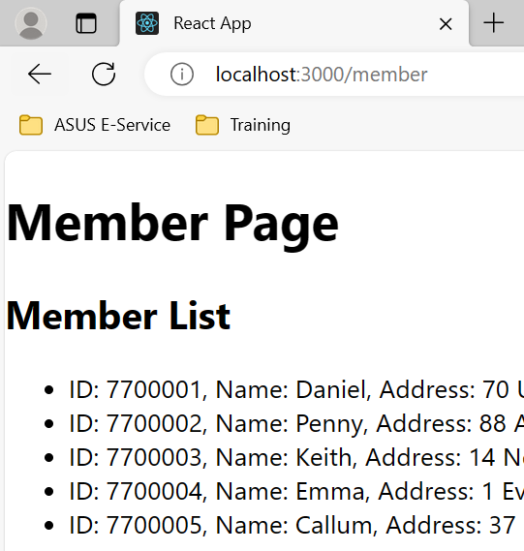
Project Results
Delete Member
After clicking ‘Delete Member’

Slide 31
Proposed Improvements – rephrasing needed
Future plans include the incorporation of password encryption.
Enhancements to achieve responsiveness are on the agenda.
The user interface has room for improvement to enhance user-friendliness.
Presently, librarians manually add members; however, a signup form will be introduced for members to register independently in the future.
The implementation of a search function is pending until more books are added to our library collection.

Slide 32
List of References
List the websites, resources you used
https://www.analyticsvidhya.com/blog/2022/07/library-management-system-using-mysql/
https://www.gutenberg.org/
https://archive.org/
https://chat.openai.com/
https://github.com/

Slide 33

THANK YOU

