Slide 1
Concepts for realizing environment dependent user interfaces in mixed reality scenarios
Oliver Jung
13.12.2018
Kickoff: Bachelor Informatik: Games Engineering
Supervisor: Sven Liedtke

Slide 2
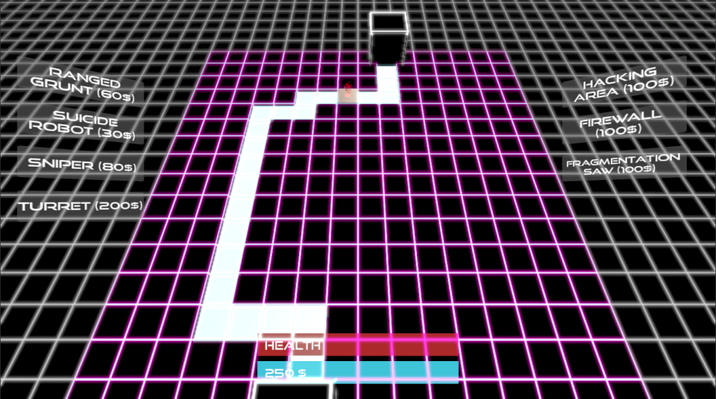
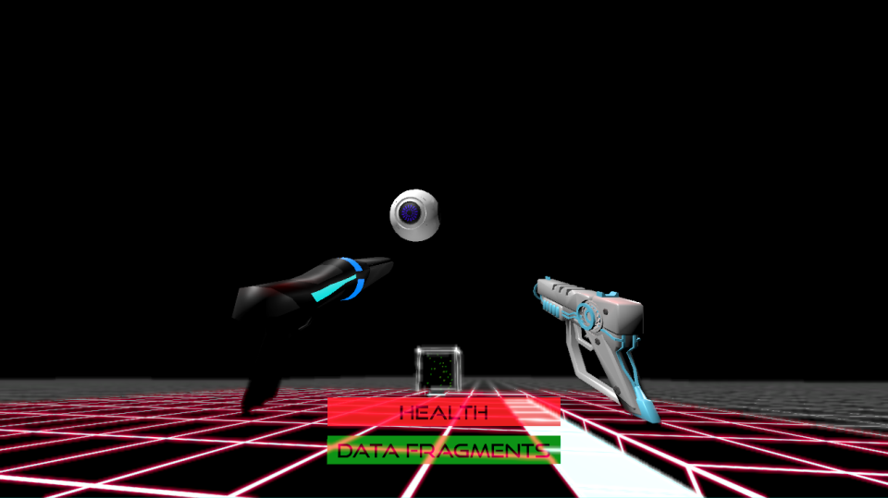

Slide 3
Introduction / Motivation
No usual positioning implemented yet → Only individual implementation for each project
No cross-platform implementation available yet

Slide 4
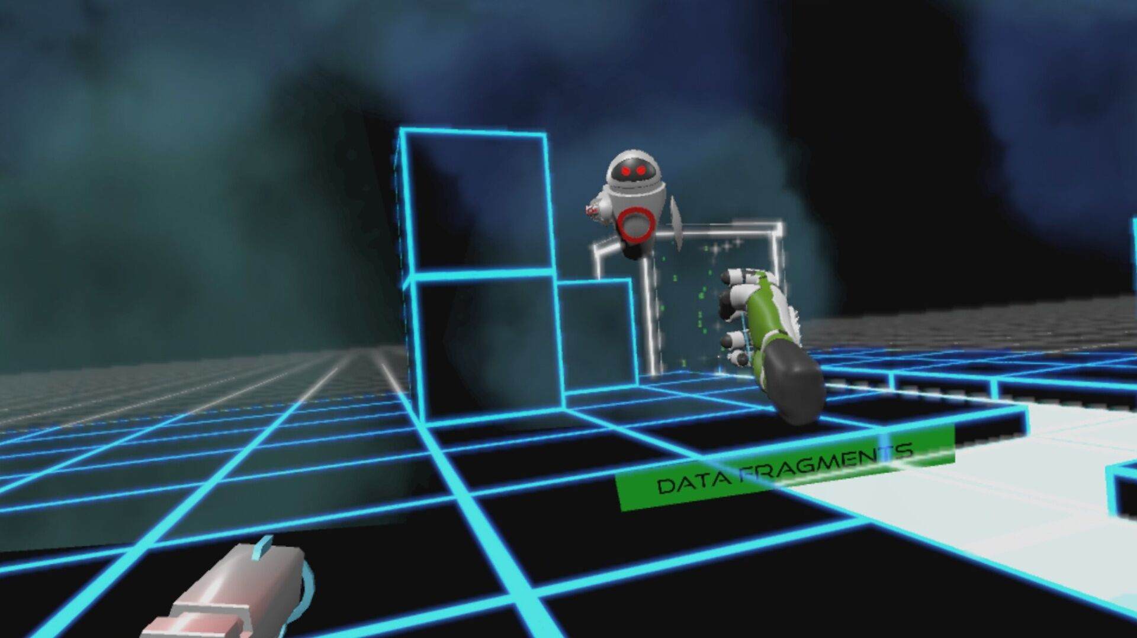

Slide 5
Problem Description: Issues
Define anchor positions for the user interface
Detect missing tracked positions
Initiate transition of UI between anchors

Slide 6
Goals of this Thesis
Develop a concept for positioning UI in mixed reality
Enable usage on different devices

Slide 7
Proposed Work / Approach
Using tracked head and hand positions as anchors
Enable stacking of UI on single anchor with switches or according “main menus”

Slide 8
Discussion of Potential Issues
Transition of complex UI might not work properly
Unwanted hiding of important UI

Slide 9
Time Line
January 1, 2019: Implement anchor positioning
January 15, 2019: Finish testable version
Until February 15, 2019: Finish user survey

Slide 10
Questions?

