Slide 1
Memory Management
Da-Wei Chang
CSIE.NCKU
Source: Abraham Silberschatz, Peter B. Galvin, and Greg Gagne, "Operating System Concepts", 9th Edition, Wiley.

Slide 2
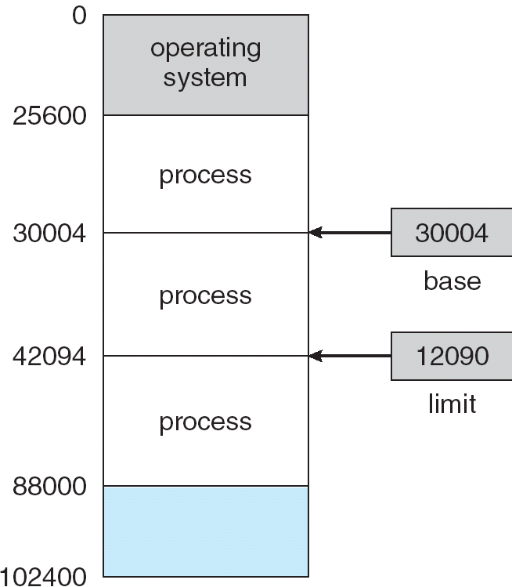
Basic Hardware
Make sure that each process has a separate memory space

Slide 3

Basic Hardware
On each memory access ---
Base and Limit registers are loaded by OS
- prevent user programs from changing the register contents
No address translation, no concept of virtual addresses….

Slide 4
Logical vs. Physical Address Space
Logical address – generated by the CPU; also referred to as virtual address
Physical address – addresses seen by the memory unit
Logical address space
  All logical addresses generated by a program
Physical address space
  Set of physical addresses corresponding to these logical addresses
The concept of a logical address space that is bound to a separate physical address space is central to proper memory management in an OS

Slide 5
Memory-Management Unit
(MMU)
Hardware unit that maps/translates virtual addresses to physical addresses
A simple MMU scheme
  physical addr. = virtual addr. + value in relocation register
The user program deals with logical addresses; it never sees the physical addresses
  Different from the basic HW (slide 2), the logical address starts from 0

Slide 6

Dynamic Relocation Using a Relocation Register

Slide 7

Ref: Swapping - Dealing with Limited Memory
A process can be swapped temporarily out of memory to a backing store, and then brought back into memory for continued execution

Slide 8
Ref: Swapping
Whenever the CPU scheduler decides to execute a process
  Check to see if the process is in memory
  Swap in if necessary
  Swap out (another) if necessary
Major part of swap time is transfer time; total transfer time is directly proportional to the amount of memory swapped
  Swap in/out involves disk IO
    Swap in a 10MB process on a disk with 40MB/s bandwidth
      250 ms ( usually larger than a time quantum in RR!!!)
  Reduce the transfer size
    Swap what is actually used….(we will see later )

Slide 9
Memory Allocation
Which memory addresses should be allocated for a process?
Main memory is usually separated into two partitions
  Resident operating system, usually held in low memory with interrupt vector table
  User processes then held in high memory
    So, the high-memory area can be allocated to processes

Slide 10
Contiguous Allocation
A process is allocated a range of physical addresses
Memory mapping and protection
  Can be implemented by the relocation-register scheme
    protect user processes from each other, and from changing operating-system code and data
  Relocation register: records the smallest physical address of the process
    Translate logical address to physical address
  limit register: max logical addresses + 1
    Valid logical address ranges from 0 to (limit -1)

Slide 11
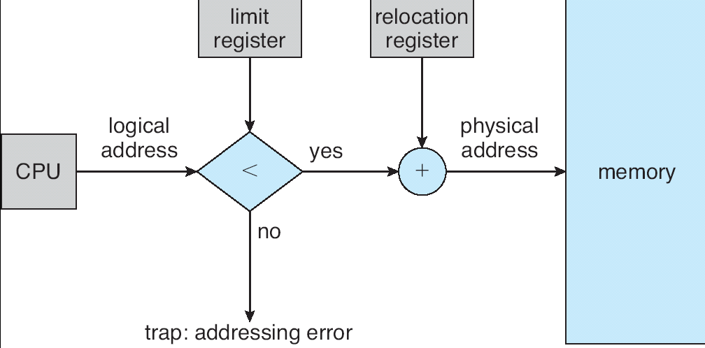
HW of Relocation and Limit
Registers
.Valid logical address (0, limit -1 )
.The register values will be “switched” during context switches

Slide 12
Contiguous Allocation
At any time, memory consists of a set of variable-sized used partitions and free partitions (i.e. holes)
When a process needs to be brought into memory, we need a hole (that is large enough) to accommodate the process
After the allocation, the values of the relocation and limit registers are determined.
How to satisfy a request of size n from a list of holes ?
  First-fit: Allocate the first hole that is big enough
  Best-fit: Allocate the smallest hole that is big enough; must search entire list, unless ordered by size. Produces the smallest leftover hole.
  Worst-fit: Allocate the largest hole; must also search entire list. Produces the largest leftover hole.
First-fit is better than best/worst-fit in terms of speed
Best-fit is better than worst-fit in terms of storage utilization

Slide 13
Fragmentation
External Fragmentation – small holes; total free memory is large enough to satisfy a request, but it is not contiguous

Slide 14
Paging
Physical address space of a process can be noncontiguous
  process is allocated physical memory whenever the latter is available
Idea
  Divide physical memory into fixed-sized blocks called frames (size is power of 2, between 512 bytes and 8192 bytes)
  Divide logical memory into blocks of same size called pages
  To run a program of size n pages, the OS needs to find n free frames and then load the program
    Keep track of all free frames
  Set up a page table to translate logical to physical addresses
Internal fragmentation

Slide 15

Paging Model of Logical and
Physical Memory
.May have internal fragmentation
- average 1/2 page per process
.No external fragmentation
- every frame is useful

Slide 16
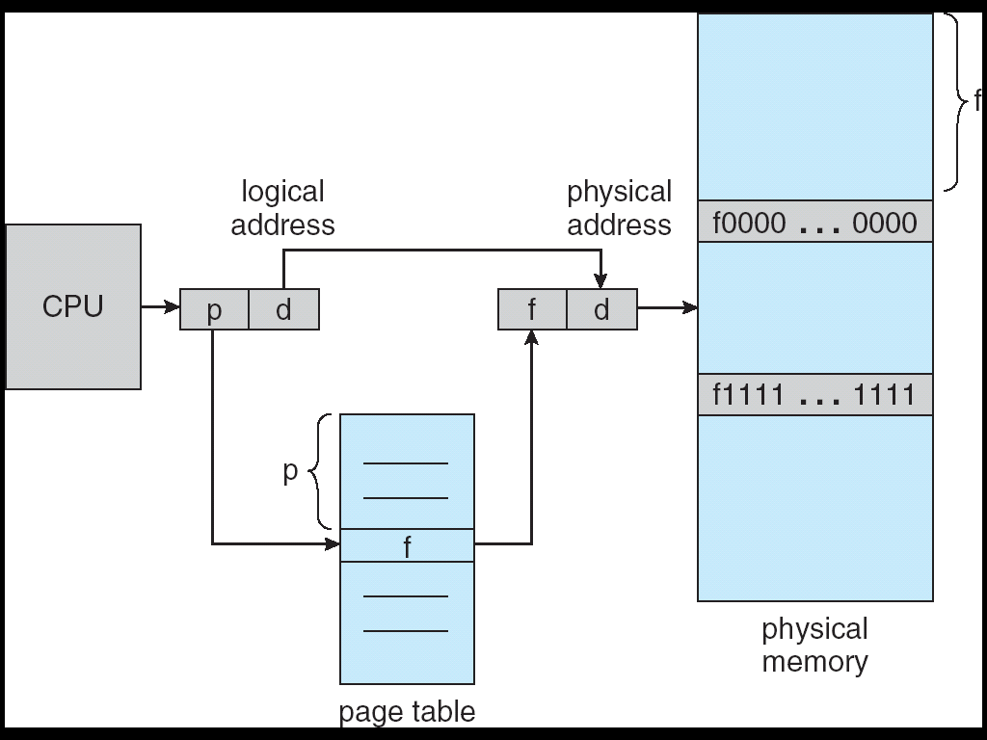
Paging Hardware
f
p : page number
d : page offset
m - n n bits

Slide 17

Paging Example (for 4-byte Page)
Logical addr (LA) 0 ➔ page 0, offset 0 ➔ frame 5 ➔ physical addr (PA) 5*4 +0 = 20
LA = 5 ➔ PA = ?

Slide 18

Allocating Frames to a Process
.A system-wide free frame list is maintained by the OS
Before allocation
After allocation

Slide 19
Paging
Paging provides a clear separation between the user’s view of memory and the actual physical memory
  User program views memory as a contiguous space
  the single space map to non-contiguous physical frames by the address translation HW
    The HW consults the page table!!
  OS maintains a page table for each process
    Base address of the page table is changed during a context switch
  User process has no way of addressing memory outside of its page table

Slide 20
Implementation of Page Table
Page table is kept in main memory
  For a 4MB process (page size: 4KB) ➔ at least 1K entries ➔ register storage is not big enough!!!
Page-table base register (PTBR) points to the page table of the current process
In this scheme every data/instruction access requires two memory accesses. One for the page table and one for the data/instruction.
The two-memory-access problem can be solved by the use of a special fast-lookup hardware cache called associative memory or translation look-aside buffers (TLBs)

Slide 21
TLB
A TLB entry has at least two fields
  Key (tag) : virtual page number
  value : physical page (frame) number
Fully associative memory
  Content search in TLB is done by HW
Typically, 64 to 1024 entries
  Cannot contain the full content of a page table, just a cache

Slide 22

Paging Hardware with TLB

Slide 23
TLB Miss
On a TLB miss
  insert the information about the PTE into the TLB
    Page number, frame number
  TLB full?
    Replacement
      Random
      LRU (Least Recently Used)
  Some TLB entries can be wired-down
    System will never remove these entries from the TLB
    Entries for kernel code are typically wired-down

Slide 24
Effective Access Time
Associative Lookup (TLB) = t time units
Assume memory cycle time = m time units
Hit ratio – percentage of times that a page number is found in the associative registers
Hit ratio = α
Effective Access Time (EAT)
EAT = α (m + t) + (1 – α)(2m + t)
e.g., t = 20ns, m = 100ns, α = 0.8
EAT = 0.8*120 + 0.2*220 = 140ns

Slide 25
Memory Protection
Memory protection implemented by associating protection bit with each PTE
  Read-only, read-write, execute-only
  Exceptions (traps) happen for illegal accesses
    memory protection violations

Slide 26
Structures of Page Tables
Hierarchical Paging
Hashed Page Tables
Inverted Page Tables

Slide 27
Ref: Hierarchical Page Tables
Large logical address space
  2³² – 2⁶⁴
  For 4KB pages, 2³² requires 1M PTEs
    Contiguous memory is required for each PT
    Required space 1M * PTE size * process number !!!!
A lot of memory is required for PTs
Break up the logical address space into multiple page tables to reduce the memory requirement
  Split a page table into several pages and use extra levels of PTs
A simple technique is a two-level page table

Slide 28

Ref: Two-Level Page-Table Scheme
Page table doesn’t need to be contiguous
May use less memory
-not all pages of the table need to be presented!!!

Slide 29
Ref: Two-Level Paging Example
A logical address (on 32-bit machine with 4K page size) is divided into:
  a page number consisting of 20 bits
  a page offset consisting of 12 bits
Since the page table is paged, the page number is further divided into:
  a 10-bit page number
  a 10-bit page offset
Thus, a logical address is as follows:
where p₁ is an index into the outer page table, and p₂ is the offset within the page of the outer page table; p₂ is used to index the (inner) page table
page number
page offset
p₁
p₂
d
10
10
12

Slide 30

Ref: Address-Translation Scheme
Address-translation scheme for a two-level 32-bit paging architecture

Slide 31
Ref: Hierarchical Page Tables
Some systems use more levels of PT
  SPARC (32bit) : 3 levels
  Motorola 68030 (32bit) : 4 levels
On 64-bit systems, more levels should be used
  UltraSPARC (64bit) : 7 levels

Slide 32
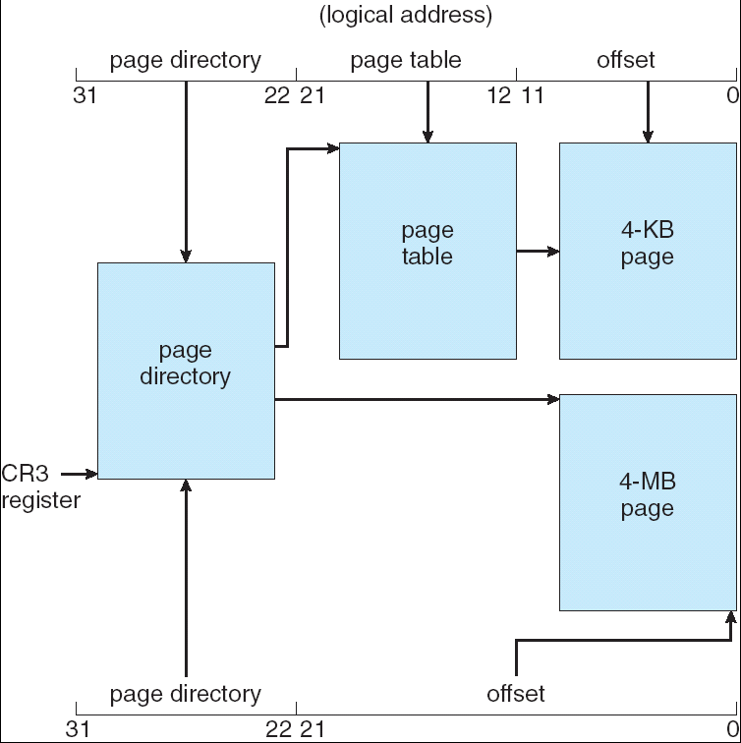
Ref: IA-32 Paging
linear address
PPN
PPN

Slide 33
Demand Paging
Bring a page into memory only when it is needed
  Less I/O needed
  Less memory needed
  Faster response
  More users
Page is needed? ⇒ reference to the page
  invalid reference ⇒ abort/exception
  not-in-memory ⇒ bring to memory

Slide 34
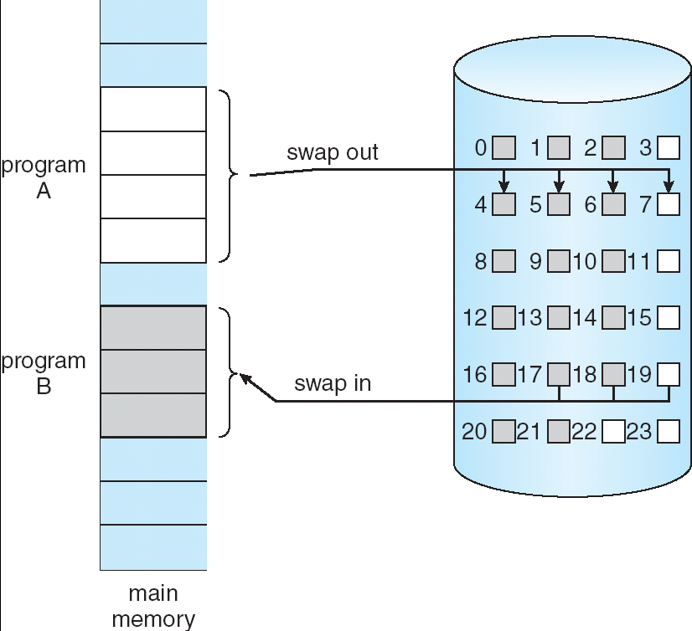
Transferring Pages between
Memory and Disk
Demand paging is similar to a paging system with swapping
However, it uses a lazy swapper ➔ swap in a page only when the page is needed
The lazy swapper is called pager…

Slide 35

Not-in-Memory Pages
How do we know if a page is in memory or not?
Present bit
P
NP
P
NP
NP
P
NP
NP
A page fault happens when a process tries to
access a page that is not in memory

Slide 36

Steps in Handling a Page Fault
NP
In the pure demand paging scheme
-never bring a page into memory until it is required
-a process is started with no pages in memory

Slide 37
Page Replacement
Swap in a page when all the frames are occupied ➔ page replacement is needed
Page-fault service routine needs to deal with page replacement

Slide 38

Need for Page Replacement
Present bit
P
P
P
NP
Present bit
P
NP
P
P

Slide 39
Page Fault Steps
Find the location of the desired page on disk
Find a free frame
- If there is a free frame, use it
- If there is no free frame, use a page replacement algorithm to select a victim frame
Write the page in the victim frame to the disk (i.e., page out) if the page is dirty
Read the desired page into the (newly) free frame (i.e., page in)
Update the page tables
Restart the process

Slide 40

Page Replacement
Present bit
100
NP
P
not-present
100
101
101
.Use modify (dirty) bit to reduce overhead of page transfers – only modified pages are written to disk
.Page replacement completes separation between logical memory and physical memory – large virtual memory can be provided on a smaller physical memory

Slide 41

Number of Page Faults vs.
Number of Frames
Page faults slow down the system
A good page replacement algorithm should not cause high page faults…

Slide 42

FIFO Page Replacement
15 page faults in this case
FIFO is not always good
  - e.g. first-in != seldom-used
Suffers from the belady’s anomaly

Slide 43

Belady’s Anomaly
Page reference string: 1 2 3 4 1 2 5 1 2 3 4 5
Belady’s anomaly: page fault rate may increase as the number of allocated frames increases

Slide 44
Stack Algorithms
Can be shown that the set of pages in memory for n frames is always a subset of the set of pages that would be in memory with n+1 frames
Never exhibit belady’s anomaly
FIFO is not a stack algorithm, prove it by yourself…
  You can test the cases of 3 & 4 frames

Slide 45

Optimal Page Replacement
Replace the page that will not be used for the longest period of time
9 faults in this case
Has the lowest page fault rate
Never suffers from the belady’s anomaly
Optimal, but NOT Feasible !

Slide 46

LRU (Least Recently Used)
Replace the page that has not been used for the longest period of time
  Use the recent past as the approximation of the near future
12 faults in this case
Never suffers from the belady’s anomaly
How to implement ?
  -Clock counters (Timers)
  -Stack

Slide 47
LRU Implementation Based on Timer
Associate with each PTE a time-of-use field (i.e. clock counter)
Access the page ➔ update the field with current time
Problems
  Requires a search of the PT to find the LRU page
  Clock counters can overflow

Slide 48

LRU Implementation Based on
Stack
at
at
Record the access order, instead of the absolute access time
Use doubly-linked list to implement the stack
- because removal from the stack is needed

Slide 49
LRU Approximation - Second Chance Algorithm (Clock Algorithm)
  Need reference bit
    HW sets the bit as 1 when the page is accessed
  Clock replacement
    OS scans the PTEs in a clock order
    If the page has reference bit = 0 ➔ replace it
    If the page has reference bit = 1
      set reference bit as 0
      leave the page in memory
      check next page in clock order
  If the page is accessed often enough, it will never been replaced

Slide 50

Second-Chance (Clock)
Page-Replacement Algorithm
Use a circular queue to implement

