Slide 1
Predicting logD for Rare-Earth Solvent Extraction
Using LLM-assisted coding to predict logD and judge how well an extractant separates two f-elements, with calibrated confidence and a comparison with Dr. Zhang's model
Skyler Epstein

Slide 2
Dataset
The goal is to predict how well an extractant separates two f-elements, with logD (the log of the distribution coefficient, D) as the target. The inputs are molecular descriptors, the SMILES string, molecular fingerprints, and environmental factors such as pH and temperature.
8,075
measurements
295
distinct extractants
28
f-element metals
~17.5
log-unit range of logD

Slide 3
Two prediction tasks
The tasks are kept apart so a molecule cannot leak across training and testing, which would inflate the score.
Track A: screen a new molecule
molecule-grouped cross-validation
R-squared 0.466 RMSE 1.148
Most confident 10 percent: R-squared 0.912, RMSE 0.493
Track B: optimize conditions
condition-key CV (honest)
R-squared 0.61 RMSE 0.979
Most confident 10 percent: R-squared 0.874, RMSE 0.430

Slide 4
Definitions
Confidence score: a second model estimates how far off each prediction is likely to be, so a small estimated error means high confidence.
Most confident 10 percent (or 25, or 50): the fraction of predictions with the smallest estimated error. Keeping only those gives much higher accuracy.
Uncertainty interval: instead of a single number, the model returns a range of logD values for each prediction.
90 percent interval: a range built to contain the true logD about 90 percent of the time. An 80 percent interval is narrower and contains it about 80 percent of the time.
Coverage: the fraction of points whose true value actually lands inside the interval. We measured 0.89 to 0.90 against the 90 percent target, so the ranges are honest.

Slide 5
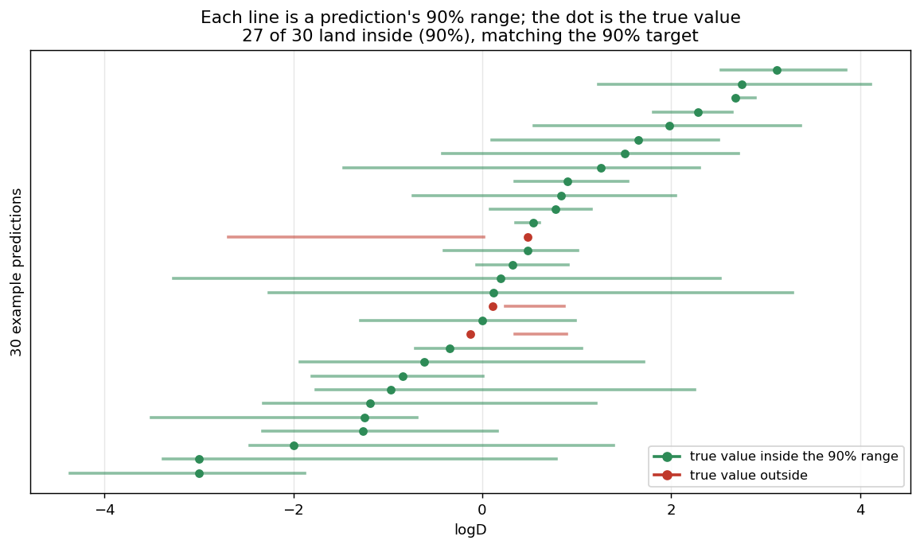
What a 90 percent interval means
The model gives a range, not just a single number. For example, it might predict a logD of 1.5 and report that it is 90 percent sure the true value is between 0.6 and 2.4. Across many predictions, each with its own 90 percent range, the true value should land inside about 90 times out of 100, while an 80 percent range is narrower and contains it about 80 times out of 100.
Coverage is how often this actually happens. Checking every range against the real value, the true logD landed inside the 90 percent range 89 to 90 percent of the time, right on target, which is what it means to say the ranges are honest.

Slide 6
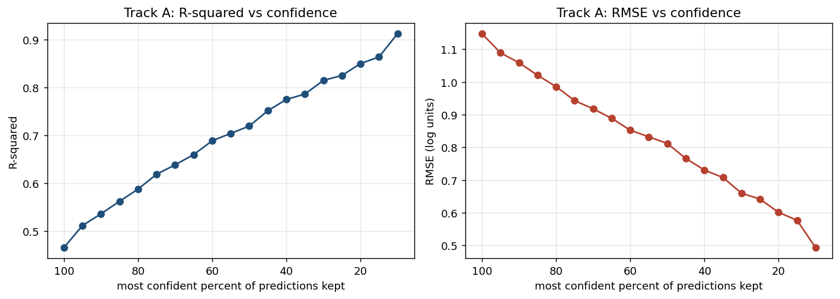
Accuracy versus confidence, Track A
Moving right to left keeps fewer but more confident predictions. The most confident tenth (the tenth with the smallest estimated error) reaches R-squared 0.912 and RMSE 0.493, against 0.466 and 1.148 over all predictions.

Slide 7
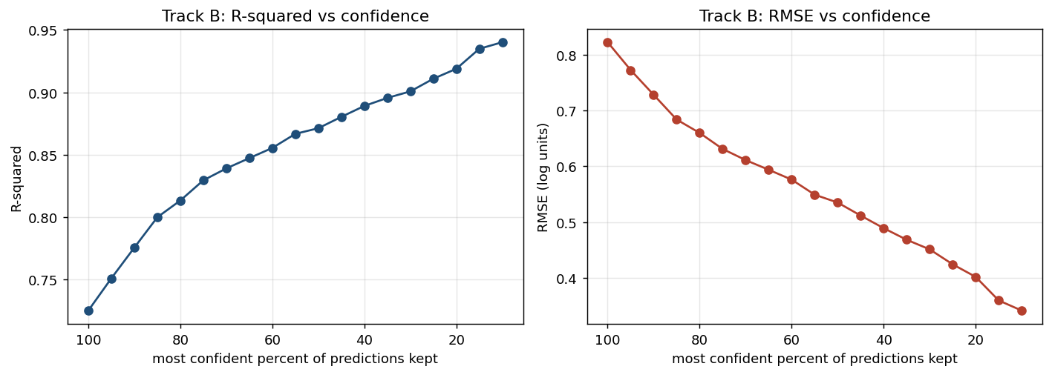
Accuracy versus confidence, Track B
The same pattern holds for condition optimization: the most confident tenth reaches R-squared 0.874 and RMSE 0.430, against 0.61 and 0.979 over all predictions.

Slide 8
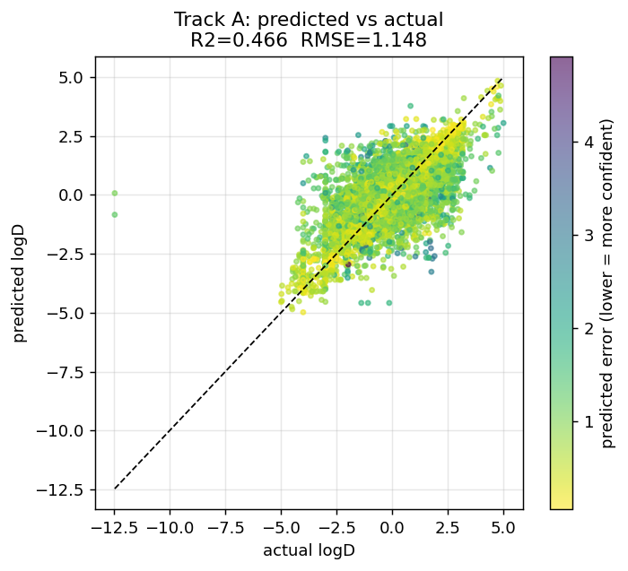
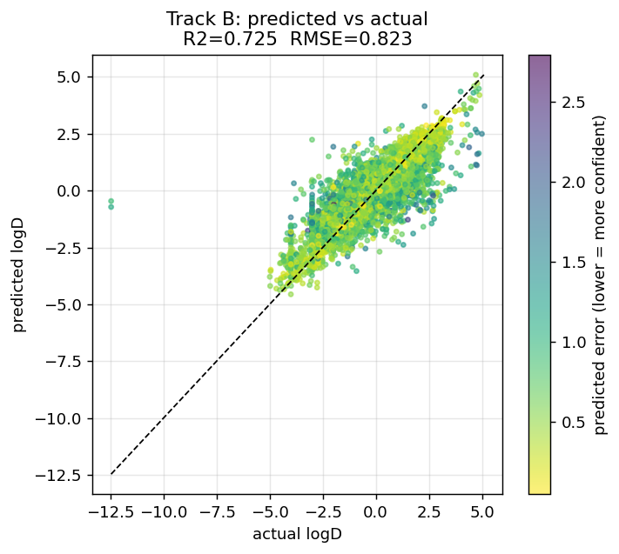
Predicted versus actual logD
Left: Track A, new molecules. Right: Track B, known molecules. Each point is a prediction; darker points are the more confident ones and lie closer to the diagonal, where predicted equals actual.

Slide 9
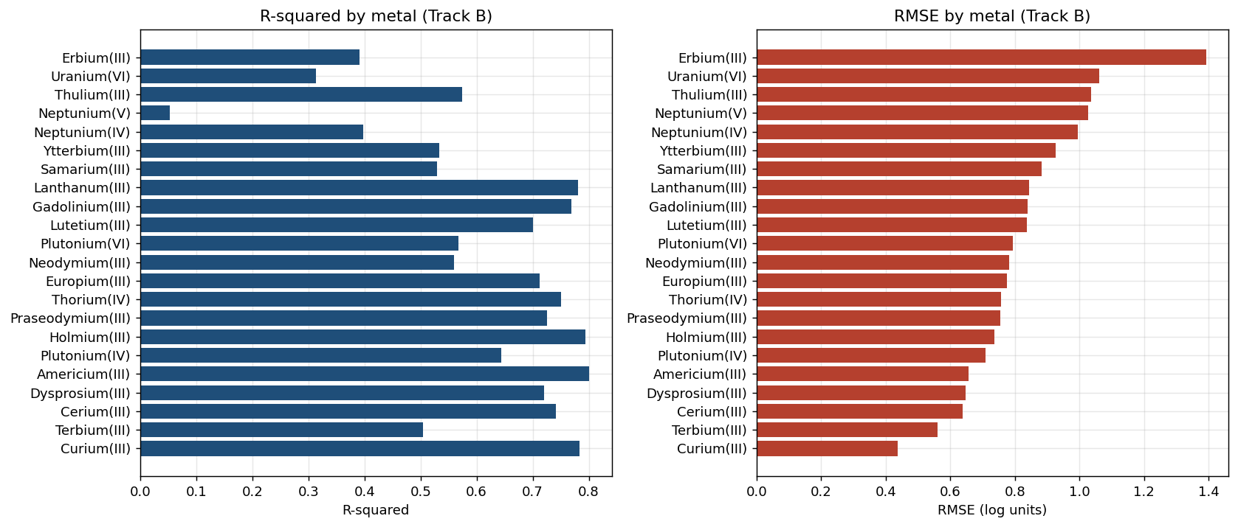
Accuracy by metal
Accuracy is not uniform. It is highest on Americium and Curium and lowest on Neptunium(V), Erbium, and Uranium(VI), so a single overall number hides large differences between metals.

Slide 10
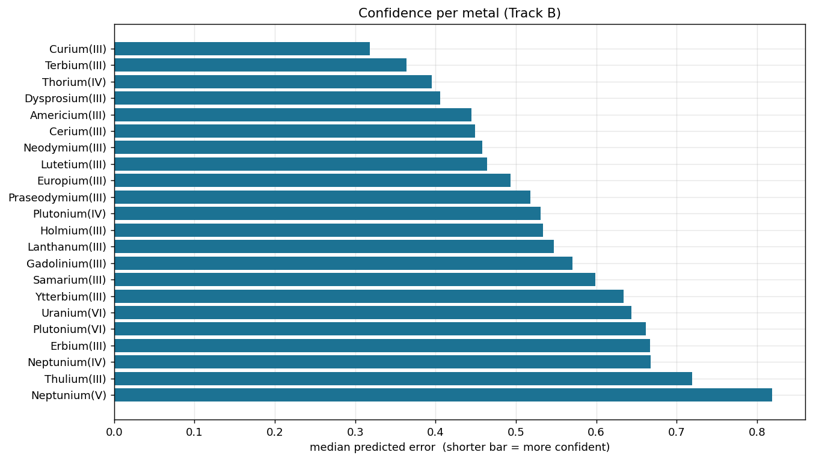
Confidence by metal
Each bar is the model's median estimated error for a metal, which is its confidence signal, so a shorter bar means it is more sure. The model is most confident on Americium and Curium and least confident on Neptunium(V), Uranium(VI), and Erbium.

Slide 11
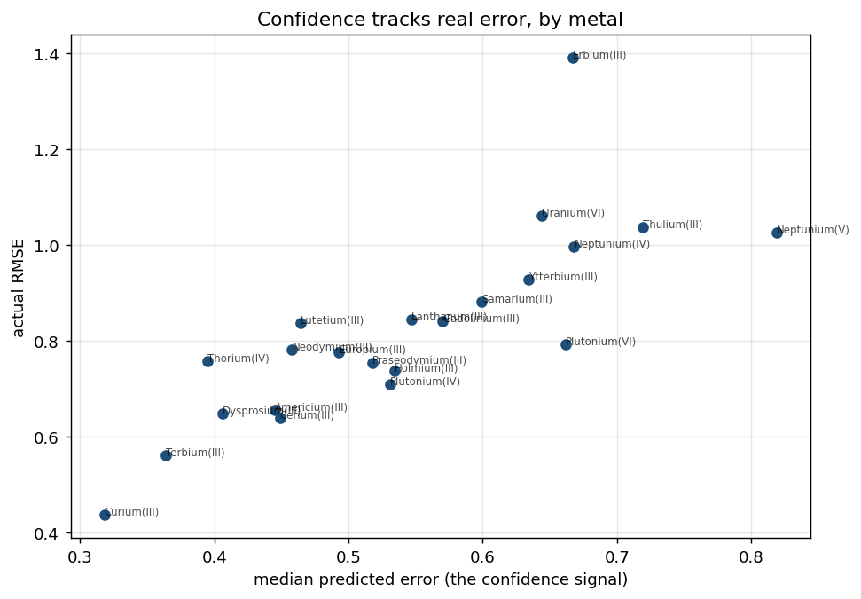
Confidence versus error, by metal
The horizontal axis is the model's estimated error and the vertical axis is the actual error. They line up, so Americium and Curium sit low on both while Neptunium(V), Uranium(VI), and Erbium sit high on both, which is what lets the model flag the metals it cannot predict well.

Slide 12
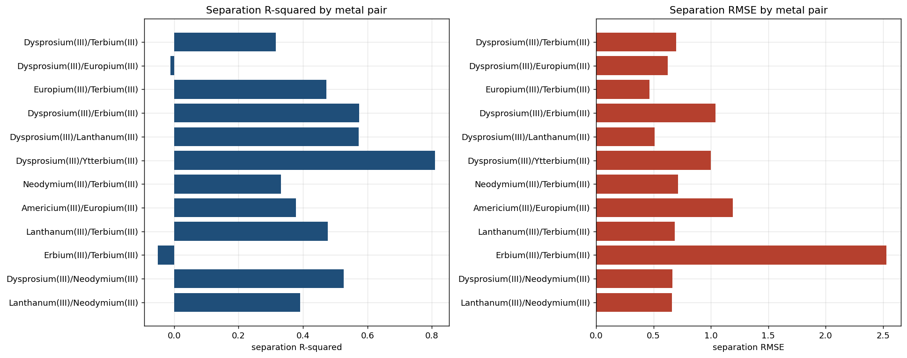
Separation between metal pairs
A separation is the logD difference between two metals at the same conditions. Pairs far apart in logD such as Dysprosium and Ytterbium are predicted well, while tight adjacent pairs such as Erbium and Terbium are hardest, which is the case that matters most for industry.

Slide 13
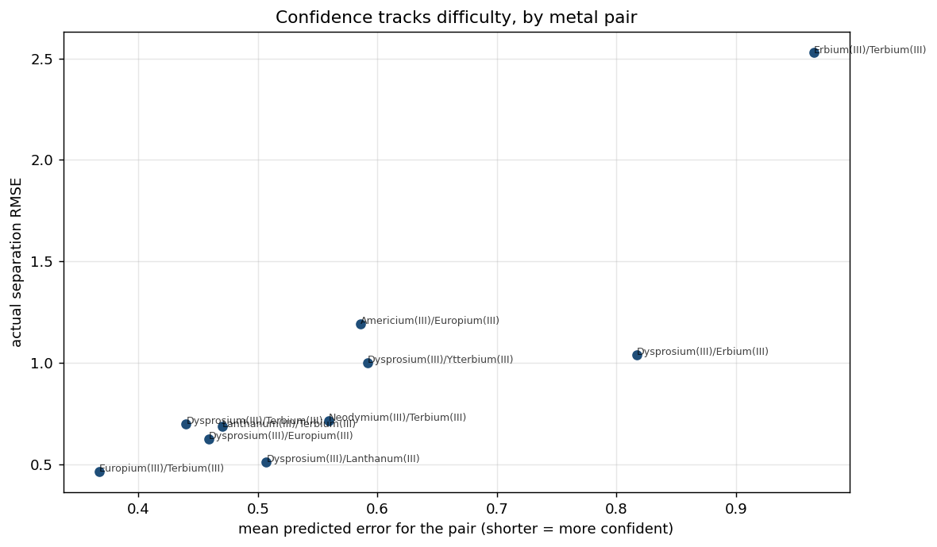
Confidence by metal pair
Confidence behaves the same way on pairs: the model's estimated error for a pair lines up with the actual separation error, so it is most confident on the easy far-apart pairs and least confident on hard adjacent pairs such as Erbium and Terbium.

Slide 14
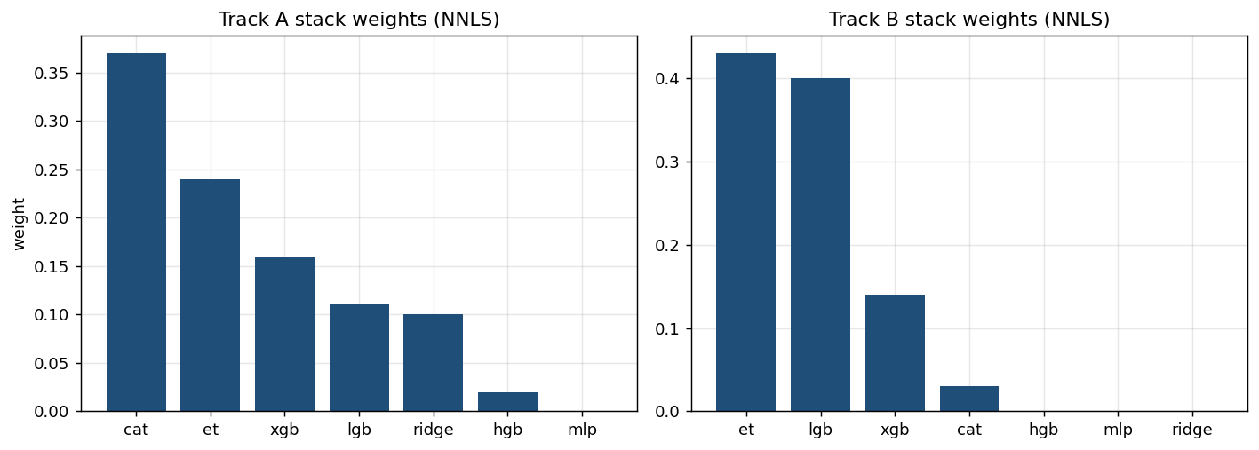
Ensemble weights
Non-negative least squares keeps only the members that help, leaving ExtraTrees, LightGBM, and XGBoost on Track B and dropping the rest to a weight of zero.

Slide 15
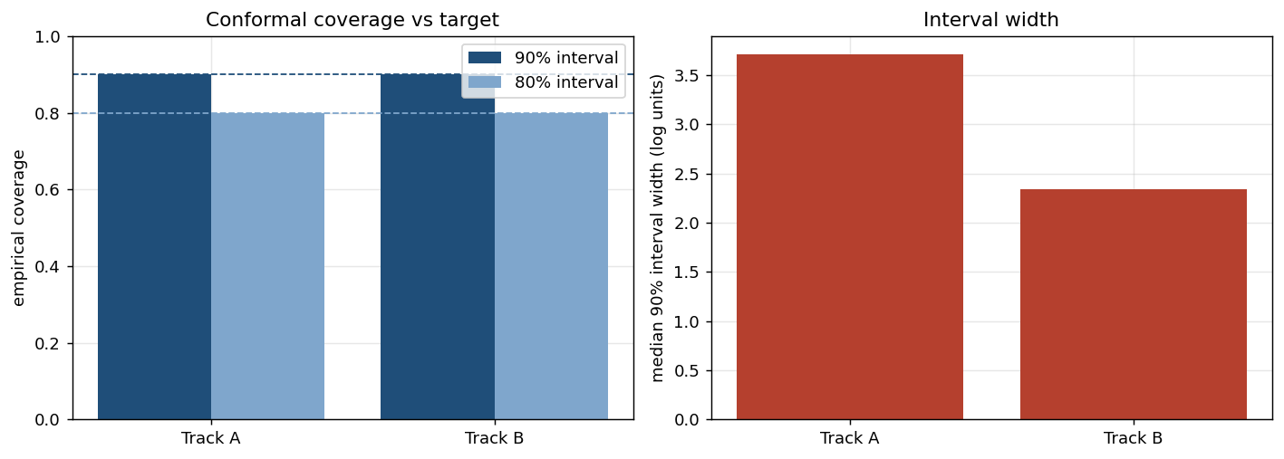
Uncertainty intervals
Each prediction comes with a range. A 90 percent interval is built to contain the true logD about 90 percent of the time, an 80 percent interval about 80 percent. The left bars show the measured coverage (0.89 to 0.90 and 0.79 to 0.80), so the ranges are honest; the right bars show the typical width, narrower on Track B.

Slide 16
Comparison with Dr. Zhang's model
Both projects use the same 8,075-row f-element dataset (295 molecules, 28 metals), so the comparison is fair on the data.
His supervised model is a 3-class XGBoost classifier that reports 72 percent accuracy on one 494-row held-out test, with no way to rank which predictions to trust.
Ours predicts the continuous logD value with a confidence score and an uncertainty interval, and it can also be scored as a classifier on his exact task, which the next slides do.

Slide 17
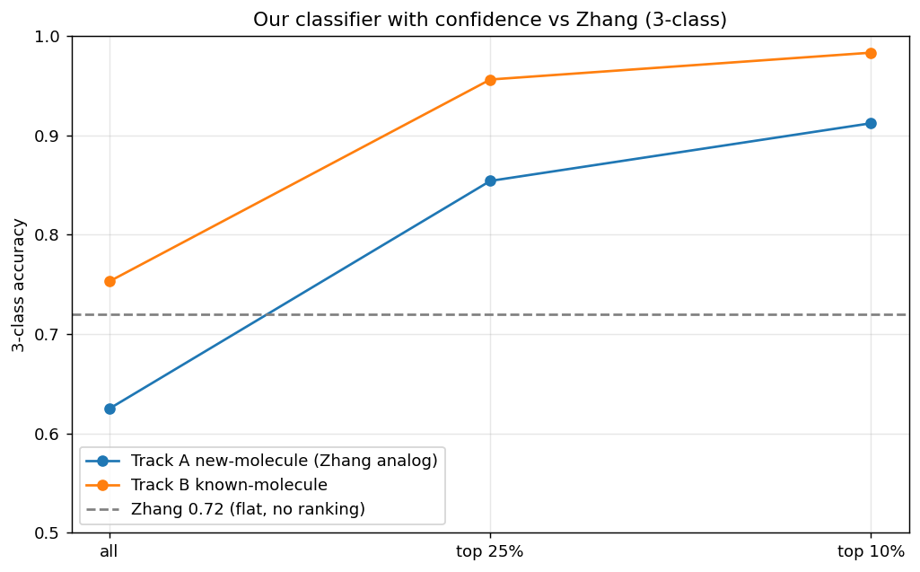
Accuracy by confidence level, versus Zhang
His 0.72 is a single value over all molecules. Ours can be ranked by confidence, so on the predictions it is most sure about it is far more accurate, which a single value cannot offer.

Slide 18
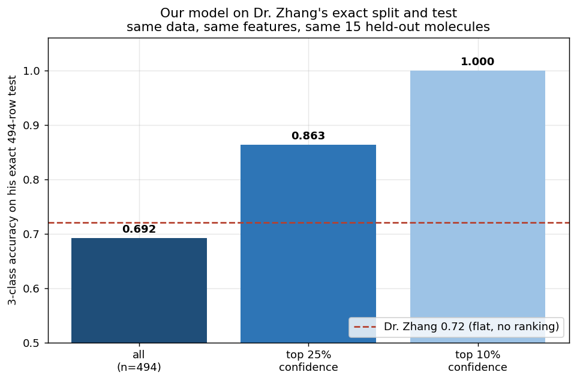
Our model on Dr. Zhang's test set
On his exact 494-row test our model reaches 0.692, essentially matching his 0.72, and our confidence then sorts the reliable predictions to 0.863 over the top quarter and 1.000 over the most confident fifty.

Slide 19
Effect of model and split
 | Our split (cross-validation) | His split (494-row holdout)
Our model (LightGBM) | 0.657 | 0.692
His model (XGBoost) | 0.648 | 0.680 (his tuned: 0.72)
Same data and features throughout. On a common split the two models are about equal, ours slightly ahead, and the single held-out test reads a little higher than cross-validation for both, so the split explains most of the gap rather than the model. The bottom-right is an untuned reproduction of his XGBoost at 0.680, while his grid-tuned version reported 0.72. Our model on our own cross-validation is the top-left at 0.657.

Slide 20
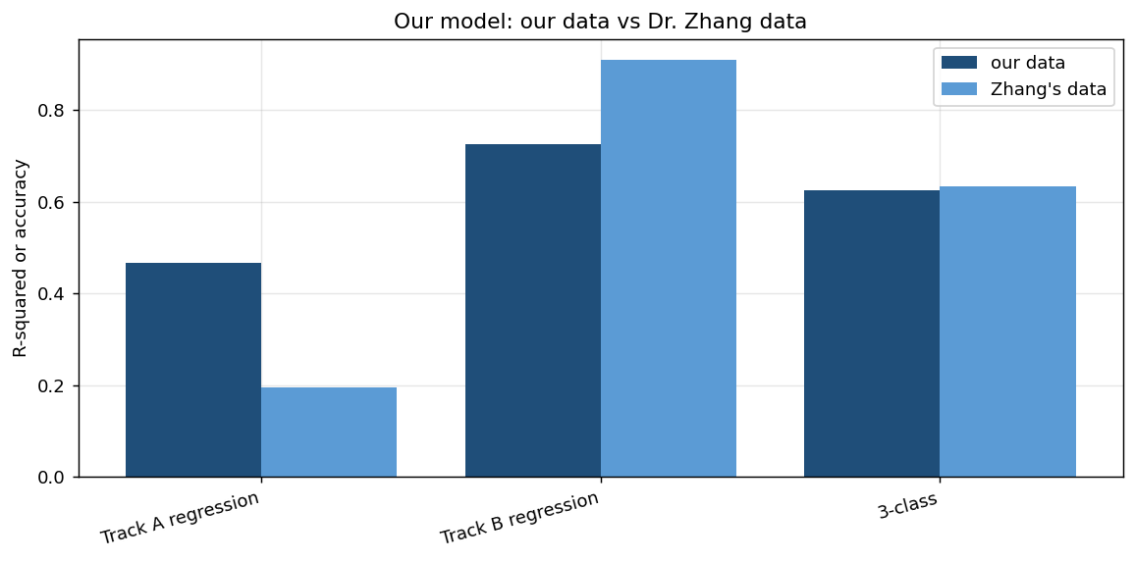
Training on Dr. Zhang's data
Training on his data reproduces our results, so his dataset is not better, it is the same; the edge is the feature engineering and the confidence layer, not the data.

Slide 21
Summary
The dataset is shared with Dr. Zhang, so the difference is method, not data.
On his exact test our model matches his accuracy, 0.69 against 0.72, and on a common split the two models are about equal.
The confidence score estimates each prediction's error, so the most confident predictions are far more accurate, up to 1.000 on the most confident fifty of his test.
Confidence shifts sensibly across metals and metal pairs, staying high where the model is accurate and dropping where it is not.
Beyond a class, our model returns the continuous logD value and a calibrated uncertainty interval, neither of which his classifier provides.
Next steps: a direct separation-factor model and replicate averaging to push past the current ceilings.

Slide 22
Dataset features and why
Extractant structure: SMILES, a Morgan fingerprint, RDKit descriptors, and donor-atom counts (O, N, S, P) with logP. These set how, and how strongly, the extractant binds a metal.
Metal descriptors: ionic radius, charge and oxidation state, ionization energies, electronegativity, and atomic number. These carry the lanthanide-contraction trend that makes neighboring rare earths hard to separate.
Acid and conditions: acid type and concentration, temperature, and extractant concentration. logD is an equilibrium, so it shifts with these as much as with the molecule.
Diluent (solvent): molar mass, logP, boiling and melting points, density, solubility, and dipole moment. The diluent sets the organic-phase environment around the extractant.

Slide 23
Predicting the free energy of extraction
Target: delta G = -2.303 R T logD, in kJ/mol, so a favorable extraction is a negative, spontaneous free energy. Predicted from the extractant structure and the metal, with the reaction conditions left out.
Why drop the conditions: the free energy is meant to be a property of the extractant and the metal, not of the acid concentration or temperature, so the model predicts the thermodynamics from structure alone.
Two framings: per-row keeps every measurement; per-pair averages delta G to one value per extractant, metal, acid, and diluent system and is condition-independent, which is the cleaner target.

Slide 24
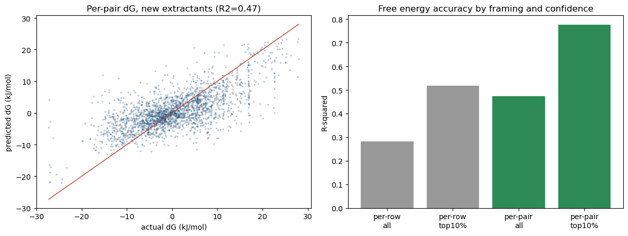
Free energy (delta G) results
Per-pair is the better target (R-squared about 0.46, RMSE 6.3 kJ/mol) than per-row (0.28), molecule-grouped so the extractants are new. The 0.473 shown elsewhere was a selected maximum; the mean over shuffled splits is 0.461 plus or minus 0.009. Confidence is strong: the most confident tenth drop RMSE to 3.6 kJ/mol.

Slide 25
Delta G ensemble sweep
Best model: RandomForest, R-squared about 0.46 plus or minus 0.01 (RMSE 6.3 kJ/mol) for the per-pair free energy; 0.473 was the maximum of the search, the mean over splits is 0.461. The bagged-tree models beat the gradient boosters on this small, wide table of 2,273 systems.
The field: XGBoost 0.444, CatBoost 0.441, HistGB 0.426, LightGBM 0.424, ExtraTrees 0.419, and a linear Ridge near zero, so the signal is nonlinear.
Stacking: an NNLS stack, scored with its own cross-validation, reaches 0.474, a tie with RandomForest alone, so stacking is not used and the free-energy model is a plain RandomForest.

Slide 26
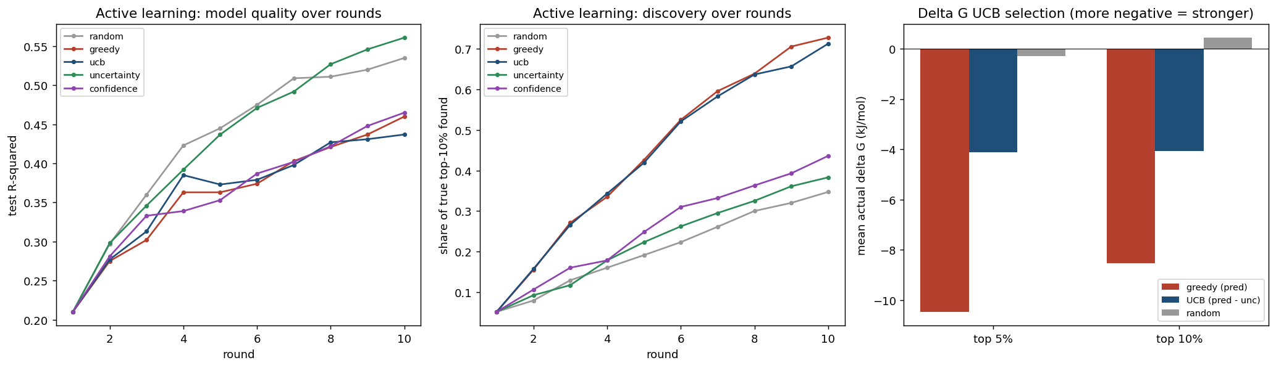
UCB and active-learning results
Left: sampling the uncertain points builds the best model. Middle: ranking by prediction (greedy) or UCB finds the strongest extractants fastest. Right: for a one-shot pick on delta G, greedy reaches the most negative, strongest extractants, UCB sits in the middle, and random gets nothing. UCB does not beat the simpler choices here.

Slide 27
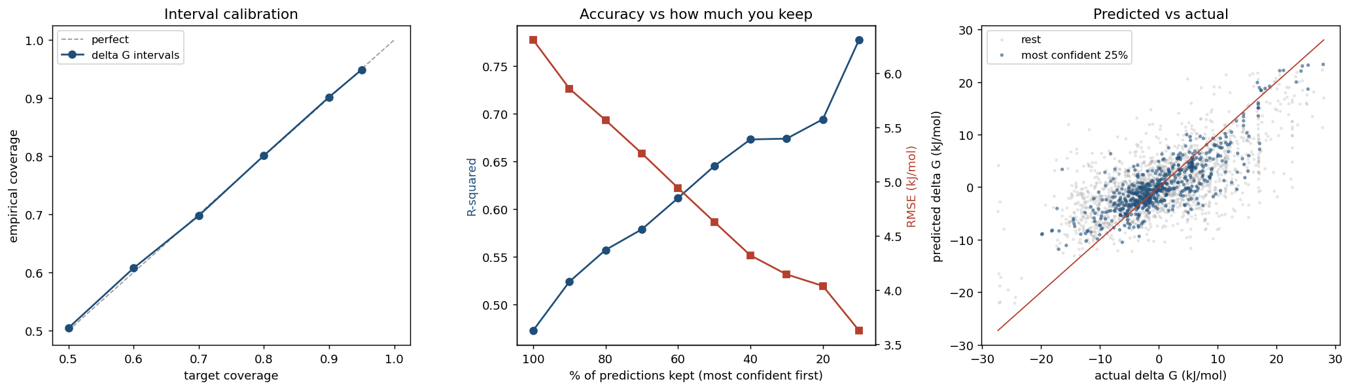
Active analysis: calibrated intervals
Left: the delta G intervals are calibrated, target coverage matches empirical coverage at every level. Middle: keeping only the most confident predictions raises R-squared from 0.47 to 0.78 and cuts RMSE from 6.3 to 3.6 kJ/mol. Right: the most confident quarter (blue) hug the diagonal. Calibrated, heterogeneous intervals are what let the model say which predictions to trust and which to test.

Slide 28
Honest numbers after the audit
Track A (new molecule): logD R-squared 0.466, unchanged and honest.
Track B (known molecule): honest R-squared about 0.61, interpolating conditions for a molecule already seen. The 0.725 figure was a random-row split that memorizes replicates; on genuinely new molecules these features fall to about 0.44.
Free energy (delta G): R-squared about 0.46 plus or minus 0.01; the 0.473 was a selected maximum of a model search.
Confidence: the 90 percent intervals are calibrated (they cover 90 percent); the most-confident-slice figures are operating points, not overall accuracy.
Versus Dr. Zhang: about equal on the same data and split (0.657 vs 0.648); the split, not the model, drives his 0.72 headline.

Slide 29
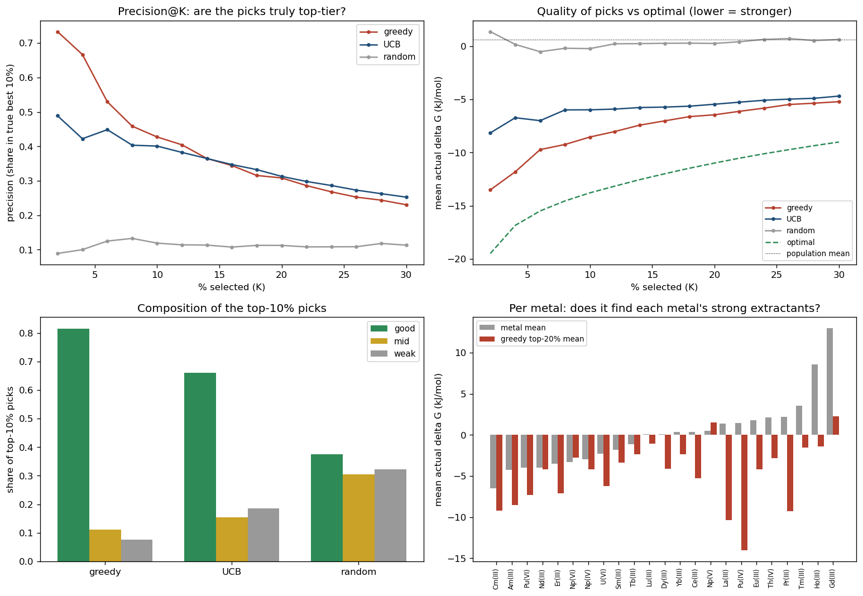
Active analysis: good picks or mid?
Greedy selection puts 81 percent of its top picks in the strongest tertile (vs 37 percent random) and beats each metal's average, but it captures only about 62 percent of the achievable strength and about 57 percent of its top-decile picks miss the true elite. Its confident picks are the trustworthy ones.

Slide 30
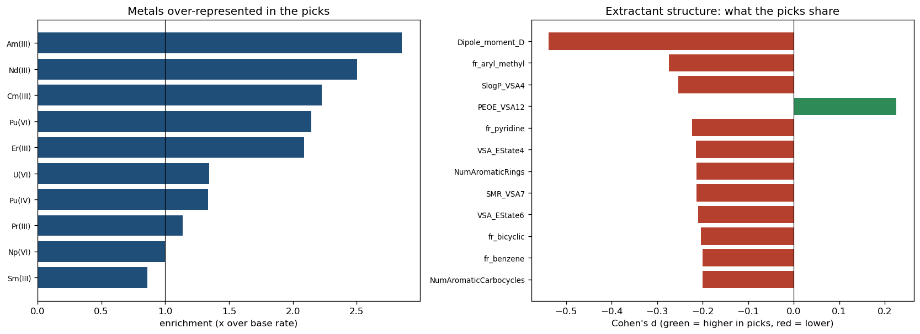
What the chosen extractants share
The picks concentrate on americium and the trivalent lanthanides and actinides (americium 2.85x over-represented, 30 percent of picks), and lean toward less-aromatic, more aliphatic extractants, consistent with classic organophosphorus f-element extractants. Effect sizes are modest.

Slide 31
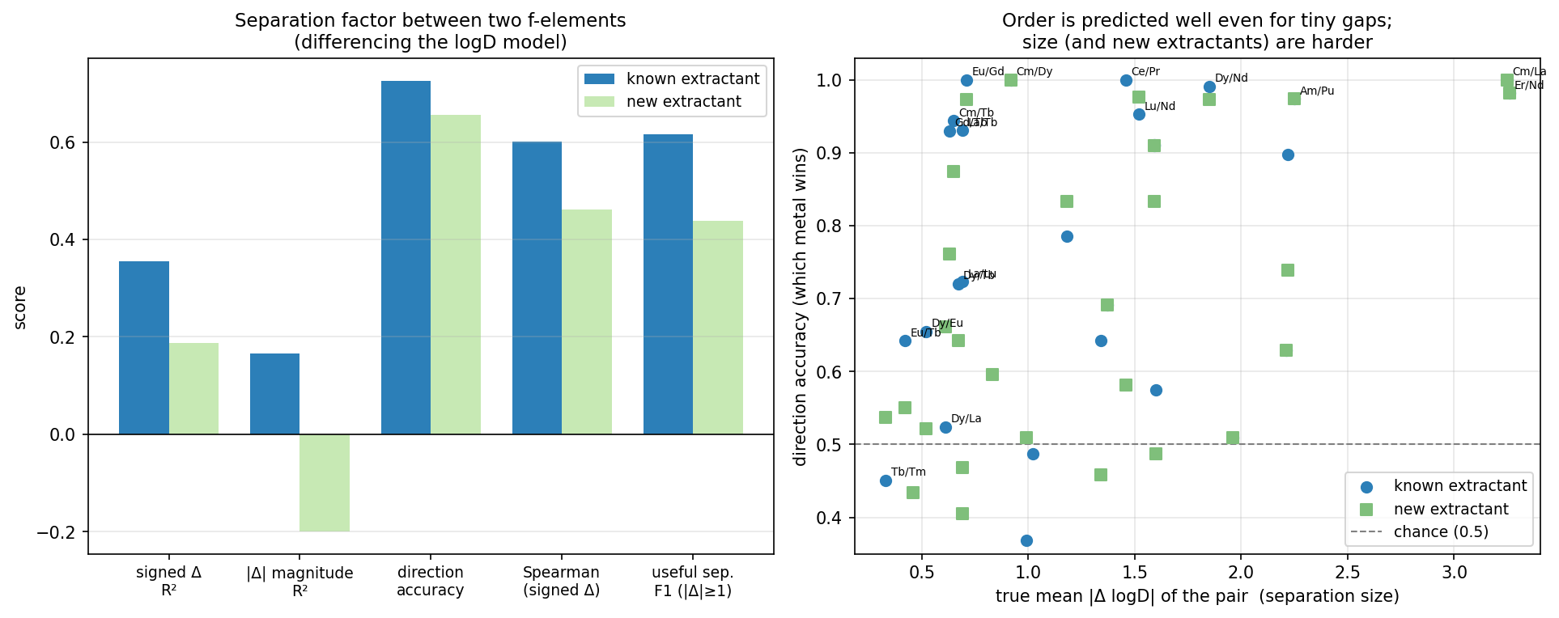
Separation between two f-elements
Separation is obtained by differencing the logD model. The order, which f-element extracts more, is predicted moderately (direction 0.73 known, 0.66 new), even for near-identical neighbors; the size of the gap is not (magnitude R-squared 0.17 known, negative for new).

Slide 32
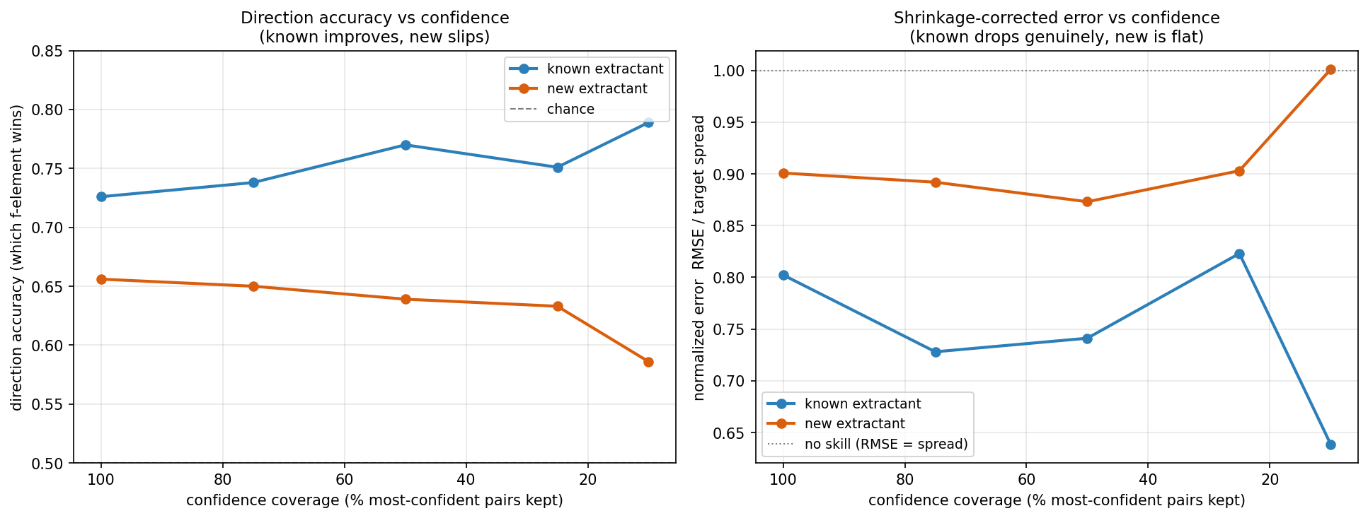
Separation: confidence helps known extractants
Keeping only the most confident pairs improves a known extractant (direction 0.73 to 0.79, error dropping below the no-skill line) but not a new one (direction slips, error stays flat). The confidence layer earns its keep on known extractants.

Slide 33
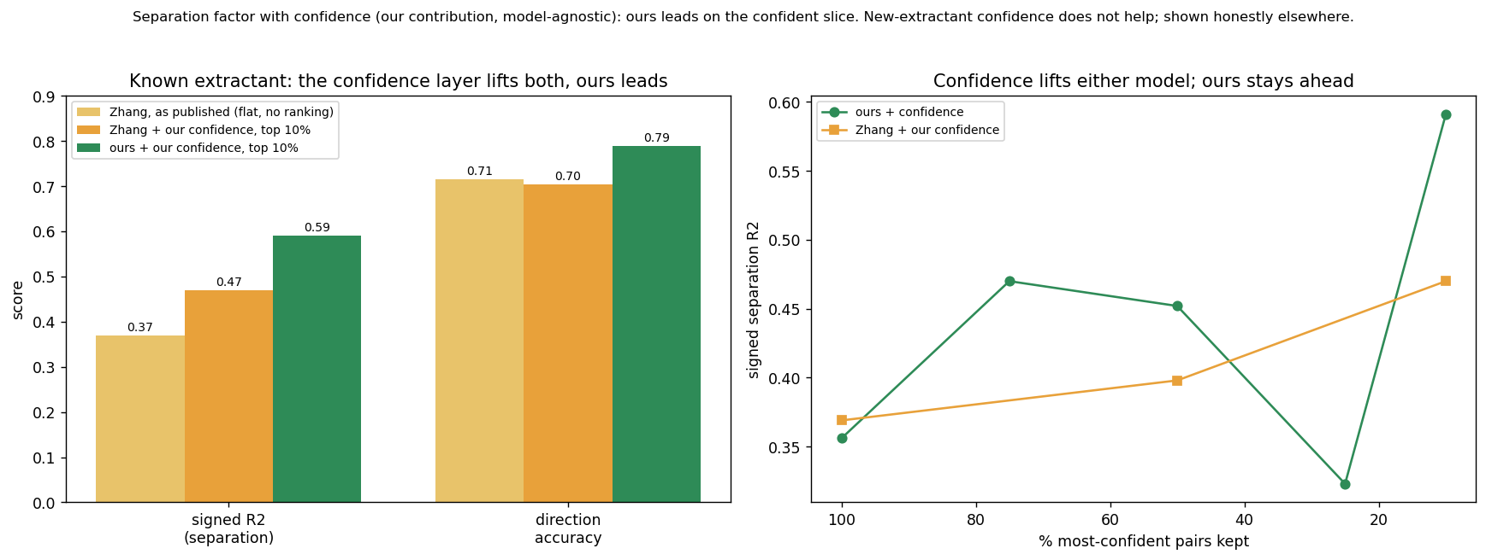
Separation vs Dr. Zhang, with our confidence
The confidence layer is our contribution and is model-agnostic. His published model reports one flat number; applied to either base model our model leads on the confident slice (signed R-squared 0.59 vs 0.47, direction 0.79 vs 0.70, known extractant).

Slide 34
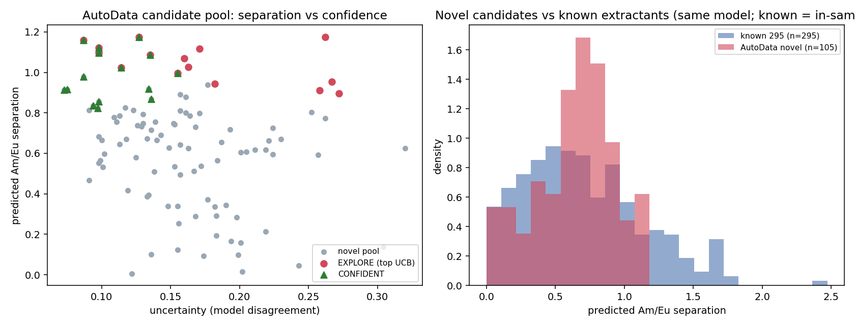
AutoData: generating candidate extractants
An agentic generate-score-refine loop proposes novel extractant molecules. It rediscovers the right soft-donor families (dithiophosphinic acids, thiopicolinamides) but does not beat the best known extractants: novel predicted separation p90 near a factor of 10, the in-sample known near 22. A candidate generator for the wet lab, not a labeler.

Slide 35
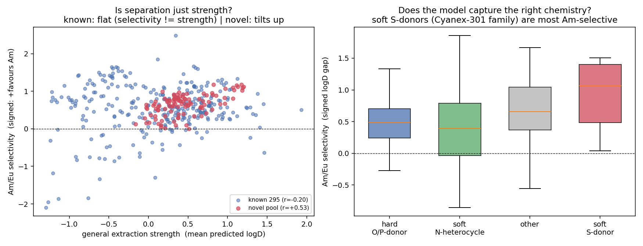
Does it separate two metals, or just extract everything?
The honest check: separation needs selectivity, not general strength. On known extractants the model captures real selectivity (uncorrelated with strength, correct soft-donor mechanism). On novel molecules it partly collapses into strength, so the ranking is strength-adjusted.

Slide 36
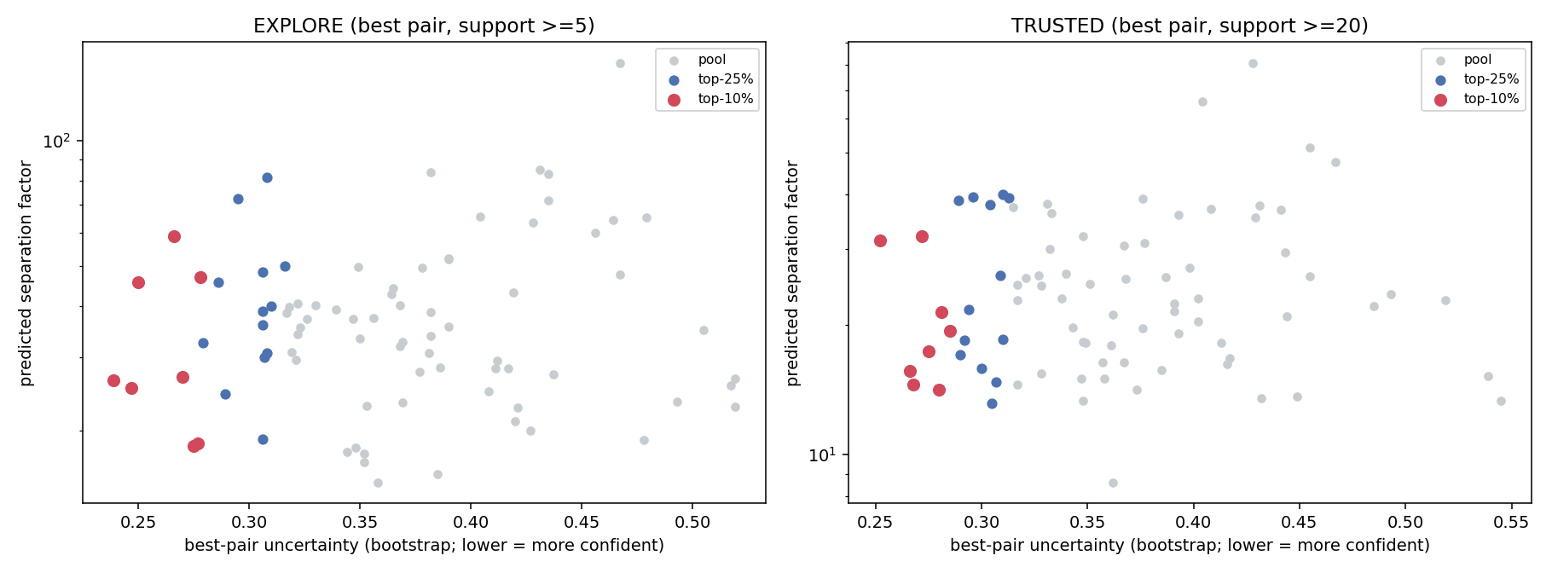
Separation as the target: two confidence-gated shortlists
With separation set as the search target, each molecule is scored by its best f-element pair. EXPLORE keeps pairs with at least 5 measured extractants (higher factors, thin data); TRUSTED keeps at least 20 (real support). Both are gated to the most confident top 25 and top 10 percent.

Slide 37
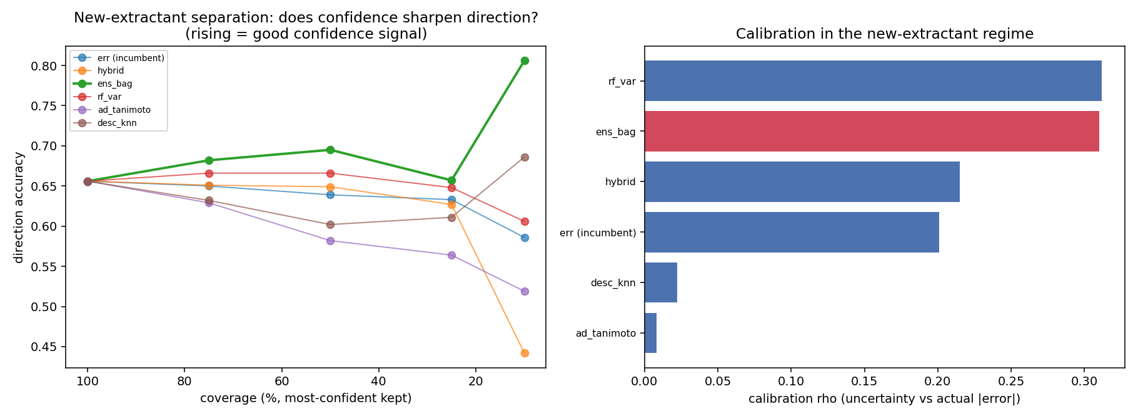
A confidence algorithm that works for new extractants
Bake-off winner: bootstrap-bagged ensemble disagreement. It is the only method that sharpens new-extractant separation (top-10 percent direction 0.66 to 0.81, signed R-squared about 0.00 to 0.28, calibration 0.20 to 0.31). The applicability-domain distances expected to win lost. The known-extractant confidence layer is unchanged.

