Slide 1
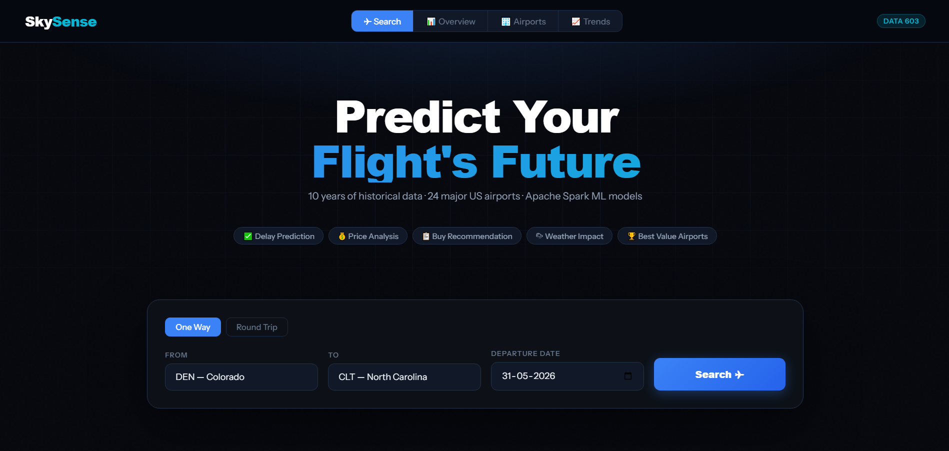
Sky Sense
Flight Intelligence Platform
A big-data predictive modeling project for delay risk, fare behavior, weather impact, and itinerary recommendation.
DATA 603 · Platforms for Big Data Processing · Spring 2026
FINAL PROJECT

Slide 2
What the project had to deliver
REQUIREMENTS
Mapping the professor’s requirements to our final package.
21.2GB
24
10+ yrs
6
Full local data processed with Spark; sample only included for submission
Major airports in the app RDD/network; broader output covers hundreds of airports
Historical delay/fare/weather data window used for aggregate trends
Pipeline stages from Spark processing to Flask web demo
Search origin, destination, and travel date in the web app demo.
Return expected delays, price fluctuation estimate, recommendations, and final advice.
Show busiest airports, departure/arrival delays, fare trends, weather risk, and best value airports.
Use historical data only; no randomly generated flight data.
Submission includes slides, project source code, sample data, README.txt, processed outputs, and the web app files.

Slide 3
Data scope and sources
DATA
Large-scale historical data was reduced into clean Spark outputs for the app.
Flight delay data
BTS / DOT style CSVs
Fare data
Airfare by year/quarter/origin
Weather data
NOAA station and delay signals
Historical outputs
Processed CSV + JSON
131.3M
24
5,000
$430.37
fare records processed
major airports in web app network
route-carrier combinations loaded into app
overall historical average fare
The sample dataset has been uploaded that contains small samples plus processed outputs.

Slide 4
System architecture
PIPELINE
How the project turns 21.2GB of raw data into a usable flight recommendation tool.
Raw CSVs
Delays · Fares · Weather
Apache Spark
RDD + DataFrames
Processed outputs
CSV + metrics JSON
Model layer
Spark ML + rules
Web app
Flask + HTML + results.json
Spark handles the heavy processing; the web app loads only aggregated results.
results.json acts as the bridge between back-end analysis and front-end demo.
This design keeps the demo fast while preserving the big-data pipeline behind it.

Slide 5
Steps 1–2: Airports and Delay Analysis
SPARK
First, identify the airport network; then calculate the delay story.
ATL
7.8M
busiest airport by total traffic
combined departures + arrivals
Busiest airports
Top departure delay airports

Slide 6
Step 3: Fare Analysis
FARES
Historical fare data was cleaned, aggregated, and connected to the app recommendation logic.
$430
131.3M
For the demo, fare is a historical estimate, not a live airline price.
overall average fare
fare rows processed

Slide 7
Step 4: Weather Impact
WEATHER
Weather data was analyzed alongside flight delays to identify disruption patterns.
Weather risk was summarized by origin airport and month.
Delay causes show that weather is one factor in a broader operational delay system.
The app surfaces weather risk when the selected origin has historically high weather delays.

Slide 8
Step 5: Machine Learning Model
MODEL
Spark ML was used to build delay and fare prediction models from engineered historical features.
GBT
26.76
14.92
0.1132
+0.0957
delay model algorithm
delay RMSE
delay MAE
delay R²
R² improvement over baseline
Feature engineering used:
Goal:
Predict expected flight departure delay using historical flight, airport, carrier, route, time, and weather-related features.
Feature Engineering:
• Extracted time-based features: month, day of week, departure hour
• Created travel-pattern flags: weekend, summer, winter, holiday season
• Encoded categorical variables: carrier, origin airport, destination airport
• Added route and airport history: origin delay, destination delay, route delay, carrier-route delay
• Included operational features such as distance and scheduled elapsed time
• Added weather-delay signal to capture weather-related disruption risk
Modeling Approach:
• Used PySpark ML pipeline for scalable processing
• Trained delay prediction models on large historical flight records
• Saved processed outputs and model results for use in the web app
• Web app uses generated results instead of rerunning the full 21.2GB pipeline live

Slide 9
Step 6: Graph/Network Analysis and Results.json
APP DATA
Route nodes and edges became a compact web-app data layer.
Airport nodes
traffic · degree · delay
Route edges
origin → destination
Carrier lookup
route-level delay/cancel risk
results.json
web app payload
5,000
50
24
route lookup records in app payload
busiest routes saved for visualization
airport nodes in user-selectable network
Graph-style analysis helped rank airports by traffic, route connectivity, and network importance instead of looking only at single-airport averages.

Slide 10
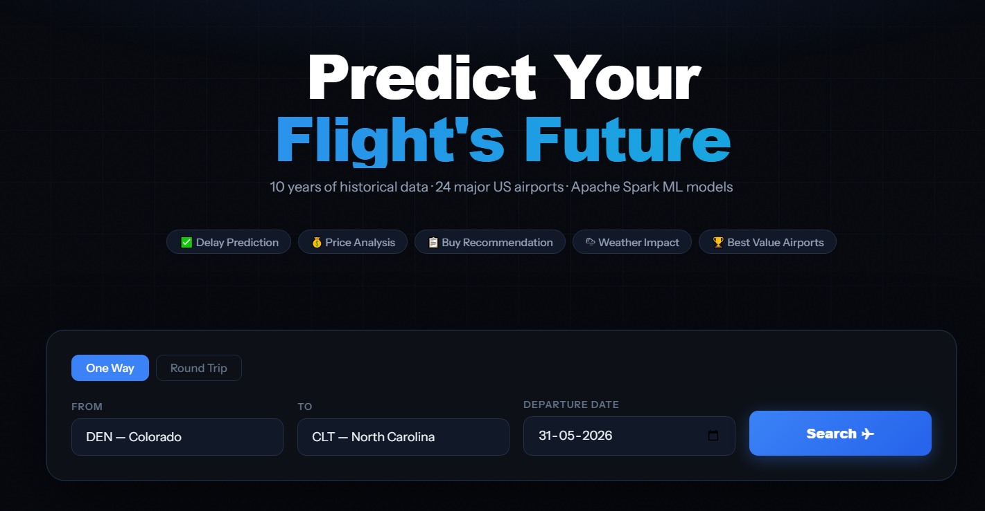
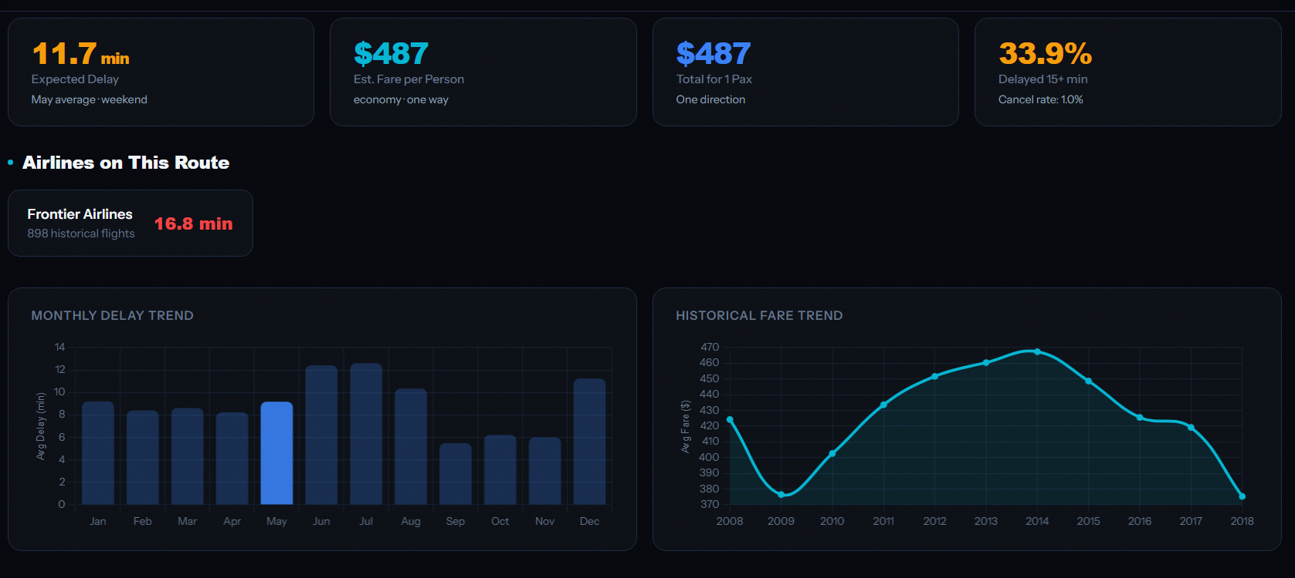
Web app demo: SkySense
DEMO
The demo turns historical analysis into a user-facing flight decision tool.
Run app.py, open localhost, and demo one route end-to-end.
Show Search, Overview, Airports, and Trends pages.
Explain that the app uses historical aggregates and results.json, not live ticket prices.

Slide 11
Key findings
INSIGHTS
The project connects airport operations, ticket pricing, and traveler recommendations.
ATL
Q2
Late aircraft
Route-specific
largest traffic hub in the dataset
highest average fare quarter in current processed output
largest average delay cause in breakdown
carrier history changes the recommendation
High-traffic airports are not always the worst delay airports; delay risk needs its own ranking.
Fare patterns are seasonal and airport-dependent, so quarter and airport both matter.
Weather is important, but carrier and late-aircraft delay patterns can be stronger signals in delay breakdowns.
A clean recommendation requires combining delay, cancellation, fare, and route-history signals.

Slide 12
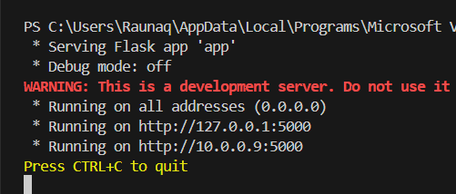
Problems and issues faced
ISSUES
The biggest challenge was making a large Spark project dependable enough to demo.
The full dataset was too large for a normal submission package, so sample data and processed outputs were separated from raw data.
Windows Spark setup required stable Java, Hadoop/winutils, and Python 3.11 configuration.
Some fare data needed quality checks because certain files used inconsistent fare units.
Opening HTML directly can block results.json, so Flask app.py was added for a reliable demo.
Some routes do not have direct historical route data; the app handles this with airport-level fallback logic.
These are useful to mention because the professor specifically asked for problems and issues faced.

Slide 13
Lessons learned and final demo flow
CLOSE
A good big-data project needs both analysis depth and a clean user-facing story.
Spark is best used for the heavy transformations; the web app should stay lightweight.
Processed outputs and JSON are a clean bridge between big-data analysis and frontend demo.
Data cleaning and assumptions matter as much as the model itself.
The final story should be user-centered: expected delay, fare estimate, risk, and final advice.
Demo sequence
1. Run app.py
2. Search route
3. Explain result cards
4. Show Overview/Airports/Trends
5. Close with lessons learned
Questions?

