Slide 1

Bootstrap, from Twitter
Bootstrap is a toolkit from Twitter designed to kickstart development of webapps and sites. It includes base CSS and HTML for typography, forms, buttons, tables, grids, navigation, and more.
Bootstrap

Slide 2
What is bootstrap
Twitter Bootstrap is a toolkit to develop web apps and sites fast. It includes basic CSS and HTML for creating Grids, Layouts, Typography, Tables, Forms, Navigation, Alerts, Popovers etc.
At its core, Bootstrap is just CSS, but it's built with {less}, a flexible pre-processor that offers much more power and flexibility than regular CSS. With Less, we gain a range of features like nested declarations, variables, mixins, operations, and color functions.

Slide 3
{less}
The dynamic stylesheet language.
LESS extends CSS with dynamic behavior such as variables, mixins, operations and functions.

Slide 4
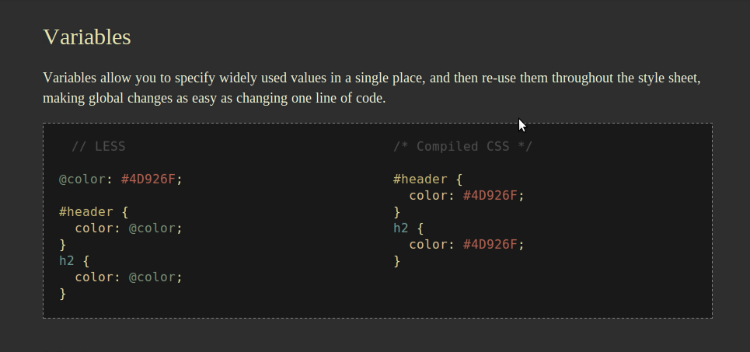

Slide 5
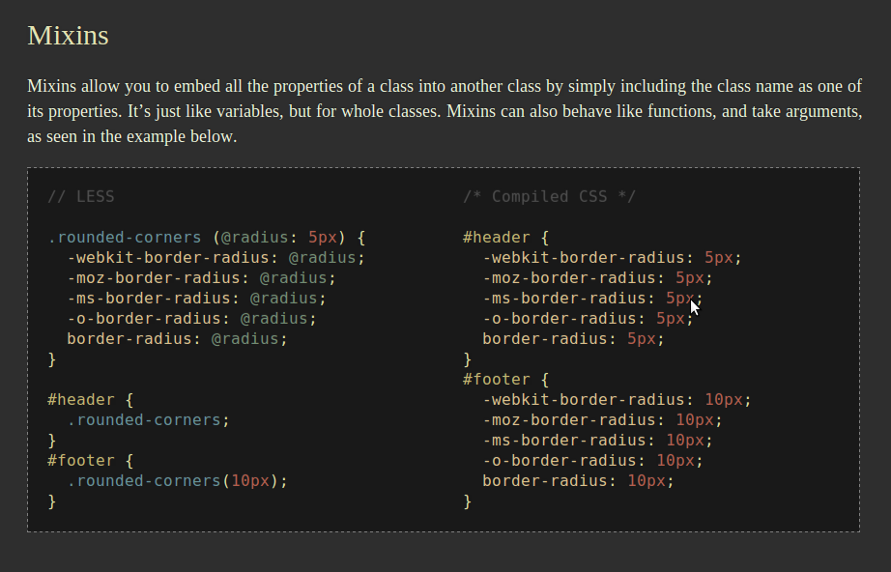

Slide 6
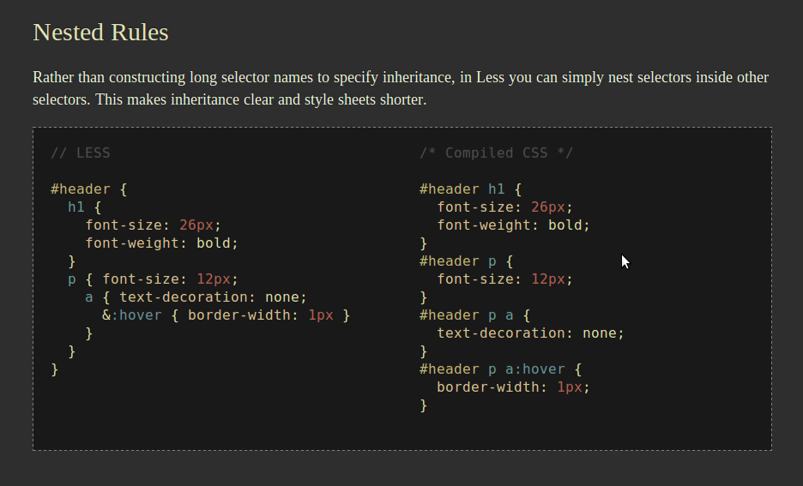

Slide 7
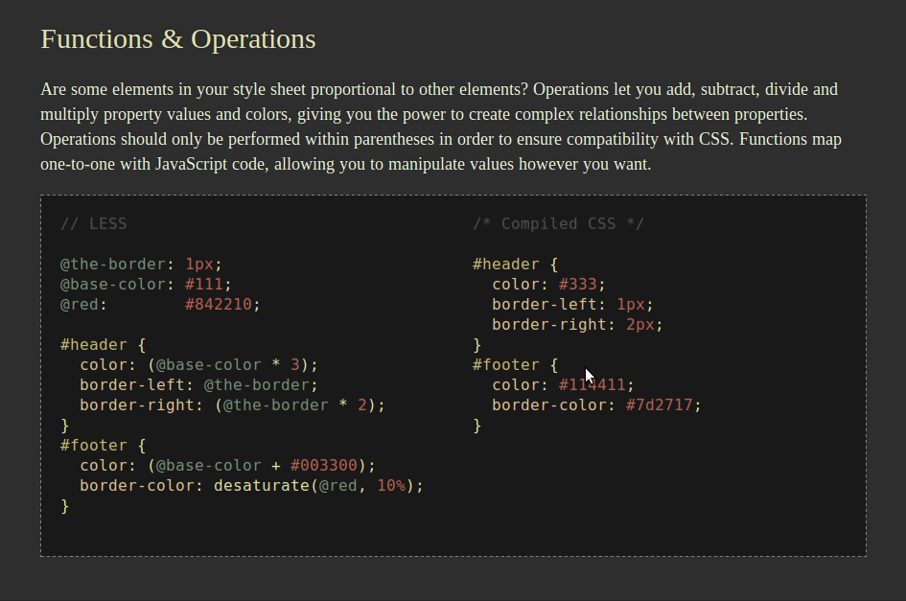

Slide 8
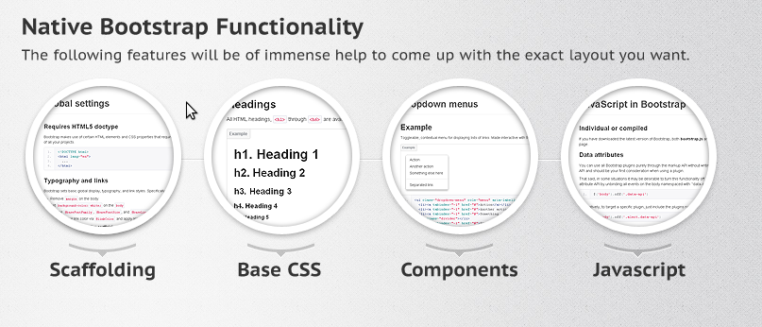
Bootstarp Functionality

Slide 9
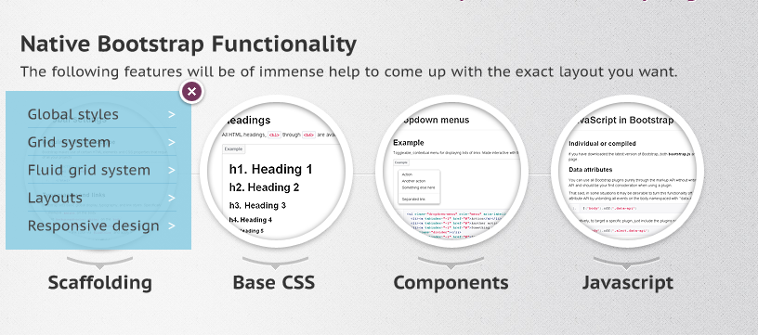
Bootstrap is built on responsive 12-column grids, layouts, and components.
Scaffolding is a CSS pre-processor that allows developers to easily create custom extensions to CSS and reduce the amount of time they spend writing code.

Slide 10
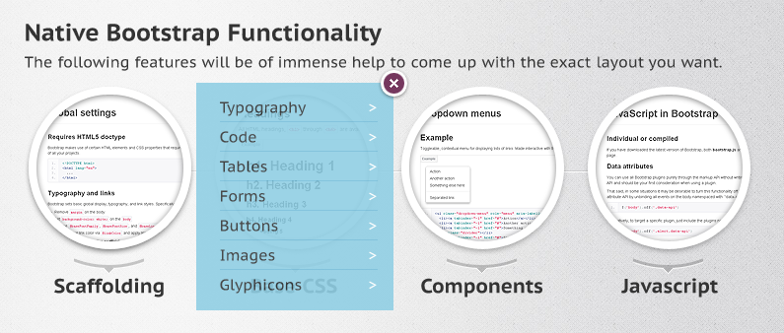
Fundamental HTML elements styled and enhanced with extensible classes.

Slide 11
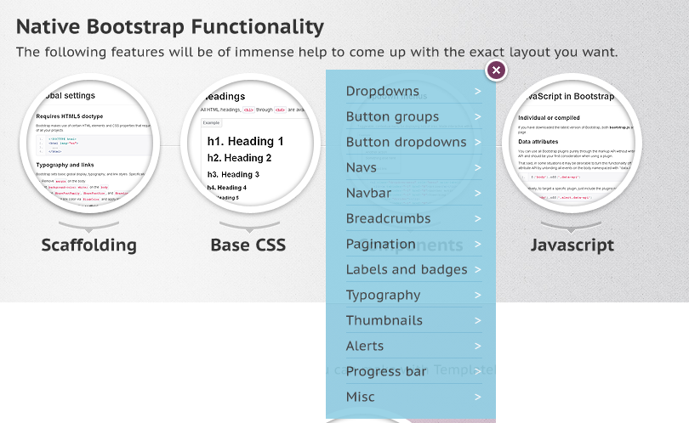
Dozens of reusable components built to provide navigation, alerts, popovers, and more.

Slide 12
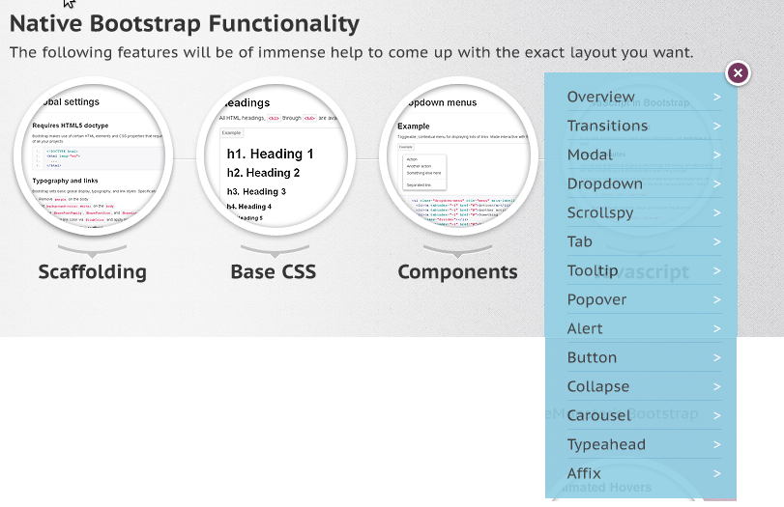
Bring Bootstrap's components to life—now with 13 custom jQuery plugins.

Slide 13
Why every NEW website will use Bootstrap
First, Bootstrap remains very easy to implement; just drop it in your code and go.
Second, once complied, Bootstrap contains nothing but CSS, meaning there are no superfluous images, Flash, or Javascript. All that remains is simple and powerful CSS for your web development needs.

Slide 14
Browser Support
Twitter Bootstrap is created with modern browsers in mind. So, you will find it working perfectly with all the modern versions of Chrome, Firefox, Safari, Opera and Internet Explorer.

Slide 15
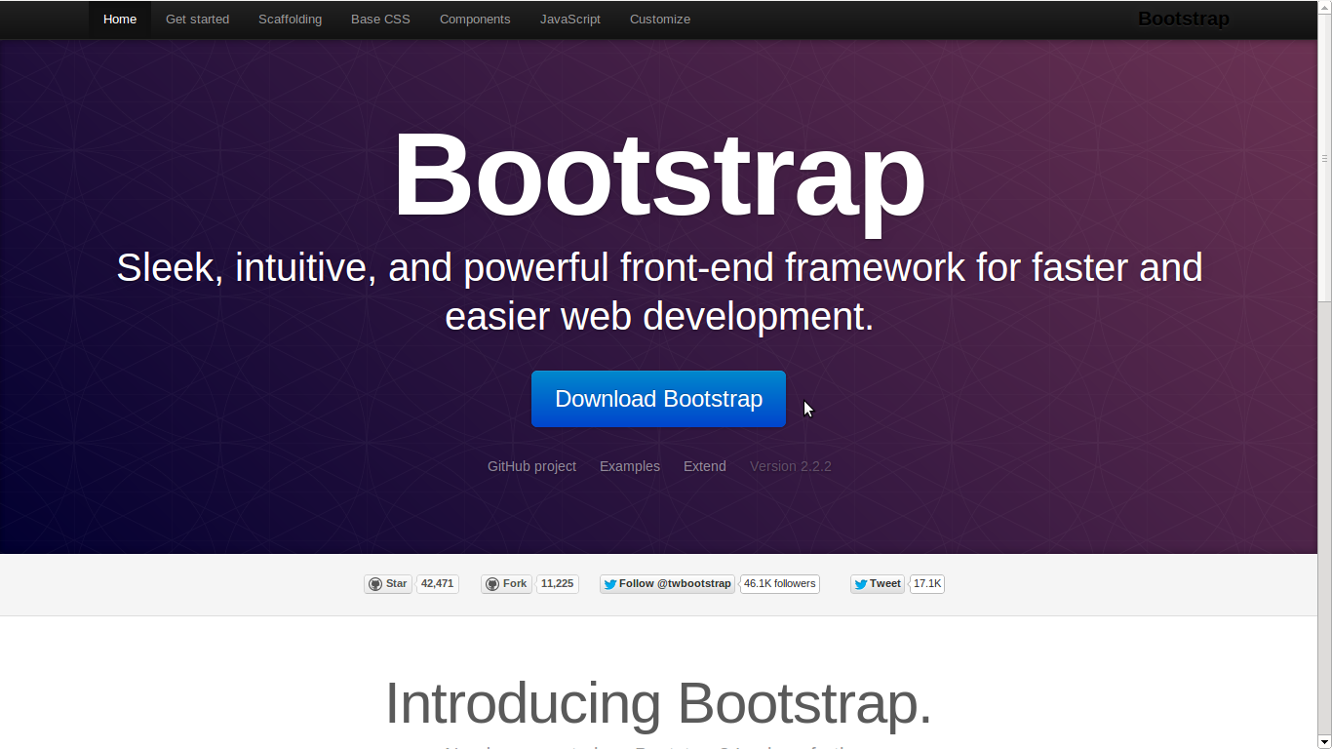
http://twitter.github.com/bootstrap/

Slide 16
Questions?

Slide 17
Presentey By
Manjunath N. Lamani
Thank You

