Slide 1


Accident SEVERITY Prediction
Matteo Orsini 1795119
Fabrizio Rossi 1815023
Mina MAKAR 1804475
Notes:
Good evening, our team is composed by Matteo, Fabrizio and me, Mina.
During this project we tried to predict the severity of an accident.

Slide 2
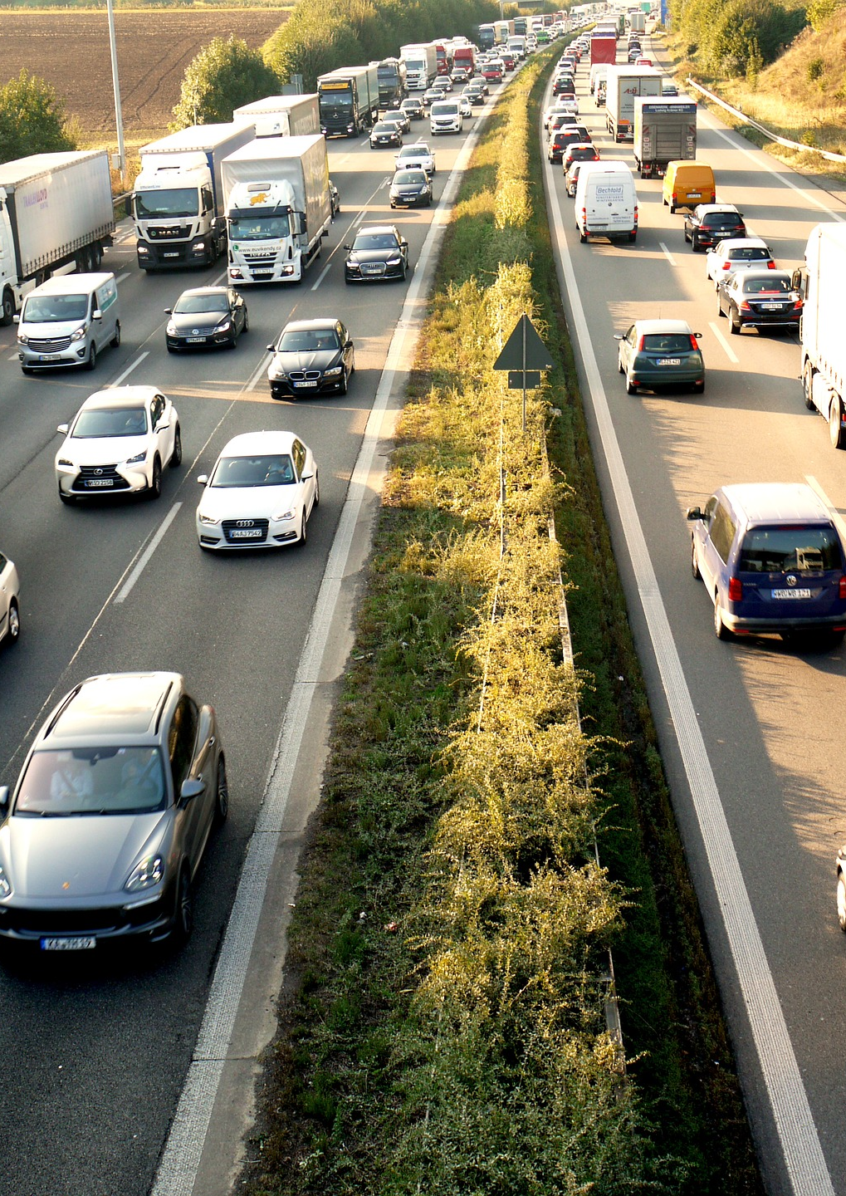
Task - Severity
Classify the impact of an accident on the traffic (severity)
The scale of the severity goes from 1 (low impact) to 4 (high impact)
We used the dataset «US Accidents» from Kaggle
Contains about 3.5 million accidents collected in the US
Notes:
So, the task of our project was to classify an accident based on its severity, which is a metric that measures the impact of an accident on the traffic, and goes from 1, a low impact, to 4, an high impact.
We used a dataset from Kaggle called «US Accidents» which contains about 3.5 million accidents.

Slide 3
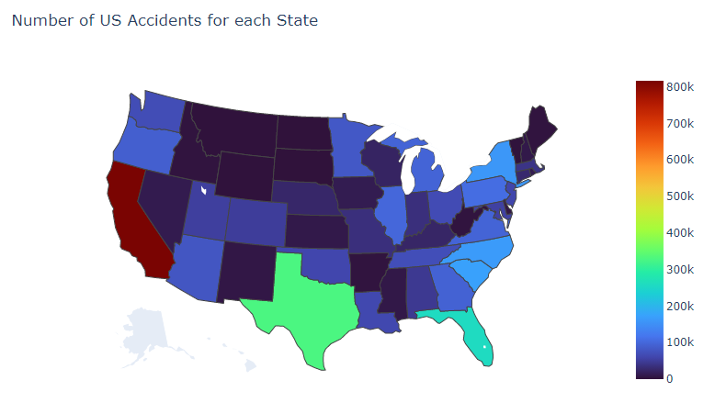
Exploratory Data Analysis
Notes:
We started doing a exploratory data analysis by inspecting the number of accident for each state.
In the map we can see that the state with the highest number of accident is California, then we have Texas and Florida.

Slide 4
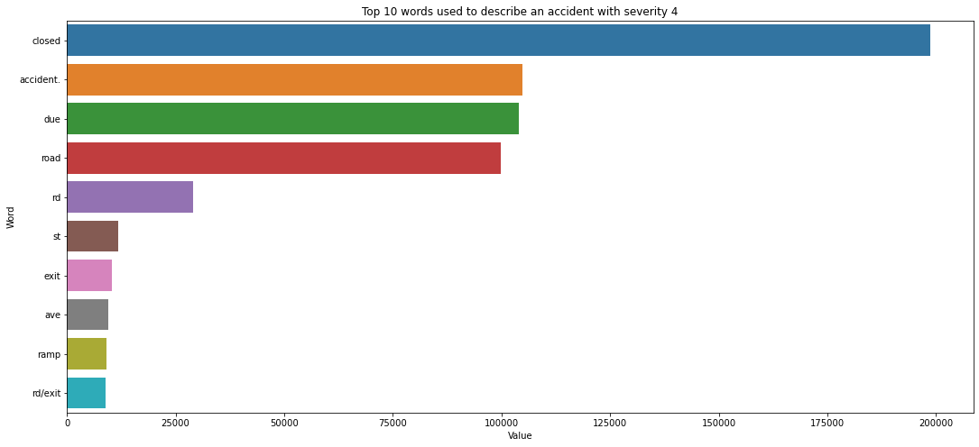
Exploratory Data Analysis
Notes:
Then, we inspected the description of each accident with severity 4 and in this chart we can see the top 10 most used words.
«Closed» is the top one, followed by «accident» and so on.

Slide 5
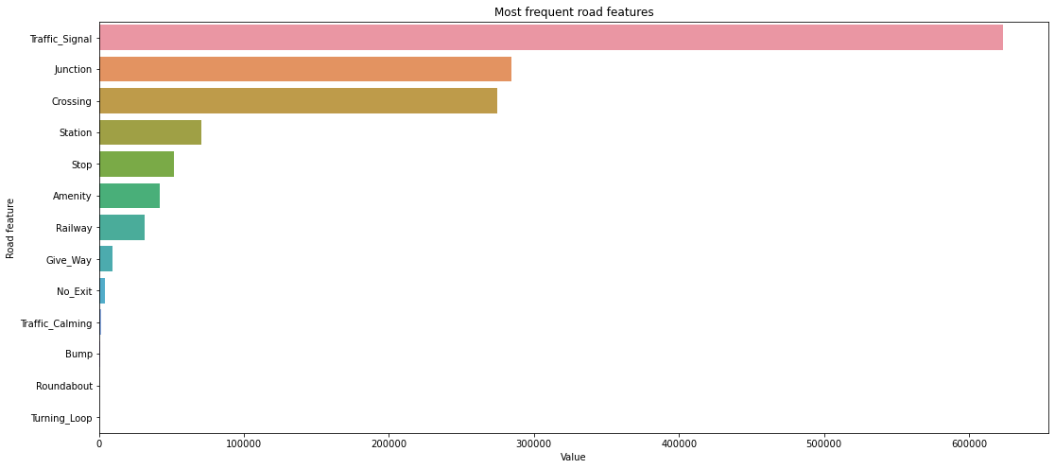
Exploratory Data Analysis
Notes:
Then, we analyzed the road features, which indicate the presence of a particular point of interest.
From the plot we can see that the traffic signal is the most frequent road feature in an accident, then we have a junction, crossing and so on.

Slide 6
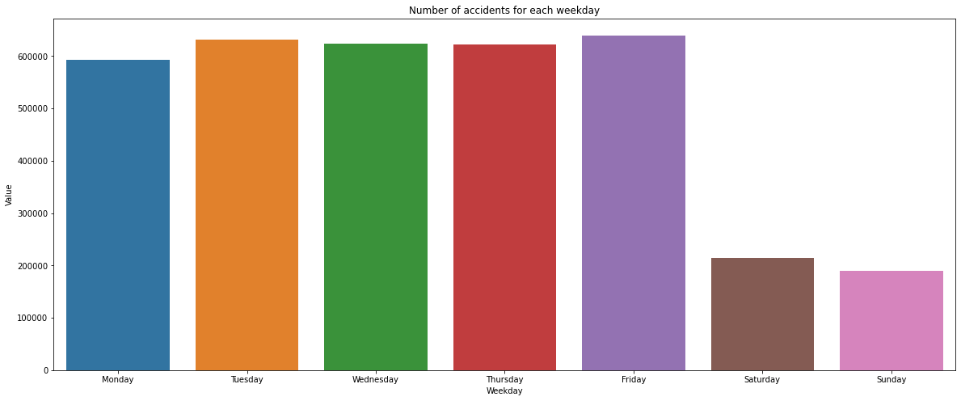
Exploratory Data Analysis
Notes:
Finally, we plotted the number of accidents for each weekday. From the plot we can see that the safest days are saturdays and sundays, in contrast to our expectations.

Slide 7
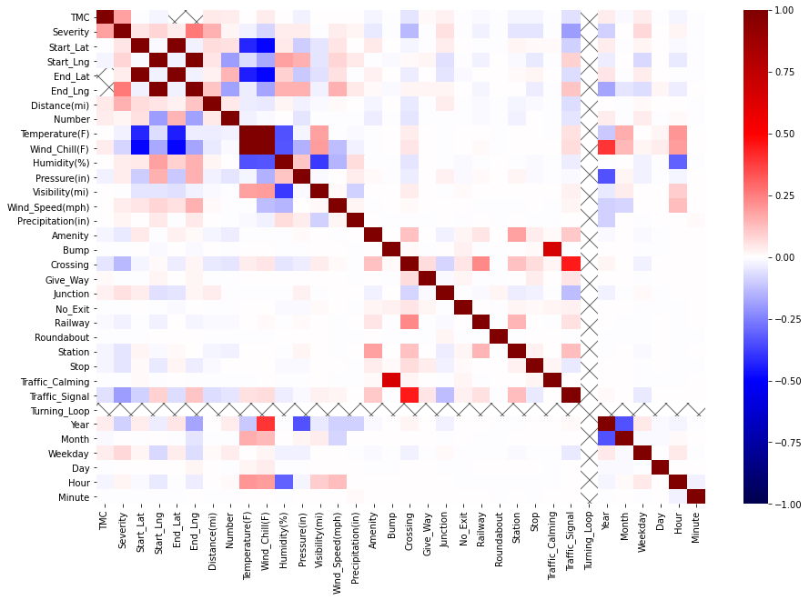
CORRELATION MATRIX

Slide 8
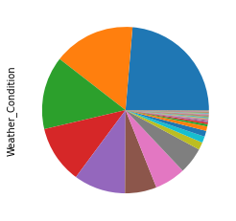
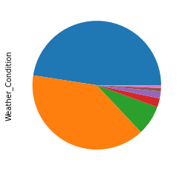
DATA PREPROCESSING
Reduced number of classes for Weather_Condition (128 → 11) and Wind_Direction (24 → 10)
Filled missing values with mean for numerical features
Removed records with missing values for categorical features
Scaled and encoded features using the one-hot encoding for the categorical features
City was encoded using the binary encoder due to the large number of unique values
Notes:
Then, we proceded with the data preprocessing phase where we reduced the number of classes for the Weather_Condition and the Wind_Direction features, as we can see in the two plots below.
We filled the missing values with the mean for the numerical features, and removed the records for the categorical features.
In the end, we scaled and encoded the features using the one-hot encoding for all the categorical features except the City which was encoded using the binary encoder in order to reduce the memory usage due to the large number of unique values.

Slide 9
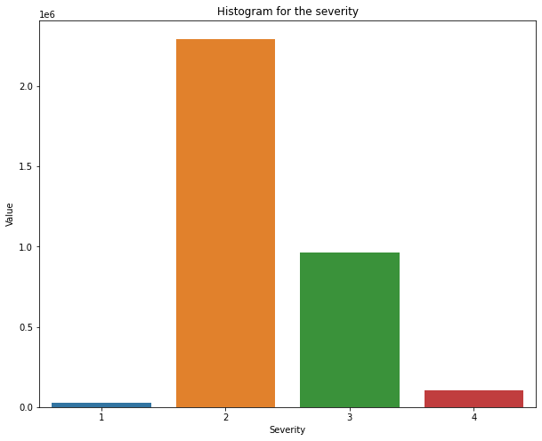
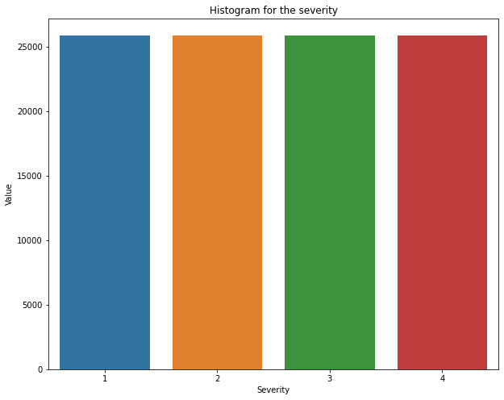
DATA PREPROCESSING
We handled the unbalanced dataset problem using the undersampling technique
We splitted the dataset in train set, validation set and test set
Dataset
64%
Train
16%
Validate
20%
Test
Notes:
From the plot on the left we can see that the dataset is highly unbalanced so we used the undersampling technique to address this problem, so the number of samples for each class was reduced to about 26 thousand.
And then, we splitted the dataset in train set, to train the models, validation set, to tune the hyperparameters, and test set, to evaluate the best model.

Slide 10
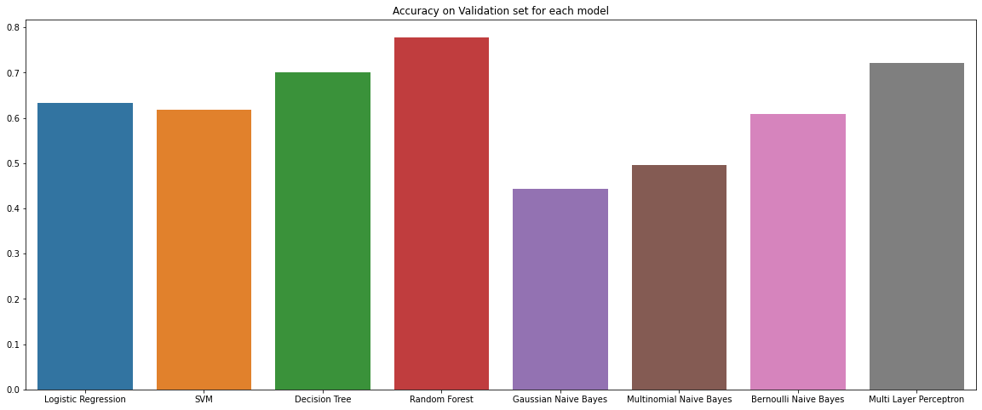
Results – ACCURACY
Notes:
In out project we tried several models and in this plot we can see the accuracy computed for each model using the validation set.
As we can see the tree based models, the decision tree and the random forest, seems to outperform the other models.
While the logistic regression, the support vector machine and the bernoulli naive bayes performed similarly.
The multi layer perceptron performs better than the average even if it was trained just for 100 iterations and with a small number of neurons.
In contrast to our expectations the Support Vector Machine seems to be even a bit worse than the logistic regression model but was trained with less records, about 10.000, due to the high computational requirements.

Slide 11
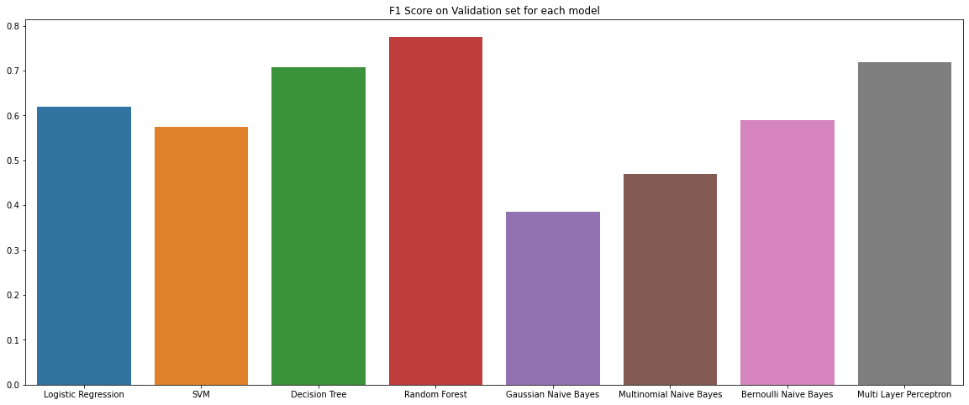
Results – F1 score
Notes:
Instead, here, we have the f1 score of each model, which seems to be very similar to previous values of the accuracy since we balanced the dataset.
So the previous observations on the accuracy are still valid.

Slide 12
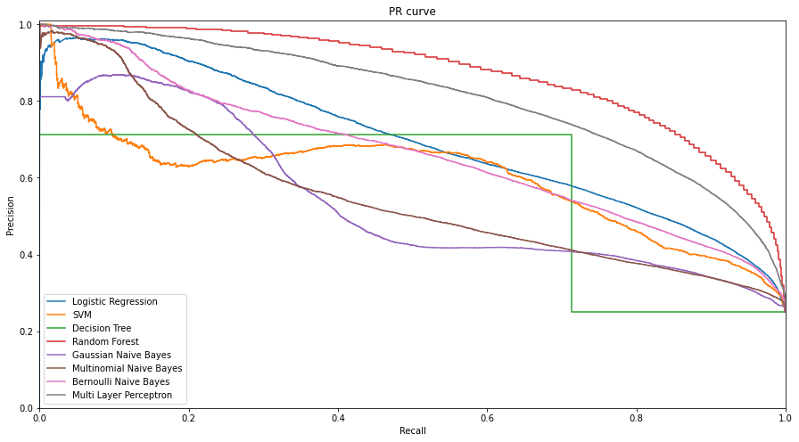
Results – PR Curve
Notes:
Here are presented the PR curves for all the models, and
We can see that the best one is the Random Forest since its curve is the closest to the top right corner which indicates the perfect classifier.
The Random Forest is followed by the Multi Layer Perceptron while all the other models perform worse,

Slide 13
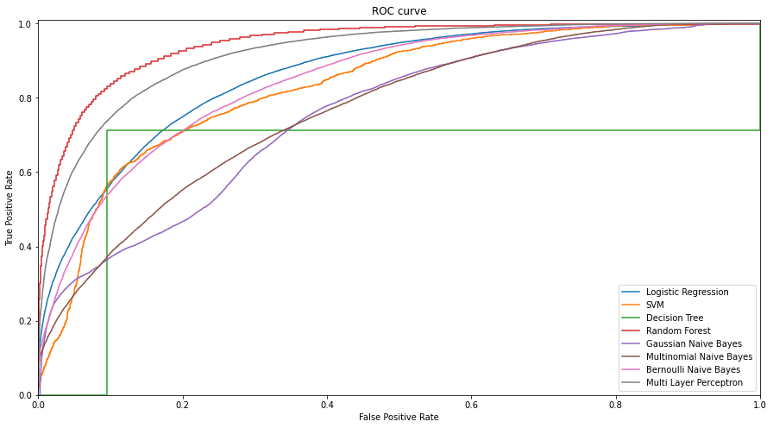
Results – ROC Curve
Notes:
In this slide, instead, we can see the ROC curves and like in the previous plot the Random Forest is the best performer still followed by the multi layer perceptron.

Slide 14
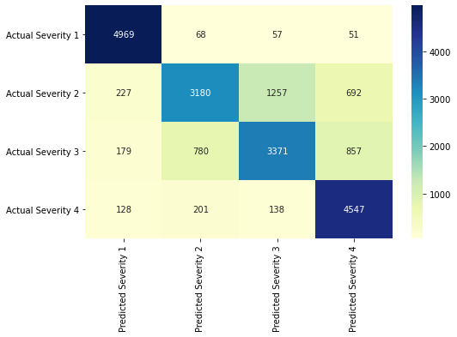
Results – Random forest test set
Class | Precision | Recall | F1-Score
1 | 0,90 | 0,97 | 0,93
2 | 0,75 | 0,59 | 0,66
3 | 0,70 | 0,65 | 0,67
4 | 0,74 | 0,91 | 0,81
Macro avg | 0,77 | 0,78 | 0,77
Notes:
Here, we present the results of the best model which is the random forest, obtained with the test set.
On the left we can see the confusion matrix which indicates that the class 1 and 4 are the most accurately classified.
While on the right there is a table with the precision, recall and f1-score values for each class which reflect what we said for the confusion matrix.

Slide 15
Related works
Medium Article (Link)
Kaggle Notebook (Link)
Notes:
In conclusion, we compared our best model with some related works that we found, in particular with a medium article and a kaggle notebook.
As we can see, the medium article obtained a better accuracy with a neural network respect to our best model, while we obtained the same accuracy as the random forest model presented in the kaggle notebook that we found.
Extra:
We decomposed the Start_Time of the accident in Year, Month, Day, Weekday, Hour and Minute
Handled some erroneous data in the Pressure and Visibility columns
We scaled using MixMaxScaler

