Slide 1
IP API DOCUMENTATION
CÎrjan Cosmin-Constantin

Slide 2
Base URL
http://185.207.251.196/api/
Requirements
Postman

Slide 3
Navigate < CTRL + CLICK >
-> Alerts Patients <-
-> Caretakers Users <-
-> Medical Files Senders <-
-> Medic Sensor Data <-
-> Mobile Data Supervisors <-

Slide 4
ENDPOINTS FOR ALERTS
Back to navigation
{GET} http://185.207.251.196:9000/api/alerts/ => selects all alerts
{GET} http://185.207.251.196:9000/api/alerts/id/{number}/ => select the alert row that has the specified ID
{POST} http://185.207.251.196:9000/api/alerts/create/ => create a new alert row
{PUT} http://185.207.251.196:9000/api/alerts/id/{number}/ => update an alert row by ID
{DELETE} http://185.207.251.196:9000/api/alerts/id/{number}/ => delete an alert by the specified ID

Slide 5
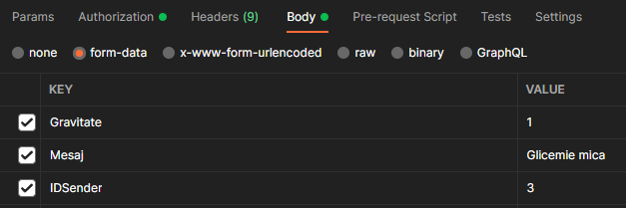
BODY PARAMETERS FOR ALERTS
Back to navigation
Create || Update

Slide 6
ENDPOINTS FOR CARETAKERS
Back to navigation
{GET} http://185.207.251.196:9000/api/caretakers/ => selects all caretakers
{GET} http://185.207.251.196:9000/api/caretakers/id/{number}/ => select the caretaker row that has the specified ID
{GET} http://185.207.251.196:9000/api/caretakers/username/{string}/ => select the caretaker that has the specified username
{GET} http://185.207.251.196:9000/api/caretakers/patientscount/{id}/ => see the number of patients of a caretaker
{POST} http://185.207.251.196:9000/api/caretakers/create/ => create a new caretaker row
{PUT} http://185.207.251.196:9000/api/caretakers/id/{number}/ => update a caretaker row by ID
{DELETE} http://185.207.251.196:9000/api/caretakers/id/{number}/ => delete a caretaker by the specified ID

Slide 7
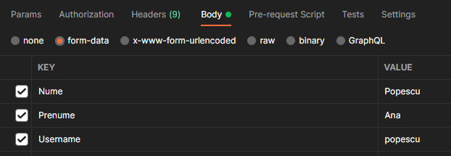
BODY PARAMETERS FOR CARETAKERS
Back to navigation
Create || Update

Slide 8
ENDPOINTS FOR MEDICAL FILES
Back to navigation
{GET} http://185.207.251.196:9000/api/medicalfile/ => selects all medical file
{GET} http://185.207.251.196:9000/api/medicalfile/id/{number}/ => select the row medical file that has the specified ID
{POST} http://185.207.251.196:9000/api/medicalfile/create/ => create a new medical file row
{POST} http://185.207.251.196:9000/api/medicalfile/idpatient/{id}/ => see the medical file of a specified pacient (by ID)
{PUT} http://185.207.251.196:9000/api/medicalfile/id/{number}/ => update a medical file row by ID
{DELETE} http://185.207.251.196:9000/api/medicalfile/id/{number}/ => delete a medical file by the specified ID

Slide 9
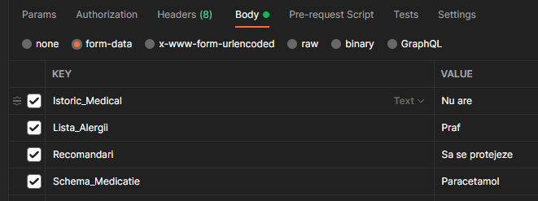
BODY PARAMETERS FOR MEDICAL FILE
Back to navigation
Create || Update

Slide 10
ENDPOINTS FOR MEDIC
Back to navigation
{GET} http://185.207.251.196:9000/api/medic/ => selects all medic staff
{GET} http://185.207.251.196:9000/api/medic/id/{number}/ => select the medic row that has the specified ID
{GET} http://185.207.251.196:9000/api/medic/username/{string}/ => select the medic that has the specified username
{POST} http://185.207.251.196:9000/api/medic/create/ => create a new medic row
{PUT} http://185.207.251.196:9000/api/medic/id/{number}/ => update a medic row by ID
{DELETE} http://185.207.251.196:9000/api/medic/id/{number}/ => delete a medic row by the specified ID

Slide 11
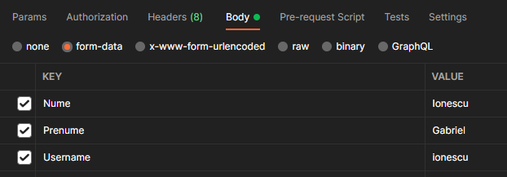
BODY PARAMETERS FOR MEDIC
Back to navigation
Create || Update

Slide 12
ENDPOINTS FOR MOBILE DATA
Back to navigation
{GET} http://185.207.251.196:9000/api/android/ => selects all mobile data
{GET} http://185.207.251.196:9000/api/android/id/{number}/ => select the mobile data row that has the specified ID
{POST} http://185.207.251.196:9000/api/android/create/ => create a new medical data row
{GET} http://185.207.251.196:9000/api/android/idpatient/{number}/ => select the mobile data row that has the specified patient ID
{PUT} http://185.207.251.196:9000/api/android/id/{number}/ => update a medical data row by ID
{DELETE} http://185.207.251.196:9000/api/android/id/{number}/ => delete a medical data row by the specified ID

Slide 13
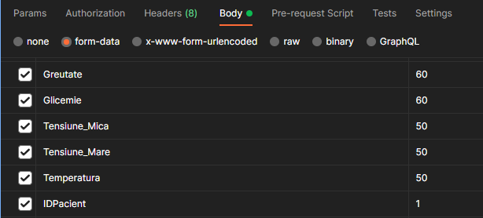
BODY PARAMETERS FOR MOBILE DATA
Back to navigation
Create || Update

Slide 14
ENDPOINTS FOR PATIENTS
Back to navigation
{GET} http://185.207.251.196:9000/api/patients/ => selects all patients
{GET} http://185.207.251.196:9000/api/patients/id/{number}/ => select the patient row that has the specified ID
{GET} http://185.207.251.196:9000/api/patients/username/{string}/ => select the patient that has the specified username
{GET} http://185.207.251.196:9000/api/patients/idmedic/{number}/ => select the patient row that has the specified medic ID
{GET} http://185.207.251.196:9000/api/patients/idsupervisor/{number}/ => select the patient row that has the specified supervisor ID
{POST} http://185.207.251.196:9000/api/patients/create/ => create a new patient row
{PUT} http://185.207.251.196:9000/api/patients/id/{number}/ => update a patient row by ID
{DELETE} http://185.207.251.196:9000/api/patients/id/{number}/ => delete a patient row by the specified ID

Slide 15
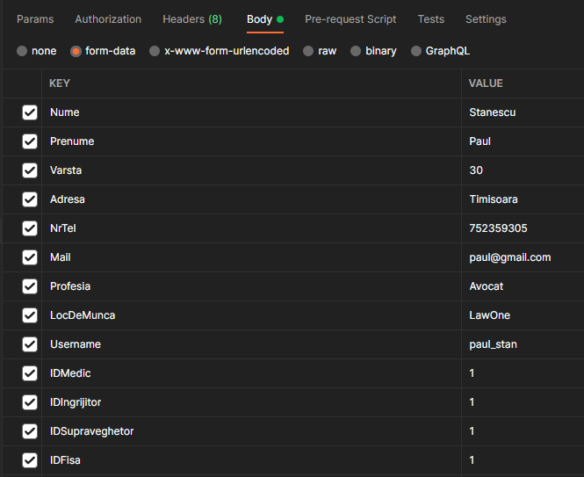
BODY PARAMETERS FOR PATIENTS
Back to navigation
Create || Update

Slide 16
ENDPOINTS FOR USERS
Back to navigation
{GET} http://185.207.251.196:9000/api/users/ => selects all users
{GET} http://185.207.251.196:9000/api/users/id/{number}/ => select the user row that has the specified ID
{GET} http://185.207.251.196:9000/api/users/username/{string}/ => select the user that has the specified username
{POST} http://185.207.251.196:9000/api/users/create/ => create a new user row
{PUT} http://185.207.251.196:9000/api/users/id/{number}/ => update a user row by ID
{DELETE} http://185.207.251.196:9000/api/users/id/{number}/ => delete a user row by the specified ID

Slide 17
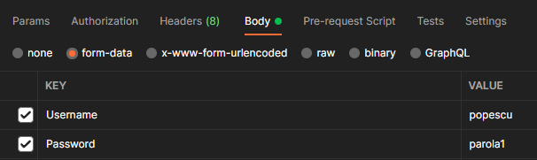
BODY PARAMETERS FOR USERS
Back to navigation
Create || Update

Slide 18
ENDPOINTS FOR SENDERS
Back to navigation
{GET} http://185.207.251.196:9000/api/senders/ => selects all senders
{GET} http://185.207.251.196:9000/api/senders/id/{number}/ => select the sender row that has the specified ID
{GET} http://185.207.251.196:9000/api/users/senders/{string}/ => select the sender that has the specified username
{GET} http://185.207.251.196:9000/api/senders/idpatient/{number}/ => select the sender row that has the specified patient ID
{POST} http://185.207.251.196:9000/api/senders/create/ => create a new sender row
{PUT} http://185.207.251.196:9000/api/senders/id/{number}/ => update a sender row by ID
{DELETE} http://185.207.251.196:9000/api/senders/id/{number}/ => delete a sender row by the specified ID

Slide 19
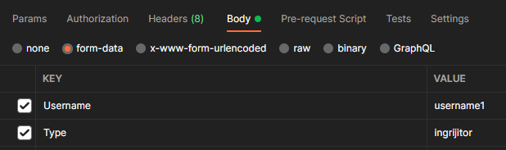
BODY PARAMETERS FOR SENDERS
Back to navigation
Create || Update

Slide 20
ENDPOINTS FOR SENSORS DATA
Back to navigation
{GET} http://185.207.251.196:9000/api/sensors/ => selects all sensor data
{GET} http://185.207.251.196:9000/api/sensors/id/{number}/ => select the sensor data row that has the specified ID
{POST} http://185.207.251.196:9000/api/sensors/create/ => create a new sensor data row
{PUT} http://185.207.251.196:9000/api/sensors/id/{number}/ => update a sensor data row by ID
{DELETE} http://185.207.251.196:9000/api/sensors/id/{number}/ => delete a sensor data row by the specified ID

Slide 21
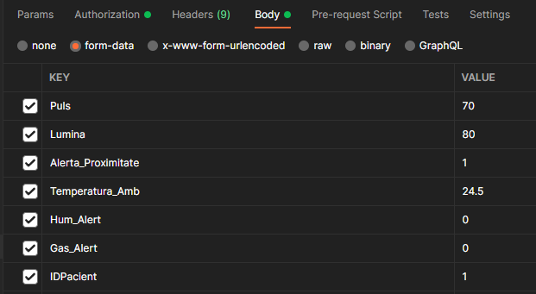
BODY PARAMETERS FOR SENSORS DATA
Back to navigation
Create || Update

Slide 22
ENDPOINTS FOR SUPERVISORS
Back to navigation
{GET} http://185.207.251.196:9000/api/supervisors/ => selects all supervisors
{GET} http://185.207.251.196:9000/api/supervisors/id/{number}/ => select the supervisor row that has the specified ID
{GET} http://185.207.251.196:9000/api/supervisors/username/{string}/ => select the supervisor that has the specified username
{POST} http://185.207.251.196:9000/api/supervisors/create/ => create a new supervisor row
{PUT} http://185.207.251.196:9000/api/supervisors/id/{number}/ => update a supervisor row by ID
{DELETE} http://185.207.251.196:9000/api/supervisors/id/{number}/ => delete a supervisor by the specified ID

Slide 23
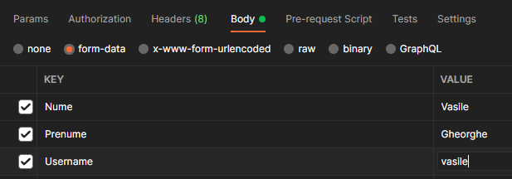
BODY PARAMETERS FOR SENSORS DATA
Back to navigation
Create || Update

