Slide 1

COMPLETE MACHINE LEARNING
& NLP BOOTCAMP
Course-aligned study deck
Python • Data Science • Mathematics • ML • Deep Learning • NLP • Deployment • MLOps
01

Slide 2
COURSE CONTENT
Complete Machine Learning & NLP Bootcamp
01 Python Foundations
Python syntax, data structures, functions, OOP, packages, exceptions and virtual environments
02 Data Science & EDA
NumPy, Pandas, data cleaning, missing values, visualization and exploratory data analysis
03 Mathematics & Statistics
Linear algebra, probability, descriptive statistics, distributions and hypothesis testing
04 Classical Machine Learning
Supervised and unsupervised learning, regression, classification, clustering and feature engineering
05 Model Evaluation & Tuning
Train/test splits, cross-validation, metrics, hyperparameter tuning and model selection
06 Deep Learning
Neural networks, backpropagation, optimization, CNNs, sequence models and transfer learning
07 NLP & Text Analytics
Text preprocessing, tokenization, vectorization, embeddings, sentiment analysis and text classification
08 Transformers & Generative AI
Attention, transformer concepts, LLMs, prompting, fine-tuning concepts, LoRA/QLoRA and agents
09 RAG & AI Applications
Embeddings, vector search, retrieval-augmented generation, retrieval quality and hallucination checks
10 Deployment & MLOps
Model APIs, Docker, cloud deployment, CI/CD, experiment tracking, monitoring and model lifecycle
11 Responsible AI
Privacy, fairness, explainability, guardrails, security and responsible deployment
12 Projects & Portfolio
Hands-on exercises, end-to-end capstone, testing, documentation, assessment and portfolio presentation
SkyNetix Systems LLP • Learn concepts, practice with code, and build production-oriented projects.

Slide 3
How to use this deck
ORIENTATION
Course alignment — Topics follow the public course outline: foundations through deployment and MLOps.
Learning rhythm — Read the concept, run the code, then change an input and predict the result.
Practice — Use the mini-projects and checkpoint questions to test understanding.
Scope note — This is an original study guide; it does not reproduce paid lecture videos or private course resources.
ML • NLP • Deep Learning • MLOps
02

Slide 4
Learning roadmap
ORIENTATION
Python & Tools
Data & Math
Classical ML
Deep Learning
NLP
MLOps & Deploy
Build foundations first, then move from modeling to reliable production systems.
Explanation: Follow the diagram from input to output. Identify what each step receives, what it changes, and what it produces. Use the example to check whether the result meets the task's goal.
ML • NLP • Deep Learning • MLOps
03

Slide 5
AI, ML, deep learning and data science
ORIENTATION
Artificial intelligence — A broad field focused on systems that perform tasks associated with intelligent behavior.
Machine learning — Methods that learn patterns from examples rather than relying only on hand-written rules.
Deep learning — ML using multi-layer neural networks to learn representations.
Data science — The end-to-end practice of collecting, cleaning, analyzing and communicating insights from data.
ML • NLP • Deep Learning • MLOps
04

Slide 6
Development environment
PYTHON FOUNDATIONS
Install Python or Anaconda; use VS Code, Jupyter Notebook or Google Colab.
Create an isolated environment for each project to avoid dependency conflicts.
Track dependencies in requirements.txt or an environment.yml file.
Keep notebooks for exploration and move reusable logic into tested .py modules.
ML • NLP • Deep Learning • MLOps
05

Slide 7
Virtual environments and packages
PYTHON FOUNDATIONS
# Create and activate a virtual environment
python -m venv .venv
# Windows PowerShell
.venv\Scripts\Activate.ps1
# Install core data libraries
python -m pip install numpy pandas matplotlib scikit-learn
# Capture project dependencies
python -m pip freeze > requirements.txt
ML • NLP • Deep Learning • MLOps
06

Slide 8
Python syntax, variables and types
PYTHON FOUNDATIONS
customer = "Maya"
orders = 3
order_value = 249.50
is_member = True
print(type(customer), type(orders))
total = orders * order_value
print(f"{customer}'s total: ₹{total:.2f}")
ML • NLP • Deep Learning • MLOps
07

Slide 9
Operators and expressions
PYTHON FOUNDATIONS
Arithmetic — +, -, *, /, //, %, **
Comparison — ==, !=, <, <=, >, >=
Logical — and, or, not
Membership — in and not in
Best practice — Use parentheses when they make precedence easier to read.
ML • NLP • Deep Learning • MLOps
08

Slide 10
Control flow
PYTHON FOUNDATIONS
score = 78
if score >= 85:
grade = "A"
elif score >= 70:
grade = "B"
else:
grade = "C"
print(grade) # B
ML • NLP • Deep Learning • MLOps
09

Slide 11
Loops and iteration
PYTHON FOUNDATIONS
scores = [72, 91, 64, 88]
passed = []
for score in scores:
if score >= 70:
passed.append(score)
print(passed) # [72, 91, 88]
ML • NLP • Deep Learning • MLOps
10

Slide 12
Core data structures
PYTHON FOUNDATIONS
List — Ordered, mutable collection; useful for sequences.
Tuple — Ordered, immutable collection; useful for fixed records.
Set — Unique elements; useful for membership and set operations.
Dictionary — Key-value mapping; useful for structured records and lookups.
ML • NLP • Deep Learning • MLOps
11

Slide 13
Comprehensions and common patterns
PYTHON FOUNDATIONS
values = [2, 5, 8, 11, 14]
squares_of_evens = [x * x for x in values if x % 2 == 0]
lookup = {x: x * x for x in values}
print(squares_of_evens) # [4, 64, 196]
print(lookup[11]) # 121
ML • NLP • Deep Learning • MLOps
12

Slide 14
Functions and reusable code
PYTHON FOUNDATIONS
def mean(values):
if not values:
raise ValueError("values must not be empty")
return sum(values) / len(values)
print(mean([10, 20, 30])) # 20.0
ML • NLP • Deep Learning • MLOps
13

Slide 15
Lambda, map and filter
PYTHON FOUNDATIONS
prices = [100, 250, 400, 550]
discounted = list(map(lambda p: p * 0.9, prices))
large_orders = list(filter(lambda p: p >= 400, prices))
print(discounted)
print(large_orders)
ML • NLP • Deep Learning • MLOps
14

Slide 16
Modules, packages and imports
PYTHON FOUNDATIONS
Use imports to reuse standard-library and third-party functionality.
Organize related modules in packages; keep public APIs small and clear.
Avoid running expensive work at import time.
Use a main guard for script entry points: if __name__ == '__main__':
ML • NLP • Deep Learning • MLOps
15

Slide 17
Files, exceptions and robust code
PYTHON FOUNDATIONS
from pathlib import Path
import json
path = Path("config.json")
try:
config = json.loads(path.read_text(encoding="utf-8"))
except FileNotFoundError:
config = {"mode": "development"}
except json.JSONDecodeError as exc:
raise ValueError("Invalid JSON configuration") from exc
ML • NLP • Deep Learning • MLOps
16

Slide 18
Object-oriented Python
PYTHON FOUNDATIONS
class ModelConfig:
def __init__(self, name, learning_rate=0.01):
self.name = name
self.learning_rate = learning_rate
def describe(self):
return f"{self.name}: lr={self.learning_rate}"
cfg = ModelConfig("baseline")
print(cfg.describe())
ML • NLP • Deep Learning • MLOps
17

Slide 19
Python practice checkpoint
PYTHON FOUNDATIONS
Write a function that returns the largest value in a list without using max().
Remove duplicates while preserving the original order.
Count the frequency of words in a sentence.
Read a CSV file and handle missing or malformed input safely.
ML • NLP • Deep Learning • MLOps
18

Slide 20
NumPy arrays and vectorization
DATA SCIENCE
import numpy as np
x = np.array([10, 20, 30, 40])
z = (x - x.mean()) / x.std()
print(x.mean(), x.std())
print(z.round(2))
ML • NLP • Deep Learning • MLOps
19

Slide 21
Pandas: inspect and clean data
DATA SCIENCE
import pandas as pd
df = pd.read_csv("customers.csv")
print(df.shape)
print(df.head())
print(df.isna().sum())
df = df.drop_duplicates()
df["age"] = df["age"].fillna(df["age"].median())
ML • NLP • Deep Learning • MLOps
20

Slide 22
Exploratory data analysis
DATA SCIENCE
Inspect dimensions, types, ranges, missingness and duplicate rows.
Use summary statistics to understand central tendency and spread.
Explore distributions and relationships with plots and grouped summaries.
Check target balance, outliers and possible data leakage before modeling.
ML • NLP • Deep Learning • MLOps
21

Slide 23
Data visualization
DATA SCIENCE
import matplotlib.pyplot as plt
df["monthly_spend"].hist(bins=25)
plt.title("Monthly spend distribution")
plt.xlabel("Spend")
plt.ylabel("Customers")
plt.tight_layout()
plt.show()
ML • NLP • Deep Learning • MLOps
22

Slide 24
Descriptive statistics
MATHEMATICS FOR ML
Mean — Arithmetic average; sensitive to extreme values.
Median — Middle observation; robust to skew and outliers.
Variance / standard deviation — Measure dispersion around the mean.
Quantiles and IQR — Describe distribution position and middle-spread.
Correlation — Measures association; does not prove causation.
ML • NLP • Deep Learning • MLOps
23

Slide 25
Probability and conditional probability
MATHEMATICS FOR ML
Probability quantifies uncertainty and ranges from 0 to 1.
P(A and B) describes joint occurrence; P(A | B) describes A given B.
Bayes' theorem updates beliefs using observed evidence.
Base rates matter: a high test accuracy can still produce many false alarms for rare events.
ML • NLP • Deep Learning • MLOps
24

Slide 26
Distributions and sampling
MATHEMATICS FOR ML
Normal distribution — Symmetric bell-shaped model used in many statistical methods.
Binomial distribution — Counts successes across fixed independent trials.
Sampling — A sample estimates properties of a population.
Sampling bias — A sample can systematically misrepresent the population.
Central limit idea — Under suitable conditions, sample means become approximately normal as sample size grows.
ML • NLP • Deep Learning • MLOps
25

Slide 27
Linear algebra essentials
MATHEMATICS FOR ML
Scalar, vector, matrix — Numbers, ordered arrays, and 2D arrays.
Dot product — Combines aligned values; central to linear models and neural layers.
Matrix multiplication — Composes linear transformations.
Norm — Measures vector magnitude; often used in regularization.
Shape discipline — Track rows, columns and feature dimensions explicitly.
ML • NLP • Deep Learning • MLOps
26

Slide 28
Calculus and gradients
MATHEMATICS FOR ML
A derivative measures how a function changes with an input.
A partial derivative measures change with respect to one parameter.
The gradient collects partial derivatives for all model parameters.
Gradient descent updates parameters in the direction that reduces the loss.
ML • NLP • Deep Learning • MLOps
27

Slide 29
Train, validation and test split
DATA SCIENCE
Raw data
Train set
Validation set
Test set
Fit parameters on training data, tune choices on validation data, and reserve test data for final evaluation.
Explanation: Follow the diagram from input to output. Identify what each step receives, what it changes, and what it produces. Use the example to check whether the result meets the task's goal.
ML • NLP • Deep Learning • MLOps
28

Slide 30
Data preprocessing pipeline
DATA SCIENCE
Raw data
Impute
Encode
Scale
Model
Fit preprocessing only on training data; use a pipeline to apply the same learned transformations to validation, test and production data.
Explanation: Follow the diagram from input to output. Identify what each step receives, what it changes, and what it produces. Use the example to check whether the result meets the task's goal.
ML • NLP • Deep Learning • MLOps
29

Slide 31
Machine learning workflow
CLASSICAL ML
Define problem
Collect data
Prepare features
Train
Evaluate
Deploy & monitor
The workflow is iterative: monitoring can reveal drift or data-quality issues that require retraining.
Explanation: Follow the diagram from input to output. Identify what each step receives, what it changes, and what it produces. Use the example to check whether the result meets the task's goal.
ML • NLP • Deep Learning • MLOps
30

Slide 32
Learning paradigms
CLASSICAL ML
Supervised learning — Learns from labeled examples; regression and classification.
Unsupervised learning — Finds structure in unlabeled data; clustering and dimensionality reduction.
Reinforcement learning — Learns behavior through actions, rewards and interaction.
Semi/self-supervised learning — Uses limited labels or learning signals derived from the data itself.
ML • NLP • Deep Learning • MLOps
31

Slide 33
Regression vs classification
CLASSICAL ML
Input features
Learning algorithm
Numeric output
(regression)
Classification instead predicts a class or class probability; choose metrics that match the business goal.
Explanation: Follow the diagram from input to output. Identify what each step receives, what it changes, and what it produces. Use the example to check whether the result meets the task's goal.
ML • NLP • Deep Learning • MLOps
32

Slide 34
Simple and multiple linear regression
CLASSICAL ML
Model a target as a weighted sum of input features plus an intercept.
Coefficients estimate the direction and magnitude of a feature's association, conditional on the model.
Inspect residuals and evaluate on held-out data.
Linear models are interpretable baselines, but can miss nonlinear relationships.
ML • NLP • Deep Learning • MLOps
33

Slide 35
Regression loss and metrics
CLASSICAL ML
MAE — Average absolute prediction error; easy to interpret in target units.
MSE — Squares errors, penalizing large mistakes more heavily.
RMSE — Square root of MSE; returns to target units.
R² — Compares model performance with a mean-target baseline; can be negative on test data.
ML • NLP • Deep Learning • MLOps
34

Slide 36
Polynomial regression and regularization
CLASSICAL ML
Polynomial features allow a linear model to fit curved relationships.
Higher degree increases flexibility and can overfit.
Ridge — L2 penalty shrinks coefficients.
Lasso — L1 penalty can drive some coefficients to zero.
Tune complexity and regularization using validation or cross-validation.
ML • NLP • Deep Learning • MLOps
35

Slide 37
Logistic regression and classification
CLASSICAL ML
Logistic regression maps a linear score to a probability using a sigmoid for binary classification.
Choose a decision threshold based on the cost of false positives and false negatives.
Multiclass problems can use one-vs-rest or softmax-based approaches.
Calibrated probabilities can be important for risk-based decisions.
ML • NLP • Deep Learning • MLOps
36

Slide 38
Confusion matrix and classification metrics
CLASSICAL ML
True positive / true negative — Correct positive / negative predictions.
False positive / false negative — Incorrect positive / negative predictions.
Precision — Of predicted positives, how many were correct?
Recall — Of actual positives, how many were found?
F1 — Harmonic mean of precision and recall.
ML • NLP • Deep Learning • MLOps
37

Slide 39
Decision trees and ensembles
CLASSICAL ML
Decision trees split data using feature rules to reduce impurity or prediction error.
Trees are intuitive but can be unstable and overfit without constraints.
Random forests average many randomized trees to reduce variance.
Gradient boosting builds learners sequentially to correct earlier errors.
ML • NLP • Deep Learning • MLOps
38

Slide 40
K-nearest neighbors and support vector machines
CLASSICAL ML
KNN — Predicts from nearby examples; sensitive to scaling and choice of k.
Distance metrics — Euclidean, Manhattan and cosine similarity serve different data geometries.
SVM — Finds a margin-separating boundary; kernels can represent nonlinear boundaries.
Scale features and tune hyperparameters using a disciplined validation process.
ML • NLP • Deep Learning • MLOps
39

Slide 41
Naive Bayes and probabilistic baselines
CLASSICAL ML
Uses Bayes' theorem with a conditional-independence assumption.
Common variants include Gaussian, Multinomial and Bernoulli Naive Bayes.
Often useful for text classification and fast baseline models.
The independence assumption is simplified, but predictive performance can still be strong.
ML • NLP • Deep Learning • MLOps
40

Slide 42
Clustering: K-means intuition
CLASSICAL ML
Choose k
Assign points
Update centroids
Repeat until stable
K-means minimizes within-cluster squared distances; scale features and inspect whether clusters are meaningful.
Explanation: Follow the diagram from input to output. Identify what each step receives, what it changes, and what it produces. Use the example to check whether the result meets the task's goal.
ML • NLP • Deep Learning • MLOps
41

Slide 43
Dimensionality reduction and PCA
CLASSICAL ML
High-dimensional data can contain redundancy and noise.
PCA finds orthogonal directions that capture decreasing amounts of variance.
Standardize features when their scales are not comparable.
Use PCA for compression, visualization and preprocessing—not as a guarantee of better predictive accuracy.
ML • NLP • Deep Learning • MLOps
42

Slide 44
Cross-validation and hyperparameter tuning
CLASSICAL ML
Cross-validation estimates how results vary across data splits.
Grid search evaluates a defined parameter grid; randomized search samples candidates.
Use stratified folds for imbalanced classification where appropriate.
Keep the final test set out of repeated model-selection decisions.
ML • NLP • Deep Learning • MLOps
43

Slide 45
Overfitting, underfitting and bias-variance
CLASSICAL ML
Underfitting — Model is too simple to capture the signal; both train and validation scores are poor.
Overfitting — Model memorizes training details; training score is strong but validation performance drops.
Bias — Error from overly restrictive assumptions.
Variance — Sensitivity to the particular training sample.
Use more representative data, regularization, suitable complexity and careful validation.
ML • NLP • Deep Learning • MLOps
44

Slide 46
Feature engineering and leakage
CLASSICAL ML
Create domain-relevant features, aggregate histories and derive useful time-based variables.
Encode categories and scale numeric inputs where the algorithm needs it.
Leakage occurs when training uses information unavailable at prediction time.
Split by time, customer or entity when random splitting would let related records cross partitions.
ML • NLP • Deep Learning • MLOps
45

Slide 47
Imbalanced classification
CLASSICAL ML
Accuracy can be misleading when one class dominates.
Inspect precision-recall curves, recall, precision, F1 and class-specific errors.
Consider class weights, resampling or threshold adjustment—inside training/validation only.
Evaluate on data reflecting real-world prevalence and decision costs.
ML • NLP • Deep Learning • MLOps
46

Slide 48
Neural network building blocks
DEEP LEARNING
Input features
Hidden layer(s)
Activation
Output layer
Weights and biases are learned from data; activations allow the network to represent nonlinear functions.
Explanation: Follow the diagram from input to output. Identify what each step receives, what it changes, and what it produces. Use the example to check whether the result meets the task's goal.
ML • NLP • Deep Learning • MLOps
47

Slide 49
Forward pass, loss and backpropagation
DEEP LEARNING
Forward pass computes predictions from current parameters.
Loss compares predictions with targets.
Backpropagation applies the chain rule to compute parameter gradients.
The optimizer updates parameters; training repeats over batches and epochs.
ML • NLP • Deep Learning • MLOps
48

Slide 50
Activation functions
DEEP LEARNING
ReLU — max(0, x); common in hidden layers.
Sigmoid — Maps a scalar to (0, 1); common binary probability output.
Tanh — Maps to (-1, 1).
Softmax — Converts class scores to a probability distribution.
Activation choice depends on the architecture and task.
ML • NLP • Deep Learning • MLOps
49

Slide 51
Loss functions and optimizers
DEEP LEARNING
MSE — Common for regression.
Binary / categorical cross-entropy — Common for classification.
SGD — Simple gradient-based optimizer; momentum can smooth updates.
Adam — Adaptive per-parameter learning rates and momentum estimates.
Learning rate is a key hyperparameter; monitor both training and validation loss.
ML • NLP • Deep Learning • MLOps
50

Slide 52
Training loop concepts
DEEP LEARNING
Epoch — One pass through the training dataset.
Batch size — Examples processed before an update.
Learning rate — Step size used by the optimizer.
Early stopping — Stop when validation performance ceases to improve.
Checkpointing — Save model weights and training state for recovery or selection.
Explanation: Machine learning includes regression for numeric predictions, classification for categories, clustering for unlabeled groups, and dimensionality reduction for compact features. Choose based on the task and validate with suitable metrics.
ML • NLP • Deep Learning • MLOps
51

Slide 53
Convolutional neural networks
DEEP LEARNING
Image
Convolution
Activation & pooling
Feature maps
Classifier
CNNs use local filters and shared weights to learn spatial features from images.
Explanation: Linear regression learns feature weights to predict a number, such as a house price. Check residuals and test on unseen data to see whether a linear relationship is suitable.
ML • NLP • Deep Learning • MLOps
52

Slide 54
CNN: practical considerations
DEEP LEARNING
Normalize image values and apply consistent resizing and channel ordering.
Use augmentation to improve robustness when transformations preserve labels.
Transfer learning can reuse pretrained visual features when data is limited.
Track class-wise performance and inspect false predictions, not only aggregate accuracy.
Explanation: Logistic regression estimates class probabilities. A threshold turns probability into a label; choose the threshold based on the relative cost of false positives and false negatives.
ML • NLP • Deep Learning • MLOps
53

Slide 55
Sequence models and embeddings
DEEP LEARNING
Sequences have order: tokens, sensor readings, events or time steps.
Embeddings map discrete tokens or categories to dense vectors.
RNNs process sequential state; LSTMs and GRUs help preserve longer-range information.
Transformers use attention to model relationships across tokens.
Explanation: Decision trees split data using feature-based rules. Random forests combine many trees to improve stability. Limit tree depth and evaluate on unseen data to reduce overfitting.
ML • NLP • Deep Learning • MLOps
54

Slide 56
NLP pipeline
NLP
Raw text
Clean & normalize
Tokenize
Vectorize / embed
Model
Evaluate
The right preprocessing depends on the task; preserve important signals such as negation and domain-specific terms.
Explanation: KNN predicts using nearby training examples. Feature scaling matters because distance drives the result; small K is sensitive to noise, while large K can blur local patterns.
ML • NLP • Deep Learning • MLOps
55

Slide 57
Text cleaning and tokenization
NLP
Normalize casing and whitespace when appropriate.
Handle punctuation, URLs, emojis, language variants and domain-specific terms deliberately.
Tokenization can be word-, subword- or character-based.
Avoid removing words such as “not” when they change meaning.
Explanation: SVM finds a boundary with a wide margin between classes. Scaling and kernel choice affect results, so compare settings using validation or cross-validation.
ML • NLP • Deep Learning • MLOps
56

Slide 58
Stemming, lemmatization and stop words
NLP
Stemming — Heuristic chopping that may produce non-words.
Lemmatization — Maps words to dictionary forms using linguistic analysis.
Stop-word removal — Can reduce noise, but may remove meaningful terms.
Always test preprocessing against the actual task and language.
Explanation: Naive Bayes uses Bayes' theorem with a simplifying conditional-independence assumption. It is fast and often useful for text classification; evaluate with precision and recall.
ML • NLP • Deep Learning • MLOps
57

Slide 59
Bag of words and TF-IDF
NLP
Bag of words represents documents by token counts and ignores word order.
TF-IDF downweights terms common across many documents.
Sparse vector representations work well with linear models and Naive Bayes.
Fit vectorizers on training text only to avoid leakage.
Explanation: DBSCAN groups dense regions and marks sparse points as noise. Tune neighborhood radius and minimum samples carefully because scale strongly affects the clusters.
ML • NLP • Deep Learning • MLOps
58

Slide 60
Word embeddings and semantic similarity
NLP
Embeddings map words, tokens or documents into dense vector spaces.
Similar contexts may produce nearby vectors under a chosen similarity metric.
Static embeddings assign one vector per word; contextual embeddings vary with context.
Cosine similarity is often used to compare embedding directions.
Explanation: PCA creates new components that preserve as much variance as possible. It can compress features or aid visualization, but components may be less interpretable than original variables.
ML • NLP • Deep Learning • MLOps
59

Slide 61
Transformers and attention
NLP
Tokens
Token + position embeddings
Self-attention blocks
Contextual representations
Task head
Self-attention lets each token combine information from other tokens; position information helps represent order.
Explanation: Gradient descent updates parameters in the direction that reduces loss. A learning rate that is too high may overshoot; one that is too low makes training slow.
ML • NLP • Deep Learning • MLOps
60

Slide 62
NLP tasks and evaluation
NLP
Classification — Sentiment, topic, intent and spam detection.
Sequence labeling — Named-entity recognition and token tagging.
Generation — Summarization, translation and assistant responses.
Metrics — Accuracy/F1 for classification; task-specific overlap or human evaluation for generation.
Evaluate failure cases, bias, privacy and robustness in addition to scores.
Explanation: Backpropagation uses the chain rule to calculate gradients through network layers. The optimizer uses those gradients to update weights.
ML • NLP • Deep Learning • MLOps
61

Slide 63
Text classification mini-project
NLP
from sklearn.pipeline import make_pipeline
from sklearn.feature_extraction.text import TfidfVectorizer
from sklearn.linear_model import LogisticRegression
model = make_pipeline(
TfidfVectorizer(ngram_range=(1, 2), min_df=2),
LogisticRegression(max_iter=1000)
)
model.fit(train_texts, train_labels)
predictions = model.predict(test_texts)
Explanation: CNN filters learn local image patterns. Early layers often detect edges and textures, while deeper layers combine them into features useful for classification.
ML • NLP • Deep Learning • MLOps
62

Slide 64
NLP project checklist
NLP
Define labels and split data before fitting any text transformations.
Build a simple baseline before using a large pretrained model.
Review confusion pairs, class imbalance and ambiguous labels.
Record dataset version, preprocessing, model parameters and metrics.
Plan inference latency, monitoring, privacy and safe handling of user text.
Explanation: RNNs process sequences step by step. LSTMs add gates that help preserve or discard information over longer sequences.
ML • NLP • Deep Learning • MLOps
63

Slide 65
Reinforcement learning loop
REINFORCEMENT LEARNING
Agent observes state
Chooses action
Environment responds
Reward + next state
Update policy
The agent aims to maximize cumulative reward; exploration and exploitation must be balanced.
Explanation: Self-attention lets each token combine information from other tokens. Query, key, and value vectors determine which context is most useful.
ML • NLP • Deep Learning • MLOps
64

Slide 66
RL vocabulary and use cases
REINFORCEMENT LEARNING
State — Information available to the agent.
Action — Choice made by the agent.
Reward — Feedback signal for the outcome.
Policy — Mapping from states to actions.
Examples include robotics, resource allocation, game-playing and control; real-world use requires safe constraints.
Explanation: Embeddings map items to vectors. Similarity can find semantically related text, but similarity alone does not prove that a result is correct.
ML • NLP • Deep Learning • MLOps
65

Slide 67
From notebook to production
DEPLOYMENT
Explore in notebook
Refactor code
Test & package
Serve model
Monitor
Productionization adds reproducibility, validation, observability, security and an operational owner.
Explanation: RAG retrieves source passages before generating an answer. Evaluate retrieval relevance and verify that the answer's claims are supported by the retrieved evidence.
ML • NLP • Deep Learning • MLOps
66

Slide 68
Model serving patterns
DEPLOYMENT
Batch inference — Score many records on a schedule.
Online API — Return a prediction for each request.
Streaming — Score events as they arrive.
Edge deployment — Run near the data source under compute constraints.
Choose based on latency, throughput, freshness, cost and failure tolerance.
Explanation: An agent cycles through planning, tool use, observing results, and choosing the next step. Limit permissions and iterations, and require approval for consequential actions.
ML • NLP • Deep Learning • MLOps
67

Slide 69
A minimal prediction API concept
DEPLOYMENT
# Conceptual FastAPI-style endpoint
from fastapi import FastAPI
from pydantic import BaseModel
app = FastAPI()
class Request(BaseModel):
age: float
monthly_spend: float
@app.post("/predict")
def predict(req: Request):
features = [[req.age, req.monthly_spend]]
prediction = model.predict(features)[0]
return {"prediction": float(prediction)}
ML • NLP • Deep Learning • MLOps
68

Slide 70
Testing an ML system
DEPLOYMENT
Unit tests — Validate transformations, feature calculations and utility functions.
Data tests — Check schema, ranges, missingness and unexpected category values.
Model tests — Verify expected metrics and basic invariants.
API tests — Validate request/response contracts, errors and timeouts.
Test reproducibility and behavior on edge cases, not only happy paths.
Explanation: LLM outputs can sound convincing while being unsupported. Ground answers in trusted sources, check citations, and allow the model to abstain when evidence is missing.
ML • NLP • Deep Learning • MLOps
69

Slide 71
Containers and reproducible environments
DEPLOYMENT
Package code and runtime dependencies into an immutable image.
Pin dependency versions and separate build-time from runtime configuration.
Keep secrets outside the image; inject them securely at runtime.
Use health checks, resource limits, logs and graceful shutdown.
Scan images and minimize unnecessary packages.
Explanation: Prevent data leakage by splitting data before fitting preprocessing steps. Fit transformations on training data only; preserve chronology for time-series problems.
ML • NLP • Deep Learning • MLOps
70

Slide 72
MLOps lifecycle
MLOPS
Data versioning
Experiment tracking
Model registry
CI/CD
Deploy
Monitor & retrain
MLOps applies engineering discipline to data, experiments, models, deployment and continuous feedback.
Explanation: Use validation data or cross-validation to compare models. Keep the final test set untouched until model choices are complete.
ML • NLP • Deep Learning • MLOps
71

Slide 73
Experiment tracking with MLflow
MLOPS
Log parameters, metrics, artifacts and model files for each run.
Compare experiments using consistent validation data and metrics.
Register approved model versions and record their provenance.
A model registry supports stage transitions, review and rollback.
Explanation: Forecasting should use chronological splits so training data comes before validation data. Compare against simple baselines and respect the forecast horizon.
ML • NLP • Deep Learning • MLOps
72

Slide 74
Data and model versioning with DVC
MLOPS
Version dataset and model artifacts without committing large files directly to Git.
Represent pipelines as stages with explicit dependencies.
Reproduce experiments using code, data references, parameters and environment information.
Ensure remote storage permissions and retention policies match organizational needs.
Explanation: Class weights or resampling can help with rare classes. Apply resampling only inside training folds and evaluate precision, recall, F1, or PR-AUC.
ML • NLP • Deep Learning • MLOps
73

Slide 75
Packaging models with BentoML
MLOPS
Package a model and its inference code into a deployable service.
Define input/output schemas and validate requests.
Build repeatable service artifacts for local testing and deployment.
Measure latency, throughput, resource use and error rates before rollout.
Explanation: Scaling puts numeric features on comparable ranges. Fit scalers on training data only; distance-based and gradient-based models often benefit most.
ML • NLP • Deep Learning • MLOps
74

Slide 76
Monitoring data and model drift
MLOPS
Data quality — Schema, missing values, range changes and unseen categories.
Data drift — Input distributions change over time.
Concept drift — The relationship between inputs and targets changes.
Model quality — Track metrics when labels become available.
Drift alerts should trigger investigation; retraining is not automatically the correct response.
Explanation: One-hot encoding represents each category with a binary column, avoiding a false numeric order. Learn category mappings from training data.
ML • NLP • Deep Learning • MLOps
75

Slide 77
CI/CD for ML systems
MLOPS
Run linting, unit tests, data validation and model checks on each change.
Build immutable artifacts and promote them through controlled environments.
Use canary or shadow deployment to reduce rollout risk.
Keep rollback paths and monitor business outcomes after release.
Explanation: Investigate why values are missing before imputing them. Fit imputation rules on training data and apply the same rules during inference.
ML • NLP • Deep Learning • MLOps
76

Slide 78
Responsible AI and governance
MLOPS
Assess privacy, consent, data retention and access control.
Evaluate subgroup performance and potential disparate impact.
Document intended use, limitations, data lineage and model changes.
Use human oversight and escalation paths for high-impact decisions.
Secure model endpoints and treat user-provided inputs as untrusted.
Explanation: TF-IDF emphasizes distinctive words and is a strong lexical baseline. Embeddings represent semantic relationships and can improve meaning-based retrieval.
ML • NLP • Deep Learning • MLOps
77

Slide 79
Project 1: end-to-end tabular ML
PROJECTS
Problem: predict a numeric or categorical outcome from structured records.
Prepare a data dictionary; inspect missingness, duplicates and target distribution.
Build a preprocessing + baseline model pipeline.
Compare candidates with cross-validation and report test metrics.
Package the selected model with schema checks and a reproducible README.
Explanation: BLEU and ROUGE compare generated text with reference text. They are useful indicators but should be combined with factuality checks and human review.
ML • NLP • Deep Learning • MLOps
78

Slide 80
Project 2: NLP text classifier
PROJECTS
Problem: classify support tickets, reviews or messages into useful categories.
Create a leakage-safe train/validation/test split.
Compare TF-IDF + linear baseline with a pretrained transformer if justified.
Analyze false positives/negatives and per-class precision/recall.
Expose a small API and log predictions without storing unnecessary sensitive text.
Explanation: Text classification converts text into features, trains a classifier, and predicts labels such as sentiment or spam. Keep training and inference preprocessing consistent.
ML • NLP • Deep Learning • MLOps
79

Slide 81
Project 3: image classification
PROJECTS
Define classes and split by source or subject to avoid near-duplicate leakage.
Normalize images and apply label-preserving augmentation.
Train a small CNN or fine-tune a pretrained model.
Inspect a confusion matrix and examples of incorrect predictions.
Save model version, preprocessing configuration and class mapping together.
Explanation: NER identifies spans such as people, organizations, places, and dates. Evaluate entity-level precision, recall, and F1 on representative examples.
ML • NLP • Deep Learning • MLOps
80

Slide 82
Project 4: MLOps mini-pipeline
PROJECTS
Commit code
Validate data
Train & evaluate
Register model
Deploy
Monitor
Automate repeatable steps and require explicit approval before production promotion.
Explanation: Extractive summarization selects existing sentences; abstractive summarization generates new wording. Check that key facts are covered and not invented.
ML • NLP • Deep Learning • MLOps
81

Slide 83
Project documentation template
PROJECTS
Problem statement, user and business value.
Dataset source, licensing, schema, limitations and split strategy.
Baseline, experiment table, chosen metric and rationale.
Reproduction steps, environment, tests and deployment instructions.
Known failure modes, monitoring plan, owner and retraining criteria.
Explanation: Explainability helps describe model behavior globally or for one prediction. Feature attributions are approximations and need careful interpretation.
ML • NLP • Deep Learning • MLOps
82

Slide 84
Common mistakes to avoid
REVIEW
Preprocessing the full dataset before splitting.
Optimizing accuracy when the real objective is precision, recall, cost or ranking quality.
Tuning repeatedly on the test set.
Reporting a single score without uncertainty or error analysis.
Shipping a model without schema validation, monitoring or rollback.
Explanation: Bias may enter through data, labels, or deployment. Compare error rates across relevant groups and continue monitoring after release.
ML • NLP • Deep Learning • MLOps
83

Slide 85
Final review: explain these concepts
REVIEW
How do train, validation and test sets differ?
When would you choose MAE instead of RMSE?
How does regularization reduce overfitting?
Why is TF-IDF a useful NLP baseline?
What does attention add to transformer architectures?
What should be monitored after a model is deployed?
Explanation: Protect ML systems with least-privilege access, input validation, secret management, safe logging, and testing for malicious or sensitive inputs.
ML • NLP • Deep Learning • MLOps
84

Slide 86
Suggested next steps
REVIEW
Follow the matching Udemy lectures in order and annotate this deck with lecture-specific notes.
Run every code example in a clean Python environment.
Complete at least one tabular ML, one NLP and one deployment project.
Track experiments and version data/models from the beginning.
Revisit weak areas using short practice questions and explain concepts aloud.
Explanation: Measure latency, throughput, memory, and cost per request. Benchmark realistic workloads before choosing caching, batching, quantization, or smaller models.
ML • NLP • Deep Learning • MLOps
85

Slide 87
Course alignment and scope
REFERENCE
Primary source — Public Udemy course page and publicly visible curriculum outline.
Coverage — Python, data structures, NumPy/Pandas, statistics and math, ML algorithms, deep learning/CNNs, NLP, RL overview, projects, deployment and MLOps.
Study-note status — Original explanations, examples and diagrams created to support learning.
Limitations — Private lecture transcripts, downloadable course resources and members-only details were not available from the public page.
Explanation: A/B testing compares a new model with the current one under controlled traffic. Define success and safety metrics before starting the experiment.
ML • NLP • Deep Learning • MLOps
86

Slide 88
Python program execution
PYTHON FOUNDATIONS
Source code
Interpreter
Bytecode / runtime
Output
Readability: names + indentation
Runtime: errors, imports and dependencies
Debug: inspect values and stack traces
Explanation: A canary sends a small share of traffic to a new model. Increase traffic only when health metrics are acceptable, and keep rollback ready.
Concept map • Editable PowerPoint shapes and arrows

Slide 89
Data structures at a glance
PYTHON FOUNDATIONS
List
ordered + mutable
Tuple
ordered + immutable
Set
unique values
Dictionary
key → value
Choose by required operations
Sets support fast membership tests
Dictionaries model records and lookups
Explanation: Active learning selects examples for labeling, often based on uncertainty or diversity. Compare it with random sampling to confirm it improves learning efficiency.
Concept map • Editable PowerPoint shapes and arrows

Slide 90
Function call and return
PYTHON FOUNDATIONS
Arguments
Function body
Return value
Caller continues
Inputs define the contract
Keep functions small and testable
Return values are easier to reuse than print-only output
Explanation: Reinforcement learning improves actions through rewards from an environment. Poorly designed rewards can cause unintended behavior, so test safely.
Concept map • Editable PowerPoint shapes and arrows

Slide 91
NumPy vectorization
DATA SCIENCE
Array input
Vectorized operation
Broadcasting
Array output
Less Python-loop overhead
Shapes must be compatible
Check dtype and missing/invalid values
Explanation: Validate clusters with metrics such as silhouette score and with domain usefulness, stability, and cluster-size checks.
Concept map • Editable PowerPoint shapes and arrows

Slide 92
Pandas analysis workflow
DATA SCIENCE
Load
Inspect
Clean
Transform
Summarize
Schema + row counts
Missing values + duplicates
Group, aggregate and visualize
Explanation: An ML project moves from problem definition and data validation through training, evaluation, deployment, and monitoring. Keep data, code, and experiments reproducible.
Concept map • Editable PowerPoint shapes and arrows

Slide 93
Statistics: spread and center
MATHEMATICS FOR ML
Raw observations
Center
mean / median
Spread
SD / IQR
Interpretation
Outliers move the mean more than the median
Standard deviation is scale-sensitive
Use plots with summary statistics
Explanation: RAG ingests and chunks documents, embeds them, retrieves relevant passages for a query, and generates an answer grounded in those passages.
Concept map • Editable PowerPoint shapes and arrows

Slide 94
Bayes theorem concept
MATHEMATICS FOR ML
Prior belief
Evidence
Likelihood
Posterior belief
Prior: what was believed before
Likelihood: evidence under a hypothesis
Posterior: updated belief after evidence
Explanation: Validate schemas, duplicates, missing values, ranges, and label consistency. Clear annotation guidelines and reviewer agreement improve training data quality.
Concept map • Editable PowerPoint shapes and arrows

Slide 95
Gradient descent update
MATHEMATICS FOR ML
Initialize parameters
Compute loss
Update weights
Compute gradient
Iterative loop: use results and monitoring to decide the next action.
Explanation: Data versioning records which snapshot and transformations produced a model, supporting reproducibility, audits, and rollback.

Slide 96
Leakage-safe data split
DATA SCIENCE
Split records
Fit transforms on train
Tune on validation
Final test once
Never learn imputation/scaling from all rows
Respect time or entity boundaries
Keep test set out of tuning
Explanation: A model card documents intended use, evaluation, limitations, and known risks so users can judge whether a model fits their situation.
Concept map • Editable PowerPoint shapes and arrows

Slide 97
Supervised learning map
CLASSICAL ML
Labeled examples
Feature matrix X
Train model
Predict target y
Regression → numeric values
Classification → class / probability
Measure on unseen examples
Explanation: Orchestration coordinates data checks, training, evaluation, and deployment. Use retries, timeouts, notifications, and quality gates before promotion.
Concept map • Editable PowerPoint shapes and arrows

Slide 98
Bias–variance trade-off
CLASSICAL ML
Too simple
underfit
Balanced model
Too complex
overfit
Training and validation both poor: underfit
Validation improves then worsens: overfit
Use CV, regularization and more representative data
Explanation: Batch scoring generates predictions for many records on a schedule. Track counts, failures, model version, and completion status.
Concept map • Editable PowerPoint shapes and arrows

Slide 99
Regression model workflow
CLASSICAL ML
Features
Linear / polynomial model
Predictions
Residual analysis
MAE: average absolute error
RMSE: penalizes large errors
Residual patterns can reveal misspecification
Explanation: Online inference responds to live requests, so latency, concurrency, timeouts, and fallback behavior must be tested under realistic load.
Concept map • Editable PowerPoint shapes and arrows

Slide 100
Classification decision process
CLASSICAL ML
Features
Class probability
Threshold
Predicted class
Threshold is a business choice
Lower threshold often raises recall and false positives
Calibrate probabilities when decisions depend on risk
Explanation: Experiment tracking records code, data version, parameters, metrics, and artifacts so results can be compared and reproduced.
Concept map • Editable PowerPoint shapes and arrows

Slide 101
Confusion matrix anatomy
CLASSICAL ML
Actual positive
Predicted positive → TP
Predicted negative → FN
Precision = TP / (TP + FP)
Recall = TP / (TP + FN)
Inspect errors by class and subgroup
Explanation: A model registry stores model versions, lineage, metrics, and approval status. Link each deployment to an exact artifact to support audits and rollback.
Concept map • Editable PowerPoint shapes and arrows

Slide 102
Tree ensembles comparison
CLASSICAL ML
Single tree
Random forest
Gradient boosting
Single tree: interpretable but unstable
Forest: averages randomized trees
Boosting: sequentially corrects errors
Explanation: Follow the diagram from input to output. Identify what each step receives, what it changes, and what it produces. Use the example to check whether the result meets the task's goal.
Concept map • Editable PowerPoint shapes and arrows

Slide 103
K-means clustering cycle
CLASSICAL ML
Initialize centroids
Assign points
Converge
Recompute centers
Iterative loop: use results and monitoring to decide the next action.
Explanation: Follow the diagram from input to output. Identify what each step receives, what it changes, and what it produces. Use the example to check whether the result meets the task's goal.

Slide 104
PCA dimensionality reduction
CLASSICAL ML
Feature matrix
Center / scale
Principal components
Lower-dimensional view
Components capture decreasing variance
PCA is unsupervised
Interpret components carefully
Explanation: Follow the diagram from input to output. Identify what each step receives, what it changes, and what it produces. Use the example to check whether the result meets the task's goal.
Concept map • Editable PowerPoint shapes and arrows

Slide 105
Cross-validation and tuning
CLASSICAL ML
Training folds
Fit candidates
Compare validation scores
Select parameters
Use the same evaluation protocol for candidates
Avoid tuning against the test set
Track variability across folds
Concept map • Editable PowerPoint shapes and arrows

Slide 106
Neural network training loop
DEEP LEARNING
Forward pass
Loss
Optimizer update
Backpropagation
Iterative loop: use results and monitoring to decide the next action.
Explanation: Follow the diagram from input to output. Identify what each step receives, what it changes, and what it produces. Use the example to check whether the result meets the task's goal.

Slide 107
Activation functions map
DEEP LEARNING
ReLU
hidden layers
Sigmoid
binary output
Softmax
multiclass output
ReLU supports nonlinear hidden representations
Sigmoid maps a score to (0,1)
Softmax probabilities sum to 1
Concept map • Editable PowerPoint shapes and arrows

Slide 108
CNN feature hierarchy
DEEP LEARNING
Image pixels
Edges / textures
Shapes / parts
Class prediction
Explanation: Follow the diagram from input to output. Identify what each step receives, what it changes, and what it produces. Use the example to check whether the result meets the task's goal.
Layers transform information into progressively more useful representations.

Slide 109
Sequence modeling overview
DEEP LEARNING
Token sequence
Embedding vectors
Sequence model
Task output
RNN/LSTM/GRU process sequential state
Transformers use attention
Padding and masks matter for batches
Explanation: Follow the diagram from input to output. Identify what each step receives, what it changes, and what it produces. Use the example to check whether the result meets the task's goal.
Concept map • Editable PowerPoint shapes and arrows

Slide 110
Transformer attention flow
NLP
Tokens
Query / key / value
Attention weights
Contextual tokens
Explanation: Follow the diagram from input to output. Identify what each step receives, what it changes, and what it produces. Use the example to check whether the result meets the task's goal.
Layers transform information into progressively more useful representations.

Slide 111
Text vectorization choices
NLP
Raw documents
Counts / TF-IDF
Static embeddings
Contextual embeddings
Sparse baselines are fast and interpretable
Embeddings encode semantic relationships
Choose complexity to match data and task
Concept map • Editable PowerPoint shapes and arrows

Slide 112
NLP text classification
NLP
Text + labels
Tokenize / vectorize
Train classifier
Evaluate F1 + errors
Fit vocabulary only on training text
Check class imbalance
Review confusing examples
Explanation: Follow the diagram from input to output. Identify what each step receives, what it changes, and what it produces. Use the example to check whether the result meets the task's goal.
Concept map • Editable PowerPoint shapes and arrows

Slide 113
Reinforcement learning interaction
REINFORCEMENT LEARNING
Observe state
Choose action
Update policy
Receive reward
Iterative loop: use results and monitoring to decide the next action.
Explanation: Follow the diagram from input to output. Identify what each step receives, what it changes, and what it produces. Use the example to check whether the result meets the task's goal.

Slide 114
Model serving request lifecycle
DEPLOYMENT
Request validation
Feature transform
Model inference
Response + logs
Validate schema and ranges
Keep preprocessing aligned with training
Log safely without leaking sensitive data
Explanation: Follow the diagram from input to output. Identify what each step receives, what it changes, and what it produces. Use the example to check whether the result meets the task's goal.
Concept map • Editable PowerPoint shapes and arrows

Slide 115
Container deployment path
DEPLOYMENT
Source + tests
Build image
Registry
Runtime environment
Pin dependencies
Scan image and limit permissions
Keep secrets outside the image
Explanation: Follow the diagram from input to output. Identify what each step receives, what it changes, and what it produces. Use the example to check whether the result meets the task's goal.
Concept map • Editable PowerPoint shapes and arrows

Slide 116
MLflow experiment tracking
MLOPS
Run
Parameters + metrics
Artifacts
Compare / register
Track code, data and environment references
Use consistent validation data
Promote only reviewed model versions
Explanation: Follow the diagram from input to output. Identify what each step receives, what it changes, and what it produces. Use the example to check whether the result meets the task's goal.
Concept map • Editable PowerPoint shapes and arrows

Slide 117
DVC reproducible pipeline
MLOPS
Version data
Run pipeline
Track outputs
Reproduce experiment
Keep large artifacts in configured remote storage
Model stages as explicit dependencies
Commit metadata and pipeline definitions
Explanation: Follow the diagram from input to output. Identify what each step receives, what it changes, and what it produces. Use the example to check whether the result meets the task's goal.
Concept map • Editable PowerPoint shapes and arrows

Slide 118
Model monitoring feedback loop
MLOPS
Production inputs
Quality / drift checks
Retrain or rollback
Alert + investigate
Iterative loop: use results and monitoring to decide the next action.
Explanation: Follow the diagram from input to output. Identify what each step receives, what it changes, and what it produces. Use the example to check whether the result meets the task's goal.

Slide 119
Responsible AI review
MLOPS
Privacy & security
Fairness checks
Robustness tests
Human oversight
Limit data access and retention
Evaluate relevant subgroups
Document intended use and known limitations
Explanation: Follow the diagram from input to output. Identify what each step receives, what it changes, and what it produces. Use the example to check whether the result meets the task's goal.
Concept map • Editable PowerPoint shapes and arrows

Slide 120
End-to-end project lifecycle
PROJECTS
Problem framing
Data + baseline
Model experiments
Deploy
Monitor
Define success before training
Compare against a simple baseline
Include ownership and maintenance
Explanation: Follow the diagram from input to output. Identify what each step receives, what it changes, and what it produces. Use the example to check whether the result meets the task's goal.
Concept map • Editable PowerPoint shapes and arrows

Slide 121
Machine Learning Paradigms — Visual Map
REFERENCE THEME: MACHINE-LEARNING PARADIGMS OVERVIEW
SUPERVISED LEARNING
UNSUPERVISED LEARNING
REINFORCEMENT LEARNING
Labeled examples
Regression • Classification
Unlabeled data
Clustering • PCA
Actions + rewards
Policy learning
Decision trees • SVM • Linear models
K-means • Dimensionality reduction
Agent • Environment • Reward
Choose the learning paradigm from the type of feedback available and the goal of the task.
Original editable diagram inspired by themes in the user's Google Images search

Slide 122
NLP Classification Pipeline
REFERENCE THEME: TEXT PREPROCESSING, MODELS, VALIDATION AND EXPLAINABILITY
Raw text
Preprocess
Represent
Train models
Evaluate
Documents / labels
Normalize • tokenize
TF-IDF / embeddings
ML / RNN / transformer
F1 • confusion matrix
Explain errors
LIME / SHAP / manual review
Fit vocabulary and preprocessing on training data only; tune on validation data and keep the test set for final evaluation.
Original editable diagram inspired by themes in the user's Google Images search

Slide 123
End-to-End Neural Network Project Lifecycle
REFERENCE THEME: DATA SCIENCE PROJECT LIFE CYCLE
1. Frame problem
2. Collect data
3. Prepare data
Goal • metric • constraints
Sources • labels • permissions
Clean • split • transform
4. Train model
5. Tune & evaluate
6. Deploy & monitor
Baseline • architecture
Validation • error analysis
Serve • measure • improve
Feedback from production can trigger investigation, data fixes, retraining, or rollback.
Original editable diagram inspired by themes in the user's Google Images search

Slide 124
Transformer Attention — Conceptual Flow
REFERENCE THEME: QUERY/KEY/VALUE ATTENTION AND WEIGHTED REPRESENTATIONS
Input tokens + positional information
Query vectors
Key vectors
Value vectors
Similarity scores
(Q × Kᵀ)
Softmax
attention weights
Weighted sum of V
(context vectors)
Contextual token representations → feed-forward layers → next-token prediction or task output
Attention weights determine how information from other tokens contributes to each token's representation.
Original editable diagram inspired by themes in the user's Google Images search

Slide 125
Model Validation, Explainability and Production Feedback
REFERENCE THEME: EVALUATION, EXPLAINABILITY AND MONITORING
Validation
Error analysis
Explainability
Release decision
Monitoring
Metrics + calibration
False positives / negatives
Feature / token influence
Approval + rollback plan
Drift + live quality
If quality degrades: investigate → correct data/model/system → validate → redeploy or roll back
Monitor both technical metrics (latency, errors, drift) and task/business outcomes.
Original editable diagram inspired by themes in the user's Google Images search

Slide 126
Classical NLP vs Deep Learning NLP
Two common approaches for turning raw text into useful predictions and language tasks
CLASSICAL NLP
Raw text
Language
detection
Tokenize
Normalize
Stop words
Stem /
Lemma
Vectorize
(TF-IDF)
Classifier
Score /
label
Pre-processing + hand-crafted features
DEEP LEARNING
Embedding
layer
Classification
Sentiment
Entity extraction
Raw text
Tokenize +
subword IDs
Output head
Learned representations + neural network
Key idea: classical pipelines rely more on engineered features; deep learning learns useful representations from data.

Slide 127
NLP Text Classification Pipeline
Example: classify a customer review as positive, neutral, or negative
1. Text input
2. Clean
3. Tokenize
4. Represent
5. Model
6. Predict
“The delivery was fast and great”
Lowercase, remove noise
[delivery, fast, great]
TF-IDF or embeddings
Naive Bayes / SVM / BERT
Positive · 0.94 confidence
Training data + labels
Train / validate / tune
Evaluate: F1, precision, recall
Watch for data leakage, class imbalance, and changes in language after deployment.

Slide 128
Transformer: From Tokens to Contextual Meaning
Simplified encoder-style flow; decoder-based models add autoregressive generation steps
Input text
Token IDs
Embeddings +
position
Self-attention
Feed-forward
network
Context vectors
Task head
“AI helps people”
[101, AI, helps…]
Vector + position
Tokens exchange context
Non-linear transform
Meaning-aware tokens
Classify / extract
Query (Q)
Key (K) + Value (V)
Attention weights × values
Self-attention lets each token use information from other tokens; positional information helps preserve order.

Slide 129
End-to-End Machine Learning Lifecycle
A production ML system is a loop, not a one-time model-training exercise
Collect
Prepare
Explore
Train
Evaluate
Deploy
Monitor
Data sources
Clean + split
EDA + features
Fit candidates
Metrics + tests
API / batch
Drift + quality
Monitoring feedback informs new data, features, and retraining
Version data + code
Reproducible runs
Rollback safely
Explanation: Follow the diagram from input to output. Identify what each step receives, what it changes, and what it produces. Use the example to check whether the result meets the task's goal.

Slide 130
Choosing the Right Model
Start with a baseline, then increase complexity only when evidence supports it
Structured / tabular data
Text / sequences
Images / spatial data
Baseline
Linear / logistic
Baseline
TF-IDF + linear
Baseline
Flatten + dense
Non-linear
Tree / random forest
Sequence model
RNN / LSTM
Local patterns
CNN
Boosting
XGBoost / LightGBM
Context model
Transformer
Large-scale
Vision Transformer
Compare on the same split and metric; account for latency, interpretability, cost, and maintenance.

Slide 131
Classification Evaluation: Confusion Matrix to Metrics
Illustrative binary classifier; rows are actual labels and columns are predicted labels
PREDICTED
Precision = TP / (TP + FP)
Positive
Negative
True Positive
(TP)
False Negative
(FN)
Actual
Positive
Recall = TP / (TP + FN)
False Positive
(FP)
True Negative
(TN)
F1 = harmonic mean of precision and recall
Actual
Negative
Accuracy can mislead on imbalanced data
Choose metrics based on the cost of false positives vs false negatives.

Slide 132
1. Supervised vs. Unsupervised vs. Reinforcement Learning
Choose the learning setup based on the feedback available to the model.
SUPERVISED
UNSUPERVISED
REINFORCEMENT
Labeled examples
Unlabeled data
Rewards / penalties
Predict a target
Discover structure
Learn actions
Spam detection
House prices
Customer segments
Anomaly discovery
Game agent
Robot control
Explanation: Follow the diagram from input to output. Identify what each step receives, what it changes, and what it produces. Use the example to check whether the result meets the task's goal.

Slide 133
2. A Typical Machine Learning Workflow
The model is only one part of a repeatable data-to-decision pipeline.
Collect data
Explore & clean
Engineer features
Train model
Evaluate
Deploy & monitor
Feedback loop: monitor errors, data drift, latency and business outcomes; then retrain when justified.
Explanation: Follow the diagram from input to output. Identify what each step receives, what it changes, and what it produces. Use the example to check whether the result meets the task's goal.

Slide 134
3. Train, Validation and Test Split
Keep the final test set separate until model selection is complete.
TRAIN
VALIDATION
TEST
70%
15%
15%
Fit model parameters
Tune choices / hyperparameters
Final unbiased evaluation
Important: split before preprocessing that learns from the data, and avoid leakage across related records.

Slide 135
4. Overfitting vs. Underfitting
Compare training error and validation error as model complexity grows.
Error
Validation error
Training error
Model complexity →
Too simple
Good balance
Too complex
Explanation: Follow the diagram from input to output. Identify what each step receives, what it changes, and what it produces. Use the example to check whether the result meets the task's goal.

Slide 136
5. Feature Engineering: From Raw Data to Model Inputs
Transform domain data into meaningful, model-ready signals.
Raw records
Clean values
Encode categories
Scale / transform
Select features
Model matrix
Example: 'Pune' → one-hot encoding; income → scaling; timestamp → hour/day features.
Explanation: Follow the diagram from input to output. Identify what each step receives, what it changes, and what it produces. Use the example to check whether the result meets the task's goal.

Slide 137
6. Decision Tree: How a Prediction Is Made
A tree routes an example through feature-based questions to a leaf prediction.
Income > ₹8L?
No
Yes
Credit score > 700?
Approve loan
Decline
Review
Explanation: Follow the diagram from input to output. Identify what each step receives, what it changes, and what it produces. Use the example to check whether the result meets the task's goal.

Slide 138
7. Random Forest: Many Trees, One Decision
Bootstrap samples and random feature subsets help trees make diverse predictions.
Sample 1
+ random features
Sample 2
+ random features
Sample 3
+ random features
Decision tree 1
Decision tree 2
Decision tree 3
Aggregate predictions
(majority vote / average)
Final prediction

Slide 139
8. Gradient Boosting: Learn from Previous Errors
Each new weak learner focuses on residual errors from the current ensemble.
Initial model
Measure errors
Fit next learner
Update ensemble
Repeat / stop
Final model = weighted combination of learners; regularization and early stopping control complexity.
Explanation: Follow the diagram from input to output. Identify what each step receives, what it changes, and what it produces. Use the example to check whether the result meets the task's goal.

Slide 140
9. K-Means Clustering
Assign points to the nearest centroid, update centroids, and repeat until stable.
1. Choose K centroids
2. Assign each point
to nearest centroid
3. Recompute centroids
4. Check convergence
Illustrative groups: cluster colors are not known labels; K must be chosen or tuned.

Slide 141
10. PCA: Compress Features While Preserving Variation
Principal Component Analysis creates new orthogonal axes from correlated features.
Original features
(many dimensions)
Center / scale
Find principal
components
Keep top k
Lower-dimensional
representation
Use cases: visualization, compression, noise reduction. Components may be harder to interpret than original features.

Slide 142
11. Neural Network: Forward Pass and Learning
Predictions flow forward; gradients flow backward to update weights.
h₁
x₁
z₁
h₂
x₂
z₂
ŷ
h₃
x₃
h₄
z₃
Forward: input → activations → prediction
Backward: loss gradient → weight updates
Explanation: Follow the diagram from input to output. Identify what each step receives, what it changes, and what it produces. Use the example to check whether the result meets the task's goal.

Slide 143
12. Gradient Descent and Learning Rate
The learning rate controls the size of each parameter update.
Too small
Well tuned
Too large
Slow progress
Steady convergence
May overshoot / diverge
Explanation: Follow the diagram from input to output. Identify what each step receives, what it changes, and what it produces. Use the example to check whether the result meets the task's goal.

Slide 144
13. CNN for Image Recognition
Convolutional layers learn local patterns; pooling reduces spatial dimensions.
Input image
Convolution
+ activation
Pooling
More feature
maps
Flatten / head
Class scores
Early layers: edges and textures • Deeper layers: shapes and object parts • Output: class probabilities

Slide 145
14. Classical NLP vs. Deep Learning NLP
Classical pipelines often engineer linguistic features; deep models learn representations from context.
CLASSICAL NLP
Text
Tokenize
TF-IDF / features
Classifier
Label
DEEP LEARNING
Text
Tokens + embeddings
Attention / neural layers
Task head
Label
Both need representative data, careful evaluation, and checks for bias and drift.

Slide 146
15. Text Preprocessing and Vectorization
A common classical NLP path converts text into numerical features.
Raw text
Normalize case
Tokenize
Remove / handle
stop words
Stem / lemmatize
Vectorize
Example: “Dogs are running” → tokens → normalized terms → numeric vector (Bag of Words / TF-IDF).
Preprocessing depends on the task: stop-word removal or stemming can harm some meanings.

Slide 147
16. TF-IDF: Emphasize Informative Terms
A term is important when frequent in a document but less common across the corpus.
TERM FREQUENCY (TF)
How often term appears
in this document
INVERSE DOCUMENT FREQUENCY (IDF)
Down-weight terms found
in many documents
TF-IDF
Term weight
×
“the” often gets low weight; a rare topic word may get a higher weight.

Slide 148
17. Transformer Self-Attention
Each token can use information from other tokens to build a contextual representation.
The
animal
didn't
cross
because
it
Q / K / V
Q / K / V
Q / K / V
Q / K / V
Q / K / V
Q / K / V
Attention scores compare queries with keys; weighted values produce contextual token representations.
Multi-head attention learns different relationships in parallel; positional information preserves order.

Slide 149
18. NLP Model Evaluation and Deployment Feedback
Evaluate the task, monitor real-world behavior, and feed evidence back into improvement.
Labeled examples
Model inference
Metrics
(precision / recall)
Human review
Production monitor
Feedback: investigate errors, check data drift, refresh labels, retrain only when validation supports it.

Slide 150
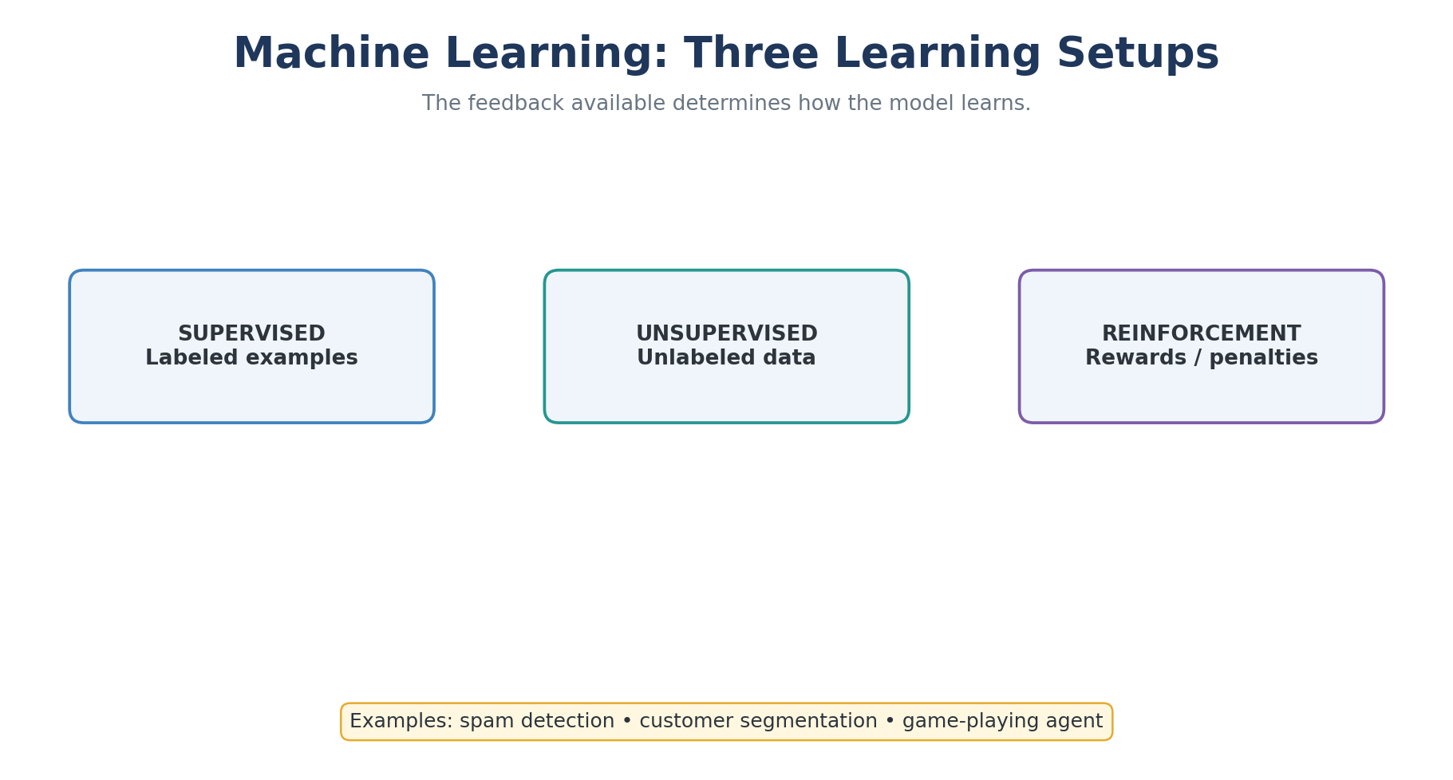
Image Diagram 01 — 01 Learning Types
Explanation: Follow the diagram from input to output. Identify what each step receives, what it changes, and what it produces. Use the example to check whether the result meets the task's goal.

Slide 151
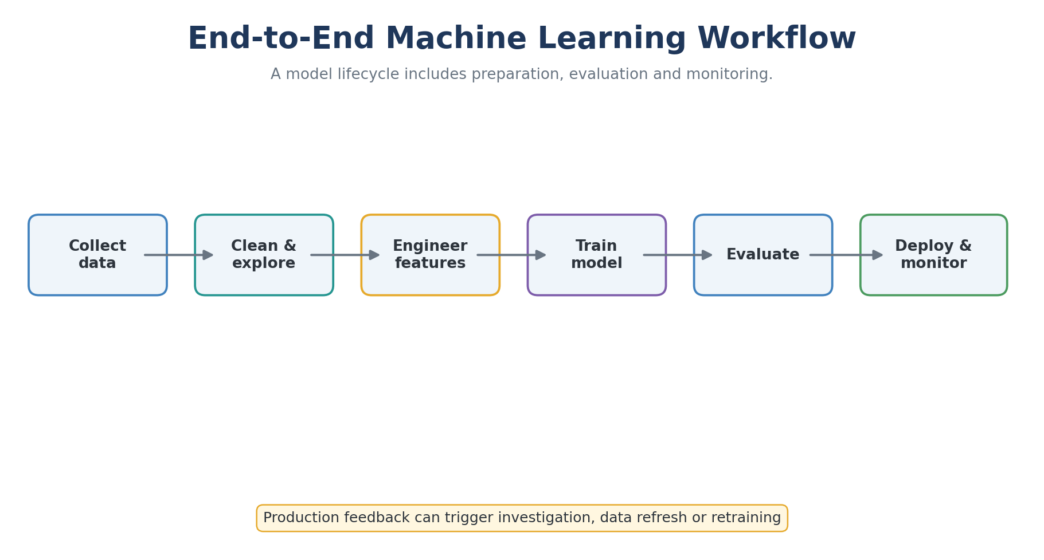
Image Diagram 02 — 02 Ml Workflow
Explanation: Follow the diagram from input to output. Identify what each step receives, what it changes, and what it produces. Use the example to check whether the result meets the task's goal.

Slide 152
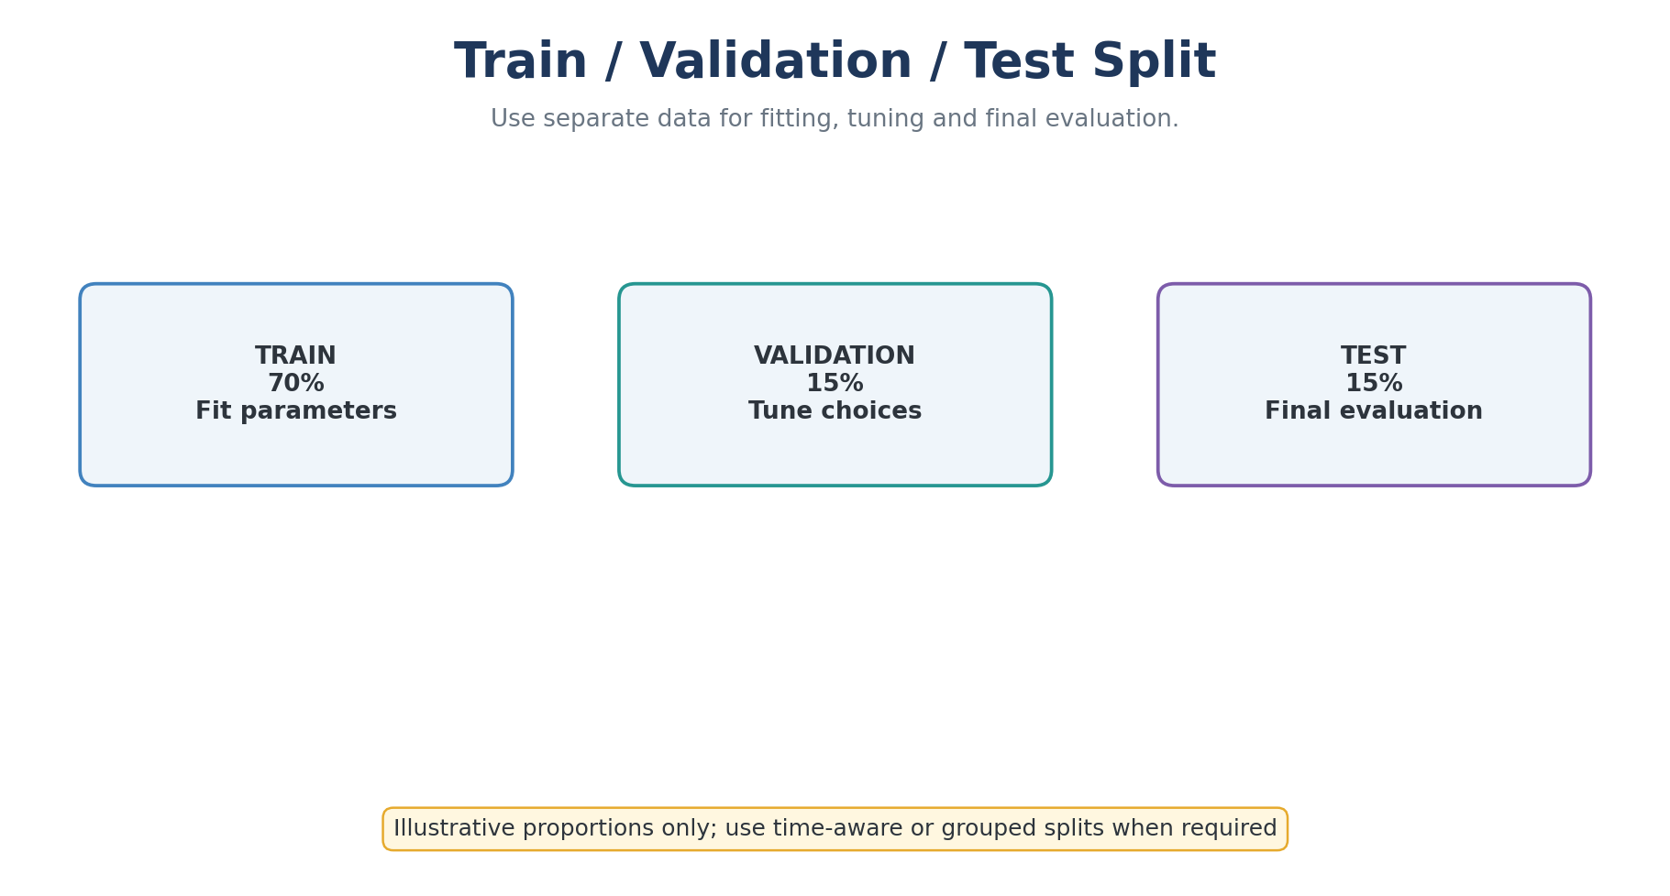
Image Diagram 03 — 03 Data Split
Explanation: Follow the diagram from input to output. Identify what each step receives, what it changes, and what it produces. Use the example to check whether the result meets the task's goal.

Slide 153
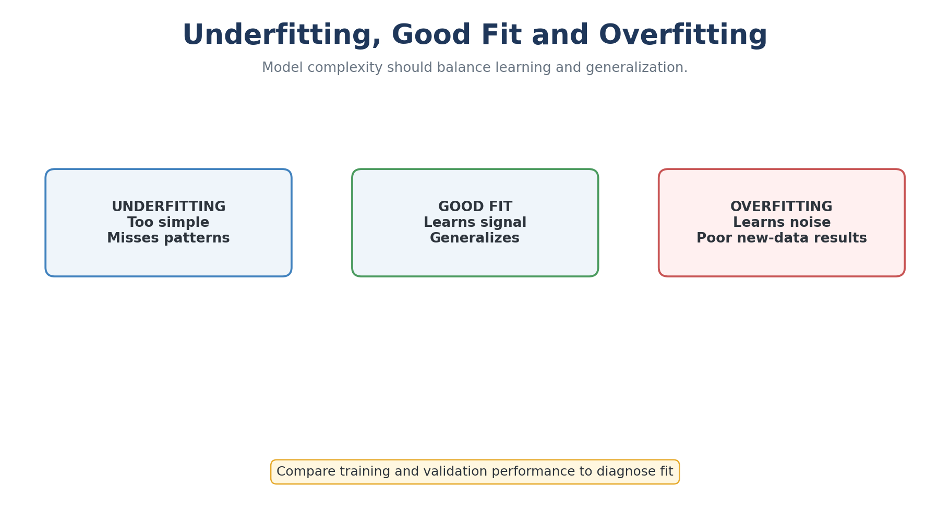
Image Diagram 04 — 04 Fit Balance
Explanation: Follow the diagram from input to output. Identify what each step receives, what it changes, and what it produces. Use the example to check whether the result meets the task's goal.

Slide 154
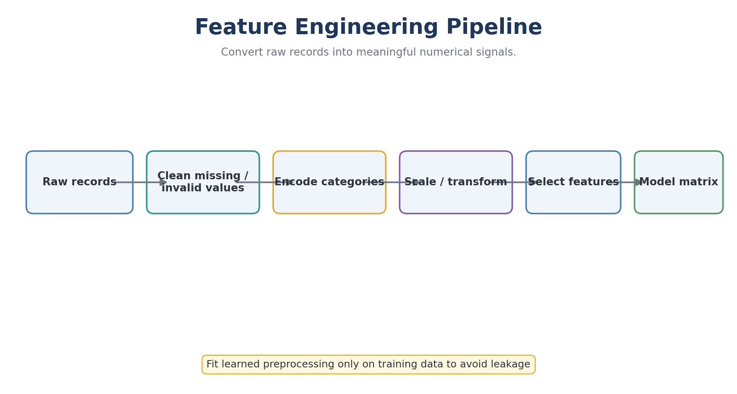
Image Diagram 05 — 05 Feature Engineering
Explanation: Follow the diagram from input to output. Identify what each step receives, what it changes, and what it produces. Use the example to check whether the result meets the task's goal.

Slide 155
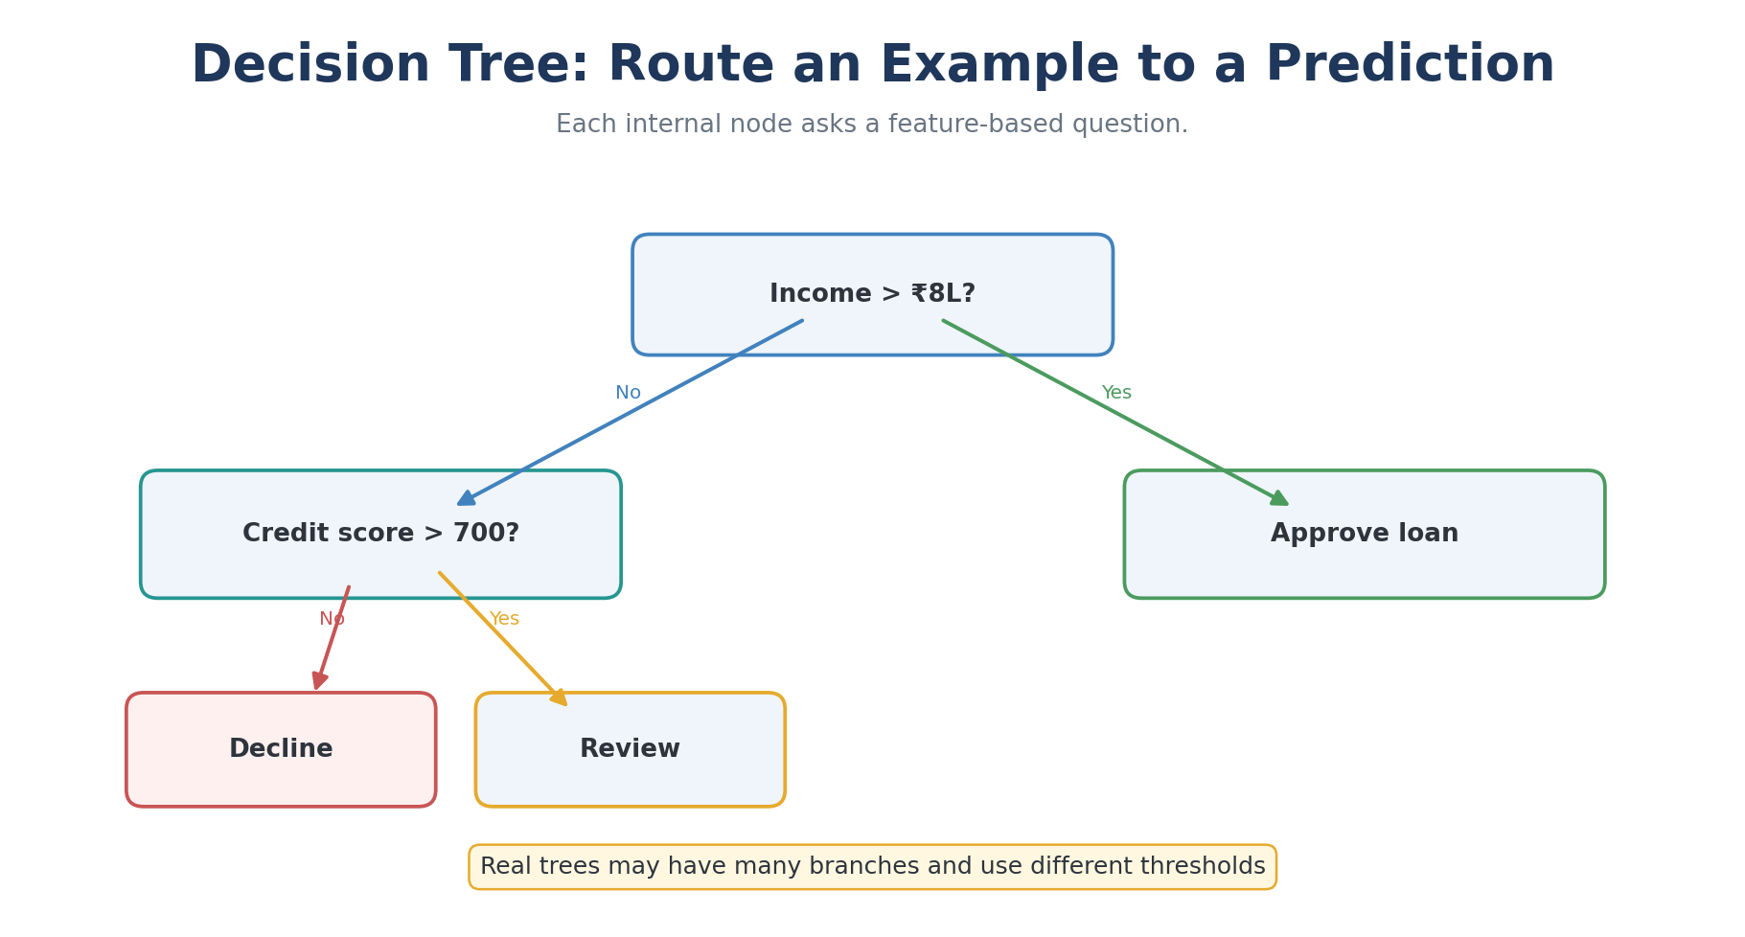
Image Diagram 06 — 06 Decision Tree
Explanation: Follow the diagram from input to output. Identify what each step receives, what it changes, and what it produces. Use the example to check whether the result meets the task's goal.

Slide 156
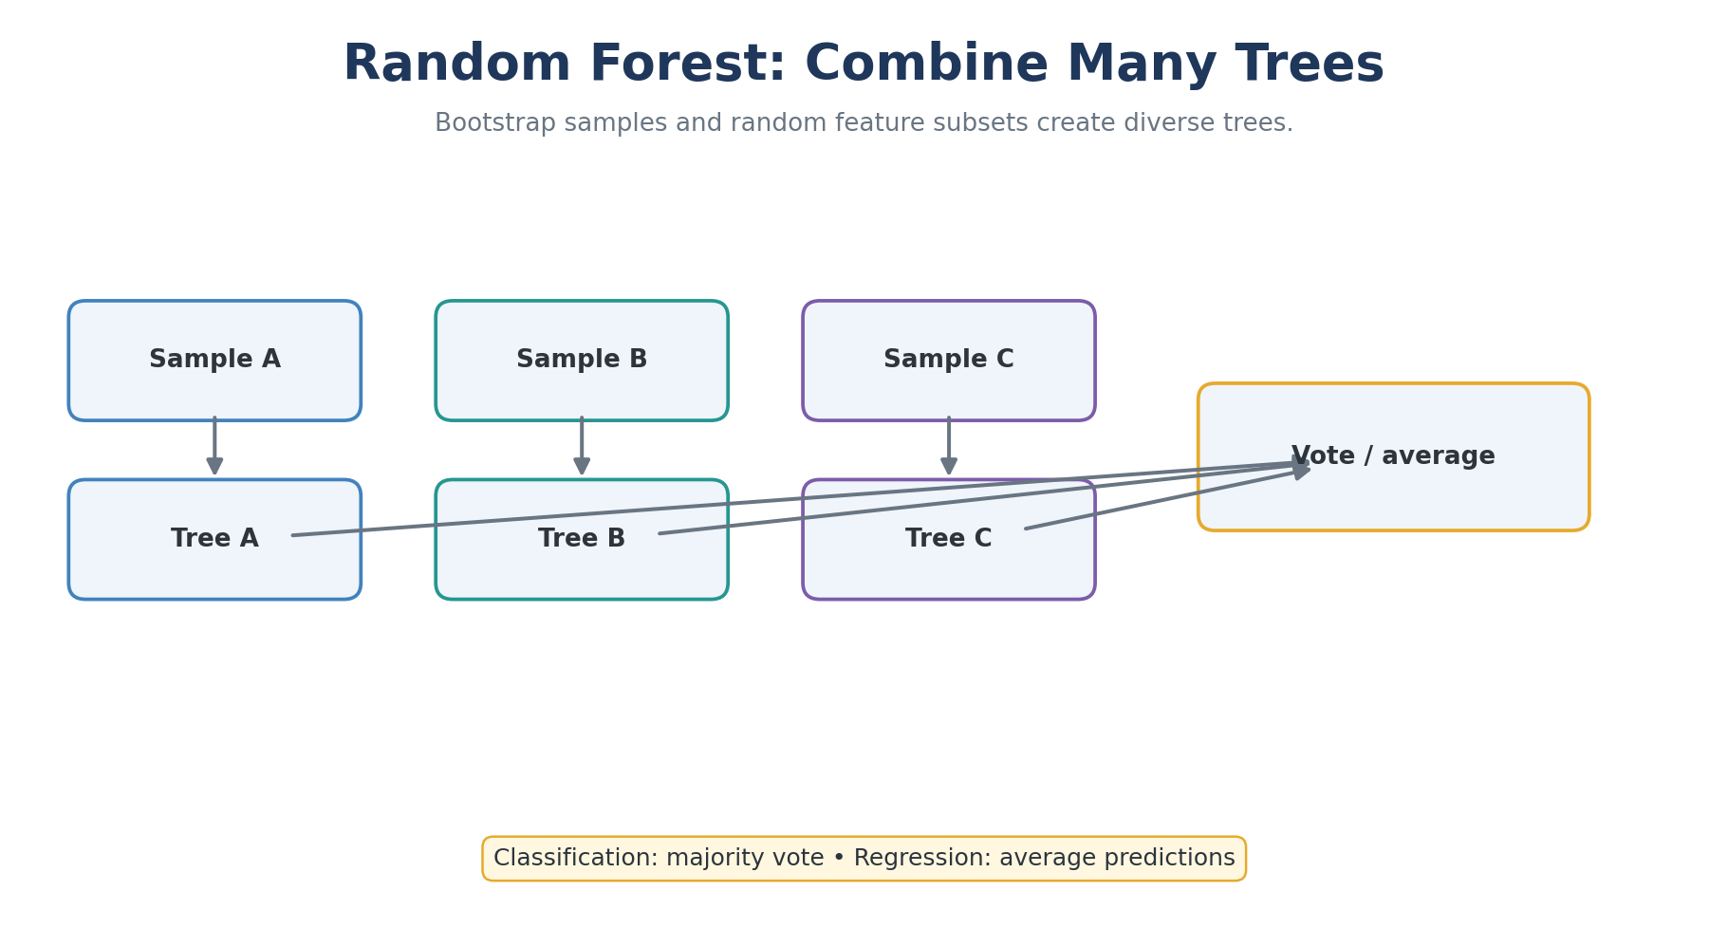
Image Diagram 07 — 07 Random Forest
Explanation: Follow the diagram from input to output. Identify what each step receives, what it changes, and what it produces. Use the example to check whether the result meets the task's goal.

Slide 157
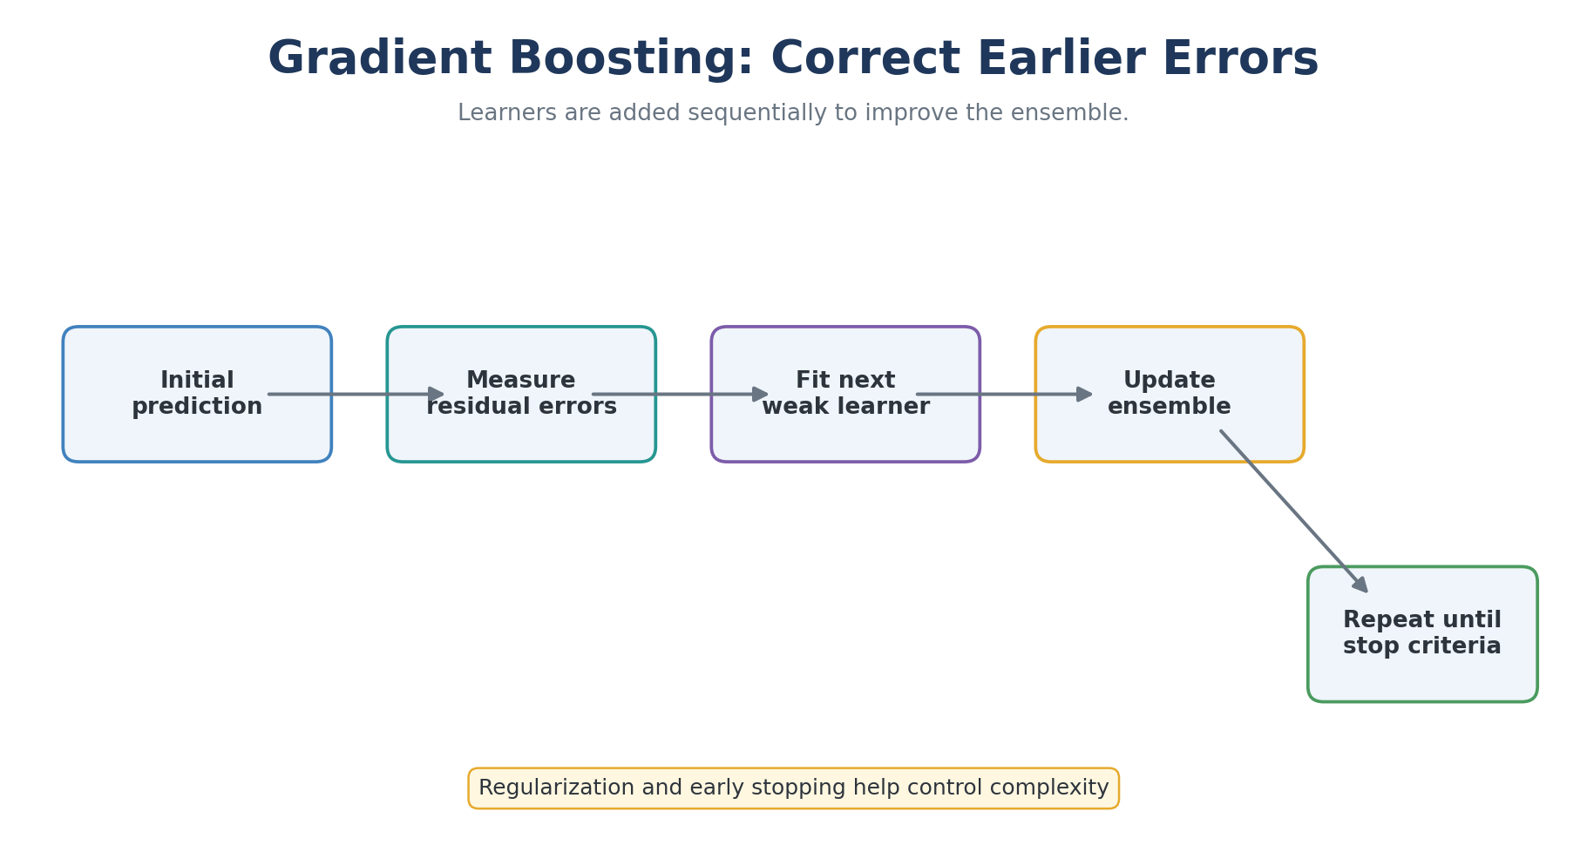
Image Diagram 08 — 08 Boosting
Explanation: Follow the diagram from input to output. Identify what each step receives, what it changes, and what it produces. Use the example to check whether the result meets the task's goal.

Slide 158
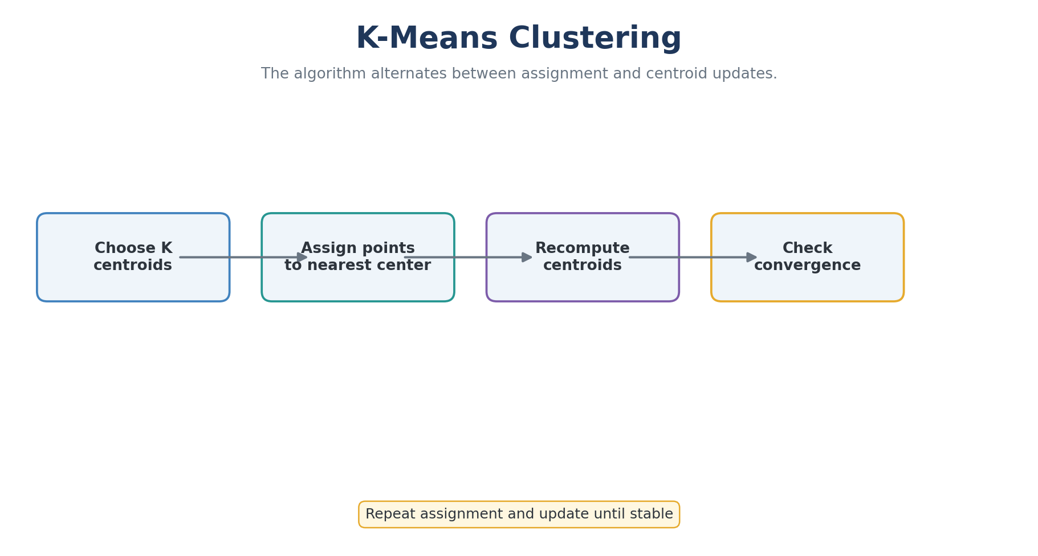
Image Diagram 09 — 09 Kmeans
Explanation: Follow the diagram from input to output. Identify what each step receives, what it changes, and what it produces. Use the example to check whether the result meets the task's goal.

Slide 159
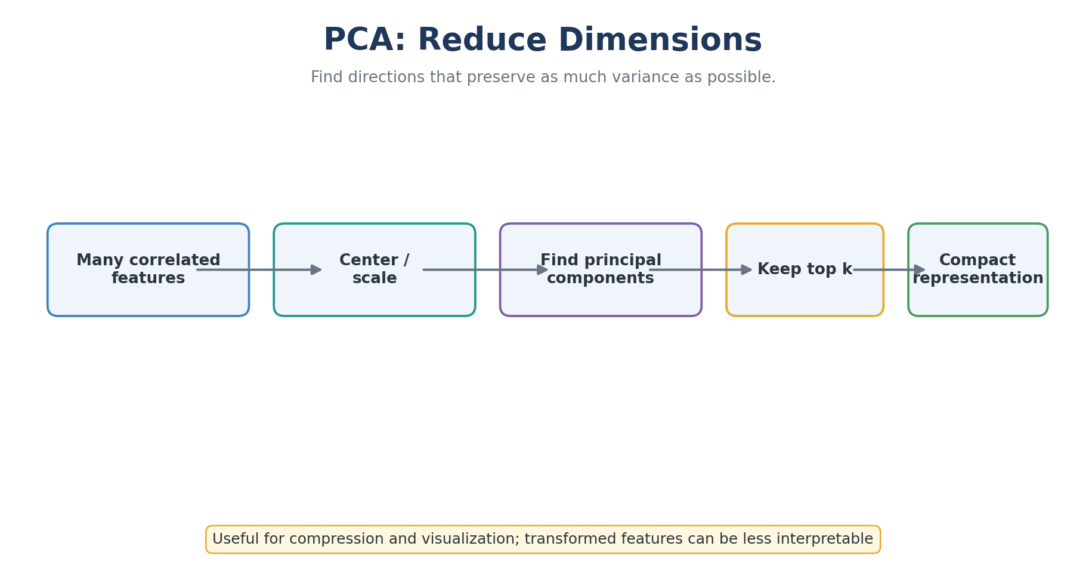
Image Diagram 10 — 10 Pca
Explanation: Follow the diagram from input to output. Identify what each step receives, what it changes, and what it produces. Use the example to check whether the result meets the task's goal.

Slide 160
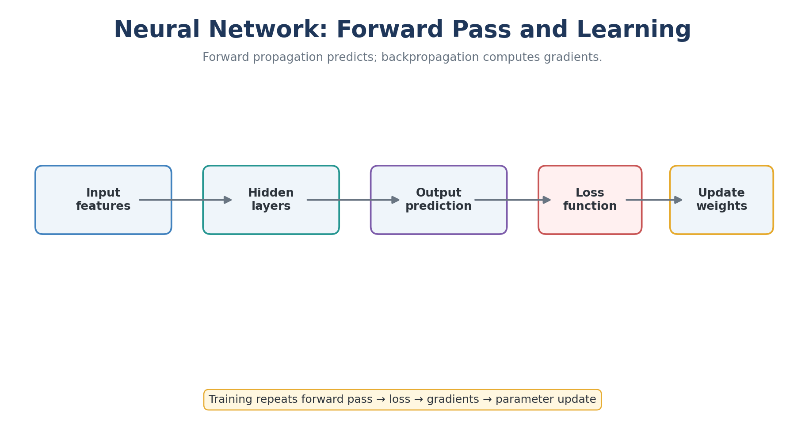
Image Diagram 11 — 11 Neural Network
Explanation: Follow the diagram from input to output. Identify what each step receives, what it changes, and what it produces. Use the example to check whether the result meets the task's goal.

Slide 161
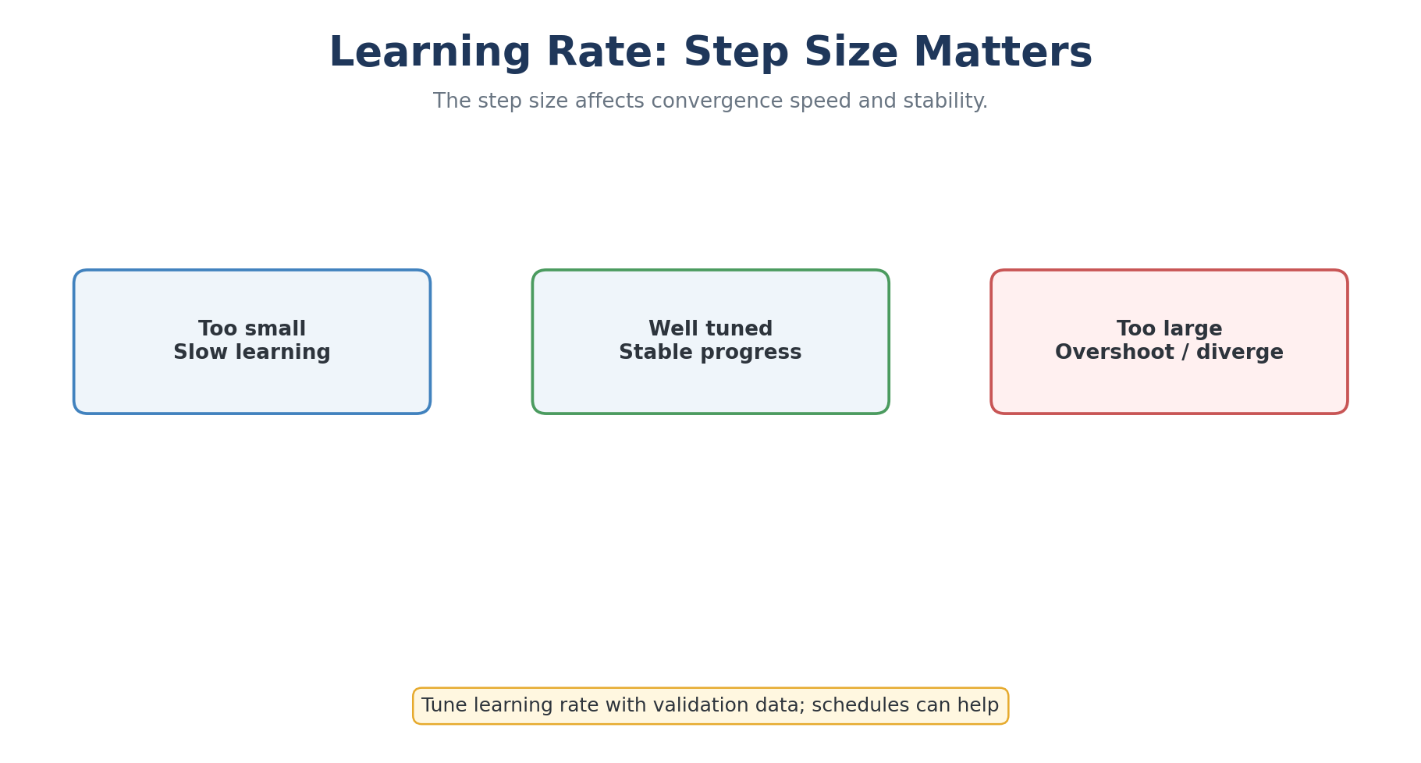
Image Diagram 12 — 12 Learning Rate
Explanation: Follow the diagram from input to output. Identify what each step receives, what it changes, and what it produces. Use the example to check whether the result meets the task's goal.

Slide 162
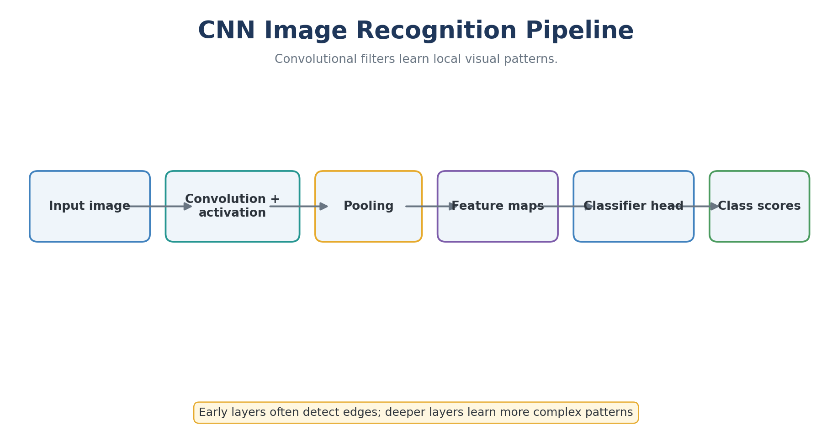
Image Diagram 13 — 13 Cnn
Explanation: Follow the diagram from input to output. Identify what each step receives, what it changes, and what it produces. Use the example to check whether the result meets the task's goal.

Slide 163
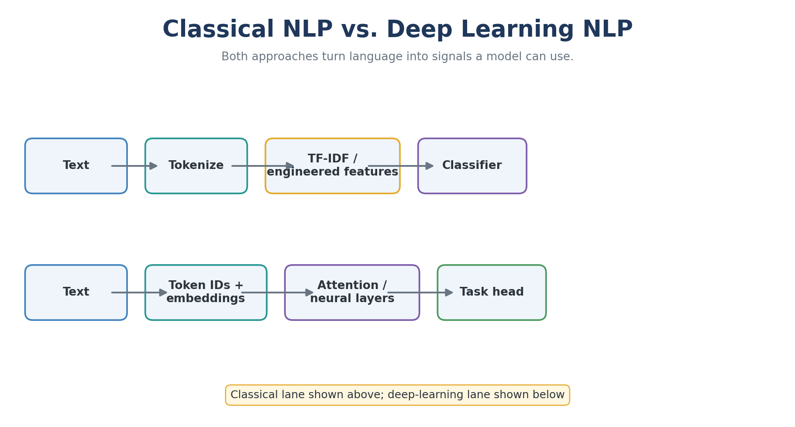
Image Diagram 14 — 14 Classical Vs Deep Nlp
Explanation: Follow the diagram from input to output. Identify what each step receives, what it changes, and what it produces. Use the example to check whether the result meets the task's goal.

Slide 164
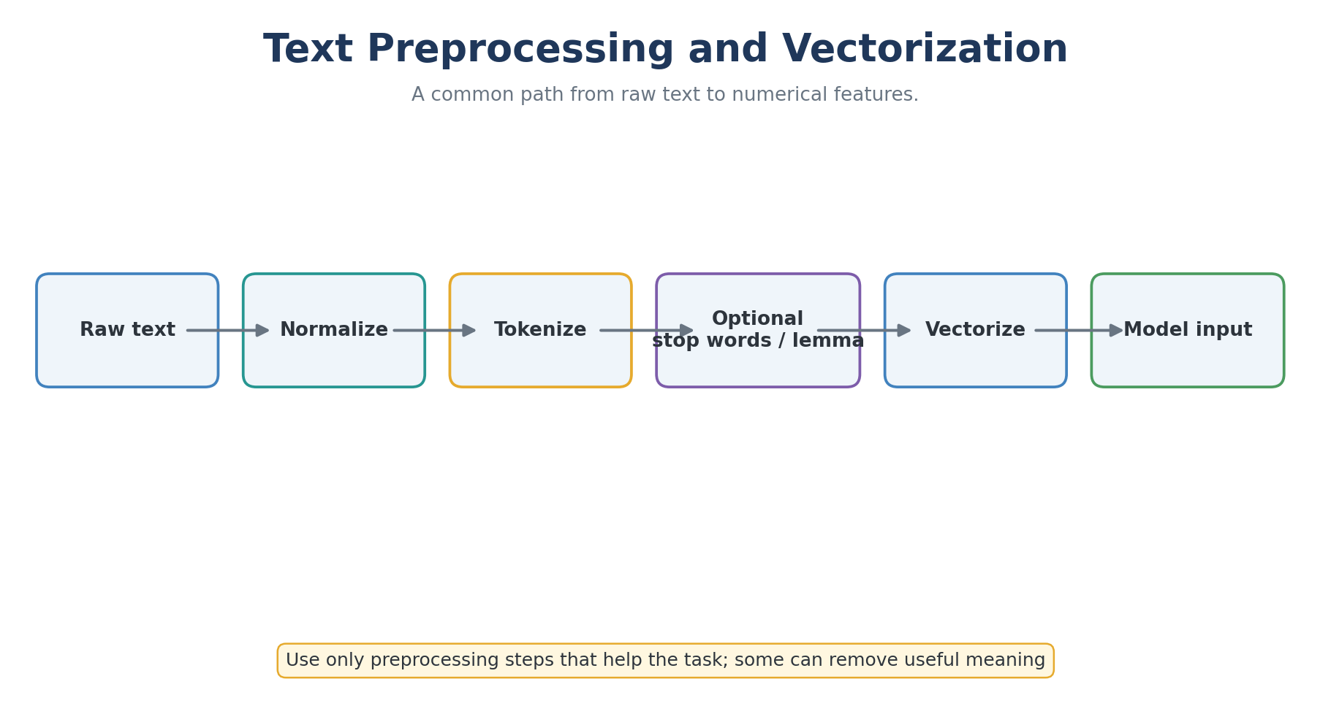
Image Diagram 15 — 15 Nlp Preprocessing
Explanation: Follow the diagram from input to output. Identify what each step receives, what it changes, and what it produces. Use the example to check whether the result meets the task's goal.

Slide 165
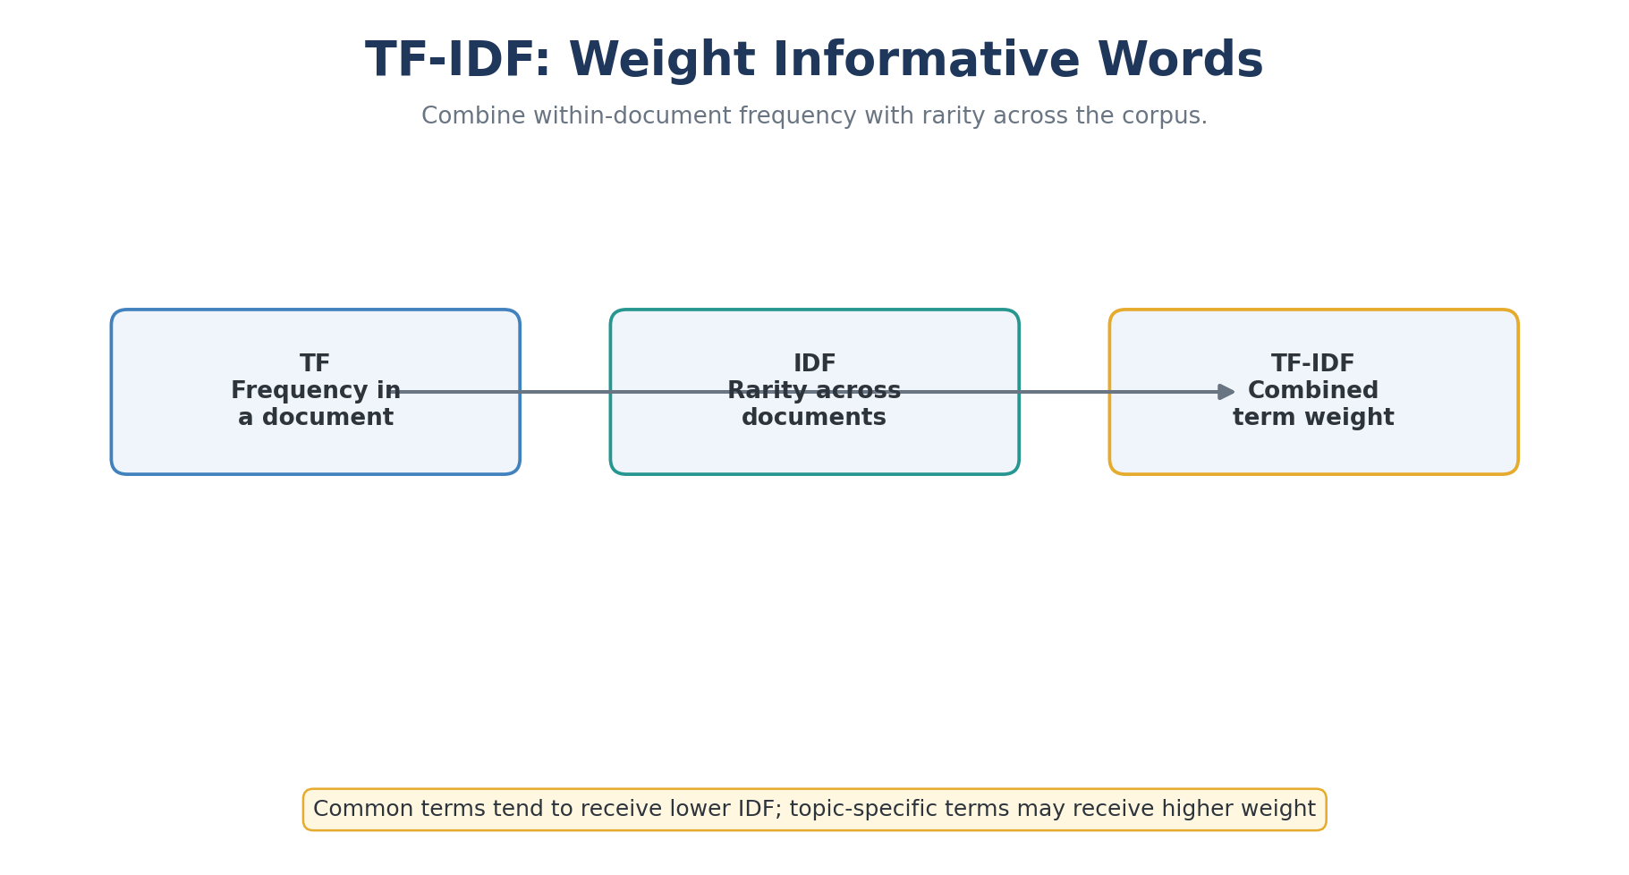
Image Diagram 16 — 16 Tfidf
Explanation: Follow the diagram from input to output. Identify what each step receives, what it changes, and what it produces. Use the example to check whether the result meets the task's goal.

Slide 166
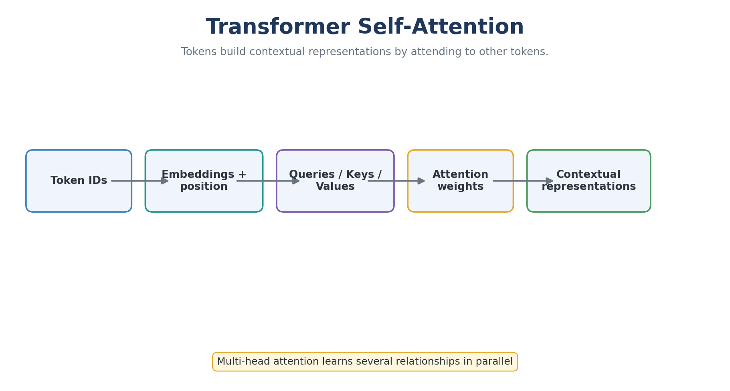
Image Diagram 17 — 17 Transformer Attention
Explanation: Follow the diagram from input to output. Identify what each step receives, what it changes, and what it produces. Use the example to check whether the result meets the task's goal.

Slide 167
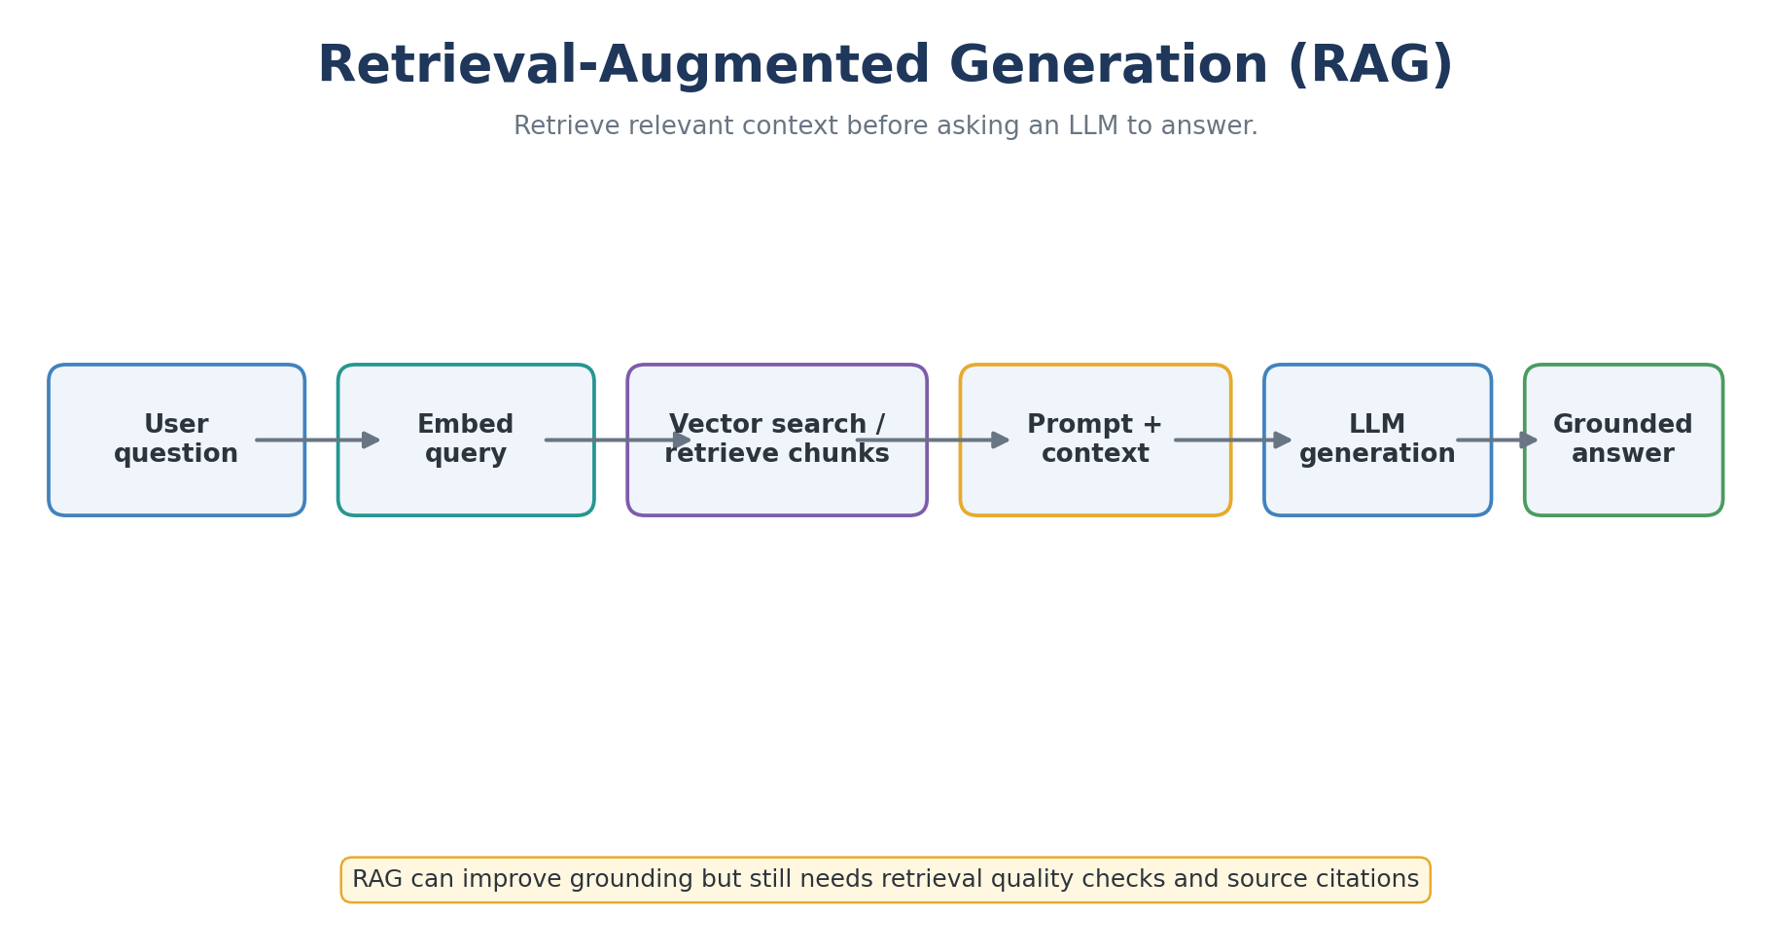
Image Diagram 18 — 18 Rag Pipeline
Explanation: Follow the diagram from input to output. Identify what each step receives, what it changes, and what it produces. Use the example to check whether the result meets the task's goal.

Slide 168
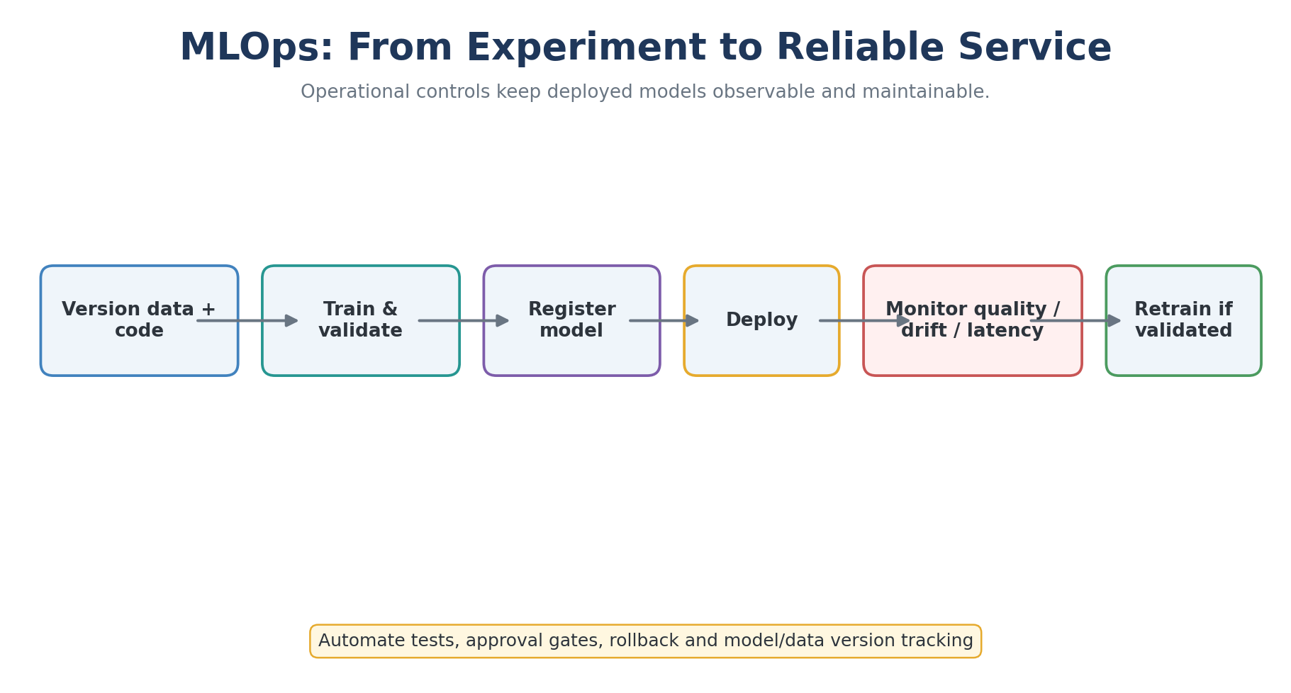
Image Diagram 19 — 19 Mlops Lifecycle
Explanation: Follow the diagram from input to output. Identify what each step receives, what it changes, and what it produces. Use the example to check whether the result meets the task's goal.

Slide 169
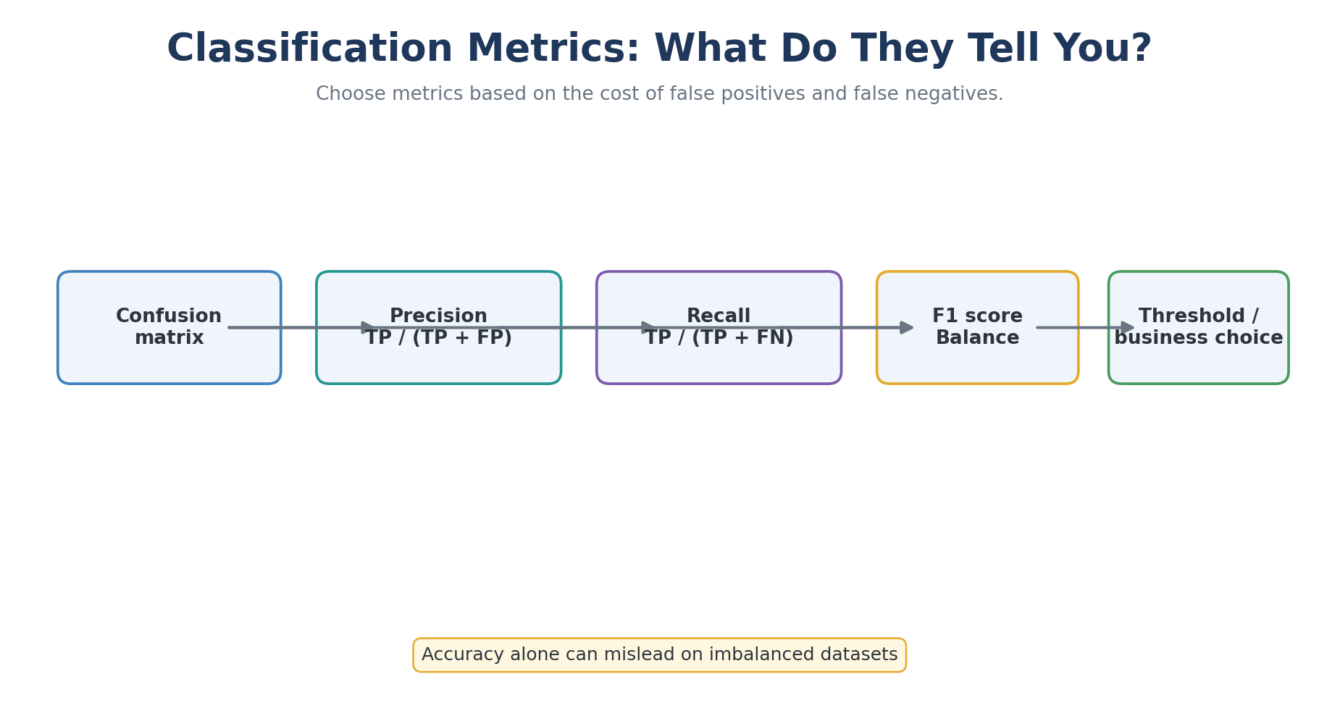
Image Diagram 20 — 20 Classification Metrics
Explanation: Follow the diagram from input to output. Identify what each step receives, what it changes, and what it produces. Use the example to check whether the result meets the task's goal.

Slide 170
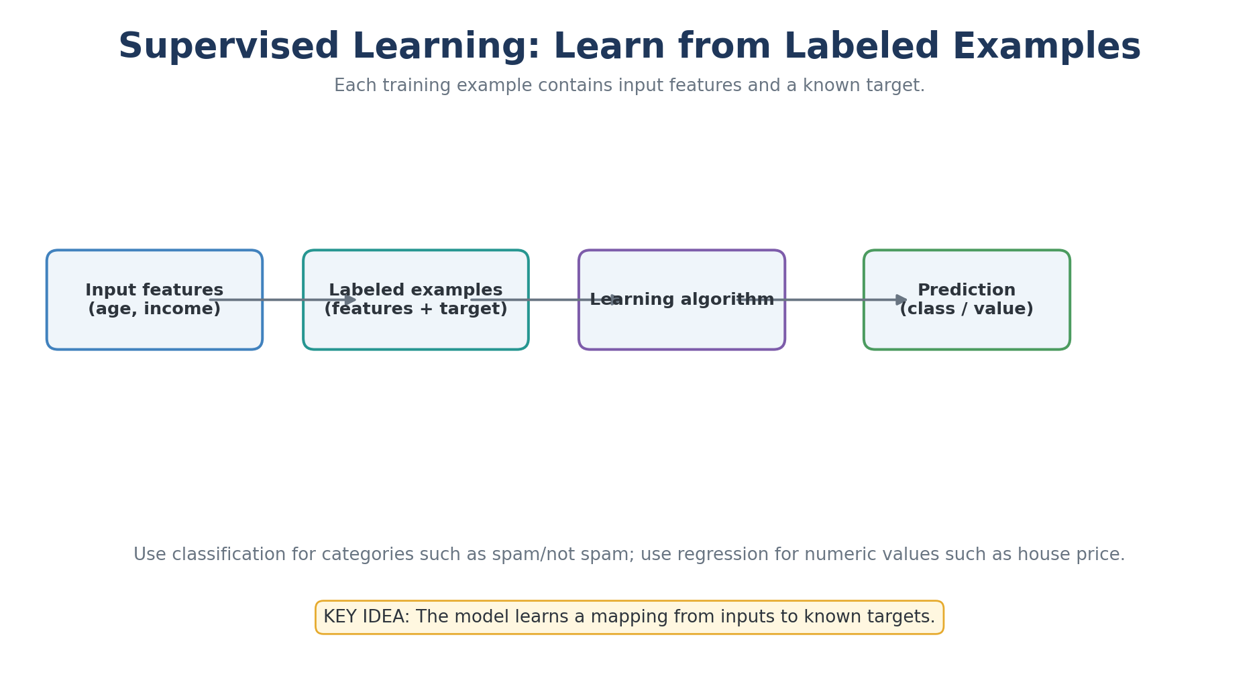
Explained Image Diagram 01: Supervised Learning: Learn from Labeled Examples
Explanation: Use classification for categories such as spam/not spam; use regression for numeric values such as house price.
Remember: The model learns a mapping from inputs to known targets.

Slide 171
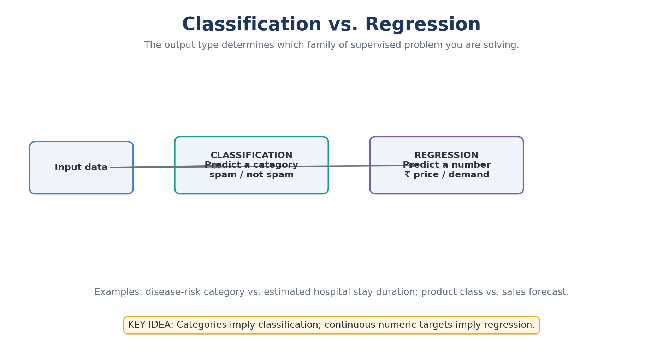
Explained Image Diagram 02: Classification vs. Regression
Explanation: Examples: disease-risk category vs. estimated hospital stay duration; product class vs. sales forecast.
Remember: Categories imply classification; continuous numeric targets imply regression.

Slide 172
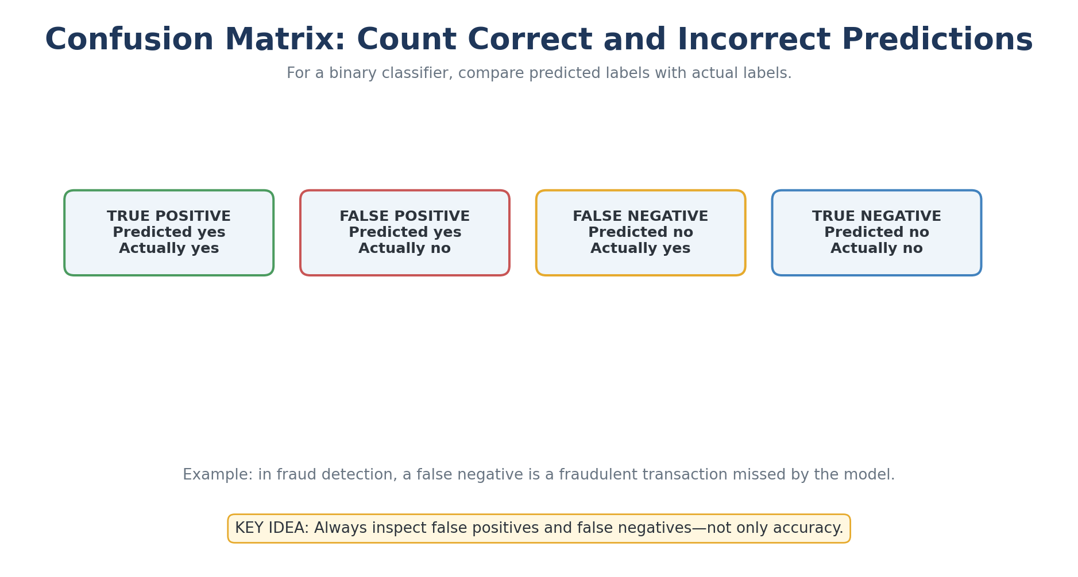
Explained Image Diagram 03: Confusion Matrix: Count Correct and Incorrect Predictions
Explanation: Example: in fraud detection, a false negative is a fraudulent transaction missed by the model.
Remember: Always inspect false positives and false negatives—not only accuracy.

Slide 173
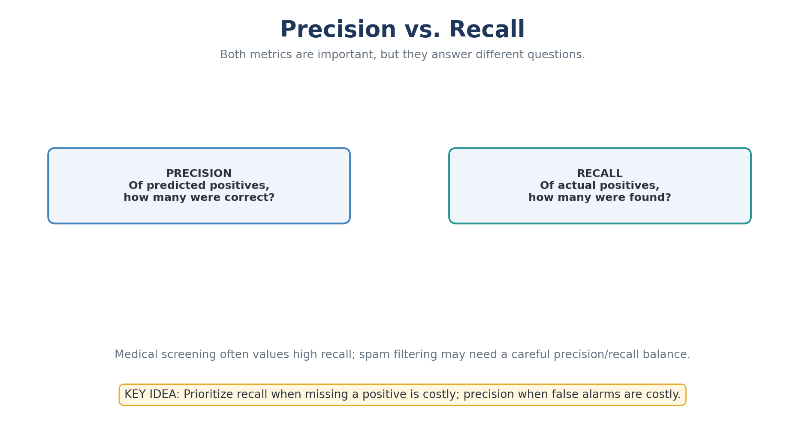
Explained Image Diagram 04: Precision vs. Recall
Explanation: Medical screening often values high recall; spam filtering may need a careful precision/recall balance.
Remember: Prioritize recall when missing a positive is costly; precision when false alarms are costly.

Slide 174
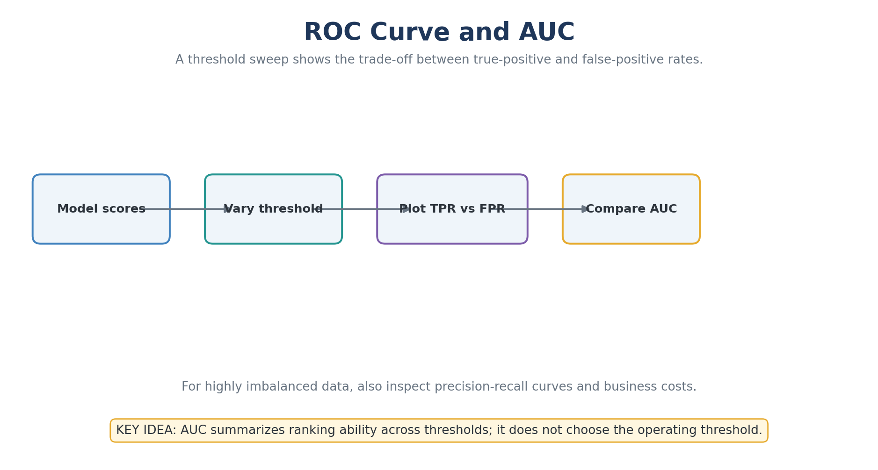
Explained Image Diagram 05: ROC Curve and AUC
Explanation: For highly imbalanced data, also inspect precision-recall curves and business costs.
Remember: AUC summarizes ranking ability across thresholds; it does not choose the operating threshold.

Slide 175
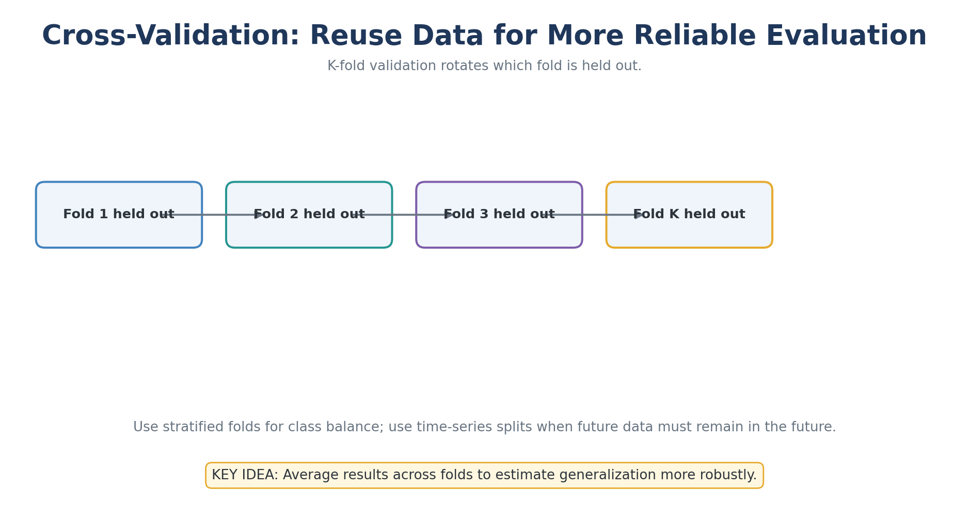
Explained Image Diagram 06: Cross-Validation: Reuse Data for More Reliable Evaluation
Explanation: Use stratified folds for class balance; use time-series splits when future data must remain in the future.
Remember: Average results across folds to estimate generalization more robustly.

Slide 176
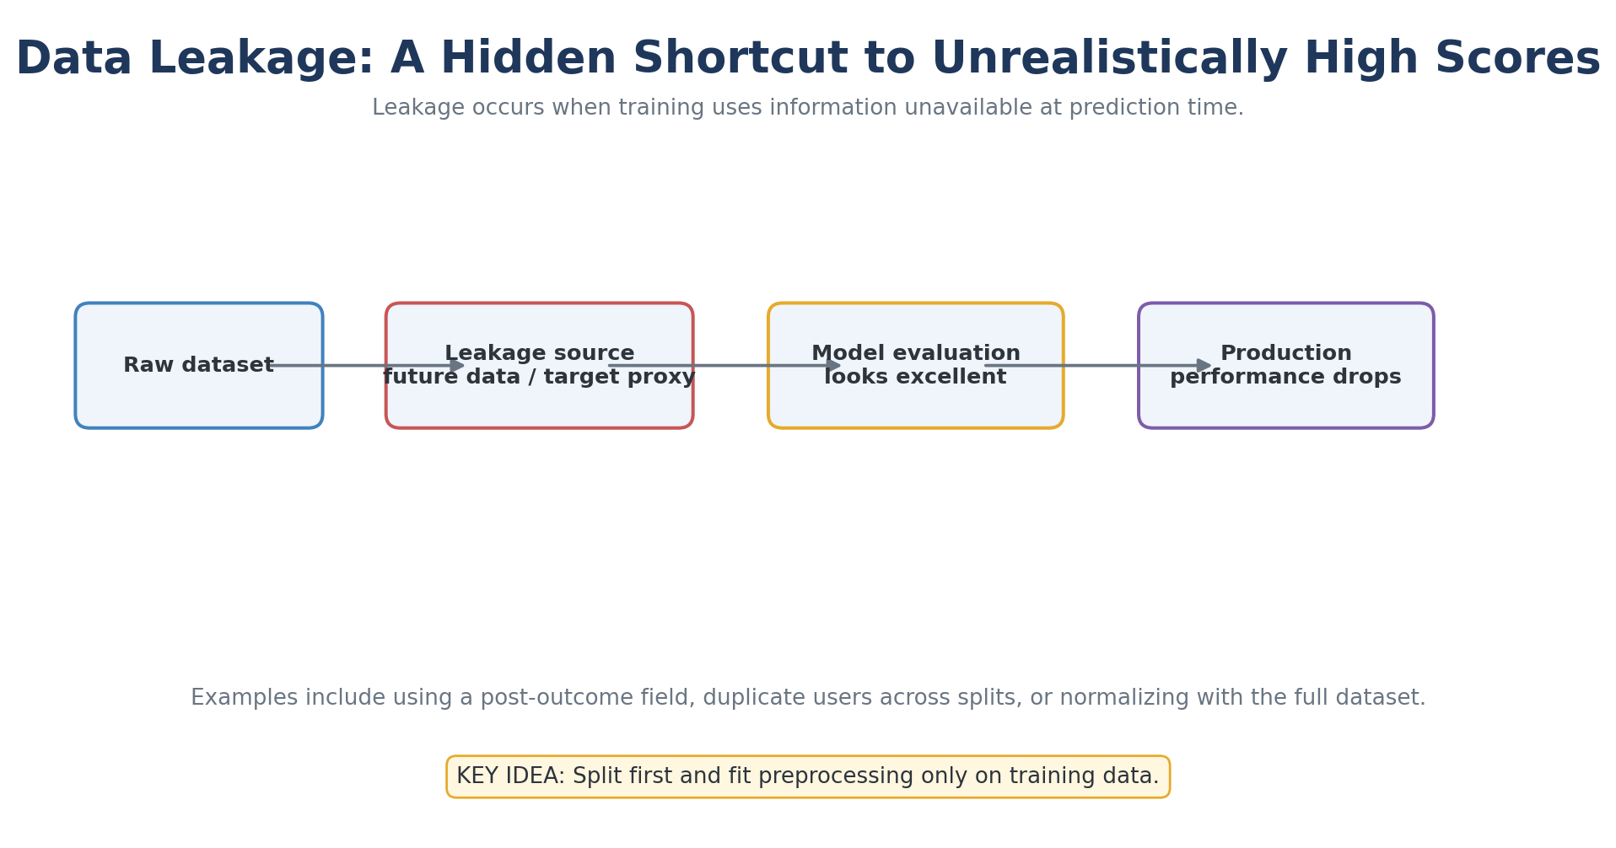
Explained Image Diagram 07: Data Leakage: A Hidden Shortcut to Unrealistically High Scores
Explanation: Examples include using a post-outcome field, duplicate users across splits, or normalizing with the full dataset.
Remember: Split first and fit preprocessing only on training data.

Slide 177
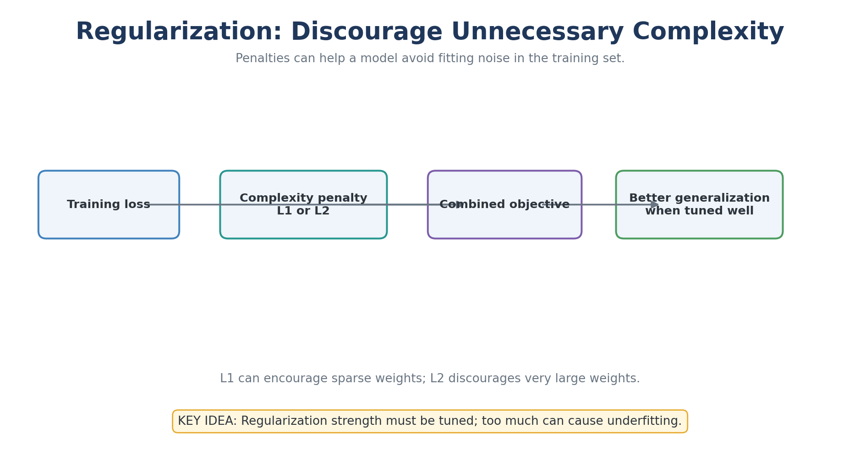
Explained Image Diagram 08: Regularization: Discourage Unnecessary Complexity
Explanation: L1 can encourage sparse weights; L2 discourages very large weights.
Remember: Regularization strength must be tuned; too much can cause underfitting.

Slide 178
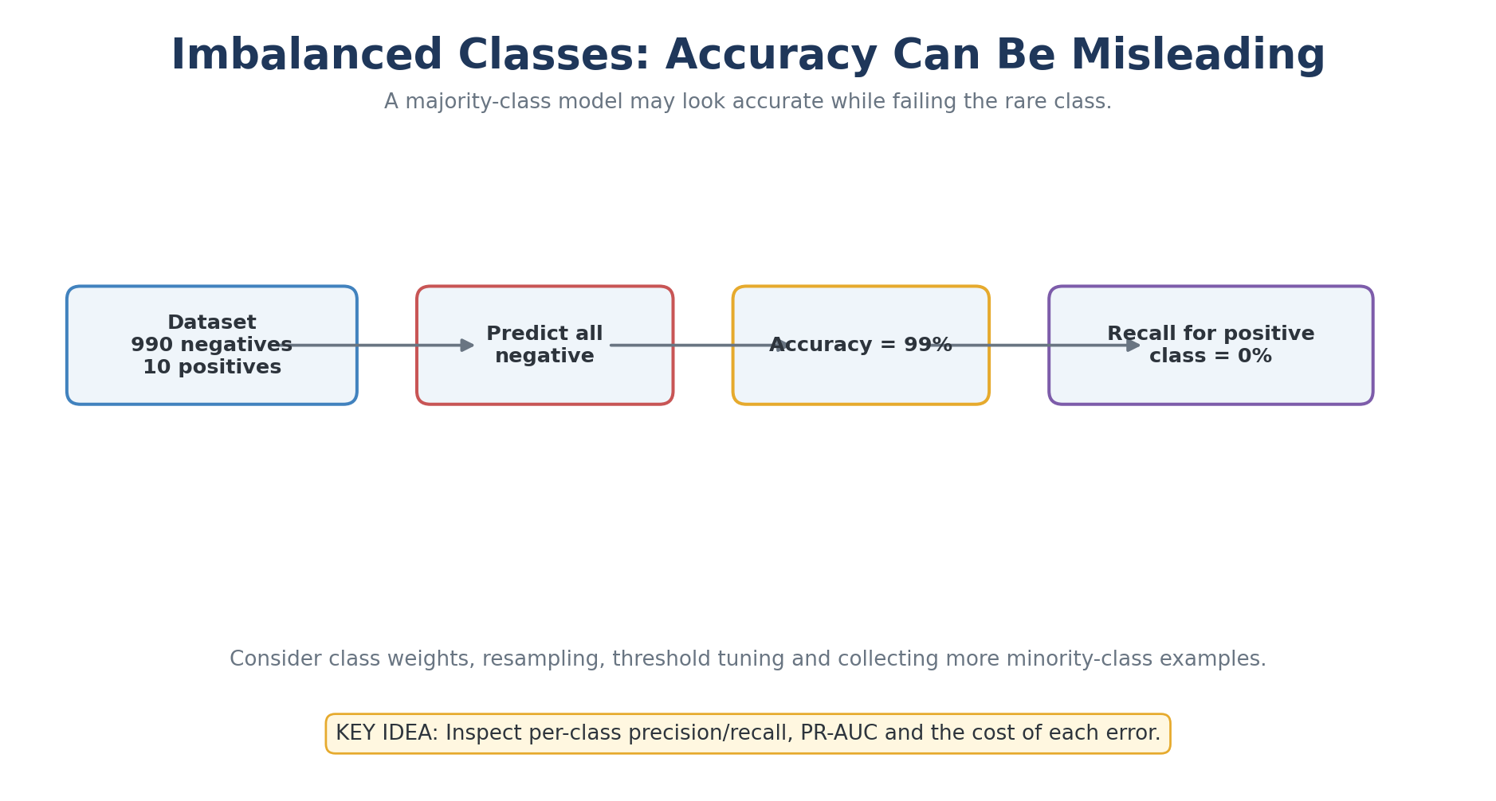
Explained Image Diagram 09: Imbalanced Classes: Accuracy Can Be Misleading
Explanation: Consider class weights, resampling, threshold tuning and collecting more minority-class examples.
Remember: Inspect per-class precision/recall, PR-AUC and the cost of each error.

Slide 179
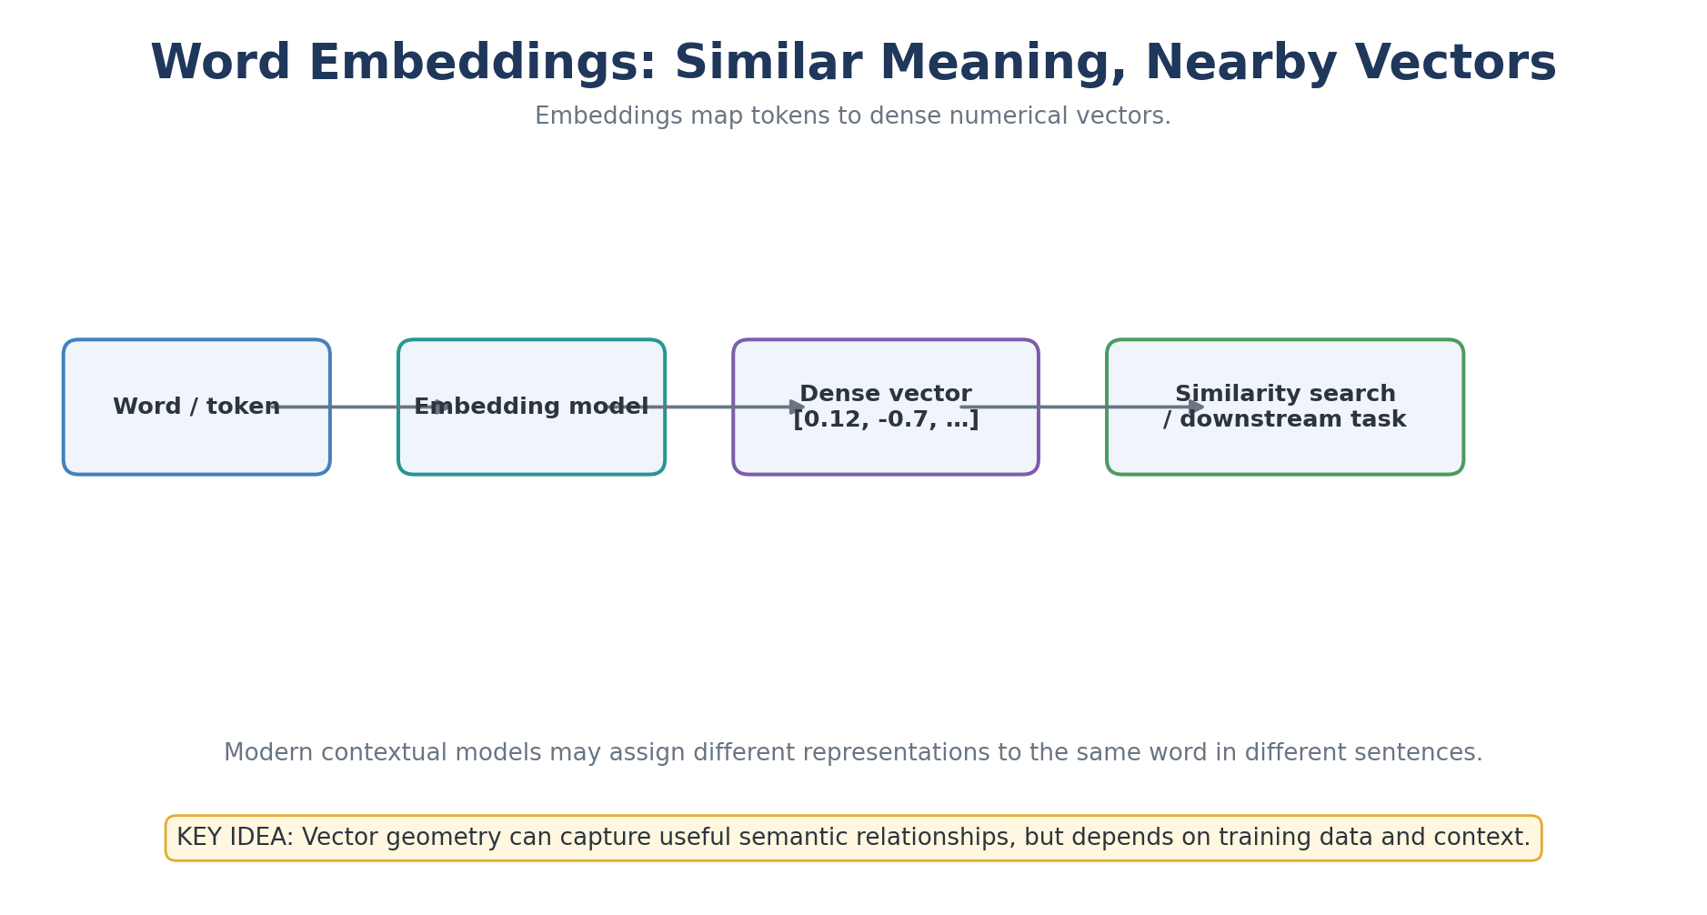
Explained Image Diagram 10: Word Embeddings: Similar Meaning, Nearby Vectors
Explanation: Modern contextual models may assign different representations to the same word in different sentences.
Remember: Vector geometry can capture useful semantic relationships, but depends on training data and context.

Slide 180
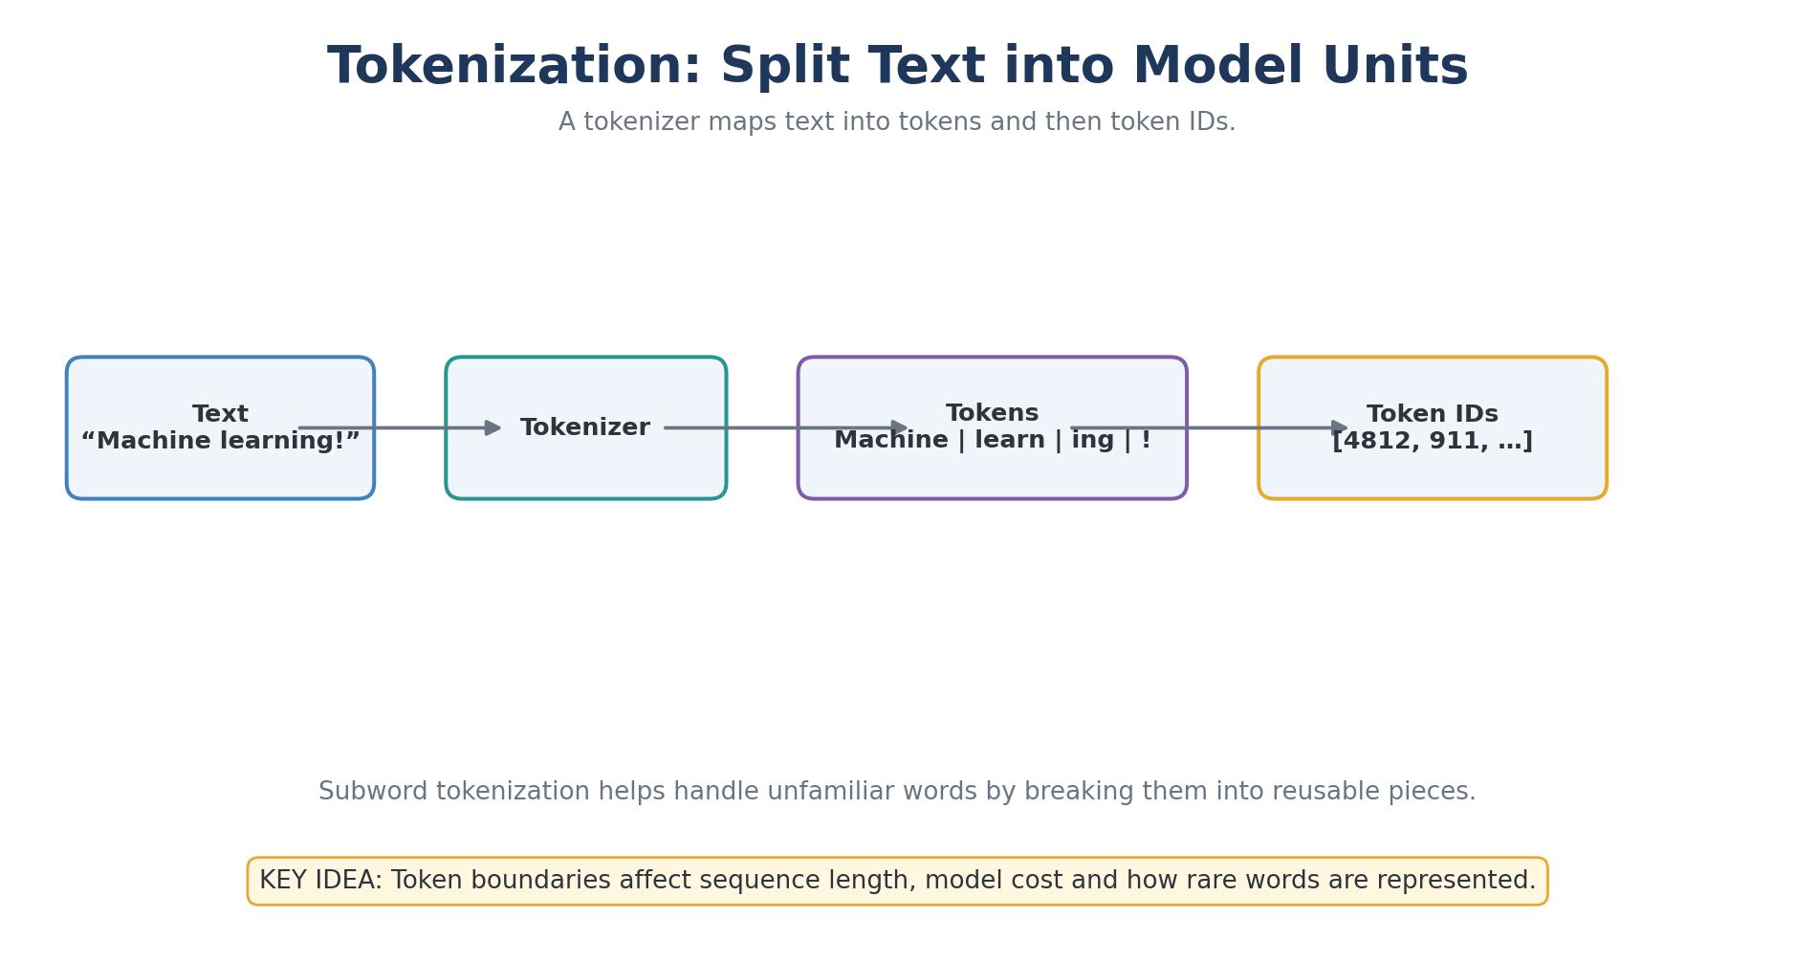
Explained Image Diagram 11: Tokenization: Split Text into Model Units
Explanation: Subword tokenization helps handle unfamiliar words by breaking them into reusable pieces.
Remember: Token boundaries affect sequence length, model cost and how rare words are represented.

Slide 181
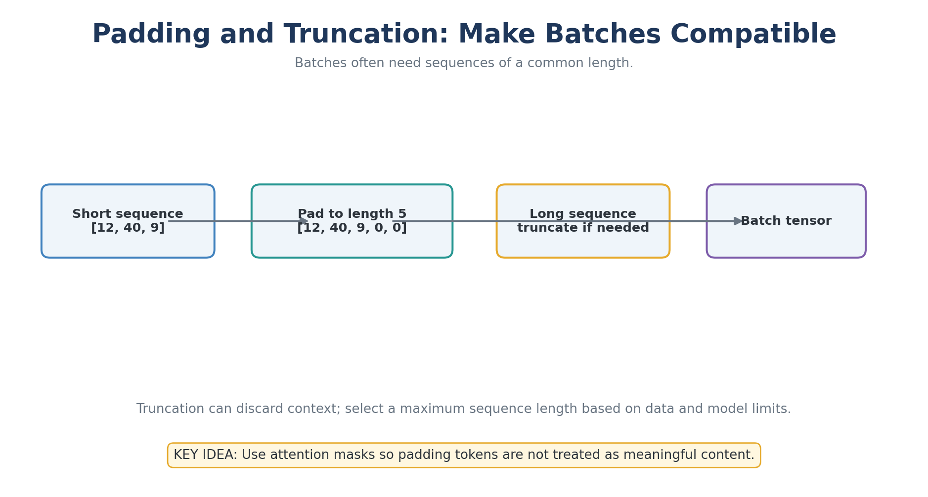
Explained Image Diagram 12: Padding and Truncation: Make Batches Compatible
Explanation: Truncation can discard context; select a maximum sequence length based on data and model limits.
Remember: Use attention masks so padding tokens are not treated as meaningful content.

Slide 182
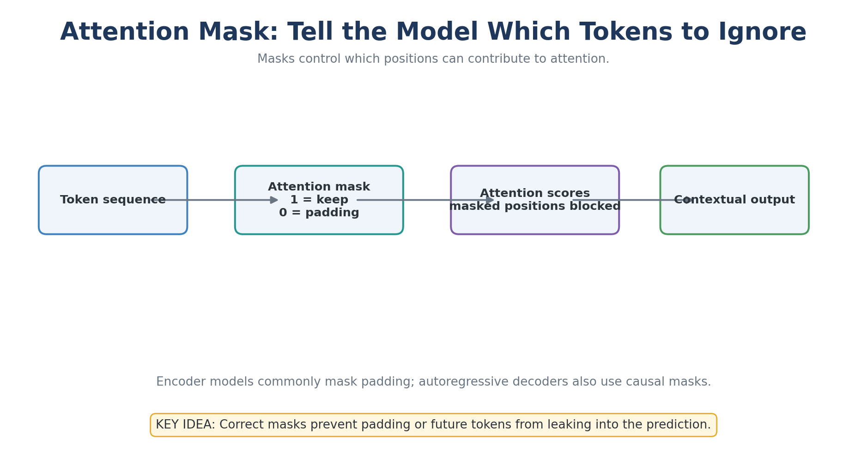
Explained Image Diagram 13: Attention Mask: Tell the Model Which Tokens to Ignore
Explanation: Encoder models commonly mask padding; autoregressive decoders also use causal masks.
Remember: Correct masks prevent padding or future tokens from leaking into the prediction.

Slide 183
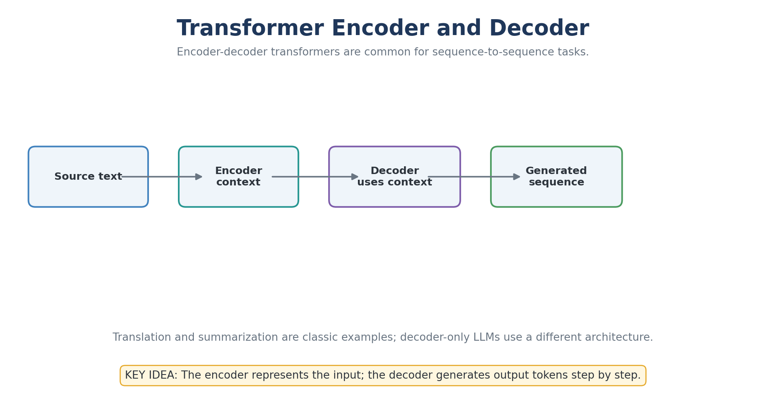
Explained Image Diagram 14: Transformer Encoder and Decoder
Explanation: Translation and summarization are classic examples; decoder-only LLMs use a different architecture.
Remember: The encoder represents the input; the decoder generates output tokens step by step.

Slide 184
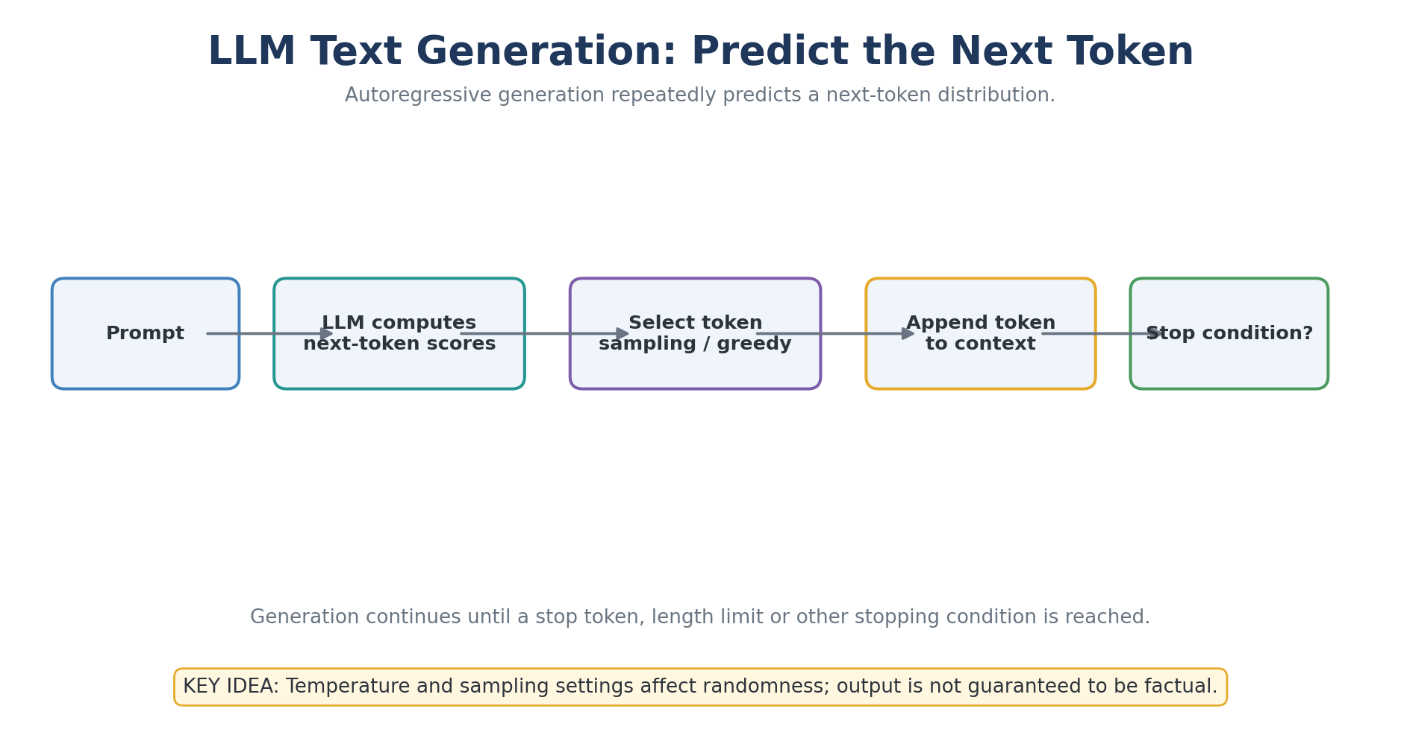
Explained Image Diagram 15: LLM Text Generation: Predict the Next Token
Explanation: Generation continues until a stop token, length limit or other stopping condition is reached.
Remember: Temperature and sampling settings affect randomness; output is not guaranteed to be factual.

Slide 185
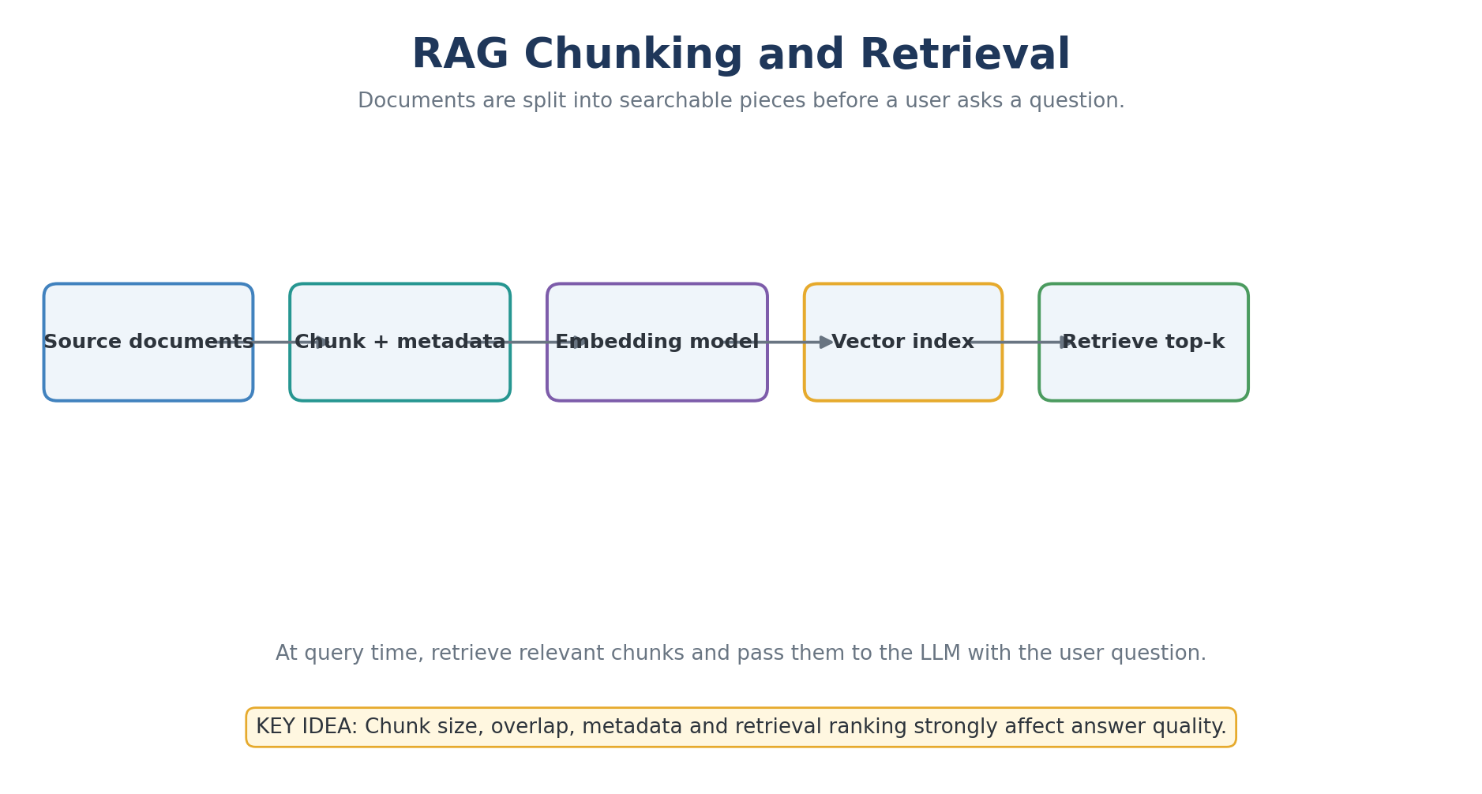
Explained Image Diagram 16: RAG Chunking and Retrieval
Explanation: At query time, retrieve relevant chunks and pass them to the LLM with the user question.
Remember: Chunk size, overlap, metadata and retrieval ranking strongly affect answer quality.

Slide 186
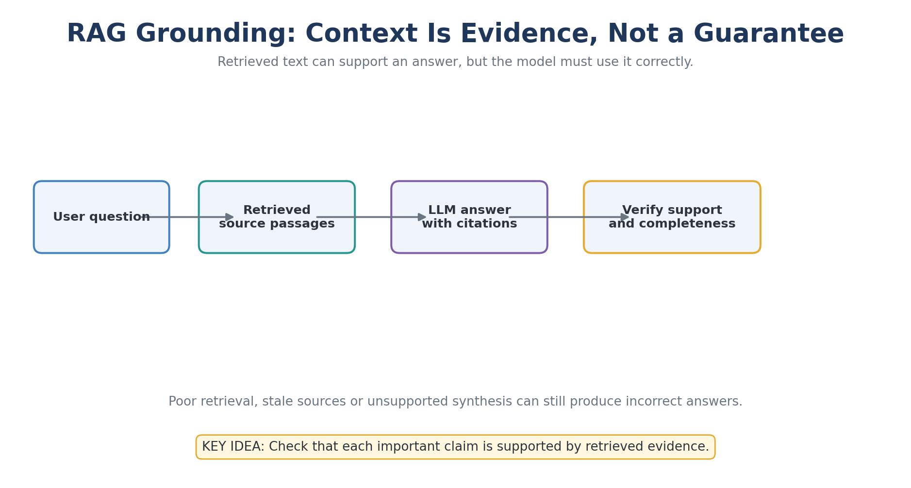
Explained Image Diagram 17: RAG Grounding: Context Is Evidence, Not a Guarantee
Explanation: Poor retrieval, stale sources or unsupported synthesis can still produce incorrect answers.
Remember: Check that each important claim is supported by retrieved evidence.

Slide 187
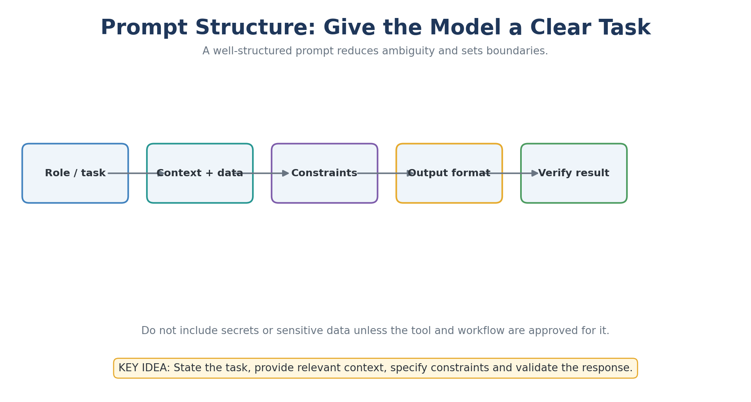
Explained Image Diagram 18: Prompt Structure: Give the Model a Clear Task
Explanation: Do not include secrets or sensitive data unless the tool and workflow are approved for it.
Remember: State the task, provide relevant context, specify constraints and validate the response.

Slide 188
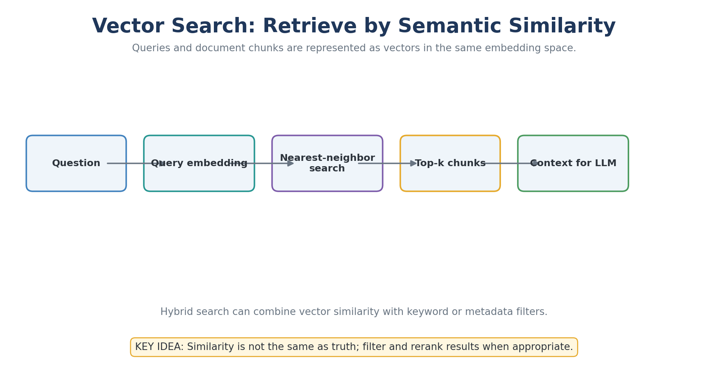
Explained Image Diagram 19: Vector Search: Retrieve by Semantic Similarity
Explanation: Hybrid search can combine vector similarity with keyword or metadata filters.
Remember: Similarity is not the same as truth; filter and rerank results when appropriate.

Slide 189
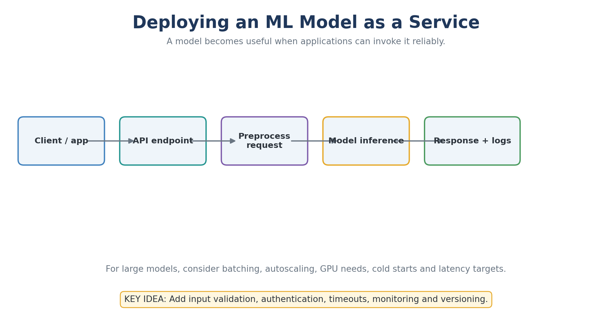
Explained Image Diagram 20: Deploying an ML Model as a Service
Explanation: For large models, consider batching, autoscaling, GPU needs, cold starts and latency targets.
Remember: Add input validation, authentication, timeouts, monitoring and versioning.

Slide 190
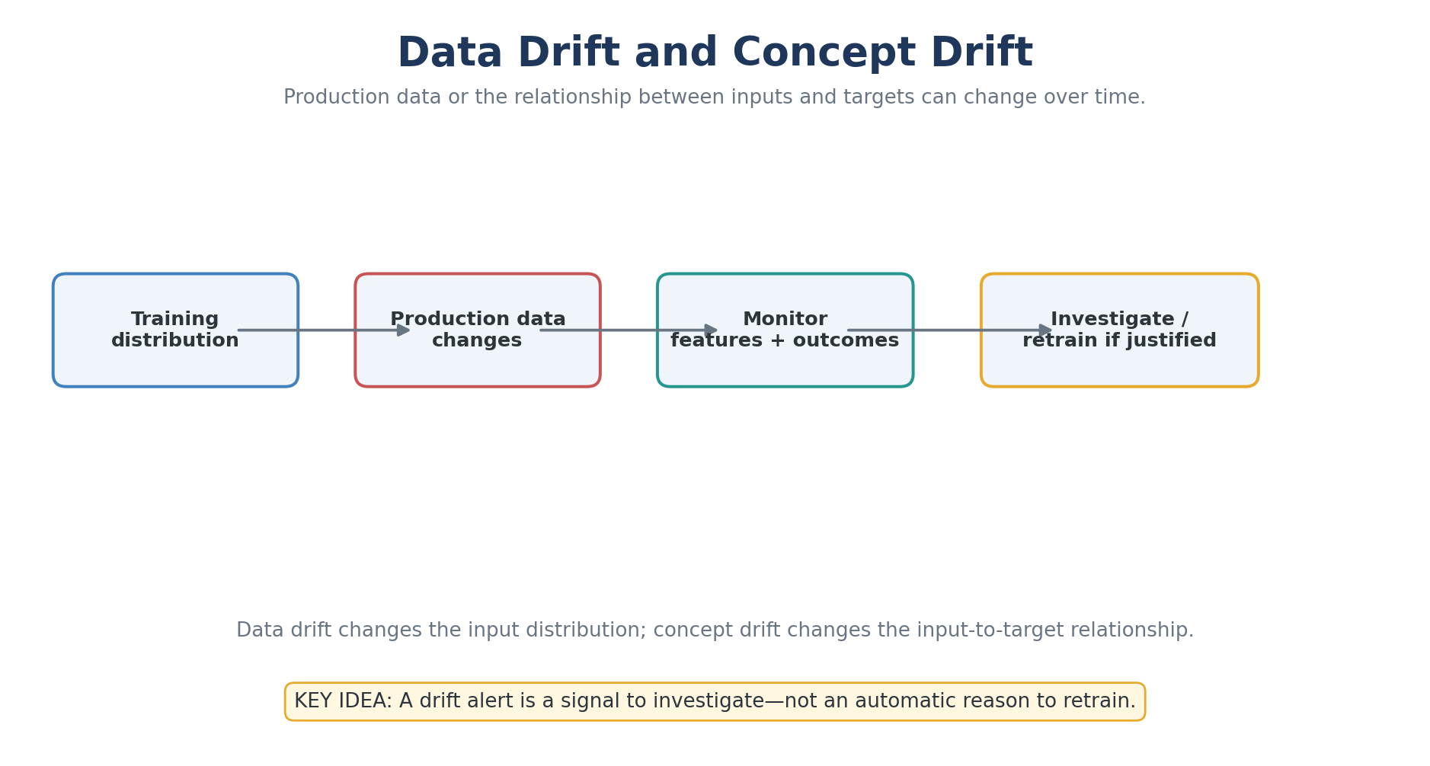
Explained Image Diagram 21: Data Drift and Concept Drift
Explanation: Data drift changes the input distribution; concept drift changes the input-to-target relationship.
Remember: A drift alert is a signal to investigate—not an automatic reason to retrain.

Slide 191
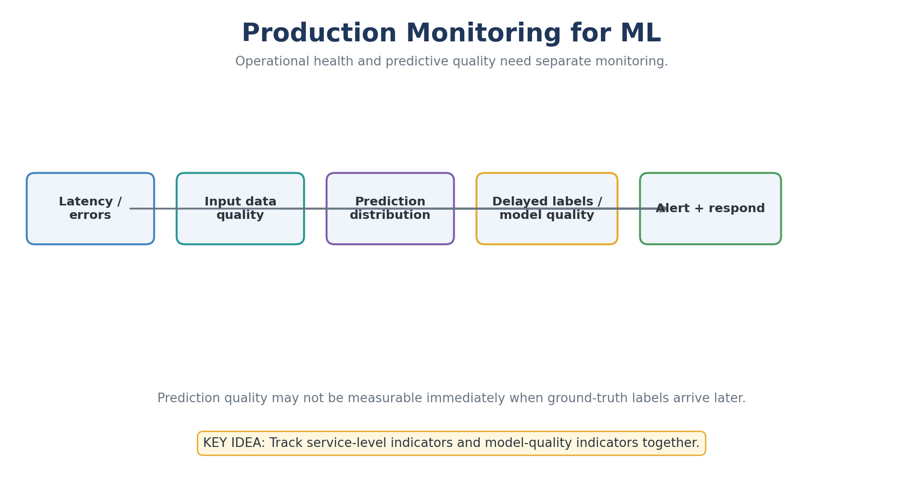
Explained Image Diagram 22: Production Monitoring for ML
Explanation: Prediction quality may not be measurable immediately when ground-truth labels arrive later.
Remember: Track service-level indicators and model-quality indicators together.

Slide 192
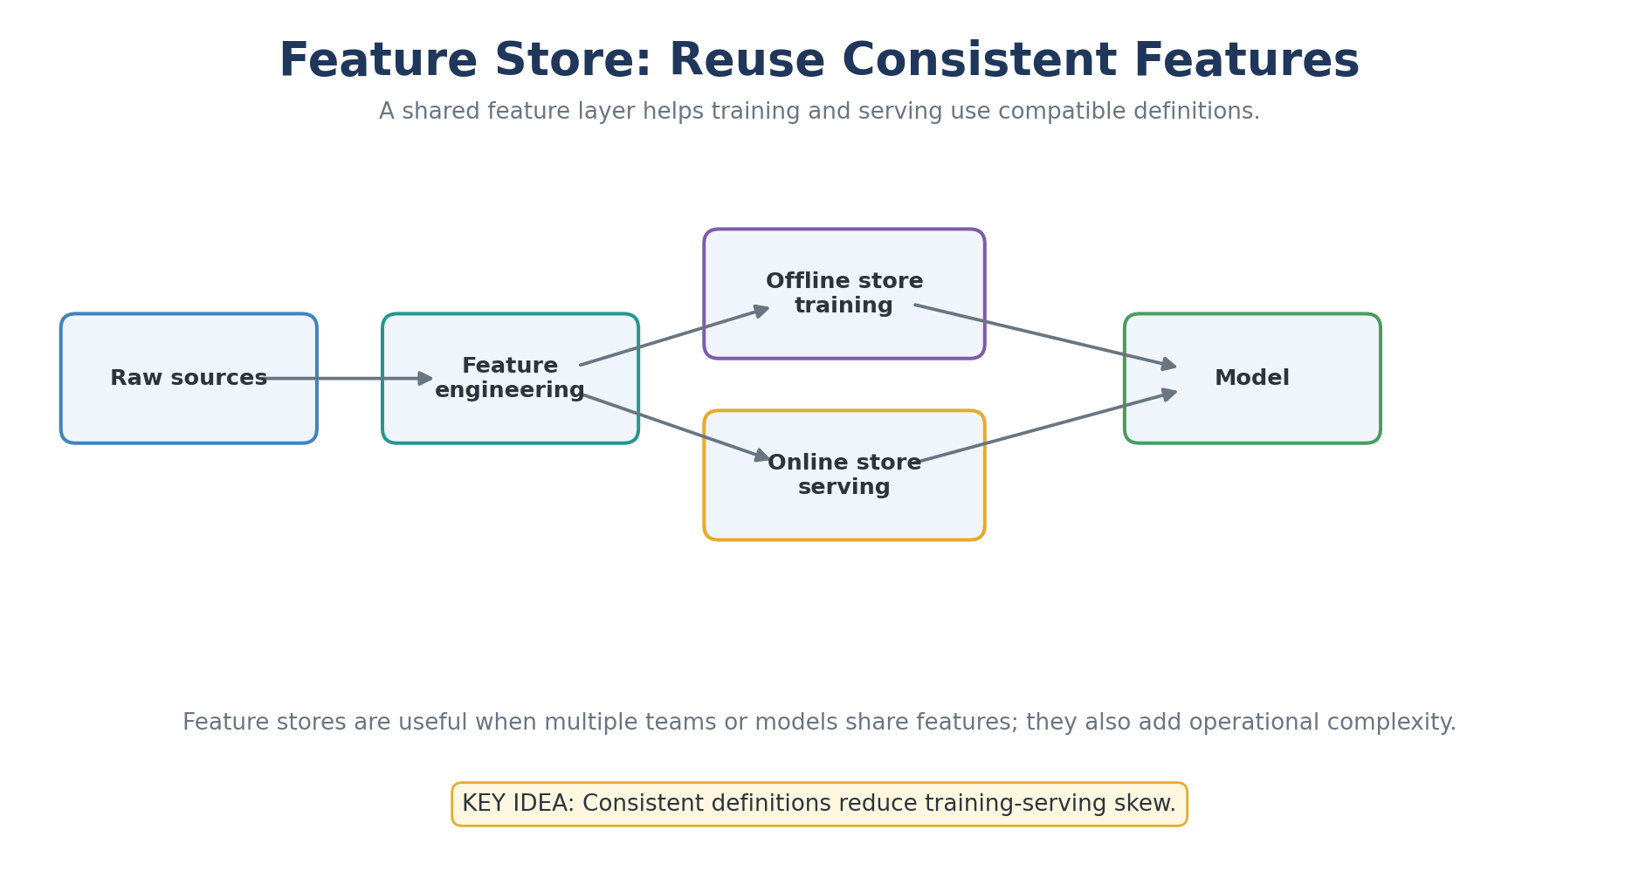
Explained Image Diagram 23: Feature Store: Reuse Consistent Features
Explanation: Feature stores are useful when multiple teams or models share features; they also add operational complexity.
Remember: Consistent definitions reduce training-serving skew.

Slide 193
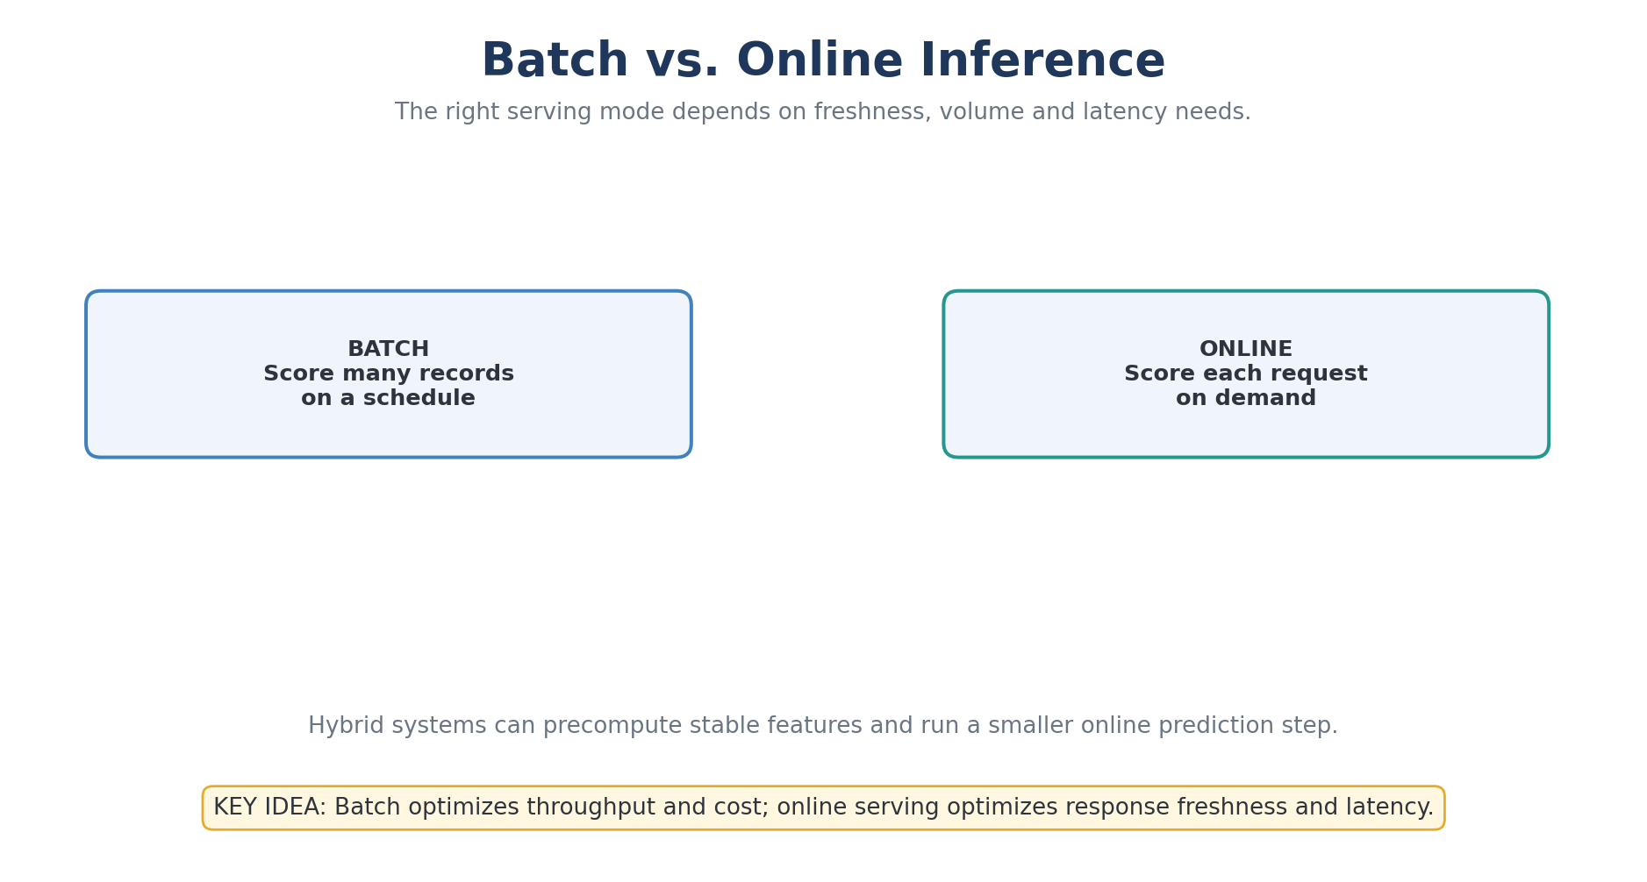
Explained Image Diagram 24: Batch vs. Online Inference
Explanation: Hybrid systems can precompute stable features and run a smaller online prediction step.
Remember: Batch optimizes throughput and cost; online serving optimizes response freshness and latency.

Slide 194
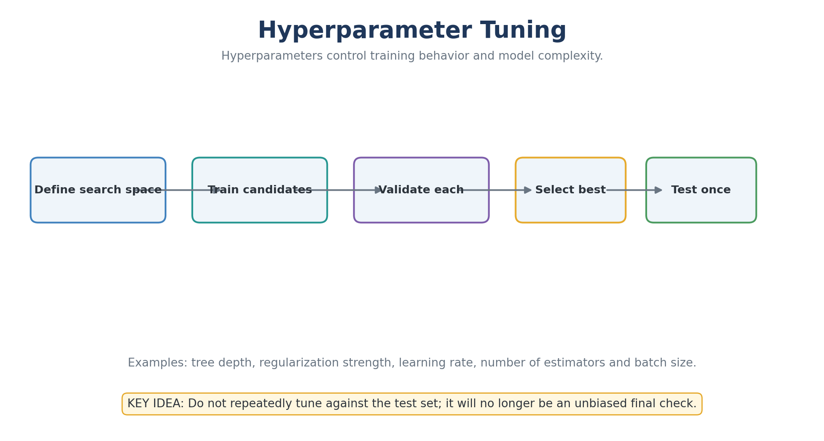
Explained Image Diagram 25: Hyperparameter Tuning
Explanation: Examples: tree depth, regularization strength, learning rate, number of estimators and batch size.
Remember: Do not repeatedly tune against the test set; it will no longer be an unbiased final check.

Slide 195
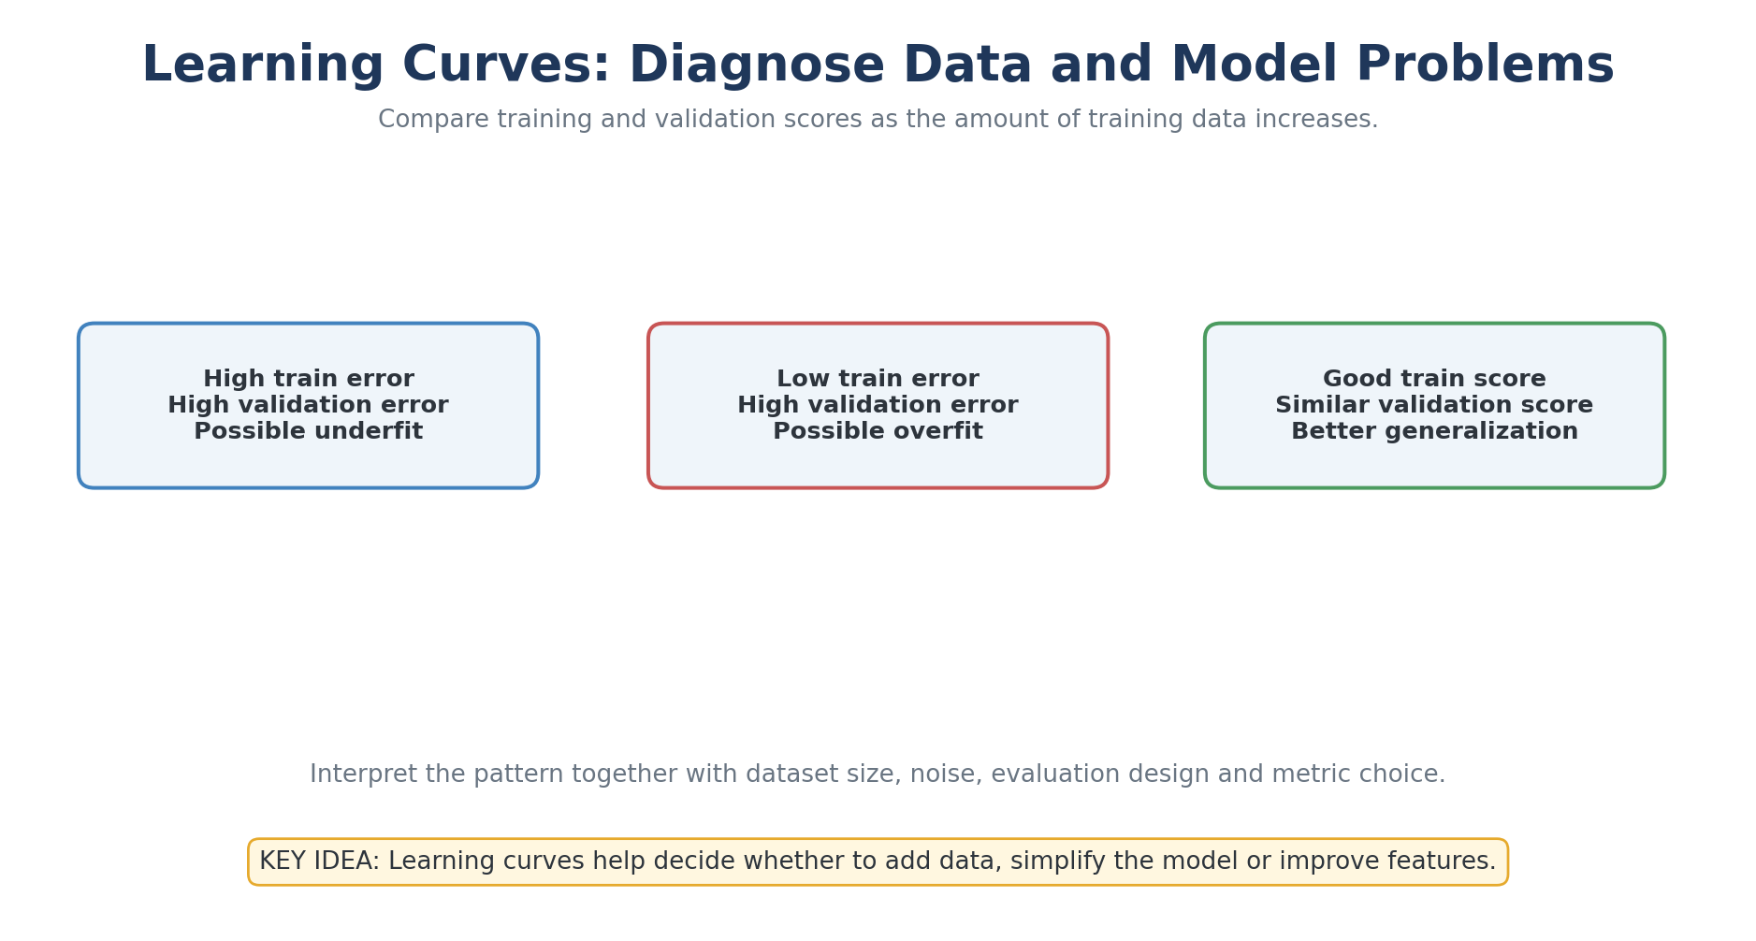
Explained Image Diagram 26: Learning Curves: Diagnose Data and Model Problems
Explanation: Interpret the pattern together with dataset size, noise, evaluation design and metric choice.
Remember: Learning curves help decide whether to add data, simplify the model or improve features.

Slide 196
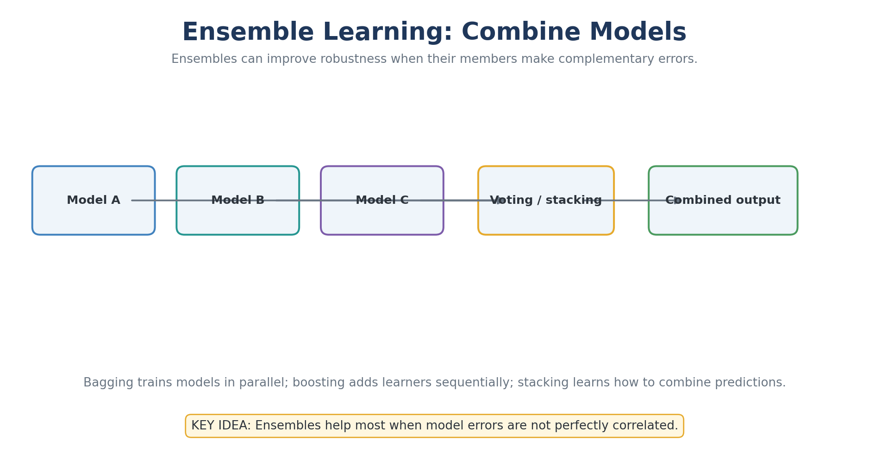
Explained Image Diagram 27: Ensemble Learning: Combine Models
Explanation: Bagging trains models in parallel; boosting adds learners sequentially; stacking learns how to combine predictions.
Remember: Ensembles help most when model errors are not perfectly correlated.

Slide 197
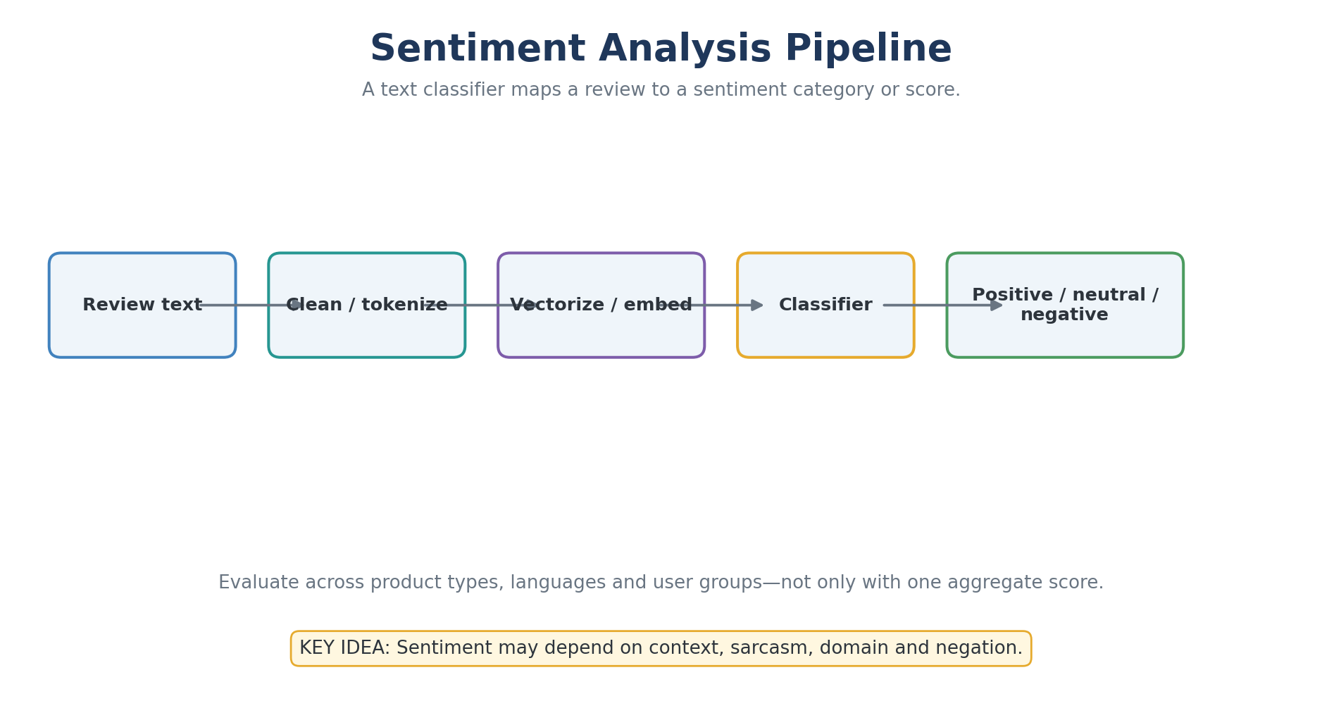
Explained Image Diagram 28: Sentiment Analysis Pipeline
Explanation: Evaluate across product types, languages and user groups—not only with one aggregate score.
Remember: Sentiment may depend on context, sarcasm, domain and negation.

Slide 198
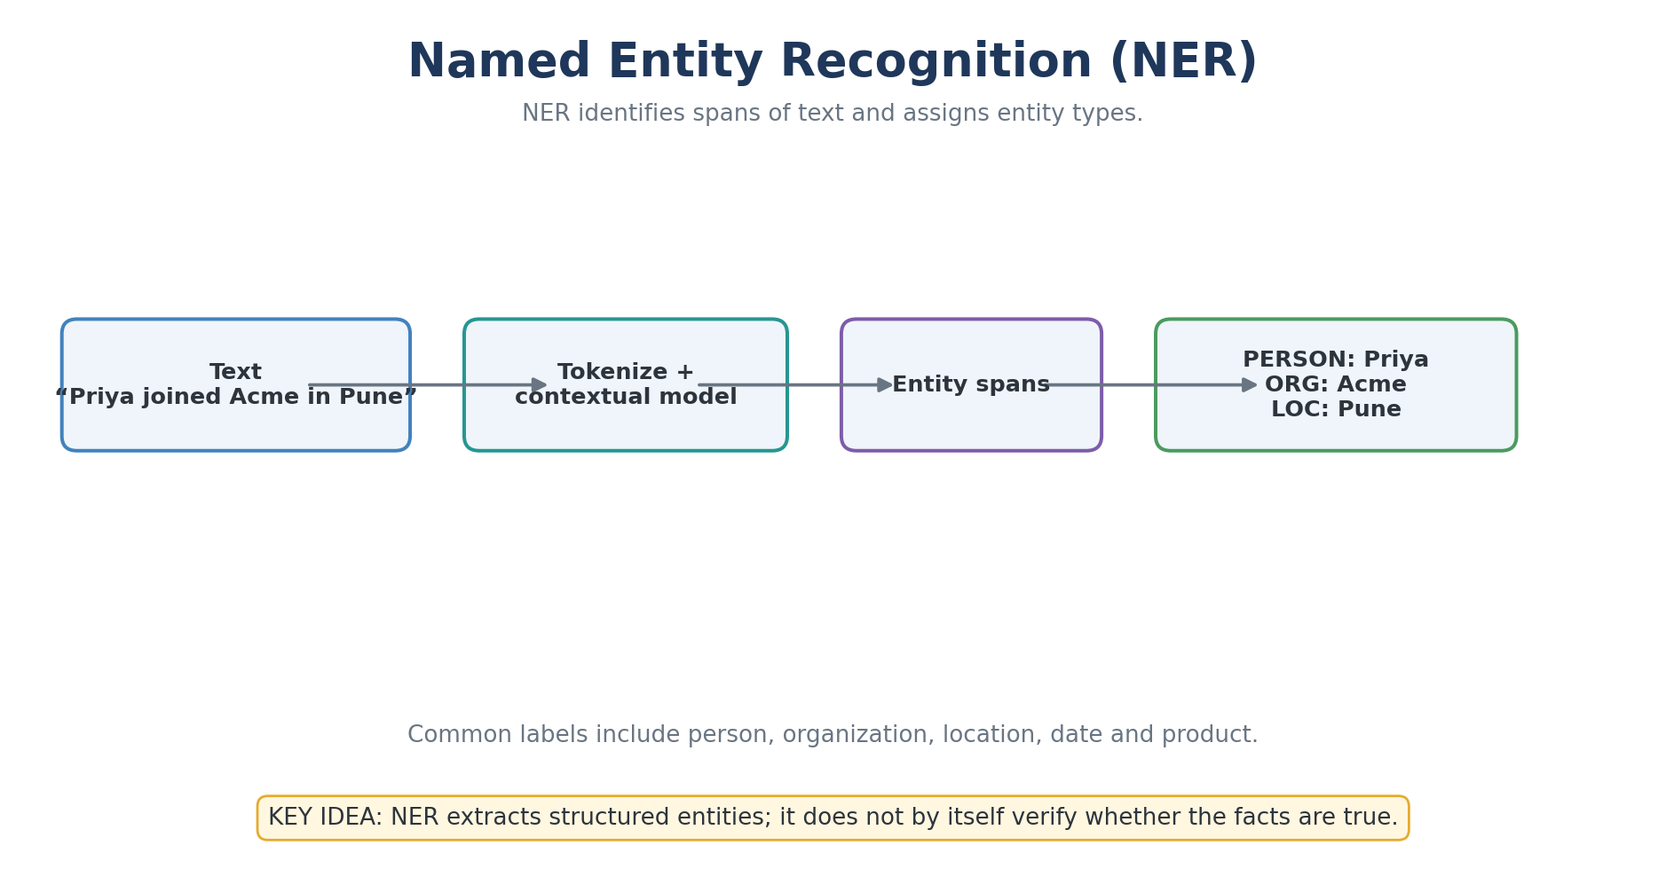
Explained Image Diagram 29: Named Entity Recognition (NER)
Explanation: Common labels include person, organization, location, date and product.
Remember: NER extracts structured entities; it does not by itself verify whether the facts are true.

Slide 199
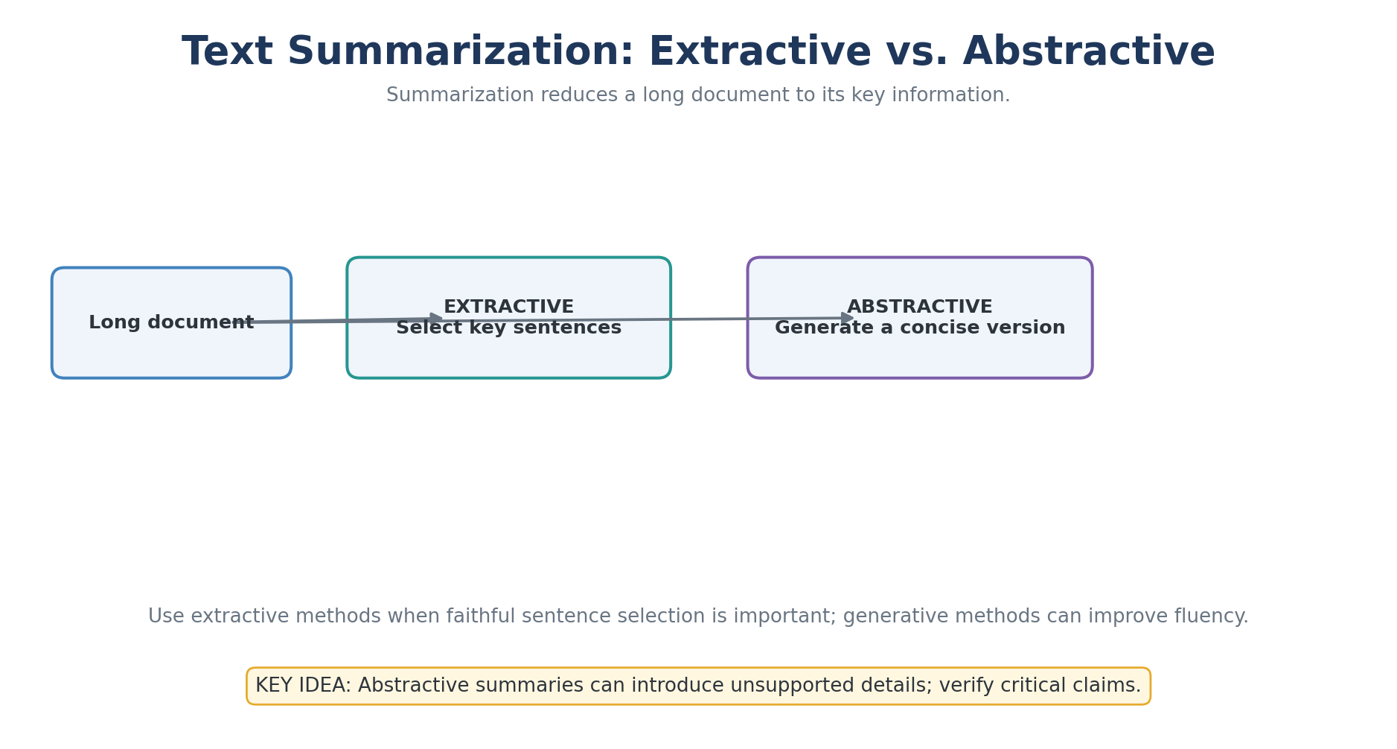
Explained Image Diagram 30: Text Summarization: Extractive vs. Abstractive
Explanation: Use extractive methods when faithful sentence selection is important; generative methods can improve fluency.
Remember: Abstractive summaries can introduce unsupported details; verify critical claims.

Slide 200
PRODUCTION ML
MLOps: reproducibility and model lifecycle
Experiment tracking
Record parameters, metrics, artifacts, code revision, environment and dataset version for every run.
Deployment strategies
Use batch or online inference as appropriate; consider canary rollout, shadow testing and rollback.
Model registry
Promote models through candidate, validated and production stages with ownership and approval metadata.
Monitoring
Track service health, data drift, concept drift, delayed labels, subgroup performance and cost.
Automated quality gates
Test data schemas, preprocessing, model metrics, API contracts, security and latency before release.
Reproducible release
Keep model, code, data, configuration and evaluation report linked to a versioned release.
SkyNetix Systems LLP • AI / ML Bootcamp

Slide 201
READY FOR REVIEW
Industrial assessment and portfolio deliverables
Problem definition
State the user, business objective, target, prediction horizon, constraints and measurable success criteria.
Architecture & operations
Show architecture, API contract, deployment guide, security controls and monitoring plan.
Engineering evidence
Provide reproducible code, environment instructions, tests, data checks and documented assumptions.
GenAI evidence
For RAG/LLMs, include retrieval tests, answer-grounding checks, prompt/version records and safety evaluations.
Evaluation evidence
Include baseline comparison, suitable metrics, error analysis, limitations and fairness considerations.
Presentation
Demonstrate the end-to-end workflow, explain trade-offs and list known limitations and next steps.
SkyNetix Systems LLP • AI / ML Bootcamp

Slide 202


Slide 203
AI, ML, deep learning and data science — Detailed Explanation
CONCEPT GUIDE • 01 • Complete ML & NLP Bootcamp
1. WHAT THE CONCEPT MEANS
Artificial intelligence (AI) is the broad goal of making systems perform tasks associated with intelligence. Machine learning (ML) is one approach: a system learns patterns from examples instead of relying only on manually written rules. Deep learning (DL) is a subset of ML that uses multi-layer neural networks. Data science is the end-to-end discipline of collecting, cleaning, analyzing and communicating data to support decisions.
2. HOW IT WORKS / HOW TO APPLY IT
Think of these as overlapping, not competing, fields. A data scientist may use statistics and visualization without training an ML model; an ML engineer may deploy a model; a deep-learning engineer may train a neural network. The right tool depends on the problem, available data, explainability needs and operating cost.
3. PRACTICAL EXAMPLE
Example: a retailer explores sales with charts (data science), trains a model to forecast demand (ML), and uses a neural network for complex image recognition (DL).
4. COMMON PITFALLS / CHECKS
Do not assume deep learning is always better. For small tabular datasets, a simpler model can be faster, cheaper and easier to explain.
Study prompt: Explain the concept without reading, implement a small example, and state one limitation or assumption.
01

Slide 204
Development environment — Detailed Explanation
CONCEPT GUIDE • 02 • Complete ML & NLP Bootcamp
1. WHAT THE CONCEPT MEANS
A development environment is the collection of tools used to write, execute, debug and organize code. Python provides the runtime; VS Code is an editor; Jupyter notebooks support interactive exploration; Anaconda can manage Python and packages; Colab offers a hosted notebook environment.
2. HOW IT WORKS / HOW TO APPLY IT
Choose one primary workflow and keep project files organized. Use notebooks for experiments, then move stable functions into Python modules that can be tested and reused. Record package versions so another machine can reproduce the same environment.
3. PRACTICAL EXAMPLE
Example: create a project folder with notebooks/, src/, data/ and requirements.txt; run exploratory analysis in a notebook and import reusable cleaning functions from src/.
4. COMMON PITFALLS / CHECKS
A notebook that works only because of hidden execution order is fragile. Restart the kernel and run all cells from top to bottom before sharing it.
Study prompt: Explain the concept without reading, implement a small example, and state one limitation or assumption.
02

Slide 205
Virtual environments and packages — Detailed Explanation
CONCEPT GUIDE • 03 • Complete ML & NLP Bootcamp
1. WHAT THE CONCEPT MEANS
A virtual environment isolates a project’s installed libraries from other projects. A package is reusable code distributed for installation, commonly through pip or conda. Isolation helps prevent version conflicts—for example, one project may require a different NumPy or scikit-learn version from another.
2. HOW IT WORKS / HOW TO APPLY IT
Create an environment, activate it, install only the dependencies needed, and capture those dependencies in a file. Use requirements.txt for pip-based projects or environment.yml for conda environments. Rebuild the environment periodically to check that setup instructions are complete.
3. PRACTICAL EXAMPLE
Example: python -m venv .venv; activate it; run python -m pip install numpy pandas scikit-learn; then python -m pip freeze > requirements.txt.
4. COMMON PITFALLS / CHECKS
Do not install every package globally or commit secrets and local machine paths into dependency files.
Study prompt: Explain the concept without reading, implement a small example, and state one limitation or assumption.
03

Slide 206
Python syntax, variables and types — Detailed Explanation
CONCEPT GUIDE • 04 • Complete ML & NLP Bootcamp
1. WHAT THE CONCEPT MEANS
Python code is organized by indentation, and variable names refer to objects. Common types include int, float, str and bool. Types affect which operations are valid: numbers can be multiplied, strings can be concatenated, and booleans represent True or False.
2. HOW IT WORKS / HOW TO APPLY IT
Use meaningful names, convert types deliberately, and inspect unfamiliar values with type(). Python is dynamically typed, but the data still has a type; a value read from a CSV may be text even when it looks numeric. Format output for readability rather than mixing display formatting with calculations.
3. PRACTICAL EXAMPLE
Example: orders = 3; price = 249.50; total = orders * price. The calculation is numeric, while f"Total: ₹{total:.2f}" formats the result for display.
4. COMMON PITFALLS / CHECKS
Watch for strings such as "100" being mistaken for numbers, and for floating-point representation when comparing decimal values.
Study prompt: Explain the concept without reading, implement a small example, and state one limitation or assumption.
04

Slide 207
Operators and expressions — Detailed Explanation
CONCEPT GUIDE • 05 • Complete ML & NLP Bootcamp
1. WHAT THE CONCEPT MEANS
Operators combine values into expressions. Arithmetic operators calculate values; comparison operators return booleans; logical operators combine conditions; membership operators test whether an item occurs in a collection. Operator precedence determines which parts are evaluated first.
2. HOW IT WORKS / HOW TO APPLY IT
Use parentheses when a condition is complex. For chained decisions, make each condition explicit and ensure the logic matches the business rule. In Python, and/or short-circuit, so the second condition may not be evaluated if the first already determines the result.
3. PRACTICAL EXAMPLE
Example: if age >= 18 and has_id: allow_entry = True. Both conditions must be true for entry to be allowed.
4. COMMON PITFALLS / CHECKS
Use == for equality and = for assignment. Be careful with precedence and with comparing values of incompatible types.
Study prompt: Explain the concept without reading, implement a small example, and state one limitation or assumption.
05

Slide 208
Control flow — Detailed Explanation
CONCEPT GUIDE • 06 • Complete ML & NLP Bootcamp
1. WHAT THE CONCEPT MEANS
Control flow determines which statements run. if/elif/else selects among branches based on conditions. The first matching branch executes, so the order of conditions matters—especially when one condition is broader than another.
2. HOW IT WORKS / HOW TO APPLY IT
Write branches that cover expected cases and decide what should happen for invalid or missing input. For classification rules, test boundary values such as exactly 70 or exactly 85, not only typical examples.
3. PRACTICAL EXAMPLE
Example: a score of 78 enters the branch score >= 70 and receives grade B if the A threshold is 85.
4. COMMON PITFALLS / CHECKS
Overlapping conditions can make later branches unreachable. Include tests for the minimum, maximum and threshold boundaries.
Study prompt: Explain the concept without reading, implement a small example, and state one limitation or assumption.
06

Slide 209
Loops and iteration — Detailed Explanation
CONCEPT GUIDE • 07 • Complete ML & NLP Bootcamp
1. WHAT THE CONCEPT MEANS
Loops repeat work over a sequence or while a condition remains true. A for loop is usually preferred when iterating over known items; a while loop is useful when repetition depends on a changing condition. break exits a loop and continue skips to the next iteration.
2. HOW IT WORKS / HOW TO APPLY IT
For data processing, loops can validate records, aggregate values or transform items. Track the loop variable clearly and ensure while-loop conditions eventually become false. For large numerical arrays, vectorized NumPy operations are often faster than Python-level loops.
3. PRACTICAL EXAMPLE
Example: loop through test scores and append scores greater than or equal to 70 to a passed list.
4. COMMON PITFALLS / CHECKS
An accidental infinite loop or an off-by-one range boundary can cause incorrect results. Test with an empty collection and a one-item collection.
Study prompt: Explain the concept without reading, implement a small example, and state one limitation or assumption.
07

Slide 210
Core data structures — Detailed Explanation
CONCEPT GUIDE • 08 • Complete ML & NLP Bootcamp
1. WHAT THE CONCEPT MEANS
Lists are ordered and mutable; tuples are ordered and immutable; sets hold unique values; dictionaries map keys to values. The choice affects ordering, update behavior and lookup performance. Dictionaries are especially useful for records and fast key-based access.
2. HOW IT WORKS / HOW TO APPLY IT
Use a list when order and edits matter, a tuple for a fixed group of values, a set for uniqueness or membership tests, and a dictionary for named attributes or lookups. A set does not promise the same semantic ordering as a list.
3. PRACTICAL EXAMPLE
Example: a list stores customer IDs in order; a set identifies unique IDs; a dictionary maps each customer ID to a customer record.
4. COMMON PITFALLS / CHECKS
Lists and dictionaries are mutable. Avoid unintentionally sharing a mutable object between records or using mutable values as dictionary keys.
Study prompt: Explain the concept without reading, implement a small example, and state one limitation or assumption.
08

Slide 211
Comprehensions and common patterns — Detailed Explanation
CONCEPT GUIDE • 09 • Complete ML & NLP Bootcamp
1. WHAT THE CONCEPT MEANS
Comprehensions create collections from an iterable with concise transformation and optional filtering. A list comprehension builds a list; a dictionary comprehension builds key-value mappings; a set comprehension collects unique results.
2. HOW IT WORKS / HOW TO APPLY IT
Use them for simple transformations that remain easy to read. If the logic requires multiple nested conditions or side effects, a regular loop is often clearer. Remember that a comprehension creates a new collection in memory.
3. PRACTICAL EXAMPLE
Example: [x*x for x in values if x % 2 == 0] squares only even values. A dictionary comprehension can map each number to its square.
4. COMMON PITFALLS / CHECKS
Conciseness is not the same as clarity. Avoid deeply nested comprehensions that are difficult to debug.
Study prompt: Explain the concept without reading, implement a small example, and state one limitation or assumption.
09

Slide 212
Functions and reusable code — Detailed Explanation
CONCEPT GUIDE • 10 • Complete ML & NLP Bootcamp
1. WHAT THE CONCEPT MEANS
A function names a reusable unit of behavior. Parameters provide inputs, return sends a result back, and local variables keep implementation details scoped to the function. Functions make code easier to test, explain and maintain.
2. HOW IT WORKS / HOW TO APPLY IT
Give functions one clear responsibility, validate inputs, choose useful names and document non-obvious behavior. Prefer returning a value over printing inside the function so callers can reuse the result in other calculations.
3. PRACTICAL EXAMPLE
Example: mean(values) checks that the list is not empty, calculates sum(values)/len(values), and returns the numeric average.
4. COMMON PITFALLS / CHECKS
Handle edge cases such as empty inputs and unexpected types. Avoid mutable default arguments such as def f(items=[]), because the same list is reused across calls.
Study prompt: Explain the concept without reading, implement a small example, and state one limitation or assumption.
10

Slide 213
Lambda, map and filter — Detailed Explanation
CONCEPT GUIDE • 11 • Complete ML & NLP Bootcamp
1. WHAT THE CONCEPT MEANS
A lambda is a small anonymous function. map applies a function to each item, while filter keeps items for which a predicate is true. These tools support functional-style transformations and can be combined with iterables.
2. HOW IT WORKS / HOW TO APPLY IT
Use them when the transformation is short and obvious. A list comprehension is often more readable in Python, and map/filter return iterators in Python 3, so wrap them in list() only when a materialized list is needed.
3. PRACTICAL EXAMPLE
Example: map(lambda price: price*0.9, prices) calculates a 10% discount; filter(lambda price: price >= 400, prices) keeps higher-priced items.
4. COMMON PITFALLS / CHECKS
Prefer a named function when the logic needs comments, several steps or reuse across modules.
Study prompt: Explain the concept without reading, implement a small example, and state one limitation or assumption.
11

Slide 214
Modules, packages and imports — Detailed Explanation
CONCEPT GUIDE • 12 • Complete ML & NLP Bootcamp
1. WHAT THE CONCEPT MEANS
A module is a Python file that groups related code; a package organizes modules under a shared namespace. Imports let a program reuse standard-library and third-party functionality instead of reimplementing it.
2. HOW IT WORKS / HOW TO APPLY IT
Keep modules cohesive, avoid circular imports, and separate configuration, data access and business logic where practical. Use a main guard to ensure command-line behavior runs only when a file is executed directly, not when imported by tests or another module.
3. PRACTICAL EXAMPLE
Example: place data-cleaning functions in src/cleaning.py and import them from a notebook or training script.
4. COMMON PITFALLS / CHECKS
Import-time code should not unexpectedly download data, train models or modify files. Keep side effects inside functions or an explicit entry point.
Study prompt: Explain the concept without reading, implement a small example, and state one limitation or assumption.
12

Slide 215
Files, exceptions and robust code — Detailed Explanation
CONCEPT GUIDE • 13 • Complete ML & NLP Bootcamp
1. WHAT THE CONCEPT MEANS
File handling reads and writes persistent data such as CSV, JSON and model artifacts. Exceptions represent failures that need to be handled or surfaced clearly. try/except lets a program respond to known errors without hiding every failure.
2. HOW IT WORKS / HOW TO APPLY IT
Use pathlib for paths, context managers for resources, explicit encodings for text, and narrow exception handlers for expected problems. Validate file contents after parsing; successfully reading JSON does not guarantee the expected keys or data types are present.
3. PRACTICAL EXAMPLE
Example: read config.json, handle FileNotFoundError with a safe development default, and report malformed JSON as a clear configuration error.
4. COMMON PITFALLS / CHECKS
Do not catch Exception and silently continue. Preserve useful error context so problems can be diagnosed.
Study prompt: Explain the concept without reading, implement a small example, and state one limitation or assumption.
13

Slide 216
Object-oriented Python — Detailed Explanation
CONCEPT GUIDE • 14 • Complete ML & NLP Bootcamp
1. WHAT THE CONCEPT MEANS
Object-oriented programming groups state and behavior into classes. An object is an instance of a class; attributes hold its state and methods operate on that state. OOP can model concepts such as a model configuration or a data-processing component.
2. HOW IT WORKS / HOW TO APPLY IT
Use classes when state and related operations belong together. Use simple functions and data structures when a class adds no meaningful benefit. Keep initialization predictable and avoid classes that combine unrelated responsibilities.
3. PRACTICAL EXAMPLE
Example: ModelConfig stores a model name and learning rate, and describe() returns a readable representation of those settings.
4. COMMON PITFALLS / CHECKS
Python supports composition and inheritance, but deep inheritance hierarchies often make code harder to understand. Prefer simple composition when components need to be combined.
Study prompt: Explain the concept without reading, implement a small example, and state one limitation or assumption.
14

Slide 217
NumPy arrays and vectorization — Detailed Explanation
CONCEPT GUIDE • 15 • Complete ML & NLP Bootcamp
1. WHAT THE CONCEPT MEANS
NumPy provides efficient n-dimensional arrays and numerical operations. Vectorization applies an operation to whole arrays without writing an explicit Python loop for each element. Arrays also support broadcasting, aggregation and linear-algebra operations.
2. HOW IT WORKS / HOW TO APPLY IT
NumPy arrays typically use a consistent data type and compact memory layout, which makes numerical computation efficient. Shape matters: operations must align dimensions correctly, and broadcasting can expand compatible shapes implicitly.
3. PRACTICAL EXAMPLE
Example: z = (x - x.mean()) / x.std() standardizes values by subtracting the mean and dividing by standard deviation.
4. COMMON PITFALLS / CHECKS
Check array shape, dtype and zero standard deviation. Vectorized code can be concise but may create large intermediate arrays if memory is ignored.
Study prompt: Explain the concept without reading, implement a small example, and state one limitation or assumption.
15

Slide 218
Pandas: inspect and clean data — Detailed Explanation
CONCEPT GUIDE • 16 • Complete ML & NLP Bootcamp
1. WHAT THE CONCEPT MEANS
Pandas represents tabular data with DataFrames and labeled columns. Before modeling, inspect row and column counts, types, missing values, duplicates, ranges and category frequencies. Cleaning makes the data consistent enough for analysis and training.
2. HOW IT WORKS / HOW TO APPLY IT
Use isna() to locate missing values, duplicated() to identify repeated rows, astype() or to_numeric() to correct types, and explicit rules for imputation or removal. Preserve the raw data and document transformations so cleaning is reproducible.
3. PRACTICAL EXAMPLE
Example: read customers.csv, inspect df.shape and df.head(), count missing values, remove exact duplicates and convert monthly_spend to numeric.
4. COMMON PITFALLS / CHECKS
Do not drop missing rows automatically. Missingness may be meaningful, and careless cleaning can remove the very population the model needs to represent.
Study prompt: Explain the concept without reading, implement a small example, and state one limitation or assumption.
16

Slide 219
Exploratory data analysis — Detailed Explanation
CONCEPT GUIDE • 17 • Complete ML & NLP Bootcamp
1. WHAT THE CONCEPT MEANS
Exploratory data analysis (EDA) uses summaries and visualizations to understand a dataset before choosing a model. It helps reveal data quality issues, unusual values, skew, relationships, group differences and possible target leakage.
2. HOW IT WORKS / HOW TO APPLY IT
Begin with dimensions and types, then examine missingness, descriptive statistics, distributions and relationships between features and the target. Form hypotheses from plots, but verify them with appropriate analysis rather than treating visual correlation as causation.
3. PRACTICAL EXAMPLE
Example: compare monthly spend by customer segment and inspect whether a few extreme customers dominate the mean.
4. COMMON PITFALLS / CHECKS
Perform EDA without leaking test-set information into training decisions. Keep the test set reserved for final evaluation.
Study prompt: Explain the concept without reading, implement a small example, and state one limitation or assumption.
17

Slide 220
Data visualization — Detailed Explanation
CONCEPT GUIDE • 18 • Complete ML & NLP Bootcamp
1. WHAT THE CONCEPT MEANS
Charts encode data using position, length, color and shape. Histograms show distributions; scatter plots reveal relationships; bar charts compare categories; line charts show change over time; box plots summarize spread and outliers.
2. HOW IT WORKS / HOW TO APPLY IT
Choose a chart based on the question, label axes with units, show sample sizes where relevant, and use scales that do not exaggerate differences. A visualization should expose a pattern rather than decorate the slide.
3. PRACTICAL EXAMPLE
Example: a histogram of monthly_spend can reveal right skew and whether a small group of customers spends much more than most customers.
4. COMMON PITFALLS / CHECKS
Correlation in a plot does not prove causation. Check missing values, aggregation choices and misleading axis ranges.
Study prompt: Explain the concept without reading, implement a small example, and state one limitation or assumption.
18

Slide 221
Descriptive statistics — Detailed Explanation
CONCEPT GUIDE • 19 • Complete ML & NLP Bootcamp
1. WHAT THE CONCEPT MEANS
Descriptive statistics summarize a dataset. Mean is the arithmetic average; median is the middle value; variance and standard deviation describe spread; quantiles describe cut points; range is maximum minus minimum. Different measures tell different parts of the story.
2. HOW IT WORKS / HOW TO APPLY IT
The mean is sensitive to extreme values, while the median is more robust for skewed data. Standard deviation is expressed in the same units as the data; variance is in squared units. Always interpret a statistic alongside the distribution and sample size.
3. PRACTICAL EXAMPLE
Example: for salaries with a few very high values, the mean may be much higher than the median, so reporting both gives a more balanced picture.
4. COMMON PITFALLS / CHECKS
A single average can hide subgroups, skew and outliers. Do not infer that data is normally distributed from the mean and standard deviation alone.
Study prompt: Explain the concept without reading, implement a small example, and state one limitation or assumption.
19

Slide 222
Probability and conditional probability — Detailed Explanation
CONCEPT GUIDE • 20 • Complete ML & NLP Bootcamp
1. WHAT THE CONCEPT MEANS
Probability quantifies uncertainty between 0 and 1. Joint probability describes two events occurring together; conditional probability P(A|B) is the probability of A given that B occurred. Independence means knowing B does not change the probability of A.
2. HOW IT WORKS / HOW TO APPLY IT
Bayes’ theorem reverses conditional probabilities by combining the likelihood of evidence with prior probability. This is especially important when a condition is rare: even a good test can produce many false positives if the base rate is low.
3. PRACTICAL EXAMPLE
Example: a fraud model estimates P(fraud | transaction features), not simply the overall proportion of fraudulent transactions.
4. COMMON PITFALLS / CHECKS
Do not confuse P(A|B) with P(B|A). The denominator and base rate matter.
Study prompt: Explain the concept without reading, implement a small example, and state one limitation or assumption.
20

Slide 223
Distributions and sampling — Detailed Explanation
CONCEPT GUIDE • 21 • Complete ML & NLP Bootcamp
1. WHAT THE CONCEPT MEANS
A probability distribution describes how possible values are distributed. The normal distribution is symmetric; the binomial distribution counts successes across a fixed number of independent trials; other distributions model counts, waiting times or skewed values.
2. HOW IT WORKS / HOW TO APPLY IT
A sample is used to estimate properties of a population. Random sampling reduces systematic selection bias, while larger samples generally reduce sampling variability. Confidence intervals express uncertainty in an estimate under stated assumptions.
3. PRACTICAL EXAMPLE
Example: estimate average customer spend from a random sample and report both the point estimate and uncertainty interval.
4. COMMON PITFALLS / CHECKS
A large sample does not fix biased sampling. Check independence, sampling method and whether the assumed distribution fits the data.
Study prompt: Explain the concept without reading, implement a small example, and state one limitation or assumption.
21

Slide 224
Linear algebra essentials — Detailed Explanation
CONCEPT GUIDE • 22 • Complete ML & NLP Bootcamp
1. WHAT THE CONCEPT MEANS
Linear algebra represents numerical data as scalars, vectors and matrices. A feature vector describes one observation; a matrix can hold many observations; a dot product combines aligned values. Matrix multiplication supports linear models and neural-network layers.
2. HOW IT WORKS / HOW TO APPLY IT
Shape compatibility is essential. If X has n rows and p features, a weight vector typically has p entries; X multiplied by the weights yields one score per row. Geometric ideas such as distance and projection also appear in clustering and dimensionality reduction.
3. PRACTICAL EXAMPLE
Example: a linear model computes score = w1*x1 + w2*x2 + b, where weights determine feature contribution and b is the intercept.
4. COMMON PITFALLS / CHECKS
Check dimensions and feature order. A matrix can multiply another matrix only when the inner dimensions match.
Study prompt: Explain the concept without reading, implement a small example, and state one limitation or assumption.
22

Slide 225
Calculus and gradients — Detailed Explanation
CONCEPT GUIDE • 23 • Complete ML & NLP Bootcamp
1. WHAT THE CONCEPT MEANS
A derivative measures how a function changes as an input changes. For a model, a partial derivative measures how the loss changes when one parameter changes. The gradient collects these derivatives and points toward the steepest local increase in loss.
2. HOW IT WORKS / HOW TO APPLY IT
Gradient descent moves parameters in the opposite direction of the gradient to reduce loss. The learning rate controls step size: too large can overshoot or diverge; too small can make learning very slow. In neural networks, backpropagation efficiently computes gradients through layers.
3. PRACTICAL EXAMPLE
Example: update a weight with w_new = w_old - learning_rate * gradient.
4. COMMON PITFALLS / CHECKS
A gradient describes local change, not a guarantee of a global optimum. Loss scaling and learning-rate choice affect stability.
Study prompt: Explain the concept without reading, implement a small example, and state one limitation or assumption.
23

Slide 226
Train, validation and test split — Detailed Explanation
CONCEPT GUIDE • 24 • Complete ML & NLP Bootcamp
1. WHAT THE CONCEPT MEANS
The training set is used to fit model parameters. The validation set helps select models and tune hyperparameters. The test set estimates final performance on data not used for those choices.
2. HOW IT WORKS / HOW TO APPLY IT
Split data before learning preprocessing statistics. For time-dependent problems, preserve temporal order; for classification, stratification can preserve class proportions. If multiple records belong to one person or entity, consider group-based splitting to prevent related examples crossing splits.
3. PRACTICAL EXAMPLE
Example: fit on 70%, tune on 15%, and evaluate once on the final 15%, with exact proportions adjusted to the data size and use case.
4. COMMON PITFALLS / CHECKS
Repeatedly checking test performance turns the test set into a tuning set. Leakage can produce impressive scores that fail in production.
Study prompt: Explain the concept without reading, implement a small example, and state one limitation or assumption.
24

Slide 227
Data preprocessing pipeline — Detailed Explanation
CONCEPT GUIDE • 25 • Complete ML & NLP Bootcamp
1. WHAT THE CONCEPT MEANS
Preprocessing converts raw features into consistent model inputs. Common steps include imputing missing values, encoding categories, scaling numerical features and selecting or transforming features. A pipeline chains these operations with the estimator so training and inference apply the same sequence.
2. HOW IT WORKS / HOW TO APPLY IT
Fit preprocessing steps only on training data; at prediction time, apply the already-fitted transformations. This prevents information from validation or test data influencing learned means, categories or feature selection. Pipelines also simplify cross-validation and deployment.
3. PRACTICAL EXAMPLE
Example: median-impute numeric columns, one-hot encode categories, scale selected features and train a classifier in one scikit-learn Pipeline.
4. COMMON PITFALLS / CHECKS
Never independently preprocess training and production data using different rules. Watch for unseen categories and missing columns at inference time.
Study prompt: Explain the concept without reading, implement a small example, and state one limitation or assumption.
25

Slide 228
Machine learning workflow — Detailed Explanation
CONCEPT GUIDE • 26 • Complete ML & NLP Bootcamp
1. WHAT THE CONCEPT MEANS
A practical ML workflow starts with a clearly defined decision and target, then gathers data, validates and prepares it, builds a baseline, trains candidates, evaluates them, deploys the chosen model and monitors outcomes. The workflow is iterative rather than strictly linear.
2. HOW IT WORKS / HOW TO APPLY IT
Define success before training: metric, decision threshold, latency, cost, fairness and acceptable error types. Compare with a simple baseline and keep an experiment record. After deployment, monitor both service health and whether real-world data or relationships change.
3. PRACTICAL EXAMPLE
Example: for churn prediction, define what counts as churn and the prediction horizon before choosing features and metrics.
4. COMMON PITFALLS / CHECKS
A high offline score does not guarantee business value. Ensure the model output can be acted upon and evaluated against a relevant baseline.
Study prompt: Explain the concept without reading, implement a small example, and state one limitation or assumption.
26

Slide 229
Learning paradigms — Detailed Explanation
CONCEPT GUIDE • 27 • Complete ML & NLP Bootcamp
1. WHAT THE CONCEPT MEANS
Supervised learning learns from labeled examples. Unsupervised learning searches for structure without target labels. Reinforcement learning learns a policy by interacting with an environment and receiving rewards or penalties.
2. HOW IT WORKS / HOW TO APPLY IT
Choose the paradigm based on the available feedback. Regression and classification are supervised; clustering and PCA are common unsupervised tools; reinforcement learning suits sequential decisions where actions affect future states and rewards.
3. PRACTICAL EXAMPLE
Example: predict house prices with supervised regression, group customers with clustering, and optimize a simulated robot’s actions with reinforcement learning.
4. COMMON PITFALLS / CHECKS
Clustering does not automatically produce meaningful business segments, and reinforcement learning can be expensive or unsafe to explore in a real environment.
Study prompt: Explain the concept without reading, implement a small example, and state one limitation or assumption.
27

Slide 230
Regression vs classification — Detailed Explanation
CONCEPT GUIDE • 28 • Complete ML & NLP Bootcamp
1. WHAT THE CONCEPT MEANS
Regression predicts a numeric quantity, such as demand or price. Classification predicts a category or class probability, such as spam/not spam. The output type determines the model setup, loss function, evaluation metric and interpretation.
2. HOW IT WORKS / HOW TO APPLY IT
For regression, common metrics include MAE and RMSE. For classification, precision, recall, F1, ROC-AUC or PR-AUC may be appropriate. A classifier’s probability becomes a label only after applying a decision threshold, which should reflect the cost of false positives and false negatives.
3. PRACTICAL EXAMPLE
Example: estimate delivery time in minutes with regression; predict whether an order will be late with classification.
4. COMMON PITFALLS / CHECKS
Do not use accuracy or RMSE by habit. Choose metrics that match the target and the real-world cost of errors.
Study prompt: Explain the concept without reading, implement a small example, and state one limitation or assumption.
28

Slide 231
Simple and multiple linear regression — Detailed Explanation
CONCEPT GUIDE • 29 • Complete ML & NLP Bootcamp
1. WHAT THE CONCEPT MEANS
Linear regression models a numeric target as an intercept plus a weighted sum of features. Simple regression uses one feature; multiple regression uses several. The learned coefficients describe the model’s estimated relationship while holding other included features fixed.
2. HOW IT WORKS / HOW TO APPLY IT
Train the model on representative examples, inspect residuals and evaluate on held-out data. Coefficients are not automatically causal effects; correlated features, omitted variables and non-linear relationships can complicate interpretation.
3. PRACTICAL EXAMPLE
Example: predict house price using area, number of bedrooms and location indicators. Each coefficient contributes to the predicted value according to its feature value.
4. COMMON PITFALLS / CHECKS
Check residual patterns, influential outliers, feature scaling when regularization is used, and multicollinearity when interpreting coefficients.
Study prompt: Explain the concept without reading, implement a small example, and state one limitation or assumption.
29

Slide 232
Regression loss and metrics — Detailed Explanation
CONCEPT GUIDE • 30 • Complete ML & NLP Bootcamp
1. WHAT THE CONCEPT MEANS
A loss function is the quantity optimized during training; an evaluation metric summarizes performance in a useful unit. MAE averages absolute errors, MSE averages squared errors, and RMSE is the square root of MSE, returning to the target’s units.
2. HOW IT WORKS / HOW TO APPLY IT
MSE penalizes large errors more strongly than MAE. R-squared compares the model to a mean-prediction baseline under its definition, but it does not prove that the model is appropriate. Compare errors against business tolerances and simple baselines.
3. PRACTICAL EXAMPLE
Example: if the model predicts delivery time, MAE = 5 means the average absolute error is five minutes on the evaluation sample.
4. COMMON PITFALLS / CHECKS
An average metric can hide systematic errors for particular segments or ranges. Inspect residuals and per-group performance.
Study prompt: Explain the concept without reading, implement a small example, and state one limitation or assumption.
30

Slide 233
Polynomial regression and regularization — Detailed Explanation
CONCEPT GUIDE • 31 • Complete ML & NLP Bootcamp
1. WHAT THE CONCEPT MEANS
Polynomial regression adds powers or interactions of features so a linear estimator can fit curved relationships. Regularization penalizes model complexity: Ridge uses an L2 penalty, while Lasso uses an L1 penalty that can drive some coefficients to zero.
2. HOW IT WORKS / HOW TO APPLY IT
Increasing polynomial degree increases flexibility but can overfit. Standardize features when penalty scales would otherwise be incomparable, and select degree and regularization strength using cross-validation.
3. PRACTICAL EXAMPLE
Example: fit a curved relationship between temperature and demand with temperature and temperature-squared as inputs.
4. COMMON PITFALLS / CHECKS
Extrapolation outside the training range can be unstable. Strong regularization can underfit; weak regularization may retain noisy patterns.
Study prompt: Explain the concept without reading, implement a small example, and state one limitation or assumption.
31

Slide 234
Logistic regression and classification — Detailed Explanation
CONCEPT GUIDE • 32 • Complete ML & NLP Bootcamp
1. WHAT THE CONCEPT MEANS
Logistic regression is a classification model that converts a linear score into a probability using the logistic sigmoid for binary outcomes. The probability is compared with a threshold to produce a class label.
2. HOW IT WORKS / HOW TO APPLY IT
The coefficients affect log-odds, not directly the probability. Logistic regression is a useful baseline because it is fast and interpretable, especially with well-prepared features. Multiclass variants can handle more than two classes.
3. PRACTICAL EXAMPLE
Example: a model estimates a 0.82 probability that a transaction is fraudulent; a threshold of 0.5 flags it, while a higher threshold may reduce false alarms.
4. COMMON PITFALLS / CHECKS
Choose the threshold using validation data and business costs. A probability is not automatically well calibrated simply because it lies between zero and one.
Study prompt: Explain the concept without reading, implement a small example, and state one limitation or assumption.
32

Slide 235
Confusion matrix and classification metrics — Detailed Explanation
CONCEPT GUIDE • 33 • Complete ML & NLP Bootcamp
1. WHAT THE CONCEPT MEANS
A confusion matrix counts true positives, true negatives, false positives and false negatives. Precision is the fraction of predicted positives that are truly positive; recall is the fraction of actual positives found; F1 balances precision and recall using their harmonic mean.
2. HOW IT WORKS / HOW TO APPLY IT
Accuracy can be misleading when one class dominates. Select metrics according to the decision: fraud detection may emphasize recall but still constrain false alerts; a medical triage system may prioritize missed cases differently from a content moderation system.
3. PRACTICAL EXAMPLE
Example: among 100 flagged transactions, 80 are truly fraudulent, so precision is 80%; if 100 of 200 fraud cases are found, recall is 50%.
4. COMMON PITFALLS / CHECKS
Always state which class is considered positive and inspect the actual confusion counts, not only a single score.
Study prompt: Explain the concept without reading, implement a small example, and state one limitation or assumption.
33

Slide 236
Decision trees and ensembles — Detailed Explanation
CONCEPT GUIDE • 34 • Complete ML & NLP Bootcamp
1. WHAT THE CONCEPT MEANS
A decision tree repeatedly splits data using feature rules, creating branches that reduce impurity for classification or prediction error for regression. Trees can represent non-linear relationships and interactions, and are often easy to visualize.
2. HOW IT WORKS / HOW TO APPLY IT
Random forests average many trees trained with data and feature randomness, reducing variance. Gradient boosting builds learners sequentially to correct residual errors. Ensembles can improve accuracy but increase complexity and reduce simple interpretability.
3. PRACTICAL EXAMPLE
Example: a tree may split first on account age and then transaction amount; a random forest combines many such trees for a more stable prediction.
4. COMMON PITFALLS / CHECKS
Deep trees can memorize noise. Tune depth and leaf size, validate carefully, and distinguish feature importance from causal explanation.
Study prompt: Explain the concept without reading, implement a small example, and state one limitation or assumption.
34

Slide 237
K-nearest neighbors and support vector machines — Detailed Explanation
CONCEPT GUIDE • 35 • Complete ML & NLP Bootcamp
1. WHAT THE CONCEPT MEANS
K-nearest neighbors (KNN) predicts from the labels or values of nearby training examples. A support vector machine (SVM) finds a decision boundary with a large margin; kernels can represent non-linear boundaries without explicitly constructing all transformed features.
2. HOW IT WORKS / HOW TO APPLY IT
KNN depends on distance, so feature scaling is important; small k can be noisy and large k can blur boundaries. SVMs also benefit from scaling and require tuning of regularization and, for kernel SVMs, kernel parameters.
3. PRACTICAL EXAMPLE
Example: classify a new customer by the majority class among the closest customers after scaling spend, tenure and order count.
4. COMMON PITFALLS / CHECKS
KNN prediction can be slow for large datasets. SVMs may become costly with many observations, and both methods need validation on representative data.
Study prompt: Explain the concept without reading, implement a small example, and state one limitation or assumption.
35

Slide 238
Naive Bayes and probabilistic baselines — Detailed Explanation
CONCEPT GUIDE • 36 • Complete ML & NLP Bootcamp
1. WHAT THE CONCEPT MEANS
Naive Bayes applies Bayes’ theorem while assuming features are conditionally independent given the class. The assumption is often unrealistic, but the model can still work well, particularly for text classification with word-count features.
2. HOW IT WORKS / HOW TO APPLY IT
Gaussian Naive Bayes is used for continuous features; Multinomial Naive Bayes is common for counts; Bernoulli Naive Bayes models binary feature presence. A simple baseline provides a useful reference before more complex models are built.
3. PRACTICAL EXAMPLE
Example: a spam classifier estimates how likely words such as “offer” and “winner” are under spam versus non-spam messages.
4. COMMON PITFALLS / CHECKS
Check whether feature representation suits the chosen variant, and do not interpret the independence assumption as a statement that words are truly independent.
Study prompt: Explain the concept without reading, implement a small example, and state one limitation or assumption.
36

Slide 239
Clustering: K-means intuition — Detailed Explanation
CONCEPT GUIDE • 37 • Complete ML & NLP Bootcamp
1. WHAT THE CONCEPT MEANS
K-means partitions observations into k clusters by repeatedly assigning each point to its nearest centroid and updating centroids to the mean of assigned points. It aims to reduce within-cluster squared distance.
2. HOW IT WORKS / HOW TO APPLY IT
Choose k using domain knowledge and validation tools such as elbow plots or silhouette scores. Scale features when units differ, inspect cluster profiles and test stability across random initializations. Cluster labels are arbitrary identifiers, not ranked categories.
3. PRACTICAL EXAMPLE
Example: group customers using standardized recency, frequency and monetary-value features, then describe each cluster’s behavior.
4. COMMON PITFALLS / CHECKS
K-means favors roughly spherical clusters and is sensitive to outliers and initialization. It requires choosing k and may not suit irregular cluster shapes.
Study prompt: Explain the concept without reading, implement a small example, and state one limitation or assumption.
37

Slide 240
Dimensionality reduction and PCA — Detailed Explanation
CONCEPT GUIDE • 38 • Complete ML & NLP Bootcamp
1. WHAT THE CONCEPT MEANS
Principal component analysis (PCA) transforms correlated numeric features into orthogonal components ordered by the amount of variance they explain. Keeping fewer components can compress data, reduce noise and help visualize high-dimensional structure.
2. HOW IT WORKS / HOW TO APPLY IT
PCA is sensitive to scale, so standardization is often appropriate. Fit PCA only on training data, inspect explained-variance ratios, and remember that components are combinations of original features that may be harder to interpret.
3. PRACTICAL EXAMPLE
Example: reduce dozens of correlated measurements to a smaller set of components before plotting or training a model.
4. COMMON PITFALLS / CHECKS
High explained variance does not guarantee preservation of predictive information. PCA is linear and may not capture non-linear structure.
Study prompt: Explain the concept without reading, implement a small example, and state one limitation or assumption.
38

Slide 241
Cross-validation and hyperparameter tuning — Detailed Explanation
CONCEPT GUIDE • 39 • Complete ML & NLP Bootcamp
1. WHAT THE CONCEPT MEANS
Cross-validation splits training data into folds, fits on some folds and evaluates on the held-out fold, repeating so each fold is used for evaluation. Hyperparameters are choices set before or around training, such as tree depth, k in KNN or regularization strength.
2. HOW IT WORKS / HOW TO APPLY IT
Use the average validation score and its variability to compare candidates. Grid search tests specified combinations; randomized search samples combinations and can be more efficient in large spaces. Keep preprocessing inside the pipeline to avoid leakage.
3. PRACTICAL EXAMPLE
Example: compare logistic regression regularization strengths using stratified five-fold cross-validation.
4. COMMON PITFALLS / CHECKS
Do not repeatedly tune against the final test set. Use time-aware or group-aware splits when random folds would violate the data structure.
Study prompt: Explain the concept without reading, implement a small example, and state one limitation or assumption.
39

Slide 242
Overfitting, underfitting and bias-variance — Detailed Explanation
CONCEPT GUIDE • 40 • Complete ML & NLP Bootcamp
1. WHAT THE CONCEPT MEANS
Underfitting occurs when a model is too simple to capture useful structure; overfitting occurs when it learns noise or details that do not generalize. Bias reflects systematic error from simplifying assumptions, while variance reflects sensitivity to the training sample.
2. HOW IT WORKS / HOW TO APPLY IT
Compare training and validation performance. Poor scores on both often suggest underfitting; excellent training performance with much worse validation performance suggests overfitting. More representative data, regularization, simpler models and better validation can help.
3. PRACTICAL EXAMPLE
Example: a depth-1 tree may miss important patterns, while an unrestricted tree may memorize individual training records.
4. COMMON PITFALLS / CHECKS
Never diagnose solely from training accuracy. Also consider label noise, distribution shift and whether the chosen metric reflects the task.
Study prompt: Explain the concept without reading, implement a small example, and state one limitation or assumption.
40

Slide 243
Feature engineering and leakage — Detailed Explanation
CONCEPT GUIDE • 41 • Complete ML & NLP Bootcamp
1. WHAT THE CONCEPT MEANS
Feature engineering turns raw inputs into useful representations: extracting date parts, creating ratios, encoding categories, scaling values or aggregating historical behavior. Leakage occurs when a feature or transformation uses information unavailable at the real prediction time or uses held-out data improperly.
2. HOW IT WORKS / HOW TO APPLY IT
For every feature, ask when it becomes available and whether it would exist at inference time. Split data before fitting transformations. For time-based prediction, build historical aggregates using only past events relative to each prediction timestamp.
3. PRACTICAL EXAMPLE
Example: days_since_last_purchase can be useful; a “refund approved” field is leakage if the model is meant to predict refunds before the decision occurs.
4. COMMON PITFALLS / CHECKS
Leakage can create implausibly high validation scores. Document feature provenance and replicate the production-time data path.
Study prompt: Explain the concept without reading, implement a small example, and state one limitation or assumption.
41

Slide 244
Imbalanced classification — Detailed Explanation
CONCEPT GUIDE • 42 • Complete ML & NLP Bootcamp
1. WHAT THE CONCEPT MEANS
Class imbalance means one class is much rarer than another. A model can achieve high accuracy by mostly predicting the majority class while failing to identify the minority cases that matter.
2. HOW IT WORKS / HOW TO APPLY IT
Evaluate precision, recall, F1, PR-AUC and the confusion matrix. Potential approaches include class weights, careful over/undersampling, threshold tuning and gathering more minority-class examples. Resampling must occur only within training folds.
3. PRACTICAL EXAMPLE
Example: if only 1% of transactions are fraudulent, a model that predicts “not fraud” for every transaction has 99% accuracy but no fraud-detection value.
4. COMMON PITFALLS / CHECKS
Balancing the training set does not change the real-world base rate. Recheck probability calibration and operational alert volume.
Study prompt: Explain the concept without reading, implement a small example, and state one limitation or assumption.
42

Slide 245
Neural network building blocks — Detailed Explanation
CONCEPT GUIDE • 43 • Complete ML & NLP Bootcamp
1. WHAT THE CONCEPT MEANS
A neural network contains layers of units that combine inputs with weights and biases, then apply activation functions. The input layer represents features, hidden layers learn intermediate representations, and the output layer produces predictions or scores.
2. HOW IT WORKS / HOW TO APPLY IT
Training adjusts parameters to minimize a loss. More layers and units increase capacity but also require more data, computation and regularization. Input and output shapes, activation functions and initialization all affect training behavior.
3. PRACTICAL EXAMPLE
Example: a network for tabular data might take ten numeric features, pass them through two hidden layers and output a probability for a binary class.
4. COMMON PITFALLS / CHECKS
A neural network is not automatically superior to tree-based models on tabular data. Start with a baseline and measure generalization.
Study prompt: Explain the concept without reading, implement a small example, and state one limitation or assumption.
43

Slide 246
Forward pass, loss and backpropagation — Detailed Explanation
CONCEPT GUIDE • 44 • Complete ML & NLP Bootcamp
1. WHAT THE CONCEPT MEANS
The forward pass computes predictions by passing inputs through the network. A loss function compares predictions with target labels. Backpropagation applies the chain rule to calculate how each parameter contributed to the loss, and an optimizer uses those gradients to update parameters.
2. HOW IT WORKS / HOW TO APPLY IT
Training repeats forward pass, loss calculation, gradient computation and parameter update over batches. Gradients must flow through the computation graph; unstable activations or poor learning rates can cause vanishing or exploding gradients.
3. PRACTICAL EXAMPLE
Example: for a batch of images, the network predicts classes, cross-entropy measures error, backprop computes gradients and Adam updates the weights.
4. COMMON PITFALLS / CHECKS
The training loss alone is insufficient. Track validation metrics and verify that gradients and loss remain finite.
Study prompt: Explain the concept without reading, implement a small example, and state one limitation or assumption.
44

Slide 247
Activation functions — Detailed Explanation
CONCEPT GUIDE • 45 • Complete ML & NLP Bootcamp
1. WHAT THE CONCEPT MEANS
Activation functions introduce non-linearity. Without them, a stack of linear layers is still equivalent to a linear transformation and cannot learn complex non-linear patterns. ReLU is common in hidden layers; sigmoid maps a scalar to (0,1); softmax converts class scores into a probability distribution.
2. HOW IT WORKS / HOW TO APPLY IT
Choose the output activation to match the task and pair it with a compatible loss. For example, binary classification commonly uses logits with binary cross-entropy-with-logits; multiclass classification commonly uses logits with cross-entropy.
3. PRACTICAL EXAMPLE
Example: ReLU outputs max(0, x), allowing positive signals through while setting negative values to zero.
4. COMMON PITFALLS / CHECKS
Sigmoid can saturate for very large positive or negative inputs, and softmax probabilities should not be mistaken for guaranteed calibration.
Study prompt: Explain the concept without reading, implement a small example, and state one limitation or assumption.
45

Slide 248
Loss functions and optimizers — Detailed Explanation
CONCEPT GUIDE • 46 • Complete ML & NLP Bootcamp
1. WHAT THE CONCEPT MEANS
Loss functions quantify how wrong a model’s predictions are; optimizers decide how to change parameters to reduce that loss. Cross-entropy is common for classification, while mean squared error is common for regression. SGD, momentum and Adam are widely used optimizers.
2. HOW IT WORKS / HOW TO APPLY IT
Learning rate is often the most influential optimizer setting. Batch size affects gradient noise and hardware use. Learning-rate schedules can reduce step size over training. Choose the loss and output representation together to avoid numerical instability.
3. PRACTICAL EXAMPLE
Example: train a classifier using cross-entropy and Adam, then reduce the learning rate when validation performance stops improving.
4. COMMON PITFALLS / CHECKS
Lower training loss does not always mean better generalization. Watch validation metrics and use early stopping when appropriate.
Study prompt: Explain the concept without reading, implement a small example, and state one limitation or assumption.
46

Slide 249
Training loop concepts — Detailed Explanation
CONCEPT GUIDE • 47 • Complete ML & NLP Bootcamp
1. WHAT THE CONCEPT MEANS
A training loop repeatedly loads a batch, runs the model, calculates loss, clears old gradients, computes gradients, updates parameters and records metrics. An epoch is one pass through the training dataset; a batch is a subset used for one update.
2. HOW IT WORKS / HOW TO APPLY IT
Keep training and evaluation modes distinct when layers such as dropout or batch normalization behave differently. Use a validation loop without gradient updates, save checkpoints and set random seeds where reproducibility is important.
3. PRACTICAL EXAMPLE
Example: train for several epochs, evaluate validation loss after each epoch, and save the checkpoint with the best validation score.
4. COMMON PITFALLS / CHECKS
Forgetting to clear gradients or accidentally updating weights during evaluation can corrupt results. Monitor memory and ensure batches and labels have expected shapes.
Study prompt: Explain the concept without reading, implement a small example, and state one limitation or assumption.
47

Slide 250
Convolutional neural networks — Detailed Explanation
CONCEPT GUIDE • 48 • Complete ML & NLP Bootcamp
1. WHAT THE CONCEPT MEANS
CNNs are designed to exploit local spatial structure in images. Convolutional filters slide across an image to detect patterns such as edges and textures; deeper layers combine those patterns into more complex features. Pooling or strided convolutions can reduce spatial dimensions.
2. HOW IT WORKS / HOW TO APPLY IT
CNNs share filter weights across locations, which reduces parameters compared with fully connected layers on raw pixels. The output head converts learned features into class scores or other task-specific outputs.
3. PRACTICAL EXAMPLE
Example: a classifier may learn edge detectors in early layers and combine them into shapes that help distinguish cats from dogs.
4. COMMON PITFALLS / CHECKS
CNNs still need representative data and correct preprocessing. Image size, channel order, normalization and augmentation must match the model’s expectations.
Study prompt: Explain the concept without reading, implement a small example, and state one limitation or assumption.
48

Slide 251
CNN: practical considerations — Detailed Explanation
CONCEPT GUIDE • 49 • Complete ML & NLP Bootcamp
1. WHAT THE CONCEPT MEANS
Practical CNN performance depends on data quantity, image quality, preprocessing, architecture, regularization and compute. Transfer learning starts from a model pretrained on a large dataset and adapts it to a narrower task, often improving results when labeled data is limited.
2. HOW IT WORKS / HOW TO APPLY IT
Use realistic augmentation that preserves the label, split images by subject or source when duplicates could leak across splits, and inspect class-wise errors. For deployment, consider image resize cost, GPU availability, batch size and latency requirements.
3. PRACTICAL EXAMPLE
Example: fine-tune a pretrained image model to classify a small set of manufacturing defects, using validation images from a different production batch.
4. COMMON PITFALLS / CHECKS
Augmentation must not create impossible examples. Watch for near-duplicate images in train and test sets.
Study prompt: Explain the concept without reading, implement a small example, and state one limitation or assumption.
49

Slide 252
Sequence models and embeddings — Detailed Explanation
CONCEPT GUIDE • 50 • Complete ML & NLP Bootcamp
1. WHAT THE CONCEPT MEANS
Sequence models process ordered inputs such as text, audio or time series. RNNs and LSTMs maintain a hidden state across steps; embeddings represent discrete items such as words or tokens as dense vectors that can capture learned relationships.
2. HOW IT WORKS / HOW TO APPLY IT
Sequence order matters: “dog bites man” and “man bites dog” contain similar words but different meaning. Padding makes variable-length sequences batchable, while masks indicate which positions are real. Modern transformers often replace recurrent processing for many NLP tasks.
3. PRACTICAL EXAMPLE
Example: a sentiment model maps tokens to embeddings, processes the sequence and predicts positive, neutral or negative sentiment.
4. COMMON PITFALLS / CHECKS
Long sequences can exceed model limits; truncation can discard useful context. Embedding similarity is a signal, not proof that two items mean exactly the same thing.
Study prompt: Explain the concept without reading, implement a small example, and state one limitation or assumption.
50

Slide 253
NLP pipeline — Detailed Explanation
CONCEPT GUIDE • 51 • Complete ML & NLP Bootcamp
1. WHAT THE CONCEPT MEANS
An NLP pipeline converts raw text into representations a model can use and then turns predictions into application outputs. Typical stages include collecting text, cleaning or normalizing where appropriate, tokenizing, representing text, training or calling a model, evaluating and integrating the result.
2. HOW IT WORKS / HOW TO APPLY IT
Preprocessing choices depend on the task and model. Traditional bag-of-words models may use lowercasing and stop-word handling; pretrained transformers generally require their own tokenizer and special tokens. Keep the same transformation rules for training and inference.
3. PRACTICAL EXAMPLE
Example: customer reviews are tokenized and converted into features, a classifier predicts sentiment, and evaluation checks errors across review categories.
4. COMMON PITFALLS / CHECKS
Over-cleaning can remove negation, punctuation or domain-specific meaning. Preserve raw text and compare preprocessing choices empirically.
Study prompt: Explain the concept without reading, implement a small example, and state one limitation or assumption.
51

Slide 254
Text cleaning and tokenization — Detailed Explanation
CONCEPT GUIDE • 52 • Complete ML & NLP Bootcamp
1. WHAT THE CONCEPT MEANS
Text cleaning standardizes input when variation is irrelevant, while tokenization splits text into units such as words, subwords or characters. Tokenizers determine the sequence that a model sees and therefore affect vocabulary coverage, sequence length and semantics.
2. HOW IT WORKS / HOW TO APPLY IT
Traditional pipelines may normalize case, whitespace and punctuation. Transformer models typically use model-specific subword tokenizers, which help represent unfamiliar words as smaller units. Preserve important signals such as negation, emojis or product codes when the task needs them.
3. PRACTICAL EXAMPLE
Example: “The service isn’t good!” must not be cleaned into a positive-looking phrase by removing “n’t” or the negation itself.
4. COMMON PITFALLS / CHECKS
Use the tokenizer that matches the pretrained model. Inconsistent tokenization between training and inference can degrade results.
Study prompt: Explain the concept without reading, implement a small example, and state one limitation or assumption.
52

Slide 255
Stemming, lemmatization and stop words — Detailed Explanation
CONCEPT GUIDE • 53 • Complete ML & NLP Bootcamp
1. WHAT THE CONCEPT MEANS
Stemming strips word endings using heuristic rules and may produce fragments. Lemmatization maps a word to a dictionary base form using linguistic information. Stop words are frequent terms that some traditional pipelines remove to reduce noise.
2. HOW IT WORKS / HOW TO APPLY IT
These methods can reduce vocabulary size in classical NLP, but are not universally helpful. Words such as “not” can reverse sentiment, and removing them may damage classification. Transformer tokenizers and pretrained models generally expect their own input format rather than aggressive stemming.
3. PRACTICAL EXAMPLE
Example: “studies”, “studying” and “studied” may be normalized toward “study”; stemming can produce a less natural fragment than lemmatization.
4. COMMON PITFALLS / CHECKS
Decide preprocessing from validation results and task requirements. Do not remove words merely because they are common.
Study prompt: Explain the concept without reading, implement a small example, and state one limitation or assumption.
53

Slide 256
Bag of words and TF-IDF — Detailed Explanation
CONCEPT GUIDE • 54 • Complete ML & NLP Bootcamp
1. WHAT THE CONCEPT MEANS
Bag of words represents a document by counts of terms, ignoring word order. TF-IDF weights a term by how often it appears in a document and how uncommon it is across the corpus. Frequent terms in one document can be useful, while terms appearing everywhere carry less distinguishing information.
2. HOW IT WORKS / HOW TO APPLY IT
TF-IDF produces sparse vectors that work well with linear models and provide a strong classical text baseline. Fit the vocabulary and IDF weights on training data only, then apply the same vectorizer to validation, test and production text.
3. PRACTICAL EXAMPLE
Example: “refund” may receive a high TF-IDF weight in a complaint if it is important to that document and relatively uncommon across all documents.
4. COMMON PITFALLS / CHECKS
Bag-of-words features do not understand word order or deep context. Vocabulary drift and rare terms need handling.
Study prompt: Explain the concept without reading, implement a small example, and state one limitation or assumption.
54

Slide 257
Word embeddings and semantic similarity — Detailed Explanation
CONCEPT GUIDE • 55 • Complete ML & NLP Bootcamp
1. WHAT THE CONCEPT MEANS
Embeddings map tokens, sentences or documents to dense numeric vectors. During training, vector positions can capture useful patterns of meaning or usage. Similarity is often measured with cosine similarity, which compares vector direction rather than magnitude.
2. HOW IT WORKS / HOW TO APPLY IT
Static word embeddings assign one vector per word, while contextual models create representations influenced by surrounding text. Embeddings power semantic search, clustering and retrieval, but similarity depends on the model and domain.
3. PRACTICAL EXAMPLE
Example: a semantic search system may retrieve a document about “vehicle repair” for a query about “fixing a car,” even when the exact words differ.
4. COMMON PITFALLS / CHECKS
Nearby vectors do not guarantee factual equivalence. Evaluate retrieval quality on representative queries and consider keyword or metadata filters.
Study prompt: Explain the concept without reading, implement a small example, and state one limitation or assumption.
55

Slide 258
Transformers and attention — Detailed Explanation
CONCEPT GUIDE • 56 • Complete ML & NLP Bootcamp
1. WHAT THE CONCEPT MEANS
Transformers use attention to let each token combine information from other relevant tokens. Self-attention computes query, key and value projections, scores token relationships, normalizes the scores and forms weighted combinations of value vectors. Multiple heads learn different relationship patterns.
2. HOW IT WORKS / HOW TO APPLY IT
Positional information is needed because attention alone does not encode sequence order. Encoder models create contextual representations; decoder-only models commonly predict the next token; encoder-decoder models can map an input sequence to an output sequence.
3. PRACTICAL EXAMPLE
Example: in “The animal didn’t cross the road because it was tired,” attention can help represent which words are relevant to interpreting “it.”
4. COMMON PITFALLS / CHECKS
Attention weights are not a complete explanation of model reasoning. Long contexts increase compute and memory demands.
Study prompt: Explain the concept without reading, implement a small example, and state one limitation or assumption.
56

Slide 259
NLP tasks and evaluation — Detailed Explanation
CONCEPT GUIDE • 57 • Complete ML & NLP Bootcamp
1. WHAT THE CONCEPT MEANS
NLP tasks include text classification, sentiment analysis, named-entity recognition, question answering, summarization, translation and information extraction. Evaluation depends on the output type: classification uses metrics such as precision/recall/F1; sequence tasks may use token-level or task-specific metrics plus human review.
2. HOW IT WORKS / HOW TO APPLY IT
Create representative held-out data, define label guidelines and inspect errors by category, language and user group. For generative outputs, automatic overlap scores may miss factual errors, so evaluate faithfulness, relevance, safety and usefulness as well.
3. PRACTICAL EXAMPLE
Example: a sentiment classifier can score well overall but fail on sarcasm or mixed-language reviews; per-segment error analysis reveals the weakness.
4. COMMON PITFALLS / CHECKS
High aggregate metrics can hide harmful subgroup failures. Check annotation consistency and avoid data leakage through duplicate text.
Study prompt: Explain the concept without reading, implement a small example, and state one limitation or assumption.
57

Slide 260
Text classification mini-project — Detailed Explanation
CONCEPT GUIDE • 58 • Complete ML & NLP Bootcamp
1. WHAT THE CONCEPT MEANS
A text-classification project turns labeled documents into a repeatable prediction system. Define the label set, inspect class balance, split the data, build a simple TF-IDF baseline, train a classifier, evaluate errors and package the inference path.
2. HOW IT WORKS / HOW TO APPLY IT
Keep training and inference preprocessing identical. Save the fitted vectorizer together with the classifier, version the dataset and record the evaluation set. Inspect confusion-matrix examples to understand whether mistakes come from ambiguous labels, missing context or data quality.
3. PRACTICAL EXAMPLE
Example: classify support tickets into billing, account access, technical issue or other, then route low-confidence cases for human review.
4. COMMON PITFALLS / CHECKS
Do not evaluate on training examples or allow near-duplicate tickets to cross splits. Measure operational impact, not only model score.
Study prompt: Explain the concept without reading, implement a small example, and state one limitation or assumption.
58

Slide 261
NLP project checklist — Detailed Explanation
CONCEPT GUIDE • 59 • Complete ML & NLP Bootcamp
1. WHAT THE CONCEPT MEANS
A reliable NLP project documents the task, data sources, label definitions, privacy constraints, preprocessing, model choice, metrics, error analysis and deployment interface. Reproducibility requires versioning the dataset, code, dependencies and trained artifacts.
2. HOW IT WORKS / HOW TO APPLY IT
Before launch, validate input length and encoding, define fallback behavior, monitor distribution changes and create a process for reviewing errors. For user-facing systems, consider personal information, bias, language coverage and human escalation.
3. PRACTICAL EXAMPLE
Example: a support-ticket classifier should have a documented taxonomy, a test set, model artifact version, API contract and a plan for misrouted tickets.
4. COMMON PITFALLS / CHECKS
A notebook that demonstrates one successful run is not a production-ready system. Ensure the pipeline can be rebuilt and monitored.
Study prompt: Explain the concept without reading, implement a small example, and state one limitation or assumption.
59

Slide 262
Reinforcement learning loop — Detailed Explanation
CONCEPT GUIDE • 60 • Complete ML & NLP Bootcamp
1. WHAT THE CONCEPT MEANS
Reinforcement learning (RL) models sequential decision-making. An agent observes a state, selects an action, receives a reward and transitions to a new state. The policy maps states to actions; the objective is to maximize expected cumulative reward over time.
2. HOW IT WORKS / HOW TO APPLY IT
The reward signal defines what the agent optimizes, so poorly designed rewards can produce unwanted behavior. Exploration gathers information about actions; exploitation uses what the agent currently believes is best. Training commonly begins in a simulator when real-world experimentation is costly or risky.
3. PRACTICAL EXAMPLE
Example: a game-playing agent tries actions, receives rewards for progress and learns a policy that improves its long-term score.
4. COMMON PITFALLS / CHECKS
RL is not simply supervised learning with labels. Reward delay, exploration risk and environment mismatch make evaluation challenging.
Study prompt: Explain the concept without reading, implement a small example, and state one limitation or assumption.
60

Slide 263
RL vocabulary and use cases — Detailed Explanation
CONCEPT GUIDE • 61 • Complete ML & NLP Bootcamp
1. WHAT THE CONCEPT MEANS
An environment is the world the agent interacts with; a state describes the current situation; an action is a choice; a reward evaluates an outcome; a policy selects actions; a value function estimates future return. A model-based method also predicts environment transitions.
2. HOW IT WORKS / HOW TO APPLY IT
RL can be useful for robotics, game strategy, scheduling and some resource-allocation problems when actions affect future outcomes and feedback is available. Compare with simpler optimization or supervised approaches before choosing RL.
3. PRACTICAL EXAMPLE
Example: a warehouse simulator can reward shorter routes while penalizing collisions and delays.
4. COMMON PITFALLS / CHECKS
Reward hacking, unsafe exploration and differences between simulation and reality are major risks. Define safety constraints and evaluate beyond reward alone.
Study prompt: Explain the concept without reading, implement a small example, and state one limitation or assumption.
61

Slide 264
From notebook to production — Detailed Explanation
CONCEPT GUIDE • 62 • Complete ML & NLP Bootcamp
1. WHAT THE CONCEPT MEANS
A notebook is ideal for exploration, but production systems need repeatable execution, input validation, dependency management, logging, monitoring, security and operational ownership. Productionization turns experimental code into a service or scheduled job with a clear contract.
2. HOW IT WORKS / HOW TO APPLY IT
Separate data preparation, model loading and prediction logic. Package artifacts and dependencies, test expected and invalid inputs, set timeouts and resource limits, and define how new model versions are promoted and rolled back.
3. PRACTICAL EXAMPLE
Example: convert a notebook’s final prediction function into a tested module, expose it through an API and deploy it in a container.
4. COMMON PITFALLS / CHECKS
Do not train a model at every API request unless that is explicitly intended. Load the approved artifact and monitor its behavior.
Study prompt: Explain the concept without reading, implement a small example, and state one limitation or assumption.
62

Slide 265
Model serving patterns — Detailed Explanation
CONCEPT GUIDE • 63 • Complete ML & NLP Bootcamp
1. WHAT THE CONCEPT MEANS
Model serving exposes predictions to downstream users or systems. Batch inference scores many records on a schedule; online inference responds to individual requests; streaming inference processes events continuously. The right pattern depends on freshness, throughput, latency and cost.
2. HOW IT WORKS / HOW TO APPLY IT
Online services need validation, authentication, timeouts, scaling and low latency. Batch jobs need restartability, checkpoints and output reconciliation. Streaming systems need event ordering, idempotency and handling of late or repeated events.
3. PRACTICAL EXAMPLE
Example: nightly churn scoring is naturally batch; real-time fraud screening is online; sensor anomaly detection may be streaming.
4. COMMON PITFALLS / CHECKS
Do not select online inference by default. It can add operational complexity when a batch result would meet the business requirement.
Study prompt: Explain the concept without reading, implement a small example, and state one limitation or assumption.
63

Slide 266
A minimal prediction API concept — Detailed Explanation
CONCEPT GUIDE • 64 • Complete ML & NLP Bootcamp
1. WHAT THE CONCEPT MEANS
A prediction API accepts a structured request, validates its fields, transforms the inputs, calls a loaded model and returns a structured response. A clear API contract defines required fields, types, response schema and error behavior.
2. HOW IT WORKS / HOW TO APPLY IT
Load the model once during application startup rather than on every request. Add schema validation, request IDs, safe logging, timeouts and version metadata. Separate expected client errors from internal failures and avoid returning stack traces or sensitive details.
3. PRACTICAL EXAMPLE
Example: POST /predict accepts customer features and returns a probability plus a model version.
4. COMMON PITFALLS / CHECKS
Validate missing and out-of-range values. Secure the endpoint and ensure API input order and preprocessing match training.
Study prompt: Explain the concept without reading, implement a small example, and state one limitation or assumption.
64

Slide 267
Testing an ML system — Detailed Explanation
CONCEPT GUIDE • 65 • Complete ML & NLP Bootcamp
1. WHAT THE CONCEPT MEANS
ML testing includes ordinary software tests and data/model-specific checks. Unit tests verify functions; integration tests verify components together; data tests validate schema and ranges; model tests check metrics and behavior on known cases; service tests verify the deployed interface.
2. HOW IT WORKS / HOW TO APPLY IT
Use a fixed evaluation dataset and tolerances for key metrics. Test edge cases, missing values, unseen categories, malformed requests and model artifact loading. Because model outputs can be probabilistic, use appropriate tolerances instead of brittle exact equality when needed.
3. PRACTICAL EXAMPLE
Example: assert that a valid request returns a probability between 0 and 1, invalid input produces a clear 4xx response, and evaluation F1 does not fall below an agreed threshold.
4. COMMON PITFALLS / CHECKS
A model can pass unit tests yet fail due to drift, leakage or a mismatch between offline and production data. Combine tests with monitoring.
Study prompt: Explain the concept without reading, implement a small example, and state one limitation or assumption.
65

Slide 268
Containers and reproducible environments — Detailed Explanation
CONCEPT GUIDE • 66 • Complete ML & NLP Bootcamp
1. WHAT THE CONCEPT MEANS
A container packages an application and its runtime dependencies into an image so it can run consistently across environments. Docker images describe the filesystem and startup command; containers are running instances of those images.
2. HOW IT WORKS / HOW TO APPLY IT
Pin dependencies, use a small trusted base image, avoid running as root when practical, configure health checks and keep secrets outside the image. A container does not automatically make a system secure or reproducible if external data and dependencies remain unpinned.
3. PRACTICAL EXAMPLE
Example: package a FastAPI model-serving application with its Python dependencies and model-loading code, then run the same image locally and in a cloud service.
4. COMMON PITFALLS / CHECKS
Do not bake credentials into Dockerfiles or images. Track image versions and scan dependencies for vulnerabilities.
Study prompt: Explain the concept without reading, implement a small example, and state one limitation or assumption.
66

Slide 269
MLOps lifecycle — Detailed Explanation
CONCEPT GUIDE • 67 • Complete ML & NLP Bootcamp
1. WHAT THE CONCEPT MEANS
MLOps applies engineering practices to the full ML lifecycle: data preparation, experimentation, training, evaluation, release, monitoring and retraining. It connects data science work with repeatable deployment and operations.
2. HOW IT WORKS / HOW TO APPLY IT
Useful practices include versioned data and code, experiment tracking, automated tests, model registries, reproducible builds, deployment approvals and rollback plans. Automation should make a validated process repeatable rather than automatically promoting every new model.
3. PRACTICAL EXAMPLE
Example: a pipeline validates data, trains candidate models, records metrics, registers the best candidate and deploys it only after quality checks and approval.
4. COMMON PITFALLS / CHECKS
MLOps is not just CI/CD. Data quality, model quality and changes in the real-world distribution also need lifecycle management.
Study prompt: Explain the concept without reading, implement a small example, and state one limitation or assumption.
67

Slide 270
Experiment tracking with MLflow — Detailed Explanation
CONCEPT GUIDE • 68 • Complete ML & NLP Bootcamp
1. WHAT THE CONCEPT MEANS
Experiment tracking records how a model was produced: parameters, metrics, artifacts, code revision, environment and dataset reference. MLflow provides tracking APIs and a UI to compare runs and inspect artifacts.
2. HOW IT WORKS / HOW TO APPLY IT
Log each meaningful experiment consistently and define a baseline before tuning. Track the exact data and code used, not only a run name. A model registry can help manage candidate and approved model versions when used as part of the workflow.
3. PRACTICAL EXAMPLE
Example: record max_depth, learning_rate, validation F1 and a confusion-matrix artifact for each candidate model run.
4. COMMON PITFALLS / CHECKS
Metrics are not reproducible if the data or code version is unknown. Avoid logging sensitive training data or credentials as artifacts.
Study prompt: Explain the concept without reading, implement a small example, and state one limitation or assumption.
68

Slide 271
Data and model versioning with DVC — Detailed Explanation
CONCEPT GUIDE • 69 • Complete ML & NLP Bootcamp
1. WHAT THE CONCEPT MEANS
Data Version Control (DVC) tracks large datasets and model artifacts alongside code while storing the heavy files in configured remote storage. It can also define pipeline stages and dependencies so outputs can be reproduced from inputs.
2. HOW IT WORKS / HOW TO APPLY IT
Use versioned references for datasets and model artifacts, document remote storage and ensure team members can access the required objects. Versioning makes it possible to answer which data and code produced a model and to reproduce or compare prior runs.
3. PRACTICAL EXAMPLE
Example: a DVC pipeline connects raw data, preprocessing, training and evaluation; changing a dependency causes the affected stages to rerun.
4. COMMON PITFALLS / CHECKS
Versioning does not replace data governance, access control or backups. Make sure remote artifacts are protected and retention is defined.
Study prompt: Explain the concept without reading, implement a small example, and state one limitation or assumption.
69

Slide 272
Packaging models with BentoML — Detailed Explanation
CONCEPT GUIDE • 70 • Complete ML & NLP Bootcamp
1. WHAT THE CONCEPT MEANS
Model packaging tools bundle a trained model with an inference interface and runtime dependencies so it can be served consistently. BentoML supports packaging and serving ML models and can help standardize build and deployment workflows.
2. HOW IT WORKS / HOW TO APPLY IT
Define a stable input/output schema, load the intended model artifact, test locally and package the service as a versioned build. Measure startup time, throughput and latency before selecting deployment resources.
3. PRACTICAL EXAMPLE
Example: package a text classifier with its vectorizer and prediction code, then expose a REST endpoint for incoming text.
4. COMMON PITFALLS / CHECKS
Packaging alone does not provide a complete production architecture. Authentication, monitoring, scaling, rollout and data privacy still need design.
Study prompt: Explain the concept without reading, implement a small example, and state one limitation or assumption.
70

Slide 273
Monitoring data and model drift — Detailed Explanation
CONCEPT GUIDE • 71 • Complete ML & NLP Bootcamp
1. WHAT THE CONCEPT MEANS
Data drift means the input distribution changes; concept drift means the relationship between inputs and the target changes. Either can reduce performance. Service monitoring also tracks latency, errors, throughput, resource usage and availability.
2. HOW IT WORKS / HOW TO APPLY IT
Monitor input statistics and prediction distributions, compare them with a training baseline, and use ground-truth outcomes when they become available. Alerts should trigger investigation and a defined response such as data review, threshold adjustment or retraining.
3. PRACTICAL EXAMPLE
Example: after a pricing policy changes, customer-spend distributions shift and a demand model’s errors rise; monitoring detects the change before it becomes widespread.
4. COMMON PITFALLS / CHECKS
A drift alert does not automatically mean the model is worse, and no drift alert does not prove quality. Use business outcomes and labeled performance when possible.
Study prompt: Explain the concept without reading, implement a small example, and state one limitation or assumption.
71

Slide 274
CI/CD for ML systems — Detailed Explanation
CONCEPT GUIDE • 72 • Complete ML & NLP Bootcamp
1. WHAT THE CONCEPT MEANS
Continuous integration (CI) automatically checks changes through tests, linting, data validation and build steps. Continuous delivery/deployment (CD) packages and promotes a validated service or model through environments. ML pipelines add data and model-quality checks to normal software delivery.
2. HOW IT WORKS / HOW TO APPLY IT
Use immutable artifacts, automated regression tests, environment-specific configuration, staged rollout and rollback. Separate code release from model release where that improves safety, and require approval for high-impact use cases.
3. PRACTICAL EXAMPLE
Example: a pull request runs unit tests; a pipeline builds a container; a candidate model is evaluated; only a passing, approved version is promoted to production.
4. COMMON PITFALLS / CHECKS
Do not deploy a model solely because the code build passed. Model metrics, data checks and safety criteria must also pass.
Study prompt: Explain the concept without reading, implement a small example, and state one limitation or assumption.
72

Slide 275
Responsible AI and governance — Detailed Explanation
CONCEPT GUIDE • 73 • Complete ML & NLP Bootcamp
1. WHAT THE CONCEPT MEANS
Responsible AI addresses fairness, privacy, transparency, accountability, security and appropriate human oversight. Governance defines who owns the model, what uses are allowed, how risks are assessed and how issues are reported or corrected.
2. HOW IT WORKS / HOW TO APPLY IT
Assess training-data representativeness, evaluate performance across relevant groups, minimize personal data, protect model endpoints and document limitations. Human review is especially important when errors can materially affect people. Establish retention, access and incident-response policies.
3. PRACTICAL EXAMPLE
Example: for a lending-related model, document the intended use, examine subgroup performance, protect sensitive attributes and create an appeal or review process.
4. COMMON PITFALLS / CHECKS
Fairness is context-dependent and cannot be proven by one metric. Legal and domain-specific requirements should be reviewed by qualified stakeholders.
Study prompt: Explain the concept without reading, implement a small example, and state one limitation or assumption.
73

Slide 276
Project 1: end-to-end tabular ML — Detailed Explanation
CONCEPT GUIDE • 74 • Complete ML & NLP Bootcamp
1. WHAT THE CONCEPT MEANS
This project exercises the complete tabular workflow: define a target, inspect and clean records, split the data, build preprocessing, establish a baseline, train candidate models, evaluate errors and package the final pipeline.
2. HOW IT WORKS / HOW TO APPLY IT
Keep the test set untouched until the model and thresholds are selected. Track experiments and record data provenance. Include a simple baseline and explain the metric in business terms, not just as a score.
3. PRACTICAL EXAMPLE
Example: predict customer churn from historical behavior, evaluate recall and precision, then expose a batch or API prediction interface.
4. COMMON PITFALLS / CHECKS
Ensure every feature exists at the prediction time. Document assumptions, limitations and what action follows from a prediction.
Study prompt: Explain the concept without reading, implement a small example, and state one limitation or assumption.
74

Slide 277
Project 2: NLP text classifier — Detailed Explanation
CONCEPT GUIDE • 75 • Complete ML & NLP Bootcamp
1. WHAT THE CONCEPT MEANS
Build a labeled text dataset, define a consistent label taxonomy, split examples, create a TF-IDF baseline, train a classifier, inspect errors and package the fitted preprocessing plus model.
2. HOW IT WORKS / HOW TO APPLY IT
Compare performance across classes and inspect ambiguous or mislabeled examples. If data contains repeated messages or related users, use split rules that prevent near-duplicate leakage. Save the vectorizer and classifier as a single reproducible artifact.
3. PRACTICAL EXAMPLE
Example: classify support messages by intent and route them to the appropriate team, with a human fallback for low-confidence predictions.
4. COMMON PITFALLS / CHECKS
Consider privacy in text data and monitor changes in vocabulary, product names and customer behavior after deployment.
Study prompt: Explain the concept without reading, implement a small example, and state one limitation or assumption.
75

Slide 278
Project 3: image classification — Detailed Explanation
CONCEPT GUIDE • 76 • Complete ML & NLP Bootcamp
1. WHAT THE CONCEPT MEANS
An image-classification project maps an image to one of several labels. The workflow includes labeling, train/validation/test splits, consistent resizing and normalization, model training or transfer learning, evaluation and error inspection.
2. HOW IT WORKS / HOW TO APPLY IT
Check class balance and image provenance. Use augmentation only when transformed images remain valid examples. Examine per-class metrics and visual examples of mistakes, then package preprocessing with the model so inference matches training.
3. PRACTICAL EXAMPLE
Example: classify product photos into categories or detect common defect types from manufacturing images.
4. COMMON PITFALLS / CHECKS
Prevent near-duplicate or same-subject images from leaking across splits. Assess lighting, camera and background changes likely in production.
Study prompt: Explain the concept without reading, implement a small example, and state one limitation or assumption.
76

Slide 279
Project 4: MLOps mini-pipeline — Detailed Explanation
CONCEPT GUIDE • 77 • Complete ML & NLP Bootcamp
1. WHAT THE CONCEPT MEANS
An MLOps mini-pipeline automates data checks, preprocessing, training, evaluation, artifact tracking and packaging. It demonstrates how an experiment becomes a repeatable build rather than a sequence of manual notebook actions.
2. HOW IT WORKS / HOW TO APPLY IT
Keep stages modular and record inputs, outputs and metrics. Fail early when schemas or quality thresholds are violated. Use versioned artifacts and make deployment a deliberate step gated by quality checks.
3. PRACTICAL EXAMPLE
Example: a scheduled pipeline retrains a classifier, logs the run, compares it to the current model and produces a candidate artifact for review.
4. COMMON PITFALLS / CHECKS
Automation can repeat a flawed process at scale. Validate assumptions, secure credentials and define rollback and ownership.
Study prompt: Explain the concept without reading, implement a small example, and state one limitation or assumption.
77

Slide 280
Project documentation template — Detailed Explanation
CONCEPT GUIDE • 78 • Complete ML & NLP Bootcamp
1. WHAT THE CONCEPT MEANS
Good project documentation explains the problem, intended users, target variable, data sources, assumptions, pipeline, model choice, metrics, results, limitations and how to run the system. It should let another engineer reproduce the result.
2. HOW IT WORKS / HOW TO APPLY IT
Include environment setup, data preparation instructions, model artifact location, API or CLI examples, known failure cases and a decision log. Avoid publishing personal data or secrets in sample files.
3. PRACTICAL EXAMPLE
Example: a README includes setup commands, training command, evaluation metrics, a sample request and a short explanation of when the model should not be used.
4. COMMON PITFALLS / CHECKS
Document the actual behavior and limitations, not only the intended design. Keep documentation updated when schemas or model versions change.
Study prompt: Explain the concept without reading, implement a small example, and state one limitation or assumption.
78

Slide 281
Common mistakes to avoid — Detailed Explanation
CONCEPT GUIDE • 79 • Complete ML & NLP Bootcamp
1. WHAT THE CONCEPT MEANS
Common failures include skipping a baseline, splitting data after preprocessing, tuning on the test set, using inappropriate metrics, ignoring class imbalance, failing to inspect errors and assuming offline results will transfer to production.
2. HOW IT WORKS / HOW TO APPLY IT
Adopt a repeatable checklist: define the task, validate data, create leakage-safe splits, build a baseline, choose suitable metrics, record experiments, inspect subgroup errors and test the deployed pipeline. Simplicity and reproducibility often beat complexity.
3. PRACTICAL EXAMPLE
Example: a 99% accurate fraud classifier may be useless if fraud represents only 1% of transactions and recall is zero.
4. COMMON PITFALLS / CHECKS
When results look unexpectedly excellent, investigate leakage, duplicate records, label construction and split methodology before celebrating.
Study prompt: Explain the concept without reading, implement a small example, and state one limitation or assumption.
79

Slide 282
Detailed Concept Explanations
This section expands the core teaching topics with definitions, practical reasoning, examples and common pitfalls. Use it alongside the original slides and the Udemy lectures.
SUGGESTED STUDY METHOD
Read the concept, watch the matching lecture, run the example, then explain the idea in your own words.
IMPORTANT SCOPE NOTE
These are original study explanations aligned to the course topics, not a verbatim transcript of Udemy lectures.
Source alignment: public course outline for Complete Data Science, Machine Learning, DL, NLP Bootcamp. Detailed examples are explanatory study material.

Slide 283
Nexus Curriculum Coverage Map
Purpose: This section maps the study deck to every module and deliverable named in the Nexus AI & ML Mastery Program presentation.
Module 1 — Curriculum Structure: Python, data handling, statistics and mathematics; machine learning; deep learning; generative AI; production engineering; industrial capstone.
Module 2 — AI & ML Foundations: Python syntax, OOP basics, virtual environments, Jupyter, clean coding; NumPy, Pandas, data cleaning, joins, aggregation and pipelines; EDA and visualization; statistics and mathematics; supervised and unsupervised learning; evaluation and tuning.
Module 3 — Advanced ML, Deep Learning & GenAI: XGBoost/LightGBM, imbalanced learning, hypothesis testing and A/B testing, interpretability; neural networks, backpropagation, optimizers, PyTorch/TensorFlow and GPU use; CNNs, transfer learning, NLP, tokenization, embeddings, transformers, BERT/GPT; LLMs, RAG, vector databases, tool calling and fine-tuning.
Module 4 — Production AI & MLOps: FastAPI, Docker, databases, cloud, CI/CD, latency, drift, alerts, secrets, access control, AI safety, production architecture, experiment tracking, model registry, versioning, automated testing, deployment strategies and GenAI quality/cost controls.
Module 5 — Six Projects: EDA/data quality; predictive ML application; production-ready ML service; deep learning application; RAG knowledge assistant; end-to-end industrial AI/GenAI capstone.
Module 6 — Assessment & Technology Stack: Requirement analysis, data/model/GenAI lifecycles, production-readiness review, engineering standards, architecture diagram, README, API docs, test report, model/LLM evaluation report, deployment guide and reproducible code.
Supplement aligned to the uploaded Nexus AI & ML Mastery Program curriculum

Slide 284
Statistics for ML: Hypothesis Testing
Definition: Hypothesis testing uses sample data to assess a claim about a population. The null hypothesis (H0) represents a baseline claim; the alternative (H1) represents a difference or effect.
Workflow: State H0 and H1, select a test based on the data and assumptions, choose a significance level, calculate the test statistic and p-value, then interpret the result in context.
Interpretation: A p-value is the probability—assuming H0 and the test assumptions are true—of seeing results at least as extreme as those observed. It is not the probability that H0 is true.
Pitfalls: Statistical significance is not the same as practical importance. Check sample size, independence, distributional assumptions, multiple comparisons and confidence intervals.
Supplement aligned to the uploaded Nexus AI & ML Mastery Program curriculum

Slide 285
A/B Testing for Product Decisions
Definition: An A/B test compares a control experience with a variant to estimate whether a change affects a defined outcome, such as conversion or completion rate.
Design: Define one primary metric, assign eligible users randomly, set the sample-size and duration plan in advance, and avoid changing the test after seeing early results.
Analysis: Compare the outcome using a suitable statistical method and report effect size, confidence interval and uncertainty—not only a p-value.
Pitfalls: Watch for sample-ratio mismatch, novelty effects, repeated peeking, overlapping experiments, selection bias and guardrail metrics such as latency or error rate.
Supplement aligned to the uploaded Nexus AI & ML Mastery Program curriculum

Slide 286
Advanced Boosting: XGBoost and LightGBM
Gradient boosting: Boosting builds a sequence of weak learners. Each new learner improves the current ensemble by optimizing a loss-related objective.
XGBoost: XGBoost is a gradient-boosted tree framework with regularization and practical controls for missing values, tree complexity and computational efficiency.
LightGBM: LightGBM is designed for efficient boosted-tree training and uses histogram-based methods and leaf-wise tree growth, which can be fast but may overfit on small datasets without constraints.
Practical workflow: Start with a baseline, create leakage-safe preprocessing, tune depth/leaves, learning rate, number of trees and regularization, then compare using cross-validation and a held-out test set.
Supplement aligned to the uploaded Nexus AI & ML Mastery Program curriculum

Slide 287
Imbalanced Classification
Problem: Class imbalance occurs when one outcome is much rarer than another. A model can achieve high accuracy by mostly predicting the majority class while missing the rare event.
Evaluation: Inspect the confusion matrix, precision, recall, F1, PR-AUC and business cost of false positives versus false negatives. Select metrics based on the decision being made.
Mitigation: Consider class weights, threshold tuning, careful over/undersampling or synthetic sampling within training folds only.
Pitfalls: Never resample before splitting the data. Preserve realistic class prevalence in validation/test data and evaluate probability calibration when probabilities drive decisions.
Supplement aligned to the uploaded Nexus AI & ML Mastery Program curriculum

Slide 288
Model Interpretability and Explainability
Global vs local: Global explanations describe overall model behavior; local explanations explain a single prediction. Feature importance is useful but does not establish causality.
Methods: Use permutation importance, partial-dependence or accumulated-local-effect plots, and model-agnostic local explanation methods where appropriate.
Validation: Check whether explanations are stable across samples, time periods and relevant user groups. Compare explanations with domain knowledge and known data-generation processes.
Communication: Explain intended use, limitations, uncertainty and the difference between correlation, model reliance and causal effect.
Supplement aligned to the uploaded Nexus AI & ML Mastery Program curriculum

Slide 289
Deep Learning: Training Loop and GPU Use
Training loop: A typical loop performs a forward pass, calculates a loss, backpropagates gradients, updates parameters with an optimizer and repeats over batches and epochs.
Frameworks: PyTorch and TensorFlow provide tensor operations, automatic differentiation, model building and training utilities. Choose one framework for a project rather than mixing APIs unnecessarily.
GPU considerations: GPUs accelerate parallel tensor computation when data and model sizes justify it. Data transfer, batch size, memory limits and kernel overhead can affect actual speed.
Debugging: Track training and validation loss, check tensor shapes and devices, fix random seeds when feasible, save checkpoints and investigate exploding/vanishing gradients.
Supplement aligned to the uploaded Nexus AI & ML Mastery Program curriculum

Slide 290
Computer Vision: CNNs and Transfer Learning
CNNs: Convolutional neural networks learn local spatial patterns with filters; pooling or strided operations reduce spatial resolution, and deeper layers learn increasingly abstract features.
Transfer learning: Start from a model pretrained on a large dataset, replace or adapt the task-specific head, train it, then optionally unfreeze selected layers for fine-tuning.
Data preparation: Use consistent resizing, normalization and label mapping. Augmentation should reflect realistic variation and must not change the image's label.
Evaluation: Inspect per-class precision/recall and confusion matrices, review misclassified images, and prevent leakage when multiple images come from the same person, object or source.
Supplement aligned to the uploaded Nexus AI & ML Mastery Program curriculum

Slide 291
LLM Fundamentals, Embeddings and Vector Databases
LLMs: Large language models predict or generate token sequences from learned parameters and context. Their output is probabilistic and can be fluent while still being incorrect.
Embeddings: An embedding maps text or other content into a numeric vector intended to preserve useful semantic relationships. Similarity search often compares vectors using cosine similarity or another distance measure.
Vector database: A vector store indexes embeddings and may support metadata filters, approximate nearest-neighbor search and document identifiers for retrieving relevant content.
Practical checks: Choose an embedding model compatible with the task, keep document metadata, measure retrieval relevance, and secure stored content and access paths.
Supplement aligned to the uploaded Nexus AI & ML Mastery Program curriculum

Slide 292
RAG System: Ingestion to Evaluation
Ingestion: Load documents, extract text, clean it, split it into chunks, attach metadata and create embeddings. Keep source identifiers so retrieved evidence can be traced.
Retrieval and generation: Embed the user query, retrieve candidate chunks, optionally rerank them, then provide the selected evidence and question to the language model.
Evaluation: Measure retrieval relevance/recall, answer correctness, groundedness, citation quality, latency and cost using representative test questions.
Failure handling: Poor chunking, stale sources, missing access controls and weak retrieval can produce unsupported answers. Include abstention behavior when evidence is insufficient.
Supplement aligned to the uploaded Nexus AI & ML Mastery Program curriculum

Slide 293
Fine-Tuning: SFT, PEFT, LoRA and QLoRA
When to fine-tune: Fine-tuning adapts model behavior using examples. Consider it when prompting or RAG cannot reliably achieve the desired behavior, format or task performance.
Supervised fine-tuning: SFT trains on curated input/output examples. Dataset quality, diversity, correctness and separation of train/validation/test data are essential.
PEFT and LoRA: Parameter-efficient fine-tuning updates a small set of added or selected parameters. LoRA learns low-rank updates to model weights, reducing the number of trainable parameters.
QLoRA and evaluation: QLoRA combines quantized base weights with trainable low-rank adapters to reduce memory requirements. Evaluate task quality, regressions, safety and deployment constraints before release.
Supplement aligned to the uploaded Nexus AI & ML Mastery Program curriculum

Slide 294
FastAPI: Serving an ML Model
API role: FastAPI exposes a trained model through HTTP endpoints so other systems can submit validated inputs and receive predictions.
Request lifecycle: Validate the request schema, load model artifacts efficiently, apply the exact training-time preprocessing, predict, validate the response and return a clear status.
Engineering: Define typed request/response models, health checks, useful error messages, timeouts, structured logging and versioned API contracts.
Testing and security: Test valid and invalid inputs, model loading, preprocessing parity and failure cases. Apply authentication, authorization, rate limits and safe handling of sensitive data.
Supplement aligned to the uploaded Nexus AI & ML Mastery Program curriculum

Slide 295
Databases and Data Pipelines
Data role: Production AI applications may use relational databases for structured records, object storage for files/artifacts, and vector databases for semantic retrieval.
Data pipeline: A pipeline ingests data, validates schema and quality, transforms features, persists outputs and records lineage so results can be reproduced.
Reliability: Make pipeline stages idempotent where possible, handle retries and partial failures, track data freshness and alert on schema or volume changes.
Governance: Apply least-privilege access, encryption, retention rules and appropriate masking for personal or confidential information.
Supplement aligned to the uploaded Nexus AI & ML Mastery Program curriculum

Slide 296
Cloud Deployment and CI/CD
Cloud: Cloud platforms provide compute, storage, networking, identity and managed services. Select services based on workload, security, reliability, latency and budget.
Containerization: Docker packages the application and dependencies into an image, reducing environment drift between development, test and production.
CI/CD: Automated pipelines run linting, unit/integration tests, security checks, build and deploy steps. Promote only validated artifacts and keep rollback options.
Deployment strategy: Choose batch or online inference according to freshness and latency needs. Use staged releases, health checks, canary or shadow evaluation where suitable.
Supplement aligned to the uploaded Nexus AI & ML Mastery Program curriculum

Slide 297
Production Monitoring: Latency, Drift and Alerts
Service monitoring: Track request volume, error rate, p50/p95/p99 latency, resource utilization, availability and dependency failures.
Data and model drift: Data drift means input distributions change; concept drift means the relationship between inputs and outcomes changes. Drift signals investigation, not automatic proof that a model is failing.
Quality monitoring: Where labels arrive later, compare predictions with outcomes, monitor model metrics and review representative errors. For LLM/RAG, monitor retrieval quality, groundedness and user feedback.
Alerts and response: Define thresholds, ownership, runbooks and escalation paths. Record model/data versions and support rollback or retraining only after evidence-based review.
Supplement aligned to the uploaded Nexus AI & ML Mastery Program curriculum

Slide 298
AI Security, Privacy and Guardrails
Secrets and access: Store credentials in a secret manager or protected environment configuration, never in source code or container images. Apply least privilege and rotate credentials.
Privacy: Minimize personal data, restrict access, set retention rules and redact sensitive information from logs where appropriate.
AI safety: Use input/output validation, policy checks, grounding, safe tool permissions and human approval for consequential actions. Treat retrieved documents and user inputs as untrusted data.
Fairness and governance: Evaluate errors across relevant groups, document limitations and intended use, maintain audit trails and provide a process for reporting and correcting failures.
Supplement aligned to the uploaded Nexus AI & ML Mastery Program curriculum

Slide 299
Project 1: EDA and Data Quality
Objective: Deliver a reusable notebook that explains the dataset, identifies quality issues and communicates patterns relevant to a business question.
Steps: Define the question; inspect schema and types; profile missingness and duplicates; check outliers and inconsistent categories; clean data; visualize distributions and relationships.
Deliverables: Notebook, data dictionary, documented cleaning decisions, key charts, findings and limitations.
Quality gate: Keep raw data unchanged, make transformations reproducible, and check that conclusions are not caused by leakage or biased sampling.
Supplement aligned to the uploaded Nexus AI & ML Mastery Program curriculum

Slide 300
Project 2: End-to-End Predictive ML App
Objective: Build a prediction application with a repeatable feature pipeline and a documented inference API.
Steps: Define target and metric; split data; establish a baseline; preprocess within a pipeline; compare candidate models; tune on training/validation data; evaluate once on held-out data.
Deliverables: Trained model, preprocessing pipeline, API, tests, README and model evaluation report.
Quality gate: Check leakage, class balance, error costs, reproducibility and parity between training and inference preprocessing.
Supplement aligned to the uploaded Nexus AI & ML Mastery Program curriculum

Slide 301
Project 3: Production-Ready ML Service
Objective: Turn a model into a maintainable service that can be built, tested, deployed and monitored.
Components: Docker image, API contract, input validation, logs, health endpoint, automated tests, dependency pinning and configuration management.
Operations: Document deployment steps, service-level expectations, monitoring metrics, alert thresholds and rollback procedure.
Acceptance: A reviewer can reproduce the build, run tests, invoke predictions and understand known limitations.
Supplement aligned to the uploaded Nexus AI & ML Mastery Program curriculum

Slide 302
Project 4: Deep Learning Application
Objective: Train and serve a neural model for a defined task, documenting the training process and evaluation evidence.
Steps: Prepare data; choose a baseline; define architecture and loss; train with optimizer and checkpoints; monitor validation; tune regularization; evaluate errors.
Tools: Use PyTorch or TensorFlow, experiment tracking and GPU acceleration where it helps.
Deliverables: Training code, versioned configuration, checkpoints, metrics/plots, inference interface and documented limitations.
Supplement aligned to the uploaded Nexus AI & ML Mastery Program curriculum

Slide 303
Project 5: RAG Knowledge Assistant
Objective: Answer questions over a defined document collection using retrieved evidence rather than relying only on model memory.
Steps: Ingest documents; chunk and embed; index in a vector store; retrieve and optionally rerank; generate an answer with source references; evaluate with a question set.
Deliverables: Ingestion pipeline, retrieval component, generation API, evaluation report and instructions for updating documents.
Quality gate: Test answerability, citation correctness, retrieval relevance, access controls, hallucination rate, latency and cost.
Supplement aligned to the uploaded Nexus AI & ML Mastery Program curriculum

Slide 304
Project 6: Industrial AI/GenAI Capstone
Objective: Deliver a complete, reproducible AI/GenAI solution from requirements to production-readiness evidence.
Lifecycle: Requirements and success metrics → data lifecycle → model/LLM lifecycle → architecture → implementation → tests and evaluation → deployment → monitoring.
Deliverables: Architecture diagram, README, API documentation, test report, model/LLM evaluation report, deployment guide and reproducible code.
Review criteria: Correctness, security/privacy, reliability, fairness, maintainability, cost, latency, monitoring and clarity of limitations.
Supplement aligned to the uploaded Nexus AI & ML Mastery Program curriculum

Slide 305
Industrial Training: Assessment and Engineering Standards
Requirement analysis: Document users, problem statement, constraints, data availability, success criteria and acceptance tests before choosing an algorithm.
Lifecycle understanding: Explain the data lifecycle, model lifecycle and GenAI lifecycle, including versioning, evaluation, release and ongoing monitoring.
Production-readiness review: Check tests, dependency management, reproducibility, security, observability, rollback, documentation and operational ownership.
Professional presentation: Present the problem, architecture, design trade-offs, results, known gaps and next steps. Keep evidence and claims traceable to experiments.
Supplement aligned to the uploaded Nexus AI & ML Mastery Program curriculum

Slide 306
Technology Stack: What Each Tool Does
Core: Python is the primary programming language; SQL queries relational data; Git versions code and supports collaboration.
Data and visualization: NumPy provides numerical arrays; Pandas supports tabular manipulation; Matplotlib and Seaborn visualize data and patterns.
ML and DL: Scikit-learn supports common ML workflows; XGBoost/LightGBM support gradient-boosted trees; PyTorch/TensorFlow build neural networks; Transformers provides pretrained transformer models and tooling.
Production: FastAPI serves APIs; Docker packages services; MLflow tracks experiments and model artifacts; PostgreSQL stores structured data; Pytest tests Python code.
Cloud: AWS, Azure and GCP offer compute, storage, identity, networking and managed AI services. The exact service choice depends on architecture and organizational constraints.
Supplement aligned to the uploaded Nexus AI & ML Mastery Program curriculum

