Slide 1
GenAI HCP Knowledge Assistant — Architecture
TechnoGen for GSK · Nov 2024 – Present
Sr Application Architect: Architecture, RAG, Compliance, CI/CD

Slide 2
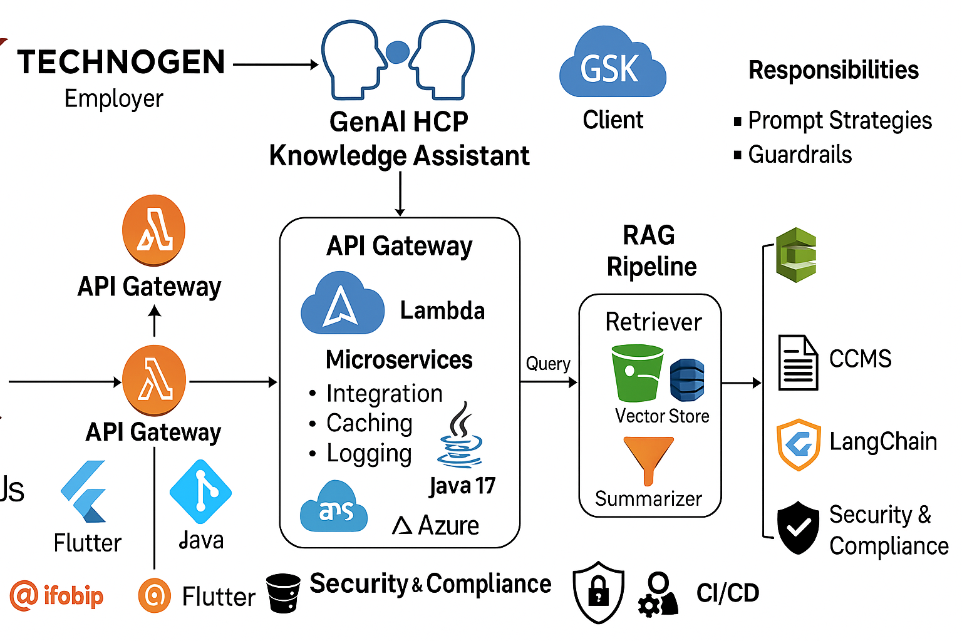

Slide 3
Overview
Project: GenAI‑Powered HCP Knowledge Assistant for GlaxoSmithKline (GSK)
Objective: Provide medical teams secure, compliant natural‑language access to CCMS‑approved content using Retrieval‑Augmented Generation (RAG)
Tech stack: Java 17 microservices, NextJS (web), Flutter (mobile), AWS (Lambda, API Gateway, S3, DynamoDB, ECR, CodePipeline/CodeBuild/CodeDeploy), Azure, OpenAI/Bedrock, LangChain, Infobip

Slide 4
Logical Components
User Interfaces: NextJS web chat + Flutter mobile chat integrated into HCP Messenger & CCMS
API Layer: API Gateway fronting Lambda / Java microservices for orchestration
RAG Pipeline: Preprocessor → Vector Store → Retriever → Reader/Summarizer (LLM)
Data Stores: S3 (documents), DynamoDB (session/metadata), Vector DB for embeddings
CI/CD: CodePipeline → CodeBuild → push to ECR → CodeDeploy to target

Slide 5
RAG Pipeline (Details)
Ingest: CCMS content export → S3 (source of truth) with metadata mapping
Preprocess: chunking, metadata tagging, embedding generation (Bedrock/OpenAI)
Vector Store: store embeddings + metadata (e.g., OpenSearch/FAISS/managed DB)
Retriever: similarity search (top‑K) → candidate passages with doc IDs
Reader/Summarizer: LLM with prompt templates + grounding logic produces answer with citations
Safety: filter outputs, redaction, and confidence scoring before return

Slide 6
API Gateway & Microservices
API Gateway manages auth, throttling, request validation, monitoring
Microservices (Java 17): integration adapters for CCMS, caching, prompt orchestration, audit logging
State & sessions: DynamoDB for ephemeral session state and rate limits
Secrets & config: AWS Secrets Manager / Parameter Store for keys and endpoints

Slide 7
Security & Compliance
Only CCMS‑approved content is indexed; strict content ingestion controls
Prompt guardrails: denial lists, policy checks, allowed response formats
Audit trail: log queries, selected sources, and final responses for compliance reviews
Network & IAM: VPC endpoints, least‑privilege IAM roles, private data flows where required
PII handling: detect/redact and route any PII incidents to secure review workflow

Slide 8
CI/CD & Deployment
Source → CodePipeline orchestrates build/test/deploy for services
CodeBuild creates artifacts and Docker images, pushes to ECR
CodeDeploy executes blue/green or rolling deployments to ECS/Lambda
Automated tests: unit, integration, contract tests against CCMS sandbox
Image immutability (tags = commit sha) and automated rollback on health checks

Slide 9
Observability & Monitoring
Structured logs to CloudWatch / centralized logging (ELK) with request IDs
Distributed tracing using OpenTelemetry / X‑Ray across retrieval & LLM calls
Metrics & alerts: latency, error rates, token spend, retrieval accuracy
Dashboards for SREs and Product; playbooks for incident response

Slide 10
Scalability & Resilience
Autoscale Lambdas and ECS based on load; DynamoDB on‑demand or auto‑scaling
Vector DB: shard/replicate to meet low‑latency SLAs; precompute popular embeddings
Fallback behavior: cache results when LLM unavailable, show degraded UI messaging
Multi‑AZ deployment and optional multi‑region for critical availability

Slide 11
Design Decisions & Tradeoffs
RAG chosen for grounding answers and providing traceable citations (critical for HCP use)
Managed LLMs reduce ops burden but increase token cost; balance with caching & summarization
Vector DB decision driven by latency, cost, and compliance needs
Multi‑stage retrieval (fast vector search + reranker + reader) balances speed & accuracy

Slide 12
Architect Role & Responsibilities
Designed end‑to‑end RAG architecture using AWS (Lambda, DynamoDB, API Gateway, S3, Bedrock/OpenAI)
Built Java 17 microservices integrating CCMS with GenAI pipelines for retrieval & summarization
Developed chat UI strategy with NextJS and Flutter; integrated into HCP Messenger
Implemented prompt strategies, guardrails, and compliance rules tied to CCMS
Led architecture governance, cross‑team reviews, and best‑practice documentation

Slide 13
Next Steps & Appendix
Appendix items: sample prompt templates, embedding configs, vector metadata schema
Action items: cost optimisation, guardrail review cadence, production runbooks
Optional: sequence diagrams and deployment topology slides on request

