Slide 1
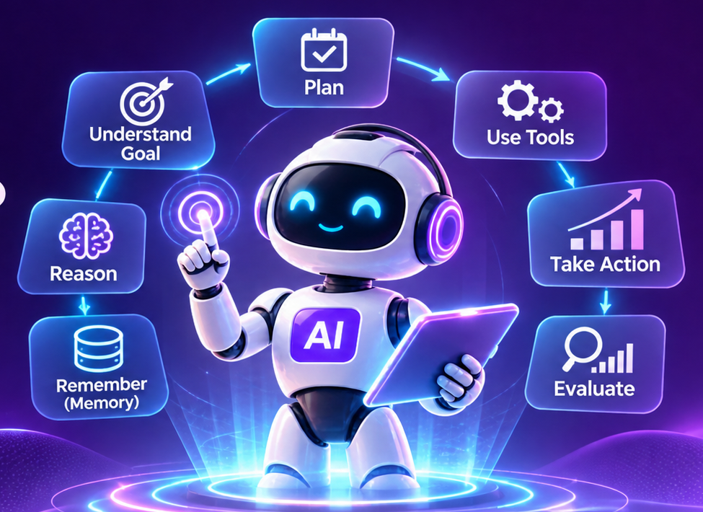
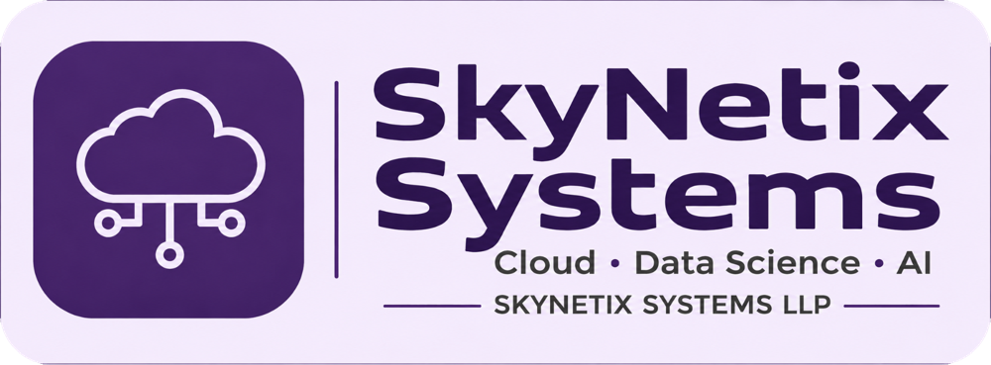
SKYNETIX SYSTEMS | CONCEPT SESSION
WHAT IS
AGENTIC AI?
From AI that responds
to AI that can take action.
BEGINNER FRIENDLY
CONCEPTS ONLY
Understand the idea • See the workflow • Explore the possibilities

Slide 2
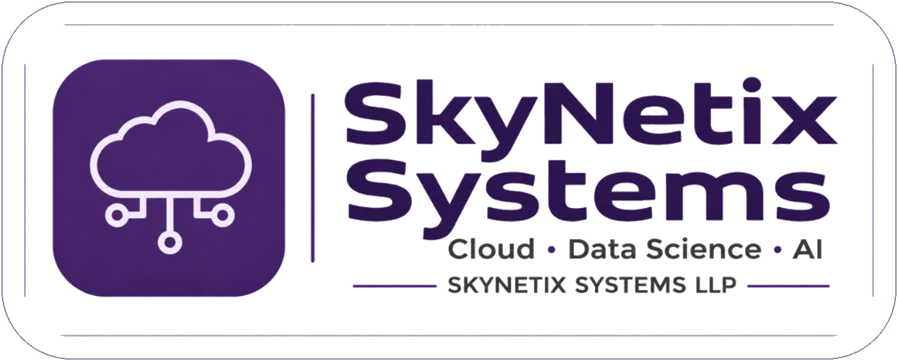
01 THE MEANING
What is Agentic AI?
A simple definition to remember.
AGENTIC AI
An AI system that can work towards a goal by understanding instructions, planning steps, using tools, taking actions and evaluating results.
The key idea: it does more than generate an answer — it can help carry out a task.
SKYNETIX SYSTEMS • WHAT IS AGENTIC AI?
02

Slide 3
02 THE BIG SHIFT
From answering questions to pursuing goals
Agentic AI changes the role AI can play in a workflow.
A chatbot responds
An agent works
A person stays in control
You ask: “How can I research potential clients?”
It explains the steps.
You ask it to research potential clients.
It can search, collect and organise information.
You review important findings and approve consequential actions.
Agentic does not mean unlimited autonomy. The system still needs boundaries and oversight.
SKYNETIX SYSTEMS • WHAT IS AGENTIC AI?
03

Slide 4
03 THREE WAYS TO THINK ABOUT AI
Traditional software vs Generative AI vs Agentic AI
These categories can overlap, but they describe different capabilities.
TRADITIONAL SOFTWARE
GENERATIVE AI
AGENTIC AI
Follows programmed rules.
Example: a calculator applies a fixed formula.
Creates content in response to a prompt.
Example: ChatGPT drafts an email.
Works towards a goal through planning and actions.
Example: researches prospects and prepares a report.
SKYNETIX SYSTEMS • WHAT IS AGENTIC AI?
04

Slide 5
04 A PRACTICAL EXAMPLE
Imagine using an AI agent for business research
Goal: identify potential Java subcontracting opportunities for SkyNetix.
01
Understand the goal
02
Break it into research tasks
03
Search for relevant companies
04
Collect and compare information
05
Prepare a business report
06
Request approval before outreach
A useful agent can move a multi-step workflow forward.
SKYNETIX SYSTEMS • WHAT IS AGENTIC AI?
05

Slide 6
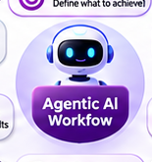
05 THE AGENT LOOP
How does Agentic AI work?
A goal-driven system repeats a simple cycle until it reaches a stopping point.
GOAL
PLAN
ACT
OBSERVE
ADAPT
Know the outcome
Choose the next steps
Use a tool or perform a task
Check what happened
Adjust the next step
The cycle may repeat — with limits, checks and a clear finish condition.
SKYNETIX SYSTEMS • WHAT IS AGENTIC AI?
06

Slide 7
06 INSIDE AN AGENT
The building blocks of Agentic AI
A practical mental model — not every agent uses every component in exactly the same way.
GOAL
LLM / BRAIN
INSTRUCTIONS
What outcome is needed?
Interprets, reasons and helps plan.
Defines role, rules and boundaries.
TOOLS
MEMORY & CONTEXT
FEEDBACK
Connects to search, APIs, files and systems.
Makes relevant information available.
Checks results and decides what next.
SKYNETIX SYSTEMS • WHAT IS AGENTIC AI?
07

Slide 8
07 TOOLS MAKE ACTION POSSIBLE
Tools connect an agent to the outside world
A model can reason about a task; tools let the system interact with other capabilities.
WEB SEARCH
DATABASE
EMAIL
Find information
Read or update approved records
Draft or send with permission
CALENDAR
FILES
APIs
Check or create events
Read and prepare documents
Interact with business systems
Tool access should be permission-based and limited to what the task requires.
SKYNETIX SYSTEMS • WHAT IS AGENTIC AI?
08

Slide 9
08 PLANNING AND MEMORY
How does an agent handle a complex task?
It breaks the goal into smaller steps and keeps track of relevant information.
PLANNING
MEMORY & CONTEXT
Big goal: prepare a market brief.
1. Define the question
2. Gather sources
3. Compare findings
4. Draft the brief
Keeps relevant details available as work progresses.
Examples: the user's objective, previous findings, task status and decisions.
Memory is useful when designed carefully — it is not a guarantee that an agent remembers everything.
SKYNETIX SYSTEMS • WHAT IS AGENTIC AI?
09

Slide 10
09 ONE AGENT OR MANY?
Single-agent and multi-agent systems
Some tasks need one capable agent. Others benefit from specialised roles.
SINGLE AGENT
MULTI-AGENT SYSTEM
One agent uses its instructions and tools to complete a workflow.
Example: research a topic and create a summary.
Several specialised agents collaborate under coordination.
Example: a researcher gathers evidence, an analyst compares it and a writer prepares a report.
SKYNETIX SYSTEMS • WHAT IS AGENTIC AI?
10

Slide 11
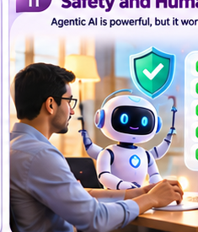
10 RESPONSIBLE AUTONOMY
Why do agents need human oversight?
An agent that can take actions must operate within clear boundaries.
PERMISSIONS
APPROVALS
LIMITS
Only access what it needs.
Confirm high-impact actions.
Set budgets, timeouts and step caps.
VALIDATION
AUDIT TRAIL
STOP RULES
Check outputs before relying on them.
Record actions and results.
Pause or escalate when uncertain.
More autonomy requires stronger controls — not less human responsibility.
SKYNETIX SYSTEMS • WHAT IS AGENTIC AI?
11

Slide 12
SKYNETIX SYSTEMS • THE BIG PICTURE
So, what is Agentic AI?
✓
Understands a goal.
✓
Plans a sequence of steps.
✓
Uses tools to take actions.
✓
Observes results and adapts.
✓
Works within permissions and human oversight.
LLM + Tools + Planning + Feedback + Controlled Actions
SKYNETIX SYSTEMS LLP

