Slide 1
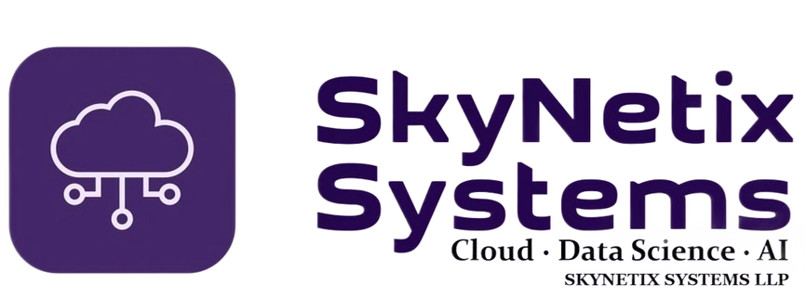
SKYNETIX SYSTEMS LLP
AGENTIC AI
ENGINEERING
Practical training in AI agents, RAG, MCP & multi-agent systems
Build real-world AI applications—from research assistants to business automation.
AI AGENTS
RAG
MCP
MULTI-AGENT SYSTEMS

Slide 2
Learning outcomes
By the end of this training, learners will be able to:
• Build agents that use tools, state and bounded action loops
• Create RAG applications grounded in trusted documents
• Expose business functions through MCP servers
• Orchestrate specialist agents for research and business workflows
• Evaluate, secure and deploy AI applications
Portfolio deliverables
A working agent, a cited RAG assistant, an MCP integration, a multi-agent workflow and a capstone demo.
SKYNETIX SYSTEMS LLP | CLOUD • DATA SCIENCE • AI
02

Slide 3
Module 1 — Agentic AI foundations
Understand the agent loop before selecting a framework.
• Chatbots vs agents: goals, tools, state and iterative actions
• Agent loop: observe → reason → call tool → evaluate
• Structured outputs, memory and context engineering
• Tool permissions, guardrails, approvals and stopping conditions
• Model choice: hosted APIs versus local models
Lab: First agent
Build a support assistant that answers FAQs and calls a mock order-status tool.
SKYNETIX SYSTEMS LLP | CLOUD • DATA SCIENCE • AI
03

Slide 4
Reference architecture
A reusable mental model for projects across the course.
• User interface and application API
• Agent runtime: state, orchestration and policies
• Tools and MCP servers for external capabilities
• RAG pipeline for knowledge retrieval
• Cross-cutting: identity, evaluation, observability, privacy and cost
Design principle
Keep model decisions separate from permissions enforced by your application.
SKYNETIX SYSTEMS LLP | CLOUD • DATA SCIENCE • AI
04

Slide 5
Module 2 — RAG & Agentic RAG
Ground answers in evidence and let agents decide when retrieval is needed.
• Document parsing, chunking and metadata
• Embeddings, vector search and hybrid retrieval
• Context assembly, source references and citations
• Evaluate retrieval relevance and answer groundedness
• Agentic RAG: query rewrite, routing, retries and tool-based retrieval
Project: Knowledge assistant
Answer questions over company policies and technical documents with source references.
SKYNETIX SYSTEMS LLP | CLOUD • DATA SCIENCE • AI
05

Slide 6
Module 3 — Model Context Protocol (MCP)
Connect agents to reusable tools and context through a standard interface.
• MCP host, client and server roles
• Tools, resources and prompts
• Build an MCP server around business functions
• Connect agents to one or more MCP servers
• Least privilege, input validation, secrets and audit logs
Project: Business MCP server
Expose customer lookup, ticket creation and order status as controlled tools.
SKYNETIX SYSTEMS LLP | CLOUD • DATA SCIENCE • AI
06

Slide 7
Module 4 — Frameworks & orchestration
Teach core patterns first, then compare frameworks.
• OpenAI Agents SDK: tools, handoffs and guardrails
• LangGraph: stateful graphs, branches, retries and human approval
• CrewAI / AutoGen: role-based collaboration
• Patterns: router, planner–executor, supervisor and parallel agents
• Manage state, errors, timeouts and cost budgets
Instructor tip
Use the simplest framework that fits the use case; frameworks are not the architecture.
SKYNETIX SYSTEMS LLP | CLOUD • DATA SCIENCE • AI
07

Slide 8
Project 1 — Career & knowledge digital twin
A personal assistant that retrieves trusted information and performs bounded actions.
• Ingest a resume, portfolio and approved documents
• Use RAG to answer questions with evidence
• Add tools for job search or drafting tailored responses
• Require approval before sending or submitting anything
• Evaluate answer quality, privacy and unsafe action attempts
Deliverable
A demonstrable assistant with retrieval, tool use, audit trail and a human approval step.
SKYNETIX SYSTEMS LLP | CLOUD • DATA SCIENCE • AI
08

Slide 9
Project 2 — Sales development assistant
Automate research and drafting while keeping a human in control.
• Enrich a lead from approved sources
• Summarize fit using a qualification rubric
• Retrieve approved product and case-study information
• Draft personalized outreach with grounded claims
• Add CRM mock tools and approval before sending
Success criteria
Useful personalization, no unsupported claims, no duplicate outreach and complete logs.
SKYNETIX SYSTEMS LLP | CLOUD • DATA SCIENCE • AI
09

Slide 10
Project 3 — Multi-agent deep research
Coordinate specialist agents without assuming more agents are always better.
• Planner creates research questions and work packages
• Research agents gather evidence from approved sources
• Critic checks unsupported claims and gaps
• Writer produces a structured report with citations
• Human reviewer approves the final report
Evaluation rubric
Source quality • coverage • citation accuracy • consistency • latency • cost
SKYNETIX SYSTEMS LLP | CLOUD • DATA SCIENCE • AI
10

Slide 11
Project 4 — AI engineering team
Demonstrate controlled delegation, not unrestricted production access.
• Break a software task into testable work items
• Delegate implementation, test writing and code review
• Run tests in a sandbox and summarize failures
• Use browser automation on a demo site
• Require confirmation for destructive or external actions
Safety boundaries
Sandbox execution, least-privilege credentials, allow-listed domains and human approval.
SKYNETIX SYSTEMS LLP | CLOUD • DATA SCIENCE • AI
11

Slide 12
Project 5 — MCP business operations capstone
Combine multiple agents, MCP tools and a trusted knowledge base.
• Create MCP servers for CRM, knowledge search and task management
• Connect each specialist agent only to required tools
• Use RAG for policies and product facts
• Orchestrate a workflow with checkpoints and audit events
• Test permissions, tool failures and recovery paths
Example scenario
Lead arrives → research company → retrieve offerings → draft proposal → create CRM task → request approval.
SKYNETIX SYSTEMS LLP | CLOUD • DATA SCIENCE • AI
12

Slide 13
Module 5 — Evaluation, security & deployment
A useful demo is not automatically production-ready.
• Create evaluation datasets and regression tests
• Trace prompts, tool calls, retrieval and final outputs
• Defend against prompt injection and data leakage
• Manage secrets, permissions, rate limits and spend
• Add retries, timeouts, fallbacks, monitoring and escalation
Production checklist
Security • observability • reliability • privacy • cost • rollback
SKYNETIX SYSTEMS LLP | CLOUD • DATA SCIENCE • AI
13

Slide 14
Suggested four-week delivery plan
Adapt the pace to student experience and available lab time.
• Week 1: foundations, tool calling, first agent and structured outputs
• Week 2: RAG, vector retrieval and MCP server/client
• Week 3: orchestration, multi-agent research and sales projects
• Week 4: evaluation, security, deployment and capstone demo
• Assess with code review, architecture discussion and a live demo
Assessment
Weekly labs + project demo + architecture review + final capstone.
SKYNETIX SYSTEMS LLP | CLOUD • DATA SCIENCE • AI
14

Slide 15
Student portfolio outcomes
Finish with demonstrable artifacts, not only notes.
• Working agent with tool calling and safe action boundaries
• RAG assistant with citations and an evaluation set
• MCP server and client integration
• Multi-agent workflow with traceable handoffs
• Capstone repository, README, architecture diagram and demo
Suggested grading
Correctness 30% • evaluation 20% • security 20% • architecture 15% • demo/documentation 15%
SKYNETIX SYSTEMS LLP | CLOUD • DATA SCIENCE • AI
15

