Slide 1
GIT
A Practical Tutorial
From first commit to collaboration, branching, and recovery
Beginner-friendly • Command-line focused • Developer workflow
Includes command examples, safe workflows, and practice exercises
GIT TUTORIAL • 01

Slide 2
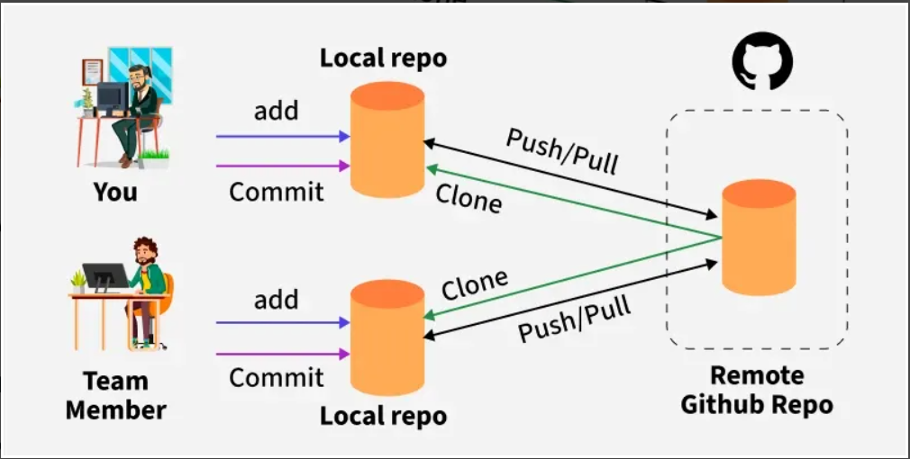
Learning roadmap
START HERE
• Understand Git, repositories, commits, and the working tree
• Install and configure Git; create a repository and track files
• Inspect changes, stage work, commit, and use history
• Branch, merge, resolve conflicts, and work with remotes
• Undo mistakes safely, follow team practices, and complete a mini-lab
GIT TUTORIAL • 02

Slide 3
What is Git?
FOUNDATIONS
• Git is a distributed version control system (DVCS).
• It records project history as snapshots called commits.
• Each developer can have a full local copy of the repository history.
• Git helps compare changes, experiment safely, and collaborate.
git --version
GIT TUTORIAL • 03

Slide 4
Git vs. GitHub / GitLab / Bitbucket
FOUNDATIONS
• Git is the version-control tool that runs locally.
• GitHub, GitLab, and Bitbucket host repositories and add collaboration features.
• Remote hosting supports pull requests, reviews, issue tracking, and automation.
• You can use Git without a hosting service.
GIT TUTORIAL • 04

Slide 5
Core Git concepts
FOUNDATIONS
• Working directory: files you are editing.
• Staging area (index): changes selected for the next commit.
• Repository: committed history stored in .git.
• Commit: a named snapshot with an ID, author, message, and parent history.
Working tree → Staging area → Commit
GIT TUTORIAL • 05

Slide 6
Install and verify Git
SETUP
• Install Git using the official installer for your operating system.
• On Windows, Git Bash provides a familiar shell; PowerShell also works.
• Verify installation before creating your first repository.
git --version
git --help
Official download: https://git-scm.com/downloads
GIT TUTORIAL • 06

Slide 7
Set your identity
SETUP
• Set a name and email used in commit metadata.
• Use --global for defaults across repositories; omit it for a project-specific setting.
• These values label commits; they are not your hosting-service login.
git config --global user.name "Your Name"
git config --global user.email "you@example.com"
git config --list
GIT TUTORIAL • 07

Slide 8
Create your first repository
CREATE A REPOSITORY
• Create a project folder and initialize Git inside it.
• The .git directory stores repository metadata and history.
• Use git status often; it explains what Git sees.
mkdir hello-git
cd hello-git
git init
git status
GIT TUTORIAL • 08

Slide 9
Track a file and make a commit
THE FIRST COMMIT
• Create a file such as README.md.
• Stage the file to choose what enters the next commit.
• Commit with a concise message describing the change.
git status
git add README.md
git commit -m "Add project README"
GIT TUTORIAL • 09

Slide 10
The everyday status cycle
DAILY WORKFLOW
• Edit files in the working directory.
• Inspect what changed before staging.
• Stage only the changes you intend to commit.
• Commit a coherent unit of work, then verify the repository is clean.
git status
git diff
git add <file>
git commit -m "Explain the change"
GIT TUTORIAL • 10

Slide 11
Inspect changes before committing
REVIEW CHANGES
• git diff shows unstaged changes.
• git diff --staged shows changes already staged for the next commit.
• git status summarizes staged, unstaged, and untracked files.
• Review diffs for secrets, debug output, unrelated edits, and accidental deletions.
git diff
git diff --staged
git status
GIT TUTORIAL • 11

Slide 12
Understand the commit history
HISTORY
• Use concise history for a quick overview.
• Show patches when you need to inspect what a commit changed.
• Commit IDs identify exact snapshots; branches and tags are human-friendly references.
git log --oneline --graph --decorate --all
git show <commit-id>
GIT TUTORIAL • 12

Slide 13
Ignore generated and local files
REPOSITORY HYGIENE
• A .gitignore file lists intentionally untracked files or patterns.
• Typical examples: build output, logs, local environment files, and IDE caches.
• .gitignore does not remove files that are already tracked.
• Never commit passwords, tokens, private keys, or production secrets.
echo "build/" >> .gitignore
echo ".env" >> .gitignore
git status
GIT TUTORIAL • 13

Slide 14
Branches: work without disrupting main
BRANCHING
• A branch is a movable name pointing to a commit.
• Use a short-lived branch for a feature, bug fix, or experiment.
• Keep branches focused and sync with the team’s agreed workflow.
git switch -c feature/login
git branch
git switch main
GIT TUTORIAL • 14

Slide 15
Merge a branch
BRANCHING
• Switch to the target branch before merging.
• Merge brings the source branch’s changes into the current branch.
• A fast-forward merge moves the branch pointer; other merges may create a merge commit.
• Run tests and inspect the result after merging.
git switch main
git merge feature/login
GIT TUTORIAL • 15

Slide 16
Resolve merge conflicts
CONFLICT RESOLUTION
• A conflict occurs when Git cannot combine overlapping edits automatically.
• Open each conflicted file and review the conflict markers.
• Choose the correct combined result; remove markers and test the file.
• Stage the resolved file and finish the merge.
git status
git add <resolved-file>
git commit
GIT TUTORIAL • 16

Slide 17
Remote repositories
COLLABORATION
• A remote is a named reference to another repository, often hosted online.
• origin is the common default name for the primary remote.
• Clone copies a remote repository; fetch downloads new history without integrating it.
• Pull fetches and integrates changes; push sends local commits to a remote.
git remote -v
git clone <repository-url>
git fetch origin
GIT TUTORIAL • 17

Slide 18
Push and pull safely
COLLABORATION
• Pull before pushing when the remote may have new commits.
• Resolve integration conflicts and run tests before pushing.
• Push your branch and open a pull/merge request for review when your team uses that workflow.
• Avoid force-pushing shared branches unless your team explicitly agrees.
git pull --rebase origin main
git push -u origin feature/login
Use the integration method required by your team; merge-based pull is also common.
GIT TUTORIAL • 18

Slide 19
A typical team workflow
COLLABORATION
• 1. Update main and create a focused feature branch.
• 2. Make small commits and test locally.
• 3. Push the branch and open a pull request.
• 4. Address review feedback, then merge using team policy.
• 5. Delete the merged branch when it is no longer needed.
git switch main
git pull
git switch -c feature/search
GIT TUTORIAL • 19

Slide 20
Undo: choose the right tool
RECOVERY
• Use git restore to discard unstaged file edits when you are sure.
• Use git restore --staged to unstage without deleting working changes.
• Use git revert to create a new commit that reverses an earlier commit.
• Use reset carefully: it moves the current branch pointer and can discard work.
git restore <file>
git restore --staged <file>
git revert <commit-id>
GIT TUTORIAL • 20

Slide 21
Reset: understand the risk
RECOVERY
• --soft: move HEAD; keep changes staged.
• --mixed (default): move HEAD; keep changes unstaged.
• --hard: reset index and working tree; can permanently discard uncommitted work.
• Before destructive commands, check git status and consider making a backup branch.
git reset --soft HEAD~1
git reset --mixed HEAD~1
# Use --hard only when you understand the consequences
GIT TUTORIAL • 21

Slide 22
Stash temporary work
RECOVERY
• Stash can set aside tracked changes while you switch tasks.
• Use list to see saved stashes and apply/pop to restore them.
• Stash is temporary storage, not a replacement for meaningful commits.
git stash push -m "WIP: search form"
git stash list
git stash pop
GIT TUTORIAL • 22

Slide 23
Tags and releases
RELEASE BASICS
• Tags mark important points such as release versions.
• Annotated tags include metadata and a message; they are useful for releases.
• Push tags explicitly if your workflow requires publishing them.
git tag -a v1.0.0 -m "Release 1.0.0"
git push origin v1.0.0
GIT TUTORIAL • 23

Slide 24
Cherry-pick and rebase: use thoughtfully
INTERMEDIATE TOPICS
• Cherry-pick applies a selected commit onto the current branch.
• Rebase replays commits on a new base, creating new commit IDs.
• Rebase can make a linear history, but avoid rewriting commits others depend on.
• Use your team's policy for shared branches and release branches.
git cherry-pick <commit-id>
git rebase main
GIT TUTORIAL • 24

Slide 25
Useful search and inspection commands
COMMAND TOOLBOX
• Find which commit changed a line or file.
• Search tracked files for text patterns.
• Compare branches to understand differences before merging.
git blame <file>
git grep "TODO"
git diff main...feature/login
GIT TUTORIAL • 25

Slide 26
Authentication: HTTPS or SSH
COLLABORATION AND SECURITY
• Hosting providers may support HTTPS tokens or SSH keys.
• Follow the provider’s current instructions to configure credentials.
• Do not put access tokens or private keys into source code or Git history.
• Use least privilege and rotate credentials if they are exposed.
GIT TUTORIAL • 26

Slide 27
Commit message best practices
TEAM PRACTICES
• Start with a clear verb: Add, Fix, Update, Remove, Refactor.
• Explain why the change exists when the purpose is not obvious.
• Keep each commit focused and avoid mixing unrelated changes.
• Do not use vague messages such as 'stuff' or 'changes'.
git commit -m "Fix timeout handling for profile API"
GIT TUTORIAL • 27

Slide 28
Common mistakes and fixes
TROUBLESHOOTING
• Committed the wrong file? Inspect history and choose a safe correction; do not panic.
• Pushed a secret? Revoke/rotate it immediately; deleting it from the latest commit is not enough.
• Push rejected? Fetch/pull the remote changes, integrate them, test, then push.
• Wrong branch? Check git status and branch name before committing or pushing.
GIT TUTORIAL • 28

Slide 29
Practice lab 1: local repository
HANDS-ON LAB
• Create a folder named git-practice and initialize Git.
• Add README.md and write a short project description.
• Stage and commit the file.
• Edit the README, inspect the diff, and create a second commit.
• Use git log to review both commits.
git init
git add README.md
git commit -m "Add README"
GIT TUTORIAL • 29

Slide 30
Practice lab 2: branch and merge
HANDS-ON LAB
• Create a feature branch named feature/about.
• Add an About section and commit it.
• Switch to main and make a separate edit.
• Merge the feature branch and inspect the resulting history.
• Repeat with overlapping edits to practice resolving a conflict.
git switch -c feature/about
git add README.md
git commit -m "Add about section"
git switch main
git merge feature/about
GIT TUTORIAL • 30

Slide 31
Practice lab 3: remote collaboration
HANDS-ON LAB
• Create an empty remote repository on your hosting service.
• Add it as origin, then push your local branch.
• Clone the repository into another folder and make a commit there.
• Fetch/pull those changes in the original clone and inspect the history.
git remote add origin <repository-url>
git push -u origin main
git fetch origin
GIT TUTORIAL • 31

Slide 32
Quick reference: everyday commands
CHEAT SHEET
• Start / inspect: git init, git clone, git status
• Review / record: git diff, git add, git commit, git log
• Branch: git switch -c <name>, git switch <name>, git merge <name>
• Remote: git remote -v, git fetch, git pull, git push
• Recover: git restore, git restore --staged, git revert, git stash
GIT TUTORIAL • 32

Slide 33
Before you push: checklist
CHECKLIST
• Am I on the correct branch?
• Did I review git status and the staged diff?
• Are secrets, local config, and generated files excluded?
• Did I run relevant tests and checks?
• Is the commit message clear, and is the remote target correct?
GIT TUTORIAL • 33

Slide 34
Key takeaways
WRAP-UP
• Git records project history; remote hosting enables collaboration.
• The core cycle is inspect → stage → commit.
• Branches isolate work; merges integrate it; conflicts require human judgment.
• Use restore, revert, reset, and stash for different recovery needs.
• Check status, review diffs, protect secrets, and communicate with your team.
GIT TUTORIAL • 34

Slide 35
Official learning resources
FURTHER LEARNING
• Git documentation: https://git-scm.com/doc
• Pro Git book (free online): https://git-scm.com/book/en/v2
• Git reference: https://git-scm.com/docs
• Practice with a throwaway repository before using destructive recovery commands.
GIT TUTORIAL • 35

