Slide 1
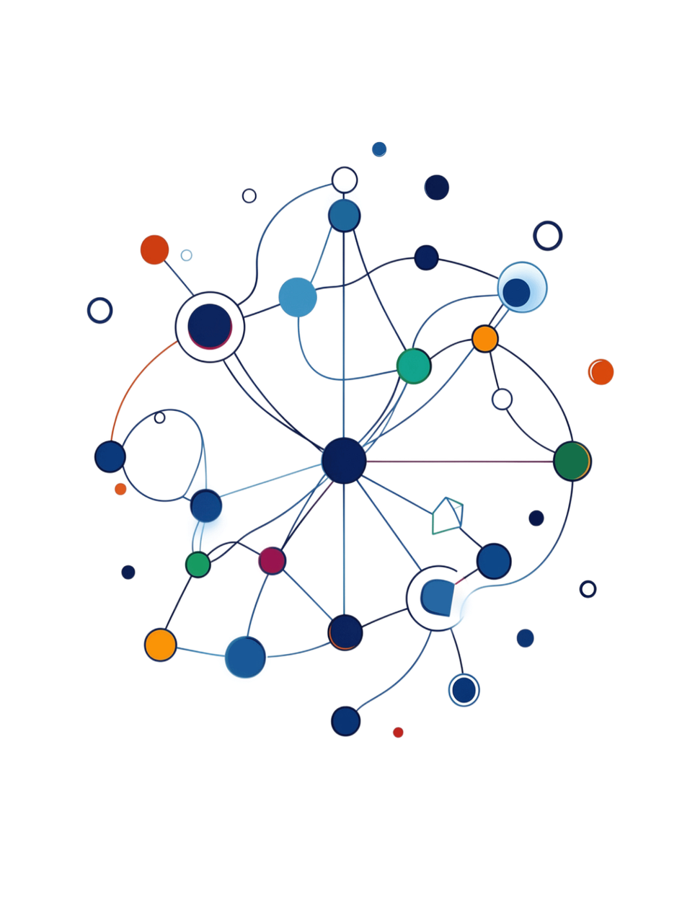



Corporate training center
Nexus AI & ML Mastery
Program
Your fast track to a high-paying data career — guaranteed.

Slide 2

Your Journey Starts Here
12
Weeks
of intensive, hands-on learning
6
Projects
progressive builds leading to a production capstone
20+
Tools
industry-standard technologies and real-world practices
1
Portfolio
portfolio-ready deliverables upon completion
Notes:
2

Slide 3


Who Should Enroll?
Data Analysts & Business Professionals
Upskill and command higher salaries in your field
IT Staff & Aspiring Tech Professionals
Transition into high-demand BI and analytics roles
Beginners to Advanced Users
Curriculum designed to meet you at your current level
No Coding Required
Basic Excel knowledge is helpful — nothing more needed

Slide 4
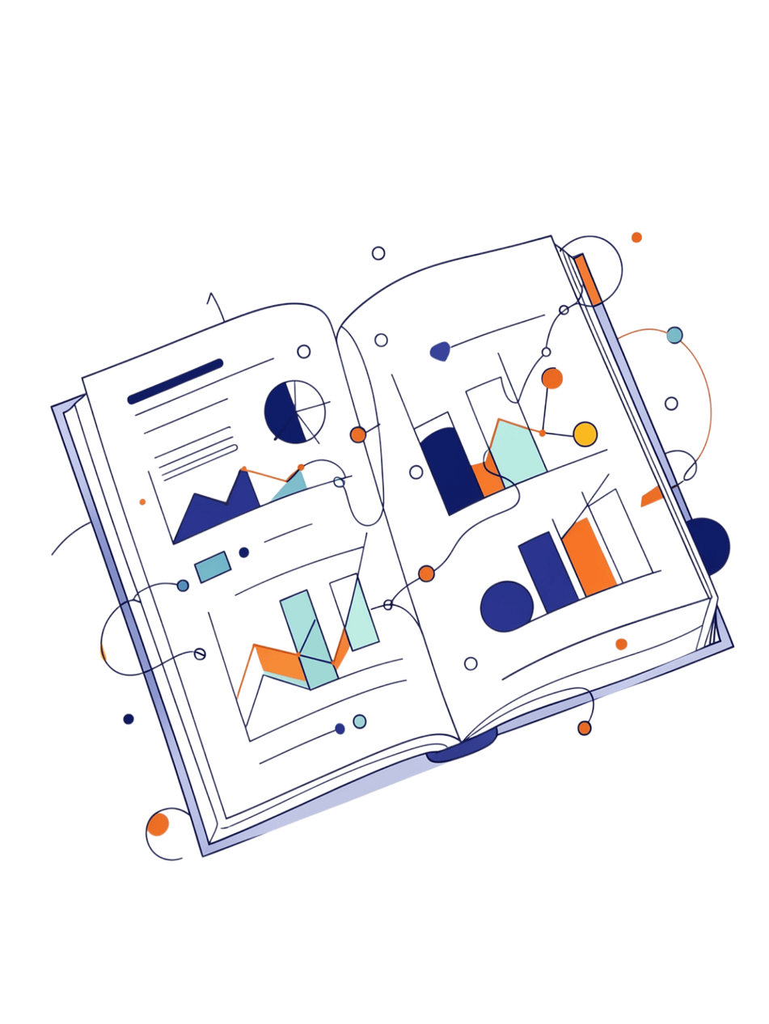

CHAPTER
AIML Curriculum
From Python fundamentals to production-ready AI systems — a complete 12-week transformation.
1
Curriculum Structure
5
Hands-On Project Progression
2
AI & Machine Learning Foundations
6
Industrial Training, Assessment & Technology Stack
3
Advanced ML, Deep Learning & Generative AI
4
MODULE 4: Production AI, MLOps & Industrial Project

Slide 5
MODULE 1: Curriculum Structure
Foundation
Machine Learning
Python, data handling, statistics, mathematics
Supervised/unsupervised learning, evaluation, feature engineering, tuning
Deep Learning
Generative AI
Neural networks, CNNs, sequence models, transformers
LLMs, embeddings, RAG, agents, fine-tuning concepts
Production
Industrial Training
APIs, Docker, cloud, CI/CD, MLOps, monitoring, Git
End-to-end capstone, documentation, testing, presentation
Notes:
3

Slide 6

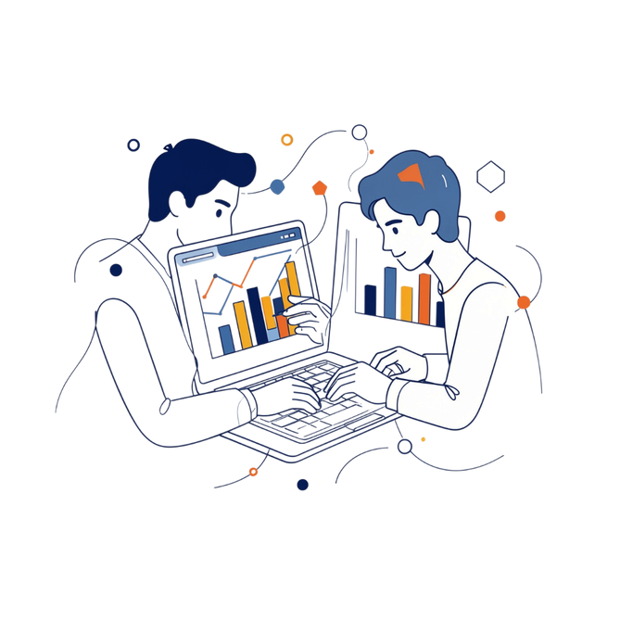

MODULE 2: AI & Machine Learning Foundations
Python for AI/ML
Data Handling
Data Visualization & EDA
Syntax, OOP basics, virtual environments, Jupyter, clean coding practices
NumPy, Pandas, indexing, joins, aggregation, missing values, pipelines
Matplotlib, Seaborn, business-driven EDA
Stat for ML
Supervised & Unsupervised Learning
Model Evaluation & Feature Engineering
Linear algebra, probability, distributions, correlation,statistics, derivatives, gradients, optimization
Classification, Regression, KNN, trees, random forests, boosting, K-Means, PCA
Accuracy, Precision, recall, F1, ROC-AUC, cross-validation, Grid Search, Random search
Notes:
4

Slide 7





MODULE 3: Advanced ML, Deep Learning & Generative AI
Advanced ML & Statistical Thinking
Deep Learning Foundations
Computer Vision & NLP
CNNs, transfer learning, text preprocessing, tokenization, embeddings, transformer architecture, BERT, GPT
XGBoost/LightGBM, imbalanced learning, hypothesis testing, A/B testing, model interpretability
Neurons, backpropagation, optimizers, PyTorch/TensorFlow, training loops, GPU usage
LLMs, RAG & Agents
Fine-Tuning Concepts
Large language models, vector databases, RAG systems, tool calling, multi-step automation, evaluation
Prompt tuning vs fine-tuning, supervised fine-tuning, PEFT,LoRA/QLoRA, dataset preparation and evaluation
Notes:
5

Slide 8
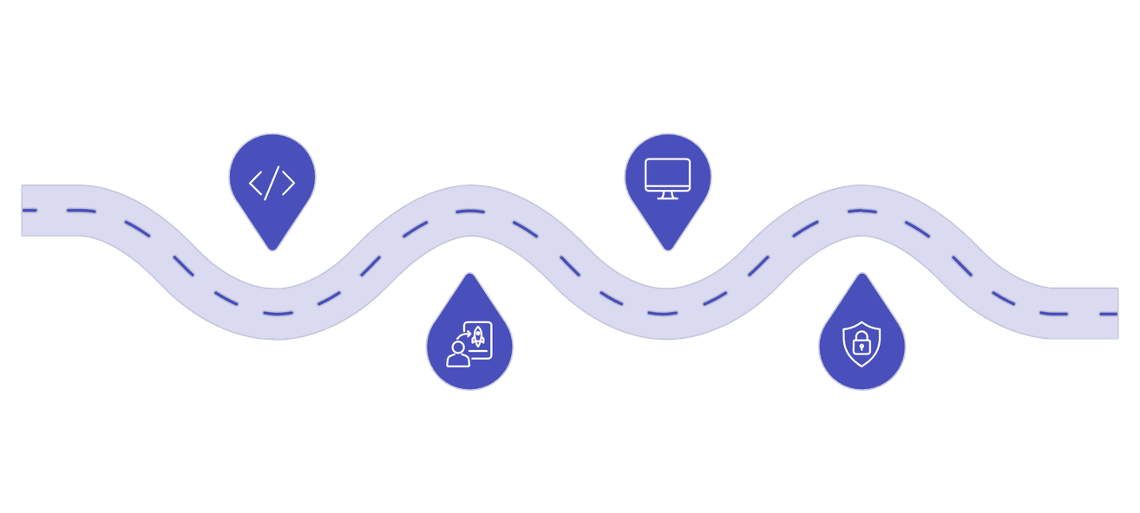
MODULE 4: Production AI, MLOps & Industrial Project
Production ML Architecture
From notebook to service: data ingestion, preprocessing, model layer, API layer, storage, observability
Build
Monitor
FastAPI, Docker, databases
Latency, drift, alerts
MLOps & CI/CD
Experiment tracking, model registry, data/model versioning, automated testing, deployment strategies
GenAI Production Engineering
RAG optimization, prompt/Template management, Retrival Quality, hallucination reduction, latency/cost optimization
Deploy
Secure
Cloud, CI/CD, containers
Secrets, access control, AI safety
Security & System Design
Secrets management, PII handling, Guardrails, bias/fairness, batch vs real-time inference, cost-aware architecture
Notes:
6

Slide 9
MODULE 5: Hands-On Project Progression
Foundation
1
EDA & Data Quality Project — cleaning, visualizations, reusable notebook
2
ML
End-to-End Predictive ML App — feature pipeline, model comparison, API, docs
Advanced ML
3
Production-Ready ML Service — Docker image, tests, logging, monitoring plan
4
Deep Learning
DL Application — training pipeline, experiment tracking, inference service
GenAI
5
RAG Knowledge Assistant — ingestion, vector search, retrieval, generation, evaluation
6
Capstone
Industrial AI/GenAI Solution — full architecture, cloud deployment, CI/CD, monitoring
Notes:
7

Slide 10
MODULE 6: Industrial Training, Assessment & Technology Stack
Industrial Training & Assessment
Recommended Technology Stack
1
Requirement analysis, data lifecycle, model lifecycle, GenAI lifecycle, production readiness review, engineering standards
Core
Data & Viz
Python · SQL · Git
NumPy · Pandas · Matplotlib · Seaborn
2
Conceptual understanding of AI/ML/DL/GenAI; ability to clean/analyze data, select/train/tune models, build LLM applications, expose production APIs, containerize/deploy/monitor applications
ML & DL
Production
Scikit-learn · XGBoost/LightGBM · PyTorch/TensorFlow · Transformers
FastAPI · Docker · MLflow · PostgreSQL · Pytest
3
Professional deliverables: architecture diagram, README, API docs, test report, model/LLM evaluation report, deployment guide, documented end-to-end capstone with reproducible code
Cloud
AWS / Azure / GCP
Notes:
8

Slide 11

Start Your Journey
Program Fee
Get In Touch
₹35,000
📞 +91-9545450677 / +91-9545450788
🌐 www.nexusctc.com
EMI options available — 100%
Join 2.5 lakh+ successful Nexus students who have transformed their careers. Your placement-guaranteed Power BI journey starts today.

