Slide 1
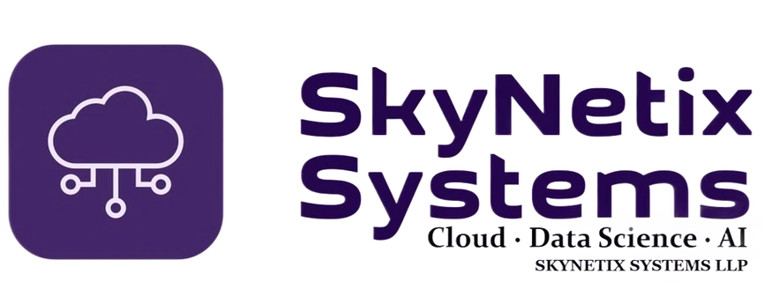
BUILD
MODERN
DIGITAL
TECHNOLOGY SERVICES
& DELIVERY PARTNER
CAPABILITIES
Cloud • Data Science • AI
COMPANY PROFILE | 2027
www.skynetixsystems.com

Slide 2
01 / COMPANY OVERVIEW
Technology that moves business forward
SkyNetix Systems LLP is a technology services partner focused on software engineering, cloud-led transformation, data and AI.
OUR FOCUS
HOW WE ENGAGE
Design, build and evolve reliable software solutions — from backend platforms
and integrations to cloud-native systems and AI-enabled experiences.
Project delivery, dedicated engineering capacity, specialist consulting,
staff augmentation and subcontracting partnerships.
THREE TECHNOLOGY PILLARS
CLOUD
DATA
AI
Architecture • Migration • Operations
Engineering • Analytics • Platforms
GenAI • Automation • Applied ML
SKYNETIX SYSTEMS LLP | COMPANY PROFILE
02

Slide 3
02 / WHY SKYNETIX
A practical partner from idea to implementation
Architecture thinking, hands-on engineering and delivery flexibility — aligned to your business priorities.
Architecture-led
Engineering depth
Sound foundations, clear trade-offs and solutions designed for scale.
Backend, APIs, integrations, data platforms and cloud-native application development.
Flexible capacity
Delivery mindset
Support for a defined project, specialist workstream or ongoing engineering needs.
Focus on maintainability, quality, security awareness and business outcomes.
SKYNETIX SYSTEMS LLP | COMPANY PROFILE
03

Slide 4
03 / SERVICES
End-to-End software and technology services
Capability areas can be combined to match your roadmap, delivery model and technical environment.
Custom software engineering
Cloud & DevOps
Data engineering & analytics
Enterprise applications, backend services, APIs,
integrations and modernisation.
Cloud architecture, AWS / Azure / GCP, CI/CD,
infrastructure as code and containers.
Data pipelines, data platforms, processing, reporting
foundations and analytics.
AI & GenAI solutions
Web & mobile development
Technology consulting
LLM integration, RAG, knowledge assistants and
AI-enabled workflows.
Responsive web applications, frontend integration
and cross-platform mobile solutions.
Architecture reviews, solution design, technical
assessments and delivery planning.
SKYNETIX SYSTEMS LLP | COMPANY PROFILE
04

Slide 5
04 / CLOUD & ARCHITECTURE
Build resilient, scalable digital foundations
Cloud-native engineering focused on secure architecture, operational readiness and sustainable growth.
CORE CAPABILITIES
EXPERIENCE
Web • Mobile • APIs
• Cloud solution architecture across AWS, Microsoft Azure and Google Cloud
• Microservices, API-first design and event-driven systems
• Containerisation, Kubernetes-ready platforms and deployment automation
• Infrastructure as Code, CI/CD, monitoring and observability
• Performance, scalability, availability and cost-aware design
↓
APPLICATIONS
Services • Workflows
↓
DATA & AI
Pipelines • Models • RAG
↓
CLOUD PLATFORM
Compute • Storage • Network
SKYNETIX SYSTEMS LLP | COMPANY PROFILE
05

Slide 6
05 / DATA & AI
Turn data and AI into useful business capability
From data foundations to AI-assisted workflows, we focus on solutions that fit operational needs.
DATA ENGINEERING
GENERATIVE AI
INTELLIGENT AUTOMATION
Data ingestion and transformation
Pipeline design
Data integration
Analytics-ready platforms
LLM and model integration
Retrieval-Augmented Generation
Enterprise knowledge assistants
Prompt and response workflows
Workflow automation
AI-enabled business processes
Document processing
Human-in-the-loop patterns
SOLUTION PATTERNS
Knowledge assistant • Semantic search • AI-powered support • Data quality workflows • Process automation
SKYNETIX SYSTEMS LLP | COMPANY PROFILE
06

Slide 7
06 / TECHNOLOGY ECOSYSTEM
A modern, integration-friendly technology stack
Technology choices are aligned to client standards, delivery constraints and long-term maintainability.
BACKEND
FRONTEND & MOBILE
Java • Spring Boot • Node.js • Python
React • React Native • TypeScript
CLOUD & PLATFORM
DATA & MESSAGING
AWS • Azure • Google Cloud • Docker • Kubernetes
PostgreSQL • MongoDB • DynamoDB • Redis • Kafka
AI & AUTOMATION
ENGINEERING PRACTICES
LLM APIs • RAG • Vector search • Workflow automation
REST APIs • Microservices • CI/CD • IaC • Testing
Technology stack is illustrative, not restrictive. We can align with your approved platforms and toolchain.
SKYNETIX SYSTEMS LLP | COMPANY PROFILE
07

Slide 8
07 / ENGAGEMENT MODELS
Flexible ways to work together
Choose the engagement structure that best supports your project, team and procurement model.
Project-based delivery
Dedicated engineering
Defined scope, milestones, deliverables and acceptance criteria.
Ongoing engineering capacity aligned to your backlog and ways of working.
Staff augmentation
Subcontracting partnership
Specialist engineers integrated into your delivery team and governance.
White-label or partner-led delivery support under mutually agreed terms.
SKYNETIX SYSTEMS LLP | COMPANY PROFILE
08

Slide 9
08 / DELIVERY APPROACH
A clear, collaborative delivery lifecycle
A lightweight structure keeps expectations visible from discovery through dependable delivery.
01
→
02
→
03
→
04
→
05
DISCOVER
DESIGN
BUILD
RELEASE
IMPROVE
Goals, users, constraints and success measures.
Architecture, scope, interfaces and plan.
Iterative development, reviews and testing.
Deployment readiness, documentation and handover.
Monitor, learn and evolve continuously.
TRANSPARENCY • ENGINEERING QUALITY • COLLABORATION • CONTINUOUS IMPROVEMENT
SKYNETIX SYSTEMS LLP | COMPANY PROFILE
09

Slide 10
09 / QUALITY & GOVERNANCE
Built with quality, security and ownership in mind
We align delivery practices with client policies, architecture standards and applicable requirements.
Engineering quality
Security awareness
Code reviews, automated testing, maintainable design and documented decisions.
Secure development practices, access discipline and careful data handling.
Delivery visibility
Operational readiness
Clear work tracking, regular communication, risks and dependency management.
Logging, monitoring, deployment documentation and support handover.
Certifications, service levels and compliance commitments can be discussed and documented for each engagement.
SKYNETIX SYSTEMS LLP | COMPANY PROFILE
10

Slide 11
10 / LET'S COLLABORATE
Let's build what comes next.
Share your business challenge, delivery need or technology roadmap. We'll shape a practical engagement together.
Need delivery capacity?
Modernising a platform?
Exploring AI opportunities?
Add engineering bandwidth to your team.
Plan and execute cloud-native evolution.
Identify focused, valuable use cases.
SKYNETIX SYSTEMS LLP
Cloud • Data Science • AI
www.skynetixsystems.com
THANK YOU

