Slide 1

B.Tech External Project Evaluation, VIIIth Sem
Smart Wearables For Coal Mine Workers
Presented by :
Akash Rai (2019602526)
Anurag Rai( 2019600567)
Under the Supervision of:-
Mr. Amit Kumar Upadhyay
DEPARTMENT OF COMPUTER SCIENCE & ENGINEERING
SHARDA SCHOOL OF ENGINEERING AND TECHNOLOGY
November/December 2022
1

Slide 2
APPROVAL FROM GUIDE FOR EVALUATION

Slide 3



CONTENTS OF THE PRESENTATION
Introduction
Motivation
Problem Statement
Objectives of the Project
Block Diagram
Results
Conclusion
Reference

Slide 4
INTRODUCTION
The mining industry has high risks of accidents and health hazards for workers.
Advanced technologies such as the Internet of Things (IoT) and smart wearables can improve miner safety and health.
This review paper investigates the effectiveness of such technology in enhancing miner safety and health.
Studies have explored the use of smart wearables, IoT, and other advanced technologies in the mining industry.
Coal mining poses significant threats to the lives of miners due to various dangerous conditions.

Slide 5
CONTINUE
Efficient sensors integrated into safety helmets and jackets that continuously update pulse rates and GPS locations can optimize safety equipment for coal miners.
A new costume called "Smart Wearables" outfitted with cutting-edge technologies like IoT and Wireless Body Area Network (WBAN) can monitor employees' health and safety.
Surface mining and underground mining are the two primary methods of coal mining.
Underground mines are more dangerous due to difficulties associated with ventilation and the possibility of cave-ins.
The mining sector prioritizes the protection of workers as accidents cause the deaths of thousands of miners each year, particularly during the procedures of mining hard rock and coal.

Slide 6
MOTIVATION
High risks of accidents and health hazards in the mining industry motivate the development of smart wearables.
Smart wearables can significantly improve the safety and health of miners.
Coal mining poses a significant threat to the lives of miners due to various dangerous conditions.
Efficient sensors integrated into safety helmets and jackets can optimize safety equipment for coal miners.
The use of cutting-edge technologies such as IoT and WBAN in smart wearables is suggested to monitor employees' health and safety in the mining industry.

Slide 7
PROBLEM STATEMENT
Lack of effective safety measures for coal mine workers leading to high risks of accidents and health hazards.
Inadequate monitoring of miners' health and safety in underground mines due to difficulties associated with ventilation and the possibility of cave-ins.
Inefficient communication and tracking systems for coal miners working in cramped mine shafts, extreme hot temperatures, and the presence of harmful gases.
The need for continuous updates of pulse rates and GPS locations to enhance the safety and health of miners in coal mining, miners body’s conductivity.
Limited availability of affordable and durable smart wearables for coal mine workers.

Slide 8
OBJECTIVE
Real-time monitoring of air quality and dangerous events in underground mines to prevent accidents.
Automatic alert system to supervisors in case of any emergency, such as a miner falling to the ground and losing consciousness or anything fall on miners head.
Implementation of a limit switch to ensure all miners wear necessary safety equipment, such as helmets and jackets, which will increase their safety and reduce accidents.
Integration of efficient sensors into safety helmets and jackets to optimize safety equipment and enhance the health and safety of coal mine workers.
To keep track of the conductivity in miners body with the help of galvanic skin responder or accelerometer.

Slide 9
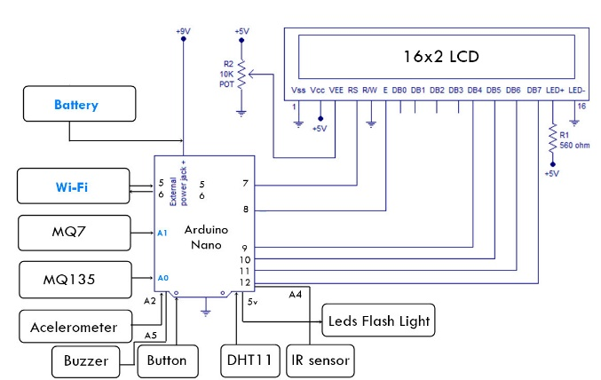
BLOCK DIAGRAM
HARDWARE COMPONENT USED
ARDUINO NANO
LCD 16X2
LED
WI-FI MODULE ESP 8266
DHT11
MQ-135,MQ-7
IR Sensor
Acelerometer (Galvanic Skin Responder)
Buzzer
Block Diagram of the Model

Slide 10
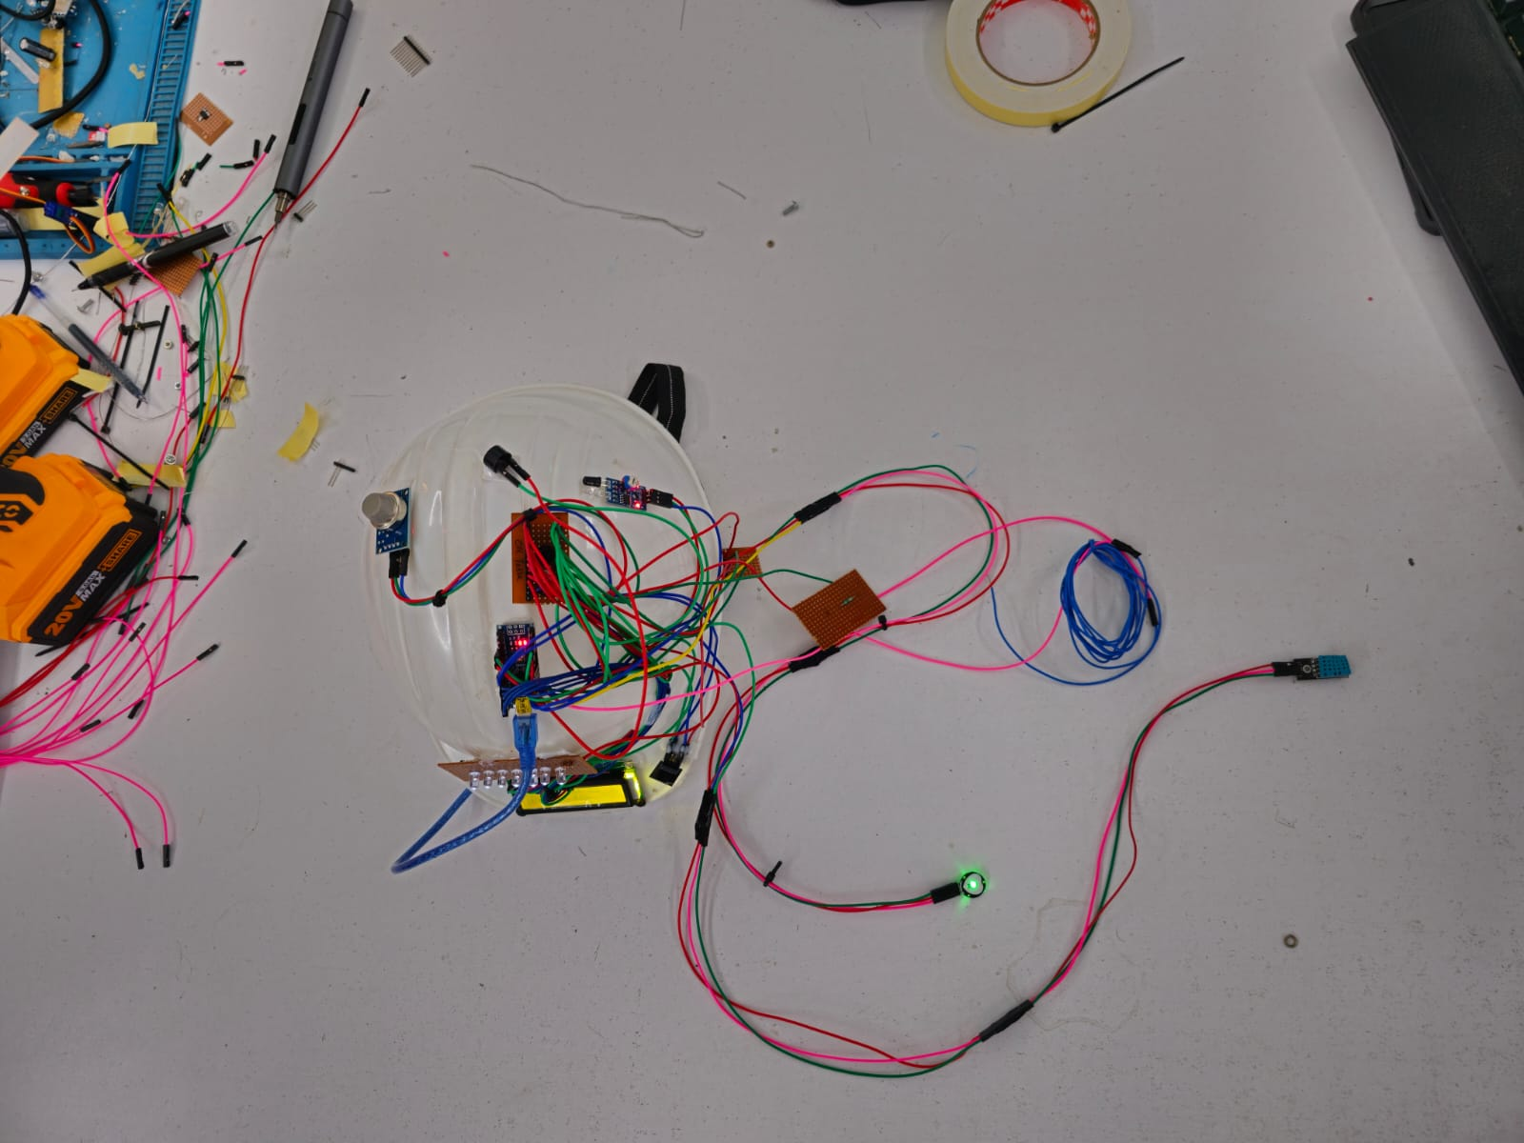
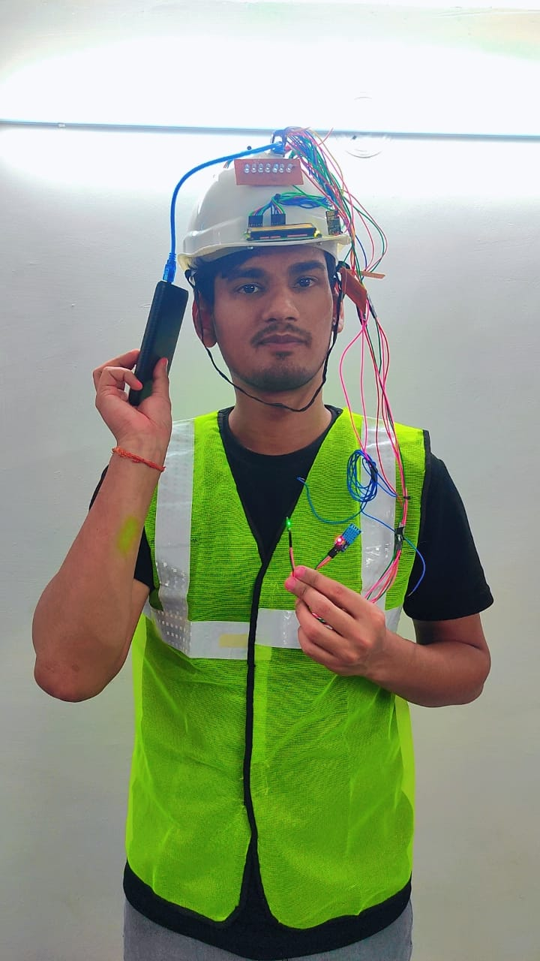
Project Images

Slide 11
Implementation
Approach to include sensors in an intelligent wearable helmet/jacket design to protect coal miners' lives.
The block diagram includes an electronic circuit with a switched-mode power supply (SMPS), capacitors, and inductors that transmit power while the switching apparatus is in its non-conduction condition. Switching power supplies are highly efficient and widely used in electronic appliances.
The MQ-135 gas sensor operates at 5 volts DC and consumes approximately 800 milliwatts of power. It can identify LPG, alcohol, propane smoke, hydrogen, methane, and carbon monoxide ranging from 200 to 10,000 parts per million (ppm).

Slide 12
Continue
When particles of semiconductors like tin dioxide are heated at a high temperature, oxygen is drawn in from the surroundings, and donor electrons in tin dioxide are activated, causing oxygen to be drawn on the surface of the sensing compounds.
The sensor data goes to Arduino and then to Thingspeak server, and the technology can identify four types of potentially hazardous occurrences: air quality, removal of a jacket/helmet, temperature, and humidity.
An infrared (IR) sensor is used to assess whether the miner's helmet is on their head.

Slide 13
Continue
The second level of concentrations of hazardous gases, including carbon monoxide (CO), sulphur dioxide (SO2), nitrogen dioxide (NO2), alcohol, and particulate matter.
The vibration sensor is the fourth instance of something that might be potentially hazardous (IR is used for this).
The real-time monitoring and data alert system is designed to identify dangerous occurrences such as the presence of poisonous gases, the removal of the miner's helmet, and the fall of a heavy object on the miner's head, and to convey relevant information to the appropriate authorities.

Slide 14
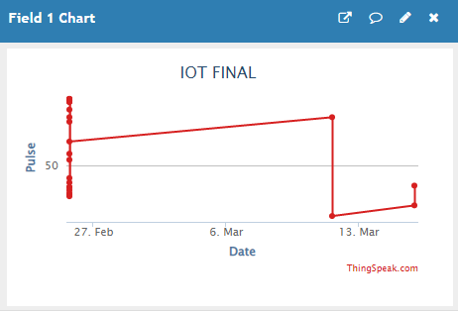
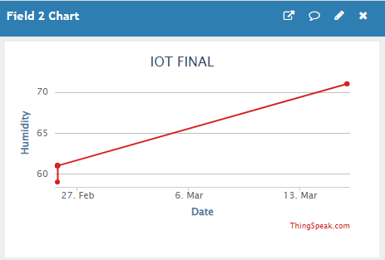
Results
Below Graph Shows change of Pulse Rate Over Time
Below Graph Shows change of Humidity Over Time

Slide 15
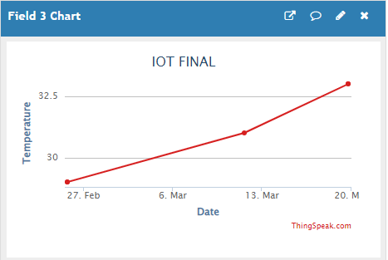
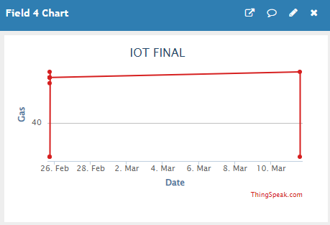
Results
Below Graph Shows change of Temperature Over Time
Below Graph Shows change of Air Quality Over Time

Slide 16
Results
Series of images and graphs shown in above slides that showcase a prototype designed for monitoring various environmental factors such as pulse rate, humidity, temperature, and gas output. These figures illustrate the results of the prototype's performance in detecting variations in these factors, with graphs provided for each type of measurement.

Slide 17
CONCLUSION
The development of a smart helmet/jacket could be a significant contribution to the safety of employees in industries, especially in coal mines where there are many factors that can impact human health. The use of IoT-based safety systems, advanced PPEs, and wearable smart kit designs can provide real-time data on environmental factors and potential hazards to enable real-time monitoring of worker health and safety. These proposals can be implemented to improve safety measures in the mining sector and ensure the safety and security of coal mine workers. By using advanced technology such as smart wearables, companies in the mining sector can prioritize the protection of workers and significantly reduce the number of accidents and health hazards that occur each year. Overall, the implementation of these proposals can be a valuable step towards improving the safety and well-being of miners and making their work environment safer.

Slide 18
REFERENCES
Mustafa Abro, Engr. Ghulam & Abid, Ghulam & Shaikh, Shoaib & Kumar, Kundan & Soomro, Safeeullah & Ahmed, Fiaz. (2019). Prototyping IOT Based Smart Wearable Jacket Design for Securing the Life of Coal Miners. 10.1109/iCCECOME.2018.8658851.
Kumar, K. & Ch, Sudha & Abdul, Naqi & Pendem, Sireesha. (2020). Smart jacket for health monitoring using LabVIEW. Materials Today: Proceedings. 10.1016/j.matpr.2020.11.028.
De fazio, Roberto & Al-Hinnawi, Abdel-Razzak & Vittorio, Massimo & Visconti, Paolo. (2022). An Energy-Autonomous Smart Shirt Employing Wearable Sensors for Users’ Safety and Protection in Hazardous Workplaces. Applied Sciences. 12. 2926. 10.3390/app12062926.
Amol Paithankar, “Hazard Identification and Risk Analysis in Mining Industry”, pp. 68-74, 2010-11
Yongping Wu and Guo Feng, “The study on coal mine monitoring using the Bluetooth wireless transmission system” , 2014 IEEE Workshop on Electronics, Computer and Applications, pp. 1016-1018, 2014.
Jingjiang Song ,Yingli Zhu and Fuzhou DongK, “automatic monitoring system for coal mine safety based on wireless sensor network”, IEEE Radio Science and Wireless Technology Conference, pp.933-936, 2011.
Pranjal Hazarika, “implementation of safety jacket for coal mine workers”, 1st IEEE International Conference on Power Electronics Intelligent Control and Energy Systems, pp. 1-3, 2016.
Zohra Aziz Ali Manjiyani, Renju Thomas Jacob, Keerthan Kumar R, Babu Varghese,‟ Development of MEMS Based 3-Axis Accelerometer for Hand Movement Monitoring‟, International Journal of Scientific and Research Publications, Volume 4, Issue 2, pp. 1-4 February 2014.
C. j. Behr, A. Kumar and G. P. Hancke, „A Smart Jacket for Air Quality and Hazardous Event Detection for the Mining Industry‟, IEEE, PP. 2028-2031, 2016.
Priya, Chandu & C, Ramya & M, Poovitha & S, Rithika & M, Sujithra. (2022). Smart Bike Helmet with Vehicle Tracking System using Arduino. 579-582. 10.1109/ICECAA55415.2022.9936590.
Alam, S. & Barua, Arnob & Raihan, Ahamed & Alam, M. & Chakma, Rocky & Mahtab, S. S. & Biswas, Chitra. (2021). Design and Implementation of a Smart Helmet System for Underground Miner’s Safety. 10.1007/978-981-33-4909-4_22.
Talpur, Mir Sajjad & Talpur, Hussain & Chohan, Amjad & Mahar, Mashooque Ali & Talpur, Fauzia & Dahari, Noor & Kehar, Asadullah & Sarwar, Raheel & Khan, Naveed. (2021). SMART HELMET FOR COAL MINES SAFETY MONITORING WITH MOBILE APP. International Journal of Computational Intelligence Studies. International Journal of Computational Intelligence in Control.
Kothakonda, Hitha. (2021). Smart Helmet for Coal Miners. SSRN Electronic Journal. 10.2139/ssrn.3918263.
.G, Pradeepkumar & Rahul, S & Sudharsanaa, N & Suvetha, S & Ponnusamy, Dineshkumar. (2021). A Smart Helmet for the Mining Industry using LoRaWAN. Journal of Physics: Conference Series. 1916. 012089. 10.1088/1742-6596/1916/1/012089.
V. Ramya, K. N, K. N, K. G and K. K. V, "Intelligent Helmet for Miners," 2021 International Conference on Design Innovations for 3Cs Compute Communicate Control (ICDI3C), Bangalore, India, 2021, pp. 234-238, doi: 10.1109/ICDI3C53598.2021.00054.
S. Li, D. Son, J. Kim, Y. B. Lee, J.-K. Song, S. Choi, D. J. Lee, J. H. Kim,M. Lee, T. Hyeon, and D.-H. Kim, ``Transparent and stretchable interactive human machine interface based on patterned graphene heterostructures,''Adv. Funct. Mater., vol. 25, no. 3, pp. 375_383, Jan. 2015, doi: 10.1002/adfm.20140298
H. Huang and A. V. Savkin, ``An energy ef_cient approach for data collection in wireless sensor networks using public transportation vehicles,'' AEU-Int. J. Electron. Commun., vol. 75, pp. 108_118 May 2017, doi: 10.1016/j.aeue.2017.03.012.

Slide 19
"Five mining disasters that shook India." Asianet Newsable, 31 Mar. 2018.
Nikulin, Andrei, Dmitry Ikonnikov, and Iliya Dolzhikov. "Smart personal protective equipment in the coal mining industry." International Journal of Civil Engineering and Technology 10.4 (2019): 852-863.
Abro, Ghulam E. Mustafa, et al. "Prototyping IOT based smart wearable jacket design for securing the life of coal miners." 2018 International Conference on Computing, Electronics & Communications Engineering (iCCECE). IEEE, 2018.
Prabhu, P., Umang, Jyothi Jayakumar, and Ch Phanindra Kumar. "Intelligent Wearable Device for Coal Miners." International Journal of Engineering & Technology, vol. 7, no. 3.12, July 2018.
Lingeshkumar, GV, Mugilarasan B, and Mrs. Jenny Niveditha G., "Smart Safety Helmet for Coal Mine Workers In Lifi." IJARIIE (International Journal of Advance Research, Ideas and Innovations in Technology), vol. 5, no. 2, 2019, ISSN(O)-2395-4396.
Kim, Yeanjae, Jieun Baek, and Yosoon Choi. "Smart helmet-based personnel proximity warning system for improving underground mine safety." Applied sciences 11.10 (2021): 4342.
Hyysalo, Jarkko, et al. "Smart mask–Wearable IoT solution for improved protection and personal health." Internet of Things 18 (2022): 100511.
Cao, H. "Smart technology for personal protective equipment and clothing." Smart textiles for protection (2013): 229-243.
Talpur, Mir Sajjad Hussain, et al. "SMART HELMET FOR COAL MINES SAFETY MONITORING WITH MOBILE APP."
Deokar, S. R., V. M. Kulkarni, and J. S. Wakode. "Smart helmet for coal mines safety monitoring and alerting." International Journal of Advanced Research in Computer and Communication Engineering (IJARCCE) 6.7 (2017).
Jeba Rani, S. H., Arun, A. S., Chakkaravarthy, J. D., & Krishna, M. J. . “Smart Wearable Device for Ensuring Safety of Mine Workers.” International Journal of Advances in Engineering and Management (IJAEM) 3.2 (2021).

Slide 20
Jha, Akshad, et al. "Safety of coal miners using IoT." Proceedings of the International Conference on IoT Based Control Networks & Intelligent Systems-ICICNIS. 2021.
Yadav, Richa, Divyanshi Mishra, Astha Singh, Tanishka, Meenakshi Singh, and Hari Mohan Rai. "Design of the smart and intelligent Automated Jacket for the coal mines workers." Neuro Quantology, vol. 20, no. 7, Jul. 2022.
Huda, Syed Faiz Ul, et al. "Iot Based Smart Kit For Coal Miners Safety Purpose." International Journal 10.3 (2021).
Tale, Chandrashekar S. Dr Sarika. "An Intelligent Ultrasonic Helmet System for Miner."
Kumar, V. Sai Prasanna, M. Shiva Rama Krishna, and Dr K. Shambavi. "A SMART HELMET FOR COAL MINERS." International Journal of Electrical Engineering and Technology (IJEET), vol. 12, no. 5, May 2021.
Kothakonda, Hitha, "Smart Helmet for Coal Miners." (June 17, 2021).
Sajjad, M. "SMART HELMET FOR COAL MINES SAFETY MONITORING WITH MOBILE APP." International Journal of Computational Intelligence in Control Copyrights@ Muk Publications 13.2 (2021).
Paul, Rohan, et al. "Smart Helmet For Coal Miners." 2022 1st International Conference on the Paradigm Shifts in Communication, Embedded Systems, Machine Learning and Signal Processing (PCEMS). IEEE, 2022.

Slide 21
THANK YOU !!!!

Slide 22
Github Link – https://github.com/SkyRai-Akash/SmartWearableForCoalMineWorkers

