Slide 1
Steam Game Review Sentiment Analysis
By Logan Morrison, Michael Zaino, and Henry Marsh

Slide 2
01
Who
Who are these people?

Slide 3
The Team:
Logan Morrison
Michael Zaino
Henry Marsh
Former computer science major turned data science major.
Computer science major who stuck with it for his masters degree.
Data science major who stuck with it for his masters degree.

Slide 4
02
What:
What dataset are we using for our project?

Slide 5
Forgemaster Steam Reviews Dataset
Sourced from Kaggle. Itself sourced by scraping the Steam API in 2021.
Comprises:
6,976,390 unique users
15,437,471 reviews
8,183 games reviewed
Spread across 11 csv files (~5 gigs worth)

Slide 6
03
Why
Why did we decide to do this specific project?

Slide 7
It sounded interesting.
We all agreed that sentiment analysis was an interesting topic, and it was related to the class. So why not?
Steam reviews just sounded more interesting than any other social media sentiment analysis too.

Slide 8
04
How
How are we going to accomplish this?

Slide 9
Our proposed methods:
Sentiment Analysis:
Clustering:
VADER (Valence Aware Dictionary and sEntiment Reasoner)
TF-IDF (Term Frequency Inverse Document Frequency)
TextBlob
K-Means
DBSCAN (Density-Based Spatial Clustering of Applications with Noise)
Hierarchical Clustering

Slide 10
Sentiment Analysis:
VADER
TF-IDF
TextBlob
Designed to analyze social media text and informal language. It is best at detecting sentiment in short pieces of text like tweets, product reviews or user comments which contain slang, emojis and abbreviations. It uses a pre-built lexicon of words associated with sentiment values and applies specific rules to calculate sentiment scores.
a statistical method used in natural language processing and information retrieval to evaluate how important a word is to a document in relation to a larger collection of documents.
TextBlob is a simple Python library for processing and analyzing text data. It builds on NLTK and Pattern, providing an easy to use interface for tasks like tokenization, part of speech tagging, sentiment analysis, translation and noun phrase extraction.

Slide 11
Clustering:
K-Means
DBSCAN
Hierarchical
An unsupervised machine learning algorithm that helps group data points into clusters based on their inherent similarity. Unlike supervised learning, where we train models using labeled data, K-Means is used when we have data that is not labeled, and the goal is to uncover hidden patterns or structures.
DBSCAN is a density-based clustering algorithm that groups data points that are closely packed together and marks outliers as noise based on their density in the feature space. It identifies clusters as dense regions in the data space separated by areas of lower density
An unsupervised learning technique used to group similar data points into clusters by building a hierarchy (tree-like structure). Unlike flat clustering like k-means hierarchical clustering does not require specifying the number of clusters.

Slide 12
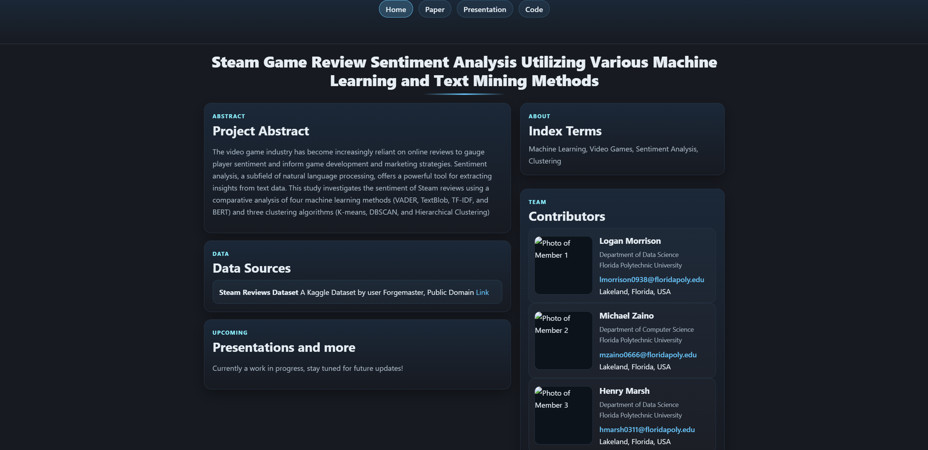
Our Website:
https://skyshroom.github.io/Data-and-Text-Mining-Project-WIP-/

Slide 13
In Conclusion:
Our project is applying sentiment analysis to Steam reviews. We will be attempting to implement three sentiment analysis methods (VADER, TF-IDF, TextBlob) as well as three clustering methods (K-Means, DBSCAN, Hierarchical Clustering).
Any Questions?

