Slide 1

Neo4j for Money-Laundry Control
Authors: Ahmed W. Toure
Dhyey Patel
Artur Bruev

Slide 2

Defining the Problem and Graph fit
Money laundering is the process of concealing the origin of money, obtained from illicit activities such as drug trafficking, corruption, embezzlement or gambling, by converting it into a legitimate source. It is a crime in many jurisdictions with varying definitions. It is usually a key operation of organized crime.
Neo4j provides an advanced, extensible foundation for fighting money laundering, reducing compliance costs and protecting brand value.

Slide 3
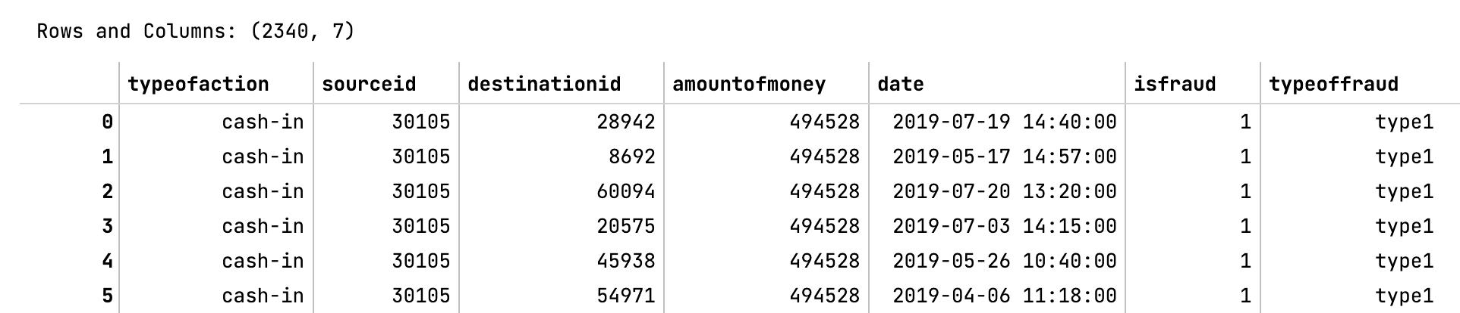

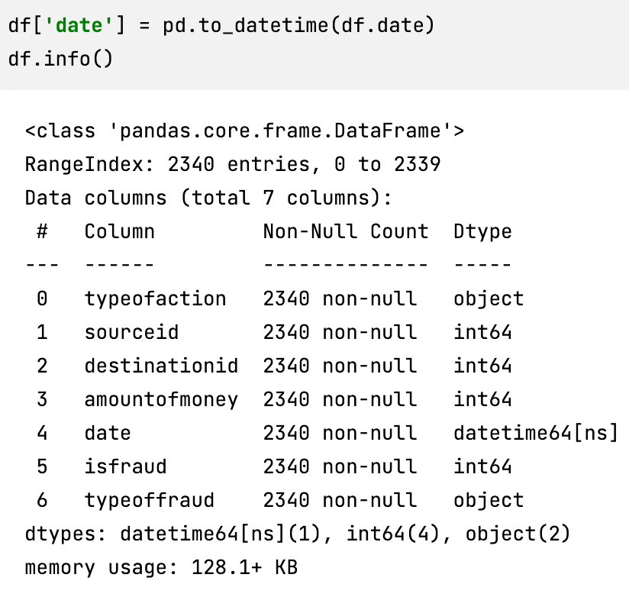
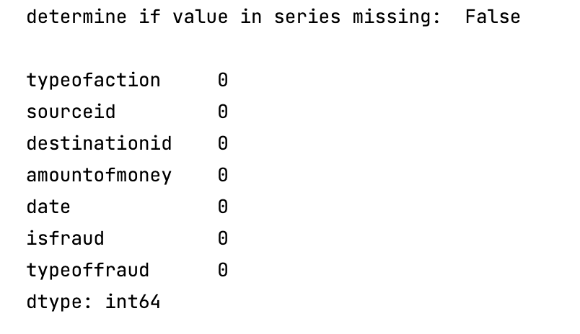
Dataset review and Manipulations
Simulation is based on three processes of money laundering in financial transactions:
1)Money placement, 2)Money layering, 3)Money integration
In simulating each of these processes, I have considered a rule. Rule 1 relates to the cashing in and Rule 2 and 3 relates to the transferring.
Column ‘Date’ was putting
to ‘time’ version.
All info included here*
Dataset has no Null values

Slide 4
Graph Data base modelling
FRAUD
If fraud is committed
Type of fraud
PERSON
TRANSACTION
Source ID
Amount
Type of fraud
Source ID
Destination ID
Amount
Date
Type of Action

Slide 5

LOAD CSV WITH HEADERS from 'file:///ReadyWork01.csv' as row with row where row.typeofaction is not null
MERGE (i:sourceid {Name: row.id})
MERGE (t:typeofaction {Name: row.typeofaction})
MERGE (s:sourceid {Name: row.sourceid})
MERGE (d:destination {Name: row.destinationid})
MERGE (a:amount {Name: row.amountofmoney})
MERGE (q:date {Name: row.date})
MERGE (f:sourceid {Name: row.isfraud})
MERGE (o:sourceid {Name: row.typeoffraud})

