Slide 1
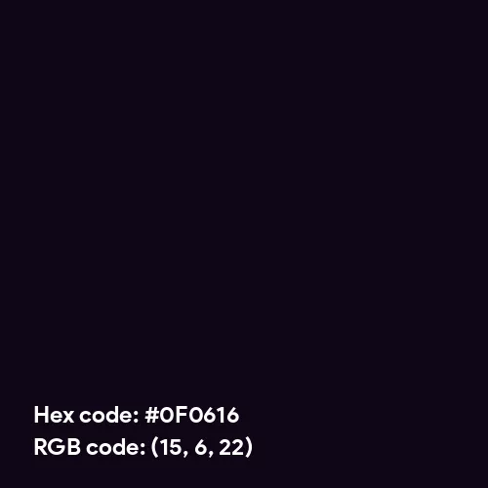
SMART SECURITY MONITORING WITH DRONES
AI POWERED REAL-TIME SURVEILLANCE
Group Members
PRINCETON MWACHALA
KENNEDY WANAKACHA
DERICK RICHARD
RONY MARUGA
JOHN MWEGA

Slide 2
PROJECT OVERVIEW
Developing an AI-powered drone surveillance system for real-time security monitoring, anomaly detection, and automated alerts.
🔹 Why AI-Powered Surveillance?
✅ Traditional CCTV has limited coverage & delayed response.
✅ Drones provide autonomous, real-time monitoring.
✅ AI enhances threat detection & reduces human error.
🔹 Expected Outcomes & Benefits
✔️ Faster response time to security threats.
✔️ Improved coverage compared to fixed security cameras.
✔️ AI-driven detection minimizes human monitoring effort.
✔️ Scalable solution for different security applications.

Slide 3
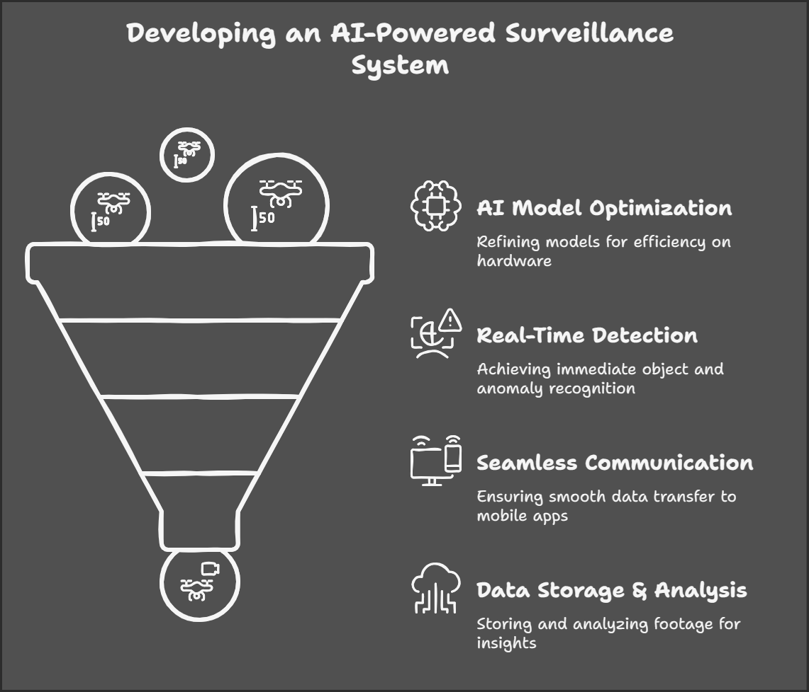
OBJECTIVES
PROBLEM
Security threats require continuous and adaptive monitoring WHERE Traditional surveillance methods (CCTVs, security patrols) lack real-time intelligence more so for a wide area coverage.
So, there is need for an autonomous, AI-powered solution that detects, analyzes, and alerts security teams instantly.
CUSTOMER

Slide 4
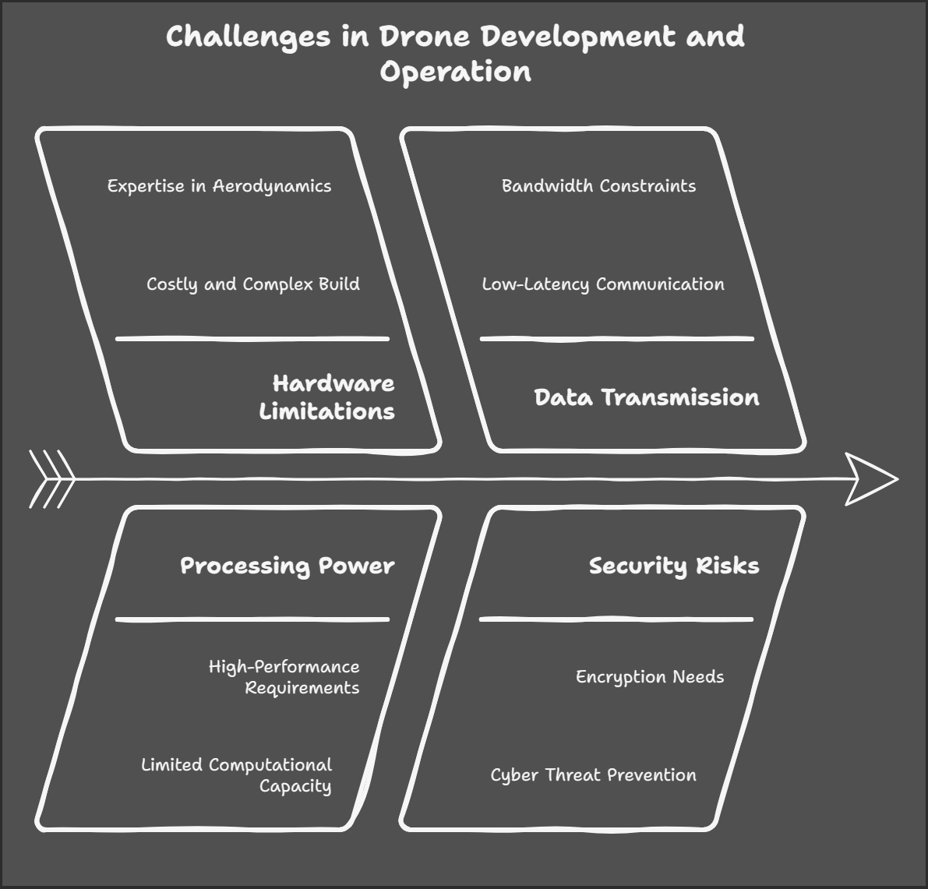
These are the constraints we encountered during our research and talk with DR Eunice for this project that ultimately had a say in our choice

Slide 5
OPTIONS WE GOT
Option 1️⃣: Using Static CCTV Cameras (Suggested by Dr Eunice)
✅ Why we considered it?
Existing security systems already use CCTV cameras.
Easy to set up and requires no additional hardware.
Integration with AI-based anomaly detection could still be possible.
❌ Why we rejected it?
CCTV cameras are stationary and have limited field of view.
They cannot actively track or follow moving objects.
Not suitable for real-time perimeter or outdoor security.
Conclusion: This was not in line with the project’s goal of mobile surveillance.

Slide 6
OPTIONS WE GOT
Option 2️⃣: Building a Drone from Scratch
✅ Why we considered it?
Custom drone development gives full control over hardware and software.
Could be optimized for specific use cases, ensuring perfect compatibility.
❌ Why we rejected it?
High costs and long development time (frame design, motors, cameras, GPS).
Complex protocols for drone communication (PX4, MAVLink, Ardupilot).
Regulatory issues: Many countries restrict custom drones due to security risks.
Required intensive testing for stability and safety.
Conclusion: Given the tight constraints, this was not practical.

Slide 7
OPTIONS WE GOT
Option 3️⃣: Using an Existing Drone Platform (Final Choice)
✅ Why we chose this approach?
Most efficient use of resources – using pre-built drones ensures reliability.
Compatible with existing drone SDKs (DJI, Ardupilot, PX4).
Faster development cycle – allows focus on AI model and app instead of drone hardware.
Allows real-time processing of live drone feeds while also storing footage for future AI analysis.
❌ Challenges with this approach?
Limited access to proprietary drone hardware APIs.
Some drones restrict real-time video feed access, requiring workarounds.
Data transmission constraints (Wi-Fi/5G, WebRTC, MQTT must be optimized).
🎯 Final Decision:
This approach best balances efficiency, feasibility, and performance while meeting the project goals.

Slide 8
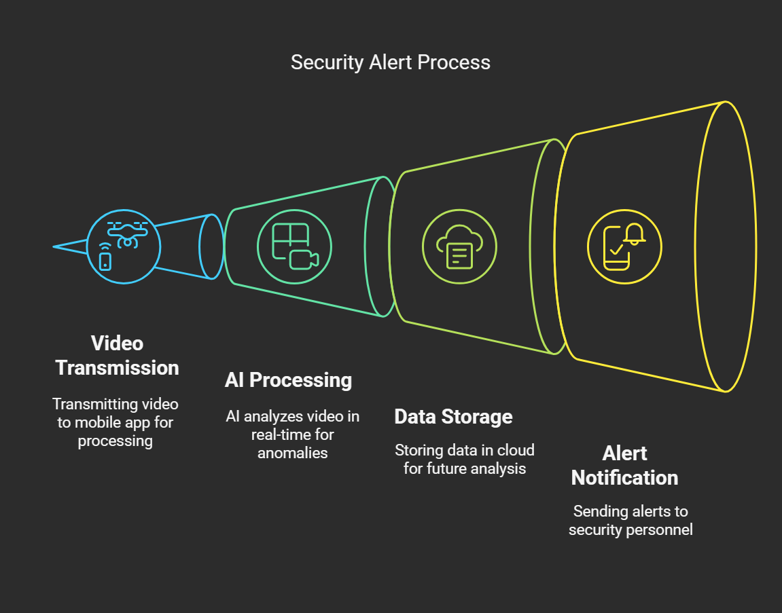
SYSTEM ARCHITECTURE

Slide 9

Team Roles & Responsibilities
Our project consists of six key roles, each contributing to a different aspect of the system:
AI & Embedded Systems Engineer – Develops AI models for real-time detection.
Drone & IoT Engineer - Ensures seamless communication between drones and the app.
Mobile App Developer – Builds the Android/iOS app for real-time monitoring.
Cloud & Backend Engineer – Handles data storage, APIs, and cloud processing.
Cybersecurity & DevOps Engineer – Secures data, manages cloud deployment.
UI/UX Designer – Ensures intuitive app interface for operators.

