Slide 1
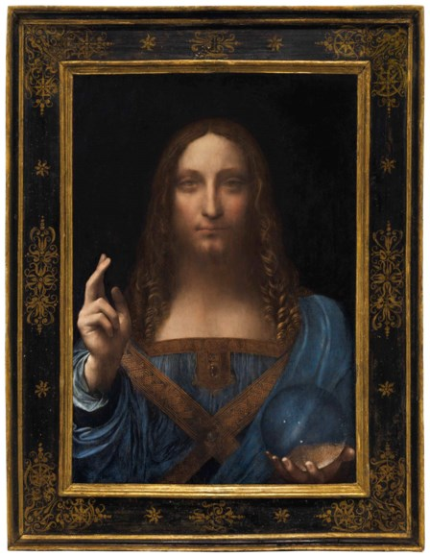
ML PROJECT · CHRISTIE’S AUCTIONS 1989–2026
$ ?
$450,312,500
Leonardo da Vinci · 2017
What is a painting worth?
Predicting auction prices from the catalogue alone
Dmytro Lapko · Mykhailo Ostapchuk
Notes:
Hi, we are Dmytro Lapko and Mykhailo Ostapchuk. Our project: can you predict what a painting sells for at Christie’s, just from its catalogue entry?

Slide 2
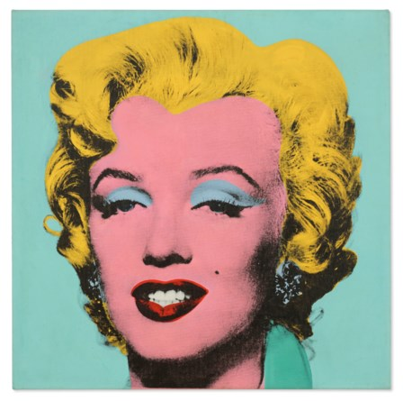
TASK
Predict the sale price — without Christie’s estimate
$ ?
$195,040,000
Andy Warhol · 2022
artist
size
medium
year painted
$ ?
signed
sale date & type
Prices range from $37 to $450,312,500 · tested on future sales (2022+)
Notes:
The task: given only what’s in the catalogue — artist, size, medium, dates, sale — predict the final price. We deliberately don’t use the auction house’s own estimate. Prices span seven orders of magnitude, so we predict log price.

Slide 3
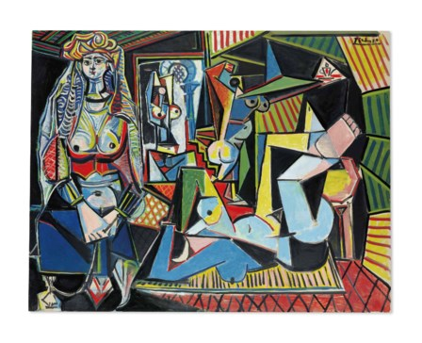
DATA
We built our own dataset from Christie’s
$ ?
$179,365,000
Pablo Picasso · 2015
560k
121k
8,249
34k
lots
artists
sales, 1989–2026
images analysed
Scrape
Parse text
64-byte binary records · 80 MB
Model
Notes:
No ready dataset existed, so we scraped Christie’s public results: 560 thousand paintings and works on paper. Descriptions were parsed into size, medium, dates and signatures, and stored in a compact custom binary format of about 80 MB. For 34 thousand paintings we also computed simple image features in the browser.

Slide 4
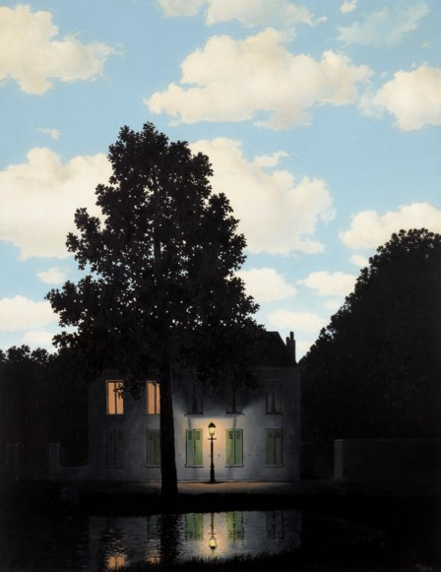
APPROACH
35k USD paintings, models from simple to strong
$ ?
$121,160,000
René Magritte · 2024
Median
Artist average
Ridge
Random forest
Gradient boosting
Train + time-ordered CV · 2010–2021 · 27,636 lots
Test 2022+
Every model with and without the artist · also tested on unseen artists
Notes:
We kept USD paintings sold since 2010, about 35 thousand. Features: size, dates, medium, artist history, sale context. We went from trivial baselines up to gradient boosting, each with and without the artist as a feature. Training and validation on 2010–2021, split by sale in time order; 2022 onwards is a held-out test used once.

Slide 5
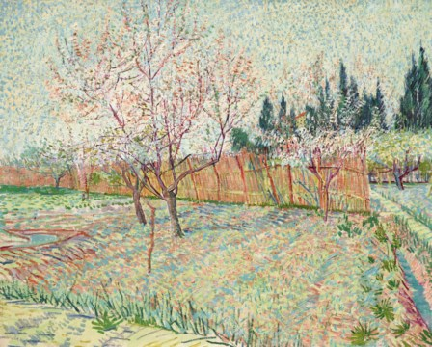
RESULTS · 2022+ TEST
Typical error: from ×5.3 down to ×2.3
$ ?
$117,180,000
Vincent van Gogh · 2022
Median guess
×5.3
Artist average
×3.2
GB, no artist
×2.7
Ridge
×2.6
Gradient boosting
×2.3 best
Artists seen before ×2.2 · artists new to the model ×3.0
Notes:
Typical error as a factor: ×2.3 means a $100k painting is typically predicted between about $43k and $230k. The best model, gradient boosting with the artist, cuts the error of a naive guess by more than half. For artists the model has never seen it is weaker, about ×3.

Slide 6
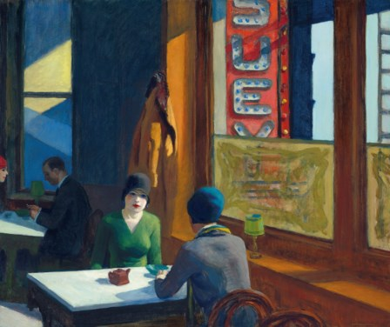
WHAT WE TRIED
What worked, what didn’t
$ ?
$91,875,000
Edward Hopper · 2018
Worked
Didn’t
Data traps
Gradient boosting
Colour & image statistics
Clocks & documents filed as paintings
Artist’s auction history
Random forest, plain linear
Sale context: evening sale, lot position
One artist, several names
Notes:
What helped most: gradient boosting, the artist’s history at auction, and how the auction house places the lot — evening sale and lot position. Image colour statistics and random forest did not help. And real data bites: some clocks and documents were filed as paintings, and one artist can appear under several names, like Canaletto.

Slide 7
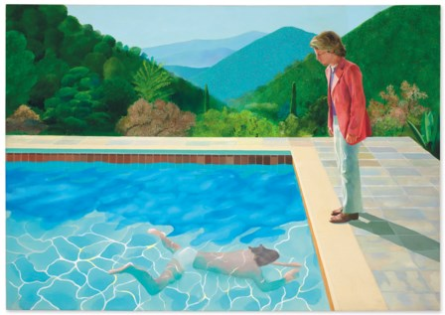
CONCLUSION
Reputation and placement matter more than the painting itself
$ ?
$90,312,500
David Hockney · 2018
TEAM
TOOLS
TIME
Dmytro Lapko — data & scraping
Python · scikit-learn · Jupyter · GitHub · Claude Code
~2 weeks · 21 Oct – 4 Nov
Mykhailo Ostapchuk — modelling & analysis
Notes:
Our main conclusion: the price is driven more by who the artist is and how the auction house positions the lot than by the painting’s own characteristics. Team: Dmytro Lapko built the scraper and dataset, Mykhailo Ostapchuk did the modelling and analysis. About two weeks of work. Thank you.

