Slide 1
The History Of The Airplane
By Lucas Eyman and Samuel Wiggins
By twee year old billy

Slide 2
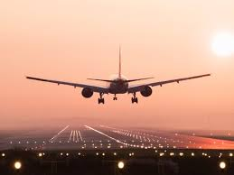
Background
Planes have been used for travel to places a long way away from where you are. If this wasn’t a thing we would still be using boats to travel oceans and cars or trains for traveling from Ohio all the way to California. This wasn’t as effective at first, this is the flight the plane took to where it is today.
(Pun intended)

Slide 3
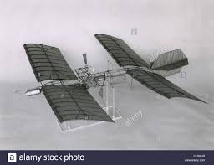
THE TRUTH (the first powered flight)
Samuel Pierpont Langley builds a gasoline-powered version of his tandem-winged "Aerodromes." the first successful flying model to be propelled by an internal combustion engine. As early as 1896 he launches steam-propelled models with wingspans of up to 15 feet on flights of more than half a mile.

Slide 4
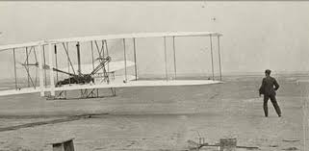
The First Flight (airplanes)
The first recorded flight was by Wilbur and Orville Wright did 4 brief flights at Kitty Hawk with the first ever airplane. The date of 12/7/18 went down in history.
Notes:
Lucas Slide :P

Slide 5
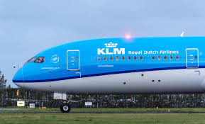
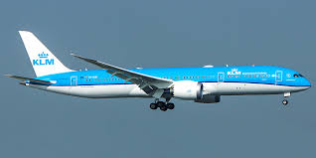
The First Airline
Formed in 1919, the first airline is still in the running, you can find it in the Netherlands. Which is called MLT or as it is called today The Royal Dutch Airlines. In 2013 they had 525 workers, which is quite a bit.

Slide 6
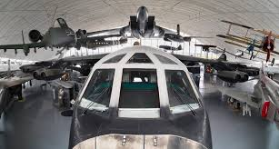
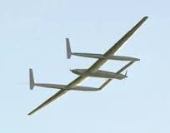
Innovations
The first takeoff from a plane was in 1910
First aluminum plane (closed) 1917
The first cockpit airplane was created in 1920
1927 flight across the entire world
1939 First jet (German WWII weapon)
1947 The sound breaker
1969 The first wide plane
1989 every part of the globe flight
1990 First multi bomber aircraft
1996 Beginning to form a next gen airline (US + Russia)

Slide 7
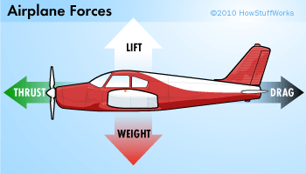
The Inner Workings of the Airplane
In order for the airplane to fly through the sky there needs to be force. Force is needed to make objects move however there are plenty of things stopping the airplane from moving.

Slide 8
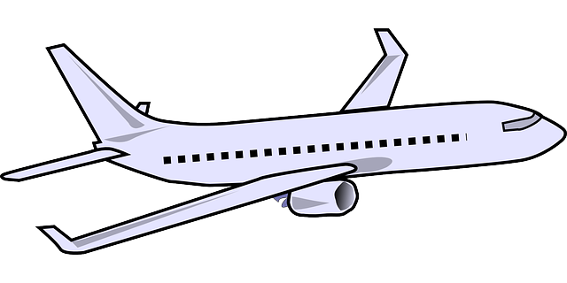
Drag is the friction that causes an object (or in this case a plane) to slow down.
Lift is the force that holds the airplane in the air (accomplished using a wing / airfoil).
LIFT
DRAG
THRUST
WEIGHT
Weight is the force caused by the mass of the airplane bringing the airplane down
Thrust is an aerodynamic force that pushes the engine forward and is caused by a propeller or jet engine.

Slide 9
Works Cited
http://www.eyewitnesstohistory.com/wright.htm
https://science.howstuffworks.com/transport/flight/modern/airplanes
https://www.worldatlas.com/articles/oldest-airlines-in-the-world-that-are-still-operating.html
http://www.greatachievements.org/?id=3728

